Slide 1

Practical Web Development with Spring boot
Orientation
Presented by ARMS（THAILAND）Co., Ltd.

Slide 2
Index
Practical Web Development with Spring boot
Orientation
Introduction
  - Instructor's Introduction and Company profile.
  - Short Introduction for supporters.
  - Student's Introduction
Class Objectives
  - Class Concepts
  - Class Timeline
  - Introduce Our Friends
Application Introduction
  - Development environment with virtual machine
  - TODO Application - Indivilister
  - Twitter Application - Emitter

Slide 3
Instructor's Introduction(Mickey)
Practical Web Development with Spring boot
Orientation
Item | Detail
Name | Mikio Kakuyama (NickName: Mickey san)
Company | ARMS Thailand Co., Ltd.
Hobby | Playing Games/Japanese Anime(One Piece, Attack on Titan)/fashion
Characteristic | ・Friendly ・Diligent ・Reliable ・positive ・realistic ・polite
Place to live | ・Japan ・Thailand ・Australia

Slide 4


Instructor's Biography (Mickey)
Practical Web Development with Spring boot
Orientation
Worked for two years in Australia and associated with people from various countries.
Started a career as an IT engineer and worked in a software development team.
Worked at a hospital to maintain and run the Hospital Information System (HIS).

Slide 5
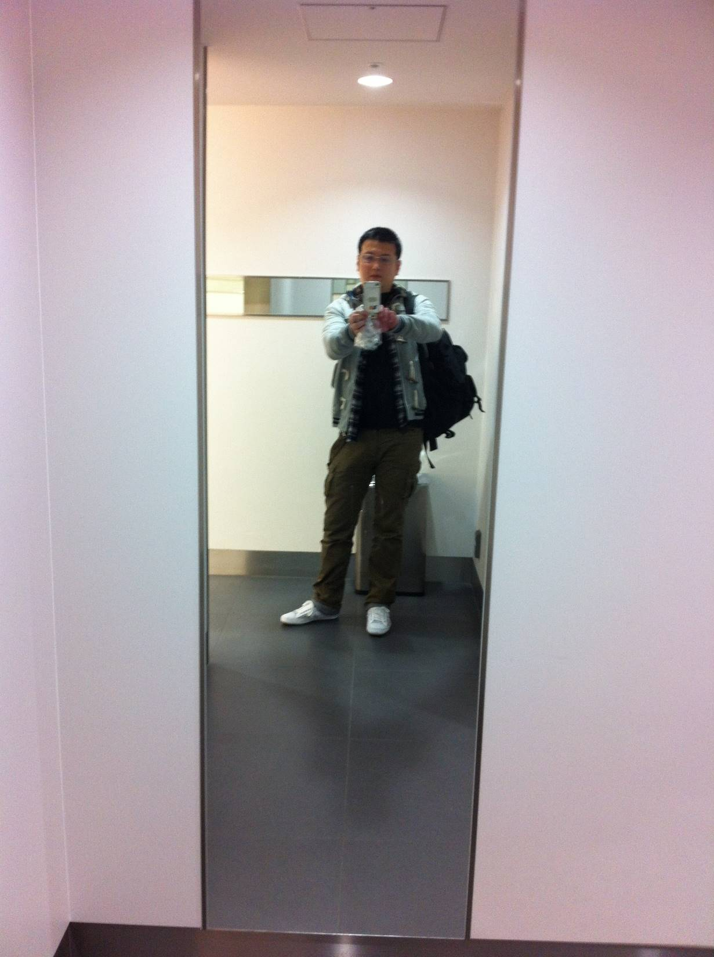
On my way to Thailand (Mickey)
Practical Web Development with Spring boot
Orientation

Slide 6
Supporter's Introduction
Practical Web Development with Spring boot
Orientation
Item | Detail
Name | Kwanchanok Im-Amornchai (HN : Jajar)
Company | ARMS Thailand Co., Ltd.
Hobby | Play game, Listen to Music, Watch a movie
Characteristic | ・Kind ・Shy ・Sensitive ・Sincere ・Patient ・Quiet ・Honest ・Polite

Slide 7
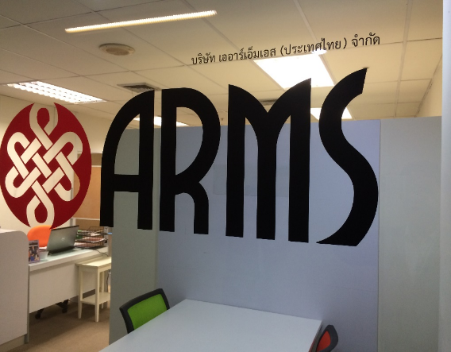
Company Profile
Practical Web Development with Spring boot
Orientation
Item | Detail
Company Name | ARMS Thailand Co., ltd.
Foundation | 2014/03/12
Executives | CEO Sho Matsushita
# of Employees | 30
Address | The Trendy Office Building, 25th Floor, Sukhumvit Road Soi 13 Bangkok, 10110 Thailand (5 minutes walk from BTS Nana)
Fields of work | Offshore-Dev：Web Application Development Offshore-Dev：Mobile Application Development
Certificate | BOI-certified

Slide 8
Student's Introduction in English (Optional JP)
Practical Web Development with Spring boot
Orientation
Introduction
Each student
Name
Feeling toward Japan
10 minutes to prepare
your introduction
Grade
The reason for attendance
Hobby
Dream (If nothing, penalty)
What do you want to learn from this class
Passionate Message to me
Question
Question to Instructor

Slide 9
Practical Web Development with Spring boot
Orientation
Examples of how you introduce yourself
NAME : I am “your name” My name is “your name”
Feeling toward Japan : My feeling toward Japan is “your thought, your feeling, your impression, and etc. I feel Japan is …..
Grade : I am the third year student. I am the fourth year student. I am in the fourth year of this University.
The reason for attendance : The reason I attend this class is “your reason” The reasons I wanted to attend the class are “reasons” (If you have many)
Hobby : My hobby is “your hobby” Things I like to do is “your hobbies”
Dream : My dream is to become “job name”
What you want to learn from this class : I want to learn “something” from this class. I would like to learn “something” from this class.
Passionate Message to me : say something in your own words

Slide 10
Class Objectives
Practical Web Development with Spring boot
Orientation
Learn
Modern Web
Development
Develop
Software
Cooperation with
Others
Your dream
Try & Build
Human Skills
Work with
Japanese
Cross-Cultural
Communications

Slide 11
Class Concepts
Practical Web Development with Spring boot
Orientation
Human Skills
Technical Skills
Communication
Technique
Motivations
Knowledge

Slide 12
Class Timeline
Practical Web Development with Spring boot
Orientation
20~30 mins
Conversation
Short Presentation
Development
2 hours
Try Development
Q & A
Communicate with friends
Extra Tasks
Additional Presentation

Slide 13

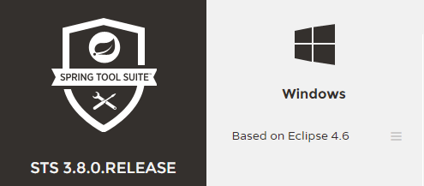








Introduce Our Friends
Practical Web Development with Spring boot
Orientation

Slide 14
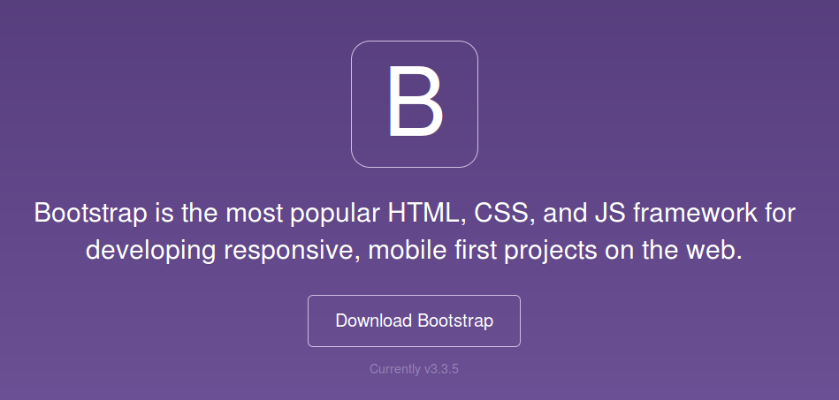
Bootstrap
Practical Web Development with Spring boot
Orientation

Slide 15
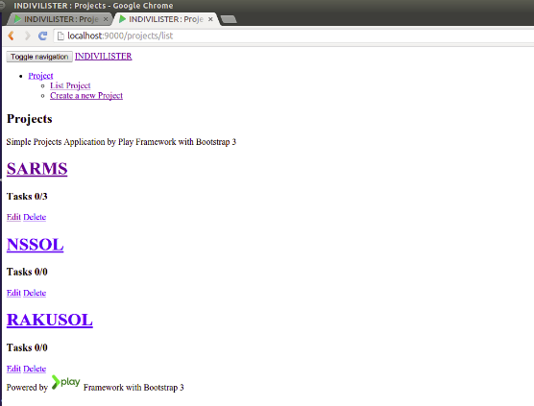
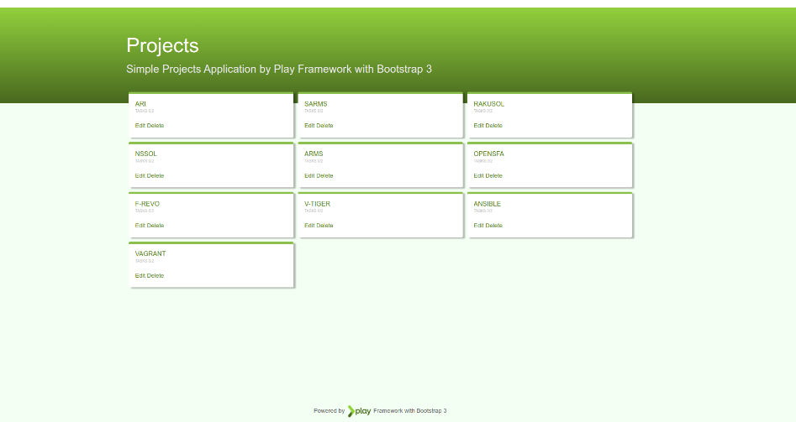
Bootstrap's Dramatic Effects
Practical Web Development with Spring boot
Orientation

Slide 16


Bootstrap's Benefits
Practical Web Development with Spring boot
Orientation
Quick building beautiful and sophisticated layout for Programmers
Can focus on coding
Can use Responsive Features without knowledge
It's the best solution for Lazy Guys

Slide 17
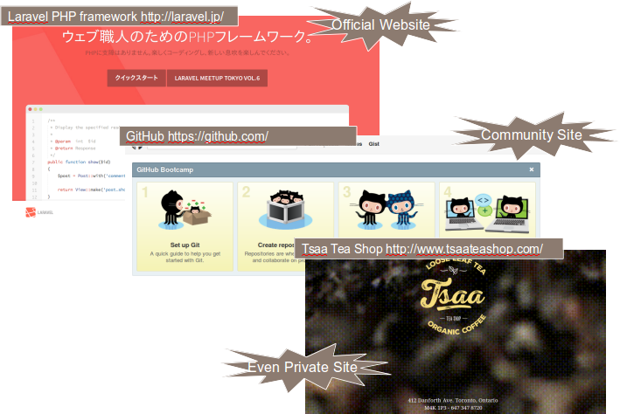
Case Study of Bootstrap
Practical Web Development with Spring boot
Orientation

Slide 18
Spring Boot
Practical Web Development with Spring boot
Orientation
Spring framework takes quite a lengthy tutorial to set it up and running
But … Spring boot has pre-configured settings to reduce configuration time and provide you with the shortest way to have its app up and running. With the smallest line of code and configuration, you can create applications.
☆whether you use Spring boot, Spring roo and Spring MVC…Spring boot is Spring, Spring roo is Spring, they have just different approaches to simplifying Spring development.

Slide 19

Development Environment with virtual machine
Practical Web Development with Spring boot
Orientation
Create Java Spring boot app in local,
build and run the app on virtual server.
You
Your local PC - Windows
VirtualBox - CentOS
Virtual Server
Setup, run, and stop
Virtual Server
Apache
MySQL
phpMyAdmin
Java1.8
Gradle
Git Bash
vagrant command
Vagrant
Create Java Spring boot app
with STS
Shared directory
D:\springclass(Windows)
/vagrant(CentOS)
Your Java
source code
Build and run your java code on Server

Slide 20
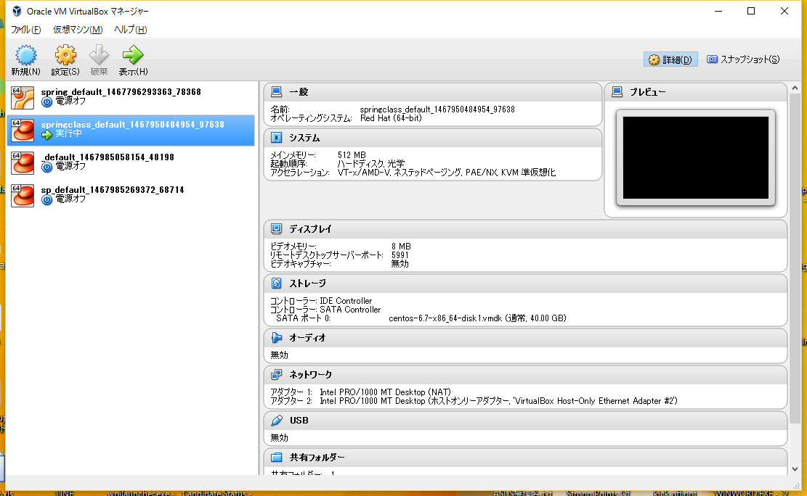
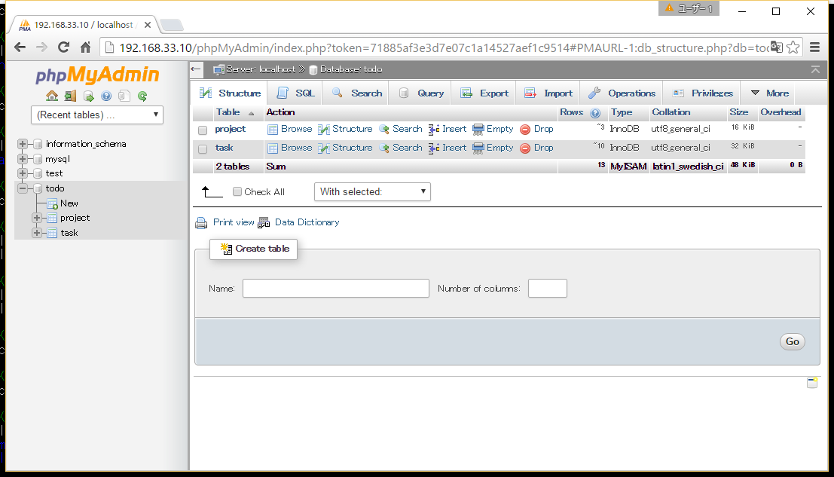
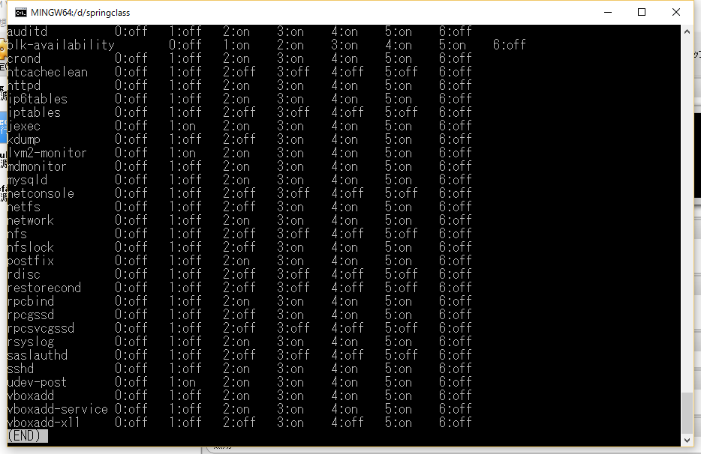
Development Environment with virtual machine
Practical Web Development with Spring boot
Orientation

Slide 21
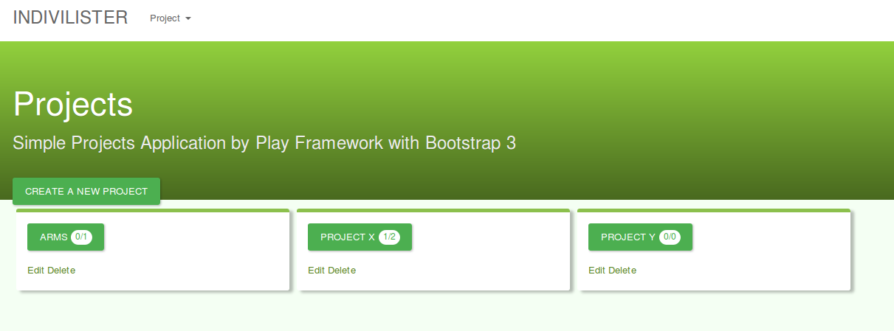
Our Application Introduction Part1
Practical Web Development with Spring boot
Orientation
Todo Application - Indivilister

Slide 22
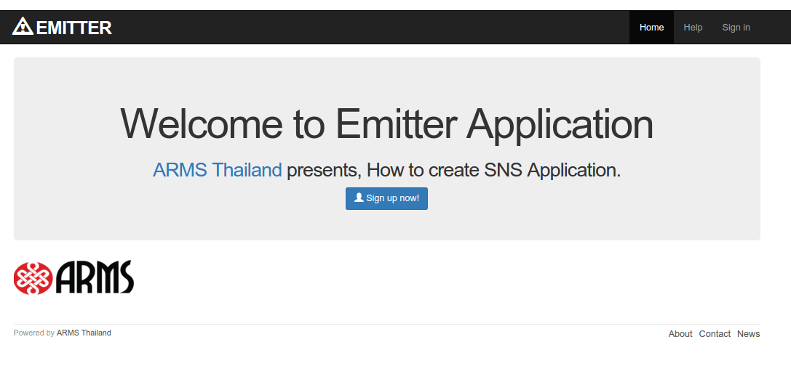
Our Application Introduction Part2
Practical Web Development with Spring boot
Orientation
SNS Application - Emitter

Slide 23

Your Idea Leads Your Ideals
homepage: http://arms-asia.com/
facebook: https://www.facebook.com/arms.asia?fref=ts

