Slide 1

Practical Web Development
Github
Presented by ARMS（THAILAND）Co., Ltd.

Slide 2
Index
Practical Web Development
Github
1. Preparing a Github ID
1-1. What are Git and Github
1-2. Create a Github ID
2. Preparing a Git
2-1. Configure
3. Getting started with Git and GitHub
3-1. Create a new repository on Github
3-2. Get local repository from Github
3-3. Record Changes to the repository
3-4. Pushing to a remote
3-5. Team collaboration
4. Git commands
4-1. Git commands

Slide 3
1. Preparing a Github ID
Practical Web Development
Github
1-1 What are Git and Github
Git is a distributed revision control system with an emphasis on speed, data integrity, and support for distributed, non-linear workflows
As with most other distributed revision control systems, and unlike most client–server systems, every Git working directory is a full-fledged repository with complete history and full version-tracking capabilities, independent of network access or a central server
See reference at "https://en.wikipedia.org/wiki/Git_(software)"

Slide 4
1. Preparing a Github ID
Practical Web Development
Github
1-1 What are Git and Github
GitHub is a web-based Git repository hosting service, which offers all of the distributed revision control and source code management (SCM) functionality of Git as well as adding its own features.
Unlike Git, which is strictly a command-line tool, GitHub provides a web-based graphical interface and desktop as well as mobile integration. It also provides access control and several collaboration features such as wikis, task management, and bug tracking and feature requests for every project
See reference at https://en.wikipedia.org/wiki/GitHub
In a nutshell, Git is a distributed version management system, Github is a web service name based on Git.
Git is developed by Linux development team.
Github is run by Github company

Slide 5
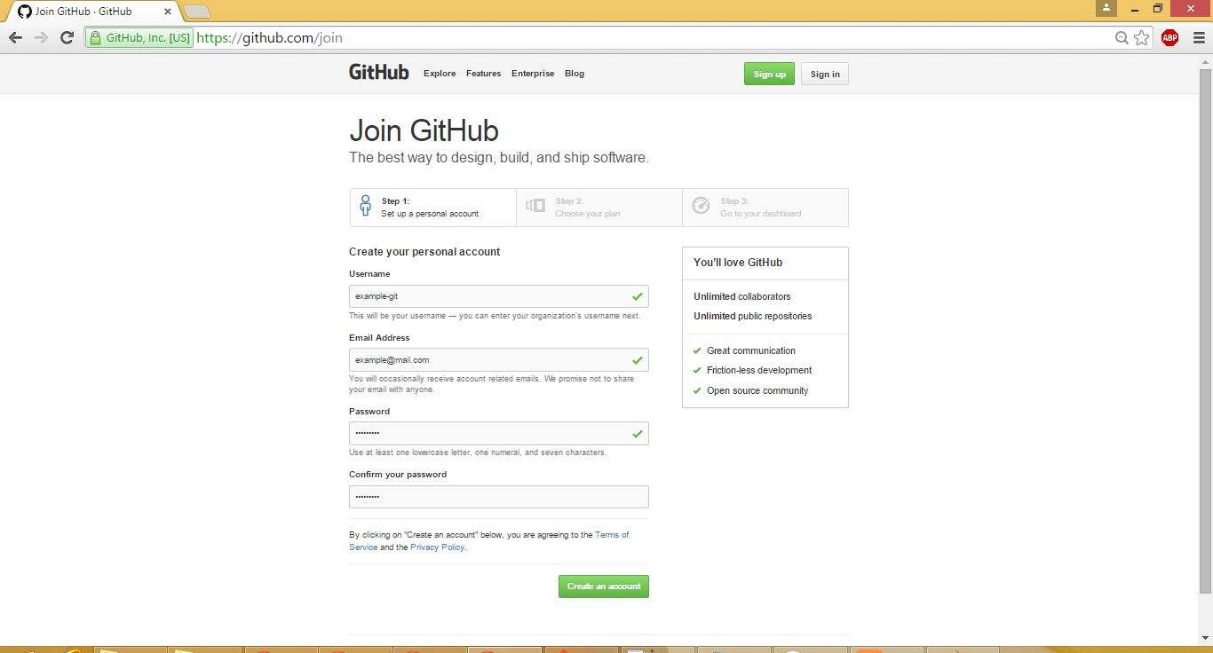
1. Preparing a Github ID
Practical Web Development
Github
1-2 Create a Github ID
Open "https://github.com/join" to create a new Github ID
Insert these information and click "Create an account"

Slide 6
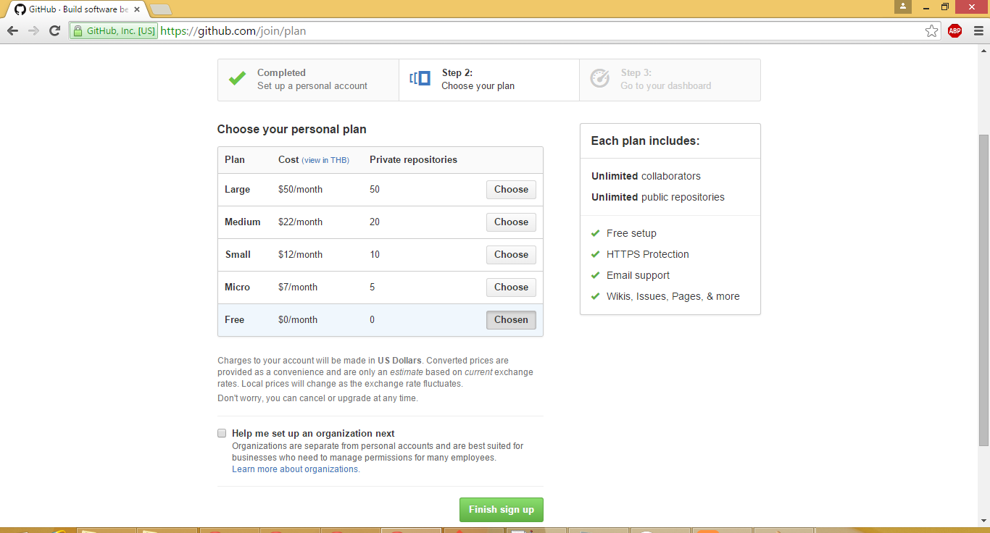
1. Preparing a Github ID
Practical Web Development
Github
1-2 Create a Github ID
Choose "Free" plan and click "Finish sign up"

Slide 7
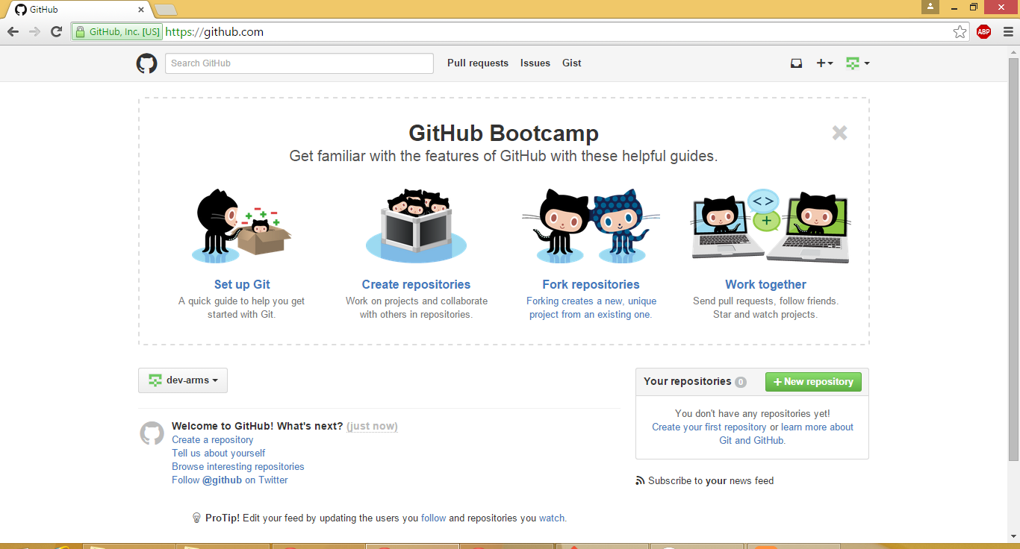
1. Preparing a Github ID
Practical Web Development
Github
1-2 Create a Github ID
Now, you got a Github ID

Slide 8
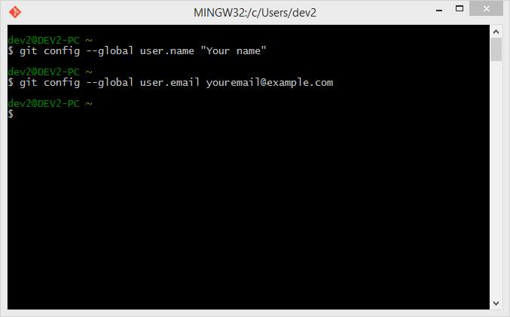
2. Preparing a Git
Practical Web Development
Github
2-1 Configure
The first thing you should do when Git installed is to set your user name and e-mail address
This is important because Git uses this information when you commit
Open Git Bash (there should be a shortcut on your desktop).
git config --global user.name "Your name"
git config --global user.email youremail@example.com

Slide 9
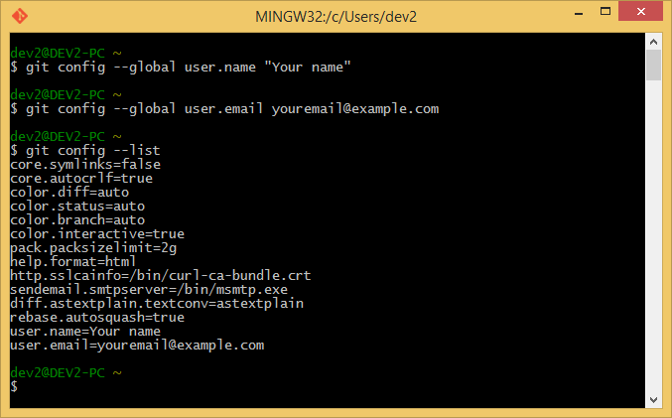
2. Preparing a Git
Practical Web Development
Github
2-1 Configure
Check your settings
Use the git config --list command to list all the settings
git config --list
Make sure that user.name and user.email have been properly added to the setting
You can check a specific key value like below
git config {key}
git config user.email

Slide 10
2. Preparing a Git
Practical Web Development
Github
2-1 Configure
If you set a wrong user.name or user.email, use the following commands to edit the wrong setting.
git config --global --edit
or
vi .gitconfig
To edit the .gitconfig, you have to use vi editor.
It has a command mode and edit mode,
1. To enter into an edit mode, press either “a” “i” “o” key.
2. To finish the edit mode, press “esc” key.
3. Then type : wq (colon : write the change and quit)
If you don’t want to write the change,
:q! (colon : quit without saving)

Slide 11
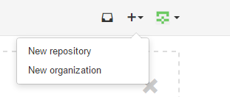
3. Getting started with Git and GitHub
Practical Web Development
Github
3-1 Create a new repository on GitHub
Open Github page, click + icon on the upper-right corner , and then click New repository

Slide 12
3. Getting started with Git and GitHub
Practical Web Development
Github
3-1 Create a new repository on GitHub
Create Repository name
Repository name : "test-git-01"
Optionally, add a description of your repository.
Desciption : "test-git-01 repository on GitHub."
Choose "Public" repository
  Public repository is a great choice for getting started! They're visible to any user on GitHub, so you can benefit from a collaborative community
  Private repository requires a little more setup. They're only available to you, the repository owner, as well as any collaborators you choose to share with. Private repository is only available for a paid account.
Select "Initialize this repository with a README"
Click "Create repository"

Slide 13
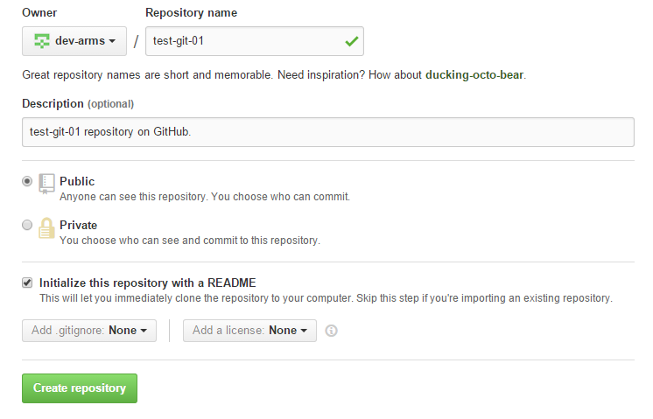
3. Getting started with Git and GitHub
Practical Web Development
Github
3-1 Create a new repository on GitHub

Slide 14
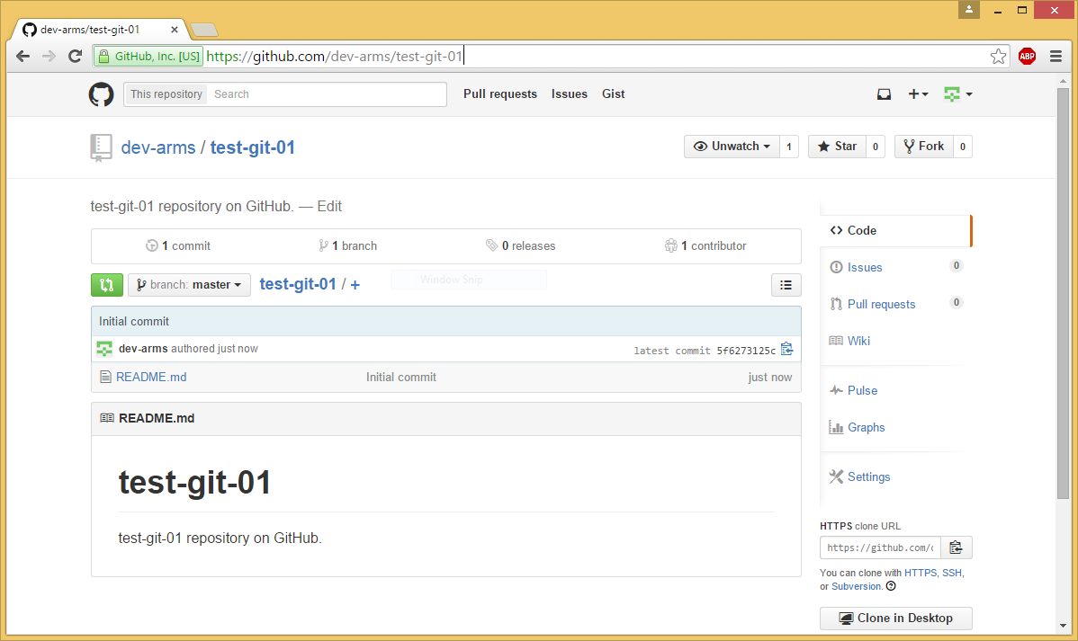
3. Getting started with Git and GitHub
Practical Web Development
Github
3-1 Create a new repository on GitHub
Now, you can see your repository.

Slide 15

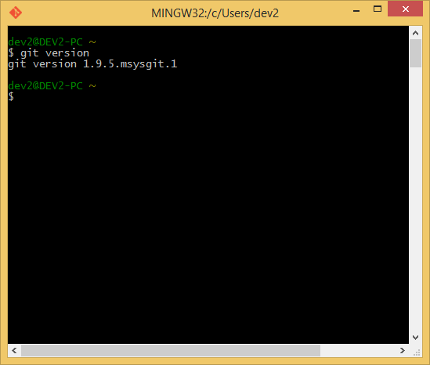
3. Getting started with Git and GitHub
Practical Web Development
Github
3-2 Get local repository from Github
You can use Git via Git Bash from desktop shortcut or via Windows Command Prompt

Slide 16
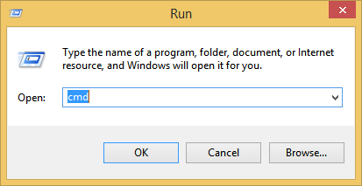
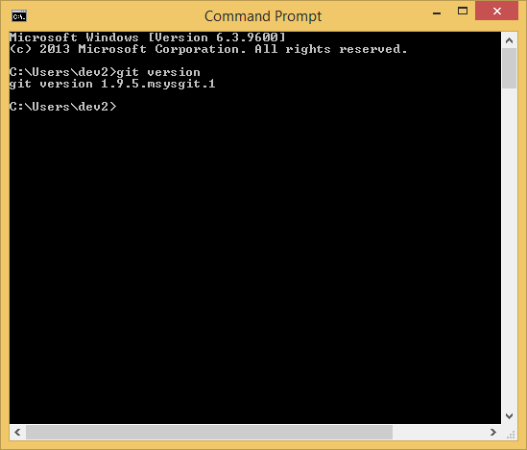
3. Getting started with Git and GitHub
Practical Web Development
Github
3-2 Get local repository from Github
You can use git via Windows Command Prompt ("Windows Key + r" and type "cmd")

Slide 17
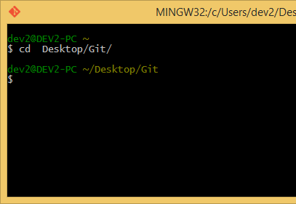
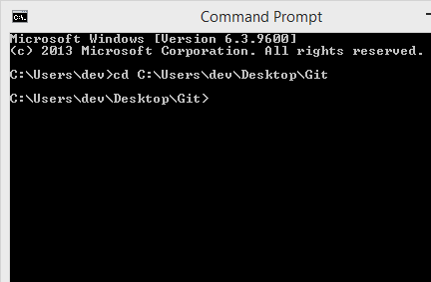
3. Getting started with Git and GitHub
Practical Web Development
Github
3-2 Get local repository from Github
Open your git bash or cmd and run "cd [path to directory]" to go to directory that you want to place this repository. For example
via Git bash use : cd Desktop/Git
via cmd use : cd C:\Users\dev\Desktop\Git
* The above directories are just an example, please create a directory such as Git by using “mkdir” command.

Slide 18
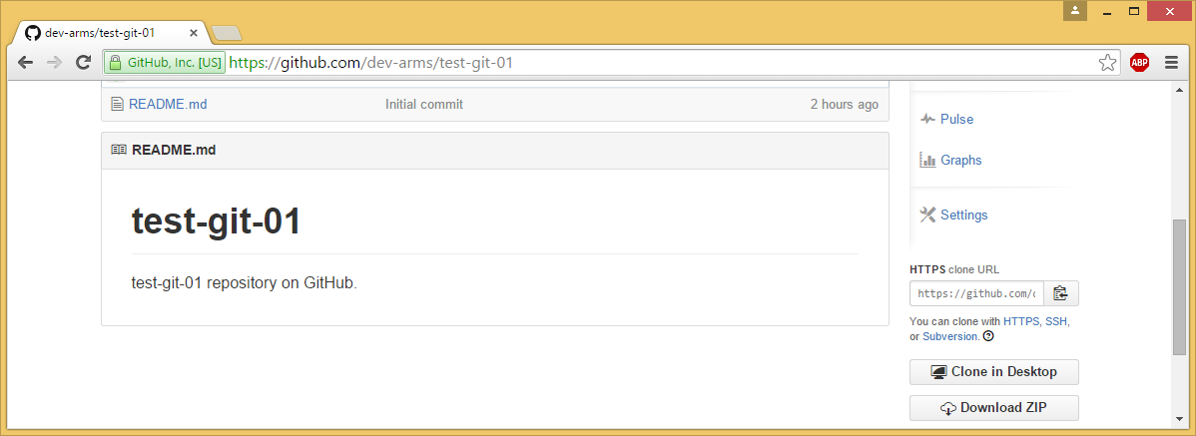
3. Getting started with Git and GitHub
Practical Web Development
Github
3-2 Get local repository from Github
Use "git clone [url]" to clone Github repository to local. You can get repository [url] from your Github repository page. Click green “Clone or download” button. Copy URL

Slide 19
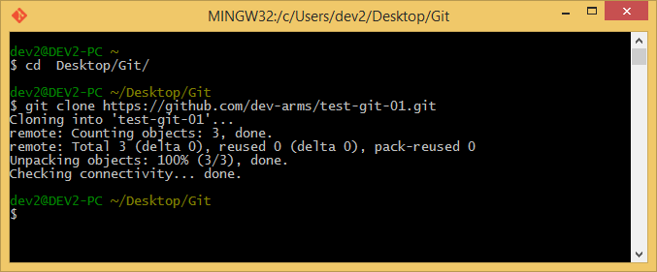
3. Getting started with Git and GitHub
Practical Web Development
Github
3-2 Get local repository from Github
Example
* URL from Github repository
git clone https://github.com/dev-arms/test-git-01.git

Slide 20
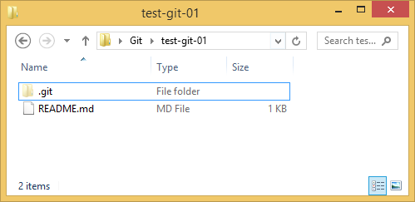
3. Getting started with Git and GitHub
Practical Web Development
Github
3-2 Get local repository from Github
Now, you can see "test-git-01" on your PC

Slide 21
3. Getting started with Git and GitHub
Practical Web Development
Github
3-3 Recording Changes to the Repository
Remember that each file in your working directory can be in one of two states: tracked or untracked
Tracked files are files that were in the last snapshot. They can be unmodified, modified, or staged
Untracked files are everything else – any files in your working directory that were not in your last snapshot and are not in your staging area. When you first clone a repository, all of your files will be tracked and unmodified because you just checked them out and haven’t edited anything

Slide 22
3. Getting started with Git and GitHub
Practical Web Development
Github
3-3 Recording Changes to the Repository
The lifecycle of your file status
Untracked
Unmodified
Modified
Staged
Add the file
Edit the file
Stage the file
Remove the file
Commit

Slide 23
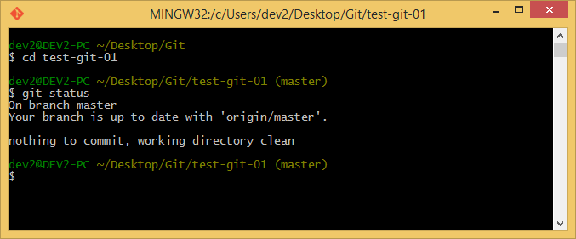
3. Getting started with Git and GitHub
Practical Web Development
Github
3-3 Recording Changes to the Repository
The main command you use to determine which files are in which state is
"git status" command
If you go to local git repository and run this command right after cloning a repository, you will see the screen below.

Slide 24
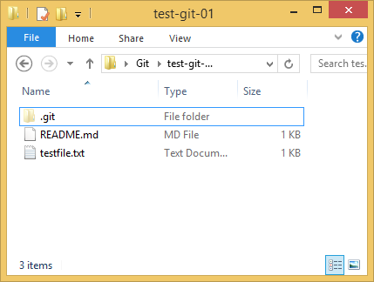
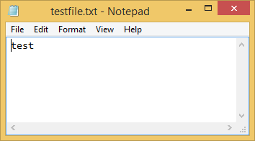
3. Getting started with Git and GitHub
Practical Web Development
Github
3-3 Recording Changes to the Repository
This means you have a clean working directory. In other words, there are no tracked and modified files.
Try to create a new file to your project.
For example, create "testfile.txt" file that included some text in your project

Slide 25
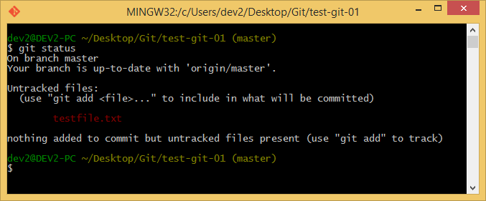
3. Getting started with Git and GitHub
Practical Web Development
Github
3-3 Recording Changes to the Repository
After creating a new file, and run "git status", you will see an untracked file.

Slide 26
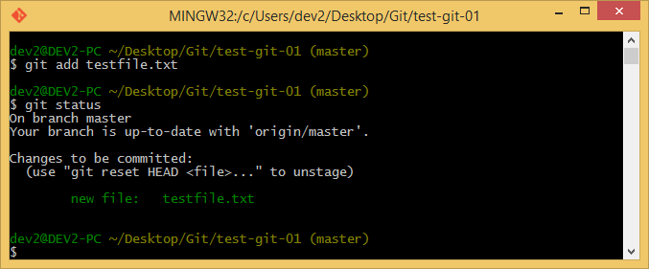
3. Getting started with Git and GitHub
Practical Web Development
Github
3-3 Recording Changes to the Repository
To begin tracking a new file, use "git add [filename]" (Or "git add *" to track all files) . git add testfile.txt" and run "git status" again
You see your "testfile.txt" file tracked and staged to be committed.

Slide 27
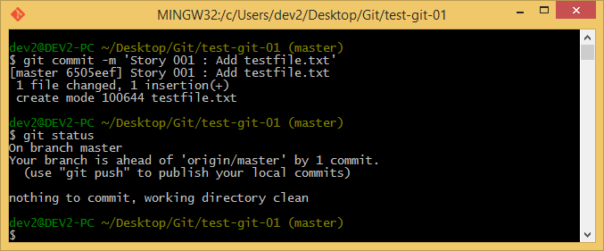
3. Getting started with Git and GitHub
Practical Web Development
Github
3-3 Recording Changes to the Repository
Now that your staging area is set up the way you want it, you can commit your changes (If you want to unstage file because you add a wrong file, you can use "git reset HEAD [filename]")
The simplest way to commit is to run "git commit -m 'commit message'" and run "git status" again.
git commit -m 'Story 001 : Add testfile.txt'
git status

Slide 28
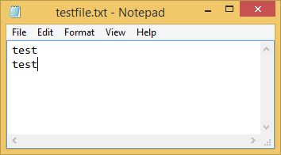
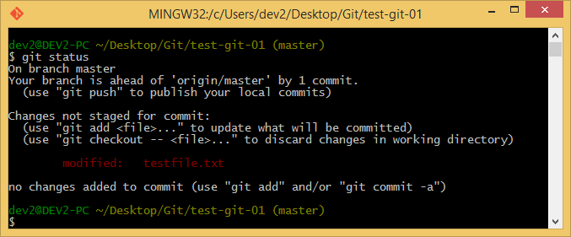
3. Getting started with Git and GitHub
Practical Web Development
Github
3-3 Recording Changes to the Repository
Try to modify text in "testfile.txt' and run "git status"
It's similar to tracking a new file. You must run "git add [filename]"
and "git commit -m 'commit message'" again. For example
git add testfile.txt
git commit -m 'Story 002 : Modify testfile.txt'
git status

Slide 29
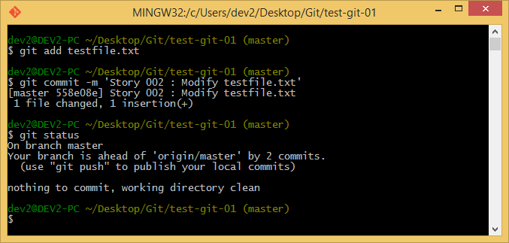
3. Getting started with Git and GitHub
Practical Web Development
Github
3-3 Recording Changes to the Repository
You can see this result

Slide 30
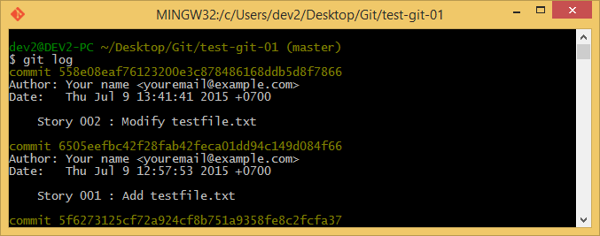
3. Getting started with Git and GitHub
Practical Web Development
Github
3-3 Recording Changes to the Repository
Remember that when you create, modify, delete, rename or something that makes a change to a file and you want to track the file, you have to run "git add [filename]" and "git commit 'commit message'" everytime changes are made.
If you want to see commit history. You can run "git log“ to see the commit history.

Slide 31
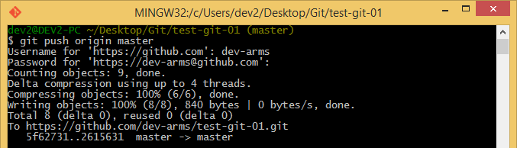
3. Getting started with Git and GitHub
Practical Web Development
Github
3-4 Pushing to a remote
Pushing is to put your commits on local to your origin repository (on GitHub)
Run "git push origin [branch name]" to push to your origin repository
When you run this command, it will ask username and password. Type your Github's username and password.
git push origin master

Slide 32
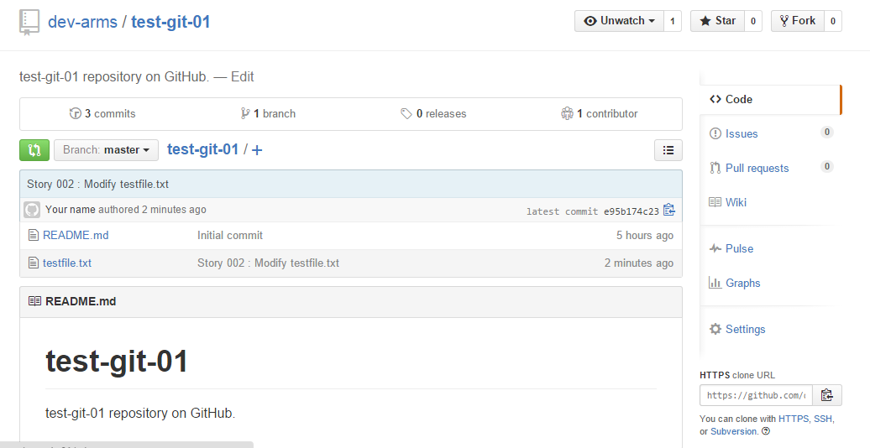
3. Getting started with Git and GitHub
Practical Web Development
Github
3-4 Pushing to a remote
Go to your repository on Github website
https://github.com/your_username/your_reponame
Now you can see new files(testfile.txt) pushed from your local.

Slide 33
3. Getting started with Git and GitHub
Practical Web Development
Github
3-4 Pushing to a remote
When you pushed something new to a remote repository on Github and you have collaborators that had cloned your repository before you pushed.
Those collaborators can run "git pull" to merge changes into their local repository, that way they can also have the same code as yours.
Important point to remember, with Git, you can also manage even Word files and other documents, so you can use Git for even managing your documents.

Slide 34
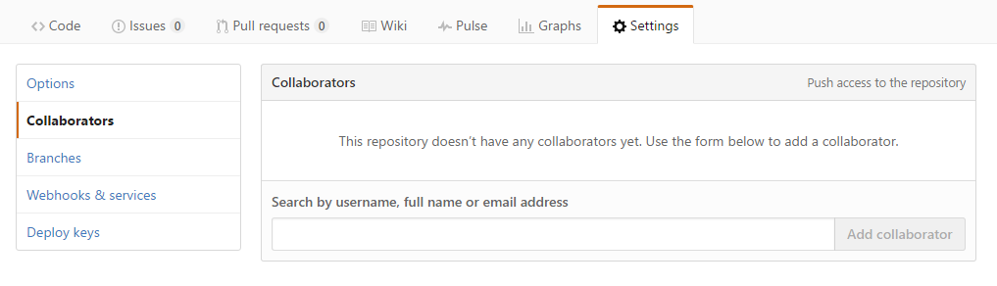
3. Getting started with Git and GitHub
Practical Web Development
Github
3-5 Team collaboration
Try team collaboration using “your" repository
To try team collaboration, you have to add collaborators for your repository.
Settings tab
Collaborators
Search and Add collaborators

Slide 35
3. Getting started with Git and GitHub
Practical Web Development
Github
3-5 Team collaboration
Try to do something to “your repository". For example, add a new file
First, Create a new Issue (An Issue is a note on a repository about something that needs attention. It could be a bug, a feature request, a question or lots of other things)
  Click the Issues tab from the sidebar on your "bu-arms-xx" repository
  Click New Issue
  Give your Issue a title and description. For example
    title : [your name] : I cannot run your Project
    description : [your name] : I cannot run your Project, Why ???

Slide 36
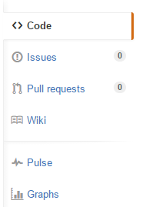
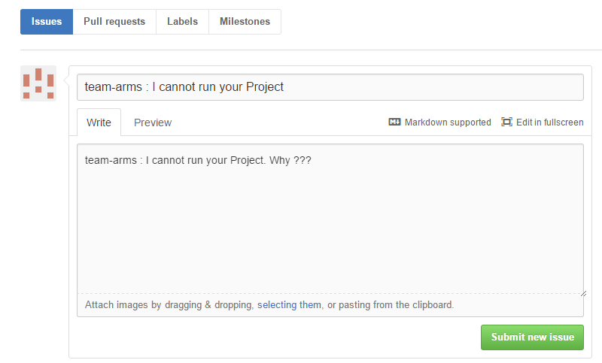
3. Getting started with Git and GitHub
Practical Web Development
Github
3-5 Team collaboration

Slide 37
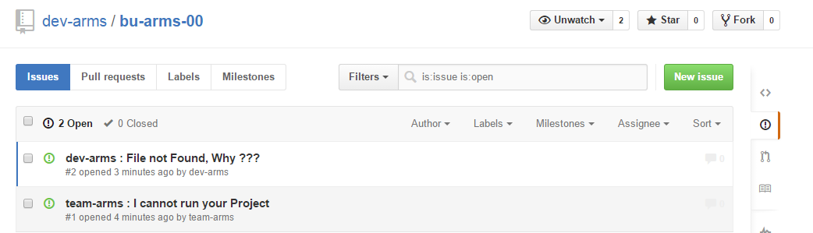
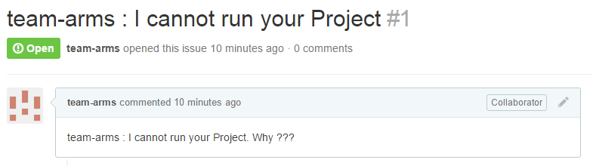
3. Getting started with Git and GitHub
Practical Web Development
Github
3-5 Team collaboration
You can see your issue and others’ issue

Slide 38
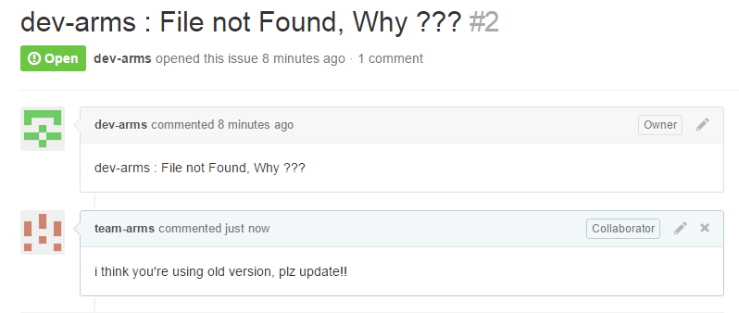
3. Getting started with Git and GitHub
Practical Web Development
Github
3-5 Team collaboration
you can share and discuss each issue like below.

Slide 39
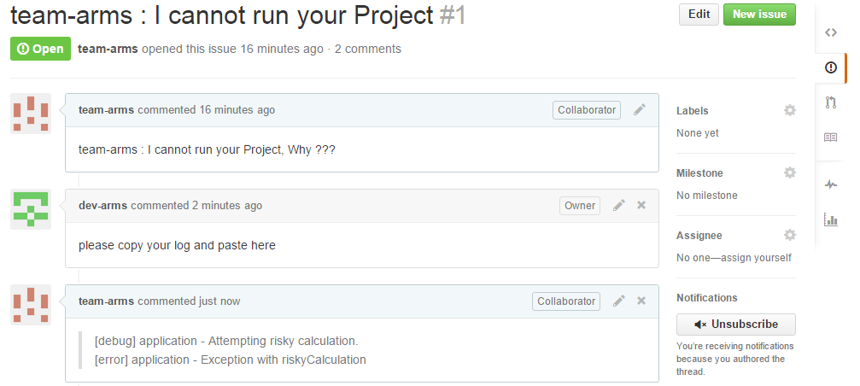
3. Getting started with Git and GitHub
Practical Web Development
Github
3-5 Team collaboration

Slide 40

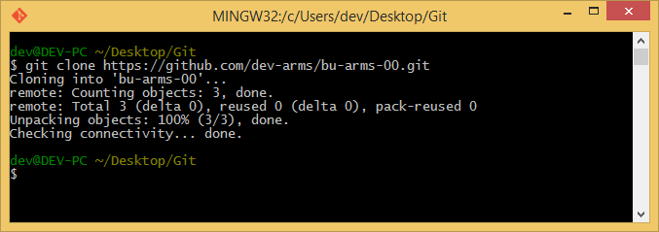
3. Getting started with Git and GitHub
Practical Web Development
Github
3-5 Team collaboration
For example….., if someone found how to solve an issue. You can clone repository, modify, commit, and push, then use pull request to merge.
Try, Clone your team repository
You can copy URL
git clone https://github.com/username/repositoryname.git

Slide 41
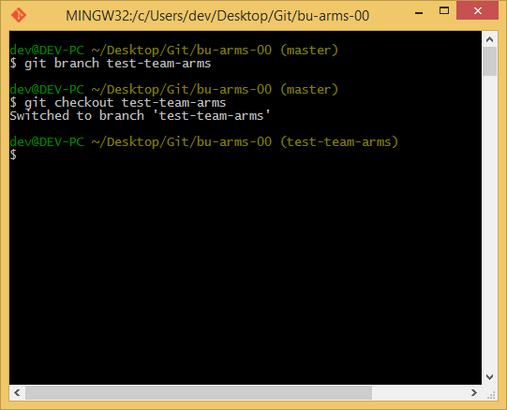
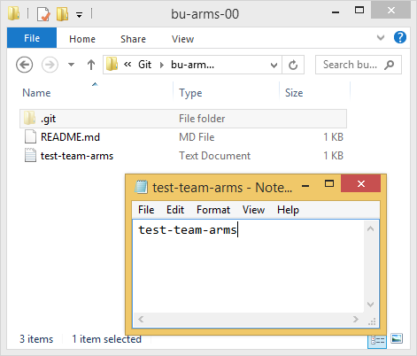
3. Getting started with Git and GitHub
Practical Web Development
Github
3-5 Team collaboration
Create branch "test-[your name]",
check out to the branch and create a new file "test-[your name].txt"
git branch test-[your name]
git checkout test-[yourname]

Slide 42
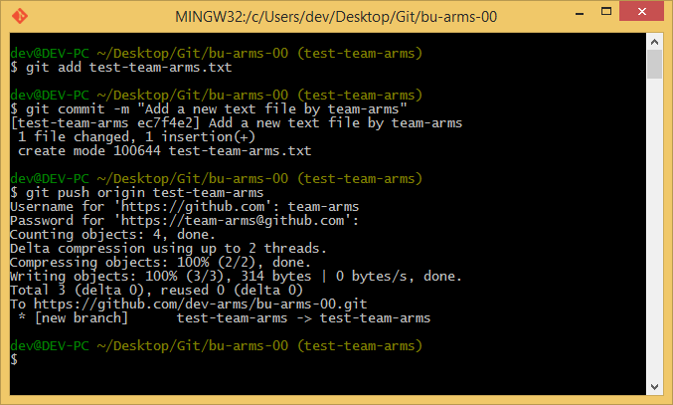
3. Getting started with Git and GitHub
Practical Web Development
Github
3-5 Team collaboration
Add "test-[your name].txt" file to commit, Commit and push to Github using your id
git add test-[your name].txt
git commit -m "Add a new text file by [your name]"
git push origin test-[your name]

Slide 43
3. Getting started with Git and GitHub
Practical Web Development
Github
3-5 Team collaboration
We will use "Pull request"
Pull Requests are the heart of collaboration on GitHub
When you make a pull request, you’re proposing changes in source code and requesting collaborators(and merge them into their branch)
GitHub’s Pull Request feature allows you to compare the content on two branches. The changes, additions and subtractions, are shown in green and red and called diffs (differences)
People use Pull Requests to discuss commits (code review) even before the code is finished, that way you can get feedback as you go or help when you’re stuck

Slide 44
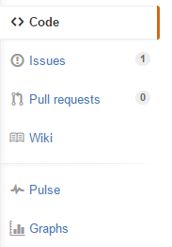
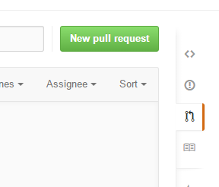
3. Getting started with Git and GitHub
Practical Web Development
Github
3-5 Team collaboration
Create a Pull Request
Click the Pull Request icon on the sidebar and click "New pull request" on your repository

Slide 45
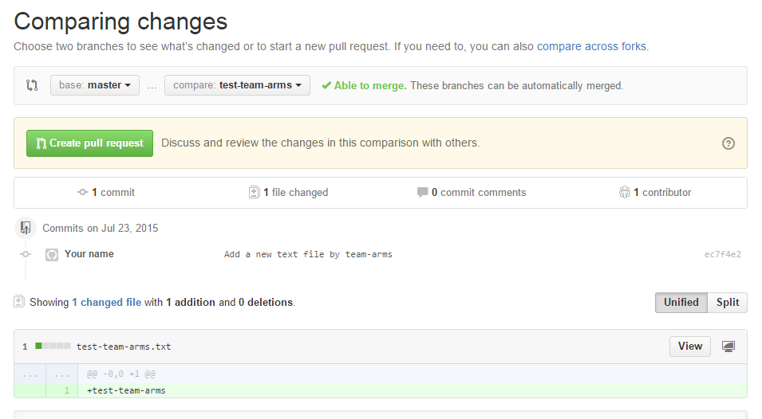
3. Getting started with Git and GitHub
Practical Web Development
Github
3-5 Team collaboration
Select the branch(test-[your name]) to compare with master
Look over your changes in the diffs, make sure they’re what you want to submit

Slide 46
3. Getting started with Git and GitHub
Practical Web Development
Github
3-5 Team collaboration
When you’re satisfied with changes, click “Create Pull Request"

Slide 47
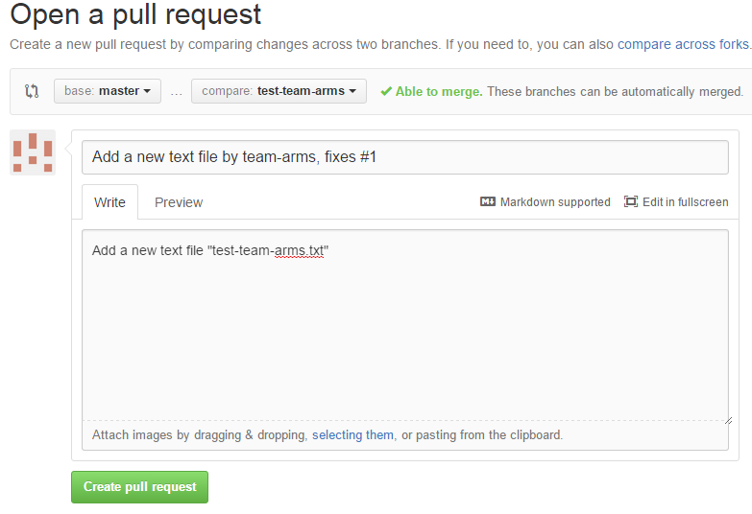
3. Getting started with Git and GitHub
Practical Web Development
Github
3-5 Team collaboration
Give your pull request a title that relates directly to an issue, include “fixes #” and the issue number in the title. Write a description of your changes
  title : Add a new text file by [your name], fixes #1
  description : Add a new text file "test-[your names].txt"

Slide 48
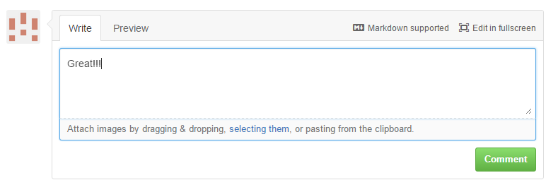
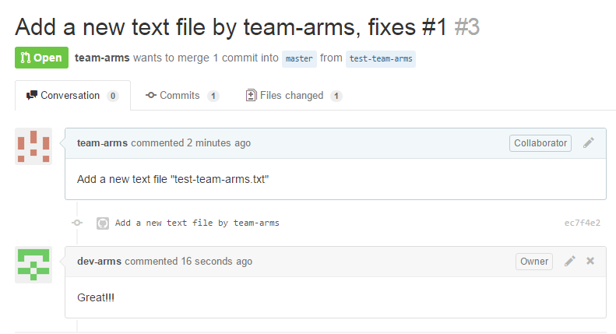
3. Getting started with Git and GitHub
Practical Web Development
Github
3-5 Team collaboration
You can comment for suggest, blame, tell the bug, and etc to this Pull request

Slide 49
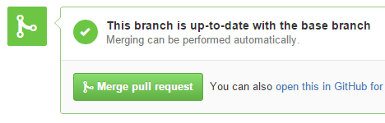
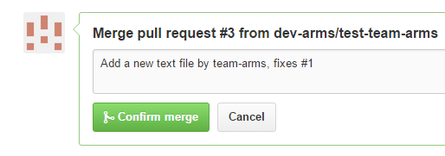

3. Getting started with Git and GitHub
Practical Web Development
Github
3-5 Team collaboration
Bring changes together – merge your "test-[your name]" branch into the "master" branch
  Click "Merge pull request" to merge the changes into master
  Click "Confirm merge"
  Go ahead and delete the branch with the "Delete branch", (since its changes have been incorporated)

Slide 50
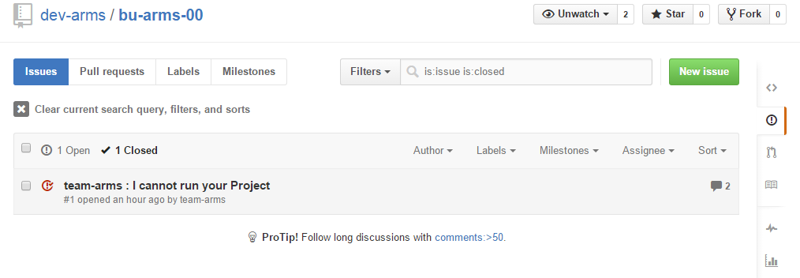
3. Getting started with Git and GitHub
Practical Web Development
Github
3-5 Team collaboration
the issue is closed

Slide 51
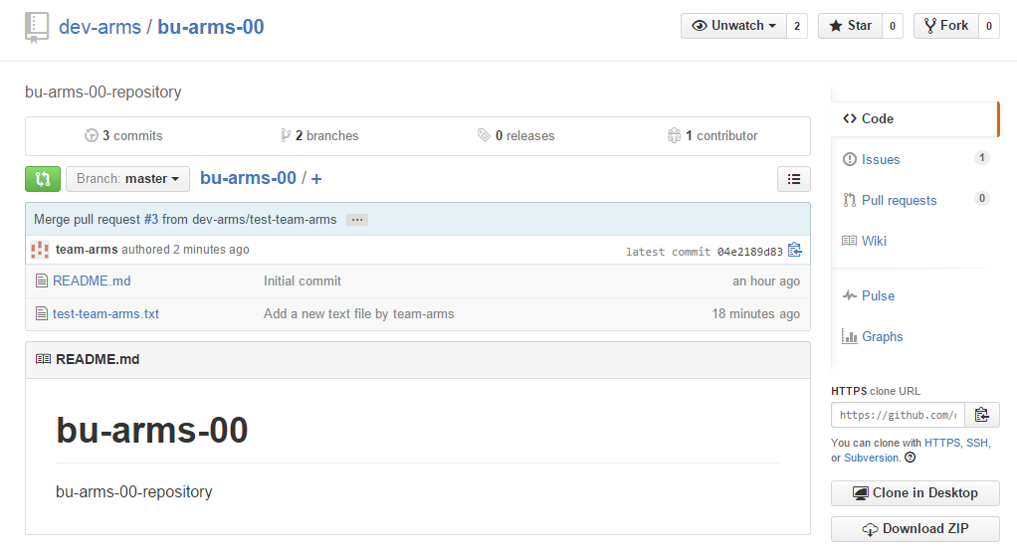
3. Getting started with Git and GitHub
Practical Web Development
Github
3-5 Team collaboration
You can see a new file or a lot of files (depends on the number of your members) on master branch because it's merged by pull request

Slide 52
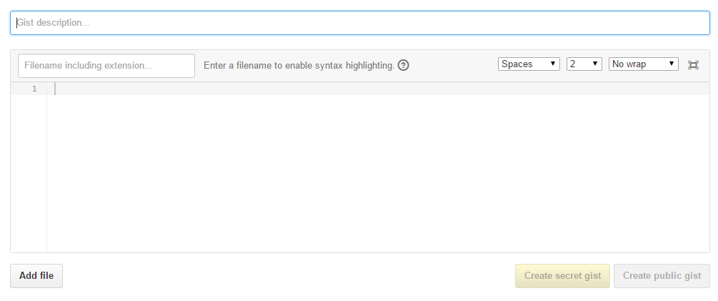
3. Getting started with Git and GitHub
Practical Web Development
Github
3-5 Team collaboration
For improving team collaboration, you can use Gist on Github
Gist is a simple way to share snippets and pastes with others. All gists are Git repositories, so they are automatically versioned, forkable and usable from Git
Try to create Gist, Open "https://gist.github.com/"

Slide 53


3. Getting started with Git and GitHub
Practical Web Development
Github
3-5 Team collaboration
Try to give snippet. For example, give Spring MVC Controller example
* Snippet is simple code that you want to share. you can give any code for trying
Click "Create secret gist" or "Create public gist" depends on your need
Secret gists are hidden from search engines but visible to anyone you give the URL

Slide 54

3. Getting started with Git and GitHub
Practical Web Development
Github
3-7 Team collaboration
Now you can share snippet with Gist to your team

Slide 55
4. Git commands
Practical Web Development
Github
4-1 Git commands
git init Create a new Git local repository
git clone Clone a Git repository into a new directory
git status Show the working directory status
git add Add files to the staging area for tracking and committing
git reset Remove the specified file from the staging area
git commit Record changes to the repository
git push Put your commits on local to your origin repository
git pull Merge changes on origin repository into local repository
git checkout Updates the files in the working directory to match the version stored in that branch
git branch Create, list, rename, and delete branches
git merge Merge the specified branch into the current branch
git log Show commit history

Slide 56
4. Git commands
Practical Web Development
Github
4-1 Git commands
Simple command cycle
merge changes
on origin repository into local repository
git pull
Remote repository
clone repository
git clone
clone repository
git clone
put commit to remote
git push
change working directory to match branch
git checkout
merge changes
on origin repository
git pull
put commit to remote
git push
devloper A
devloper B
working directory
staging area
local repository
Create a new repository
git init
stage changes
git add/reset
commit change
git commit
show status
git status
create a new branch / merge branch
git branch / merge

Slide 57

Your Idea Leads Your Ideals
homepage: http://arms-asia.com/
facebook: https://www.facebook.com/arms.asia?fref=ts

