Slide 1

Basic Spring Boot
Presented by ARMS（THAILAND）Co., Ltd.

Slide 2
Index
Practical Web Development with Spring Boot
Project
  1-1. Create a project
  1-2. Manage Dependencies
RestController
  2-1. Create RestController
3. Controller
  3-1. Create Controller
  3-2. Thymeleaf

Slide 3

1. Project
Practical Web Development with Spring Boot
1-1. Create a project
We will create a simple project and learn how to use Spring boot and thymeleaf.
thymeleaf is a template engine which works well with Spring boot
1. Double click STS icon
2. Select workspace “springclass”

Slide 4
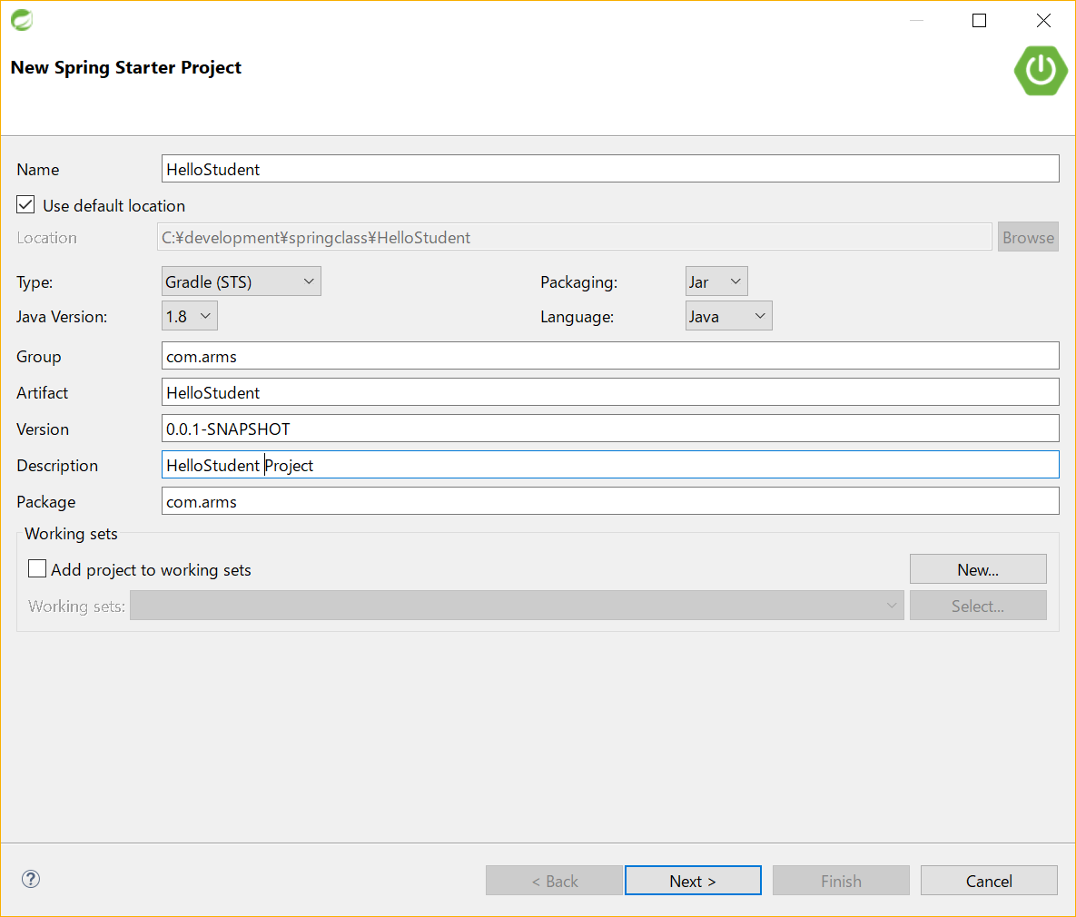
1. Project
Practical Web Development with Spring Boot
1-1. Create a project
File – New – Spring Starter Project
Name:
HelloStudent
Group:
com.arms
Artifact:
HelloStudent
Description:
HelloStudent Project
Package:
com.arms
Click Next >

Slide 5
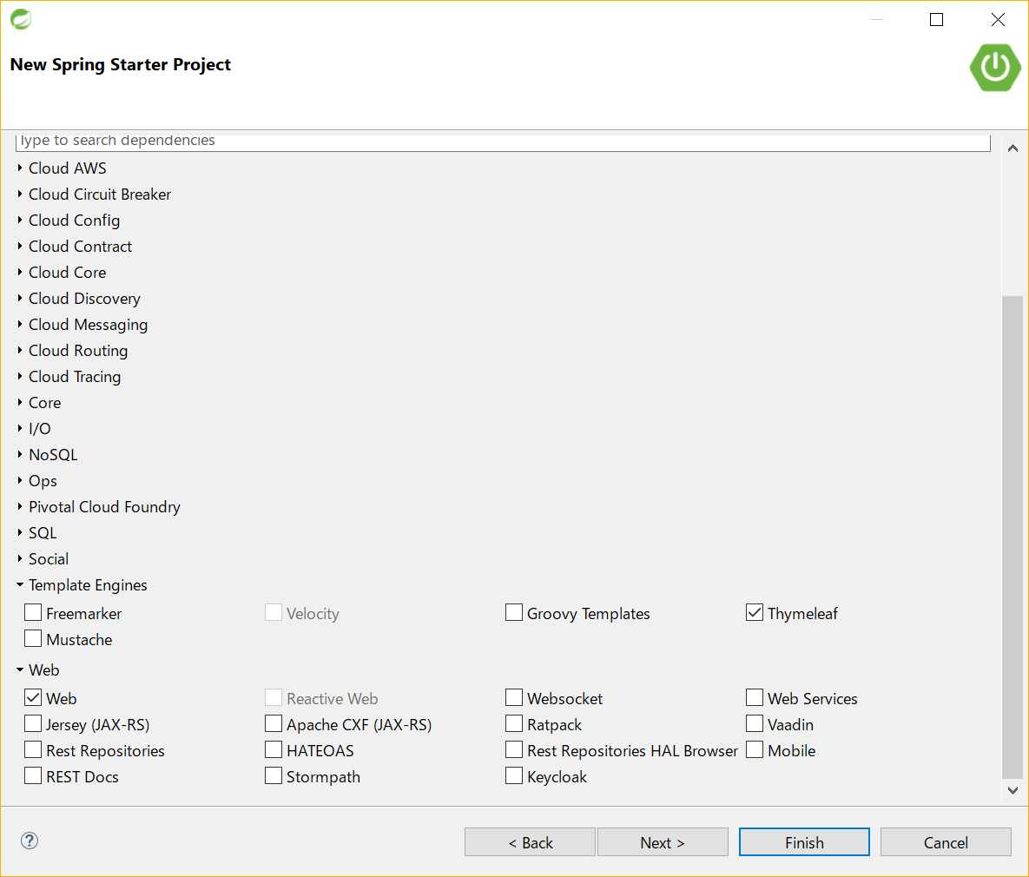
1. Project
Practical Web Development with Spring Boot
1-1. Create a project
Check Dependencies needed for the project
Check:
▼Web
Web
▼Template Engines
Thymeleaf
Click Next >

Slide 6
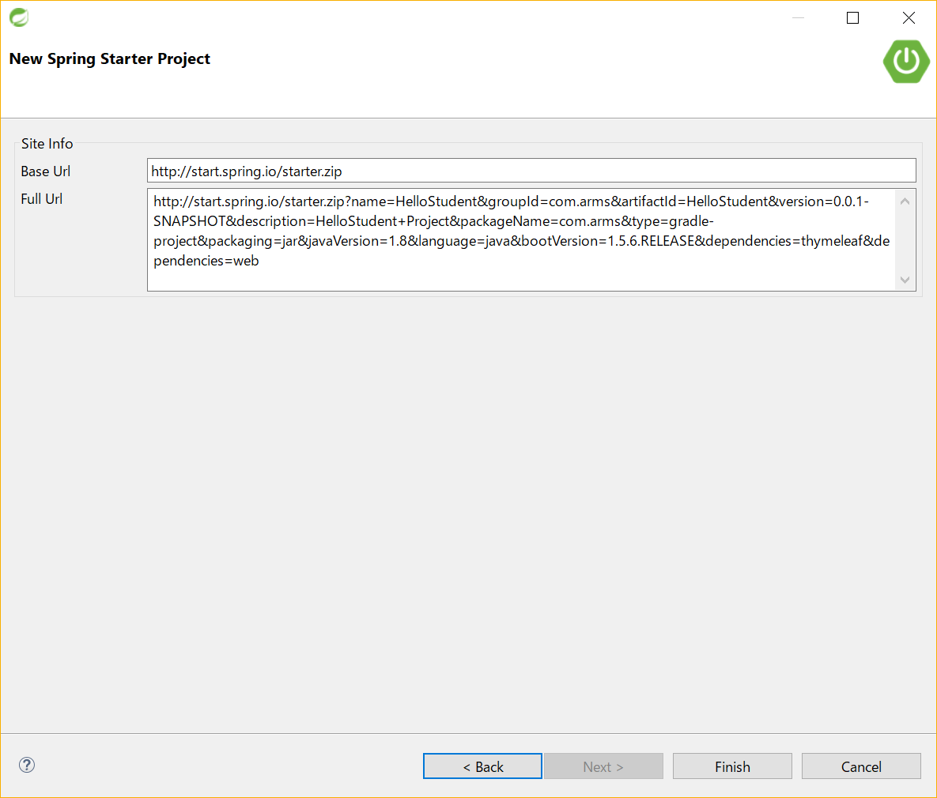
1. Project
Practical Web Development with Spring Boot
1-1. Create a project
Finish to start
This will connect to spring.io with the parameter you checked
Click Finish>

Slide 7
1. Project
Practical Web Development with Spring Boot
1-2. Manage Dependencies
Open dependencies { } of build.gradle
build.gradle
dependencies {
compile('org.springframework.boot:spring-boot-starter-thymeleaf')
compile('org.springframework.boot:spring-boot-starter-web')
testCompile('org.springframework.boot:spring-boot-starter-test')
}
Make sure that you see “web” and “thymeleaf”

Slide 8
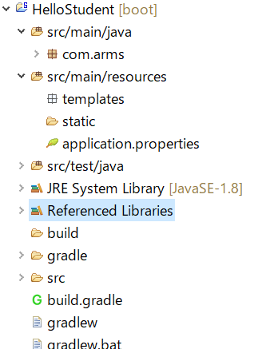
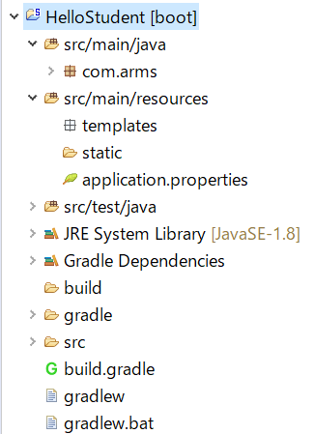
1. Project
Practical Web Development with Spring Boot
1-2. Manage Dependencies
Right-click on your project, Gradle(STS) – “Enable Dependency Management”
Right-click again on your project, Gradle(STS) – Refresh All
Ctrl + F5
After “Refresh All”, you can see the change into “Gradle Dependencies”

Slide 9
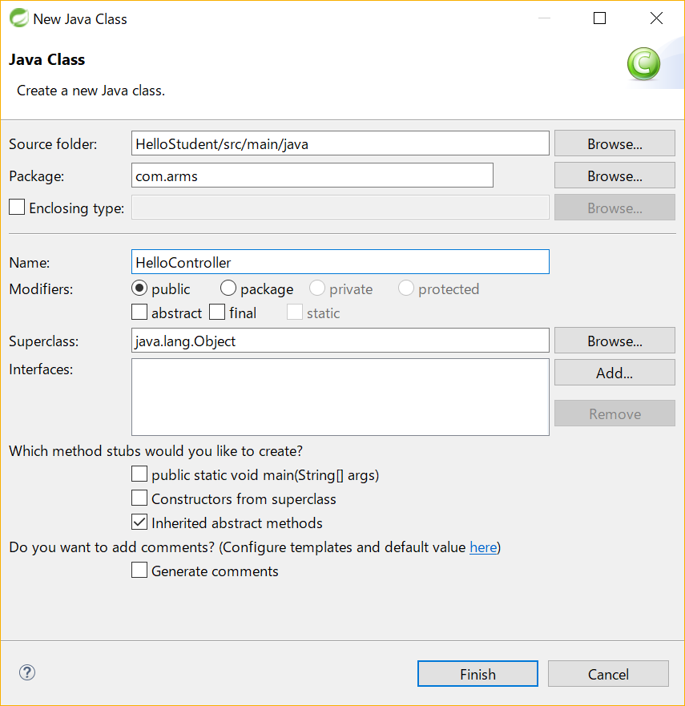
2. RestController
Practical Web Development with Spring Boot
2-1. Create RestController
Right-click on package route “com.arms”, New - Class
Name:
HelloController

Slide 10
2. RestController
Practical Web Development with Spring Boot
2-1. Create RestController
Add the following code to HelloController
HelloController.class
package com.arms;
public class HelloController {
public String list(){
return "Hello Students";
}
}
Simple Class and a method…

Slide 11
2. RestController
Practical Web Development with Spring Boot
2-1. Create RestController
Change the method into a handler method.
HelloController.class
@RestController
public class HelloController {
@RequestMapping(value="/hello", method = RequestMethod.GET)
public String list(){
return "Hello Students";
}
}
Handler method = Handling http request
@.... is called “annotation”

Slide 12
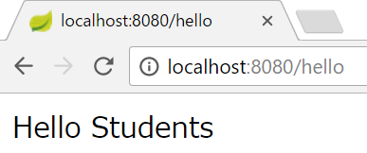
2. RestController
Practical Web Development with Spring Boot
2-1. Create RestController
Right-click on your project, Run As – Spring Boot App
Access localhost:8080/hello

Slide 13
3. Controller
Practical Web Development with Spring Boot
3-1. Create Controller
Change the annotation from @RestController to @Controller
HelloController.class
@Controller
public class HelloController {
@RequestMapping(value="/hello", method = RequestMethod.GET)
public String list(){
return "Hello Students";
}
}
Handler method = Handling http request

Slide 14
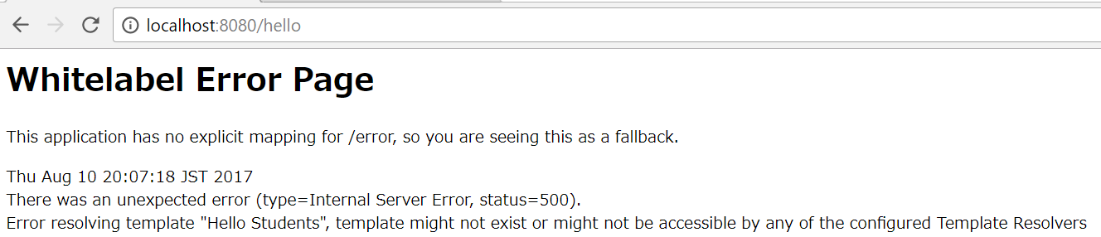
3. Controller
Practical Web Development with Spring Boot
3-1. Create Controller
Restart your application and access the same URL
HelloController.class
You will have an error…..
“Hello Students” template might not exist
@Controller annotation returns the View ( html template)

Slide 15
3. Controller
Practical Web Development with Spring Boot
3-1. Create Controller
You have to create a html template.
HelloController.class
@Controller
public class HelloController {
@RequestMapping(value="/hello", method = RequestMethod.GET)
public String list(){
return "student";
}
}
Change return string to “student”. This means “student.html”

Slide 16
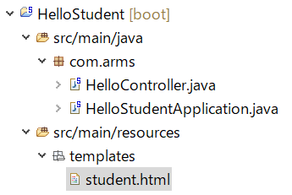
3. Controller
Practical Web Development with Spring Boot
3-1. Create Controller
Right-click on “templates”, New – File, and create “student.html”
student.html

Slide 17
3. Controller
Practical Web Development with Spring Boot
3-1. Create Controller
Add the following code to student.html
student.html
<!DOCTYPE html>
<html>
<head>
<title>Hello Students</title>
</head>
<body>
<h1>Hello Students from Thymeleaf</h1>
</body>
</html>

Slide 18
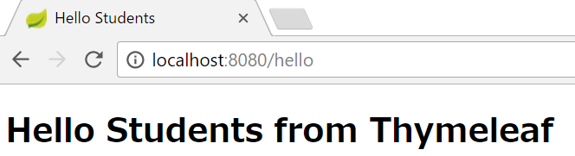
3. Controller
Practical Web Development with Spring Boot
3-1. Create Controller
Restart your application and access the same URL
You will see that “student.html” is being displayed.
Static webpage….. We can create a dynamic webpage with Thymeleaf

Slide 19
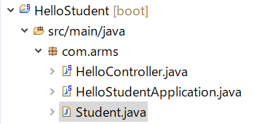
3. Controller
Practical Web Development with Spring Boot
3-2. Thymeleaf
Create Student.class and add the following code
package com.arms;
public class Student {
public int id;
public String name;
}
Student.class

Slide 20
3. Controller
Practical Web Development with Spring Boot
3-2. Thymeleaf
Modify list() method
HelloController.class
@Controller
public class HelloController {
@RequestMapping(value="/hello", method = RequestMethod.GET)
public String list(Model model){
Student student = new Student();
student.id = 3;
student.name = "John";
model.addAttribute("student", student);
return "student";
}
}

Slide 21
3. Controller
Practical Web Development with Spring Boot
3-2. Thymeleaf
Modify student.html
student.html
<!DOCTYPE html>
<html xmlns:th="http://www.thymeleaf.org">
<head>
<meta charset="UTF-8" />
<title>Hello Students</title>
</head>
<body>
<dl>
<dt>ID</dt>
<dd th:text="${student.id}">student id</dd>
<dt>NAME</dt>
<dd th:text="${student.name}">student name</dd>
</dl>
</body>
</html>
th: is thymeleaf tag
Have to define “xmlns:th”

Slide 22
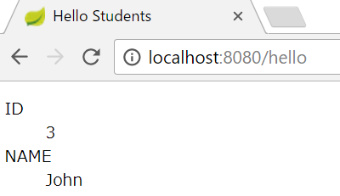
3. Controller
Practical Web Development with Spring Boot
3-2. Thymeleaf
Restart your application and access the same URL
You can see that id and name

Slide 23
3. Controller
Practical Web Development with Spring Boot
3-2. Thymeleaf
Modify list() method again.
HelloController.class
@Controller
public class HelloController {
@RequestMapping(value="/hello", method = RequestMethod.GET)
public String list(Model model){
List<Student> studentList = Arrays.asList(
new Student(){{
id = 1;
name = "John";
}},
new Student(){{
id = 2;
name = "Mike";
}},
new Student(){{
id = 3;
name = "Bob";
}});
model.addAttribute("list", studentList);
return "student";
}
}

Slide 24
3. Controller
Practical Web Development with Spring Boot
3-2. Thymeleaf
Modify student.html again
student.html
<!DOCTYPE html>
<html xmlns:th="http://www.thymeleaf.org">
<head>
<meta charset="UTF-8" />
<title>Hello Students</title>
</head>
<body>
<dl th:each="student : ${list}">
<dt>ID</dt>
<dd th:text="${student.id}">student id</dd>
<dt>NAME</dt>
<dd th:text="${student.name}">student name</dd>
</dl>
</body>
</html>

Slide 25
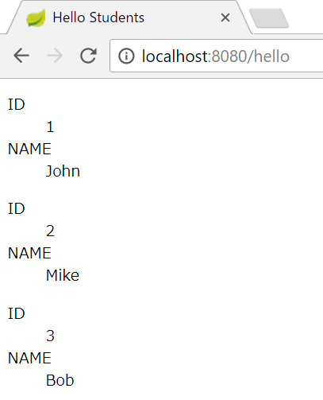
3. Controller
Practical Web Development with Spring Boot
3-2. Thymeleaf
Restart your application and access the same URL
You can see that id and name as a list (repeated)

Slide 26

Your Idea Leads Your Ideals
homepage: http://arms-asia.com/
facebook: https://www.facebook.com/arms.asia?fref=ts

