Slide 1

Create Emitter (Twitter like app) with SPRING BOOT
Presented by ARMS（THAILAND）Co., Ltd.

Slide 2
Index
Practical Web Development with Spring Boot
Create Indivilister
Create Sign in
  1-1. Find an authenticated user
  1-2. Understanding Principal
  1-3. Create a form object
  1-4. Create a signup form
  1-5. Create encrypted password
Implement AOP in Spring
  2-1. Summary
  2-2. Implement AOP
3. Create UserList
  3-1. Create users’ list
  3-2. Modify users’ list
4. Pagination
  4-1. Pagination summary
  4-2. Implement pagination
  4-3. Understanding pagination
Notes:
17/04/21

Slide 3
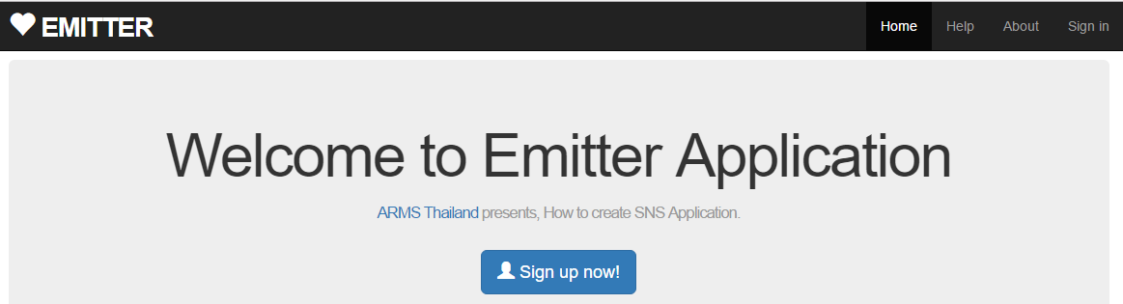
1. Create Sign in
Practical Web Development with Spring Boot
Create Emitter
1-1. Find an authenticated user
Continue from the previous class
In this chapter, we learn how to get “logged-in user” information, and use it in various ways
<div th:if="${isLogin}" class="row">
You have logged in
</div>
<div th:unless="${isLogin}" class="center jumbotron">
<h1>Welcome to Emitter Application</h1>

Slide 4
1. Create Sign in
Practical Web Development with Spring Boot
Create Emitter
1-1. Find an authenticated user
Add the following code to AppService
@Autowired
UserRepository userRepository;
public User findOne(Principal principal){
if(principal == null){
return null;
} else {
Authentication auth = (Authentication) principal;
UserDetails userDetails = (UserDetails) auth.getPrincipal();
return userRepository.findOneByEmail(userDetails.getUsername());
}
}

Slide 5

1. Create Sign in
Practical Web Development with Spring Boot
Create Emitter
1-1. Find an authenticated user
Create ControllerAspect under com.arms.domain.component
Add the following code to ControllerAspect
package com.arms.domain.component;
import java.security.Principal;
import org.springframework.beans.factory.annotation.Autowired;
import org.springframework.security.core.Authentication;
import org.springframework.stereotype.Component;
import org.springframework.web.servlet.ModelAndView;
import com.arms.domain.service.AppService;
@Component
public class ControllerAspect {
@Autowired
AppService appService;
Continue on next page

Slide 6
1. Create Sign in
Practical Web Development with Spring Boot
Create Emitter
1-1. Find an authenticated user
Add the following code to ControllerAspect
public ModelAndView setIsLogin(ModelAndView modelAndView,Principal principal){
Authentication auth = (Authentication) principal;
if (auth != null && auth.isAuthenticated()){
modelAndView.addObject("isLogin", true);
modelAndView.addObject("loginUser", appService.findOne(principal));
return modelAndView;
} else
return modelAndView.addObject("isLogin", false);
}
}
If the user is authenticated, “isLogin” true
If not, “isLogin”, false
----Your home page will change if you login or not
modelAndView.addObject("loginUser", appService.findOne(principal));
_header.html
<li><a th:href="@{/user/show/} + ${loginUser.id}">Profile</a></li>
<li><a th:href="@{/user/edit/} + ${loginUser.id}">Settings</a></li>

Slide 7
1. Create Sign in
Practical Web Development with Spring Boot
Create Emitter
1-1. Find an authenticated user
Modify HomeController as below
@Controller
public class HomeController {
@Autowired
ControllerAspect controllerAspect;
@RequestMapping("/")
public ModelAndView home(ModelAndView modelAndView, Principal principal){
controllerAspect.setIsLogin(modelAndView, principal);
modelAndView.setViewName("home/home");
return modelAndView;
}
}
Restart you app and access ------------:8080, and see if home page will change like the page 3.

Slide 8
1. Create Sign in
Practical Web Development with Spring Boot
Create Emitter
1-2. Understanding Principal
In this section, we will try several codes to understand “Principal object”, after this section, please make sure to delete the codes. We will use LoginController for this section.
Add the following code to LoginController.
@RequestMapping("/loginUser")
@ResponseBody
public String currentUser(Principal principal){
if(principal != null){
return principal.getName();
} else {
return "pricipal is null!!";
}
}
Restart your app and access ---------:8080/loginUser, before and after logging in as a user.
Make sure to delete the above code after the section 1-2 finished

Slide 9
1. Create Sign in
Practical Web Development with Spring Boot
Create Emitter
1-2. Understanding Principal
Add “/loginUser” to SecurityConfig
.and().authorizeRequests().antMatchers("/", "/user/login","/user/signUp", "/user/add", "/help", "/contact", "/about", "/loginUser").permitAll()
You can access “/loginUser” without the log-in
Restart your app and access ---------:8080/loginUser, before and after logging in as a user.
@RequestMapping("/loginUser")
@ResponseBody
public String currentUser(Principal principal){
if(principal != null){
return principal.getName();
} else {
return "pricipal is null!!";
}
}
Make sure to delete the above code after the section 1-2 finished

Slide 10
1. Create Sign in
Practical Web Development with Spring Boot
Create Emitter
1-2. Understanding Principal
Modify currentUser() method
You can access “/loginUser” without the log-in
Restart your app and access ---------:8080/loginUser, before and after logging in as a user.
@RequestMapping("/loginUser")
@ResponseBody
public Object currentUser(Principal principal){
if(principal != null){
return principal;
} else {
return "pricipal is null!!";
}
}
Now you can see that after you login, principal object is created.
Make sure to delete the above code after the section 1-2 finished

Slide 11
1. Create Sign in
Practical Web Development with Spring Boot
Create Emitter
1-2. Understanding Principal
Modify currentUser() method with Authentication
public interface Authentication extends Principal
As you see, Authentication is an interface extending Principal.
It has more information
public Object currentUser(Authentication authentication){
if(authentication != null){
return authentication.getName();
} else {
return "Authentication is null!!";
}
}
Restart your app and access ---------:8080/loginUser, before and after logging in as a user.
Make sure to delete the above code after the section 1-2 finished

Slide 12
1. Create Sign in
Practical Web Development with Spring Boot
Create Emitter
1-2. Understanding Principal
Modify currentUser() method with Authentication
As you see, Authentication is an interface extending Principal.
It has more information
@RequestMapping("/loginUser")
@ResponseBody
public Object currentUser(Authentication authentication){
if(authentication != null){
return authentication.isAuthenticated();
} else {
return "Authentication is null!!";
}
}
Restart your app and access ---------:8080/loginUser, before and after logging in as a user.
Make sure to delete the above code after the section 1-2 finished

Slide 13
1. Create Sign in
Practical Web Development with Spring Boot
Create Emitter
1-2. Understanding Principal
In spring security case, principal is just an object, most of its case, principal can be cast into UserDetails object. Userdetails is the main interface for Spring Security, although it represents a principal. UserDetails is an adapter between your database and what Spring Security needs.
How should we provide information needed for UserDetails object?
There is an interface called UserDetailsService, this has the only one method which receives username(String) and returns UserDetails
Example case
public class AuthenticationService implements UserDetailsService {
………………………………….
@Override
public UserDetails loadUserByUsername(String email) throws UsernameNotFoundException {
…………………………………………………..
return userDetails;
}

Slide 14
1. Create Sign in
Practical Web Development with Spring Boot
Create Emitter
1-2. Understanding Principal
Let’s see what is returned for UserDetails.
There is an interface called UserDetailsService, this has the only one method which receives username(String) and returns UserDetails
@RequestMapping(value = "/loginUser")
@ResponseBody
public UserDetails currentUser(Principal principal){
Authentication auth = (Authentication)principal;
UserDetails ud = (UserDetails) auth.getPrincipal();
return authenticationService.loadUserByUsername(ud.getUsername());
}
Restart your app and access ---------:8080/loginUser, before and after logging in as a user. You will see the following setting returned as the result.
UserDetails userDetails = (UserDetails) new org.springframework.security.core.userdetails.User(user.getEmail(),
user.getPassword(), isEnabled, isAccountNonExpired, isCredentialsNonExpired, isAccountNonLocked, Arrays.asList(authority));
Make sure to delete the above code after the section 1-2 finished

Slide 15
1. Create Sign in
Practical Web Development with Spring Boot
Create Emitter
1-2. Understanding Principal
Spring security provides Authentication and Authorization features
Authentication part: username and password, and once you passed, it is authenticated.
Authorization part: For authenticated users, which pages are authorized to see.
Let’s see some Authorization setting in Emitter.

Slide 16
1. Create Sign in
Practical Web Development with Spring Boot
Create Emitter
1-2. Understanding Principal
Authorization
When Spring loads an authenticated user as a userDetails, this will also return GrantendAuthority. GrantedAuthority is an authoriy granted to the principal. This authority is called “ROLE”
AuthenticationService
public UserDetails loadUserByUsername(String email) throws UsernameNotFoundException {
User user = userRepository.findOneByEmail(email);
GrantedAuthority authority = new SimpleGrantedAuthority("emitter2");
Set “ROLE” String as “emitter2”
Change .permitAll() to .hasAuthority(“emitter2”)
SecurityConfig
protected void configure(HttpSecurity http) throws Exception {
http.authorizeRequests()
.and().authorizeRequests().antMatchers("/static/**","/javascripts/**", "/images/**", "/**/favicon.ico","/fonts/**","/stylesheets/**").hasAuthority("emitter2")
.and().authorizeRequests().antMatchers("/", "/user/login","/user/signUp", "/user/add", "/help", "/contact", "/about", "/loginUser").permitAll()
.anyRequest().authenticated()
Make sure to delete the above code after the section 1-2 finished

Slide 17
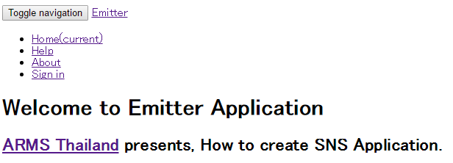
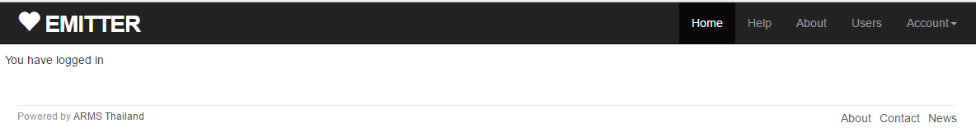
1. Create Sign in
Practical Web Development with Spring Boot
Create Emitter
1-2. Understanding Principal
Authorization
Restart your app and access -----------:8080/, and see what happens to your page.
Emitter users has a role name(authority) “emitter2”, then
Emitter users has a role name(authority) “emitter2”. After you login, you can access static folders, and design is applied.
Make sure to delete or modify the unnecessary code in this section 1-2

Slide 18
2. Implement AOP in Spring
Practical Web Development with Spring Boot
Create Emitter
2-1. Summary
Aspect-Oriented Programming (AOP)
AOP is not something to take over OOP position, but AOP complements OOP by providing another way
When you refer to the term AOP, you will often come across “cross-cutting concerns”. You can add new code without changing the original code.
So, in our case, where in Emitter could have cross-cutting concerns and you want to add new code without changing the original code????
Continue on next page

Slide 19
2. Implement AOP in Spring
Practical Web Development with Spring Boot
Create Emitter
2-1. Summary
How about this part of the code in Emitter?
public ModelAndView setIsLogin(ModelAndView modelAndView,Principal principal){
Authentication auth = (Authentication) principal;
if (auth != null && auth.isAuthenticated()){
modelAndView.addObject("isLogin", true);
modelAndView.addObject("loginUser", appService.findOne(principal));
return modelAndView;
} else
return modelAndView.addObject("isLogin", false);
}
}
Do you have to call setIsLogin() method from each controller? whenever we need login user information?
@Controller
public class HomeController {
@Autowired
ControllerAspect controllerAspect;
@RequestMapping("/")
public ModelAndView home(ModelAndView modelAndView, Principal principal){
controllerAspect.setIsLogin(modelAndView, principal);
modelAndView.setViewName("home/home");
return modelAndView;
}
}
Could this be cross-cutting matters? Does this make all controller developers write this method?
Continue on next page

Slide 20
2. Implement AOP in Spring
Practical Web Development with Spring Boot
Create Emitter
2-1. Summary
If we have more controller methods, writing the same code to each method is very troublesome and is the cause of errors?
Is there a smarter way to solve this kind of concerns?
Is there a smarter way to make this code shorter?

Slide 21
2. Implement AOP in Spring
Practical Web Development with Spring Boot
Create Emitter
2-2. Implement AOP
AOP can help!!!
Modify ControllerAspect
package com.arms.domain.component;
import com.arms.domain.service.AppService;
import org.aspectj.lang.JoinPoint;
import org.aspectj.lang.annotation.Aspect;
import org.aspectj.lang.annotation.Before;
import org.springframework.beans.factory.annotation.Autowired;
import org.springframework.security.core.Authentication;
import org.springframework.security.core.userdetails.UserDetails;
import org.springframework.stereotype.Component;
import org.springframework.web.servlet.ModelAndView;
import java.security.Principal;
@Component
@Aspect
public class ControllerAspect {
@Autowired
AppService appService;
Continue on next page

Slide 22
2. Implement AOP in Spring
Practical Web Development with Spring Boot
Create Emitter
2-2. Implement AOP
AOP can help!!!
Modify ControllerAspect
@Before("execution(* com.arms.app.*.*Controller.*(..))")
public void invokeBefore(JoinPoint joinPoint) {
Principal principal = null;
ModelAndView modelAndView = null;
for(Object object : joinPoint.getArgs()) {
if(object instanceof Principal) {
principal = (Principal) object;
} else if(object instanceof ModelAndView) {
modelAndView = (ModelAndView) object;
}
}
if(principal != null && modelAndView != null) {
setIsLogin(modelAndView, principal);
}
}
Continue on next page

Slide 23
2. Implement AOP in Spring
Practical Web Development with Spring Boot
Create Emitter
2-2. Implement AOP
AOP can help!!!
Modify ControllerAspect
private void setIsLogin(ModelAndView modelAndView, Principal principal) {
Authentication auth = (Authentication) principal;
if(auth != null && auth.isAuthenticated()) {
modelAndView.addObject("isLogin", true);
UserDetails userDetails = (UserDetails) auth.getPrincipal();
modelAndView.addObject("userInfo", userDetails);
modelAndView.addObject("loginUser", appService.findOne(principal));
} else {
modelAndView.addObject("isLogin", false);
}
}
}

Slide 24
2. Implement AOP in Spring
Practical Web Development with Spring Boot
Create Emitter
2-2. Implement AOP
You will see an error in HomeController
Comment out the error line by //
@RequestMapping("/")
public ModelAndView home(ModelAndView modelAndView, Principal principal){
// controllerAspect.setIsLogin(modelAndView, principal);
modelAndView.setViewName("home/home");
return modelAndView;
}
}
Restart your app and access ------------:8080/, and check if your app is working properly
Ctrl + / for inserting //

Slide 25
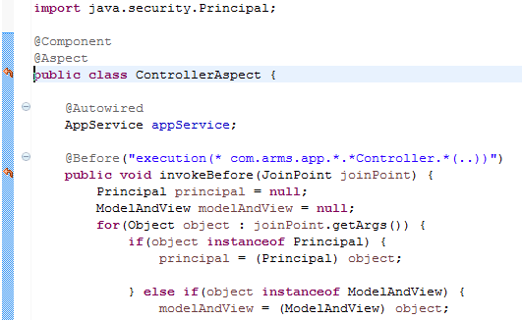
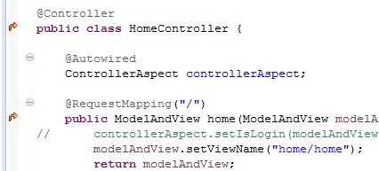
2. Implement AOP in Spring
Practical Web Development with Spring Boot
Create Emitter
2-2. Implement AOP
You will see a change in your code
ControllerAspect
Point where Aspect is applied
HomeController
See also other controllers!!

Slide 26
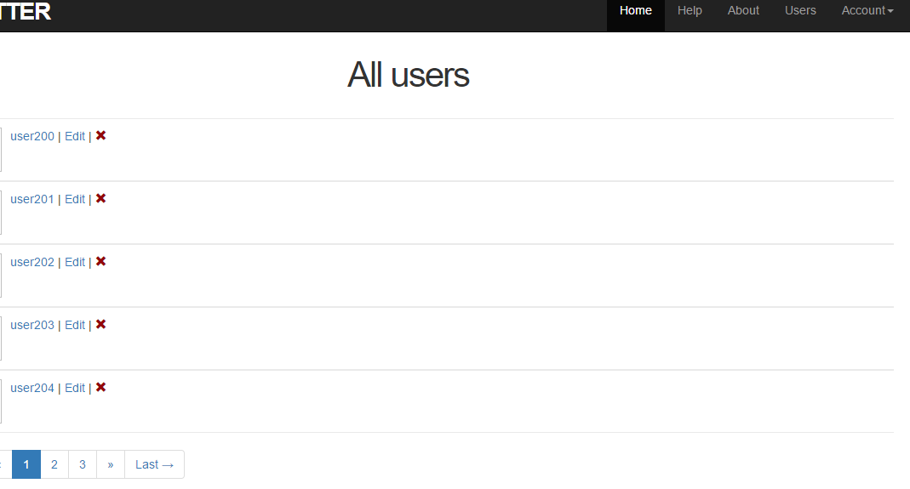
3. Create UserList
Practical Web Development with Spring Boot
Create Emitter
3-1. Create users’ list
We will create users’ list like below
After you login, you can access Users button and users’ list
<li th:if="${isLogin}"><a th:href="@{/user/list}">Users</a></li>

Slide 27

3. Create UserList
Practical Web Development with Spring Boot
Create Emitter
3-1. Create users’ list
Create UserController under com.arms.app.user
Add the following code to UserController
package com.arms.app.user;
import java.util.List;
import org.springframework.beans.factory.annotation.Autowired;
import org.springframework.stereotype.Controller;
import org.springframework.web.bind.annotation.RequestMapping;
import org.springframework.web.servlet.ModelAndView;
import com.arms.domain.entity.User;
@Controller
public class UserController {
@RequestMapping("/user/list")
public ModelAndView list(ModelAndView modelAndView){
List<User> users = userService.findAllUser();
modelAndView.addObject("users", users);
modelAndView.addObject("user/list");
return modelAndView;
}
}

Slide 28
3. Create UserList
Practical Web Development with Spring Boot
Create Emitter
3-1. Create users’ list
Add findAllUser() method to UserService
public List<User> findAllUser(){
return userRepository.findAll();
}
Annotate UserService with @Autowired (error will disappear)
…………………………………………
public class UserController {
@Autowired
UserService userService;
@RequestMapping("/user/list")
public ModelAndView list(ModelAndView modelAndView){
List<User> users = userService.findAllUser();
modelAndView.addObject("users", users);
modelAndView.addObject("user/list");
return modelAndView;
}
…………………………………………

Slide 29

3. Create UserList
Practical Web Development with Spring Boot
Create Emitter
3-1. Create users’ list
Create list.html under templates.user
Add the following code to list.html
<!DOCTYPE html>
<html xmlns="http://www.w3.org/1999/xhtml"
xmlns:th="http://www.thymeleaf.org"
xmlns:layout="http://www.ultraq.net.nz/thymeleaf/layout"
layout:decorator="layout/main">
<head>
<title>Users' list</title>
</head>
<body>
<div layout:fragment="content" th:remove="tag">
<!-- Users list.html inserted into main.html -->
<h1>All users</h1>
<span th:each="user, stat : ${users}">
<ul class="users">
<li>
<a th:href="@{/user/show/} + ${user.id}" th:text="${user.name}">AAA</a>
<span>|</span>
Continue on next page

Slide 30
3. Create UserList
Practical Web Development with Spring Boot
Create Emitter
3-1. Create users’ list
Add the following code to list.html
<a th:href="@{/user/edit/} + ${user.id}" th:text="'Edit'">BBB</a>
<span>|</span>
<a th:if="${userId != user.id}" th:href="@{/user/delete/} + ${user.id}" onclick="return confirm('Are you sure?')"><span class="glyphicon glyphicon-remove red" aria-hidden="true"></span></a>
</li>
</ul>
</span>
<!-- Users list.html inserted into main.html End -->
</div>
</body>
</html>
Restart your app and access -------------:8080/, and check if you can see users’ list

Slide 31
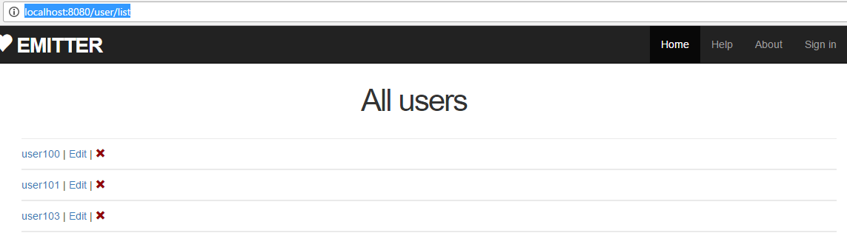
3. Create UserList
Practical Web Development with Spring Boot
Create Emitter
3-2. Modify users’ list
Now you can see users’ list. But it has a few problems.
The first problem is you can access users’ list without “login”

Slide 32
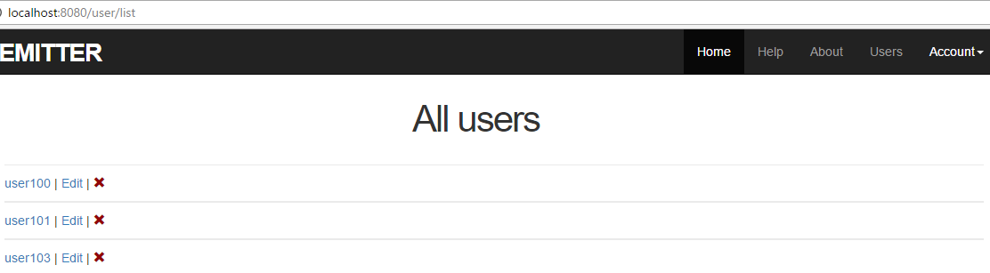
3. Create UserList
Practical Web Development with Spring Boot
Create Emitter
3-2. Modify users’ list
Add the Principal object to list() method in UserController
@RequestMapping("/user/list")
public ModelAndView list(ModelAndView modelAndView, Principal principal){
List<User> users = userService.findAllUser();
modelAndView.addObject("users", users);
modelAndView.addObject("user/list");
return modelAndView;
}
Restart your app and access ------------:8080/, and see if you can only access users’ list after you login.

Slide 33
3. Create UserList
Practical Web Development with Spring Boot
Create Emitter
3-2. Modify users’ list
The second problem you might want to modify is “not displaying ×delete icon” from the login user
If you currently login with user100, not displaying ×delete icon from user100.
So in this case, you need to know the current userId in list.html

Slide 34
3. Create UserList
Practical Web Development with Spring Boot
Create Emitter
3-2. Modify users’ list
If userId is not user.id, display ×delete button
list.html
<a th:if="${userId != user.id}" th:href="@{/user/delete/} + ${user.id}"

Slide 35
3. Create UserList
Practical Web Development with Spring Boot
Create Emitter
3-2. Modify users’ list
Add the following code to AppService
This will get “login userId” from Principal object
@Service
public class AppService {
@Autowired
UserRepository userRepository;
public Integer getUserId(Principal principal) {
if(principal == null)
return null;
else {
Authentication auth = (Authentication) principal;
UserDetails userDetails = (UserDetails) auth.getPrincipal();
User user = userRepository.findOneByEmail(userDetails.getUsername());
if(user == null)
return null;
else
return user.getId();
}
}
public User findOne(Principal principal){
………………………………………………………

Slide 36
3. Create UserList
Practical Web Development with Spring Boot
Create Emitter
3-2. Modify users’ list
Call getUserId() method from UserController
Add the following code to list() method in UserController
@RequestMapping("/user/list")
public ModelAndView list(ModelAndView modelAndView, Principal principal){
List<User> users = userService.findAllUser();
modelAndView.addObject("users", users);
modelAndView.addObject("user/list");
modelAndView.addObject("userId", userService.getUserId(principal));
return modelAndView;
}
Calling AppService method as UserService, because UserService is extending AppService.
@Service
public class UserService extends AppService {

Slide 37
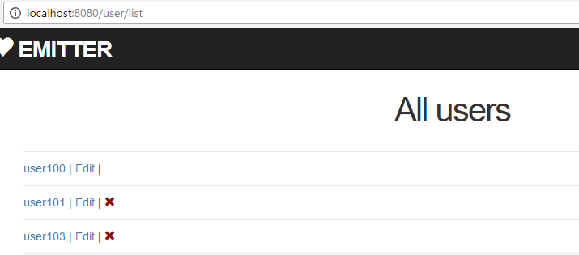
3. Create UserList
Practical Web Development with Spring Boot
Create Emitter
3-2. Modify users’ list
Restart your app and access ---------:8080/, and see if the current user’s delete icon is not displayed.
Delete icon not displayed

Slide 38
4. Pagination
Practical Web Development with Spring Boot
Create Emitter
4-1. Pagination summary
The third problem you might want to solve in this page is…
What if you have so many users? You will have to scroll forever to reach the user
If so many users in this page
You have to scroll forever………………
…
user2543

Slide 39
4. Pagination
Practical Web Development with Spring Boot
Create Emitter
4-1. Pagination summary
We will implement the pagination with the following order
Create PageWrapper class
This class has fields to store page data such as page url, page number, page content, page size, total page, and so on.
Create WebConfig class, it extends WebMvcConfigurerAdapter
Override addArgumentResolvers
PageableHandlerMethodArgumentResolver will create Pageable object with current page position and size, this Pageable object is set as Controller’s argument.
Pageable goes to Service and then Repository’s query method.
Repository query method gets data based on the Pageable object.
Continue on next page

Slide 40
4. Pagination
Practical Web Development with Spring Boot
Create Emitter
4-1. Pagination summary
We will implement the pagination with the following order
setFallbackPageable is to change (page position and the number of contents loaded)
Change from List<User> to Page<User> to load page data
Set Page<> and PageWrapper object to Controller and give them to the View
Add the pagination code to the View(html)

Slide 41

4. Pagination
Practical Web Development with Spring Boot
Create Emitter
4-2. Implement pagination
Create PageWrapper under com.arms.domain.component
Add the following code to PageWrapper
package com.arms.domain.component;
import org.springframework.data.domain.Page;
import java.util.ArrayList;
import java.util.List;
public class PageWrapper<T> {
public static final int MAX_PAGE_ITEM_DISPLAY = 5;
private Page<T> page;
private List<PageItem> items;
private int currentNumber;
private String url;
Continue on next page

Slide 42
4. Pagination
Practical Web Development with Spring Boot
Create Emitter
4-2. Implement pagination
Add the following code to PageWrapper
public String getUrl() {
return url;
}
public void setUrl(String url) {
this.url = url;
}
public PageWrapper(Page<T> page, String url){
this.page = page;
this.url = url;
items = new ArrayList<PageItem>();
currentNumber = page.getNumber() + 1; //start from 1 to match page.page
int start, size;
if (page.getTotalPages() <= MAX_PAGE_ITEM_DISPLAY){
start = 1;
size = page.getTotalPages();
} else {
if (currentNumber <= MAX_PAGE_ITEM_DISPLAY - MAX_PAGE_ITEM_DISPLAY/2){
start = 1;
size = MAX_PAGE_ITEM_DISPLAY;
Continue on next page

Slide 43
4. Pagination
Practical Web Development with Spring Boot
Create Emitter
4-2. Implement pagination
Add the following code to PageWrapper
} else if (currentNumber >= page.getTotalPages() - MAX_PAGE_ITEM_DISPLAY/2){
start = page.getTotalPages() - MAX_PAGE_ITEM_DISPLAY + 1;
size = MAX_PAGE_ITEM_DISPLAY;
} else {
start = currentNumber - MAX_PAGE_ITEM_DISPLAY/2;
size = MAX_PAGE_ITEM_DISPLAY;
}
}
for (int i = 0; i<size; i++){
items.add(new PageItem(start+i, (start+i)==currentNumber));
}
}
public List<PageItem> getItems(){
return items;
}
public int getNumber(){
return currentNumber;
}
Continue on next page

Slide 44
4. Pagination
Practical Web Development with Spring Boot
Create Emitter
4-2. Implement pagination
Add the following code to PageWrapper
public List<T> getContent(){
return page.getContent();
}
public int getSize(){
return page.getSize();
}
public int getTotalPages(){
return page.getTotalPages();
}
public boolean isFirstPage(){
return page.isFirst();
}
public boolean isLastPage(){
return page.isLast();
}
Continue on next page

Slide 45
4. Pagination
Practical Web Development with Spring Boot
Create Emitter
4-2. Implement pagination
Add the following code to PageWrapper
public boolean isHasPreviousPage(){
return page.hasPrevious();
}
public boolean isHasNextPage(){
return page.hasNext();
}
public class PageItem {
private int number;
private boolean current;
public PageItem(int number, boolean current){
this.number = number;
this.current = current;
}
Continue on next page

Slide 46
4. Pagination
Practical Web Development with Spring Boot
Create Emitter
4-2. Implement pagination
Add the following code to PageWrapper
public int getNumber(){
return this.number;
}
public boolean isCurrent(){
return this.current;
}
}
}

Slide 47

4. Pagination
Practical Web Development with Spring Boot
Create Emitter
4-2. Implement pagination
Create WebConfig under com.arms.config
Add the following code to WebConfig
package com.arms.config;
import org.springframework.context.annotation.Configuration;
import org.springframework.data.domain.PageRequest;
import org.springframework.data.web.PageableHandlerMethodArgumentResolver;
import org.springframework.web.method.support.HandlerMethodArgumentResolver;
import org.springframework.web.servlet.config.annotation.WebMvcConfigurerAdapter;
import java.util.List;
@Configuration
public class WebConfig extends WebMvcConfigurerAdapter {
@Override
public void addArgumentResolvers(List<HandlerMethodArgumentResolver> argumentResolvers) {
PageableHandlerMethodArgumentResolver resolver = new PageableHandlerMethodArgumentResolver();
resolver.setFallbackPageable(new PageRequest(0, 5));
argumentResolvers.add(resolver);
super.addArgumentResolvers(argumentResolvers);
}
}

Slide 48
4. Pagination
Practical Web Development with Spring Boot
Create Emitter
4-2. Implement pagination
Modify findAllUser method in UserService
public List<User> findAllUser(){
return userRepository.findAll();
}
Add the following code to WebConfig
Change from List<User> to Page<User> and add Pageable object as an argument
public Page<User> findAllUser(Pageable pageable){
return userRepository.findAll(pageable);
}

Slide 49
4. Pagination
Practical Web Development with Spring Boot
Create Emitter
4-2. Implement pagination
Modify list() method in UserController
@RequestMapping("/user/list")
public ModelAndView list(ModelAndView modelAndView, Principal principal){
List<User> users = userService.findAllUser();
modelAndView.addObject("users", users);
modelAndView.addObject("user/list");
modelAndView.addObject("userId", userService.getUserId(principal));
return modelAndView;
}
Adding Page<User>, PageWrapper<User>, and Pageable
↓↓↓↓↓↓↓↓↓↓↓↓↓↓↓↓↓↓↓↓↓
@RequestMapping("/user/list")
public ModelAndView list(ModelAndView modelAndView, Principal principal, Pageable pageable) {
Page<User> userPage = userService.findAllUser(pageable);
PageWrapper<User> page = new PageWrapper<>(userPage, "/user/list");
modelAndView.addObject("users", page.getContent());
modelAndView.addObject("page", page);
modelAndView.addObject("userId", userService.getUserId(principal));
modelAndView.setViewName("user/list");
return modelAndView;
}

Slide 50
4. Pagination
Practical Web Development with Spring Boot
Create Emitter
4-2. Implement pagination
Add the pagination code to list.html
<!-- Start Of Pagination -->
<div th:fragment='paginationbar'>
<div>
<ul class='pagination pagination-centered'>
<li th:class="${page.firstPage}?'disabled':''">
<span th:if='${page.firstPage}'>← First</span>
<a th:if='${not page.firstPage}' th:href='@{${page.url}(page=0,size=${page.size})}'>← First</a>
</li>
<li th:class="${page.hasPreviousPage}? '' : 'disabled'">
<span th:if='${not page.hasPreviousPage}'>«</span>
<a th:if='${page.hasPreviousPage}' th:href='@{${page.url}(page=${page.number-2},size=${page.size})}' title='Go to previous page'>«</a>
</li>
<li th:each='item : ${page.items}' th:class="${item.current}? 'active' : ''">
<span th:if='${item.current}' th:text='${item.number}'>1</span>
<a th:if='${not item.current}' th:href='@{${page.url}(page=${item.number-1},size=${page.size})}'><span th:text='${item.number}'>1</span></a>
</li>
Continue on next page

Slide 51
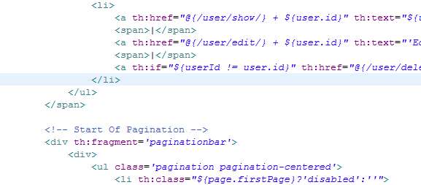
4. Pagination
Practical Web Development with Spring Boot
Create Emitter
4-3. Understanding pagination
Add the pagination code to list.html
<li th:class="${page.hasNextPage}? '' : 'disabled'">
<span th:if='${not page.hasNextPage}'>»</span>
<a th:if='${page.hasNextPage}' th:href='@{${page.url}(page=${page.number},size=${page.size})}' title='Go to next page'>»</a>
</li>
<li th:class="${page.lastPage}? 'disabled' : ''">
<span th:if='${page.lastPage}'>Last →</span>
<a th:if='${not page.lastPage}' th:href='@{${page.url}(page=${page.totalPages - 1},size=${page.size})}'>Last →</a>
</li>
</ul>
</div>
</div>
<!-- End Of Pagination -->
Insert from here

Slide 52
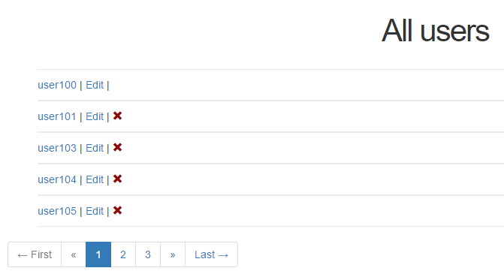
4. Pagination
Practical Web Development with Spring Boot
Create Emitter
4-3. Implement pagination
Restart your app and access ----------:8080/, and see if the pagination is working properly.
This setting can change the default position and the number of users in one page
WebConfig.java
resolver.setFallbackPageable(new PageRequest(0, 5));

Slide 53
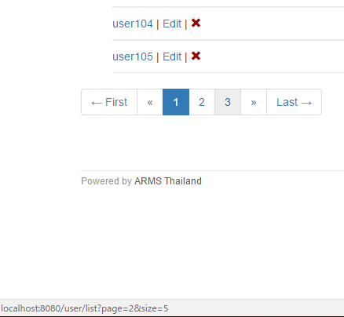
4. Pagination
Practical Web Development with Spring Boot
Create Emitter
4-3. Understanding pagination
Pagination link
list method in UserController
PageWrapper<User> page = new PageWrapper<>(userPage, "/user/list");
This part of “/user/list” is used for pagination link

Slide 54
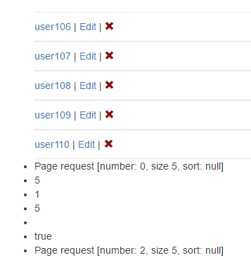
4. Pagination
Practical Web Development with Spring Boot
Create Emitter
4-3. Understanding pagination
Challenge: Display Page object to the View by using UserController and list.html
http://docs.spring.io/spring-data/data-commons/docs/current/api/org/springframework/data/domain/Page.html
http://docs.spring.io/spring-data/data-commons/docs/current/api/org/springframework/data/domain/Pageable.html

Slide 55

Your Idea Leads Your Ideals
homepage: http://arms-asia.com/
facebook: https://www.facebook.com/arms.asia?fref=ts
Notes:
17/04/21

