Slide 1

Pagination with Spring Boot
Presented by ARMS（THAILAND）Co., Ltd.

Slide 2
Index
Practical Web Development Pagination with Spring Boot
Project
  1-1. Create a project
  1-2. Manage Dependencies
  1-3. application.properties
Page, Pageable
  2-1. Create entity class
  2-2. Create repository
  2-3. Create service class
  2-4. Create controller class
  2-5. Create the View
  2-6. Customize pagination
3. Advanced Pagination
  3-1. Configure a global default
  3-2. Advanced pagination

Slide 3



1. Project
Practical Web Development Pagination with Spring Boot
1-1. Create a project
We will create two types of pagination in this document
As the data increases, pagination will become longer.
Limit the number and add Previous and Next buttons

Slide 4
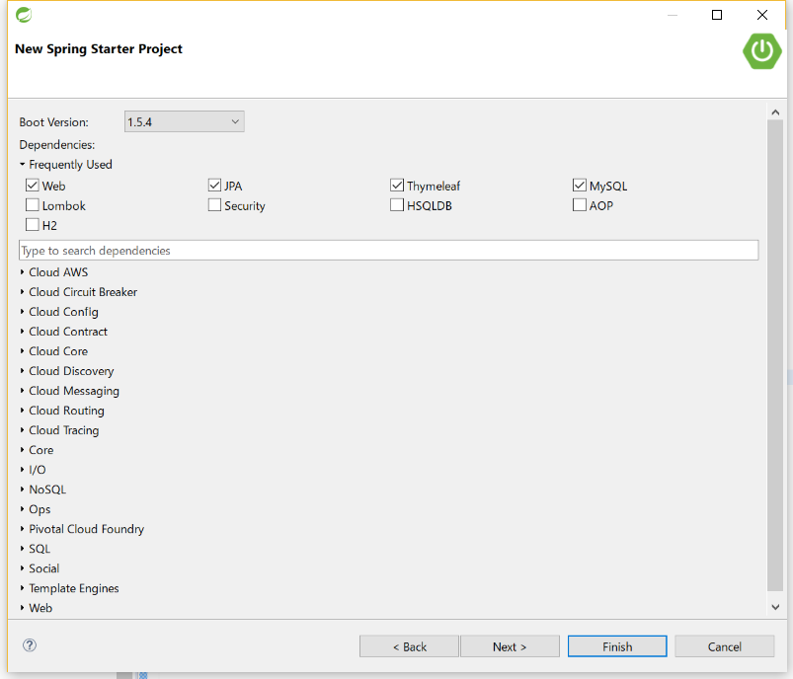
1. Project
Practical Web Development Pagination with Spring Boot
1-1. Create a project
Check Dependencies needed for the project
Check:
▼Web
Web
▼Template Engines
Thymeleaf
▼SQL
JPA
MySQL
Click Next >

Slide 5
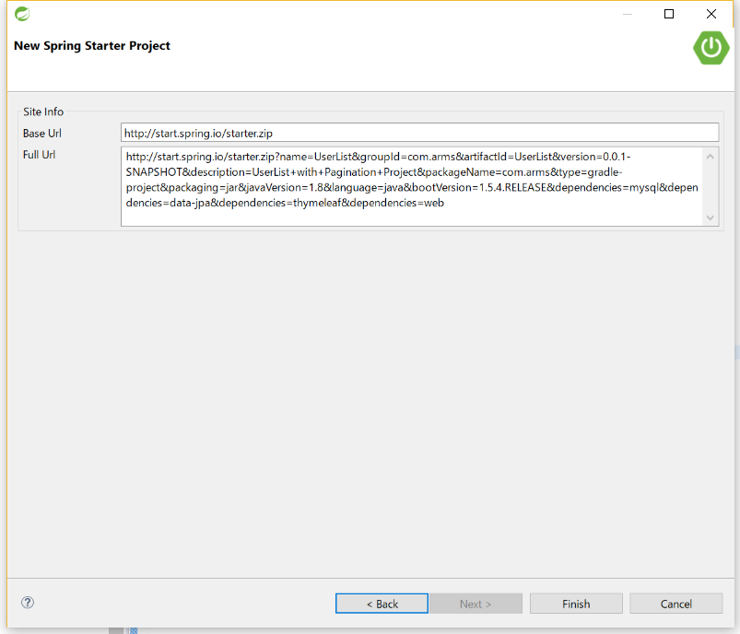
1. Project
Practical Web Development Pagination with Spring Boot
1-1. Create a project
Check Dependencies needed for the project
This will connect to spring.io with the parameter you checked
Click Finish>

Slide 6
1. Project
Practical Web Development Pagination with Spring Boot
1-2. Manage Dependencies
Modify dependencies { } of build.gradle
build.gradle
dependencies {
compile('org.springframework.boot:spring-boot-starter-data-jpa')
compile('org.springframework.boot:spring-boot-starter-thymeleaf')
compile('org.springframework.boot:spring-boot-starter-web')
runtime('mysql:mysql-connector-java')
compile('net.sourceforge.nekohtml:nekohtml')
testCompile('org.springframework.boot:spring-boot-starter-test')
}
Add HTML parser to dependencies
<title> Pagination
<title> Pagination </title>
<table>
</tablw>
<table>
</table>
nekohtml can add or modify html for you.

Slide 7
1. Project
Practical Web Development Pagination with Spring Boot
1-2. Manage Dependencies
Right-click on your project, Gradle(STS) – “Enable Dependency Management”
Right-click again on your project, Gradle(STS) – Refresh All
Ctrl + F5
After “Refresh All”, you can see “nekohtml” in “Gradle Dependencies”

Slide 8
1. Project
Practical Web Development Pagination with Spring Boot
1-3. application.properties
Go to application.properties, add the following setting.
spring.datasource.url=jdbc:mysql://192.168.33.10:3306/rsservice?useUnicode=true&characterEncoding=UTF-8&zeroDateTimeBehavior=convertToNull
spring.datasource.username=root
spring.datasource.password=manager
spring.thymeleaf.mode=LEGACYHTML5
spring.thymeleaf.cache=false
spring.thymeleaf.encoding=UTF-8

Slide 9

1. Project
Practical Web Development Pagination with Spring Boot
1-3. application.properties
Go to MySQL, create a database
After this, make sure to create Database in MySQL,
Database name : rsservice
Table name: user
Fields: id, name

Slide 10
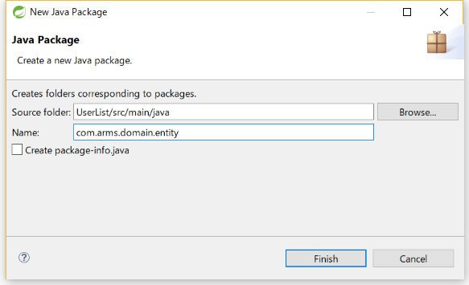
2. Page, Pageable
Practical Web Development Pagination with Spring Boot
2-1. Create entity class
Right-click on the package route “com.arms”, New- Package
Package Name: “com.arms.domain.entity”

Slide 11

2. Page, Pageable
Practical Web Development Pagination with Spring Boot
2-1. Create entity class
Under com.arms.domain.entity, create User.class.
User.class
Create two fields and its getters and setters in User.class
public class User {
private int id;
private String name;
public int getId() {
return id;
}
public void setId(int id) {
this.id = id;
}
public String getName() {
return name;
}
public void setName(String name) {
this.name = name;
}
}

Slide 12
2. Page, Pageable
Practical Web Development Pagination with Spring Boot
2-1. Create entity class
Add the following annotations to User.class
User.class
@Entity
@Table(name = "user")
public class User {
@Id
@GeneratedValue
private int id;
private String name;
…………………………………..
This class will be mapped to a table “user” in Database

Slide 13
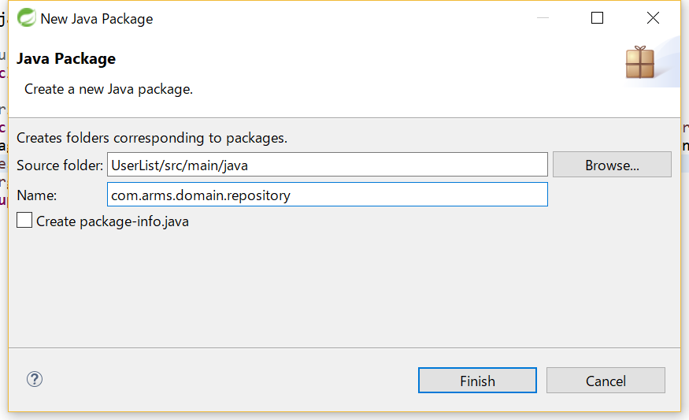
2. Page, Pageable
Practical Web Development Pagination with Spring Boot
2-2. Create repository
Right-click on the package route “com.arms”, New- Package
Package Name: “com.arms.domain.repository”

Slide 14
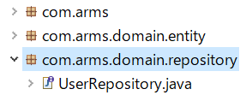
2. Page, Pageable
Practical Web Development Pagination with Spring Boot
2-2. Create repository
Under com.arms.domain.repository, create UserRepository interface.
UserRepository interface add the following code to UserRepository
package com.arms.domain.repository;
import org.springframework.data.jpa.repository.JpaRepository;
import org.springframework.stereotype.Repository;
import com.arms.domain.entity.User;
@Repository
public interface UserRepository extends JpaRepository<User, Integer> {
}

Slide 15
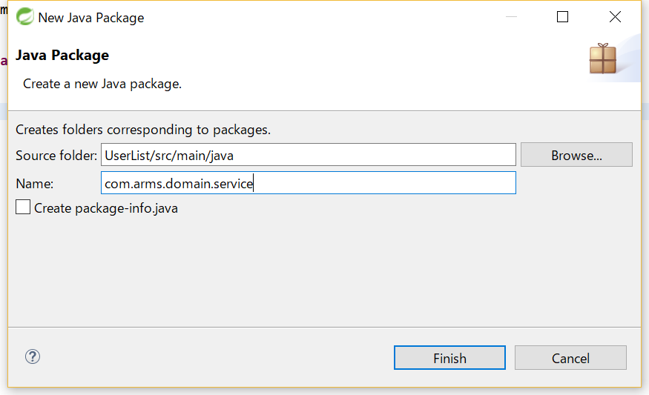
2. Page, Pageable
Practical Web Development Pagination with Spring Boot
2-3. Create service class
Right-click on the package route “com.arms”, New- Package
Package Name: “com.arms.domain.service”

Slide 16
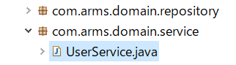
2. Page, Pageable
Practical Web Development Pagination with Spring Boot
2-3. Create service class
Under “com.arms.domain.service”, create UserService class
UserService.class add the following code to UserService.class
package com.arms.domain.service;
import org.springframework.beans.factory.annotation.Autowired;
import org.springframework.data.domain.Page;
import org.springframework.data.domain.Pageable;
import org.springframework.stereotype.Service;
import com.arms.domain.entity.User;
import com.arms.domain.repository.UserRepository;
@Service
public class UserService {
Continue on next page

Slide 17
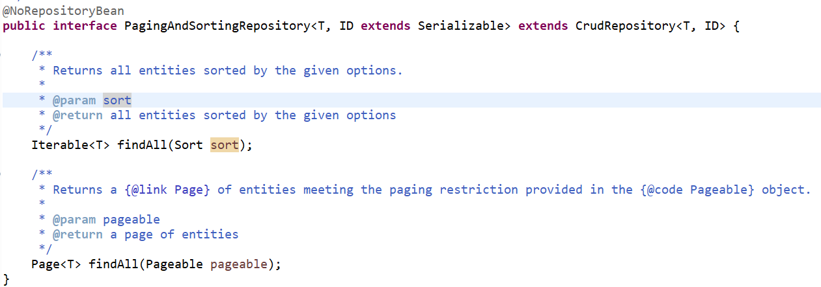
2. Page, Pageable
Practical Web Development Pagination with Spring Boot
2-3. Create service class
UserService class
@Autowired
UserRepository userRepository;
public Page<User> getAllUsers(Pageable pageable){
return userRepository.findAll(pageable);
}
}
Page<T> findAll(Pageable pageable); in PagingAndSortingRepository

Slide 18
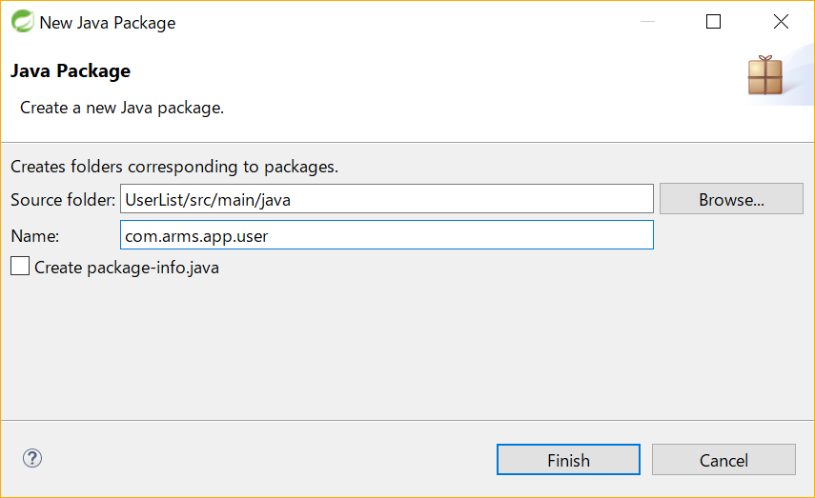
2. Page, Pageable
Practical Web Development Pagination with Spring Boot
2-4. Create controller class
Right-click on the package route “com.arms”, New- Package
Package Name: “com.arms.app.user”

Slide 19
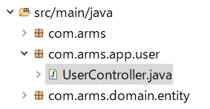
2. Page, Pageable
Practical Web Development Pagination with Spring Boot
2-4. Create controller class
Under “com.arms.app.user”, create UserController class
UserController.class add the following code.
@Controller
public class UserController {
@Autowired
UserService userService;
Continue on next page

Slide 20
2. Page, Pageable
Practical Web Development Pagination with Spring Boot
2-4. Create controller class
UserController class
@RequestMapping("/users")
public String list(Model model, Pageable pageable){
Page<User> pageUserList = userService.getAllUsers(pageable);
model.addAttribute("page", pageUserList);
model.addAttribute("users", pageUserList.getContent());
model.addAttribute("url", "/users");
return "user/list";
}
}
UserController.class add the following code.

Slide 21
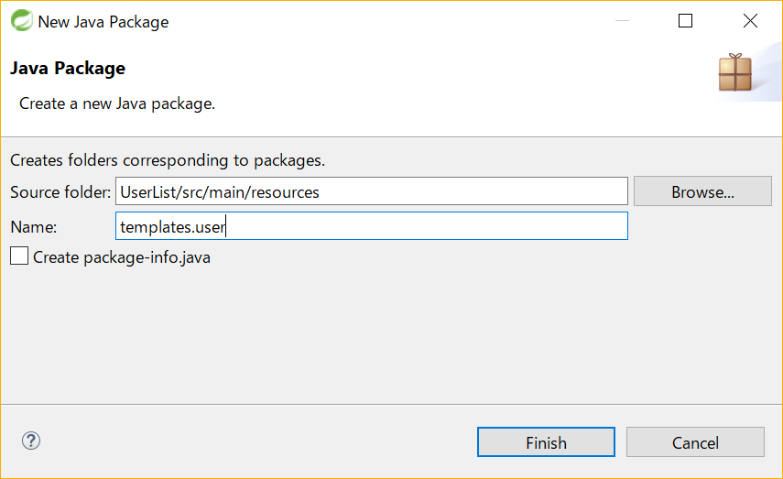
2. Page, Pageable
Practical Web Development Pagination with Spring Boot
2-5. Create the View
Right-click on the package “templates”, New- Package
Package Name: “templates.user”

Slide 22

2. Page, Pageable
Practical Web Development Pagination with Spring Boot
2-5. Create the View
Under “templates.user”, create list.html
list.html
<!DOCTYPE html>
<html xmlns="http://www.w3.org/1999/xhtml"
xmlns:th="http://www.thymeleaf.org">
<head>
<meta charset="UTF-8" />
<link rel="stylesheet" media="screen" href="/stylesheets/bootstrap.min.css" th:href="@{/stylesheets/bootstrap.min.css}">
<title>User list</title>
</head>
<body>

Slide 23
2. Page, Pageable
Practical Web Development Pagination with Spring Boot
2-5. Create the View
list.html
<div class="container">
<table class="table table-striped">
<tr>
<th>Id</th>
<th>Name</th>
</tr>
<tr th:each="user : ${users}">
<td th:text="${user.id}"></td>
<td th:text="${user.name}"></td>
</tr>
</table>
</div>
</body>
</html>

Slide 24
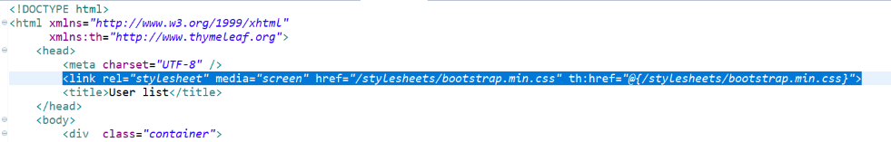
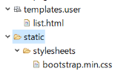
2. Page, Pageable
Practical Web Development Pagination with Spring Boot
2-5. Create the View
Call stylesheet from list.html
Copy css file to static folder

Slide 25
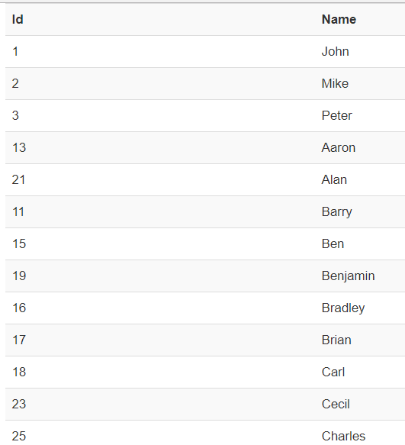
2. Page, Pageable
Practical Web Development Pagination with Spring Boot
2-5. Create the View
Start your project and see if you can see user list as below,
When you have to display vertically long data in one page, it will be nice to use pagination.

Slide 26

2. Page, Pageable
Practical Web Development Pagination with Spring Boot
2-5. Create the View
Create “templates.common” package, under which create pagination.html
pagination.html
<div th:fragment='pagination'>
<ul class='pagination pagination-centered'>
<li th:class="${page.first} ? 'disabled':''" style="display:inline">
<span th:if="${page.first}">First</span>
<a th:if="${not page.first}" th:href="@{${url}(page=0)}">First</a>
</li>
<li th:each='i : ${#numbers.sequence(0, page.totalPages-1)}' th:class="(${i}==${page.number})? 'active' : ''" style="display:inline">
<span th:if='${i}==${page.number}' th:text='${i+1}'>1</span>
<a th:if='${i}!=${page.number}' th:href="@{'/users'(page=${i})}">
<span th:text='${i+1}'>1</span>
</a>
</li>

Slide 27
2. Page, Pageable
Practical Web Development Pagination with Spring Boot
2-5. Create the View
pagination.html
<li th:class="${page.last} ? 'disabled':''" style="display:inline">
<span th:if="${page.last}">Last</span>
<a th:if="${not page.last}" th:href="@{${url}(page=(${page.totalPages}-1))}">Last</a>
</li>
</ul>
</div>
<div th:fragment='pagination'>
………………………………………
</div>
This part should be included in list.html

Slide 28

2. Page, Pageable
Practical Web Development Pagination with Spring Boot
2-5. Create the View
pagination.html should be included in list.html
<div th:include="common/pagination :: pagination"></div>
<div th:fragment='pagination'>
list.html the following code should be added
………………………………….
<tr th:each="user : ${users}">
<td th:text="${user.id}"></td>
<td th:text="${user.name}"></td>
</tr>
</table>
<div th:include="common/pagination :: pagination"></div>
</div>
</body>
………………………………..

Slide 29
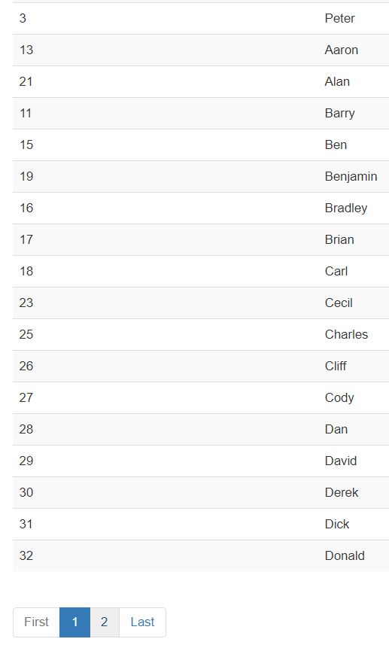
2. Page, Pageable
Practical Web Development Pagination with Spring Boot
2-5. Create the View
Refresh your browser and see pagination has been included.
20 data is displayed in one page.
Pageable object default is 20
Let’s change the default value from 20 to 3.

Slide 30
2. Page, Pageable
Practical Web Development Pagination with Spring Boot
2-5. Customize pagination
Go to UserController and add @PageableDefault annotation
UserController.class
@RequestMapping("/users")
public String list(Model model, @PageableDefault(value = 3) Pageable pageable){
Page<User> pageUserList = userService.getAllUsers(pageable);
model.addAttribute("page", pageUserList);
model.addAttribute("users", pageUserList.getContent());
model.addAttribute("url", "/users");
return "user/list";
}
value = 3 means 3 data is displayed in one page
Restart you app and see if 3 data is displayed in one page

Slide 31
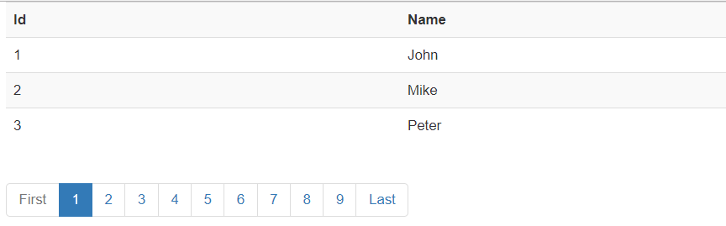
2. Page, Pageable
Practical Web Development Pagination with Spring Boot
2-5. Customize pagination
See the result
This pagination has two problems….
@PageableDefault(value = 3) is not a global setting, only for one method…
As the data increases, pagination will become really long….
Fisrt 1 2 3 4 5 6 7 8 9 10 11 12 13 14 Last

Slide 32

3. Advanced Pagination
Practical Web Development Pagination with Spring Boot
3-1. Configure a global default
Configure a global setting for PageableDefault. Create “com.arms.config” package, under which create WebAppConfig.class
WebAppConfig.class add the following code
package com.arms.config;
import java.util.List;
import org.springframework.context.annotation.Configuration;
import org.springframework.data.domain.PageRequest;
import org.springframework.data.web.PageableHandlerMethodArgumentResolver;
import org.springframework.web.method.support.HandlerMethodArgumentResolver;
import org.springframework.web.servlet.config.annotation.WebMvcConfigurerAdapter;
@Configuration
public class WebAppConfig extends WebMvcConfigurerAdapter {

Slide 33
3. Advanced Pagination
Practical Web Development Pagination with Spring Boot
3-1. Configure a global default
WebAppConfig.class
@Override
public void addArgumentResolvers(List<HandlerMethodArgumentResolver> argumentResolvers) {
PageableHandlerMethodArgumentResolver resolver = new PageableHandlerMethodArgumentResolver();
resolver.setFallbackPageable(new PageRequest(0, 3));
argumentResolvers.add(resolver);
super.addArgumentResolvers(argumentResolvers);
}
}
new PageRequest(0, 3) →this part decides how many data on one page
UserController.class delete @PageableDefault from list method
@RequestMapping("/users")
public String list(Model model, Pageable pageable){
Page<User> pageUserList = userService.getAllUsers(pageable);
………………………………………………..
…………………………………………….....

Slide 34
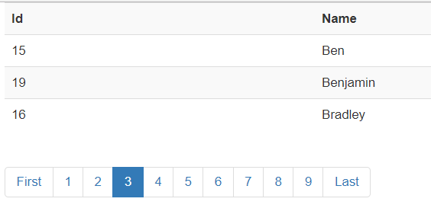
3. Advanced Pagination
Practical Web Development Pagination with Spring Boot
3-1. Configure a global default
Restart your app and see if the data is displayed properly.
This setting is now active for all methods

Slide 35

3. Advanced Pagination
Practical Web Development Pagination with Spring Boot
3-2. Advanced pagination
We will create an advanced pagination in this section.
Current Pagination
New Specification:
Add Previous and Next button
Page number displayed is limited to 5.

Slide 36

3. Advanced Pagination
Practical Web Development Pagination with Spring Boot
3-2. Advanced pagination
Create “com.arms.domain.component”, under which create PageWrapper.class
PageWrapper.class
package com.arms.domain.component;
import java.util.ArrayList;
import java.util.List;
import org.springframework.data.domain.Page;
public class PageWrapper<T> {
public static final int MAX_DISPLAYED_PAGE = 5;
private Page<T> page;
private List<PageItem> items;
private int currentNumber;
private String url;
Continue on next page

Slide 37
3. Advanced Pagination
Practical Web Development Pagination with Spring Boot
3-2. Advanced pagination
PageWrapper.class
public String getUrl() {
return url;
}
public void setUrl(String url) {
this.url = url;
}
public PageWrapper(Page<T> page, String url){
this.page = page;
this.url = url;
items = new ArrayList<PageItem>();
currentNumber = page.getNumber() + 1;
Continue on next page

Slide 38
3. Advanced Pagination
Practical Web Development Pagination with Spring Boot
3-2. Advanced pagination
PageWrapper.class
int start, size;
if (page.getTotalPages() <= MAX_DISPLAYED_PAGE){
start = 1;
size = page.getTotalPages();
} else {
if (currentNumber <= MAX_DISPLAYED_PAGE - MAX_DISPLAYED_PAGE/2){
start = 1;
size = MAX_DISPLAYED_PAGE;
} else if (currentNumber >= page.getTotalPages() - MAX_DISPLAYED_PAGE/2){
start = page.getTotalPages() - MAX_DISPLAYED_PAGE + 1;
size = MAX_DISPLAYED_PAGE;
} else {
start = currentNumber - MAX_DISPLAYED_PAGE/2;
size = MAX_DISPLAYED_PAGE;
}
}
for (int i = 0; i<size; i++){
items.add(new PageItem(start+i, (start+i)==currentNumber));
}
}
Continue on next page

Slide 39
3. Advanced Pagination
Practical Web Development Pagination with Spring Boot
3-2. Advanced pagination
PageWrapper.class
public List<PageItem> getItems(){
return items;
}
public int getNumber(){
return currentNumber;
}
public List<T> getContent(){
return page.getContent();
}
public int getSize(){
return page.getSize();
}
public int getTotalPages(){
return page.getTotalPages();
}
Continue on next page

Slide 40
3. Advanced Pagination
Practical Web Development Pagination with Spring Boot
3-2. Advanced pagination
PageWrapper.class
public boolean isFirstPage(){
return page.isFirst();
}
public boolean isLastPage(){
return page.isLast();
}
public boolean isHasPreviousPage(){
return page.hasPrevious();
}
public boolean isHasNextPage(){
return page.hasNext();
}
Continue on next page

Slide 41
3. Advanced Pagination
Practical Web Development Pagination with Spring Boot
3-2. Advanced pagination
PageWrapper.class
public class PageItem {
private int number;
private boolean current;
public PageItem(int number, boolean current){
this.number = number;
this.current = current;
}
public int getNumber(){
return this.number;
}
public boolean isCurrent(){
return this.current;
}
}
}

Slide 42
3. Advanced Pagination
Practical Web Development Pagination with Spring Boot
3-2. Advanced pagination
Go to UserController, and call PageWapper instead of Page
UserController.class
@RequestMapping("/users")
public String list(Model model, Pageable pageable) {
Page<User> pageUserList = userService.getAllUsers(pageable);
PageWrapper<User> page = new PageWrapper<User>(pageUserList, "/users");
model.addAttribute("page", page);
model.addAttribute("users", page.getContent());
return "user/list";
}

Slide 43
3. Advanced Pagination
Practical Web Development Pagination with Spring Boot
3-2. Advanced pagination
Go to pagination.html and modify the code
pagination.html
<div th:fragment='pagination'>
<ul class='pagination pagination-centered'>
<li th:class="${page.firstPage}?'disabled':''" style="display:inline">
<span th:if='${page.firstPage}'>First</span>
<a th:if='${not page.firstPage}' th:href='@{${page.url}(page=0,size=${page.size})}'>First</a>
</li>
<li th:class="${page.hasPreviousPage}? '' : 'disabled'" style="display:inline">
<span th:if='${not page.hasPreviousPage}'>Previous</span>
<a th:if='${page.hasPreviousPage}' th:href='@{${page.url}(page=${page.number-2},size=${page.size})}'>Previous</a>
</li>
<li th:each='item : ${page.items}' th:class="${item.current}? 'active' : ''" style="display:inline">
<span th:if='${item.current}' th:text='${item.number}'>1</span>
<a th:if='${not item.current}' th:href='@{${page.url}(page=${item.number-1},size=${page.size})}'>
<span th:text='${item.number}'>1</span>
</a>
</li>
Continue on next page

Slide 44
3. Advanced Pagination
Practical Web Development Pagination with Spring Boot
3-2. Advanced pagination
pagination.html
<li th:class="${page.hasNextPage}? '' : 'disabled'" style="display:inline">
<span th:if='${not page.hasNextPage}'>Next</span>
<a th:if='${page.hasNextPage}' th:href='@{${page.url}(page=${page.number},size=${page.size})}'>Next</a>
</li>
<li th:class="${page.lastPage}? 'disabled' : ''" style="display:inline">
<span th:if='${page.lastPage}'>Last</span>
<a th:if='${not page.lastPage}' th:href='@{${page.url}(page=${page.totalPages - 1},size=${page.size})}'>Last</a>
</li>
</ul>
</div>

Slide 45
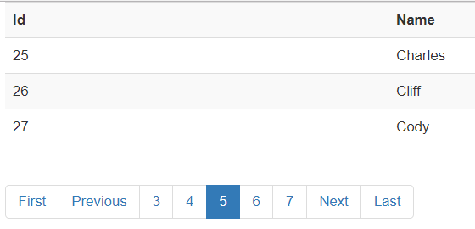
3. Advanced Pagination
Practical Web Development Pagination with Spring Boot
3-2. Advanced pagination
Restart your app and see if pagination is working properly

Slide 46

Your Idea Leads Your Ideals
homepage: http://arms-asia.com/
facebook: https://www.facebook.com/arms.asia?fref=ts

