Slide 1

Create Emitter (Twitter like app) with SPRING BOOT
Presented by ARMS（THAILAND）Co., Ltd.

Slide 2
Index
Practical Web Development with Spring Boot
Create Emitter
Update and Delete
  1-1. Update user
  1-2. Delete user
Create Microposts
  2-1. Summary
  2-2. Create entity class
  2-3. Create table relation
  2-4. Create repository
  2-5. Create Microposts
  2-6. Create Micropost feed
  2-7. Delete Micropost
3. Create User Profile
  3-1. Summary
  3-2. Micropost for each user
  3-3. Create user info

Slide 3

1. Update and Delete
Practical Web Development with Spring Boot
Create Emitter
1-1. Update user
In this section, we will edit user profile.
<a th:href="@{/user/edit/} + ${user.id}" th:text="'Edit'">
We have to edit a user by the user’s id
Create an edit method in UserController and call edit.html from the edit method
@RequestMapping(value = "/user/edit/{userId}", method = RequestMethod.GET)
public ModelAndView edit(@PathVariable int userId, ModelAndView modelAndView) {
modelAndView.setViewName("user/edit");
return modelAndView;
}
“/user/edit” user folder, edit.html
value = "/user/edit/{userId}"
@PathVariable(“userId”) int userId
Continue on next page

Slide 4
1. Update and Delete
Practical Web Development with Spring Boot
Create Emitter
1-1. Update user
We want to find user information by userId
Create a method in UserService to find one user by userId
UserService
public User findOne(int userId) {
return userRepository.findOne(userId);
}
Call the above method from the edit method in UserController
UserController
@RequestMapping(value = "/user/edit/{userId}", method = RequestMethod.GET)
public ModelAndView edit(@PathVariable int userId, ModelAndView modelAndView) {
modelAndView.addObject("user", userService.findOne(userId));
modelAndView.setViewName("user/edit");
return modelAndView;
}

Slide 5
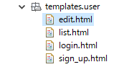
1. Update and Delete
Practical Web Development with Spring Boot
Create Emitter
1-1. Update user
Create edit.html under templates.user
Add the following code to edit.html
<!DOCTYPE html>
<html xmlns="http://www.w3.org/1999/xhtml"
xmlns:th="http://www.thymeleaf.org"
xmlns:layout="http://www.ultraq.net.nz/thymeleaf/layout"
layout:decorator="layout/main"
>
<head>
<title>Edit User</title>
</head>
<body>
<div layout:fragment="content" th:remove="tag">
<!-- Users edit.html inserted into main.html -->
<h1>Update your profile</h1>
<div class="row">
<div class="col-md-6 col-md-offset-3">
<h2 th:text="${user.name}">user name (replaced with image)</h2>
</div>
</div>
<!-- Users edit.html inserted into main.html End -->
</div>
</body>
</html>

Slide 6
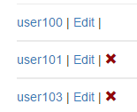
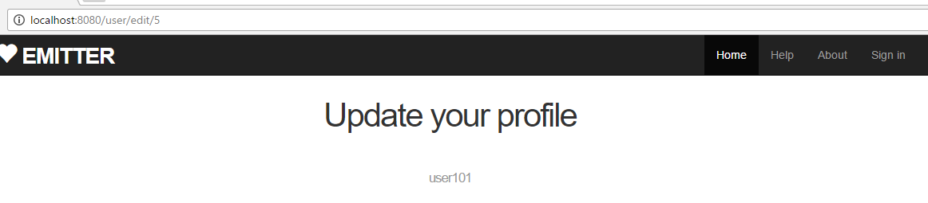
1. Update and Delete
Practical Web Development with Spring Boot
Create Emitter
1-1. Update user
Restart your app and access ----------:8080/, and then go to a user edit page.
You can now access “edit.html”, but two problems.
The two problems are “you can access without login” and “no form to edit user”

Slide 7
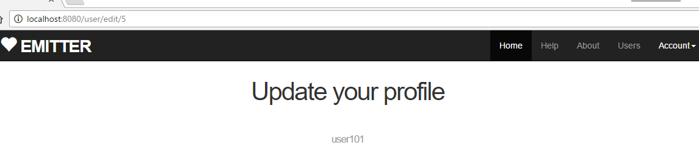
1. Update and Delete
Practical Web Development with Spring Boot
Create Emitter
1-1. Update user
You can access without “login”
UserController
@RequestMapping(value = "/user/edit/{userId}", method = RequestMethod.GET)
public ModelAndView edit(@PathVariable int userId, ModelAndView modelAndView, Principal principal) {
modelAndView.addObject("user", userService.findOne(userId));
modelAndView.setViewName("user/edit");
return modelAndView;
}
Add Principal object as a method argument.
Restart your app and access ----------:8080/, and then go to a user edit page. Now only login users can access the edit page.

Slide 8
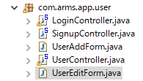
1. Update and Delete
Practical Web Development with Spring Boot
Create Emitter
1-1. Update user
No form to edit users
Create a form object to receive user input from the View(html)
Create UserEditForm under com.arms.app.user
Add the following code to UserEditForm
package com.arms.app.user;
import lombok.Data;
import org.hibernate.validator.constraints.NotEmpty;
import javax.validation.constraints.NotNull;
@Data
public class UserEditForm {
@NotNull
private Integer userId;
@NotEmpty
private String name;
private String email;
@NotEmpty
private String password;
}
Make sure to add both of them

Slide 9
1. Update and Delete
Practical Web Development with Spring Boot
Create Emitter
1-1. Update user
Add the following method to UserService
UserService
public UserEditForm setUserEditForm(int userId) {
User user = userRepository.findOne(userId);
UserEditForm userEditForm = new UserEditForm();
userEditForm.setUserId(user.getId());
userEditForm.setName(user.getName());
userEditForm.setEmail(user.getEmail());
return userEditForm;
}
Call the above method from the edit method in UserController
UserController
@RequestMapping(value = "/user/edit/{userId}", method = RequestMethod.GET)
public ModelAndView edit(@PathVariable int userId, ModelAndView modelAndView, Principal principal) {
modelAndView.addObject("user", userService.findOne(userId));
modelAndView.addObject("userEditForm", userService.setUserEditForm(userId));
modelAndView.setViewName("user/edit");
return modelAndView;
}

Slide 10
1. Update and Delete
Practical Web Development with Spring Boot
Create Emitter
1-1. Update user
Add the following form code to edit.html
<form th:action="@{/user/edit}" th:object="${userEditForm}" id="userEditForm" method="post" role="form" name="form1">
<input type="hidden" th:field="*{userId}" />
<div>
<div class="form-group" th:classappend="${#fields.hasErrors('name')}? 'has-error'">
<label for="name">Name :</label>
<input id="name" type="text" class="form-control" th:field="*{name}" /><br/>
<span th:if="*{#fields.hasErrors('name')}" th:errors="*{name}" class="help-block">error!</span>
</div>
<div class="form-group" th:classappend="${#fields.hasErrors('email')}? 'has-error'">
<label for="email">E-mail :</label>
<input id="email" type="text" class="form-control" th:field="*{email}" readonly="readonly" /><br/>
<span th:if="*{#fields.hasErrors('email')}" th:errors="*{email}" class="help-block">error!</span>
</div>
☆See the next page on where to insert this code
Continue on next page

Slide 11
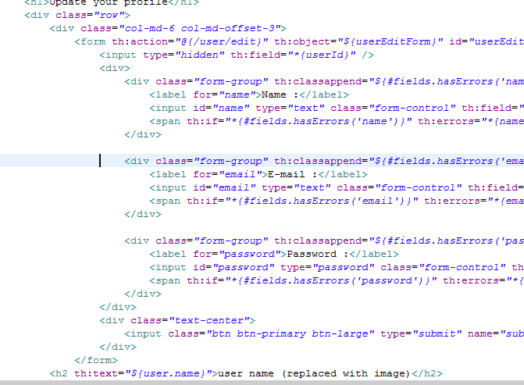
1. Update and Delete
Practical Web Development with Spring Boot
Create Emitter
1-1. Update user
Add the following form code to edit.html
<div class="form-group" th:classappend="${#fields.hasErrors('password')}? 'has-error'">
<label for="password">Password :</label>
<input id="password" type="password" class="form-control" th:field="*{password}" /><br/>
<span th:if="*{#fields.hasErrors('password')}" th:errors="*{password}" class="help-block">error!</span>
</div>
</div>
<div class="text-center">
<input class="btn btn-primary btn-large" type="submit" name="submit" value="Update my account" /><br/><br/>
</div>
</form>
Insert the form tag here

Slide 12
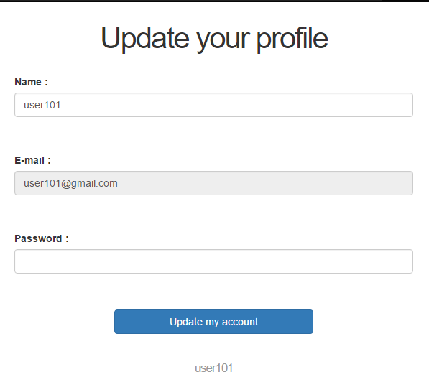
1. Update and Delete
Practical Web Development with Spring Boot
Create Emitter
1-1. Update user
Restart your app and access ------------:8080/, and go to the user edit page.
Now you can see edit form with Name and Email values
But when you update, you will see an error

Slide 13

1. Update and Delete
Practical Web Development with Spring Boot
Create Emitter
1-1. Update user
Create a method in UserController to actually update your profile
<form th:action="@{/user/edit}" th:object="${userEditForm}" id="userEditForm" method="post"
Create updateUser method in UserService
UserService
public void updateUser(UserEditForm userEditForm) throws NoSuchAlgorithmException {
Date nowDate = Calendar.getInstance().getTime();
User user = userRepository.findOne(userEditForm.getUserId());
user.setName(userEditForm.getName());
user.setPassword(passwordEncoder.hashMD5(userEditForm.getPassword()));
user.setUpdated(nowDate);
userRepository.save(user);
}
In the next page, call the above method from UserController

Slide 14
1. Update and Delete
Practical Web Development with Spring Boot
Create Emitter
1-1. Update user
Create an edit method with post in UserController
UserController
@RequestMapping(value = "/user/edit", method = RequestMethod.POST)
public Object edit(@Validated UserEditForm userEditForm, BindingResult bindingResult, RedirectAttributes redirectAttributes, ModelAndView modelAndView, Principal principal) throws NoSuchAlgorithmException {
if(bindingResult.hasErrors()) {
modelAndView.addObject("user", userService.findOne(userEditForm.getUserId()));
modelAndView.setViewName("user/edit");
return modelAndView;
}
userService.updateUser(userEditForm);
redirectAttributes.addFlashAttribute("message", "User was updated.");
return "redirect:/";
}

Slide 15
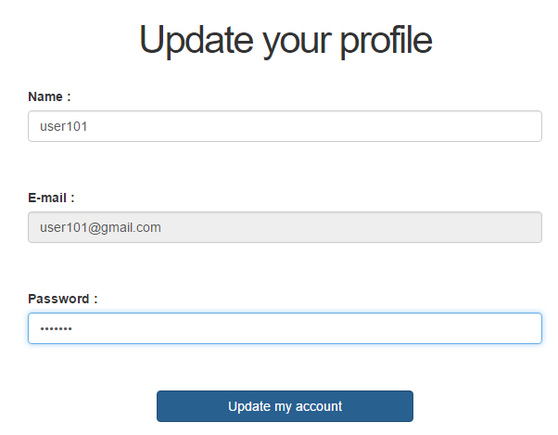
1. Update and Delete
Practical Web Development with Spring Boot
Create Emitter
1-1. Update user
Restart your app and access ----------:8080/, and see if you can update your profile

Slide 16
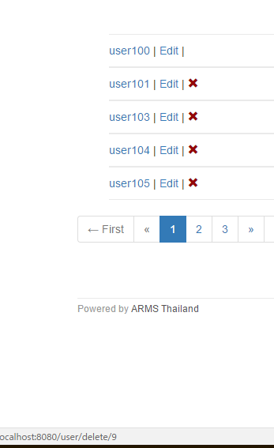
1. Update and Delete
Practical Web Development with Spring Boot
Create Emitter
1-2. Delete user
In this section, we will delete users
Delete button(icon) specification
<a th:if="${userId != user.id}"
th:href="@{/user/delete/} + ${user.id}"

Slide 17
1. Update and Delete
Practical Web Development with Spring Boot
Create Emitter
1-2. Delete user
Add deleteUser method to UserService
UserService
public void deleteUser(int userId){
userRepository.delete(userId);
}
Call the above method from delete method in UserController
UserController
@RequestMapping(value = "/user/delete/{userId}")
public String delete(@PathVariable int userId, RedirectAttributes redirectAttributes) {
userService.deleteUser(userId);
redirectAttributes.addFlashAttribute("message", "User was deleted.");
return "redirect:/";
}
Restart your app and see if you can delete users.!!!

Slide 18
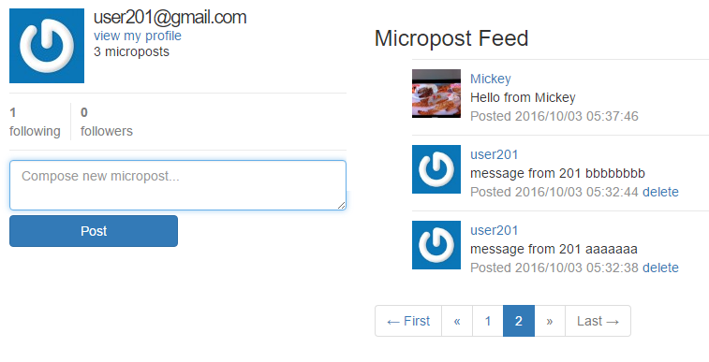
2. Create Microposts
Practical Web Development with Spring Boot
Create Emitter
2-1. Summary
We will create a micropost page like below.

Slide 19
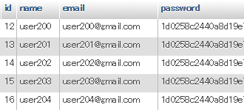
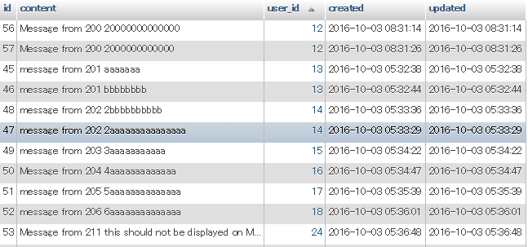
2. Create Microposts
Practical Web Development with Spring Boot
Create Emitter
2-1. Summary
We will also create a relationship between user and micropost table
user table
micropost table

Slide 20

2. Create Microposts
Practical Web Development with Spring Boot
Create Emitter
2-2. Create entity class
Create an entity class which is mapped to the micropost table
Create Micropost under com.arms.domain.entity
Add the following code to Micropost
package com.arms.domain.entity;
import java.util.Date;
import javax.persistence.Basic;
import javax.persistence.Column;
import javax.persistence.Entity;
import javax.persistence.GeneratedValue;
import javax.persistence.Id;
import lombok.Data;
@Entity
@Data
public class Micropost {
private int id;
private String content;
private Date created;
private Date updated;
Continue on next page

Slide 21
2. Create Microposts
Practical Web Development with Spring Boot
Create Emitter
2-2. Create entity class
Add the following code to micropost
@Id
@GeneratedValue
@Column(name = "id")
public int getId() {
return id;
}
public void setId(int id) {
this.id = id;
}
@Basic
@Column(name = "content")
public String getContent() {
return content;
}
public void setContent(String content) {
this.content = content;
}
Continue on next page

Slide 22
2. Create Microposts
Practical Web Development with Spring Boot
Create Emitter
2-2. Create entity class
Add the following code to micropost
@Basic
@Column(name = "created")
public Date getCreated() {
return created;
}
public void setCreated(Date created) {
this.created = created;
}
@Basic
@Column(name = "updated")
public Date getUpdated() {
return updated;
}
public void setUpdated(Date updated) {
this.updated = updated;
}
}

Slide 23
2. Create Microposts
Practical Web Development with Spring Boot
Create Emitter
2-3. Create table relation
In this section, we will create a relationship between user table and micropost table.
One user can have many microposts.(OneToMany/ManyToOne), Create OneToMany relationship
Open User.java and add the following field and its getter and setter
@Entity
@Data
public class User {
private int id;
private String name;
private String email;
private String password;
private Date created;
private Date updated;
private List<Micropost> micropostList;
The getter and setter are on next page
Continue on next page

Slide 24
2. Create Microposts
Practical Web Development with Spring Boot
Create Emitter
2-3. Create table relation
A Open User.java and add the following field and its getter and setter
private Date updated;
private List<Micropost> micropostList;
……………………………………………………
……………………………………………………
……………………………………………………
public void setUpdated(Date updated) {
this.updated = updated;
}
public List<Micropost> getMicropostList() {
return micropostList;
}
public void setMicropostList(List<Micropost> micropostList) {
this.micropostList = micropostList;
}
}

Slide 25
2. Create Microposts
Practical Web Development with Spring Boot
Create Emitter
2-3. Create table relation
Add @OneToMany annotation over List<Micropost>’s getter
User.java
@OneToMany(mappedBy="user", cascade = CascadeType.ALL)
public List<Micropost> getMicropostList() {
return micropostList;
}
User has many microposts, and the micropost has a reference back to the user.
Open Micropost.java and Add user field and its getter and setter
@Entity
@Data
public class Micropost {
private int id;
private String content;
private Date created;
private Date updated;
private User user;
public User getUser(){
return user;
}
public void setUser(User user){
this.user = user;
}

Slide 26
2. Create Microposts
Practical Web Development with Spring Boot
Create Emitter
2-3. Create table relation
Add @ManyToOne annotation over User’s getter
Micropost.java
@ManyToOne
@JoinColumn(name = "user_id", insertable = false, updatable = false)
public User getUser() {
return user;
}
insertable: whether you want to include name = “user_id” in SQL insert statement.
updatable: whether you want to include name = “user_id” in SQL update statement.

Slide 27
2. Create Microposts
Practical Web Development with Spring Boot
Create Emitter
2-3. Create table relation
Access “user_id” field by getter, add userId field and its getter and setter
Micropost.java
@Entity
@Data
public class Micropost {
private int id;
private String content;
private Date created;
private Date updated;
private User user;
private Integer userId;
@Basic
@Column(name = "user_id")
public Integer getUserId() {
return userId;
}
public void setUserId(Integer userId) {
this.userId = userId;
}

Slide 28
2. Create Microposts
Practical Web Development with Spring Boot
Create Emitter
2-4. Create repository
Create MicropostRepository interface under com.arms.domain.repository
package com.arms.domain.repository;
import org.springframework.data.jpa.repository.JpaRepository;
import org.springframework.stereotype.Repository;
import com.arms.domain.entity.Micropost;
@Repository
public interface MicropostRepository extends JpaRepository<Micropost, Integer> {
}
Make sure to extend JpaRepository and set entity type and primary key field type

Slide 29
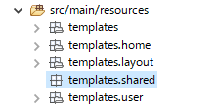

2. Create Microposts
Practical Web Development with Spring Boot
Create Emitter
2-5. Create microposts
Create templates.shared
Under templates.shared, create 3 html files,
_ feed_item.html _feed.html _micropost_form.html
home.html (isLogin (true))
home.html includes _micropost_form.html
_micropost_form.html includes _feed.html
_feed includes _feed_item.html

Slide 30
2. Create Microposts
Practical Web Development with Spring Boot
Create Emitter
2-5. Create microposts
Add the following code to home.html
home.html includes _micropost_form.html and _feed.html
<div th:if="${isLogin}" class="row">
You have logged in
<aside class="col-xs-4">
<section><div th:include="shared/_micropost_form :: micropost_form">micropost_form</div></section>
</aside>
<div class="col-xs-8">
<h3>Micropost Feed</h3>
<div th:include="shared/_feed :: feed">feed</div>
</div>
</div>

Slide 31
2. Create Microposts
Practical Web Development with Spring Boot
Create Emitter
2-5. Create microposts
Add the following code to _micropost_form.html
<!DOCTYPE html>
<html xmlns="http://www.w3.org/1999/xhtml"
xmlns:th="http://www.thymeleaf.org"
>
<head>
<title>micropost_form</title>
</head>
<body>
<div th:fragment="micropost_form" th:remove="tag">
<!-- shared _micropost_form.html included into home.html -->
<div th:if="${not #strings.isEmpty(message)}" class="alert alert-success alert-dismissible" role="alert" th:text="${message}">
<button type="button" class="close" data-dismiss="alert" aria-label="Close"><span aria-hidden="true">&times;</span></button>
</div>
<form th:action="@{/micropost/create}" th:object="${micropostCreateForm}" method="post" role="form" name="form1">
<div class="field">
<textarea class="form-control" th:field="*{content}" placeholder="Compose new micropost..."></textarea>
</div>
Continue on next page

Slide 32
2. Create Microposts
Practical Web Development with Spring Boot
Create Emitter
2-5. Create microposts
Add the following code to _micropost_form.html
<input class="btn btn-primary btn-large" type="submit" name="submit" value="Post" />
</form>
<br>
<br>
<!-- shared _micropost_form.html included into home.html End -->
</div>
</body>
</html>

Slide 33
2. Create Microposts
Practical Web Development with Spring Boot
Create Emitter
2-5. Create microposts
Add the following code to _feed.html
<!DOCTYPE html>
<html xmlns="http://www.w3.org/1999/xhtml"
xmlns:th="http://www.thymeleaf.org"
>
<head>
<title>feed</title>
</head>
<body>
<div th:fragment="feed" th:remove="tag">
<!-- shared _feed.html included into home.html -->
<ol class="microposts">
<span th:each="micropost, stat : ${microposts}">
<section><div th:include="shared/_feed_item :: feed_item(${micropost})">feed_item</div></section>
</span>
</ol>
<!-- shared _feed.html included into home.html End -->
</div>
</body>
</html>
_feed includes _feed_item.html

Slide 34
2. Create Microposts
Practical Web Development with Spring Boot
Create Emitter
2-5. Create microposts
Add the following code to _feed_item.html
<!DOCTYPE html>
<html xmlns="http://www.w3.org/1999/xhtml"
xmlns:th="http://www.thymeleaf.org"
>
<head>
<title>feed_item</title>
</head>
<body>
<div th:fragment="feed_item(micropost)" th:remove="tag">
<!-- shared _feed_item.html included into _feed.html -->
<li th:id="${micropost.id}">
<span class="user">
<a th:href="@{/user/show/} + ${micropost.user.id}" th:text="${micropost.user.name}">AAA</a>
</span>
<span class="content" th:text="${micropost.content}">BBB</span>
<span class="timestamp" th:text="'Posted ' + ${#dates.format(micropost.created, 'yyyy/MM/dd HH:mm:ss')}">
CCC
</span>
<span th:if="${userId == micropost.userId}">
<a th:href="@{/micropost/delete/} + ${micropost.id}" onclick="return confirm('Are you sure?')">delete</a>
</span>
</li>
<!-- shared _feed_item.html included into _feed.html End -->
</div>
</body>
</html>

Slide 35
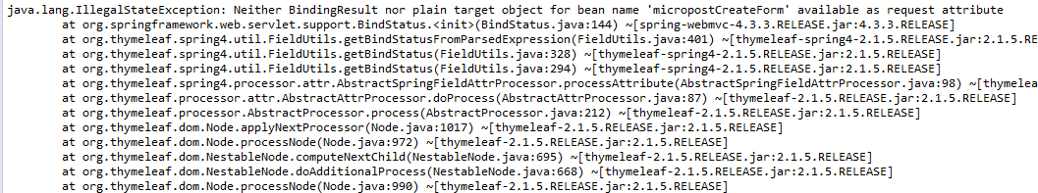
2. Create Microposts
Practical Web Development with Spring Boot
Create Emitter
2-5. Create microposts
Restart your app and access ------------:8080/, and login
After you login, you will see the following error
<form th:action="@{/micropost/create}" th:object="${micropostCreateForm}" method="post"
MicropostCreateForm object to receive data from form
MicropostController to handle request from View
MicropostService to handle request between Controller and Repository

Slide 36
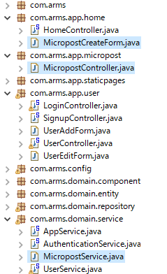
2. Create Microposts
Practical Web Development with Spring Boot
Create Emitter
2-5. Create microposts
Create the following three java
MicropostCreateForm
MicropostController
MicropostService

Slide 37
2. Create Microposts
Practical Web Development with Spring Boot
Create Emitter
2-5. Create microposts
Add the following code to MicropostCreateForm
package com.arms.app.home;
import lombok.Data;
@Data
public class MicropostCreateForm {
private String content;
private int userId;
}

Slide 38
2. Create Microposts
Practical Web Development with Spring Boot
Create Emitter
2-5. Create microposts
Open AppService and add @Autowired to MicropostRepository
@Service
public class AppService {
@Autowired
UserRepository userRepository;
@Autowired
MicropostRepository micropostRepository;
public Integer getUserId(Principal principal) {
…………………………………………
…………………………………….......;

Slide 39
2. Create Microposts
Practical Web Development with Spring Boot
Create Emitter
2-5. Create microposts
Add the following code to MicropostService
package com.arms.domain.service;
import java.util.Calendar;
import java.util.Date;
import org.springframework.stereotype.Service;
import com.arms.app.home.MicropostCreateForm;
import com.arms.domain.entity.Micropost;
@Service
public class MicropostService extends AppService {
public int createMicropost(MicropostCreateForm micropostCreateForm){
Date nowDate = Calendar.getInstance().getTime();
Micropost micropost = new Micropost();
micropost.setContent(micropostCreateForm.getContent());
micropost.setUserId(micropostCreateForm.getUserId());
micropost.setCreated(nowDate);
micropost.setUpdated(nowDate);
micropostRepository.save(micropost);
return micropost.getId();
}
}
Make sure to extend AppService

Slide 40
2. Create Microposts
Practical Web Development with Spring Boot
Create Emitter
2-5. Create microposts
Add the following code to MicropostController
package com.arms.app.micropost;
import java.security.Principal;
import org.springframework.beans.factory.annotation.Autowired;
import org.springframework.stereotype.Controller;
import org.springframework.web.bind.annotation.ModelAttribute;
import org.springframework.web.bind.annotation.RequestMapping;
import org.springframework.web.servlet.mvc.support.RedirectAttributes;
import com.arms.app.home.MicropostCreateForm;
import com.arms.domain.component.ControllerAspect;
import com.arms.domain.service.MicropostService;
@Controller
public class MicropostController {
@Autowired
ControllerAspect controllerAspect;
@Autowired
MicropostService micropostService;
Continue on next page

Slide 41
2. Create Microposts
Practical Web Development with Spring Boot
Create Emitter
2-5. Create microposts
Add the following code to MicropostController
@RequestMapping("/micropost/create")
public String create(@ModelAttribute MicropostCreateForm micropostCreateForm, Principal principal, RedirectAttributes redirectAttributes){
Integer userId = micropostService.getUserId(principal);
micropostCreateForm.setUserId(userId);
redirectAttributes.addFlashAttribute("message", "Feed was created");
micropostService.createMicropost(micropostCreateForm);
return "redirect:/";
}
}

Slide 42
2. Create Microposts
Practical Web Development with Spring Boot
Create Emitter
2-5. Create microposts
Add the following code to HomeController
@Controller
public class HomeController {
@Autowired
ControllerAspect controllerAspect;
@ModelAttribute
MicropostCreateForm setMicropostCreateForm() {
return new MicropostCreateForm();
}
………………………………………………..
………………………………………….........
Note: Adding @ModelAttribute at method level
Initialize Form object and return it.
This @ModelAttribute method is called before methods with @RequestMapping
(Regardless of the form object existence in the methods)
This means that the form object is automatically added to the model which thymeleaf can refer to. The default attribute name comes from the class name but the first letter is small. MicropostCreateForm (class name) → ｍicropostCreateForm(first letter is small)

Slide 43
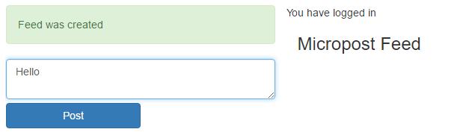


2. Create Microposts
Practical Web Development with Spring Boot
Create Emitter
2-5. Create microposts
Restart your app and access ----------:8080/, and see if you can create a micropost
After you create a few microposts, go to phpMyAdmin and see micropost table.
user table
micropost table
You can see microposts with user_id as the foreign key.

Slide 44
2. Create Microposts
Practical Web Development with Spring Boot
Create Emitter
2-6. Create micropost feed
In this section, we will create a list of microposts

Slide 45
2. Create Microposts
Practical Web Development with Spring Boot
Create Emitter
2-6. Create micropost feed
Open MicropostRepository and add three query methods to it.
@Repository
public interface MicropostRepository extends JpaRepository<Micropost, Integer> {
List<Micropost> findAllByUserId(int userId);
Page<Micropost> findAllByUserIdOrderByUpdatedDesc(int userId, Pageable pageable);
Page<Micropost> findByIdInOrderByUpdatedDesc(Collection id, Pageable pageable);
}
Find all micropost by userId
Find all microposts by userId and by page (Descending order by updateddate)
Find all microposts by Id List and by page (Descending order by updateddate)

Slide 46
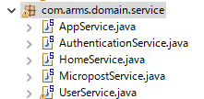
2. Create Microposts
Practical Web Development with Spring Boot
Create Emitter
2-6. Create micropost feed
Create HomeService under com.arms.domain.service
Add the following code to HomeService
package com.arms.domain.service;
import java.util.ArrayList;
import java.util.List;
import org.springframework.data.domain.Page;
import org.springframework.data.domain.Pageable;
import org.springframework.stereotype.Service;
import com.arms.domain.entity.Micropost;
@Service
public class HomeService extends AppService {
Make sure to extend AppService
Continue on next page

Slide 47
2. Create Microposts
Practical Web Development with Spring Boot
Create Emitter
2-6. Create micropost feed
Add the following code to HomeService
public List<Integer> getMyMicropost(int userId) {
List<Micropost> micropostList = micropostRepository.findAllByUserId(userId);
List<Integer> micropostIdList = new ArrayList<>();
for(Micropost micropost : micropostList) {
micropostIdList.add(micropost.getId());
}
return micropostIdList;
}
public Page<Micropost> findAllByIdList(List<Integer> micropostIdList, Pageable pageable) {
return micropostRepository.findByIdInOrderByUpdatedDesc(micropostIdList, pageable);
}
}
After you create following and follower function, the following users’ feeds are also displayed

Slide 48
2. Create Microposts
Practical Web Development with Spring Boot
Create Emitter
2-6. Create micropost feed
Modify HomeController as below,
@Controller
public class HomeController {
@Autowired
ControllerAspect controllerAspect;
@Autowired
HomeService homeService;
@ModelAttribute
MicropostCreateForm setMicropostCreateForm() {
return new MicropostCreateForm();
}
@RequestMapping("/")
public ModelAndView home(ModelAndView modelAndView, Principal principal, Pageable pageable){
Integer userId = homeService.getUserId(principal);
Continue on next page

Slide 49
2. Create Microposts
Practical Web Development with Spring Boot
Create Emitter
2-6. Create micropost feed
Modify HomeController as below,
if(userId != null){
List<Integer> micropostIdList = homeService.getMyMicropost(userId);
Page<Micropost> micropostPage = homeService.findAllByIdList(micropostIdList, pageable);
PageWrapper<Micropost> page = new PageWrapper<>(micropostPage, "/");
modelAndView.addObject("microposts", page.getContent());
modelAndView.addObject("page", page);
}
modelAndView.setViewName("home/home");
return modelAndView;
}
}

Slide 50
2. Create Microposts
Practical Web Development with Spring Boot
Create Emitter
2-6. Create micropost feed
Add the pagination code to _feed.html
<section><div th:include="shared/_feed_item :: feed_item(${micropost})">feed_item</div></section>
</span>
</ol>
…………………………..add from here!!
<!-- Start Of Pagination Bar -->
<div th:fragment='paginationbar'>
<div>
<ul class='pagination pagination-centered'>
<li th:class="${page.firstPage}?'disabled':''">
<span th:if='${page.firstPage}'>← First</span>
<a th:if='${not page.firstPage}' th:href='@{${page.url}(page=0,size=${page.size})}'>← First</a>
</li>
<li th:class="${page.hasPreviousPage}? '' : 'disabled'">
<span th:if='${not page.hasPreviousPage}'>«</span>
<a th:if='${page.hasPreviousPage}' th:href='@{${page.url}(page=${page.number-2},size=${page.size})}' title='Go to previous page'>«</a>
</li>
<li th:each='item : ${page.items}' th:class="${item.current}? 'active' : ''">
<span th:if='${item.current}' th:text='${item.number}'>1</span>
<a th:if='${not item.current}' th:href='@{${page.url}(page=${item.number-1},size=${page.size})}'><span th:text='${item.number}'>1</span></a>
</li>

Slide 51
2. Create Microposts
Practical Web Development with Spring Boot
Create Emitter
2-6. Create micropost feed
Add the pagination code to _feed.html
<li th:class="${page.hasNextPage}? '' : 'disabled'">
<span th:if='${not page.hasNextPage}'>»</span>
<a th:if='${page.hasNextPage}' th:href='@{${page.url}(page=${page.number},size=${page.size})}' title='Go to next page'>»</a>
</li>
<li th:class="${page.lastPage}? 'disabled' : ''">
<span th:if='${page.lastPage}'>Last →</span>
<a th:if='${not page.lastPage}' th:href='@{${page.url}(page=${page.totalPages - 1},size=${page.size})}'>Last →</a>
</li>
</ul>
</div>
</div>
<!-- End Of Pagination Bar -->

Slide 52
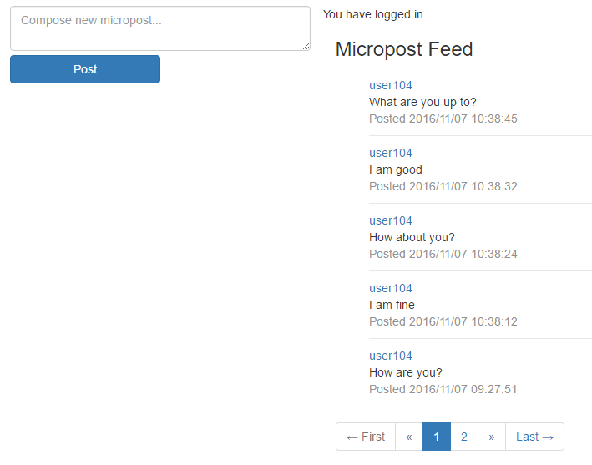
2. Create Microposts
Practical Web Development with Spring Boot
Create Emitter
2-6. Create micropost feed
Restart your app and access ------------:8080/, and then login and add more than 6 microposts.
Check if pagination is working properly, and your post is in updatedDate order.

Slide 53
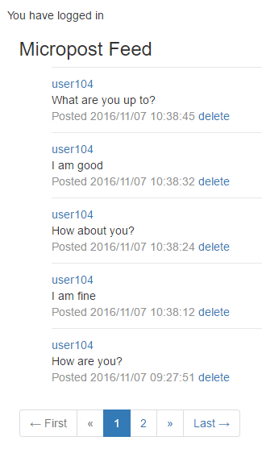
2. Create Microposts
Practical Web Development with Spring Boot
Create Emitter
2-7. Delete Micropost
Add delete function to Micropost
Micropost should only be deleted by its created user
_feed_item.html
<span th:if="${userId == micropost.userId}">
<a th:href="@{/micropost/delete/} + ${micropost.id}" onclick="return confirm('Are you sure?')">delete</a>
</span>

Slide 54
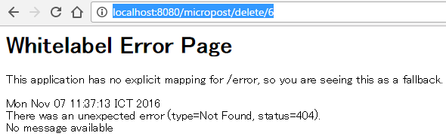

2. Create Microposts
Practical Web Development with Spring Boot
Create Emitter
2-7. Delete Micropost
Add the following code to HomeController and give userId parameter to the View
@RequestMapping("/")
public ModelAndView home(ModelAndView modelAndView, Principal principal, Pageable pageable){
Integer userId = homeService.getUserId(principal);
if(userId != null){
modelAndView.addObject("userId", userId);
List<Integer> micropostIdList = homeService.getMyMicropost(userId);
…………………………….
…………………………….
…………………………….
Get userId from principal and give its value as “userId” to the View
Restart your app and access -----------:8080/, and see if the delete button is displayed.
But if you click the delete button, error occurs

Slide 55

2. Create Microposts
Practical Web Development with Spring Boot
Create Emitter
2-7. Delete Micropost
Add the following code to MicropostService
MicropostService
public void deleteMicropost(int micropostId){
micropostRepository.delete(micropostId);
}
Call the above method from MicropostController
MicropostController
@RequestMapping("/micropost/delete/{id}")
public String delete(@PathVariable int id, RedirectAttributes redirectAttributes) {
micropostService.deleteMicropost(id);
redirectAttributes.addFlashAttribute("message", "Feed was deleted");
return "redirect:/";
}
Restart your app and access --------:8080/, and see if you can delete microposts by delete button.

Slide 56
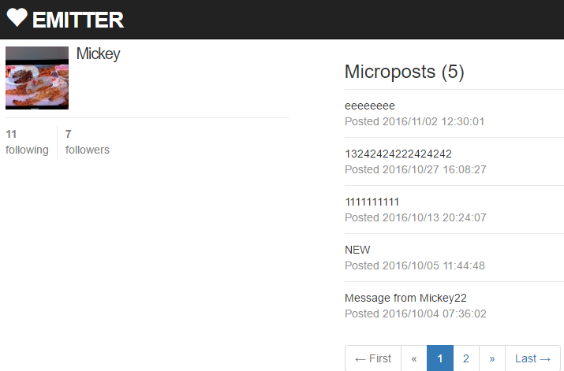
3. Create User Profile
Practical Web Development with Spring Boot
Create Emitter
3-1. Summary
In this section, we will create the user profile page as below,
User name
User name
List of microposts for the user
List of microposts for the user
Avatar (not in this section)
Following (not in this section)
Followers (not in this section)
In this section, we only display user name and a list of microposts for the user

Slide 57
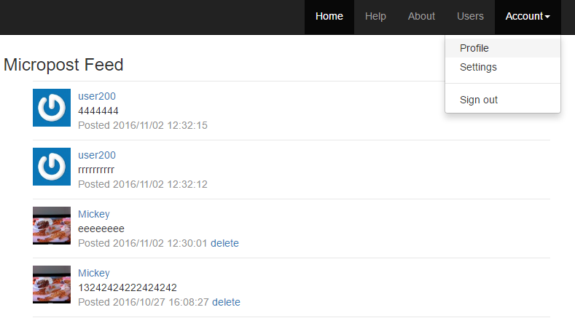
3. Create User Profile
Practical Web Development with Spring Boot
Create Emitter
3-1. Summary
You can jump to user profile either from Account menu Profile or from username on Micropost Feed

Slide 58
3. Create User Profile
Practical Web Development with Spring Boot
Create Emitter
3-2. Micropost for each user
Add the following method to UserService
UserService
public Page<Micropost> findAllMicropostByUserId(int userId, Pageable pageable) {
return micropostRepository.findAllByUserIdOrderByUpdatedDesc(userId, pageable);
}
Call the above method from UserController
UserController
@RequestMapping("/user/show/{userId}")
public ModelAndView show(@PathVariable int userId, ModelAndView modelAndView, Pageable pageable, Principal principal){
User user = userService.findOne(userId);
modelAndView.addObject("user", user);
Page<Micropost> micropostPage = userService.findAllMicropostByUserId(userId, pageable);
PageWrapper<Micropost> page = new PageWrapper<>(micropostPage, "/user/show" + '/' + userId);
modelAndView.addObject("microposts", page.getContent());
modelAndView.addObject("page", page);
modelAndView.setViewName("user/show");
return modelAndView;
}

Slide 59
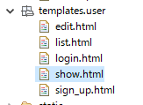
3. Create User Profile
Practical Web Development with Spring Boot
Create Emitter
3-2. Micropost for each user
Create show.html under templates.user
Add the following code to show.html
<!DOCTYPE html>
<html xmlns="http://www.w3.org/1999/xhtml"
xmlns:th="http://www.thymeleaf.org"
xmlns:layout="http://www.ultraq.net.nz/thymeleaf/layout"
layout:decorator="layout/main">
<head>
<title>Users Details</title>
</head>
<body>
<div layout:fragment="content" th:remove="tag">
<!-- Users show.html inserted into main.html -->
<div class="row">
<aside class="col-xs-4">
<section>
<h1>
<span th:text="${user.name}">AAA</span>
</h1>
</section>
Continue on next page

Slide 60
3. Create User Profile
Practical Web Development with Spring Boot
Create Emitter
3-2. Micropost for each user
Add the following code to show.html
</aside>
<div class="col-xs-8">
<span th:if="${microposts.size() > 0}">
<ol>
<h3 th:text="'Microposts (' + ${microposts.size()} + ')'">CCC</h3>
</ol>
<ol class="microposts" th:include="shared/_micropost :: micropost">micropost</ol>
</span>
</div>
</div>
<a class="btn btn-primary btn-small" href="/">
Back to Home
</a>
<!-- Users show.html inserted into main.html End -->
</div>
</body>
</html>

Slide 61

3. Create User Profile
Practical Web Development with Spring Boot
Create Emitter
3-2. Micropost for each user
Create _micropost.html under templates.shared
Add the following code to _micropost.html
<!DOCTYPE html>
<html xmlns="http://www.w3.org/1999/xhtml"
xmlns:th="http://www.thymeleaf.org"
>
<head>
<title >micropost</title>
</head>
<body>
<div th:fragment="micropost" th:remove="tag">
<!-- shared _micropost.html included into show.html -->
<span th:each="micropost, stat : ${microposts}">
<li>
<span class="content" th:text="${micropost.content}">CCC</span>
<span class="timestamp" th:text="'Posted ' + ${#dates.format(micropost.created, 'yyyy/MM/dd HH:mm:ss')}">AAA</span>
</li>
</span>
Continue on next page

Slide 62
3. Create User Profile
Practical Web Development with Spring Boot
Create Emitter
3-2. Micropost for each user
Add the following code to _micropost.html
<!-- Start Of Pagination Bar -->
<div th:fragment='paginationbar'>
<div>
<ul class='pagination pagination-centered'>
<li th:class="${page.firstPage}?'disabled':''">
<span th:if='${page.firstPage}'>← First</span>
<a th:if='${not page.firstPage}' th:href='@{${page.url}(page=0,size=${page.size})}'>← First</a>
</li>
<li th:class="${page.hasPreviousPage}? '' : 'disabled'">
<span th:if='${not page.hasPreviousPage}'>«</span>
<a th:if='${page.hasPreviousPage}' th:href='@{${page.url}(page=${page.number-2},size=${page.size})}' title='Go to previous page'>«</a>
</li>
<li th:each='item : ${page.items}' th:class="${item.current}? 'active' : ''">
<span th:if='${item.current}' th:text='${item.number}'>1</span>
<a th:if='${not item.current}' th:href='@{${page.url}(page=${item.number-1},size=${page.size})}'><span th:text='${item.number}'>1</span></a>
</li>
<li th:class="${page.hasNextPage}? '' : 'disabled'">
<span th:if='${not page.hasNextPage}'>»</span>
<a th:if='${page.hasNextPage}' th:href='@{${page.url}(page=${page.number},size=${page.size})}' title='Go to next page'>»</a>
</li>
Continue on next page

Slide 63
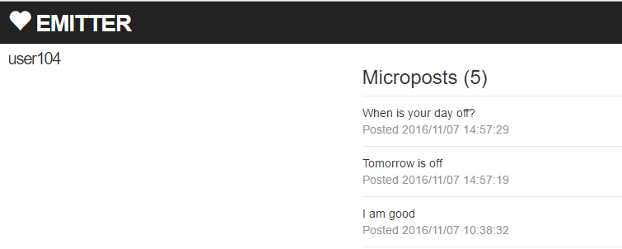
3. Create User Profile
Practical Web Development with Spring Boot
Create Emitter
3-2. Micropost for each user
Add the following code to _micropost.html
<li th:class="${page.lastPage}? 'disabled' : ''">
<span th:if='${page.lastPage}'>Last →</span>
<a th:if='${not page.lastPage}' th:href='@{${page.url}(page=${page.totalPages - 1},size=${page.size})}'>Last →</a>
</li>
</ul>
</div>
</div>
<!-- End Of Pagination Bar -->
<!-- shared _micropost.html included into show.html End -->
</div>
</body>
</html>
Restart your app and access --------:8080/, and see if you can see the page like below,

Slide 64
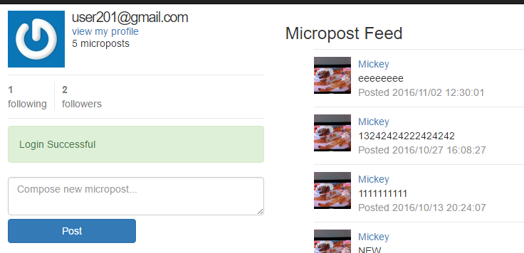
3. Create User Profile
Practical Web Development with Spring Boot
Create Emitter
3-3. Create user info
In this section, we will create user info on home.html
Add the following code to home.html, and delete “You have logged in” message
………………………………………………………
<div th:if="${isLogin}" class="row">
You have logged in
<aside class="col-xs-4">
<section><div th:include="shared/_user_info :: user_info">user_info</div></section>
<section><div th:include="shared/_micropost_form :: micropost_form">micropost_form</div></section>
</aside>
……………………………………………………….

Slide 65
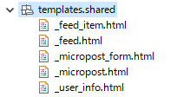
3. Create User Profile
Practical Web Development with Spring Boot
Create Emitter
3-3. Create user info
Create _user_info.html under templates.shared
Add the following code to _user_info.html
<!DOCTYPE html>
<html xmlns="http://www.w3.org/1999/xhtml"
xmlns:th="http://www.thymeleaf.org"
>
<head>
<title>User Info</title>
</head>
<body>
<div th:fragment="user_info" th:remove="tag">
<!-- shared _user_info.html included into home.html -->
<h1 th:text="${userInfo.username}">AAA</h1>
<span>
<a th:href="@{/user/show/} + ${userId}">view my profile</a>
</span>
<span th:text="${microposts.size()} + ' microposts'">
AAA
</span>
<!-- shared _user_info.html included into home.html End -->
</div>
</body>
</html>

Slide 66
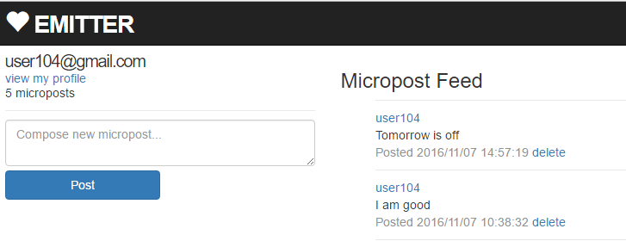
3. Create User Profile
Practical Web Development with Spring Boot
Create Emitter
3-3. Create user info
Restart your app and access -------:8080/, and check if you can see user info
_user_info.html
<h1 th:text="${userInfo.username}">AAA</h1>
<span>
<a th:href="@{/user/show/} + ${userId}">view my profile</a>
</span>
<span th:text="${microposts.size()} + ' microposts'">
AAA
</span>

Slide 67

Your Idea Leads Your Ideals
homepage: http://arms-asia.com/
facebook: https://www.facebook.com/arms.asia?fref=ts

