Slide 1

Create Emitter (Twitter like app) with SPRING BOOT
Presented by ARMS（THAILAND）Co., Ltd.

Slide 2
Index
Practical Web Development with Spring Boot
Create Emitter
Create Relationship Table
  1-1. Summary
  1-2. Create Entity Class
  1-3. Create Repository interface
Create following feature
  2-1. Summary of following
  2-2. Create following
3. Create followers feature
  3-1. Summary of followers
  3-2. Create followers
  3-3. Stats to user profile
4. Create Following List
  4-1. Summary of following list
  4-2. Create following list
5. Create Follower List
  5-1. Summary of follower list
  5-2. Create follower list
Notes:
17/04/24

Slide 3
Index
Practical Web Development with Spring Boot
Create Emitter
6. Follow and Unfollow
  6-1. Summary
  6-2. Create form object
  6-3. Follow and Unfollow
7. Create following feed
  2-1. Summary of following feed
  2-2. Following user’s feed
8. Delete user and unfollow
  8-1. Summary
  8-2. Delete user
Notes:
17/04/24

Slide 4
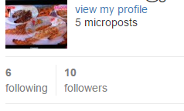
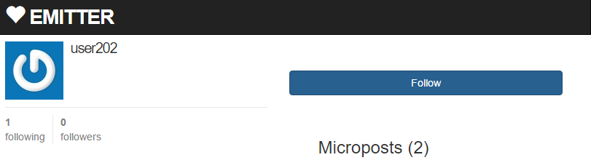
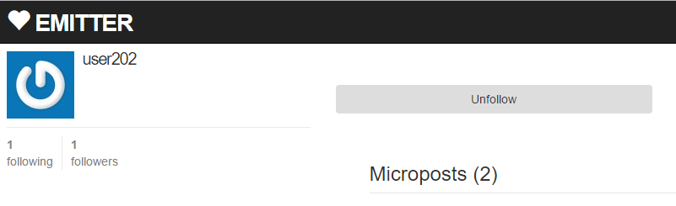
1. Create Relationship Table
Practical Web Development with Spring Boot
Create Emitter
1-1. Summary
We will create features like below
After this, you can follow users and be followed by user.

Slide 5

1. Create Relationship Table
Practical Web Development with Spring Boot
Create Emitter
1-2. Create entity class
Create RelationShip under com.arms.domain.entity
Add the following code to RelationShip
package com.arms.domain.entity;
import lombok.Data;
import javax.persistence.*;
import java.io.Serializable;
@Entity
@Data
@Table(name = "relation_ship")
public class RelationShip implements Serializable {
private int id;
private int userId;
private int followerId;
Continue on next page

Slide 6
1. Create Relationship Table
Practical Web Development with Spring Boot
Create Emitter
1-2. Create entity class
Add the following code to RelationShip
@Id
@GeneratedValue
@Column(name = "id")
public int getId() {
return id;
}
public void setId(int id) {
this.id = id;
}
@Basic
@Column(name = "user_id")
public Integer getUserId() {
return userId;
}
public void setUserId(Integer userId) {
this.userId = userId;
}
Continue on next page

Slide 7
1. Create Relationship Table
Practical Web Development with Spring Boot
Create Emitter
1-2. Create entity class
Add the following code to RelationShip
@Id
@GeneratedValue
@Column(name = "id")
public int getId() {
return id;
}
public void setId(int id) {
this.id = id;
}
@Basic
@Column(name = "user_id")
public Integer getUserId() {
return userId;
}
public void setUserId(Integer userId) {
this.userId = userId;
}
Continue on next page

Slide 8
1. Create Relationship Table
Practical Web Development with Spring Boot
Create Emitter
1-2. Create entity class
Add the following code to RelationShip
@Basic
@Column(name = "follower_id")
public Integer getFollowerId() {
return followerId;
}
public void setFollowerId(Integer followerId) {
this.followerId = followerId;
}
}
Putting @Annotation on getter is useful when internal state of entity is different from the database schema.

Slide 9

1. Create Relationship Table
Practical Web Development with Spring Boot
Create Emitter
1-3. Create Repository Interface
Create RelationShipRepository under com.arms.domain.repository
Add the following code to RelationShipRepository
package com.arms.domain.repository;
import org.springframework.data.jpa.repository.JpaRepository;
import org.springframework.stereotype.Repository;
import com.arms.domain.entity.RelationShip;
@Repository
public interface RelationShipRepository extends JpaRepository<RelationShip, Integer> {
}
Make sure to extend JpaRepository

Slide 10

2. Create following feature
Practical Web Development with Spring Boot
Create Emitter
2-1. Summary of following
We will create the following features
The number of following users and followers
“Following users” are users whom you follow their feed
“Followers” are users who follow your feed.
user table

Slide 11
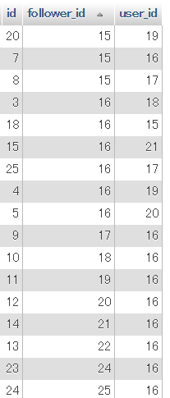

2. Create following feature
Practical Web Development with Spring Boot
Create Emitter
2-1. Summary of following
Following users
“Following users” are users whom you follow their feed
user table
id: 16 Mickey3
If you want to know the number of followings, count the id 16 in the follower_id

Slide 12
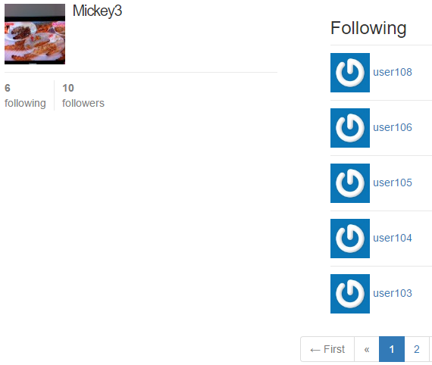
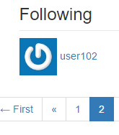
2. Create following feature
Practical Web Development with Spring Boot
Create Emitter
2-1. Summary of following
Following users
In this case, if you find all users by follower_id 16 and count it,
user table
you will get the number of followings
pagination

Slide 13
2. Create following feature
Practical Web Development with Spring Boot
Create Emitter
2-2. Create following
Create Query Methods in Repository
In this case, if you find all users by follower_id 16 and count it, you will get the number of followings
Add a query method to RelationShipRepository
@Repository
public interface RelationShipRepository extends JpaRepository<RelationShip, Integer> {
List<RelationShip> findAllByFollowerId(int followerId);
}
Add @Autowired in AppService
Call the query method from AppService(HomeService)
@Autowired
RelationShipRepository relationShipRepository;
public List<RelationShip> getFollowingListByUserId(int userId) {
return relationShipRepository.findAllByFollowerId(userId);
}

Slide 14
2. Create following feature
Practical Web Development with Spring Boot
Create Emitter
2-2. Create following
Add the method to HomeController(home method)
Use addObject to give the result to home.html(_stats.html)
@RequestMapping("/")
public ModelAndView home(ModelAndView modelAndView, Principal principal, Pageable pageable){
Integer userId = homeService.getUserId(principal);
if(userId != null) {
modelAndView.addObject("userId", userId);
modelAndView.addObject("following", homeService.getFollowingListByUserId(userId));
List<Integer> micropostIdList = homeService.getMyMicropost(userId);
………………………………………………………………………………………………
………………………………………………………………………………………………

Slide 15
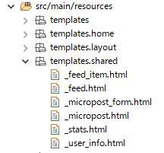
2. Create following feature
Practical Web Development with Spring Boot
Create Emitter
2-2. Create following
Create html to display the number of followings
Modify home.html to include “_stats.html”
<aside class="col-xs-4">
<section><div th:include="shared/_user_info :: user_info">user_info</div></section>
<section><div th:include="shared/_stats :: stats">stats</div></section>
<section><div th:include="shared/_micropost_form :: micropost_form">micropost_form</div></section>
</aside>
Create “_stats.html” under templates.shared
Notes:
http://m12i.hatenablog.com/entry/2013/03/28/004152

Slide 16
2. Create following feature
Practical Web Development with Spring Boot
Create Emitter
2-2. Create following
Create html to display the number of followings
Add the code to stats.html”
<!DOCTYPE html>
<html xmlns="http://www.w3.org/1999/xhtml"
xmlns:th="http://www.thymeleaf.org">
<head>
<title >stats</title>
</head>
<body>
<div th:fragment="stats" th:remove="tag">
<!-- shared _stats.html included into home.html or show_follow.html or show.html -->
<div class="stats">
<a th:href="@{/user/following/} + ${userId}">
<strong id="following" class="stat" th:text="${following.size()}">BBB</strong>following
</a>
</div>
<!-- shared _stats.html included into home.html or show_follow.html or show.html End -->
</div>
</body>
</html>

Slide 17

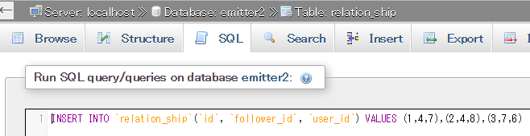
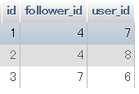

2. Create following feature
Practical Web Development with Spring Boot
Create Emitter
2-2. Create following
Restart your app and access ------------:8080/
You will see the number of following. But 0 following
Run SQL command to add a few data to relation_ship table
INSERT INTO `relation_ship`(`id`, `follower_id`, `user_id`) VALUES (1,4,7),(2,4,8),(3,7,6)
Warning: Values in SQL following_id and user_id must exist.
Refresh your browser and see the number of followings

Slide 18
3. Create followers feature
Practical Web Development with Spring Boot
Create Emitter
3-1. Summary of followers
We will create the followers feature
The number of following users and followers
“Followers” are users who follow your feed.

Slide 19
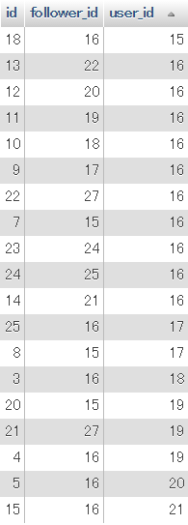
3. Create followers feature
Practical Web Development with Spring Boot
Create Emitter
3-1. Summary of followers
Followers
Followers are users who follow your feed.
user table
id: 16 Mickey3
If you want to know the number of followers, count the id 16 in the user_id

Slide 20

3. Create followers feature
Practical Web Development with Spring Boot
Create Emitter
3-1. Summary of followers
Followers
relation_ship table
If you want to know the number of followers, count user_id by id 16 in this case.
user table
id: 16 Mickey3
Pagination …….

Slide 21
3. Create followers feature
Practical Web Development with Spring Boot
Create Emitter
3-2. Create followers
Create Query Methods in Repository
the number of followers, count user_id by id 16 in this case
Add a query method to RelationShipRepository
@Repository
public interface RelationShipRepository extends JpaRepository<RelationShip, Integer> {
  List<RelationShip> findAllByFollowerId(int followerId);
  List<RelationShip> findAllByUserId(int userId);
}
Call the query method from AppService(HomeService)
public List<RelationShip> getFollowerListByUserId(int userId) {
return relationShipRepository.findAllByUserId(userId);
}

Slide 22
3. Create followers feature
Practical Web Development with Spring Boot
Create Emitter
3-2. Create followers
Add the method to HomeController(home method)
Use addObject to give the result to home.html(_stats.html)
@RequestMapping("/")
public ModelAndView home(ModelAndView modelAndView, Principal principal, Pageable pageable){
Integer userId = homeService.getUserId(principal);
if(userId != null) {
modelAndView.addObject("userId", userId);
modelAndView.addObject("following", homeService.getFollowingListByUserId(userId));
modelAndView.addObject("follower", homeService.getFollowerListByUserId(userId));
………………………………………………………………………………………………
………………………………………………………………………………………………

Slide 23
3. Create followers feature
Practical Web Development with Spring Boot
Create Emitter
3-2. Create followers
Modfiy _stats.html to display the number of followers
<!DOCTYPE html>
<html xmlns="http://www.w3.org/1999/xhtml"
xmlns:th="http://www.thymeleaf.org">
<head>
<title >stats</title>
</head>
<body>
<div th:fragment="stats" th:remove="tag">
<!-- shared _stats.html included into home.html or show_follow.html or show.html -->
<div class="stats">
<a th:href="@{/user/following/} + ${userId}">
<strong id="following" class="stat" th:text="${following.size()}">BBB</strong>following
</a>
<a th:href="@{/user/followers/} + ${userId}">
<strong id="follower" class="stat" th:text="${follower.size()}">BBB</strong>followers
</a>
</div>
<!-- shared _stats.html included into home.html or show_follow.html or show.html End -->
</div>
</body>
</html>

Slide 24

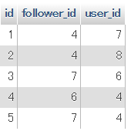

3. Create followers feature
Practical Web Development with Spring Boot
Create Emitter
3-2. Create followers
Restart your app and access -----------:8080/
You will see the number of followers. But 0 followers
Run SQL command to add a few records to relation_ship table.
INSERT INTO `relation_ship`(`id`, `follower_id`, `user_id`) VALUES (4,6,4),(5,7,4)
Refresh your browser and see the number of followers
Warning: SQL values have to be suitable for your environment.

Slide 25
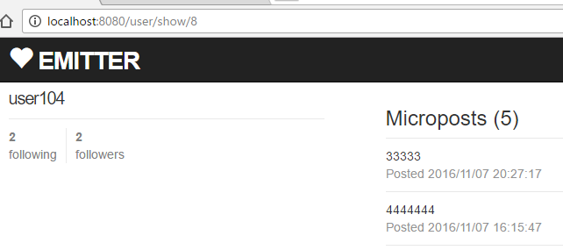
3. Create followers feature
Practical Web Development with Spring Boot
Create Emitter
3-3. Stats to user profile
We will also include _stats.html in user profile(show.html)
Add the following code to show.html to include _stats.html
show.html
<aside class="col-xs-4">
  <section>
    <h1>
    <span th:text="${user.name}">AAA</span>
    </h1>
  </section>
  <section>
  <div th:include="shared/_stats :: stats">stats</div>
  </section>
</aside>

Slide 26
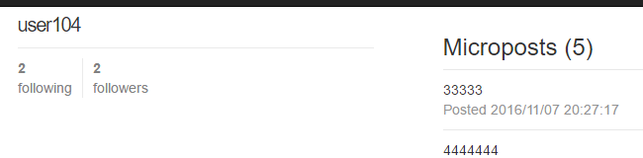
3. Create followers feature
Practical Web Development with Spring Boot
Create Emitter
3-3. Stats to user profile
Add the following code to show() method in UserController
UserController
@RequestMapping("/user/show/{userId}")
public ModelAndView show(@PathVariable int userId, ModelAndView modelAndView, Pageable pageable, Principal principal){
modelAndView.addObject("following", userService.getFollowingListByUserId(userId));
modelAndView.addObject("follower", userService.getFollowerListByUserId(userId));
User user = userService.findOne(userId);
modelAndView.addObject("user", user);
Restart your app and access ---------:8080/, and check if you can see _stats.html

Slide 27
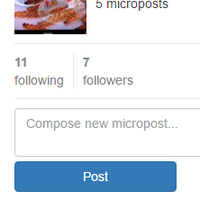
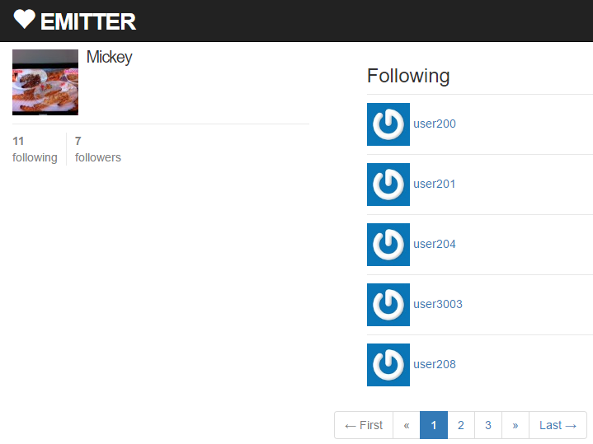
4. Create Following List
Practical Web Development with Spring Boot
Create Emitter
4-1. Summary of following list
In this chapter, we will create a list of following users
Jump to this page

Slide 28
4. Create Following List
Practical Web Development with Spring Boot
Create Emitter
4-2. Create following list
Add query method to UserRepository
UserRepository
@Repository
public interface UserRepository extends JpaRepository<User, Integer> {
User findOneByEmail(String email);
Page<User> findByIdInOrderByUpdatedDesc(Collection id, Pageable pageable);
Call the above method from UserService
UserService
public Page<User> findAllFollowing(int userId, Pageable pageable) {
List<RelationShip> relationShipList = relationShipRepository.findAllByFollowerId(userId);
List<Integer> emitterIdList = new ArrayList<>();
for(RelationShip relationShip : relationShipList) {
emitterIdList.add(relationShip.getUserId());
}
return userRepository.findByIdInOrderByUpdatedDesc(emitterIdList, pageable);
}

Slide 29
4. Create Following List
Practical Web Development with Spring Boot
Create Emitter
4-2. Create following list
Add the following code to UserController
@RequestMapping(value = "/user/following/{userId}")
public ModelAndView following(@PathVariable int userId, ModelAndView modelAndView, Principal principal, Pageable pageable) {
User user = userService.findOne(userId);
modelAndView.addObject("user", user);
modelAndView.addObject("follower", userService.getFollowerListByUserId(user.getId()));
modelAndView.addObject("following", userService.getFollowingListByUserId(user.getId()));
Page<User> userPage = userService.findAllFollowing(user.getId(), pageable);
PageWrapper<User> page = new PageWrapper<>(userPage, "/user/following" + '/' + userId);
modelAndView.addObject("followings", page.getContent());
modelAndView.addObject("page", page);
modelAndView.setViewName("user/following");
return modelAndView;
}
This following() method renders user/following.html

Slide 30
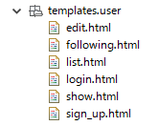
4. Create Following List
Practical Web Development with Spring Boot
Create Emitter
4-2. Create following list
Create following.html under templates.user
Add the code below to following.html
<!DOCTYPE html>
<html xmlns="http://www.w3.org/1999/xhtml"
xmlns:th="http://www.thymeleaf.org"
xmlns:layout="http://www.ultraq.net.nz/thymeleaf/layout"
layout:decorator="layout/main">
<head>
<title>Users Details</title>
</head>
<body>
<div layout:fragment="content" th:remove="tag">
<!-- Users show.html inserted into main.html -->
<div class="row">
<aside class="col-xs-4">
<section>
<h1>
<span th:text="${user.name}">AAA</span>
</h1>
</section>
This following() method renders user/following.html
Continue on next page

Slide 31
4. Create Following List
Practical Web Development with Spring Boot
Create Emitter
4-2. Create following list
Add the code below to following.html
<section>
<div th:include="shared/_stats :: stats">stats</div>
</section>
</aside>
<div class="col-xs-8">
<ol>
<h3>Following</h3>
</ol>
<ol class="microposts">
<span th:each="user, stat : ${followings}">
<li>
<span class="user">
<a th:href="@{/user/show/} + ${user.id}" th:text="${user.name}">AAA</a>
</span>
</li>
</span>
</ol>
<!-- Start Of Pagination Bar -->
<div th:fragment='paginationbar'>
<div>
<ul class='pagination pagination-centered'>
<li th:class="${page.firstPage}?'disabled':''">
<span th:if='${page.firstPage}'>← First</span>
<a th:if='${not page.firstPage}' th:href='@{${page.url}(page=0,size=${page.size})}'>← First</a>
</li>
This following() method renders user/following.html
Continue on next page

Slide 32
4. Create Following List
Practical Web Development with Spring Boot
Create Emitter
4-2. Create following list
Add the code below to following.html
<li th:class="${page.hasPreviousPage}? '' : 'disabled'">
<span th:if='${not page.hasPreviousPage}'>«</span>
<a th:if='${page.hasPreviousPage}' th:href='@{${page.url}(page=${page.number-2},size=${page.size})}' title='Go to previous page'>«</a>
</li>
<li th:each='item : ${page.items}' th:class="${item.current}? 'active' : ''">
<span th:if='${item.current}' th:text='${item.number}'>1</span>
<a th:if='${not item.current}' th:href='@{${page.url}(page=${item.number-1},size=${page.size})}'><span th:text='${item.number}'>1</span></a>
</li>
<li th:class="${page.hasNextPage}? '' : 'disabled'">
<span th:if='${not page.hasNextPage}'>»</span>
<a th:if='${page.hasNextPage}' th:href='@{${page.url}(page=${page.number},size=${page.size})}' title='Go to next page'>»</a>
</li>
<li th:class="${page.lastPage}? 'disabled' : ''">
<span th:if='${page.lastPage}'>Last →</span>
<a th:if='${not page.lastPage}' th:href='@{${page.url}(page=${page.totalPages - 1},size=${page.size})}'>Last →</a>
</li>
</ul>
</div>
</div>
<!-- End Of Pagination Bar -->
Continue on next page

Slide 33
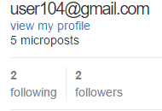
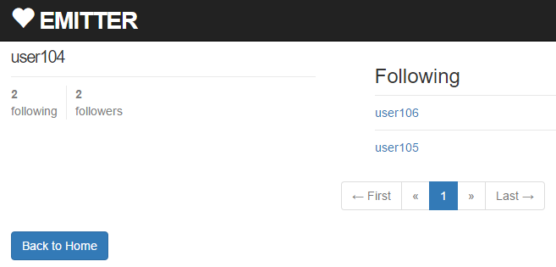
4. Create Following List
Practical Web Development with Spring Boot
Create Emitter
4-2. Create following list
Add the code below to following.html
</div>
</div>
<a class="btn btn-primary btn-small" href="/">
Back to Home
</a>
<!-- Users show.html inserted into main.html End -->
</div>
</body>
</html>
Restart your app and check if you can see a following list page

Slide 34
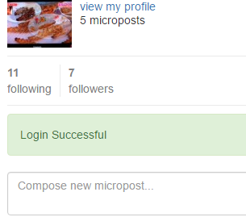
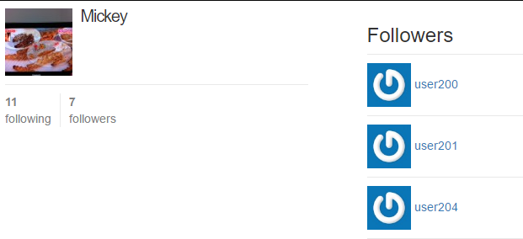
5. Create Follower List
Practical Web Development with Spring Boot
Create Emitter
5-1. Summary of follower list
In this chapter, we will create a list of followers
Jump to follower list page

Slide 35
5. Create Follower List
Practical Web Development with Spring Boot
Create Emitter
5-2. Create follower list
Add the following code to UserService
UserService
public Page<User> findAllFollower(int userId, Pageable pageable) {
List<RelationShip> relationShipList = relationShipRepository.findAllByUserId(userId);
List<Integer> followerIdList = new ArrayList<>();
for(RelationShip relationShip : relationShipList) {
followerIdList.add(relationShip.getFollowerId());
}
return userRepository.findByIdInOrderByUpdatedDesc(followerIdList, pageable);
}
In the next page, call this method from UserController

Slide 36
5. Create Follower List
Practical Web Development with Spring Boot
Create Emitter
5-2. Create follower list
Add the following code to UserController
UserController
@RequestMapping(value = "/user/followers/{userId}")
public ModelAndView follower(@PathVariable int userId, ModelAndView modelAndView, Principal principal, Pageable pageable) {
User user = userService.findOne(userId);
modelAndView.addObject("user", user);
modelAndView.addObject("following", userService.getFollowingListByUserId(user.getId()));
modelAndView.addObject("follower", userService.getFollowerListByUserId(user.getId()));
Page<User> userPage = userService.findAllFollower(user.getId(), pageable);
PageWrapper<User> page = new PageWrapper<>(userPage, "/user/followers" + '/' + userId);
modelAndView.addObject("followers", page.getContent());
modelAndView.addObject("page", page);
modelAndView.setViewName("user/followers");
return modelAndView;
}
This follower() method renders “user/followers.html

Slide 37
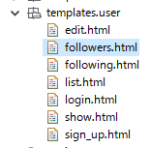
5. Create Follower List
Practical Web Development with Spring Boot
Create Emitter
5-2. Create follower list
Create followers.html under templates.user
Add the following code to followers.html
<!DOCTYPE html>
<html xmlns="http://www.w3.org/1999/xhtml"
xmlns:th="http://www.thymeleaf.org"
xmlns:layout="http://www.ultraq.net.nz/thymeleaf/layout"
layout:decorator="layout/main">
<head>
<title>Users Details</title>
</head>
<body>
<div layout:fragment="content" th:remove="tag">
<!-- Users show.html inserted into main.html -->
<div class="row">
<aside class="col-xs-4">
<section>
<h1>
<span th:text="${user.name}">AAA</span>
</h1>
</section>
Continue on next page

Slide 38
5. Create Follower List
Practical Web Development with Spring Boot
Create Emitter
5-2. Create follower list
Add the following code to followers.html
<section>
<div th:include="shared/_stats :: stats">stats</div>
</section>
</aside>
<div class="col-xs-8">
<ol>
<h3>Followers</h3>
</ol>
<ol class="microposts">
<span th:each="user, stat : ${followers}">
<li>
<span class="user">
<a th:href="@{/user/show/} + ${user.id}" th:text="${user.name}">AAA</a>
</span>
</li>
</span>
</ol>
<!-- Start Of Pagination Bar -->
<div th:fragment='paginationbar'>
<div>
<ul class='pagination pagination-centered'>
<li th:class="${page.firstPage}?'disabled':''">
<span th:if='${page.firstPage}'>← First</span>
<a th:if='${not page.firstPage}' th:href='@{${page.url}(page=0,size=${page.size})}'>← First</a>
</li>
Continue on next page

Slide 39
5. Create Follower List
Practical Web Development with Spring Boot
Create Emitter
5-2. Create follower list
Add the following code to followers.html
<li th:class="${page.hasPreviousPage}? '' : 'disabled'">
<span th:if='${not page.hasPreviousPage}'>«</span>
<a th:if='${page.hasPreviousPage}' th:href='@{${page.url}(page=${page.number-2},size=${page.size})}' title='Go to previous page'>«</a>
</li>
<li th:each='item : ${page.items}' th:class="${item.current}? 'active' : ''">
<span th:if='${item.current}' th:text='${item.number}'>1</span>
<a th:if='${not item.current}' th:href='@{${page.url}(page=${item.number-1},size=${page.size})}'><span th:text='${item.number}'>1</span></a>
</li>
<li th:class="${page.hasNextPage}? '' : 'disabled'">
<span th:if='${not page.hasNextPage}'>»</span>
<a th:if='${page.hasNextPage}' th:href='@{${page.url}(page=${page.number},size=${page.size})}' title='Go to next page'>»</a>
</li>
<li th:class="${page.lastPage}? 'disabled' : ''">
<span th:if='${page.lastPage}'>Last →</span>
<a th:if='${not page.lastPage}' th:href='@{${page.url}(page=${page.totalPages - 1},size=${page.size})}'>Last →</a>
</li>
</ul>
</div>
</div>
<!-- End Of Pagination Bar -->
Continue on next page

Slide 40
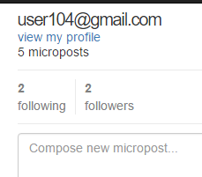
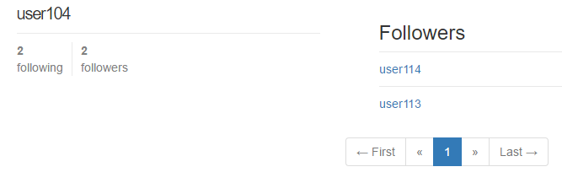
5. Create Follower List
Practical Web Development with Spring Boot
Create Emitter
5-2. Create follower list
Add the following code to followers.html
</div>
<a class="btn btn-primary btn-small" href="/">
Back to Home
</a>
</div>
<!-- Users show.html inserted into main.html End -->
</div>
</body>
</html>
Restart your app and access -----------:8080/, and check if you can see followers list.

Slide 41
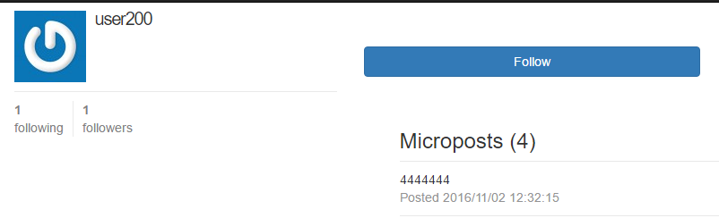
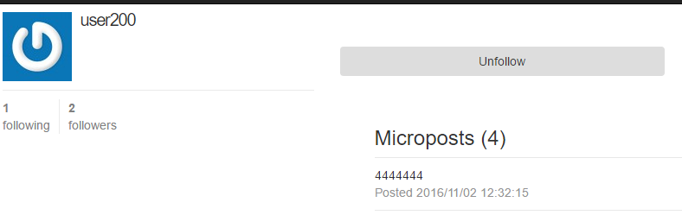
6. Follow and Unfollow
Practical Web Development with Spring Boot
Create Emitter
6-1. Summary
In this chapter, we will create Follow and Unfollow button on show.html
In login user case, the buttons are not displayed

Slide 42
6. Follow and Unfollow
Practical Web Development with Spring Boot
Create Emitter
6-1. Summary
In this chapter, we will create Follow and Unfollow button on show.html
In login user case, the buttons are not displayed
the buttons are displayed
<div th:unless="${loginUser.id == user.id}" id="follow_form">
<span th:if="${isFollow}">
<div th:include="user/_unfollow :: unfollow">unfollow</div>
</span>
<span th:unless="${isFollow}">
<div th:include="user/_follow :: follow">follow</div>
</span>
</div>

Slide 43
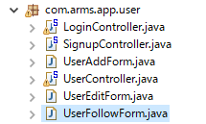
6. Follow and Unfollow
Practical Web Development with Spring Boot
Create Emitter
6-2. Create form object
Create UserFollowForm under com.arms.app.user
Add the following code to UserFollowForm
package com.arms.app.user;
import lombok.Data;
@Data
public class UserFollowForm {
private int userId;
private int followerId;
}

Slide 44
6. Follow and Unfollow
Practical Web Development with Spring Boot
Create Emitter
6-3. Follow and Unfollow
Add a query method to RelationShipRepository
@Repository
public interface RelationShipRepository extends JpaRepository<RelationShip, Integer> {
List<RelationShip> findAllByFollowerId(int followerId);
List<RelationShip> findAllByUserId(int userId);
RelationShip findOneByUserIdAndFollowerId(int userId, int followerId);
}
Add the following code to UserService
public UserFollowForm getUserFollowForm(int userId, int followerId) {
UserFollowForm userFollowForm = new UserFollowForm();
userFollowForm.setUserId(userId);
userFollowForm.setFollowerId(followerId);
return userFollowForm;
}
This form object is used as a hidden parameter in the View

Slide 45
6. Follow and Unfollow
Practical Web Development with Spring Boot
Create Emitter
6-3. Follow and Unfollow
Add three methods to UserService
public void addFollow(UserFollowForm userFollowForm) {
if(relationShipRepository.findOneByUserIdAndFollowerId(userFollowForm.getUserId(), userFollowForm.getFollowerId()) == null) {
RelationShip relationShip = new RelationShip();
relationShip.setUserId(userFollowForm.getUserId());
relationShip.setFollowerId(userFollowForm.getFollowerId());
relationShipRepository.save(relationShip);
}
}
public void deleteFollow(UserFollowForm userFollowForm) {
RelationShip relationShip = relationShipRepository.findOneByUserIdAndFollowerId(userFollowForm.getUserId(), userFollowForm.getFollowerId());
if(relationShip != null)
relationShipRepository.delete(relationShip);
}
public boolean isFollow(int emitterUserId, int followerUserId) {
if(relationShipRepository.findOneByUserIdAndFollowerId(emitterUserId, followerUserId) == null)
return false;
else
return true;
}

Slide 46
6. Follow and Unfollow
Practical Web Development with Spring Boot
Create Emitter
6-3. Follow and Unfollow
Add the following code to show() method in UserController
@RequestMapping("/user/show/{userId}")
public ModelAndView show(@PathVariable int userId, ModelAndView modelAndView, Pageable pageable, Principal principal){
modelAndView.addObject("following", userService.getFollowingListByUserId(userId));
modelAndView.addObject("follower", userService.getFollowerListByUserId(userId));
User user = userService.findOne(userId);
modelAndView.addObject("user", user);
User loginUser = userService.findOne(principal);
if(user.getId() != loginUser.getId()) {
modelAndView.addObject("isFollow", userService.isFollow(user.getId(), loginUser.getId()));
modelAndView.addObject("userFollowForm", userService.getUserFollowForm(user.getId(), loginUser.getId()));
}
Page<Micropost> micropostPage = userService.findAllMicropostByUserId(userId, pageable);

Slide 47
6. Follow and Unfollow
Practical Web Development with Spring Boot
Create Emitter
6-3. Follow and Unfollow
Add follow() and unFollow() methods to UserController
@RequestMapping(value = "/user/follow")
public String follow(@ModelAttribute("userFollowForm") UserFollowForm userFollowForm) {
userService.addFollow(userFollowForm);
return "redirect:/user/show/" + userFollowForm.getUserId();
}
@RequestMapping(value = "/user/unfollow")
public String unFollow(@ModelAttribute("userFollowForm") UserFollowForm userFollowForm) {
userService.deleteFollow(userFollowForm);
return "redirect:/user/show/" + userFollowForm.getUserId();
}

Slide 48
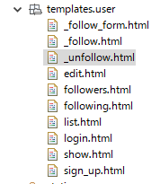
6. Follow and Unfollow
Practical Web Development with Spring Boot
Create Emitter
6-3. Follow and Unfollow
Add the following code to show.html to include _follow_form
…………………………………………….
<div class="col-xs-8">
<div th:if="${isLogin}" th:include="user/_follow_form :: follow_form">follow_form</div>
<span th:if="${microposts.size() > 0}">
<ol>
<h3 th:text="'Microposts (' + ${microposts.size()} + ')'">CCC</h3>
</ol>
<ol class="microposts" th:include="shared/_micropost :: micropost">micropost</ol>
</span>
</div>
……………………………………………
Create three html files under templates.user
_follow_form.html
_follow.html
_unfollow.html

Slide 49
6. Follow and Unfollow
Practical Web Development with Spring Boot
Create Emitter
6-3. Follow and Unfollow
Add the following code to _follow_form.html
<!DOCTYPE html>
<html xmlns="http://www.w3.org/1999/xhtml"
xmlns:th="http://www.thymeleaf.org"
>
<head>
<title >follow_form</title>
</head>
<body>
<div th:fragment="follow_form" th:remove="tag">
<!-- Users _follow_form.html included into show.html -->
<div th:unless="${loginUser.id == user.id}" id="follow_form">
<span th:if="${isFollow}">
<div th:include="user/_unfollow :: unfollow">unfollow</div>
</span>
<span th:unless="${isFollow}">
<div th:include="user/_follow :: follow">follow</div>
</span>
</div>
<!-- Users _follow_form.html included into show.html End -->
</div>
</body>
</html>

Slide 50
6. Follow and Unfollow
Practical Web Development with Spring Boot
Create Emitter
6-3. Follow and Unfollow
Add the following code to _follow.html
<!DOCTYPE html>
<html xmlns="http://www.w3.org/1999/xhtml"
xmlns:th="http://www.thymeleaf.org"
>
<head>
<title >follow</title>
</head>
<body>
<div th:fragment="follow" th:remove="tag">
<!-- Users _follow.html included into _follow_form.html -->
<form th:action="@{/user/follow}" th:object="${userFollowForm}" method="post" role="form" name="form1">
<input type="hidden" class="form-control" th:field="*{userId}" /><br>
<input type="hidden" class="form-control" th:field="*{followerId}" /><br>
<input class="btn btn-primary btn-large" type="submit" name="submit" value="Follow" />
</form>
<br>
<br>
<!-- Users _follow.html included into _follow_form.html End -->
</div>
</body>
</html>

Slide 51
6. Follow and Unfollow
Practical Web Development with Spring Boot
Create Emitter
6-3. Follow and Unfollow
Add the following code to _unfollow.html
<!DOCTYPE html>
<html xmlns="http://www.w3.org/1999/xhtml"
xmlns:th="http://www.thymeleaf.org"
>
<head>
<title >unfollow</title>
</head>
<body>
<div th:fragment="unfollow" th:remove="tag">
<!-- Users _unfollow.html included into _follow_form.html -->
<form th:action="@{/user/unfollow}" th:object="${userFollowForm}" method="post" role="form" name="form1">
<input type="hidden" class="form-control" th:field="*{userId}" /><br>
<input type="hidden" class="form-control" th:field="*{followerId}" /><br>
<input class="btn btn-large" type="submit" name="submit" value="Unfollow" />
</form>
<br>
<br>
<!-- Users _unfollow.html included into _follow_form.html End -->
</div>
</body>
</html>

Slide 52
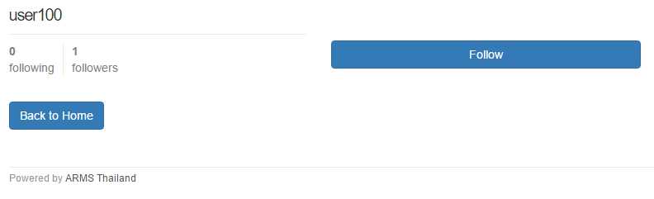
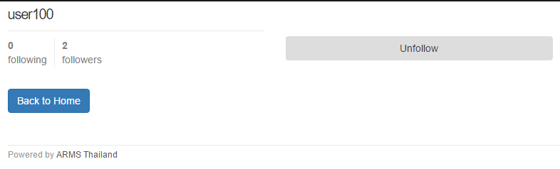
6. Follow and Unfollow
Practical Web Development with Spring Boot
Create Emitter
6-3. Follow and Unfollow
Restart your app and access ---------:8080/, check if you can follow and unfollow other users.

Slide 53
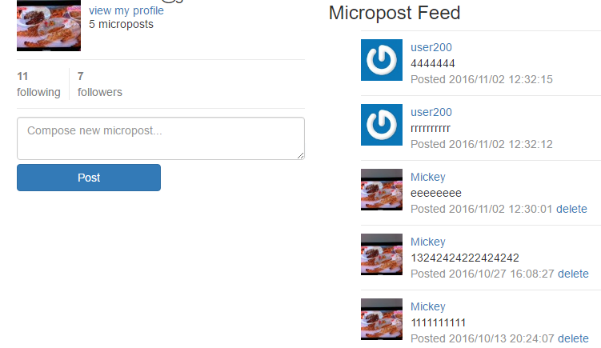
7. Create following feed
Practical Web Development with Spring Boot
Create Emitter
7-1. Summary of following feed
In this chapter, we will change the home page specification. Now you can only see your own feeds. Change it to display following user’s feed as well.
Not only can you see your own feeds, but also can see following user’s feed.

Slide 54
7. Create following feed
Practical Web Development with Spring Boot
Create Emitter
7-2. Following user’s feed
Add the following code to HomeService
HomeService
public void setFollowingMicropost(int userId, List<Integer> micropostIdList) {
List<RelationShip> relationShipList = relationShipRepository.findAllByFollowerId(userId);
for(RelationShip relationShip : relationShipList) {
List<Micropost> micropostList = micropostRepository.findAllByUserId(relationShip.getUserId());
for(Micropost micropost : micropostList) {
micropostIdList.add(micropost.getId());
}
}
}
Call the above method from HomeController
HomeController
public ModelAndView home(ModelAndView modelAndView, Principal principal, Pageable pageable) {
Integer userId = homeService.getUserId(principal);
……………………………………………………………………………………………………………..
……………………………………………………………………………………………………………..
List<Integer> micropostIdList = homeService.getMyMicropost(userId);
homeService.setFollowingMicropost(userId, micropostIdList);
Page<Micropost> micropostPage = homeService.findAllByIdList(micropostIdList, pageable);

Slide 55
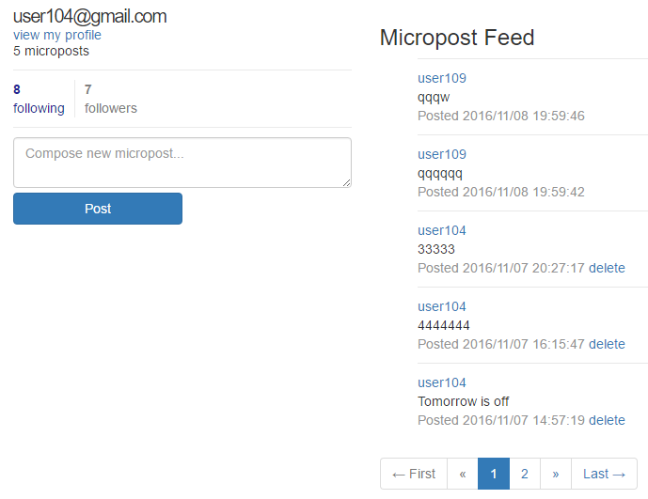
7. Create following feed
Practical Web Development with Spring Boot
Create Emitter
7-2. Following user’s feed
Restart your app and access -----------:8080/, and check if both your own feeds and following user’s feeds are displayed

Slide 56
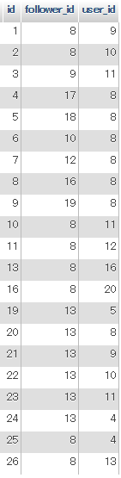
8. Delete user and unfollow
Practical Web Development with Spring Boot
Create Emitter
8-1. Summary
When you delete a user, the user’s follower and the following user should be deleted.
Relationship table
Example: Delete “id 13 user” from user table
When you delete a user with id 13
This user has 6 followings
And
1 follower
These 6 followings and 1 follower should be deleted from Relationship table
Delete 6 follower_id by id 13
Delete 1 user_id by id 13

Slide 57
8. Delete user and unfollow
Practical Web Development with Spring Boot
Create Emitter
8-2. Delete user
Add the following code to deleteUser() method in UserService
public void deleteUser(int userId){
userRepository.delete(userId);
relationShipRepository.delete(relationShipRepository.findAllByFollowerId(userId));
relationShipRepository.delete(relationShipRepository.findAllByUserId(userId));
}
Delete 6 follower_id by id 13 = findAllByFollowerId
Delete 1 user_id by id 13 = findAllByUserId
Restart your app and access -----------:8080/, and delete one user and check if following and follower are also deteled from relationship table.

Slide 58

Your Idea Leads Your Ideals
homepage: http://arms-asia.com/
facebook: https://www.facebook.com/arms.asia?fref=ts
Notes:
17/04/24
If you follow document, next class is very easy

