Slide 1

CRUD with SPRING BOOT
Presented by ARMS（THAILAND）Co., Ltd.

Slide 2
Index
Practical Web Development with Spring Boot
How to create CRUD user
Start creating a project
  1-1. Start Project
  1-2. Dependency management
Create and Read
  2-1. Create user’s list
3. Update and Delete
  3-1. Create update
  3-2. Create delete

Slide 3
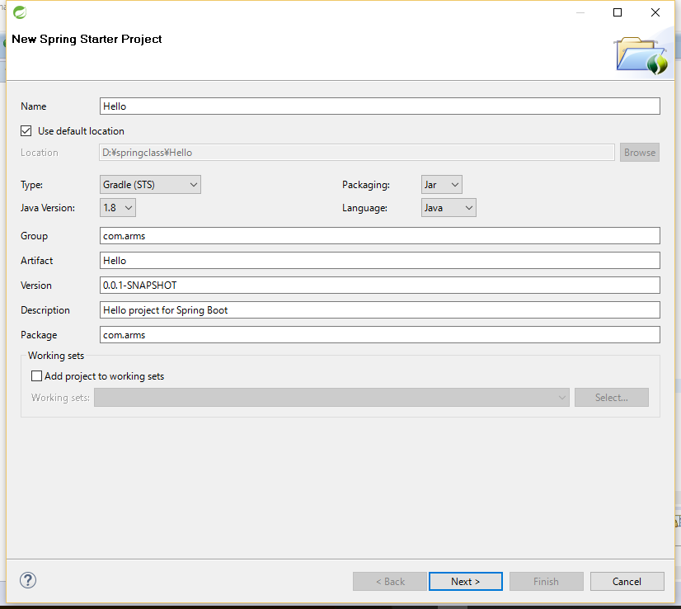
1. Start creating a project
Practical Web Development with Spring Boot
How to create CRUD user
1-1. Start Project
Open STS and File – New – Spring Starter Project
Name: Hello
Type: Gradle(STS)
Group: com.arms
Artifact: Hello
Package: com.arms
Press “Next>” button

Slide 4
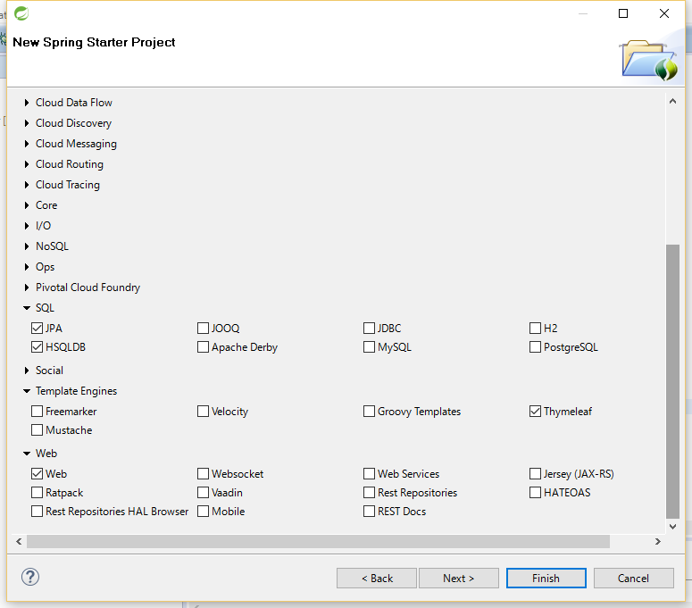
1. Start creating a project
Practical Web Development with Spring Boot
How to create CRUD user
1-1. Start Project
Open STS and File – New – Spring Starter Project
Check the following checkbox,
JPA, HSQLDB under SQL
Thymeleaf under Template Engines.
Web under Web
Press “Next>” button

Slide 5
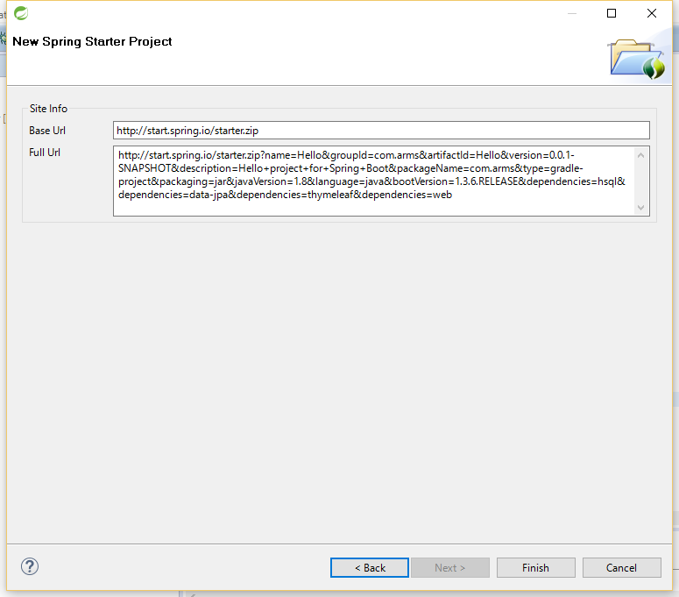
1. Start creating a project
Practical Web Development with Spring Boot
How to create CRUD user
1-1. Start Project
Open STS and File – New – Spring Starter Project
Press “Finish” button

Slide 6
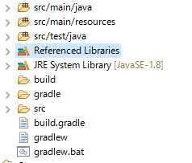
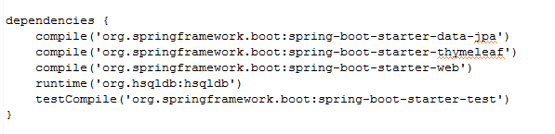
1. Start creating a project
Practical Web Development with Spring Boot
How to create CRUD user
1-1. Start Project
You will see the project structure like below
Make sure to have the version 1.8
Open “build.gradle” and make sure to have “dependencies” you added during the spring starter project.

Slide 7

1. Start creating a project
Practical Web Development with Spring Boot
How to create CRUD user
1-1. Start Project
Prepare to use thymeleaf
Open “application.properties”,
and add the following lines
# Thymeleaf
spring.thymeleaf.mode=LEGACYHTML5
spring.thymeleaf.cache=false
spring.thymeleaf.encoding=UTF-8
☆spring.thymeleaf.mode=LEGACYHTML5
Without this setting, you have to follow the precise xhtml syntax.
☆spring.thymeleaf.cache=false
Disabling thymeleaf cache for developing purpose.
application.properties is a configuration file for spring boot.

Slide 8

1. Start creating a project
Practical Web Development with Spring Boot
How to create CRUD user
1-2. Dependency management
Prepare to use thymeleaf
Open “build.gradle” and add
nekohtml
dependencies {
compile('org.springframework.boot:spring-boot-starter-data-jpa')
compile('org.springframework.boot:spring-boot-starter-thymeleaf')
compile('org.springframework.boot:spring-boot-starter-web')
runtime('org.hsqldb:hsqldb')
testCompile('org.springframework.boot:spring-boot-starter-test')
compile('net.sourceforge.nekohtml:nekohtml')
}
This setting is also needed to use legacyhtml5.

Slide 9
1. Start creating a project
Practical Web Development with Spring Boot
How to create CRUD user
1-2. Dependency management
Dependency management
One of the roles of build tool is compiling your source code into binary and packaging the binary.
In order to make the above happen, Gradle needs to know the things which your project needs. These needs are called “dependencies”( of your project)
If you add dependencies like below, Gradle will know the dependencies of your project and take care of finding these dependencies, and then make them available in your build and project.
dependencies {
compile('org.springframework.boot:spring-boot-starter-data-jpa')
compile('org.springframework.boot:spring-boot-starter-thymeleaf')
compile('org.springframework.boot:spring-boot-starter-web')
runtime('org.hsqldb:hsqldb')
testCompile('org.springframework.boot:spring-boot-starter-test')
compile('net.sourceforge.nekohtml:nekohtml')
}
Continue on next page

Slide 10
1. Start creating a project
Practical Web Development with Spring Boot
How to create CRUD user
1-2. Dependency management
Dependency management
complie
The dependencies required to compile the production source of the project.
(To compile source of project, this dependency is needed )
runtime
The dependencies required by the production classes at runtime.
(To run the production class, this dependency is needed)
testCompile
The dependencies required to compile the test source of the project.
testRuntime
The dependencies required to run the tests.
How Gradle resolves dependencies is that Gradle looks for them in a repository.
In build.gradle file, you will see the line like below.
repositories {
mavenCentral()
}

Slide 11
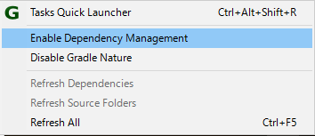
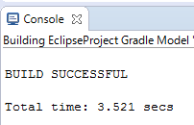
1. Start creating a project
Practical Web Development with Spring Boot
How to create CRUD user
1-1. Dependency management
Right click on your project, select Gradle(STS) – Enable Dependency Management from the context menu.
This will enable “Refresh Dependencies”
Select “Refresh All” to apply changes in the previous page.
You will see “BUILD SUCCESSFUL” message in the Console screen.
Referenced library is turned into Gradle dependencies.
Currently, Eclipse doesn’t automatically update if build.gradle is updated.

Slide 12
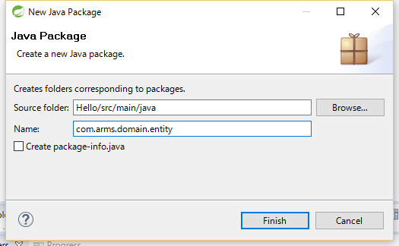
2. Create and Read
Practical Web Development with Spring Boot
How to create CRUD user
2-1. Create user’s list
Right click on “com.arms”, new - package
Type “com.arms.domain.entity” in Name field
In the same way, add two more packages as below,
com.arms.app.hello
com.arms.domain.repository

Slide 13
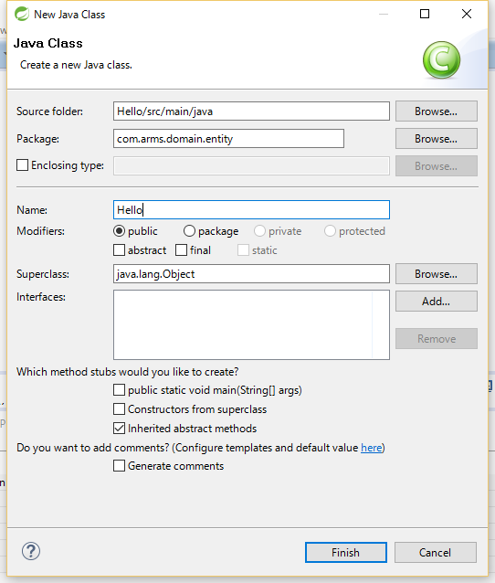
2. Create and Read
Practical Web Development with Spring Boot
How to create CRUD user
2-1. Create user’s list
Right click on “com.arms.domain.entity”, new – class to create a new class
Type “Hello” in the Name field,
and click “Finish” button.
This will create an entity class under domain entity

Slide 14
2. Create and Read
Practical Web Development with Spring Boot
How to create CRUD user
2-1. Create user’s list
Double click on Hello.java and add the following code,
package com.arms.domain.entity;
public class Hello {
private int id;
private String name;
}
This is just a simple POJO….
Two things are needed to make this work as a JPA entity class…..

Slide 15
2. Create and Read
Practical Web Development with Spring Boot
How to create CRUD user
2-1. Create user’s list
The first thing is to add JPA @Entity annotation
package com.arms.domain.entity;
import org.hibernate.validator.constraints.NotEmpty;
import javax.persistence.Entity;
import javax.persistence.GeneratedValue;
import javax.persistence.Id;
@Entity
public class Hello {
@Id
@GeneratedValue
private int id;
@NotEmpty
private String name;
}
JPA @Entity annotation tells that this class is mapped to a table, and each field of this class is mapped to the fields of the table.
@Id annotation tells that this field is a primary key field, and the value is automatically injected into the field of ObjectDB
@GeneratedValue annotation automatically allocates the primary key to the ObjectDB.
JPA: Java Persistence API makes it possible to persistently store data in a DB.
By using JPA, ORM(Object Relational Mapping) which maps DB records with Java Object can be used and deal with data as Object.

Slide 16
2. Create and Read
Practical Web Development with Spring Boot
How to create CRUD user
2-1. Create user’s list
The second thing is to add getters/setters for private fields.
package com.arms.domain.entity;
import lombok.Data;
import org.hibernate.validator.constraints.NotEmpty;
import javax.persistence.Entity;
import javax.persistence.GeneratedValue;
import javax.persistence.Id;
@Data
@Entity
public class Hello {
@Id
@GeneratedValue
private int id;
@NotEmpty
private String name;
}
Since id and name fields are private, getters/setters should be created.
In our class, we use lombok to auto-create getters/setters.

Slide 17
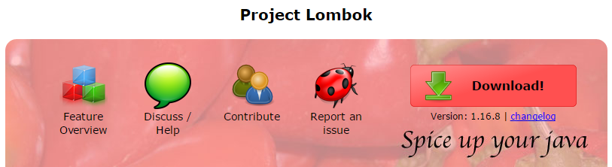
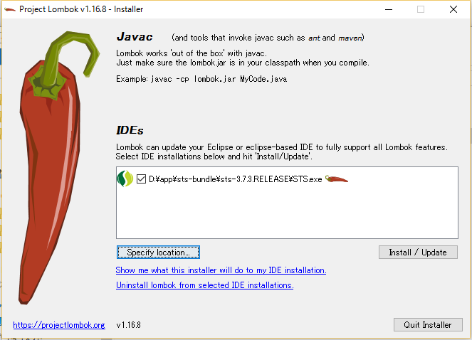
2. Create and Read
Practical Web Development with Spring Boot
How to create CRUD user
2-1. Create user’s list
To solve this lombok problem, go to https://projectlombok.org/ and click “Download!” button on the page
After downloading the lombok, double click on the lombok.jar
Lombok installer will automatically find IDEs installed on your PC.
Click “Install/Update” button
You will see “Install successful” message, and press “OK”
If you see “can’t find IDE” message, please specify the location of your IDE”

Slide 18
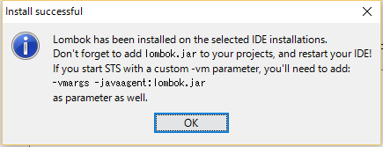
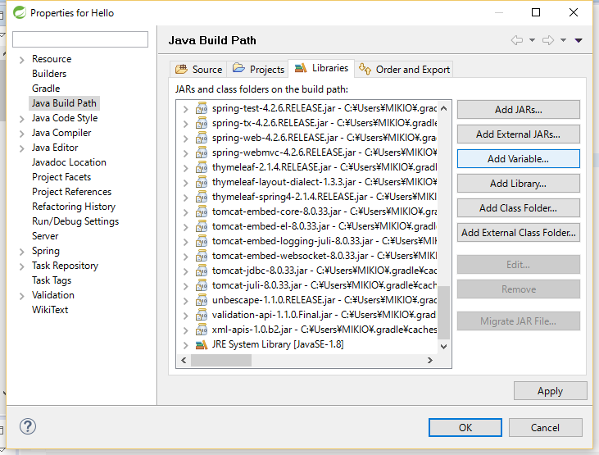
2. Create and Read
Practical Web Development with Spring Boot
How to create CRUD user
2-1. Create user’s list
As the message suggest, add lombok.jar to your project. Right-click on your project, and select “properties”
Select “Java Build Path” – “Libraries tab” – “Add External JARs…” button
You can find the lombok.jar from the location in the previous page.
Make sure to see lombok.jar in the Libraries.

Slide 19
2. Create and Read
Practical Web Development with Spring Boot
How to create CRUD user
2-1. Create user’s list
you can also add “dependencies” to “build.gradle”
dependencies {
compile('org.springframework.boot:spring-boot-starter-data-jpa')
compile('org.springframework.boot:spring-boot-starter-thymeleaf')
compile('org.springframework.boot:spring-boot-starter-web')
runtime('org.hsqldb:hsqldb')
testCompile('org.springframework.boot:spring-boot-starter-test')
compile('net.sourceforge.nekohtml:nekohtml')
compile('org.projectlombok:lombok:1.16.6')
}
If you want to run this app on server and the previous lombok installation is out of reach from the virtual server, this dependency is necessary.
Important
Whenever you add dependencies, you have to run “Refresh All”

Slide 20
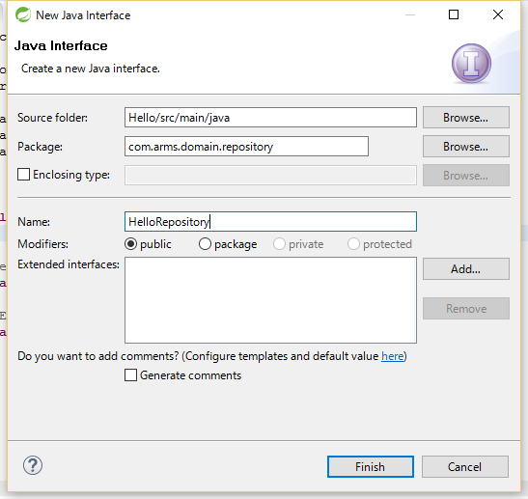
2. Create and Read
Practical Web Development with Spring Boot
How to create CRUD user
2-1. Create user’s list
Right click on “com.arms.domain.repository” New - Interface
Type “HelloRepository” in the Name field
Click “Add” button to extend this interface.

Slide 21
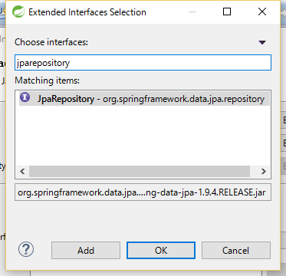
2. Create and Read
Practical Web Development with Spring Boot
How to create CRUD user
2-1. Create user’s list
Extended Interfaces Selection dialog appears.
Type “jparepository” in the textbox, you will see JpaRepository in the Matching items.
Press “OK” to close this dialog, and click “Finish” button to create this interface.

Slide 22
2. Create and Read
Practical Web Development with Spring Boot
How to create CRUD user
2-1. Create user’s list
When you extend JpaRepository, you have to specify an entity class and its primary key field.
package com.arms.domain.repository;
import org.springframework.data.jpa.repository.JpaRepository;
public interface HelloRepository extends JpaRepository<T, ID> {
}
Change <T, ID> to <Hello, Integer>
Add the following lines,
import com.arms.domain.entity.Hello;
@Repository
import org.springframework.stereotype.Repository;
☆When you add @Repository, Spring recognizes this interface as Repository. You can do the basic DB control by JPA entitymanager
package com.arms.domain.repository;
import org.springframework.data.jpa.repository.JpaRepository;
import org.springframework.stereotype.Repository;
import com.arms.domain.entity.Hello;
@Repository
public interface HelloRepository extends JpaRepository<Hello, Integer> {
}

Slide 23
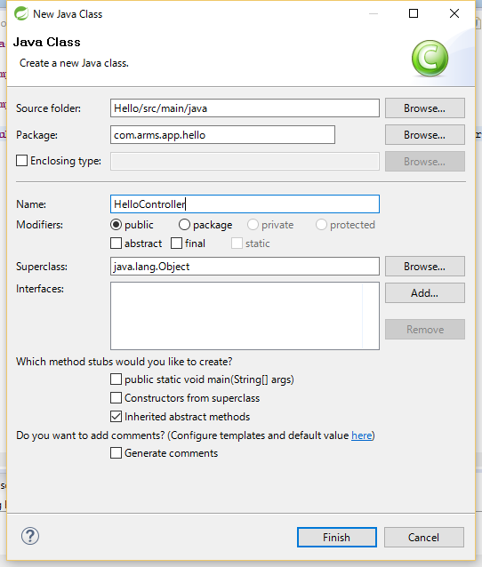
2. Create and Read
Practical Web Development with Spring Boot
How to create CRUD user
2-1. Create user’s list
Right-click on “com.arms.app.hello” new – class
Type “HelloController” in the Name field.
Press “Finish” button

Slide 24
2. Create and Read
Practical Web Development with Spring Boot
How to create CRUD user
2-1. Create user’s list
To create a controller class, you have to add the following line
package com.arms.app.hello;
import org.springframework.stereotype.Controller;
@Controller
public class HelloController {
}
1. You have to add @Controller annotation, and import.
package com.arms.app.hello;
import org.springframework.stereotype.Controller;
import org.springframework.web.bind.annotation.RequestMapping;
@Controller
@RequestMapping("/")
public class HelloController {
}
2. add @RequestMapping annotation, and import.

Slide 25
2. Create and Read
Practical Web Development with Spring Boot
How to create CRUD user
2-1. Create user’s list
Controllers in Spring works as entry points of view
package com.arms.app.hello;
import org.springframework.stereotype.Controller;
import org.springframework.web.bind.annotation.RequestMapping;
import org.springframework.web.bind.annotation.RequestMethod;
import org.springframework.web.servlet.ModelAndView;
@Controller
@RequestMapping("/")
public class HelloController {
@RequestMapping(value = "", method = RequestMethod.GET)
public ModelAndView index(ModelAndView modelAndView) {
modelAndView.addObject("list", helloRepository.findAll());
modelAndView.setViewName("hello/list");
return modelAndView;
}
}
Add red lines to HelloController.java

Slide 26
2. Create and Read
Practical Web Development with Spring Boot
How to create CRUD user
2-1. Create user’s list
Important points
In Spring Boot, http requests are handled by a controller. @Controller annotation can make it easier to indentify these requests.
The @RequestMapping annotation will make sure that HTTP requests to "/" are mapped to the index() method. If you add @RequestMapping("/") to a class level, you can abbreviate when it is used in each method. In this case, @RequestMapping(value = "") for index() method means "/".
ModelAndView class
This class holds both model and view to make it possible for a controller to return both model and view in a single return value. You can also use addObject(), setViewName(), and etc… addObject() can store an object and give it to the view. setViewName() can render the corresponding view, (“hello/list”) = hello folder, list.html

Slide 27
2. Create and Read
Practical Web Development with Spring Boot
How to create CRUD user
2-1. Create user’s list
c
Now you see “helloRepository.findAll() has a problem.
package com.arms.app.hello;
import org.springframework.stereotype.Controller;
import org.springframework.web.bind.annotation.RequestMapping;
import org.springframework.web.bind.annotation.RequestMethod;
import org.springframework.web.servlet.ModelAndView;
import org.springframework.beans.factory.annotation.Autowired;
@Controller
@RequestMapping("/")
public class HelloController {
@Autowired
HelloRepository helloRepository;
Add red lines to HelloController.java

Slide 28
2. Create and Read
Practical Web Development with Spring Boot
How to create CRUD user
2-1. Create user’s list
Spring Magic
You don’t see any findAll() method in HelloRepository, but you can call findAll() method after adding @Autowired and HelloRepository type.
This is a magic you can use when you extend JpaRepositoy and add @Autowired annotation.
Other than findAll(), you can use findOne(), delete(), save() ,and etc… without creating methods.
With @Autowired, you can call the corresponding class without creating an instance by “new” operator.

Slide 29
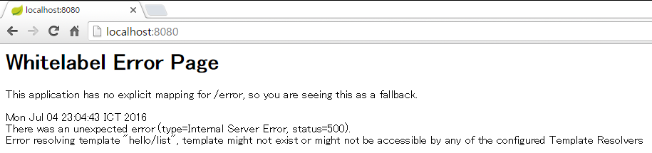
2. Create and Read
Practical Web Development with Spring Boot
How to create CRUD user
2-1. Create user’s list
Let’s check if the code is properly working so far, Right-click on your project, Run As – Spring Boot App
Check “Console” screen if an error occurs.
If you don’t see any errors, open your browser and type localhost:8080
Controller tried to render list.html in hello folder. But list.html does not exsist
When you access @RequestMapping(value = "“) = localhost:8080/, this tries to render modelAndView.setViewName("hello/list"); hello/list.html

Slide 30

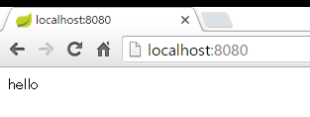
2. Create and Read
Practical Web Development with Spring Boot
How to create CRUD user
2-1. Create user’s list
Now let’s create hello folder and list.html. View files are normally created under src/main/resources/templates
Create hello folder and list.html
Write something list.html
for example, hello
Restart your project and access localhost:8080 again, you will see “hello” message

Slide 31
2. Create and Read
Practical Web Development with Spring Boot
How to create CRUD user
2-1. Create user’s list
Modify list.html as below
<!DOCTYPE html>
<html xmlns="http://www.w3.org/1999/xhtml"
xmlns:th="http://www.thymeleaf.org">
<head>
<title>Users List</title>
<meta charset="utf-8">
<link rel="stylesheet" media="screen" href="/stylesheets/main.css">
<link rel="shortcut icon" type="image/png" href="/images/favicon.png">
<script src="/javascripts/jquery-1.5.2.min.js" type="text/javascript" charset="utf-8"></script>
</head>
<body>
<h4>Users List</h4>
<ul th:each="hello : ${list}">
<li>
<span th:text="${hello.name}">AAA</span>
<a href="#" th:href="'/update/' + ${hello.id} + '?form'" th:text="Edit">Edit</a>
<a href="#" th:href="'/delete/' + ${hello.id}" th:onclick="'return confirm(\'Do you want to delete this user?\')'" th:text="Delete">Delete</a>
</li>
</ul>
<p><a href="/create?form">Create new user</a></p>
</body>
</html>

Slide 32

2. Create and Read
Practical Web Development with Spring Boot
How to create CRUD user
2-1. Create user’s list
Thymeleaf is a Java template engine for web environment and ideal for modern-day HTML5 JVM web development
http://www.thymeleaf.org/
With Thymeleaf, you can display application data on view.
To use Thymeleaf in Spring boot
1. Add the following in the gradle dependencies
compile('org.springframework.boot:spring-boot-starter-thymeleaf')
2. Declare xmlns(XML Namespace) in html
<html xmlns:th="http://www.thymeleaf.org">

Slide 33
2. Create and Read
Practical Web Development with Spring Boot
How to create CRUD user
2-1. Create user’s list
Thymeleaf Syntax
Variable Expression ${…}
Selection Variable Expression *{…}
Message Expression #{…}
URL Expression @{…}

Slide 34
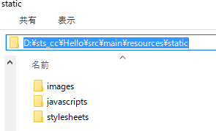
2. Create and Read
Practical Web Development with Spring Boot
How to create CRUD user
2-1. Create user’s list
Add the following image, css, and js files
<link rel="stylesheet" media="screen" href="/stylesheets/main.css">
<link rel="shortcut icon" type="image/png" href="/images/favicon.png">
<script src="/javascripts/jquery-1.5.2.min.js" type="text/javascript" charset="utf-8"></script>
Normally, these files are added to /src/main/resources/static.
If you add those files under static folder, you only need relative path to the files.
Go to static folder in your project, and copy folders and files.

Slide 35
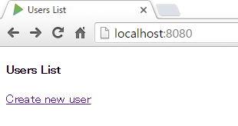
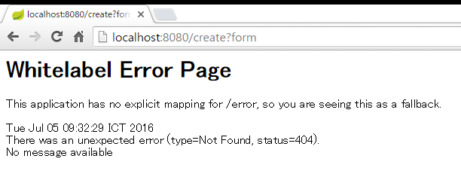
2. Create and Read
Practical Web Development with Spring Boot
How to create CRUD user
2-1. Create user’s list
Restart your project and access localhost:8080, you will see the screen as below,
Click “Create new user”
But error occurs…

Slide 36
2. Create and Read
Practical Web Development with Spring Boot
How to create CRUD user
2-1. Create user’s list
Create a controller method and create.html.
@RequestMapping(value = "create", params = "form", method = RequestMethod.GET)
public String create() {
return "hello/create";
}
Localhost:8080/create?form
Create “create.html” under hello folder.
return "hello/create";
hello
- create.html

Slide 37
2. Create and Read
Practical Web Development with Spring Boot
How to create CRUD user
2-1. Create user’s list
Add the following codes to create.html.
<!DOCTYPE html>
<html>
<head>
<title>Create a new user</title>
<meta charset="utf-8">
<link rel="stylesheet" media="screen" href="/stylesheets/main.css">
<link rel="shortcut icon" type="image/png" href="/images/favicon.png">
<script src="/javascripts/jquery-1.5.2.min.js" type="text/javascript" charset="utf-8"></script>
</head>
<body>
<h4>Create a new user</h4>
<form action="/create" method="POST" accept-charset="utf-8" enctype="application/x-www-form-urlencoded" >
<label for="name">Name:</label>
<p>
<input id="name" type="text" name="name" />
</p>
<button type="submit" id="ok">Create</button>
<button type="reset" id="reset">Reset</button>
</form>
<p>
<a href="/" id="back" >BACK TO HOME</a>
</p>
</body>
</html>

Slide 38
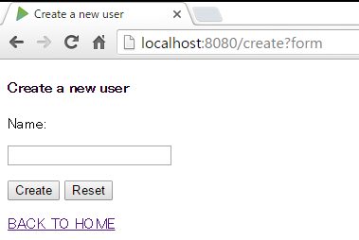
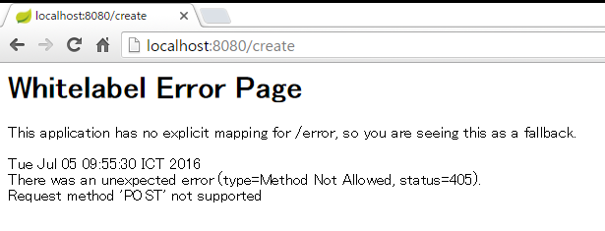
2. Create and Read
Practical Web Development with Spring Boot
How to create CRUD user
2-1. Create user’s list
Restart your project and access localhost:8080, you will see the screen as below,
Type something in the Name textbox and press “Create” button
But error occurs…

Slide 39
2. Create and Read
Practical Web Development with Spring Boot
How to create CRUD user
2-1. Create user’s list
Create a controller method to respond to this form action.
<form action="/create" method="POST“……………
@RequestMapping(value = "create", method = RequestMethod.POST)
public String doneCreate(@RequestParam("name") String name) {
Hello hello = new Hello();
hello.setName(name);
helloRepository.save(hello);
return "redirect:/list";
<form action="/create" method="POST“
↓
method = RequestMethod.POST
<input id="name" type="text" name="name" />
(@RequestParam("name") String name
hello.name = name;
return "redirect:/list";
↓
localhost:8080/list

Slide 40
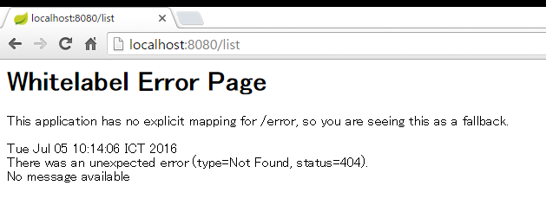
2. Create and Read
Practical Web Development with Spring Boot
How to create CRUD user
2-1. Create user’s list
Restart your project and access localhost:8080, type something in the textbox, and press “Create” button
But this time error message will change
ou

Slide 41
2. Create and Read
Practical Web Development with Spring Boot
How to create CRUD user
2-1. Create user’s list
Create a controller method to respond to this entry point.
http://localhost:8080/list
@RequestMapping(value = "list", method = RequestMethod.GET)
public ModelAndView list(ModelAndView modelAndView) {
modelAndView.addObject("list", helloRepository.findAll());
modelAndView.setViewName("hello/list");
return modelAndView;
}
return "redirect:/list";
localhost:8080/list
@RequestMapping(value = "list“
modelAndView.setViewName("hello/list");
return modelAndView;

Slide 42
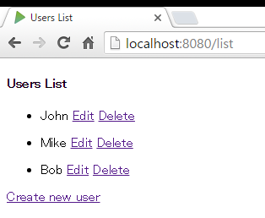
2. Create and Read
Practical Web Development with Spring Boot
How to create CRUD user
2-1. Create user’s list
Restart your project and access localhost:8080, now you can create many users
If you see the screen like the left figure, so far so good!!!
ou

Slide 43
2. Create and Read
Practical Web Development with Spring Boot
How to create CRUD user
2-1. Create user’s list
Important points
@RequestMapping(value = "list", method = RequestMethod.GET)
public ModelAndView list(ModelAndView modelAndView) {
modelAndView.addObject("list", helloRepository.findAll());
modelAndView.setViewName("hello/list");
return modelAndView;
}
<ul th:each="hello : ${list}">
<li>
<span th:text="${hello.name}">AAA</span>
<a href="#" th:href="'/update/' + ${hello.id} + '?form'" th:text="Edit">Edit</a>
<a href="#" th:href="'/delete/' + ${hello.id}" th:onclick="'return confirm(\'Do you want to delete this user?\')'" th:text="Delete">Delete</a>
</li>
</ul>
findAll() method fetches all data in database, and store them in “list” variable and give it to the view.
And then, th:each repeats ${list} as hello.
th:each, th:href, th:text and etc. are thymeleaf format.

Slide 44
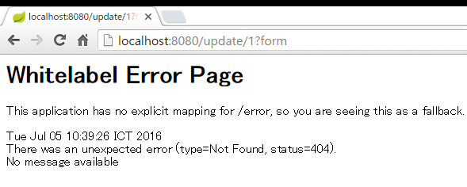
3. Update and Delete
Practical Web Development with Spring Boot
How to create CRUD user
3-1. Create update
Back to Users List and click “Edit” button
ou
You will see an error message again.

Slide 45
3. Update and Delete
Practical Web Development with Spring Boot
How to create CRUD user
3-1. Create update
Add a controller method to edit users and create the corresponding update.html
@RequestMapping(value = "update/{id}", params = "form", method = RequestMethod.GET)
public ModelAndView update(@PathVariable("id") int id, ModelAndView modelAndView) {
modelAndView.addObject("hello", helloRepository.findOne(id));
modelAndView.setViewName("hello/update");
return modelAndView;
}
http://localhost:8080/update/1?form
@RequestMapping(value = "update/{id}", params = "form",
modelAndView.addObject("hello", helloRepository.findOne(id));
This time, you want to update a specific user’s name, and have to get it by “id”.
“@PathVariable("id") int id” can get a URL parameter.
modelAndView.setViewName("hello/update");
hello folder update.html

Slide 46
3. Update and Delete
Practical Web Development with Spring Boot
How to create CRUD user
3-1. Create update
Add the following code to update.html
<!DOCTYPE html>
<html xmlns="http://www.w3.org/1999/xhtml"
xmlns:th="http://www.thymeleaf.org">
<head>
<title>Edit User</title>
<meta charset="utf-8">
<link rel="stylesheet" media="screen" href="/stylesheets/main.css">
<link rel="shortcut icon" type="image/png" href="/images/favicon.png">
<script src="/javascripts/jquery-1.5.2.min.js" type="text/javascript" charset="utf-8"></script>
</head>
<body>
<h4>Edit User</h4>
<form action="/update" method="POST" accept-charset="utf-8" enctype="application/x-www-form-urlencoded" class="form-horizontal" >
<input type="text" name="id" th:value="${hello.id}" hidden/>
<div>
<label for="name">Name :</label>
<p>
<input id="name" type="text" name="name" th:value="${hello.name}"/>
</p>
</div>
<button type="submit" id="ok">Update</button>
<button type="reset" id="reset">Reset</button>
<p>
<a href="/" id="back" >Back to Home</a>
</p>
</form>
</body>
</html>

Slide 47
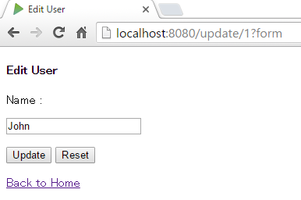
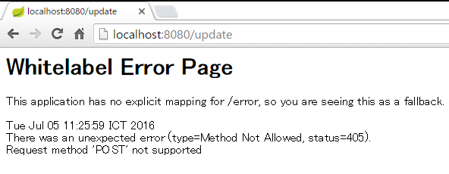
3. Update and Delete
Practical Web Development with Spring Boot
How to create CRUD user
3-1. Create update
Restart your project and go to a user’s edit page
Edit the user name as you like, and press “Update” button.
But error occurs….

Slide 48
3. Update and Delete
Practical Web Development with Spring Boot
How to create CRUD user
3-1. Create update
Add a controller method to update users
@RequestMapping(value = "update", method = RequestMethod.POST)
public String update(@RequestParam("id") int id, @RequestParam String name) {
Hello hello = helloRepository.findOne(id);
hello.setName(name);
helloRepository.save(hello);
return "redirect:/list";
}
<form action="/update" method="POST"
@RequestMapping(value = "update", method = RequestMethod.POST)
helloRepository.save(hello);
save() method again for updating???? save() can automatically check data status and choose to create or update data.
(@RequestParam("id") int id, @RequestParam String name)
@RequestParam receives values from the form.

Slide 49
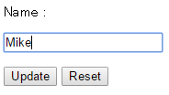
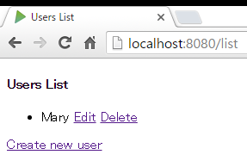
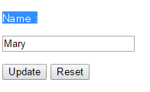
3. Update and Delete
Practical Web Development with Spring Boot
How to create CRUD user
3-1. Create update
Restart your project and try to update a user.
change or modify the user name
If it is properly working so far, you will see Users List after updating.
But…. an error occurs if you click “Delete” button

Slide 50
3. Update and Delete
Practical Web Development with Spring Boot
How to create CRUD user
3-2. Create delete
Add a controller method to delete users
@RequestMapping(value = "delete/{id}", method = RequestMethod.GET)
public String delete(@PathVariable("id") int id) {
helloRepository.delete(id);
return "redirect:/list";
}
<a href="#" th:href="'/delete/' + ${hello.id}" th:onclick="'return confirm(\'Do you want to delete this user?\')'" th:text="Delete">Delete</a>
helloRepository.delete(id);
This time also has to delete a specific user by id.
delete/{id}
↓
(@PathVariable("id") int id
↓
helloRepository.delete(id);

Slide 51
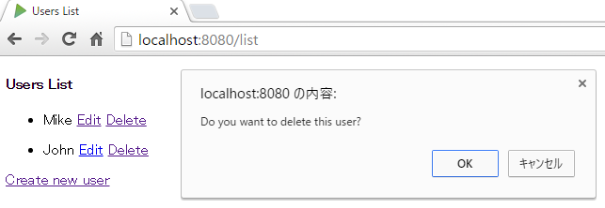
3. Update and Delete
Practical Web Development with Spring Boot
How to create CRUD user
3-2. Create delete
Restart your project and try to delete a user
You will see the confirmation message and click “OK” to delete the user.

Slide 52

Your Idea Leads Your Ideals
homepage: http://arms-asia.com/
facebook: https://www.facebook.com/arms.asia?fref=ts

