Slide 1

Creating student list (3rd class)
Presented by ARMS（THAILAND）Co., Ltd.

Slide 2
Index
Practical Web Development with Spring Boot
Create student list
Start creating a project
  1-1. Start Project
  1-2. Create packages
Create student list
  2-1. Create packages
  2-2. Create student list
  2-3. Challenge
  2-4. H2 in-memory database

Slide 3
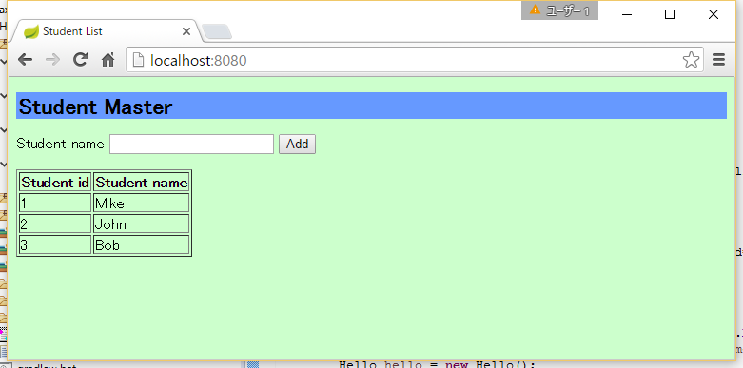
1. Start creating a project
Practical Web Development with Spring Boot
Create student list
1-1. Start Project
You will create Student list Master like below

Slide 4
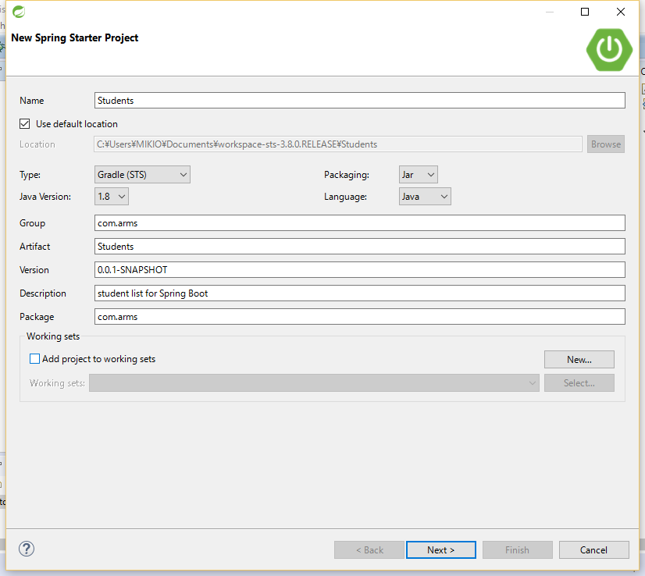
1. Start creating a project
Practical Web Development with Spring Boot
Create student list
1-1. Start Project
Open STS and File – New – Spring Starter Project
Name: Students
Type: Gradle(STS)
Group: com.arms
Artifact: Students
Package: com.arms
Press “Next>” button

Slide 5
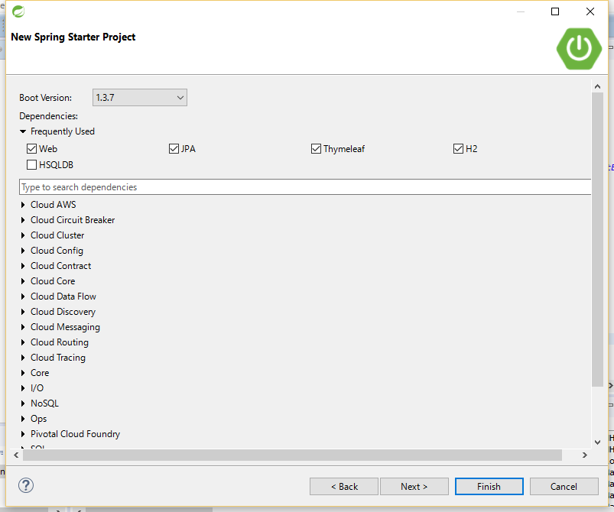
1. Start creating a project
Practical Web Development with Spring Boot
Create student list
1-1. Start Project
Open STS and File – New – Spring Starter Project
Check the following checkbox,
JPA, H2 under SQL
Thymeleaf under Template Engines.
Web under Web
Press “Next>” button

Slide 6
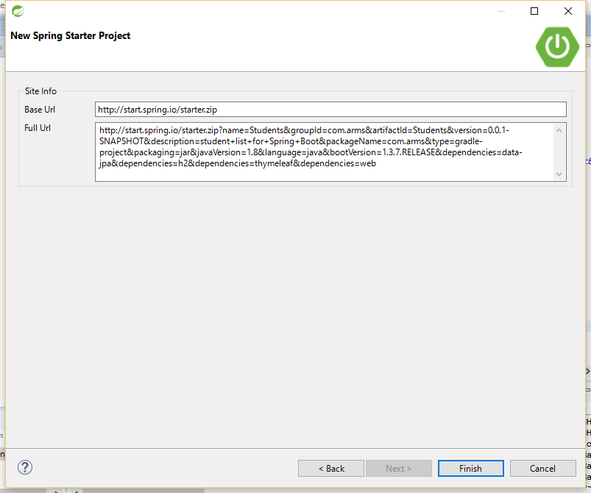
1. Start creating a project
Practical Web Development with Spring Boot
Create student list
1-1. Start Project
Open STS and File – New – Spring Starter Project
Press “Finish” button

Slide 7

1. Start creating a project
Practical Web Development with Spring Boot
Create student list
1-1. Start Project
Prepare to use thymeleaf and H2 in-memory database
Open “application.properties”,
and add the following lines
spring.thymeleaf.mode=LEGACYHTML5
spring.thymeleaf.cache=false
spring.thymeleaf.encoding=UTF-8
spring.h2.console.enabled=true
spring.h2.console.path=/console
spring.h2.console.enabled=true
This enables h2 console
spring.h2.console.path=/console
This tells which URL to access H2 console
localhost:8080/console

Slide 8

1. Start creating a project
Practical Web Development with Spring Boot
Create start project
1-1. Start Project
Prepare to use thymeleaf
Open “build.gradle”
Add lombok and nekohtml into dependencies
dependencies {
compile('org.springframework.boot:spring-boot-starter-data-jpa')
compile('org.springframework.boot:spring-boot-starter-thymeleaf')
compile('org.springframework.boot:spring-boot-starter-web')
runtime('com.h2database:h2')
testCompile('org.springframework.boot:spring-boot-starter-test')
compile('org.projectlombok:lombok:1.16.6')
compile('net.sourceforge.nekohtml:nekohtml')
}

Slide 9
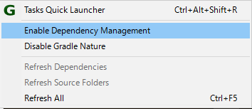
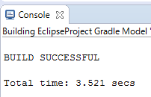
1. Start creating a project
Practical Web Development with Spring Boot
Create student list
1-1. Start Project
Right click on your project, select Gradle(STS) – Enable Dependency Management from the context menu.
This will enable “Refresh Dependencies”
Select “Refresh Dependencies” to apply changes in the previous page.
You will see “BUILD SUCCESSFUL” message in the Console screen.
Libraries go to under Gradle Dependencies management
Currently, Eclipse doesn’t automatically update if build.gradle is updated.

Slide 10
2. Create student list
Practical Web Development with Spring Boot
Create student list
2-1. Create packages
In this class, we will create this app by the following order.
Web browser
student/list.html
Controller
StudentController.java
Service
StudentService.java
Repository
StudentRepository.java
DB
Student.java

Slide 11
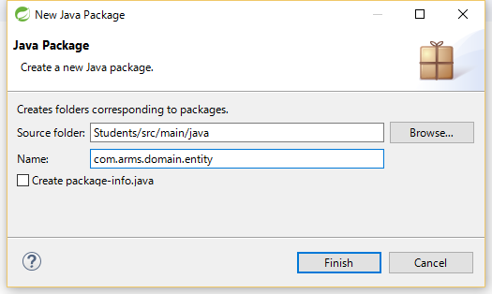
2. Create student list
Practical Web Development with Spring Boot
Create student list
2-1. Create packages
Right click on “com.arms”, New - Package
Type “com.arms.domain.entity” in Name field
In the same way, add packages as below,
src/main/java
com.arms.domain.repository
com.arms.domain.service
com.arms.app.student
src/main/resources
templates.student

Slide 12
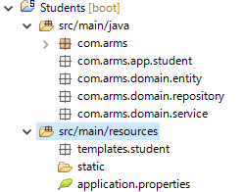
2. Create student list
Practical Web Development with Spring Boot
Create student list
2-1. Create packages
Package structure will be like below,
Create
entity class, repository interface, service component, and controller.
And list.html

Slide 13
2. Create student list
Practical Web Development with Spring Boot
Create student list
2-2. Create student list
Create Student.java
package com.arms.domain.entity;
import javax.persistence.Entity;
import javax.persistence.GeneratedValue;
import javax.persistence.Id;
import lombok.Data;
@Entity
@Data
public class Student {
@Id @GeneratedValue
private int id;
private String name;
}

Slide 14
2. Create student list
Practical Web Development with Spring Boot
Create student list
2-2. Create student list
Create StudentRepository interface with JpaRepository extended.
package com.arms.domain.repository;
import org.springframework.data.jpa.repository.JpaRepository;
import org.springframework.stereotype.Repository;
import com.arms.domain.entity.Student;
@Repository
public interface StudentRepository extends JpaRepository<Student, Integer> {
}

Slide 15
2. Create student list
Practical Web Development with Spring Boot
Create student list
2-2. Create student list
Create StudentService.java
package com.arms.domain.service;
import java.util.List;
import org.springframework.beans.factory.annotation.Autowired;
import org.springframework.stereotype.Service;
import com.arms.domain.entity.Student;
import com.arms.domain.repository.StudentRepository;
@Service
public class StudentService {
@Autowired
StudentRepository studentRepository;
public List<Student> findAllStudent() {
return studentRepository.findAll();
}
public void create(String name){
Student student = new Student();
student.setName(name);
studentRepository.save(student);
}
}

Slide 16
2. Create student list
Practical Web Development with Spring Boot
Create student list
2-2. Create student list
Create StudentController.java
package com.arms.app.student;
import org.springframework.beans.factory.annotation.Autowired;
import org.springframework.stereotype.Controller;
import org.springframework.web.bind.annotation.RequestMapping;
import org.springframework.web.bind.annotation.RequestMethod;
import org.springframework.web.bind.annotation.RequestParam;
import org.springframework.web.servlet.ModelAndView;
import com.arms.domain.service.StudentService;
@Controller
public class StudentController {
@Autowired
StudentService studentService;
@RequestMapping(value = "/", method = RequestMethod.GET)
public ModelAndView index(ModelAndView mav){
mav.addObject("list", studentService.findAllStudent());
mav.setViewName("student/list");
return mav;
}
Continue on next page

Slide 17
2. Create student list
Practical Web Development with Spring Boot
Create student list
2-2. Create student list
Create StudentController.java
@RequestMapping(value = "/", method = RequestMethod.POST)
public String createStudent(@RequestParam("name") String name){
studentService.create(name);
return "redirect:/";
}
}

Slide 18
2. Create student list
Practical Web Development with Spring Boot
Create student list
2-2. Create student list
Create list.html
<!DOCTYPE html>
<html xmlns="http://www.w3.org/1999/xhtml"
xmlns:th="http://www.thymeleaf.org">
<head>
<meta http-equiv="Content-Type" content="text/html; charset=UTF-8">
<link href="/css/style.css" th:href="@{/css/style.css}" rel="stylesheet" />
<title>Student List</title>
</head>
<body>
<h1>Student Master</h1>
<form th:action="@{/}" method="POST">
<label for="name">Student name</label>
<input th:text="${name}" id="name" type="text" name="name">
<button type="submit">Add</button>
</form>
<br />
Continue on next page

Slide 19
2. Create student list
Practical Web Development with Spring Boot
Create student list
2-2. Create student list
Create list.html
<table border="1">
<tr>
<th>Student id</th>
<th>Student name</th>
</tr>
<tr th:each="student: ${list}" th:object=${student}>
<td th:text="*{id}">Student id</td>
<td th:text="*{name}">Student name</td>
</tr>
</table>
</body>
</html>

Slide 20
2. Create student list
Practical Web Development with Spring Boot
Create student list
2-2. Create student list
Create style.css and design by yourself
<!DOCTYPE html>
<html xmlns="http://www.w3.org/1999/xhtml"
xmlns:th="http://www.thymeleaf.org">
<head>
<meta http-equiv="Content-Type" content="text/html; charset=UTF-8">
<link href="/css/style.css" th:href="@{/css/style.css}" rel="stylesheet" />
<title>Student List</title>
</head>
Make sure to put it under static folder.

Slide 21
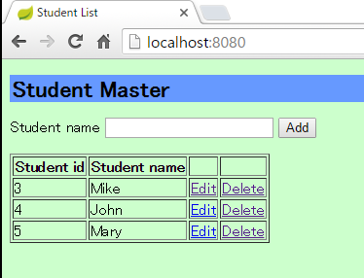
2. Create student list
Practical Web Development with Spring Boot
Create student list
2-3. Challenge
Create “edit” button
Create “delete” button

Slide 22
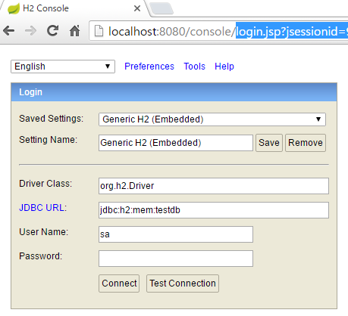
2. Create student list
Practical Web Development with Spring Boot
Create student list
2-4. H2 in-memory database
Let’s access H2 in-memory database since we configured it. Access localhost:8080/console
application.properties
spring.h2.console.enabled=true
spring.h2.console.path=/console
Change JDBC URL:
jdbc:h2:mem:testdb
And press “Connect” button

Slide 23
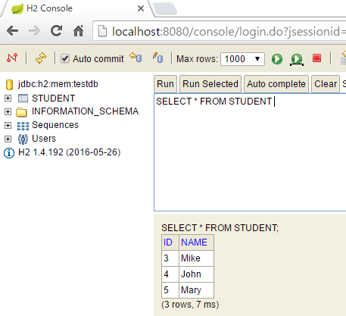
2. Create student list
Practical Web Development with Spring Boot
Create student list
2-4. H2 in-memory database
You can run SQL command to see your student list database
SELECT * FROM STUDENT

Slide 24

Your Idea Leads Your Ideals
homepage: http://arms-asia.com/
facebook: https://www.facebook.com/arms.asia?fref=ts

