Slide 1

Create to-do app called Indivilister with SPRING BOOT
Presented by ARMS（THAILAND）Co., Ltd.

Slide 2
Index
Practical Web Development with Spring Boot
Create Indivilister
Start creating a project
  1-1. Start Project(5th class)
Use thymeleaf to create view
  2-1. Create view
  2-2. Apply Bootstrap and jQuery
3. Create Indivilister’s projects
  3-1. Create a project
  3-2. Create edit a project (6th class)
  3-3. Create delete a project
4. Create Indivilister’s tasks
  4-1. Create a task
  4-2. Create edit a task
  4-3. Create delete a task
  4-4. Count tasks

Slide 3
Note
Practical Web Development with Spring Boot
Create Indivilister
Indivilister means "Individual + lister“

Slide 4
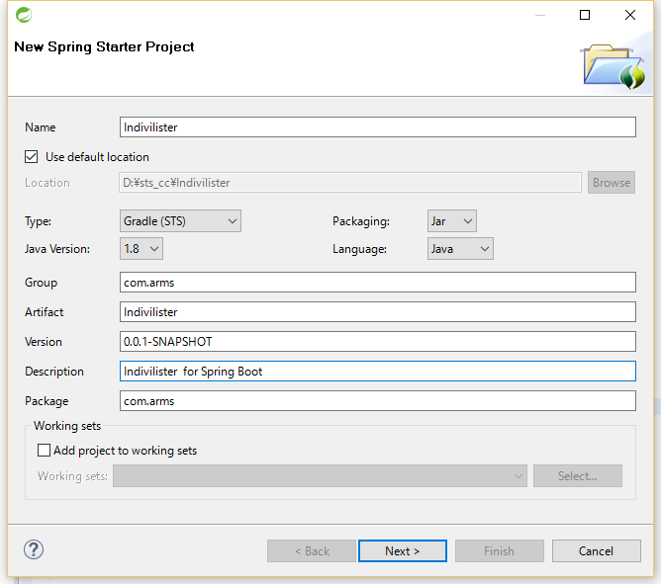
1. Start creating a project
Practical Web Development with Spring Boot
How to create CRUD user
1-1. Start Project
Open STS and File – New – Spring Starter Project
Name: Indivilister
Type: Gradle(STS)
Group: com.arms
Artifact : Indivilister
Version: 0.0.1-SNAPSHOT
Description:
Indivilister for Spring Boot
Package: com.arms
And press “Next>” button

Slide 5
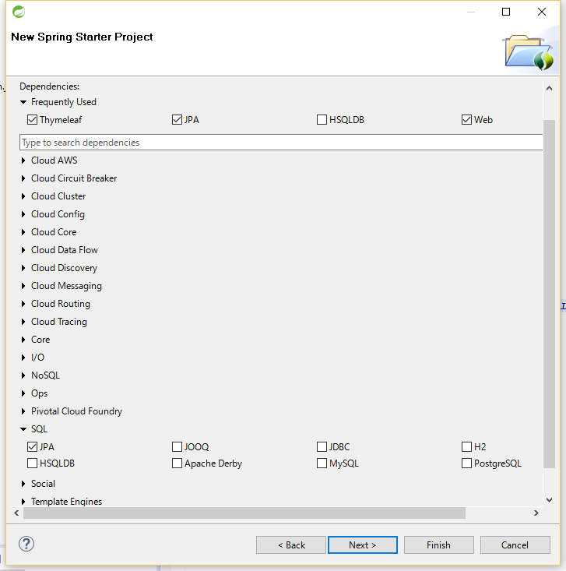
1. Start creating a project
Practical Web Development with Spring Boot
How to create CRUD user
1-1. Start Project
Open STS and File – New – Spring Starter Project
Check the following checkbox
Thymeleaf
JPA
Web
And press “Next>” button

Slide 6
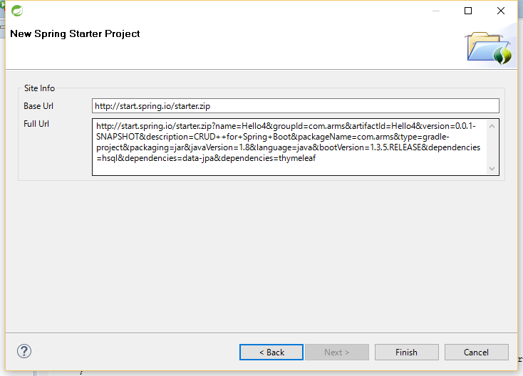
1. Start creating a project
Practical Web Development with Spring Boot
How to create CRUD user
1-1. Start Project
Open STS and File – New – Spring Starter Project

Slide 7
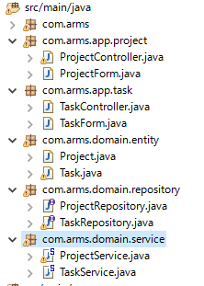
1. Start creating a project
Practical Web Development with Spring Boot
How to create CRUD user
1-1. Start Project
You will create the project structure as below
Create packages as below
com.arms.app.project
com.arms.app.task
com.arms.domain.entity
com.arms.domain.repository
com.arms.domain.service
Make sure to spell the package name right.

Slide 8
1. Start creating a project
Practical Web Development with Spring Boot
How to create CRUD user
1-1. Start Project
You will create layered architecture as below
application layer
domain layer
View
(html)
Controller
Service
Repository
com.arms.app.project
com.arms.app.task
com.arms.domain.repository
com.arms.domain.service
com.arms.domain.entity
Model

Slide 9

1. Start creating a project
Practical Web Development with Spring Boot
create Indivilister
1-1. Start Project
Prepare to use Thymeleaf and Database
Open “application.properties”, and add the following lines
spring.datasource.driverClassName=com.mysql.jdbc.Driver
spring.datasource.url=jdbc:mysql://localhost:3306/todo?useUnicode=true&characterEncoding=UTF-8
spring.datasource.username=root
spring.datasource.password=manager
spring.jpa.database=MYSQL
spring.jpa.show-sql=true
spring.jpa.hibernate.dialect=org.hibernate.dialect.MySQL5Dialect
spring.thymeleaf.mode=LEGACYHTML5
spring.thymeleaf.cache=false
spring.thymeleaf.encoding=UTF-8

Slide 10
1. Start creating a project
Practical Web Development with Spring Boot
Create indivilister
1-1. Start Project
Connection to a production database
Red letters should be changed according to your environment.
spring.datasource.driverClassName=com.mysql.jdbc.Driver
spring.datasource.url=jdbc:mysql://hostname:port/Database Name?useUnicode=true&characterEncoding=UTF-8
spring.datasource.username=a user in database
spring.datasource.password=the above user’s password
spring.jpa.database=MYSQL
spring.jpa.show-sql=true
spring.jpa.hibernate.dialect=org.hibernate.dialect.MySQL5Dialect
What dialect corresponds with MySQL. Hibernate has a dialect auto-detection mechanism
https://docs.jboss.org/hibernate/orm/3.5/api/ (other example)
spring.thymeleaf.mode=LEGACYHTML5
spring.thymeleaf.cache=false
spring.thymeleaf.encoding=UTF-8

Slide 11
1. Start creating a project
Practical Web Development with Spring Boot
Create Indivilister
1-1. Start Project
Modify build.gradle for Thymeleaf and Database connection
Red part should be added to dependencies.
dependencies {
compile('org.springframework.boot:spring-boot-starter-data-jpa')
compile('org.projectlombok:lombok:1.16.6')
compile('org.springframework.boot:spring-boot-starter-thymeleaf')
compile('org.springframework.boot:spring-boot-starter-web')
runtime('mysql:mysql-connector-java')
compile('net.sourceforge.nekohtml:nekohtml')
testCompile('org.springframework.boot:spring-boot-starter-test')
}

Slide 12
1. Start creating a project
Practical Web Development with Spring Boot
Create Indivilister
1-1. Start Project
Starter project parameters.
Name : Indivilister is project name
Artifact : Indivilister
Version: 0.0.1-SNAPSHOT
Packaging: Jar
build.gradle
jar {
baseName = 'indivilister‘
version = '0.0.1-SNAPSHOT‘
}
When gradle packaging your project into Java Archive(JAR)
baseName + version .jar
Indivilister-0.0.1-SNAPSHOT.jar
☆JAR file contains class files and related resources for your application. In general, archive enables you to bundle multiple files into a single file
Group is to identify the project, normally, package route of the project name is used.

Slide 13
1. Start creating a project
Practical Web Development with Spring Boot
Create Indivilister
1-1. Start Project
Create entity class for Indivilister’s Project. Right-click on com.arms.domain.entity. New - Class
Type Project in the name textbox and click “finish” button
package com.arms.domain.entity;
import lombok.Data;
import org.hibernate.validator.constraints.NotEmpty;
import javax.persistence.*;
import java.util.Date;
import java.util.List;
@Entity
@Data
@Table(name= "project")
public class Project {
@GeneratedValue
@Id
private int id;
@NotEmpty
private String name;
@OneToMany(mappedBy = "project", cascade = CascadeType.ALL)
private List<Task> taskList;
private Date createdDate;
private Date updatedDate;
}

Slide 14
1. Start creating a project
Practical Web Development with Spring Boot
Create Indivilister
1-1. Start Project
Create entity class for Indivilister’s Task. Right-click on com.arms.domain.entity. New - Class
Type Task in the name textbox and click “finish” button
package com.arms.domain.entity;
import lombok.Data;
import org.hibernate.validator.constraints.NotEmpty;
import javax.persistence.*;
import javax.validation.constraints.NotNull;
import java.util.Date;
import java.util.List;
@Entity
@Data
@Table(name= "task")
public class Task {
@GeneratedValue
@Id
private int id;
@ManyToOne
@JoinColumn(name = "project_id")
private Project project;
@NotEmpty
private String name;
@NotNull
private boolean status;
private Date createdDate;
private Date updatedDate;
}

Slide 15
1. Start creating a project
Practical Web Development with Spring Boot
Create Indivilister
1-1. Start Project
Important points
@Table(name= "project")
specify a table name mapped to the entity. If @Table is not defined, the default values is used which is the entity class name.
@NotEmpty Null and “” will be an error.
One-To-Many Mapping
@OneToMany(mappedBy = "project", cascade = CascadeType.ALL)
private List<Task> taskList;
Project entity has a reference to List<Task>, as one project can have many tasks. Task entity has a reference to Project. In order to make Project to Task One-to-Many, put @OneToMany annotation over List<Task>. This signifies that one project can have many tasks. On Task side, @ManyToOne should be put over Project reference. This signifies that many tasks belong to one project. Since “project_id” has to be made foreign key in Task table. Put @JoinColumn annotation over Project property in Task entity and provide the name of the column which will hold project_id values in Task table as foreign key.
@ManyToOne
@JoinColumn(name = "project_id")
private Project project;

Slide 16
1. Start creating a project
Practical Web Development with Spring Boot
Create Indivilister
1-1. Start Project
Important point: mappedBy
Each project can have zero to many tasks, and if each task has project information, you will know which project each task belongs to. To know where each task is coming from, add a foreign key to task table
[Task]
int id 3
String name prep
Project project
[Project]
int id 1
String name visiting customer
List<Task> taskList
1 project_id as foreign key
One-To-Many Mapping
@OneToMany(mappedBy = "project", cascade = CascadeType.ALL)
private List<Task> taskList;
@ManyToOne
@JoinColumn(name = "project_id")
private Project project;
Unlike One-to-One and Many-to-Many,
in One-to-Many/Many-to-One case,
“mappedBy” has to be put on One-to-Many side and indicate Many side.
Continue on next page

Slide 17
1. Start creating a project
Practical Web Development with Spring Boot
Create Indivilister
1-1. Start Project
Important point: mappedBy attribute
In One-to-Many/Many-to-One relationship, mappedBy is used for non-owner entity class, and tells that the owner is in the other entity.
1
*
Project
PK | id
Task
PK | id
FK | project_id
@ManyToOne should be defined on the owner entity class.
If @JoinColumn is not defined, the name is composed of the name of relationship property in the entity( in this case “project”) + an underscore + the name of PK on the other field.
In this way, the name would be “project_id”. @JoinColumn should be defined on the ManyToOne attribute side.
@ManyToOne
@JoinColumn(name = “project_id”)
private Project project;

Slide 18
1. Start creating a project
Practical Web Development with Spring Boot
Create Indivilister
1-1. Start Project
Important point: cascade attribute
Common way to use cascade is Parent and Child association like a One-To-Many and a Many-To-One relationship in which the cascade should be used for the One-To-Many side.
** you have to carefully use cascade, (especially,when IDE auto-creates it. )
1
*
Project
PK | id
Task
PK | id
FK | project_id
With cascade, parent operation is transmitted to its child. If a project id is removed, FK(project_id) is no longer needed.
@OneToMany(mappedBy = "project", cascade = CascadeType.ALL)
private List<Task> taskList;
Cascade Types: MERGE, PERSIST, REFRESH, REMOVE and ALL. ALL is applied for all types.

Slide 19
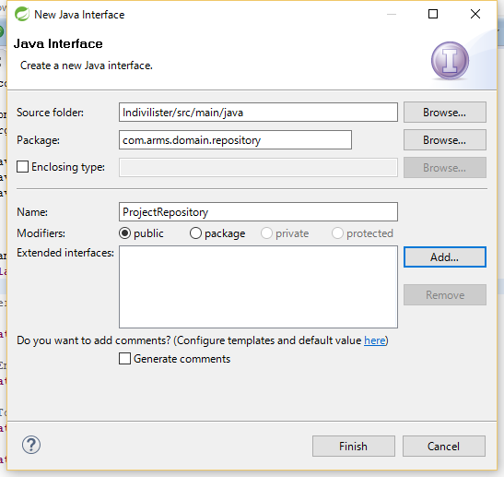
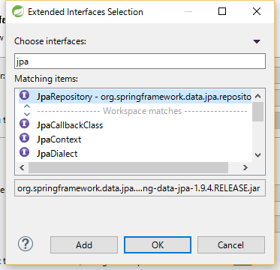
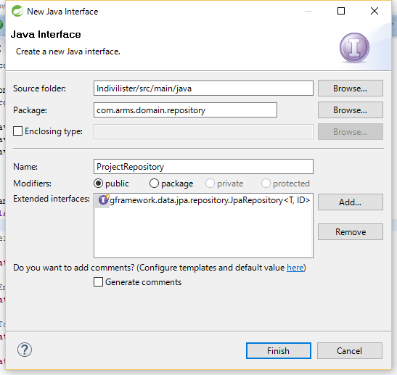
1. Start creating a project
Practical Web Development with Spring Boot
Create Indivilister
1-1. Start Project
Create repository interface for Project. Right-click on com.arms.domain.repository. New - interface
Type Project in the name textbox and click “add” button to choose interface to extend.

Slide 20
1. Start creating a project
Practical Web Development with Spring Boot
Create Indivilister
1-1. Start Project
Add @Repository annotation over interface, add Entity name and its primary key field. ProjectRepository.java
package com.arms.domain.repository;
import com.arms.domain.entity.Project;
import org.springframework.data.jpa.repository.JpaRepository;
import org.springframework.stereotype.Repository;
@Repository
public interface ProjectRepository extends JpaRepository<Project, Integer> {
}

Slide 21
1. Start creating a project
Practical Web Development with Spring Boot
Create Indivilister
1-1. Start Project
Create ProjectController under com.arms.app.project as below
package com.arms.app.project;
import java.util.List;
import org.springframework.stereotype.Controller;
import org.springframework.ui.Model;
import org.springframework.web.bind.annotation.RequestMapping;
import org.springframework.web.bind.annotation.RequestMethod;
import com.arms.domain.entity.Project;
@Controller
@RequestMapping("/project")
public class ProjectController {
@RequestMapping(value = "", method = RequestMethod.GET)
public String index(Model model) {
return "project/list";
}
}
@RequestMapping("/project") for class level
@RequestMapping(value = "", for method level
localhost:8080/project
↓
project/list.html
return "project/list";

Slide 22
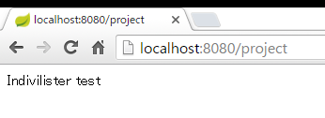
1. Start Creating a project
Practical Web Development with Spring Boot
Create Indivilister
1-1. Start Project
Create list.html under templates.project, write something in the list.html. Start your project and access server:8080/project
list.html
Indivilister test
About accessing, if you are running on server
server:8080/project
↓
192.168.33.10:8080/project
if you are running on local
server:8080/project
↓
localhost:8080/project
You will see the contents of list.html

Slide 23
2. Use thymeleaf to create view
Practical Web Development with Spring Boot
Create Indivilister
2-1. Create view
Modify list.html for Indivilister as below,
<!DOCTYPE html>
<html xmlns="http://www.w3.org/1999/xhtml"
xmlns:th="http://www.thymeleaf.org">
<head>
<meta http-equiv="Content-Type" content="text/html; charset=UTF-8">
<title>INDIVILISTER : Projects</title>
<meta name="viewport" content="width=device-width, initial-scale=1">
<link rel="stylesheet" type="text/css" href="/css/bootstrap.min.css" charset="utf-8">
<link rel="stylesheet" type="text/css" href="/css/custom.css" charset="utf-8">
</head>
<body>
<main>
<!-- START Navigation bar -->
<nav th:include="common/nav :: nav"></nav>
<!-- END Navigation bar -->
<!-- START Header -->
<div class="header-custom">
<div class="container">
<h2>Projects</h2>
<p>Simple todo app by Spring boot and Bootstrap</p>
</div>
</div>
<!-- END Header -->
Continue on next page

Slide 24
2. Use thymeleaf to create view
Practical Web Development with Spring Boot
Create Indivilister
2-1. Create view
Modify list.html for Indivilister as below,
<!-- START Content -->
<div class="container">
<div class="row">
<div class="col-xs-12">
<a th:href="@{/project/create?form}" class="btn btn-success">Let's create a new project</a>
</div>
</div>
<div class="row">
<div class="col-xs-12">
<div class="col-lg-4" style="padding: 0;" th:each="project, stat : ${projectList}">
<div class="materialCard success">
<header>
<a th:href="'/task/list/' + ${project.id}" class="btn btn-success">
<span th:text="${project.name}">project0001</span>
<span class="badge" th:text="${projectRemainingTaskMap.get(project.id)} + '/' + ${project.taskList.size()}">1/2</span>
</a>
</header>
<a th:href="'/project/edit/' + ${project.id}">Edit</a>
<a th:href="'/project/delete/' + ${project.id}" onclick="return confirm('Delete this project?');">Delete</a>
</div>
</div>
</div>
</div>
</div>
<!-- END Content -->
Continue on next page

Slide 25
2. Use thymeleaf to create view
Practical Web Development with Spring Boot
Create Indivilister
2-1. Create view
Modify list.html for Indivilister as below,
<div class="push"></div>
</main>
<!-- START Footer -->
<span th:include="common/footer :: footer"></span>
<!-- START Footer -->
<script type="text/javascript" language="javascript" charset="_charset" src="/js/jquery-1.12.2.min.js"></script>
<script type="text/javascript" language="javascript" charset="_charset" src="/js/bootstrap.min.js"></script>
</body>
</html>

Slide 26
2. Use thymeleaf to create view
Practical Web Development with Spring Boot
Create Indivilister
2-1. Create view
Create common part of the view. Navigation bar
list.html
<nav th:include="common/nav :: nav"></nav>
html path to load :: value set in th:fragment
common/nav.html
<nav th:fragment="nav“> ….contents to load… </nav>
This means nav.html should be created under common folder in order to be loaded into list.html

Slide 27

2. Use thymeleaf to create view
Practical Web Development with Spring Boot
Create Indivilister
2-1. Create view
Create templates.common package and create nav.html as below
<html xmlns="http://www.w3.org/1999/xhtml"
xmlns:th="http://www.thymeleaf.org">
<body>
<nav th:fragment="nav">
<nav class="navbar navbar-default">
<div class="container">
<div class="navbar-header">
<button type="button" class="navbar-toggle collapsed" data-toggle="collapse" data-target="#navbar-collapse">
<span class="sr-only">Toggle navigation</span>
<span class="icon-bar"></span>
<span class="icon-bar"></span>
<span class="icon-bar"></span>
</button>
<a class="navbar-brand" th:href="@{/project}">INDIVILISTER</a>
</div>
<div class="collapse navbar-collapse" id="navbar-collapse">
<ul class="nav navbar-nav">
<li class="dropdown">
Continue on next page

Slide 28
2. Use thymeleaf to create view
Practical Web Development with Spring Boot
Create Indivilister
2-1. Create view
Create templates.common package and nav.html as below
<a th:href="@{project/create#}" class="dropdown-toggle" data-toggle="dropdown" role="button" aria-expanded="false">Project
<span class="caret"></span>
</a>
<ul class="dropdown-menu">
<li>
<a th:href="@{/project}">List project</a>
</li>
<li>
<a th:href="'/project/create' + '?form'">Create a new project</a>
</li>
</ul>
</li>
</ul>
</div>
</div>
</nav>
</nav>
</body>
</html>

Slide 29

2. Use thymeleaf to create view
Practical Web Development with Spring Boot
Create Indivilister
2-1. Create view
You see the following code in list.html. Create footer.html under common folder.
list.hml
<span th:include="common/footer :: footer"></span>
common/footer.html
<span th:fragment="footer"> footer contents </span>

Slide 30
2. Use thymeleaf to create view
Practical Web Development with Spring Boot
Create Indivilister
2-1. Create view
Create footer.html as below
<html xmlns="http://www.w3.org/1999/xhtml"
xmlns:th="http://www.thymeleaf.org">
<body>
<span th:fragment="footer">
<footer>
<span>Powered by ARMS with
<img src="/img/spring_logo.png" height="30"> Spring boot and Bootstrap
</span>
</footer>
</span>
</body>
</html>

Slide 31
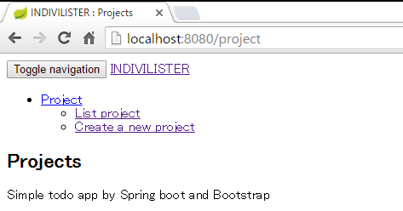
2. Use thymeleaf to create view
Practical Web Development with Spring Boot
Create Indivilister
2-1. Create view
Restart your project and access server:8080/project
You only see the plain website with no design….

Slide 32
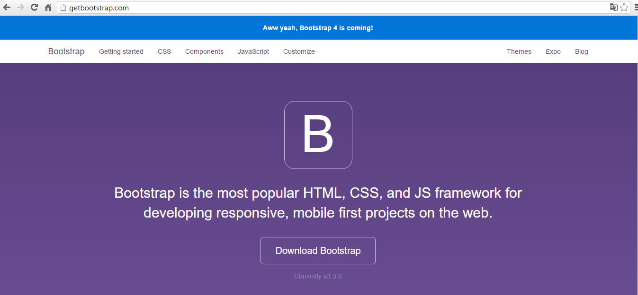
2. Use thymeleaf to create view
Practical Web Development with Spring Boot
Create Indivilister
2-2. Apply Bootstrap and jQuery
Bootstrap http://getbootstrap.com/

Slide 33
2. Use thymeleaf to create view
Practical Web Development with Spring Boot
Create Indivilister
2-2. Apply Bootstrap and jQuery
Top 5 Reasons to use Bootstrap
1. Speed of Development
2. Responsiveness
3. Consistency
4. Customizable
5. Support
Notes:
<number> https://bootstrapbay.com/blog/reasons-to-use-bootstrap/

Slide 34
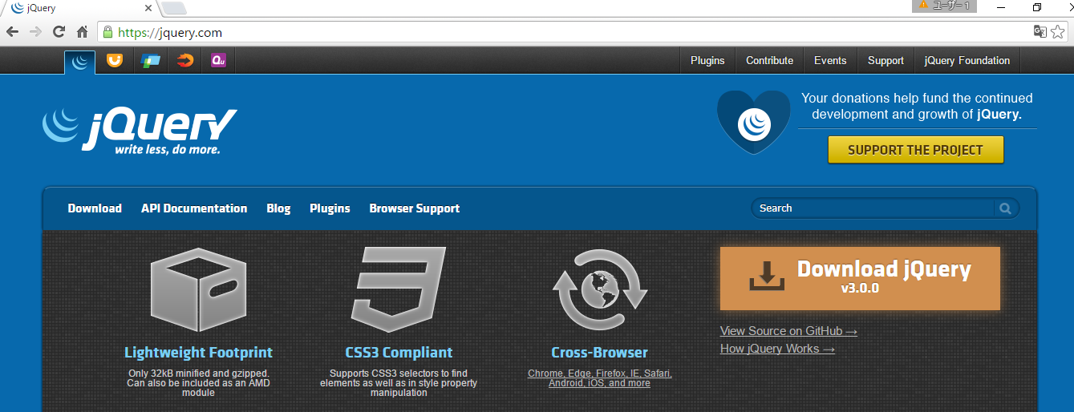
2. Use thymeleaf to create view
Practical Web Development with Spring Boot
Create Indivilister
2-2. Apply Bootstrap and jQuery
jQuery https://jquery.com/

Slide 35
2. Use thymeleaf to create view
Practical Web Development with Spring Boot
Create Indivilister
2-2. Apply Bootstrap and jQuery
jQuery Advantages
Easy to use
Large library
Opensource community
Documentation and tutorials
Ajax support

Slide 36
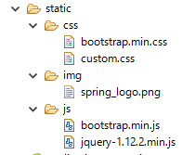
2. Use thymeleaf to create view
Practical Web Development with Spring Boot
Create Indivilister
2-2. Apply Bootstrap and jQuery
Place css and js files as below, normally if you put css and js files under static folder, you can use relative path to the files.
css
bootstrap.min.css
custom.css
img
spring_logo.png
js
bootstrap.min.js
jquery-1.12.2.min.js
list.html
<link rel="stylesheet" type="text/css" href="/css/bootstrap.min.css" charset="utf-8">

Slide 37
2. Use thymeleaf to create view
Practical Web Development with Spring Boot
Create Indivilister
2-2. Apply Bootstrap and jQuery
This is how css, js and img are used in Indivilister.
list.html
<link rel="stylesheet" type="text/css" href="/css/bootstrap.min.css" charset="utf-8">
<link rel="stylesheet" type="text/css" href="/css/custom.css" charset="utf-8">
<script type="text/javascript" language="javascript" charset="_charset" src="/js/jquery-1.12.2.min.js"></script>
<script type="text/javascript" language="javascript" charset="_charset" src="/js/bootstrap.min.js"></script>
footer.html
<img src="/img/spring_logo.png" height="30">
Make sure that all files are placed in each folder.

Slide 38
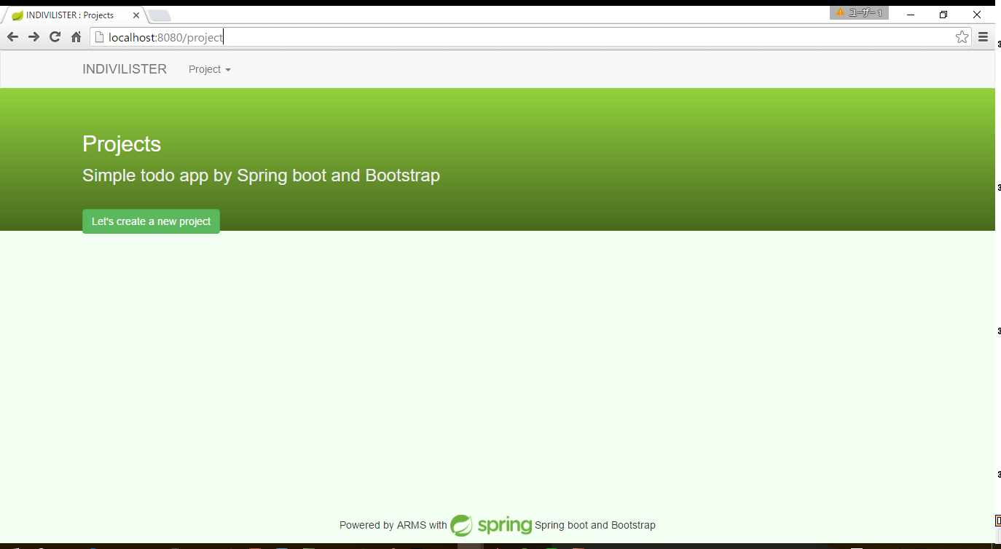
2. Use thymeleaf to create view
Practical Web Development with Spring Boot
Create Indivilister
2-2. Apply Bootstrap and jQuery
Restart your project and access server:8080/project. If you can see the following design, so far so good!!

Slide 39

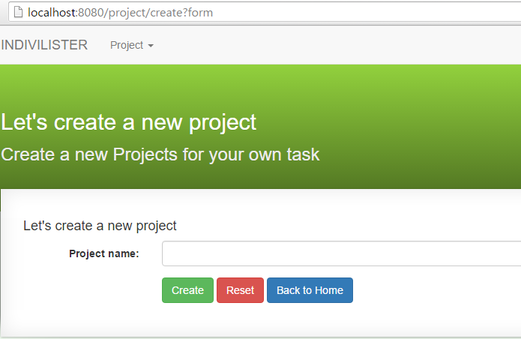
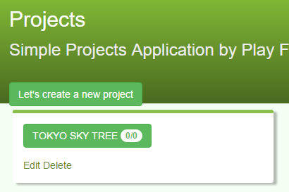
3. Create Indivilister’s projects
Practical Web Development with Spring Boot
Create Indivilister
3-1. Create a project
Create this action and page as below.
<a th:href="@{/project/create?form}" class="btn btn-success">Let's create a new project</a>
server:8080/project/create?form

Slide 40
3. Create Indivilister’s projects
Practical Web Development with Spring Boot
Create Indivilister
3-1. Create a project
Open ProjectController.java and create a method to respond to this action.
<a th:href="@{/project/create?form}" ……>Let's create a new project</a>
@RequestMapping(value = "create", params = "form", method = RequestMethod.GET)
public String createForm(Model model) {
model.addAttribute("projectForm", "Create a project");
return "project/create";
}
As you see the return value string “project/create”, this means create.html under project folder.

Slide 41
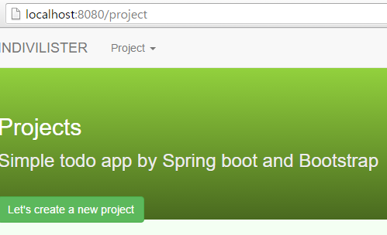

3. Create Indivilister’s projects
Practical Web Development with Spring Boot
Create Indivilister
3-1. Create a project
Create create.html under project folder and add this text
<!DOCTYPE html>
<html xmlns="http://www.w3.org/1999/xhtml"
xmlns:th="http://www.thymeleaf.org">
<head>
<meta http-equiv="Content-Type" content="text/html; charset=UTF-8">
<title>INDIVILISTER : Let's create a new project</title>
<meta name="viewport" content="width=device-width, initial-scale=1">
<link rel="stylesheet" type="text/css" href="/css/bootstrap.min.css" charset="utf-8">
<link rel="stylesheet" type="text/css" href="/css/custom.css" charset="utf-8">
</head>
<body>
<p th:text=${projectForm}>text comes here</p>
</body>
</html>
Access server:8080/project and click “Let’s create a new project” button.

Slide 42

3. Create Indivilister’s projects
Practical Web Development with Spring Boot
Create Indivilister
3-1. Create a project
Create a form object to receive data from text field. ProjectForm.java under com.arms.app.project
package com.arms.app.project;
import lombok.Data;
@Data
public class ProjectForm {
private int id;
private String name;
public ProjectForm(int id, String name) {
this.id = id;
this.name = name;
}
public ProjectForm() {}
}

Slide 43
3. Create Indivilister’s projects
Practical Web Development with Spring Boot
Create Indivilister
3-1. Create a project
Modify createForm() method.
@RequestMapping(value = "create", params = "form", method = RequestMethod.GET)
public String createForm(Model model) {
model.addAttribute("projectForm", new ProjectForm());
return "project/create";
}

Slide 44
3. Create Indivilister’s projects
Practical Web Development with Spring Boot
Create Indivilister
3-1. Create a project
Modify create.html as below
<!DOCTYPE html>
<html xmlns="http://www.w3.org/1999/xhtml"
xmlns:th="http://www.thymeleaf.org">
<head>
<meta http-equiv="Content-Type" content="text/html; charset=UTF-8">
<title>INDIVILISTER : Let's create a new project</title>
<meta name="viewport" content="width=device-width, initial-scale=1">
<link rel="stylesheet" type="text/css" href="/css/bootstrap.min.css" charset="utf-8">
<link rel="stylesheet" type="text/css" href="/css/custom.css" charset="utf-8">
</head>
<body>
<main>
<!-- START Navigation bar -->
<nav th:include="common/nav :: nav"></nav>
<!-- END Navigation bar -->
<!-- START Header -->
<div class="header-custom">
<div class="container">
<h2>Let's create a new project</h2>
<p>Create a new project for your own task</p>
</div>
</div>
<!-- END Header -->
Continue on next page

Slide 45
3. Create Indivilister’s projects
Practical Web Development with Spring Boot
Create Indivilister
3-1. Create a project
Modify create.html as below
<!-- START Content -->
<div class="container">
<div class="row">
<div class="col-lg-12">
<div class="box effect1">
<h4>Let's create a new project</h4>
<form th:action="@{/project/create}" th:object="${projectForm}" method="POST" accept-charset="utf-8" enctype="application/x-www-form-urlencoded" class="form-horizontal">
<input type="hidden" name="authenticityToken" value="e739540dfb2b4389d499e26e8b6dc17f665de703">
<div class="form-group" th:classappend="${#fields.hasErrors('name')}? 'has-error'">
<label for="name" class="col-lg-2 control-label">Project name:</label>
<div class="col-lg-10">
<input class="form-control" th:field="*{name}" id="name" type="text" name="name" required="">
<span th:if="${#fields.hasErrors('name')}" th:errors="*{name}" class="help-block">error!</span>
</div>
</div>
<div class="form-group">
<div class="col-lg-offset-2 col-lg-10">
<button type="submit" class="btn btn-success">Create</button>
<button type="reset" class="btn btn-danger">Reset</button>
<a th:href="@{/project}" class="btn btn-primary">Back to Home</a>
Continue on next page

Slide 46
3. Create Indivilister’s projects
Practical Web Development with Spring Boot
Create Indivilister
3-1. Create a project
Modify create.html as below
</div>
</div>
</form>
</div>
</div>
</div>
</div>
<!-- END Content -->
<div class="push"></div>
</main>
<!-- START Footer -->
<span th:include="common/footer :: footer"></span>
<!-- START Footer -->
<script type="text/javascript" language="javascript" charset="_charset" src="/js/jquery-1.12.2.min.js"></script>
<script type="text/javascript" language="javascript" charset="_charset" src="/js/bootstrap.min.js"></script>
</body>
</html>

Slide 47

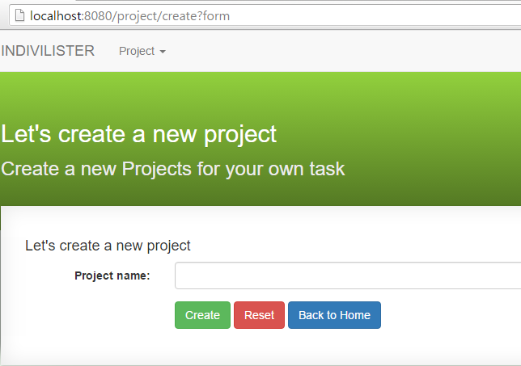
3. Create Indivilister’s projects
Practical Web Development with Spring Boot
Create Indivilister
3-1. Create a project
Restart your project and access server:8080/project, then click “Let’s create a new project” button.
If you see the screen like the left figure, so far so good!!

Slide 48
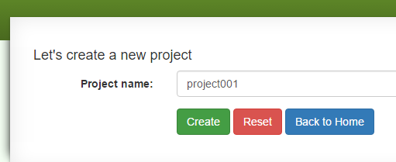
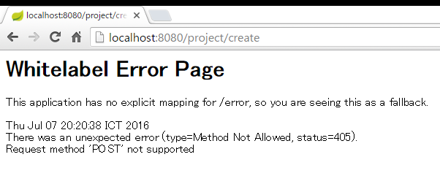
3. Create Indivilister’s projects
Practical Web Development with Spring Boot
Create Indivilister
3-1. Create a project
Type something in Project name textbox and click “Create” button
You will see the error like the left figure.

Slide 49
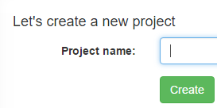
3. Create Indivilister’s projects
Practical Web Development with Spring Boot
Create Indivilister
3-1. Create a project
Let’s see the code for “Create” button
<form th:action="@{/project/create}" th:object="${projectForm}" method="POST"
<button type="submit" class="btn btn-success">Create</button>
You will need to set the controller as below
@RequestMapping("/project")
public class ProjectController {
……………………..
@RequestMapping(value = "create", method = RequestMethod.POST)
…………………..

Slide 50
3. Create Indivilister’s projects
Practical Web Development with Spring Boot
Create Indivilister
3-1. Create a project
Add create() method into ProjectController.java
@RequestMapping(value = "create", method = RequestMethod.POST)
public Object create(@ModelAttribute ProjectForm projectForm) {
projectService.save(projectForm);
return "redirect:/project";
}
This method uses “projectService” variable, but no reference to ProjectService.
So Add ProjectService projectServicev and @Autowired with it.
public class ProjectController {
@Autowired
ProjectService projectService;
Actually, we haven’t created ProjectService class…..

Slide 51
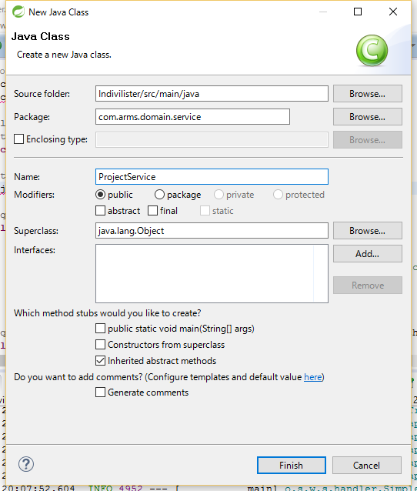
3. Create Indivilister’s projects
Practical Web Development with Spring Boot
Create Indivilister
3-1. Create a project
Right-click on com.arms.domain.service. New – Class
Type ProjectService in the Name field and press “Finish” button.

Slide 52
3. Create Indivilister’s projects
Practical Web Development with Spring Boot
Create Indivilister
3-1. Create a project
Add the following code into ProjectService.java
package com.arms.domain.service;
import java.util.Calendar;
import java.util.Date;
import org.springframework.beans.factory.annotation.Autowired;
import org.springframework.stereotype.Service;
import org.springframework.transaction.annotation.Transactional;
import com.arms.app.project.ProjectForm;
import com.arms.domain.entity.Project;
import com.arms.domain.repository.ProjectRepository;
@Service
@Transactional
public class ProjectService {
Continue on next page

Slide 53
3. Create Indivilister’s projects
Practical Web Development with Spring Boot
Create Indivilister
3-1. Create a project
Add the following code into ProjectService.java
@Autowired
ProjectRepository projectRepository;
public void save(ProjectForm projectForm) {
Date date = Calendar.getInstance().getTime();
Project project = new Project();
project.setName(projectForm.getName());
project.setCreatedDate(date);
project.setUpdatedDate(date);
projectRepository.save(project);
}
}

Slide 54

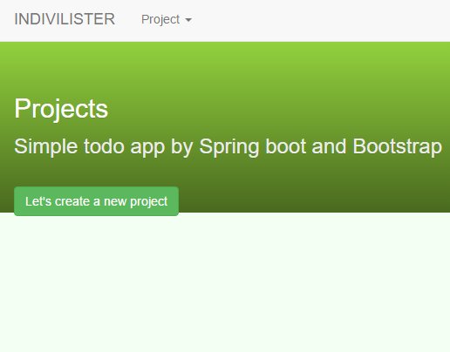
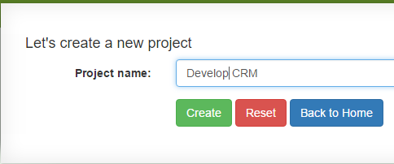
3. Create Indivilister’s projects
Practical Web Development with Spring Boot
Create Indivilister
3-1. Create a project
Restart your project and access server:8080/project, then create a project
You don’t see errors. But can’t see your project….
Projects should be listed….

Slide 55
3. Create Indivilister’s projects
Practical Web Development with Spring Boot
Create Indivilister
3-1. Create a project
Modify index() method in ProjectController, and add findAllProject() method in ProjectService
ProjectController
@RequestMapping(value = "", method = RequestMethod.GET)
public String index(Model model) {
List<Project> projectList = projectService.findAllProject();
model.addAttribute("projectList", projectList);
return "project/list";
}
ProjectService
public List<Project> findAllProject() {
return projectRepository.findAll();
}

Slide 56
3. Create Indivilister’s projects
Practical Web Development with Spring Boot
Create Indivilister
3-1. Create a project
Comment out the following part in list.html
<!-- -->
list.html
<!-- <span class="badge" th:text="${projectRemainingTaskMap.get(project.id)} + '/' + ${project.taskList.size()}">1/2</span> -->

Slide 57
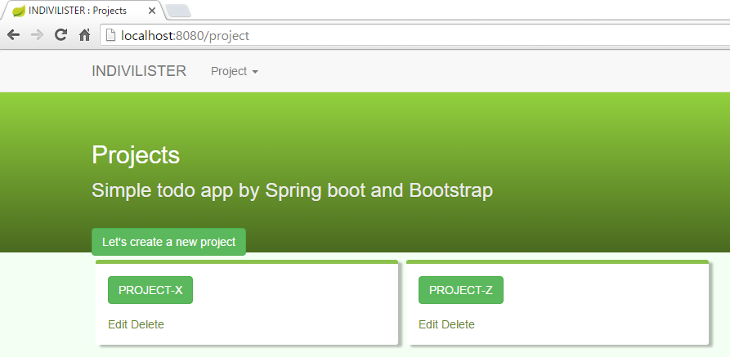
3. Create Indivilister’s projects
Practical Web Development with Spring Boot
Create Indivilister
3-1. Create a project
Restart your project and access localhost:8080/project
If you can see the page like below, so far so good!!

Slide 58
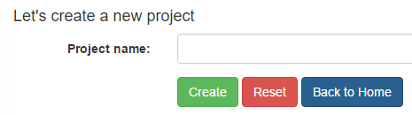
3. Create Indivilister’s projects
Practical Web Development with Spring Boot
Create Indivilister
3-1. Create a project
Let’s see “Back to Home” button
<a th:href="@{/project}" class="btn btn-primary">Back to Home</a>
When you click “Back to Home” button, the following index() method is called, and return “project/list”; project/list.html
@Controller
@RequestMapping("/project")
public class ProjectController {
@RequestMapping(value = "", method = RequestMethod.GET)
public String index(Model model) {
…………………………….
return "project/list";
}

Slide 59
3. Create Indivilister’s projects
Practical Web Development with Spring Boot
Create Indivilister
3-1. Create a project
Understand findAll()
ProjectRepository
findAll()
ProjectService
public List<Project> findAllProject() {
return projectRepository.findAll();
}
ProjectController
@RequestMapping(value = "", method = RequestMethod.GET)
public String index(Model model) {
List<Project> projectList = projectService.findAllProject();
model.addAttribute("projectList", projectList);
return "project/list";
}
list.html
<div class="col-lg-4" style="padding: 0;" th:each="project, stat : ${projectList}">
<span th:text="${project.name}">project0001</span>
←Can’t see findAll() but if you extend JpaRepository, you can use
←Return Project type List (Project data as a list)
←Store projectList into projectList, and give it to list.html
←list.html receives projectList and repeat as project
${project.name} ${project.id}

Slide 60

3. Create Indivilister’s projects
Practical Web Development with Spring Boot
Create Indivilister
3-1. Create a project
Understand the process of creating a project.
<a th:href="@{/project/create?form}“ list.html
ProjectController.java
@RequestMapping(value = "create", params = "form", method = RequestMethod.GET)
public String createForm(Model model) {
model.addAttribute("projectForm", new ProjectForm());
return "project/create";
}
createForm() method is called. ProjectForm object is created and store it in projectForm and this goes to the view(create.html)
create.html
<form th:action="@{/project/create}" th:object="${projectForm}" method="POST“
<input class="form-control" th:field="*{name}" id="name" type="text" name="name" required="">
th:object="${projectForm}” + th:field="*{name}“ This *{name} = ${projectForm.name}
Continue on next page

Slide 61
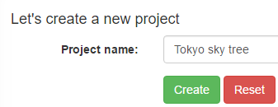
3. Create Indivilister’s projects
Practical Web Development with Spring Boot
Create Indivilister
3-1. Create a project
Understand the process of creating a project.
create.html
<form th:action="@{/project/create}" th:object="${projectForm}" method="POST“
<input class="form-control" th:field="*{name}" id="name" type="text" name="name"
Create button action calls create() method
ProjectController.java
@RequestMapping(value = "create", method = RequestMethod.POST)
public Object create(@ModelAttribute ProjectForm projectForm) {
projectService.save(projectForm);
return "redirect:/project";
}
Continue on next page

Slide 62
3. Create Indivilister’s projects
Practical Web Development with Spring Boot
Create Indivilister
3-1. Create a project
Understand the process of creating a project.
ProjectController.java
@RequestMapping(value = "create", method = RequestMethod.POST)
public Object create(@ModelAttribute ProjectForm projectForm) {
projectService.save(projectForm);
return "redirect:/project";
}
ProjectService.java
public void save(ProjectForm projectForm) {
Date date = Calendar.getInstance().getTime();
Project project = new Project();
project.setName(projectForm.getName());
project.setCreatedDate(date);
project.setUpdatedDate(date);
projectRepository.save(project);
}

Slide 63
3. Create Indivilister’s projects
Practical Web Development with Spring Boot
Create Indivilister
3-1. Create a project
Understand the process of creating a project
ProjectRepository
save()
ProjectService
public void save(ProjectForm projectForm) {
Date date = Calendar.getInstance().getTime();
Project project = new Project();
project.setName(projectForm.getName());
project.setCreatedDate(date);
project.setUpdatedDate(date);
projectRepository.save(project);
←Can’t see save() but if you extend JpaRepository, you can use
←project.name = projectForm.name;

Slide 64

Your Idea Leads Your Ideals
homepage: http://arms-asia.com/
facebook: https://www.facebook.com/arms.asia?fref=ts
Notes:
If you follow document, next class is very easy

