Slide 1


Details of OneToMany
Presented by ARMS（THAILAND）Co., Ltd.

Slide 2
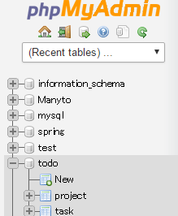

Database name
application.properties
spring.datasource.driverClassName=com.mysql.jdbc.Driver
spring.datasource.url=jdbc:mysql://192.168.33.10:3306/todo?useUnicode=true&characterEncoding=UTF-8
spring.datasource.username=root
spring.datasource.password=manager
spring.jpa.database=MYSQL
spring.jpa.show-sql=true
spring.jpa.hibernate.dialect=org.hibernate.dialect.MySQL5Dialect
spring.thymeleaf.mode=LEGACYHTML5
spring.thymeleaf.cache=false
spring.thymeleaf.encoding=UTF-8

Slide 3
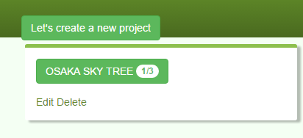
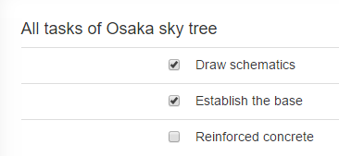
Application VIEW
Project
Task

Slide 4
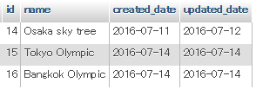
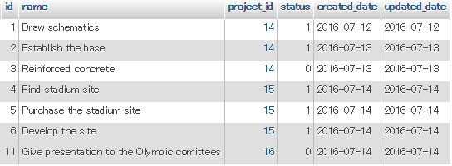
MySQL VIEW
Project table
Task table

Slide 5
@Table(name= "project")
public class Project {
@GeneratedValue
@Id
private int id;
@NotEmpty
private String name;
@OneToMany(mappedBy = "project”)
private List<Task> taskList;
private Date createdDate;
private Date updatedDate;
}
@Table(name= "task")
public class Task {
@GeneratedValue
@Id
private int id;
@ManyToOne
@JoinColumn(name = "project_id")
private Project project;
@NotEmpty
private String name;
@NotNull
private boolean status;
private Date createdDate;
private Date updatedDate;
}
1
*
Project
PK | id
Task
PK | id
FK | project_id
PK: primary key
FK: foreign key
Project class
Task class
Project VIEW

Slide 6
@Table(name= "project")
public class Project {
@GeneratedValue
@Id
private int id;
@NotEmpty
private String name;
@OneToMany(mappedBy = "project”)
private List<Task> taskList;
private Date createdDate;
private Date updatedDate;
}
@Table(name= "task")
public class Task {
@GeneratedValue
@Id
private int id;
@ManyToOne
@JoinColumn(name = "project_id")
private Project project;
@NotEmpty
private String name;
@NotNull
private boolean status;
private Date createdDate;
private Date updatedDate;
}
1
*
Project
PK | id
Task
PK | id
FK | project_id
PK: primary key
FK: foreign key

Slide 7
Important points
@Table(name= "project")
specify a table name mapped to the entity. If @Table is not defined, the default values is used which is the entity class name.
@NotEmpty Null and “” will be an error.
One-To-Many Mapping
@OneToMany(mappedBy = "project", cascade = CascadeType.ALL)
private List<Task> taskList;
Project entity has a reference to List<Task>, as one project can have many tasks. Task entity has a reference to Project. In order to make Project to Task One-to-Many, put @OneToMany annotation over List<Task>. This signifies that one project can have many tasks. On Task side, @ManyToOne should be put over Project reference. This signifies that many tasks belong to one project. Since “project_id” has to be made foreign key in Task table. Put @JoinColumn annotation over Project property in Task entity and provide the name of the column which will hold project_id values in Task table as foreign key.
@ManyToOne
@JoinColumn(name = "project_id")
private Project project;

Slide 8
Important point: mappedBy
Each project can have zero to many tasks, and if each task has project information, you will know which project each task belongs to. To know where each task is coming from, add a foreign key to task table
[Task]
int id 3
String name prep
Project project
[Project]
int id 1
String name visiting customer
List<Task> taskList
1 project_id as foreign key
One-To-Many Mapping
@OneToMany(mappedBy = "project", cascade = CascadeType.ALL)
private List<Task> taskList;
@ManyToOne
@JoinColumn(name = "project_id")
private Project project;
Unlike One-to-One and Many-to-Many, in One-to-Many/Many-to-One case, “mappedBy” has to be put on One-to-Many side and indicate Many side.

Slide 9
Important point: mappedBy attribute
1
*
Project
PK | id
Task
PK | id
FK | project_id
non-owner will let the owner decide
owner: owner will decide which table to join
@ManyToOne should be defined on the owner entity class.
If @JoinColumn is not defined, the name is composed of the name of relationship property in the entity( in this case “project”) + an underscore + the name of PK on the other field.
In this way, the name would be “project_id”. @JoinColumn should be defined on the ManyToOne attribute side.
@ManyToOne
@JoinColumn(name = “project_id”)
private Project project;

Slide 10
Important point: cascade attribute
Common way to use cascade is Parent and Child association like a One-To-Many and a Many-To-One relationship in which the cascade should be used for the One-To-Many side.
1
*
Project
PK | id
Task
PK | id
FK | project_id
With cascade, parent operation is transmitted to its child. If a project id is removed, FK(project_id) is no longer needed.
@OneToMany(mappedBy = "project", cascade = CascadeType.ALL)
private List<Task> taskList;
Cascade Types: MERGE, PERSIST, REFRESH, REMOVE and ALL. ALL is applied for all types.

Slide 11
1. Non-owner indicates the owner by “mappedBy”.(mappedBy=“project”)
2. mappedBy designates non-owner property or field name which the owner refers to.
3. In OneToMany/ManyToOne relationship, mappedBy can not be used in ManyToOne side.
4. Owner side decides which table to have relationship with, and non-owner leaves the owner to decide the relationship by using “mappedBy”
“mappedBy”.(mappedBy=“project”)
List<Task> taskList; Project project;
Project
id | PK
Task
id | PK
project_id | FK
Eventually, this means that the foreign key in Branch side is used to search with each other.

Slide 12

Your Idea Leads Your Ideals
homepage: http://arms-asia.com/
facebook: https://www.facebook.com/arms.asia?fref=ts
Notes:
If you follow document, next class is very easy

