Slide 1


Create to-do app called Indivilister with SPRING BOOT
Presented by ARMS（THAILAND）Co., Ltd.
Notes:
17/04/19

Slide 2
Index
Practical Web Development with Spring Boot
Create Indivilister
Start creating a project
  1-1. Start Project(5th class)
User thymeleaf to create view
  2-1. Create view
  2-2. Apply Bootstrap and jQuery
3. Create Indivilister’s projects
  3-1. Create a project
  3-2. Create edit a project(6th class)
  3-3. Create delete a project
4. Create Indivilister’s tasks
  4-1. Create a task
  4-2. Create edit a task
  4-3. Create delete a task
  4-4. Count tasks
  4-5. Appendix
Notes:
17/04/19

Slide 3
Note
Practical Web Development with Spring Boot
Create Indivilister
Indivilister means "Individual + lister“
Notes:
17/04/19

Slide 4
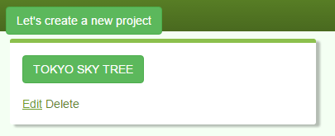
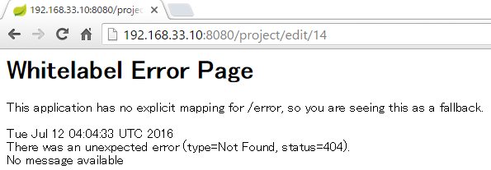
3. Create Indivilister’s projects
Practical Web Development with Spring Boot
Create Indivilister
3-2. Create edit a project
In this section, create “edit a project”
When you click “Edit” button on your project, you see the error above.
<a th:href="'/project/edit/' + ${project.id}">Edit</a>
When you edit a project, you need its unique id.
Notes:
17/04/19

Slide 5
3. Create Indivilister’s projects
Practical Web Development with Spring Boot
Create Indivilister
3-2. Create edit a project
Add the following code into ProjectController.java
edit button <a th:href="'/project/edit/' + ${project.id}">Edit</a>
@RequestMapping(value = "edit/{id}", method = RequestMethod.GET)
public String edit(@PathVariable("id") int id, Model model) {
model.addAttribute("projectForm", projectService.findProjectById(id));
return "project/edit";
}
@PathVariable can receive a parameter from URL and use it in the method.
We haven’t created this projectService.findProjectById(id) method
Notes:
17/04/19

Slide 6
3. Create Indivilister’s projects
Practical Web Development with Spring Boot
Create Indivilister
3-2. Create edit a project
Add the following code into ProjectService.java
public ProjectForm findProjectById(int id) {
Project project = projectRepository.findOne(id);
return new ProjectForm(project.getId(), project.getName());
}
No findOne() method is created in ProjectRepository, but you can already use it.
Find a project by its id, and store it “project”, when this method returns ProjectForm, it calls ProjectForm(arg1, arg2) constructor.
ProjectForm.java
public ProjectForm(int id, String name) {
this.id = id;
this.name = name;
}
Notes:
17/04/19

Slide 7
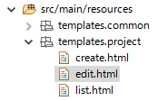
3. Create Indivilister’s projects
Practical Web Development with Spring Boot
Create Indivilister
3-2. Create edit a project
From this code, you need “edit.html”
@RequestMapping(value = "edit/{id}", method = RequestMethod.GET)
public String edit(@PathVariable("id") int id, Model model) {
model.addAttribute("projectForm", projectService.findProjectById(id));
return "project/edit";
}
Create edit.html under templates.project
Notes:
17/04/19

Slide 8
3. Create Indivilister’s projects
Practical Web Development with Spring Boot
Create Indivilister
3-2. Create edit a project
Add the following code into edit.html
<html xmlns="http://www.w3.org/1999/xhtml"
xmlns:th="http://www.thymeleaf.org">
<head>
<meta http-equiv="Content-Type" content="text/html; charset=UTF-8">
<title>INDIVILISTER : Edit an Project</title>
<meta name="viewport" content="width=device-width, initial-scale=1">
<link rel="stylesheet" type="text/css" href="/css/bootstrap.min.css" charset="utf-8">
<link rel="stylesheet" type="text/css" href="/css/custom.css" charset="utf-8">
</head>
<body>
<main>
<!-- START Navigation bar -->
<nav th:include="common/nav :: nav"></nav>
<!-- END Navigation bar -->
<!-- START Header -->
<div class="header-custom">
<div class="container">
<h2>Edit Project</h2>
<p>Edit your Project name</p>
</div>
</div>
<!-- END Header -->
Continue on next page
Notes:
17/04/19

Slide 9
3. Create Indivilister’s projects
Practical Web Development with Spring Boot
Create Indivilister
3-2. Create edit a project
Add the following code into edit.html
<!-- START Content -->
<div class="container">
<div class="row">
<div class="col-lg-12">
<div class="box effect1">
<h4>Edit Project</h4>
<form th:action="@{/project/edit}" method="POST" th:object="${projectForm}" accept-charset="utf-8" enctype="application/x-www-form-urlencoded" class="form-horizontal">
<input type="hidden" name="authenticityToken" value="e739540dfb2b4389d499e26e8b6dc17f665de703">
<input type="text" th:field="*{id}" hidden="">
<div class="form-group">
<label for="name" class="col-lg-2 control-label">Project name:</label>
<div class="col-lg-10">
<input class="form-control" th:field="*{name}" id="name" type="text" name="name" required="">
</div>
</div>
<div class="form-group">
<div class="col-lg-offset-2 col-lg-10">
<button type="submit" class="btn btn-success">Edit</button>
<button type="reset" class="btn btn-danger">Reset</button>
<a th:href="@{/project}" class="btn btn-primary">Back to Home</a>
</div>
</div>
</form>
Continue on next page
Notes:
17/04/19

Slide 10
3. Create Indivilister’s projects
Practical Web Development with Spring Boot
Create Indivilister
3-2. Create edit a project
Add the following code into edit.html
</div>
</div>
</div>
</div>
<!-- END Content -->
<div class="push"></div>
</main>
<!-- START Footer -->
<span th:include="common/footer :: footer"></span>
<!-- START Footer -->
<script type="text/javascript" language="javascript" charset="_charset" src="/js/jquery-1.12.2.min.js"></script>
<script type="text/javascript" language="javascript" charset="_charset" src="/js/bootstrap.min.js"></script>
</body>
</html>
Notes:
17/04/19

Slide 11
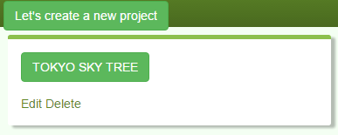
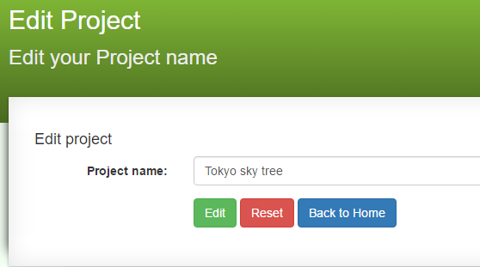
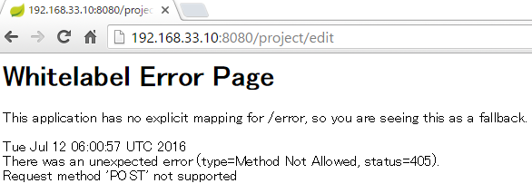
3. Create Indivilister’s projects
Practical Web Development with Spring Boot
Create Indivilister
3-2. Create edit a project
Restart your project and access server:8080/project
As you click Edit button, you will see the screen like below.
But if you click other “Edit” button,
you will see the error.
Notes:
17/04/19

Slide 12
3. Create Indivilister’s projects
Practical Web Development with Spring Boot
Create Indivilister
3-2. Create edit a project
Add the following code into ProjectController.java
<form th:action="@{/project/edit}" method="POST" th:object="${projectForm}"
@RequestMapping(value = "edit", method = RequestMethod.POST)
public Object edit(@ModelAttribute ProjectForm projectForm) {
projectService.update(projectForm);
return "redirect:/project";
}
But we haven’t created projectService.update(projectForm) method
Notes:
17/04/19

Slide 13
3. Create Indivilister’s projects
Practical Web Development with Spring Boot
Create Indivilister
3-2. Create edit a project
Add the following code into ProjectService.java
public void update(ProjectForm projectForm) {
Project project = projectRepository.findOne(projectForm.getId());
project.setName(projectForm.getName());
project.setUpdatedDate(Calendar.getInstance().getTime());
projectRepository.save(project);
}
Repository.save() method is a dual purposed method. Spring decides if this is inserted or updated. Spring checks @id(id property) of the entity to find out if the entity is new one or not. If the id property is null, the entity will be treated as new(insert), else not new(update)
Notes:
17/04/19
<number> Without this projectRepository.save(project); it can be saved.

Slide 14
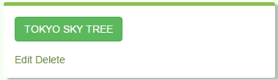
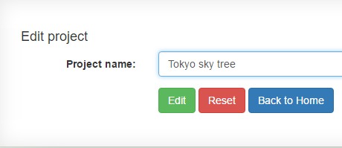
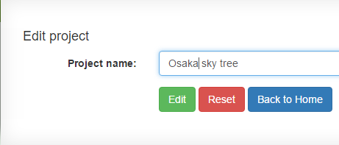
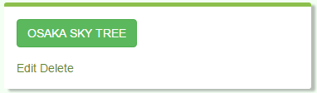
3. Create Indivilister’s projects
Practical Web Development with Spring Boot
Create Indivilister
3-2. Create edit a project
Restart your project and access server:8080/project
Edit and update your project to see if it’s properly updated.
Notes:
17/04/19
<number> UPDATE `todo`.`project` SET `updated_date` = '2016-07-03' WHERE `project`.`id` =14;
Change updated_data to old data, and see if it’s updated

Slide 15
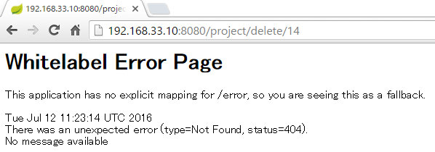
3. Create Indivilister’s projects
Practical Web Development with Spring Boot
Create Indivilister
3-3. Create delete a project
In this section, Create delete a project
As you delete your project, you will see the error like the above.
<a th:href="'/project/delete/' + ${project.id}"
Notes:
17/04/19

Slide 16
3. Create Indivilister’s projects
Practical Web Development with Spring Boot
Create Indivilister
3-3. Create delete a project
Add the following code into ProjectController.java
<a th:href="'/project/delete/' + ${project.id}"
@RequestMapping(value = "delete/{id}", method = RequestMethod.GET)
public String delete(@PathVariable("id") int projectId) {
projectService.delete(projectId);
return "redirect:/project";
}
@PathVariable receives {id} from URL, and the id goes to an argument for the delete() method.
But we haven’t created projectService.delete(projectId)
Notes:
17/04/19

Slide 17
3. Create Indivilister’s projects
Practical Web Development with Spring Boot
Create Indivilister
3-3. Create delete a project
Add the following code into ProjectService.java
public void delete(int projectId) {
projectRepository.delete(projectId);
}
No delete method is defined in ProjectRepository…, but you can also use this method.
Notes:
17/04/19

Slide 18
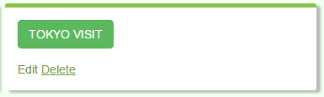
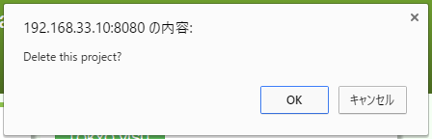
3. Create Indivilister’s projects
Practical Web Development with Spring Boot
Create Indivilister
3-3. Create delete a project
Restart your project and access server:8080/project
Check if delete function is properly working.
Notes:
17/04/19

Slide 19
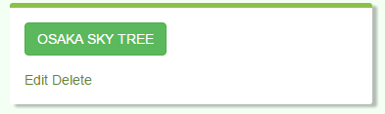
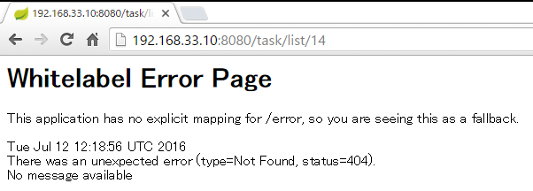
4. Create Indivilister’s tasks
Practical Web Development with Spring Boot
Create Indivilister
4-1. Create a task
In this chapter, we create tasks in a project.
As you click “project name” button to create tasks, you will see the error like the above.
<a th:href="'/task/list/' + ${project.id}" class="btn btn-success">
<span th:text="${project.name}">project0001</span>
</a>
Notes:
17/04/19

Slide 20

4. Create Indivilister’s tasks
Practical Web Development with Spring Boot
Create Indivilister
4-1. Create a task
Create a form object to receive data from text field. TaskForm.java under com.arms.app.task
Add the following code into TaskForm.java
package com.arms.app.task;
import lombok.Data;
@Data
public class TaskForm {
private int id;
private String name;
private int projectId;
}
Notes:
17/04/19

Slide 21

4. Create Indivilister’s tasks
Practical Web Development with Spring Boot
Create Indivilister
4-1. Create a task
Create TaskController.java under com.arms.app.task
Add the following code into TaskController.java
package com.arms.app.task;
import com.arms.domain.service.TaskService;
import org.springframework.beans.factory.annotation.Autowired;
import org.springframework.stereotype.Controller;
import org.springframework.ui.Model;
import org.springframework.web.bind.annotation.ModelAttribute;
import org.springframework.web.bind.annotation.PathVariable;
import org.springframework.web.bind.annotation.RequestMapping;
import org.springframework.web.bind.annotation.RequestMethod;
@Controller
@RequestMapping("task")
public class TaskController {
Continue on next page
Notes:
17/04/19

Slide 22
4. Create Indivilister’s tasks
Practical Web Development with Spring Boot
Create Indivilister
4-1. Create a task
Add the following code into TaskController.java
@Autowired
TaskService taskService;
@RequestMapping(value = "list/{project_id}", method = RequestMethod.GET)
public String list(@PathVariable("project_id") int projectId, Model model) {
TaskForm taskForm = new TaskForm();
taskForm.setProjectId(projectId);
model.addAttribute("taskForm", taskForm);
model.addAttribute("project", taskService.findProjectByProjectId(projectId));
return "task/list";
}
}
We haven’t created TaskService yet…..
Notes:
17/04/19

Slide 23

4. Create Indivilister’s tasks
Practical Web Development with Spring Boot
Create Indivilister
4-1. Create a task
Create TaskService.java under com.arms.domain.service
Add the following code into TaskService.java so that you can use it from the controller.
package com.arms.domain.service;
import com.arms.app.task.TaskForm;
import com.arms.domain.entity.Project;
import com.arms.domain.entity.Task;
import com.arms.domain.repository.ProjectRepository;
import com.arms.domain.repository.TaskRepository;
import org.springframework.beans.factory.annotation.Autowired;
import org.springframework.stereotype.Service;
import java.util.Calendar;
import java.util.Date;
@Service
public class TaskService {
Notes:
17/04/19

Slide 24
4. Create Indivilister’s tasks
Practical Web Development with Spring Boot
Create Indivilister
4-1. Create a task
Add the following code into TaskService.java
@Autowired
ProjectRepository projectRepository;
@Autowired
TaskRepository taskRepository;
public Project findProjectByProjectId(int projectId) {
return projectRepository.findOne(projectId);
}
}
Tasks should be found by project id since many tasks belong to one project. You have to be able to access Project field as well as Task field. So both Task and ProjectRepository should be annotated with @Autowired.
Notes:
17/04/19

Slide 25
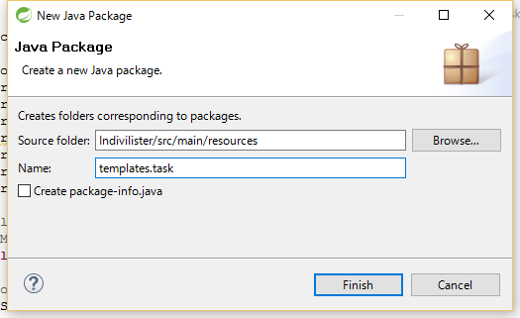
4. Create Indivilister’s tasks
Practical Web Development with Spring Boot
Create Indivilister
4-1. Create a task
Create task/list.html under templates.task
@RequestMapping(value = "list/{project_id}", method = RequestMethod.GET)
public String list(@PathVariable("project_id") int projectId, Model model) {
...............................
return "task/list";
}
As you see list() method, this returns the view task/list.html
Right-click on “src/main/resources” New – Package
Type templates.task in the Name field.
and press Finish button.
Notes:
17/04/19

Slide 26
4. Create Indivilister’s tasks
Practical Web Development with Spring Boot
Create Indivilister
4-1. Create a task
Right-click on templates.task New – File
and create list.html. Add the following code into list.html
<!DOCTYPE html>
<html xmlns="http://www.w3.org/1999/xhtml"
xmlns:th="http://www.thymeleaf.org">
<head>
<meta http-equiv="Content-Type" content="text/html; charset=UTF-8">
<title>INDIVILISTER : project0001</title>
<meta name="viewport" content="width=device-width, initial-scale=1">
<link rel="stylesheet" type="text/css" href="/css/bootstrap.min.css" charset="utf-8">
<link rel="stylesheet" type="text/css" href="/css/custom.css" charset="utf-8">
</head>
<body>
<main>
<!-- START Navigation bar -->
<nav th:include="common/nav :: nav"></nav>
<!-- END Navigation bar -->
<!-- START Header -->
<div class="header-custom">
<div class="container">
<h2>project0001</h2>
<p></p>
</div>
</div>
<!-- END Header -->
Continue on next page
Notes:
17/04/19

Slide 27
4. Create Indivilister’s tasks
Practical Web Development with Spring Boot
Create Indivilister
4-1. Create a task
Add the following code into list.html
<!-- START Content -->
<div class="container">
<div class="row">
<div class="col-xs-12">
<div class="box effect1">
<h4 th:text="'All tasks of ' + ${project.name}">All tasks of xxxx</h4>
<div class="table-responsive">
<table class="table">
<tbody>
<tr th:each="task, stat : ${project.taskList}">
<td class="col-lg-2" style="text-align: right">
<input type="checkbox" class="task-status" th:data="${task.id}" th:checked="${task.status}? 'true' : 'false'">
</td>
<td class="col-lg-8" th:text="${task.name}">task001</td>
<td class="col-lg-2">
<a th:href="'/task/delete/' + ${project.id} + '/' + ${task.id}" onclick="return confirm('Delete this task?');">Delete</a>
</td>
</tr>
</tbody>
</table>
</div>
</div>
</div>
</div>
Continue on next page
Notes:
17/04/19

Slide 28
4. Create Indivilister’s tasks
Practical Web Development with Spring Boot
Create Indivilister
4-1. Create a task
Add the following code into list.html
<div class="row">
<div class="col-xs-12">
<div class="box effect1">
<h4 th:text="'Add a new task for ' + ${project.name}">Add a new task for project0001</h4>
<form th:action="@{/task/create}" th:object="${taskForm}" method="POST" accept-charset="utf-8" enctype="application/x-www-form-urlencoded" class="form-horizontal">
<input type="hidden" name="authenticityToken" value="e739540dfb2b4389d499e26e8b6dc17f665de703">
<input type="text" id="project-id" th:field="*{projectId}" type="hidden">
<div class="form-group">
<label for="newTask" class="col-lg-2 control-label">New task:</label>
<div class="col-lg-10">
<input class="form-control" th:field="*{name}" id="newTask" type="text" name="newTask">
</div>
</div>
<div class="form-group">
<div class="col-lg-offset-2 col-lg-10">
<button type="submit" class="btn btn-success">Create a new task</button>
<button type="reset" class="btn btn-danger">Reset</button>
<a href="/project/" class="btn btn-primary">Back to Home</a>
</div>
</div>
</form>
Continue on next page
Notes:
17/04/19

Slide 29
4. Create Indivilister’s tasks
Practical Web Development with Spring Boot
Create Indivilister
4-1. Create a task
Add the following code into list.html
</div>
</div>
</div>
</div>
<!-- END Content -->
<div class="push"></div>
</main>
<!-- START Footer -->
<span th:include="common/footer :: footer"></span>
<!-- START Footer -->
<script type="text/javascript" language="javascript" charset="_charset" src="/js/jquery-1.12.2.min.js"></script>
<script type="text/javascript" language="javascript" charset="_charset" src="/js/bootstrap.min.js"></script>
<script type="text/javascript">
$(document).ready(function(){
$('.task-status').on('click',function(){
var status = $(this).prop('checked');
window.location.href = '/task/edit/' + $(this).attr('data') + '/' + status
});
});
</script>
</body>
</html>
Notes:
17/04/19

Slide 30
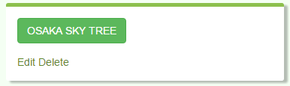
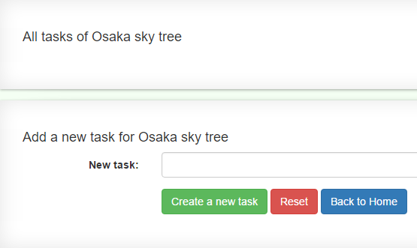
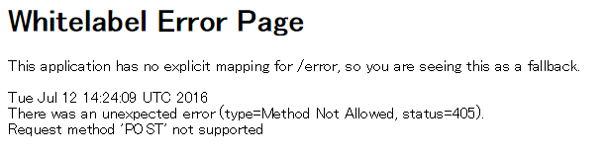
4. Create Indivilister’s tasks
Practical Web Development with Spring Boot
Create Indivilister
4-1. Create a task
Restart your project and access server:8080/project
Click “project name” button to move to the task creation screen
But…if you create a new task, you will see the error.
Notes:
17/04/19

Slide 31
4. Create Indivilister’s tasks
Practical Web Development with Spring Boot
Create Indivilister
4-1. Create a task
Create a method corresponding to this action
<form th:action="@{/task/create}" th:object="${taskForm}" method="POST"
Add the following code into TaskController.java
@RequestMapping(value = "create", method = RequestMethod.POST)
public String create(@ModelAttribute TaskForm taskForm) {
taskService.save(taskForm);
return "redirect:/task/list/" + taskForm.getProjectId();
}
We haven’t created save() method in TaskService.java
Notes:
17/04/19

Slide 32
4. Create Indivilister’s tasks
Practical Web Development with Spring Boot
Create Indivilister
4-1. Create a task
Add the following code into TaskService.java
public void save(TaskForm taskForm) {
Date date = Calendar.getInstance().getTime();
Task task = new Task();
task.setName(taskForm.getName());
task.setProject(projectRepository.findOne(taskForm.getProjectId()));
task.setStatus(false);
task.setCreatedDate(date);
task.setUpdateDate(date);
taskRepository.save(task);
}
This process is almost the same as save(project).
private boolean status (Task.java)
task.setStatus(false); (task.status = false;)
status field is boolean (true/false) . This field is linked to the checkbox of each task.
Notes:
17/04/19

Slide 33
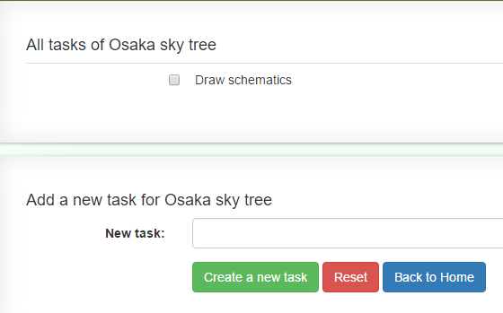

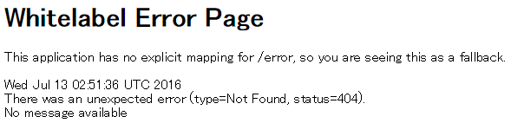
4. Create Indivilister’s tasks
Practical Web Development with Spring Boot
Create Indivilister
4-1. Create a task
Restart your project and access server:8080/project
Now you can create a new task.
But… as you make the checkbox checked, you will see the error.
Notes:
17/04/19

Slide 34
4. Create Indivilister’s tasks
Practical Web Development with Spring Boot
Create Indivilister
4-2. Create edit a task
Let us see what’ happening in the checkbox.
<tr th:each="task, stat : ${project.taskList}">
<td class="col-lg-2" style="text-align: right">
<input type="checkbox" class="task-status" th:data="${task.id}" th:checked="${task.status}? 'true' : 'false'">
</td>
<td class="col-lg-8" th:text="${task.name}">task001</td>
${project.taskList}
@OneToMany(mappedBy = "project", cascade = CascadeType.ALL)
private List<Task> taskList;
@ManyToOne
@JoinColumn(name = "project_id")
private Project project;
Thanks to this relation, you can access Task from Project such as id, status and name.
Notes:
17/04/19

Slide 35
4. Create Indivilister’s tasks
Practical Web Development with Spring Boot
Create Indivilister
4-2. Create edit a task
Let us see what’ happening in the checkbox.
<script type="text/javascript">
$(document).ready(function(){
$('.task-status').on('click',function(){
var status = $(this).prop('checked');
window.location.href = '/task/edit/' + $(this).attr('data') + '/' + status
});
});
</script>
$(document).ready(function(){
When finished loading html
Execute ………………
});
window.location.href = PATH
Move to the URL PATH
$('.task-status').on('click',function(){
var status = $(this).prop('checked');
window.location.href = '/task/edit/' + $(this).attr('data') + '/' + status
});
When task-status is clicked
status = $(.task-status).prop(true); →checked=true unchecked=false
window.location.href = /task/edit/task.id/status”
So…we need a controller method to respond to this URL request.
Notes:
17/04/19

Slide 36
4. Create Indivilister’s tasks
Practical Web Development with Spring Boot
Create Indivilister
4-2. Create edit a task
Add the following code into TaskController.java
@RequestMapping(value = "edit/{task_id}/{status}", method = RequestMethod.GET)
public String edit(@PathVariable("task_id") int taskId, @PathVariable("status") boolean status) {
taskService.update4Status(taskId, status);
return "redirect:/task/list/" + taskService.findProjectByTaskId(taskId).getId();
}
Receive taskId and status from URL, update Task DB, and then
redirected to the same page with the same project.
But… we haven’t created updated4Status and findProjectByTaskId method yet.
Notes:
17/04/19

Slide 37
4. Create Indivilister’s tasks
Practical Web Development with Spring Boot
Create Indivilister
4-2. Create edit a task
Add the following code into TaskService.java
public void update4Status(int taskId, boolean status) {
Task task = taskRepository.findOne(taskId);
task.setStatus(status);
taskRepository.save(task);
}
Find one task by taskId and update status field(true/false) ---- checkbox
Continue on next page
Notes:
17/04/19

Slide 38
4. Create Indivilister’s tasks
Practical Web Development with Spring Boot
Create Indivilister
4-2. Create edit a task
Add the following code into TaskService.java
public Project findProjectByTaskId(int taskId) {
Task task = taskRepository.findOne(taskId);
return task.getProject();
}
Find one task by taskId and update status field(true/false) ---- checkbox
Again, thanks to this relation, you can access Project from Task, and return project.
@ManyToOne
@JoinColumn(name = "project_id")
private Project project;
@RequestMapping(value = "edit/{task_id}/{status}", method = RequestMethod.GET)
public String edit(@PathVariable("task_id") int taskId, @PathVariable("status") boolean status) {
taskService.update4Status(taskId, status);
return "redirect:/task/list/" + taskService.findProjectByTaskId(taskId).getId();
}
Finally this part turns project Id --- /task/list/projectId
Notes:
17/04/19

Slide 39
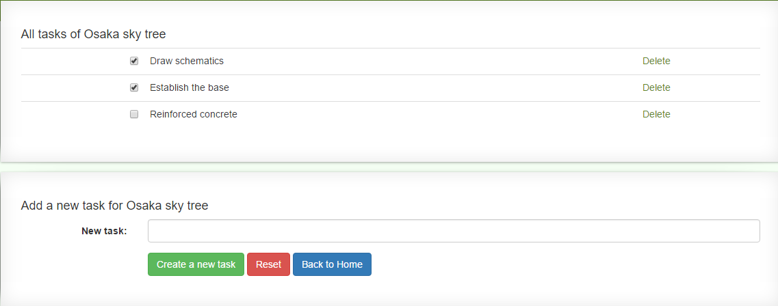
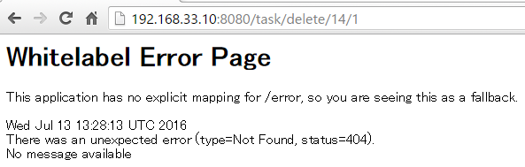

4. Create Indivilister’s tasks
Practical Web Development with Spring Boot
Create Indivilister
4-2. Create edit a task
Restart your project and access server:8080/project
Create projects and make the checkbox checked.
But… if you delete a task, the error occurs.
Notes:
17/04/19

Slide 40
4. Create Indivilister’s tasks
Practical Web Development with Spring Boot
Create Indivilister
4-3. Create delete a task
Let’s see “Delete” button code.
<a th:href="'/task/delete/' + ${project.id} + '/' + ${task.id}" onclick="return confirm('Delete this task?');">Delete</a>
A task has to be deleted by project.id and task.id
Add the following code into TaskController.java
@RequestMapping(value = "delete/{project_id}/{task_id}", method = RequestMethod.GET)
public String delete(@PathVariable("project_id") int projectId, @PathVariable("task_id") int taskId) {
taskService.delete(taskId);
return "redirect:/task/list/" + projectId;
}
But… we haven’t created taskService.delete() method
Notes:
17/04/19

Slide 41
4. Create Indivilister’s tasks
Practical Web Development with Spring Boot
Create Indivilister
4-3. Create delete a task
Add the following code into TaskService.java
public void delete(int taskId) {
taskRepository.delete(taskId);
}
No delete() method is created in TaskRepository.java, this is also JpaRepository extended result.
Notes:
17/04/19

Slide 42
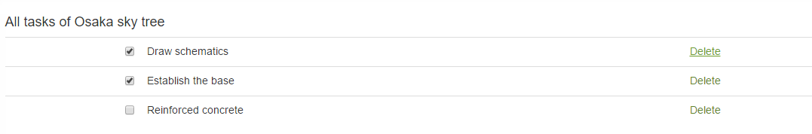
4. Create Indivilister’s tasks
Practical Web Development with Spring Boot
Create Indivilister
4-3. Create delete a task
Restart your project and access server:8080/project, and check if you can delete tasks.
Notes:
17/04/19

Slide 43
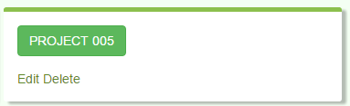
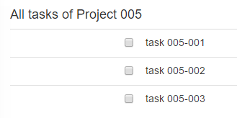
4. Create Indivilister’s tasks
Practical Web Development with Spring Boot
Create Indivilister
4-3. Create delete a task
Delete a project and its task at the same time. When a project is deleted, tasks under the project should also be deleted.
Add the following code into ProjectService.java
@Autowired
ProjectRepository projectRepository;
@Autowired
TaskRepository taskRepository;
Now you have a reference with @Autowired to TaskRepository in ProjectServce.
Continue on next page
Notes:
17/04/19

Slide 44
4. Create Indivilister’s tasks
Practical Web Development with Spring Boot
Create Indivilister
4-3. Create delete a task
Add the following code into delete method() in ProjectService.java
public void delete(int projectId) {
taskRepository.deleteByProjectId(projectId);
projectRepository.delete(projectId);
}
When this method is called from the delete button on a project, it will delete both the project and its tasks.
Notes:
17/04/19

Slide 45
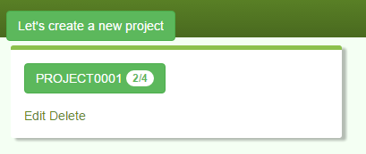
4. Create Indivilister’s tasks
Practical Web Development with Spring Boot
Create Indivilister
4-4. Count task
We will create “count tasks” as below
The number of all tasks in the PROJECT001
The number of remaining tasks in the PROJECT001
project/list.html
<span class="badge" th:text="${projectRemainingTaskMap.get(project.id)} + '/' + ${project.taskList.size()}">1/2</span>
Notes:
17/04/19

Slide 46
4. Create Indivilister’s tasks
Practical Web Development with Spring Boot
Create Indivilister
4-4. Count task
Add the following code into ProjectService.java
public Map<Integer, Integer> calcRemainingTaskNumber(List<Project> projectList) {
Map<Integer, Integer> remainingTaskNumberMap = new HashMap();
for(Project project : projectList) {
int taskCount = 0;
for(Task task : project.getTaskList()) {
if(!task.isStatus()) {
taskCount++;
}
}
remainingTaskNumberMap.put(project.getId(), taskCount);
}
return remainingTaskNumberMap;
}
Notes:
17/04/19

Slide 47
4. Create Indivilister’s tasks
Practical Web Development with Spring Boot
Create Indivilister
4-4. Count task
Let’s understand what’s in this code
java.util.Map → public Map<Integer, Integer>
To store an element in Map(HashMap), put()method in HashMap
put(K key, V value)
Initialize Map object with HashMap and store it in remainingTaskNumberMap
Repeat 1-3 for projectList
1.Get TaskList() and repeat the number of task(s)
2.if(!task.isStatus()) → getter for boolean status field
3. status = false → taskCount = taskCount + 1
remainingTaskNumberMap.put(project.getId(), taskCount);
Store (“project.id as the key”, taskCount as value)
So if you tell the key, you get the value.
In this case, you tell project.id, you will get the number of tasks(taskCount)
public Map<Integer, Integer> calcRemainingTaskNumber(List<Project> projectList) {
Map<Integer, Integer> remainingTaskNumberMap = new HashMap();
for(Project project : projectList) {
int taskCount = 0;
for(Task task : project.getTaskList()) {
if(!task.isStatus()) {
taskCount++;
}
}
remainingTaskNumberMap.put(project.getId(), taskCount);
}
return remainingTaskNumberMap;
}
Notes:
17/04/19

Slide 48
4. Create Indivilister’s tasks
Practical Web Development with Spring Boot
Create Indivilister
4-4. Count task
Add the following code into index() method in ProjectController.java
@RequestMapping(value = "", method = RequestMethod.GET)
public String index(Model model) {
List<Project> projectList = projectService.findAllProject();
model.addAttribute("projectList", projectList);
model.addAttribute("projectRemainingTaskMap", projectService.calcRemainingTaskNumber(projectList));
return "project/list";
}
Remove the <!-- --> from the following code in project/list.html
<span class="badge" th:text="${projectRemainingTaskMap.get(project.id)} + '/' + ${project.taskList.size()}">1/2</span>
Notes:
17/04/19

Slide 49
4. Create Indivilister’s tasks
Practical Web Development with Spring Boot
Create Indivilister
4-4. Count task
Understanding the following code
<span class="badge" th:text="${projectRemainingTaskMap.get(project.id)} + '/' + ${project.taskList.size()}">1/2</span>
remainingTaskNumberMap.put(project.getId(), taskCount);
return remainingTaskNumberMap;
If you tell the key, you will get the value. If you tell project.id, you will get taskCount;
${project.taskList.size()}
size() is the number of elements in collection(List)
Ex. [aaaa, bbbb, cccc, dddd] 4 elements in collection.
Notes:
17/04/19

Slide 50
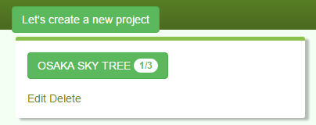
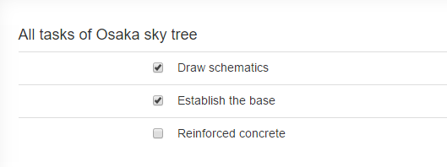
4. Create Indivilister’s tasks
Practical Web Development with Spring Boot
Create Indivilister
4-4. Count task
Restart your project and access server:8080/project
Unfinished task:1 / All tasks:3
In this example:
Check finished task:2
Uncheck unfinished task:1
All tasks:3
**Unfinished task = remaining task
Notes:
17/04/19

Slide 51
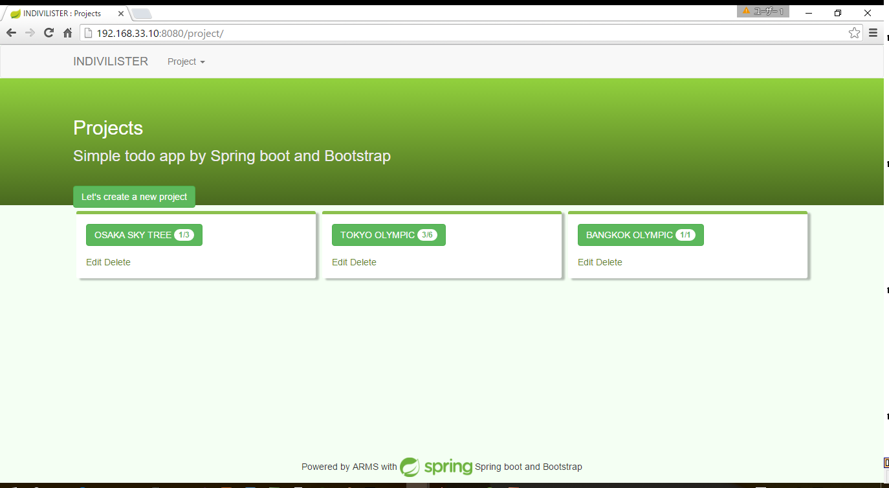
4. Create Indivilister’s tasks
Practical Web Development with Spring Boot
Create Indivilister
4-4. Count task
Complete!
Notes:
17/04/19

Slide 52
4. Create Indivilister’s tasks
Practical Web Development with Spring Boot
Create Indivilister
4-5. Appendix
Differences
 | Null | “” | space
@NotNulll | Error | Pass | Pass
@NotEmpty | Error | Error | Pass
@NotBlank | Error | Error | Error
“”
“ ” space
For NotNull, if you don’t input anything, it will be “”, it can pass validation
Notes:
17/04/19

Slide 53

Your Idea Leads Your Ideals
homepage: http://arms-asia.com/
facebook: https://www.facebook.com/arms.asia?fref=ts
Notes:
17/04/19
If you follow document, next class is very easy

