Slide 1

Creating OneToMany/ManyToOne (6th class)
Presented by ARMS（THAILAND）Co., Ltd.

Slide 2
Index
Practical Web Development with Spring Boot
OneToMany/ManyToOne
Start creating a project
  1-1. Start Project
  1-2. Create packages
Create OneToMany/ManyToOne
  2-1. Create company list
  2-2. Create branch list
  2-3. Create OneToMany/ManyToOne
  2-4. H2 in-memory database

Slide 3
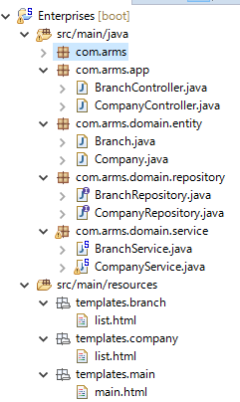
1. Start creating a project
Practical Web Development with Spring Boot
OneToMany/ManyToOne
1-1. Start Project
We will create a project as below
See the left figure and create your project.

Slide 4

1. Start creating a project
Practical Web Development with Spring Boot
OneToMany/ManyToOne
1-1. Start Project
Prepare to use thymeleaf and H2 in-memory database
Open “application.properties”,
and add the following lines
spring.thymeleaf.mode=LEGACYHTML5
spring.thymeleaf.cache=false
spring.thymeleaf.encoding=UTF-8
spring.h2.console.enabled=true
spring.h2.console.path=/console

Slide 5

1. Start creating a project
Practical Web Development with Spring Boot
OneToMany/ManyToOne
1-1. Start Project
Modify or add dependencies in build.gradle
dependencies {
compile('org.springframework.boot:spring-boot-starter-data-jpa')
compile('org.springframework.boot:spring-boot-starter-thymeleaf')
compile('org.projectlombok:lombok:1.16.6')
compile('org.springframework.boot:spring-boot-starter-web')
runtime('com.h2database:h2')
compile('net.sourceforge.nekohtml:nekohtml')
testCompile('org.springframework.boot:spring-boot-starter-test')
}

Slide 6
2. Create OneToMany/ManyToOne
Practical Web Development with Spring Boot
OneToMany/ManyToOne
2-1. Create comapny list
Create Company.java and modify this POJO to make it work for Company list database.
package com.arms.domain.entity;
public class Company {
private int id;
private String name;
}
After that, create
Repository interface,
Service,
Controller,
And company/list.html

Slide 7
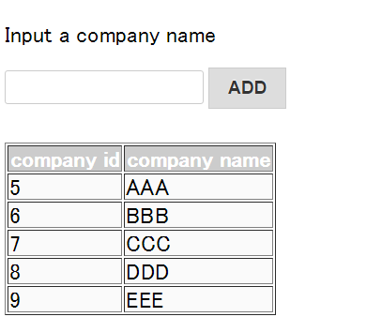
2. Create OneToMany/ManyToOne
Practical Web Development with Spring Boot
OneToMany/ManyToOne
2-2. Create company list
You will have the page as below

Slide 8
2. Create OneToMany/ManyToOne
Practical Web Development with Spring Boot
OneToMany/ManyToOne
2-2. Create branch list
Create Branch.java and modify this POJO to make it work for banch list database.
package com.arms.domain.entity;
public class Branch {
private int branchId;
private String branchName;
}
After that, create
Repository interface,
Service,
Controller,
And branch/list.html

Slide 9
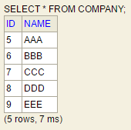
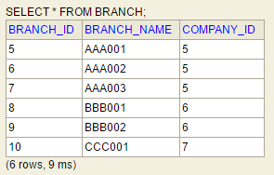
2. Create OneToMany/ManyToOne
Practical Web Development with Spring Boot
OneToMany/ManyToOne
2-3. Create OneToMany/ManyToOne
Create OneToMany/ManyToOne relationship
One company can have many branches. Many branches can belong to one company.
Company
Id | PK
Branch
branchId | PK
company_id | FK
PK: primary key
FK: foreign key
To know which company each task belongs to, this adds COMPANY_ID as a foreign key!!!

Slide 10
2. Create OneToMany/ManyToOne
Practical Web Development with Spring Boot
OneToMany/ManyToOne
2-3. Create OneToMany/ManyToOne
Create OneToMany/ManyToOne relationship
1. Non-owner decides the owner by “mappedBy”.
2. mappedBy designates non-owner property or field name which the owner refers to.
3. In OneToMany/ManyToOne relationship, mappedBy can not be used in ManyToOne side.
Company
Id | PK
Branch
branchId | PK
company_id | FK
PK: primary key
FK: foreign key

Slide 11

Your Idea Leads Your Ideals
homepage: http://arms-asia.com/
facebook: https://www.facebook.com/arms.asia?fref=ts

