Slide 1

Create Emitter (Twitter like app) with SPRING BOOT
Presented by ARMS（THAILAND）Co., Ltd.

Slide 2
Index
Practical Web Development with Spring Boot
Create Emitter
Understanding DI and AOP
  1-1. DI
  1-2. AOP
Create Database for Emitter
  2-1. Create database
  2-2. Import tables into the Emitter database
3. Create Emitter’s project
  3-1. Create a project
  3-2. Application setting and dependencies
  3-3. Spring Security
4. Thymeleaf Layout
  4-1. Create layout pages
5. Create Staticpages
  5-1. Create staticpages
6. Spring Security
  6-1. Change default user
  6-2. Create Signup Page
  6-3. Create SignupController

Slide 3

1. Understanding DI and AOP
Practical Web Development with Spring Boot
Create Emitter
1-1. DI
What is DI?
【DI】 Dependency Injection
DI is one of the software design patterns.
So how to implement DI in Spring?
One of the ways is to use Annotation @autowired
Search a term “Injection” with Google image
What have you got for the result?

Slide 4
1. Understanding DI and AOP
Practical Web Development with Spring Boot
Create Emitter
1-1. DI
What is the difference between application with DI and without DI?
Application without DI
Application with DI
class
class
class
class
class
class
class
class
class
Create an instance to use
get
instance
DI container
Use through DI container and get an instance
Application with DI
Component
class
class
class
injection
DI container

Slide 5
1. Understanding DI and AOP
Practical Web Development with Spring Boot
Create Emitter
1-1. DI
Component
@Component
@Controller, @Service, and @Repository belong to @Component, practically, use each annotation for each layer
@Controller
@Service
@Repository
When you put @Autowired over an instance variable, this will search the corresponding class which has component annotation, and inject the instance.
Component annotation
@Controller
public class ProjectController {
@Autowired
ProjectService projectService
………………………………………….
}
@Service
public class ProjectService {
…………………………
}
Inject the instance new() projectService

Slide 6
1. Understanding DI and AOP
Practical Web Development with Spring Boot
Create Emitter
1-2. AOP
What is AOP?
【AOP】 Aspect Oriented Programming
Is AOP a new concept which makes OOP obsolete?
Answer is No
AOP is something you can use together with OOP.
AOP complements OOP by providing another way.
Write essential code in classes,
Write common code (not essential code) in aspect
In other words, cross-cutting matters over many classes are put into Aspect

Slide 7
1. Understanding DI and AOP
Practical Web Development with Spring Boot
Create Emitter
1-2. AOP
【AOP】 Aspect Oriented Programming
Write essential code in classes,
Write common code (not essential code) in Aspect
What’s in Aspect?
Advice and Pointcut
For the Methods which can meet Pointcut (conditions), Aspect runs Advice (common codes).
In this way, each class only has essential code, and let Aspect handle common codes.
How to implement AOP?
Put @Aspect over the aspect class
Put types of advice over method and write pointcut in ();

Slide 8
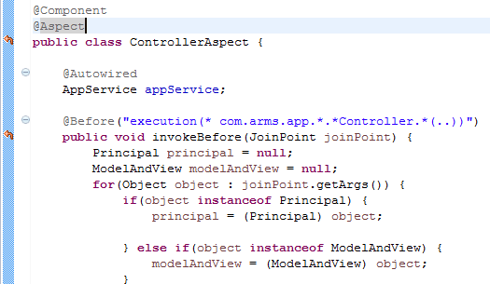
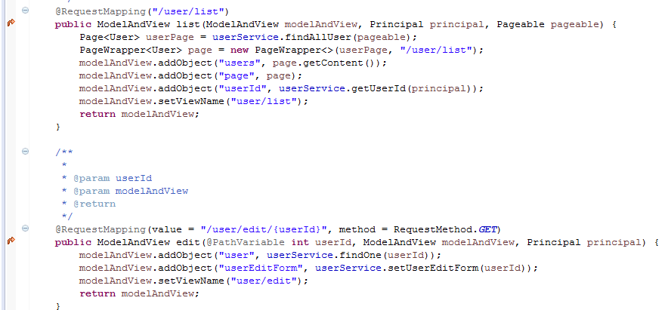
1. Understanding DI and AOP
Practical Web Development with Spring Boot
Create Emitter
1-2. AOP
【AOP】 Aspect Oriented Programming
Type of Advice:
Before, After, Around
Pointcut
Condition to execute

Slide 9
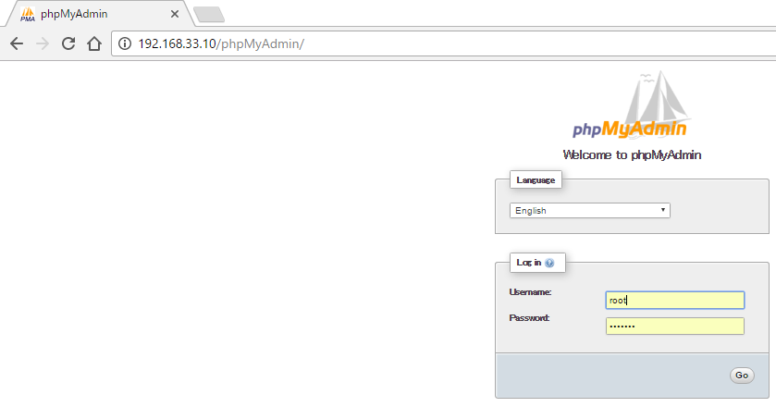
2. Create Database for Emitter
Practical Web Development with Spring Boot
Create Emitter
2-1. Create Database
Open Gitbash and Start CentOS
Run the following command in the gitbash console, and start CentOS
$ cd /d
$ cd springclass
$ vagrant up
Access 192.168.33.10/phpMyAdmin and login

Slide 10
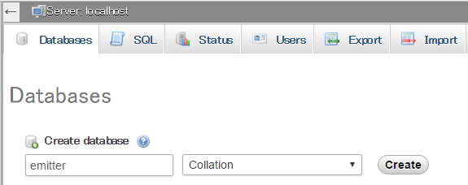
2. Create Database for Emitter
Practical Web Development with Spring Boot
Create Emitter
2-1. Create Database
Click Databases tab and create emitter database
Type emitter in database name and press “Create” button
You have created the database emitter but no tables.

Slide 11
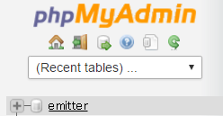
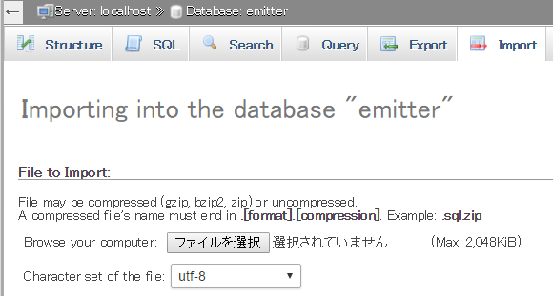
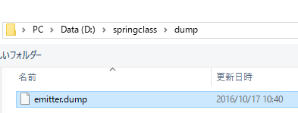

2. Create Database for Emitter
Practical Web Development with Spring Boot
Create Emitter
2-2. Import table into the Emitter Database
Select emitter and click Import tab in phpMyAdmin and import tables into the Emitter Database
Browser your computer for the emitter.dump file, and press “Go” button at the bottom of the Import page

Slide 12
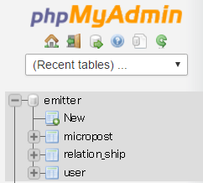
2. Create Database for Emitter
Practical Web Development with Spring Boot
Create Emitter
2-2. Import table into the Emitter Database
You will see three tables are imported into the emitter database
Make sure that you have micropost, relation_ship and user table.

Slide 13
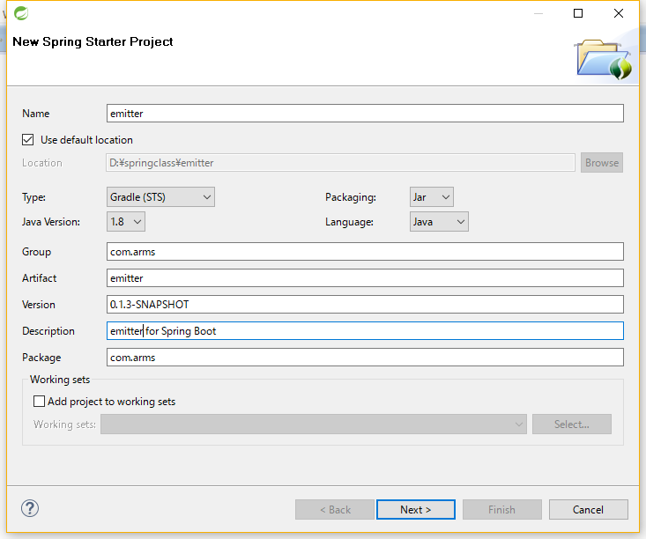
3. Create Emitter’s project
Practical Web Development with Spring Boot
Create Emitter
3-1. Create a project
Open STS – File menu – New – Spring Starter Project
Name: emitter
Group: com.arms
Artifact: emitter
Description:
emitter for Spring Boot
Package: com.arms
Set the above values and click “Next>” button

Slide 14
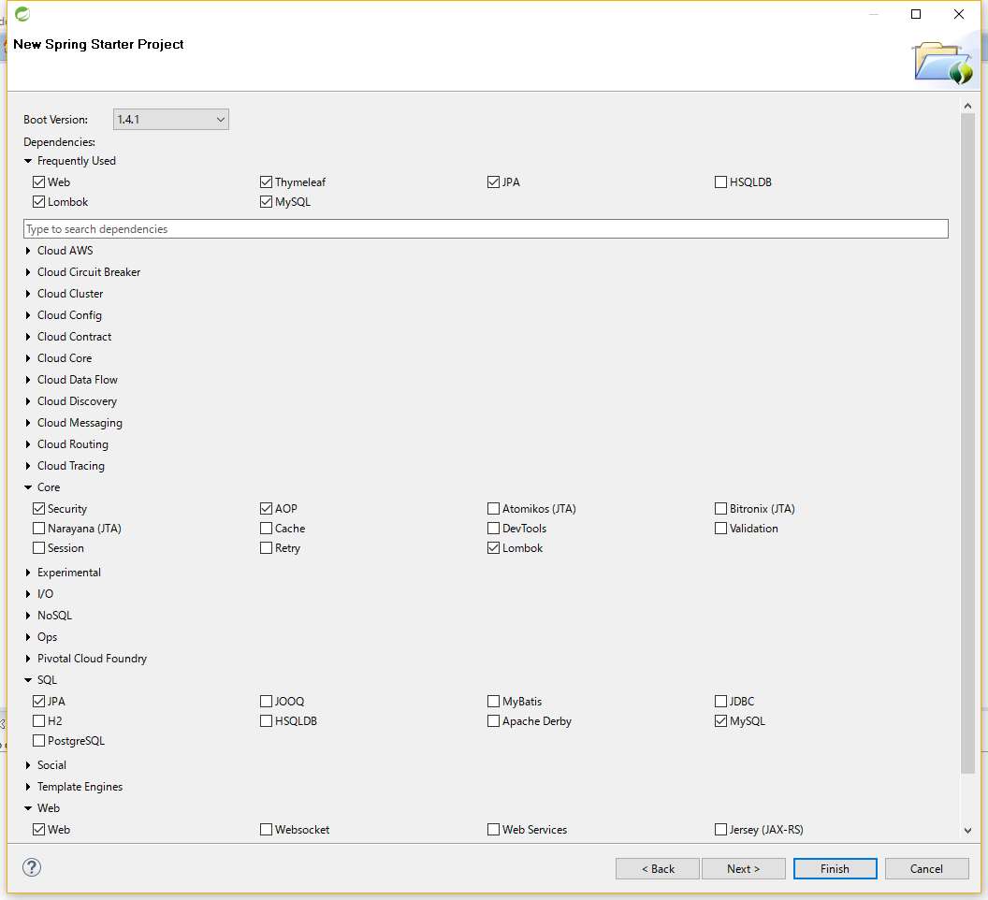
3. Create Emitter’s project
Practical Web Development with Spring Boot
Create Emitter
3-1. Create a project
For Dependencies:
▶ Core
Security, AOP, Lombok
▶ SQL
JPA, MySQL
▶ Web
Web
▶ Template Engines
Thymeleaf
Check the above checkbox and click “Next>” button

Slide 15
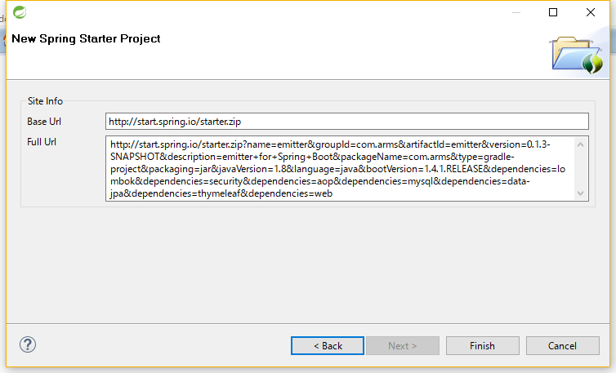
3. Create Emitter’s project
Practical Web Development with Spring Boot
Create Emitter
3-1. Create a project
Click “Finish” button
Wait for a while to finish importing starter.zip

Slide 16
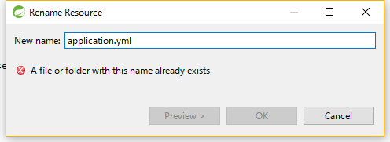
3. Create Emitter’s project
Practical Web Development with Spring Boot
Create Emitter
3-2. Application setting and dependencies
Go to src/main/resources and change the file name of application.properties
Right-click on application.properties and select “Refactor” – “Rename”.
Change the filename to application.yml

Slide 17
3. Create Emitter’s project
Practical Web Development with Spring Boot
Create Emitter
3-2. Application setting and dependencies
Create two profiles in application.yml
Add the following setting to application.yml
spring.profiles.active: mickey
---
spring:
profiles: local
datasource:
driverClassName: com.mysql.jdbc.Driver
url: jdbc:mysql://localhost:3306/emitter?useUnicode=true&characterEncoding=UTF-8
username: root
password: manager
jpa:
database: MYSQL
show-sql: true
hibernate.dialect: org.hibernate.dialect.MySQL5Dialect
thymeleaf:
mode: LEGACYHTML5
cache: false
encoding: UTF-8
---
Continue on next page

Slide 18
3. Create Emitter’s project
Practical Web Development with Spring Boot
Create Emitter
3-2. Application setting and dependencies
Create two profiles in application.yml
Add the following setting to application.yml
spring:
profiles: mickey
datasource:
driverClassName: com.mysql.jdbc.Driver
url: jdbc:mysql://192.168.33.10:3306/emitter?useUnicode=true&characterEncoding=UTF-8
username: root
password: manager
jpa:
database: MYSQL
show-sql: true
hibernate.dialect: org.hibernate.dialect.MySQL5Dialect
thymeleaf:
mode: LEGACYHTML5
cache: false
encoding: UTF-8

Slide 19
3. Create Emitter’s project
Practical Web Development with Spring Boot
Create Emitter
3-2. Application setting and dependencies
You can switch the profiles by changing the spring.profiles.active
This setting is useful when you want to run in two different environments.
Example. For testing use local, for real server, use mickey.
spring.profiles.active: mickey
---
spring:
profiles: local
…………………………………
…………………………………
---
spring:
profiles: mickey
…………………………………
…………………………………
In this case, profile mickey is active
Important : If your port 8080 is already being used by other application,
Set a different server port in application.yml as below,
server:
port: 8090

Slide 20
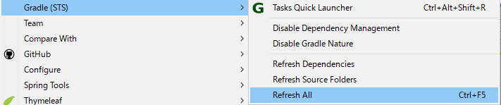
3. Create Emitter’s project
Practical Web Development with Spring Boot
Create Emitter
3-2. Application setting and dependencies
Open build.gradle and add “nekohml” to depedencies
dependencies {
compile('org.springframework.boot:spring-boot-starter-aop')
compile('org.springframework.boot:spring-boot-starter-data-jpa')
compile('org.projectlombok:lombok')
compile('org.springframework.boot:spring-boot-starter-security')
compile('org.springframework.boot:spring-boot-starter-thymeleaf')
compile('org.springframework.boot:spring-boot-starter-web')
runtime('mysql:mysql-connector-java')
testCompile('org.springframework.boot:spring-boot-starter-test')
compile('net.sourceforge.nekohtml:nekohtml')
}
Right-click on your project – Gradle(STS) – Enable Dependency Management
Then Refresh All

Slide 21
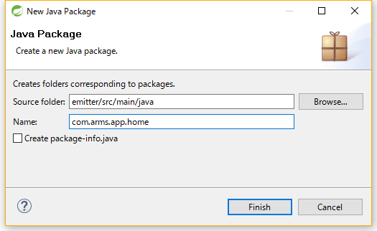

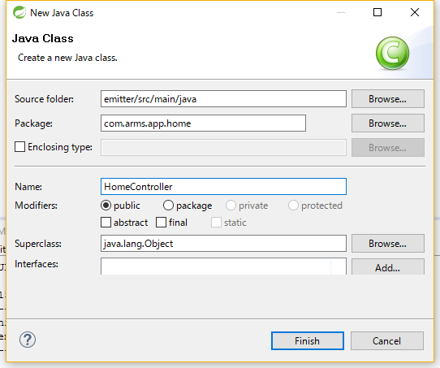

3. Create Emitter’s project
Practical Web Development with Spring Boot
Create Emitter
3-3. Spring Security
Right-click on package com.arms and create com.arms.app.home
Right-click on com.arms.app.home – New – Class ,and create HomeController

Slide 22
3. Create Emitter’s project
Practical Web Development with Spring Boot
Create Emitter
3-3. Spring Security
Add the following code to HomeController
package com.arms.app.home;
import org.springframework.stereotype.Controller;
import org.springframework.web.bind.annotation.RequestMapping;
import org.springframework.web.servlet.ModelAndView;
@Controller
public class HomeController {
@RequestMapping("/")
public ModelAndView home(ModelAndView modelAndView){
modelAndView.setViewName("home/home");
return modelAndView;
}
}

Slide 23
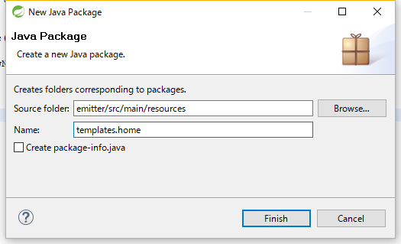


3. Create Emitter’s project
Practical Web Development with Spring Boot
Create Emitter
3-3. Spring Security
Create templates.home package and home.html
Right-click on templates.home – New – file ,and create home.html
Write something in home.html like below,
Security passed

Slide 24
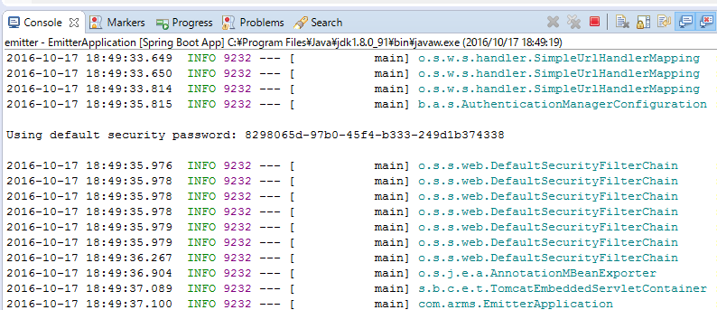
3. Create Emitter’s project
Practical Web Development with Spring Boot
Create Emitter
3-3. Spring Security
Run your application and access ------------:/8080
When you access locahost:8080/, you will see login dialog and can not access the page
Username: user
Password: see the console and copy the password

Slide 25
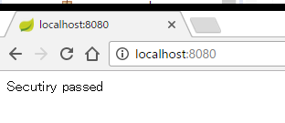
3. Create Emitter’s project
Practical Web Development with Spring Boot
Create Emitter
3-3. Spring Security
If you passed the login, you will see the homepage
You can see Spring Security is already enabled!!!
compile('org.springframework.boot:spring-boot-starter-security')
Note:If you don’t want to use the default user and password, jump to Chapter 6 and set your own user name and password.

Slide 26
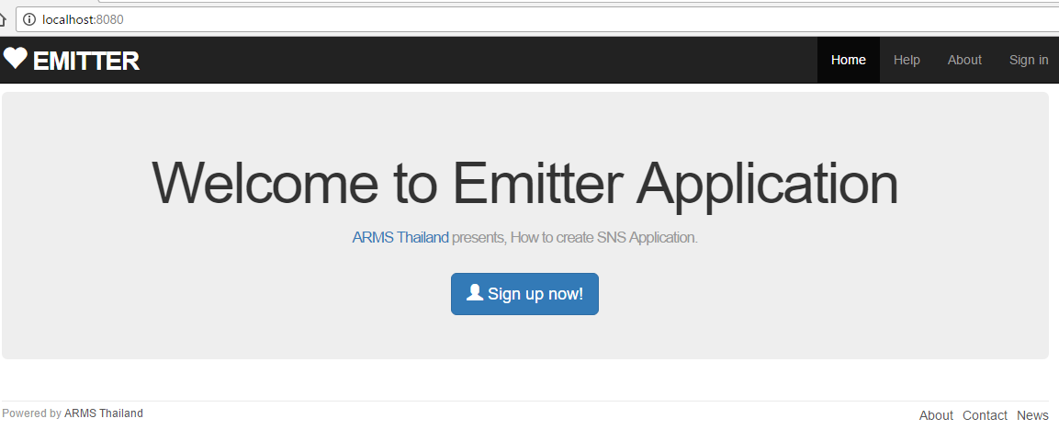
4. Thymeleaf Layout
Practical Web Development with Spring Boot
Create Emitter
4-1. Create layout pages
We will create a layout like below
_header.html
main.html
_footer.html
Other contents will be inserted into main.html

Slide 27


4. Thymeleaf Layout
Practical Web Development with Spring Boot
Create Emitter
4-1. Create layout pages
Create package templates.layout
Create three html files under templates.layout
_footer.html
_header.html
main.html

Slide 28
4. Thymeleaf Layout
Practical Web Development with Spring Boot
Create Emitter
4-1. Create layout pages
Add the following code to main.html
<!DOCTYPE html>
<html xmlns="http://www.w3.org/1999/xhtml"
xmlns:th="http://www.thymeleaf.org"
xmlns:layout="http://www.ultraq.net.nz/thymeleaf/layout">
<head>
<title>Static Pages</title>
<meta charset="utf-8">
<link rel="stylesheet" media="screen" href="/stylesheets/bootstrap.min.css" th:href="@{/stylesheets/bootstrap.min.css}">
<link rel="stylesheet" media="screen" href="/stylesheets/custom.css" th:href="@{/stylesheets/custom.css}">
<link rel="shortcut icon" type="image/png" href="/images/favicon.png" th:href="@{/images/favicon.png}">
<script src="/javascripts/jquery-1.12.2.min.js" th:src="@{/javascripts/jquery-1.12.2.min.js}" type="text/javascript" charset="utf-8"></script>
<script src="/javascripts/bootstrap.min.js" th:src="@{/javascripts/bootstrap.min.js}" type="text/javascript" charset="utf-8"></script>
</head>
Continue on next page

Slide 29
4. Thymeleaf Layout
Practical Web Development with Spring Boot
Create Emitter
4-1. Create layout pages
Add the following code to main.html
<body>
<div th:replace="layout/_header :: header">Header Menu</div>
<div class="container">
<div layout:fragment="content">
<!-- page content goes here -->
</div>
<div th:replace="layout/_footer :: footer">Footer Menu</div>
</div>
</body>
</html>

Slide 30
4. Thymeleaf Layout
Practical Web Development with Spring Boot
Create Emitter
4-1. Create layout pages
Include(relace) _header.html and _footer.html
<div th:replace="layout/_header :: header">Header Menu</div>
<div class="container">
<div layout:fragment="content">
<!-- page content goes here -->
</div>
<div th:replace="layout/_footer :: footer">Footer Menu</div>
main.html
<div th:replace="layout/_header :: header">Header Menu</div>
_header.html
<header th:fragment="header">
th:replace can replace with tag, in this case header tag

Slide 31
4. Thymeleaf Layout
Practical Web Development with Spring Boot
Create Emitter
4-1. Create layout pages
Add the following code to _header.html
<!DOCTYPE html>
<html xmlns="http://www.w3.org/1999/xhtml"
xmlns:th="http://www.thymeleaf.org"
>
<head>
<title>header</title>
</head>
<body>
<header th:fragment="header">
<!-- layout _header.html replaced into main.html -->
<nav class="navbar navbar-inverse navbar-fixed-top">
<div class="container">
<div class="navbar-header">
<button type="button" class="navbar-toggle collapsed" data-toggle="collapse" data-target="#bs-example-navbar-collapse-1" aria-expanded="false">
<span class="sr-only">Toggle navigation</span>
<span class="icon-bar"></span>
<span class="icon-bar"></span>
</button>
<a id="logo" class="navbar-brand" th:href="@{/}">
<span class="glyphicon glyphicon-heart" aria-hidden="true"></span> Emitter</a>
</div>
<div class="collapse navbar-collapse" id="bs-example-navbar-collapse-1">
<ul class="nav navbar-nav navbar-right">
<li class="active"><a th:href="@{/}">Home<span class="sr-only">(current)</span></a></li>
<li><a th:href="@{/help}">Help</a></li>
<li><a th:href="@{/about}">About</a></li>
Continue on next page

Slide 32
4. Thymeleaf Layout
Practical Web Development with Spring Boot
Create Emitter
4-1. Create layout pages
Add the following code to _header.html
<li th:if="${isLogin}"><a th:href="@{/user/list}">Users</a></li>
<li th:if="${isLogin}" class="dropdown">
<a href="#" class="dropdown-toggle" data-toggle="dropdown" role="button" aria-haspopup="true" aria-expanded="false">Account<span class="caret"></span></a>
<ul class="dropdown-menu">
<li><a th:href="@{/user/show/} + ${loginUser.id}">Profile</a></li>
<li><a th:href="@{/user/edit/} + ${loginUser.id}">Settings</a></li>
<li role="separator" class="divider"></li>
<li><a href="/user/logout">Sign out</a></li>
</ul>
</li>
<li th:unless="${isLogin}"><a href="/user/login">Sign in</a></li>
</ul>
</div>
</div>
</nav>
<!-- layout _header.html replaced into main.html END -->
</header>
</body>
</html>

Slide 33
4. Thymeleaf Layout
Practical Web Development with Spring Boot
Create Emitter
4-1. Create layout pages
Add the following code to _footer.html
<!DOCTYPE html>
<html xmlns="http://www.w3.org/1999/xhtml"
xmlns:th="http://www.thymeleaf.org"
>
<head>
<title>footer</title>
</head>
<body>
<footer th:fragment="footer" class="footer">
<!-- layout _footer.html replaced into main.html -->
<div class="row">
<div class="col-xs-6">
<small>
Powered by <a href="http://arms-asia.com/en/">ARMS Thailand</a>
</small>
</div>
<div class="col-xs-6 text-right">
Continue on next page

Slide 34
4. Thymeleaf Layout
Practical Web Development with Spring Boot
Create Emitter
4-1. Create layout pages
Add the following code to _footer.html
<nav>
<ul class="footer-menu">
<li><a th:href="@{/about}">About</a></li>
<li><a th:href="@{/contact}">Contact</a></li>
<li><a href="http://arms-asia.com/en/">News</a></li>
</ul>
</nav>
</div>
</div>
<!-- layout _footer.html replaced into main.html END -->
</footer>
</body>
</html>

Slide 35
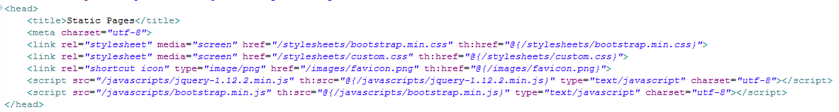
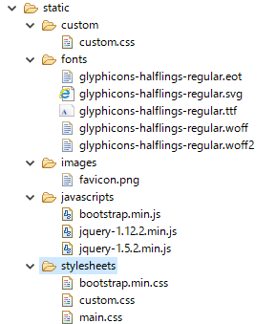
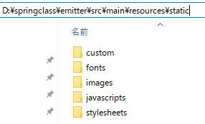
4. Thymeleaf Layout
Practical Web Development with Spring Boot
Create Emitter
4-1. Create layout pages
Copy css, js, font, and images for emitter under static folder.
Copy under static folder like this
Make sure to copy everything like the right picture

Slide 36
4. Thymeleaf Layout
Practical Web Development with Spring Boot
Create Emitter
4-1. Create layout pages
Modify home.html like below,
<!DOCTYPE html>
<html xmlns="http://www.w3.org/1999/xhtml"
xmlns:th="http://www.thymeleaf.org"
xmlns:layout="http://www.ultraq.net.nz/thymeleaf/layout"
layout:decorator="layout/main"
>
<head>
<title>Home</title>
</head>
<body>
<div layout:fragment="content" th:remove="tag">
<!-- StaticPages home.html inserted into main.html -->
Security passed and inserted into main.html
<!-- StaticPages home.html inserted into main.html End -->
</div>
</body>
</html>

Slide 37
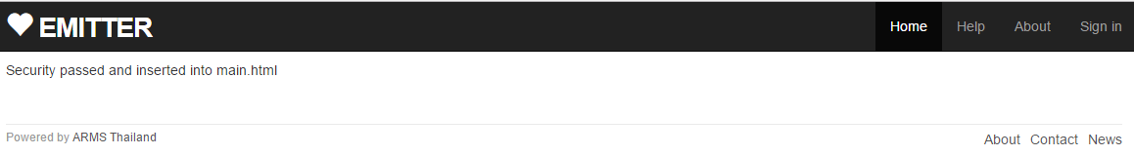
4. Thymeleaf Layout
Practical Web Development with Spring Boot
Create Emitter
4-1. Create layout pages
Restart your app and access ----------:8080/
You will see home.html is inserted into main.html
home.html
_header.html
main.html
_footer.html
xmlns:layout
<div layout:fragment="content">
<!-- page content goes here -->
</div>
xmlns:layout
layout:decorator="layout/main"
<div layout:fragment="content" th:remove="tag">
</div>
To use layout tag
Specifying main.html as a layout decorator
Declare xmlns:layout

Slide 38

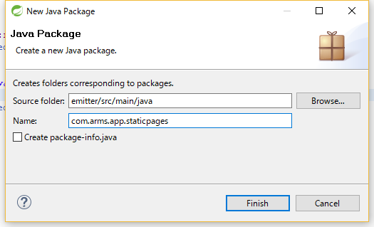
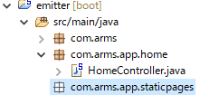
5. Create Staticpages
Practical Web Development with Spring Boot
Create Emitter
5-1. Create staticpages
Create static folder under templates package
Right-click on com.arms and create com.arms.app.staticpages

Slide 39
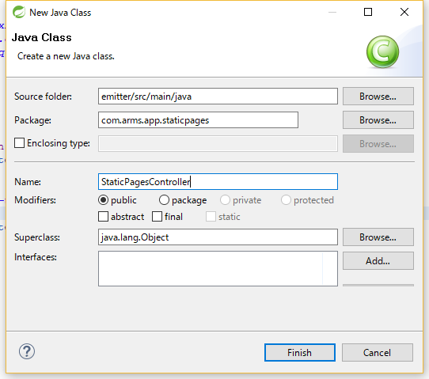
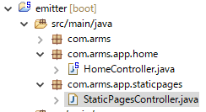
5. Create Staticpages
Practical Web Development with Spring Boot
Create Emitter
5-1. Create staticpages
Right-click on com.arms.app.staticpages and create StaticPagesController
New – Class – Name: StaticPagesController

Slide 40
5. Create Staticpages
Practical Web Development with Spring Boot
Create Emitter
5-1. Create staticpages
Add the following code to StaticPagesController
Create a help method for this link
<li><a th:href="@{/help}">Help</a></li>
package com.arms.app.staticpages;
import org.springframework.stereotype.Controller;
import org.springframework.web.bind.annotation.RequestMapping;
@Controller
public class StaticPagesController {
@RequestMapping("/help")
public String help(){
return "static/help";
}
}

Slide 41
5. Create Staticpages
Practical Web Development with Spring Boot
Create Emitter
5-1. Create staticpages
Create help.html under static folder and add the following code to it.
help.html
<!DOCTYPE html>
<html xmlns="http://www.w3.org/1999/xhtml"
xmlns:th="http://www.thymeleaf.org"
xmlns:layout="http://www.ultraq.net.nz/thymeleaf/layout"
layout:decorator="layout/main"
>
<head>
<title>Help</title>
</head>
<body>
<div layout:fragment="content" th:remove="tag">
<!-- StaticPages help.html inserted into main.html -->
<h1>Help</h1>
<p>
<span class="label label-warning">Under Construction</span>
</p>
<!-- StaticPages help.html inserted into main.html End -->
</div>
</body>
</html>

Slide 42
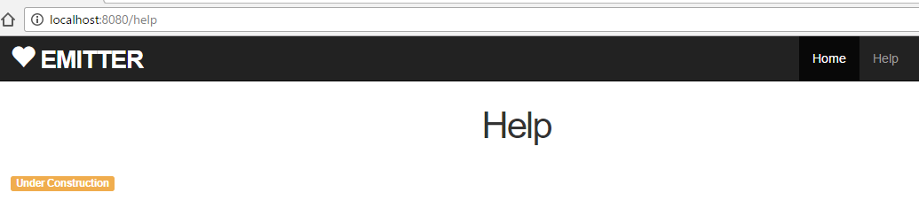
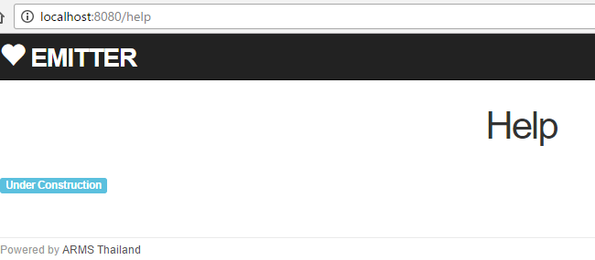
5. Create Staticpages
Practical Web Development with Spring Boot
Create Emitter
5-1. Create staticpages
Restart your app and access ---------:8080/
You can see help.html like below
Challenge: Change the color of Under Construction to light blue

Slide 43
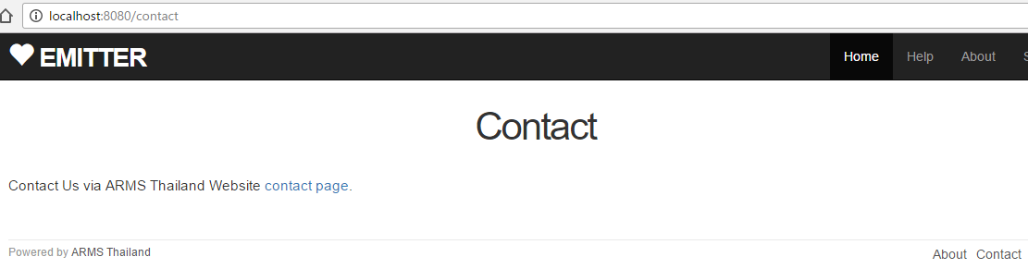
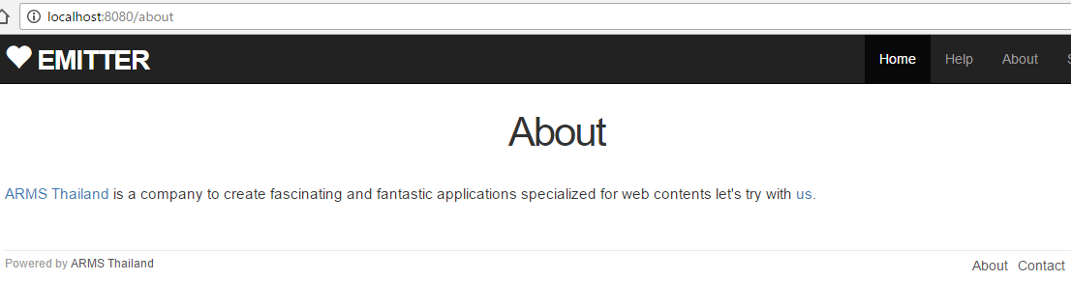
5. Create Staticpages
Practical Web Development with Spring Boot
Create Emitter
5-1. Create staticpages
Challenge: Create contact.html and about.html, then add methods to StaticPagesController and call those html.

Slide 44
6. Spring Security
Practical Web Development with Spring Boot
Create Emitter
6-1. Change default user
If you want to change the default user and password for the basic authentication, Add the following code in application.yml
………………………………………………………………….
hibernate.dialect: org.hibernate.dialect.MySQL5Dialect
thymeleaf:
mode: LEGACYHTML5
cache: false
encoding: UTF-8
security:
user:
name: mickey
password: 12345
This setting overrides the default user and password, when you run your app, password is no longer display in the console.

Slide 45
6. Spring Security
Practical Web Development with Spring Boot
Create Emitter
6-2. Create Signup Page
In our case, we want to use our own users to login Emitter.
Modify home.html as below,
<!DOCTYPE html>
<html xmlns="http://www.w3.org/1999/xhtml"
xmlns:th="http://www.thymeleaf.org"
xmlns:layout="http://www.ultraq.net.nz/thymeleaf/layout"
layout:decorator="layout/main"
>
<head>
<title>Home</title>
</head>
<body>
<div layout:fragment="content" th:remove="tag">
<!-- StaticPages home.html inserted into main.html -->
<div th:if="${isLogin}" class="row">
You have logged in
</div>
Continue on next page

Slide 46
6. Spring Security
Practical Web Development with Spring Boot
Create Emitter
6-2. Create Signup Page
In our case, we want to use our own users to login Emitter.
Modify home.html as below,
<div th:unless="${isLogin}" class="center jumbotron">
<h1>Welcome to Emitter Application</h1>
<h2>
<a href="http://arms-asia.com/en/">ARMS Thailand</a> presents, How to
create SNS Application.
</h2>
<a href="/user/signUp" class="btn btn-lg btn-primary"> <span
class="glyphicon glyphicon-user" aria-hidden="true"></span> Sign up
now!
</a>
</div>
<!-- StaticPages home.html inserted into main.html End -->
</div>
</body>
</html>

Slide 47
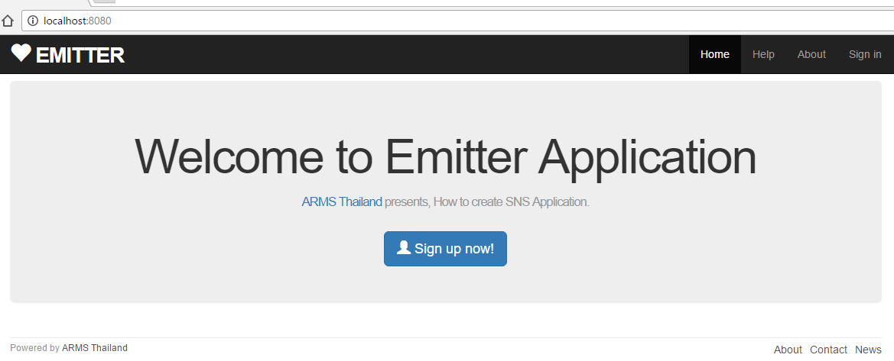
6. Spring Security
Practical Web Development with Spring Boot
Create Emitter
6-2. Create Signup Page
th:if th:unless
<div th:if="${isLogin}" class="row">
You have logged in
<div th:unless="${isLogin}"

Slide 48

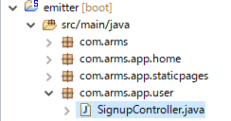

6. Spring Security
Practical Web Development with Spring Boot
Create Emitter
6-3. Create SignupController
Create SignupController under com.arms.app.user
Create com.arms.app.user package
Create SignupController under com.arms.app.user
When you click “Sign up now”
<a href="/user/signUp"

Slide 49
6. Spring Security
Practical Web Development with Spring Boot
Create Emitter
6-3. Create SignupController
Creating a corresponding method to this link in SignupController
When you click “Sign up now”
<a href="/user/signUp"
Add the following code in SignupController
package com.arms.app.user;
import org.springframework.stereotype.Controller;
import org.springframework.web.bind.annotation.RequestMapping;
import org.springframework.web.servlet.ModelAndView;
@Controller
public class SignupController {
@RequestMapping("/user/signUp")
public ModelAndView signup(ModelAndView modelAndView){
modelAndView.setViewName("user/sign_up");
return modelAndView;
}
}

Slide 50
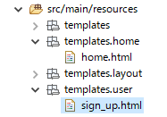
6. Spring Security
Practical Web Development with Spring Boot
Create Emitter
6-3. Create SignupController
Create templates.user and signup.html
modelAndView.setViewName("user/sign_up");
Create templates.user package and sign_up.html under it.
Create singn_up.html page by yourself with layout

Slide 51
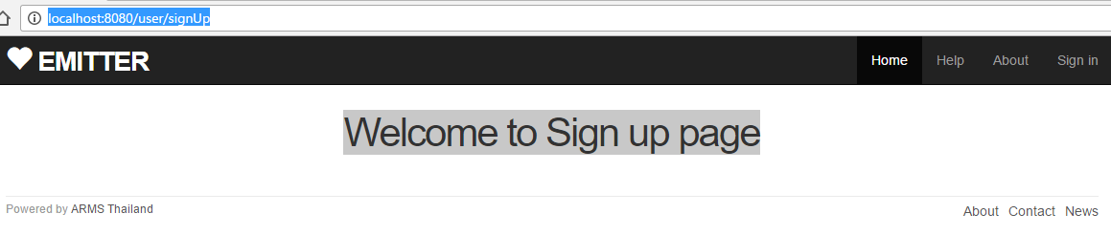
6. Spring Security
Practical Web Development with Spring Boot
Create Emitter
6-3. Create SignupController
Restart your app and access --------:8080/ and press “Sign up now”

Slide 52

Your Idea Leads Your Ideals
homepage: http://arms-asia.com/
facebook: https://www.facebook.com/arms.asia?fref=ts
Notes:
If you follow document, next class is very easy

