Slide 1

Create Emitter (Twitter like app) with SPRING BOOT
Presented by ARMS（THAILAND）Co., Ltd.

Slide 2
Index
Practical Web Development with Spring Boot
Create Indivilister
Create User
  1-1. Create a user entity class
  1-2. Create a repository interface
  1-3. Create a form object
  1-4. Create a signup form
  1-5. Create encrypted password
Create Security login
  2-1. Create a LoginController
  2-2. Set validation on signup form
3. Create Security config
  3-1. Create security config
  3-2. Create branch condition
4. Explanation
  4-1. Spring security implementation

Slide 3
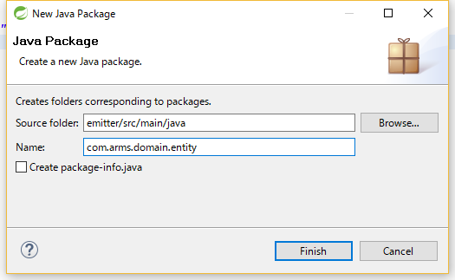
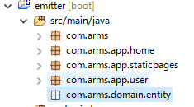
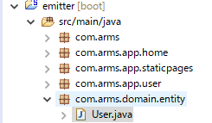
1. Create User
Practical Web Development with Spring Boot
Create Emitter
1-1. Create a user entity class
Create a package com.arms.domain.entity, and User entity class under it
Create com.arms.domain.entity
Create User entity class under com.arms.domain.entity

Slide 4
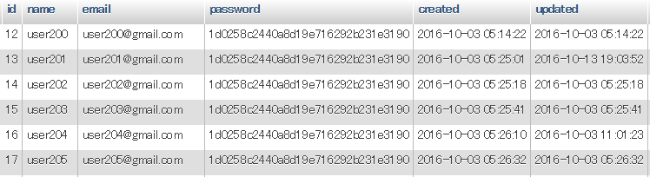
1. Create User
Practical Web Development with Spring Boot
Create Emitter
1-1. Create a user entity class
Java class is mapped to the table like below, add the following code to User.java
User.java
package com.arms.domain.entity;
import lombok.Data;
import javax.persistence.*;
import java.util.Date;
@Entity
@Data
public class User {
Continue on next page

Slide 5
1. Create User
Practical Web Development with Spring Boot
Create Emitter
1-1. Create a user entity class
User.java
private int id;
private String name;
private String email;
private String password;
private Date created;
private Date updated;
@Id
@GeneratedValue
@Column(name = "id")
public int getId() {
return id;
}
public void setId(int id) {
this.id = id;
}
@Basic
@Column(name = "name")
public String getName() {
return name;
}
Continue on next page

Slide 6
1. Create User
Practical Web Development with Spring Boot
Create Emitter
1-1. Create a user entity class
User.java
public void setName(String name) {
this.name = name;
}
@Basic
@Column(name = "email")
public String getEmail() {
return email;
}
public void setEmail(String email) {
this.email = email;
}
@Basic
@Column(name = "password")
public String getPassword() {
return password;
}
public void setPassword(String password) {
this.password = password;
}
Continue on next page

Slide 7
1. Create User
Practical Web Development with Spring Boot
Create Emitter
1-1. Create a user entity class
User.java
@Basic
@Column(name = "created")
public Date getCreated() {
return created;
}
public void setCreated(Date created) {
this.created = created;
}
@Basic
@Column(name = "updated")
public Date getUpdated() {
return updated;
}
public void setUpdated(Date updated) {
this.updated = updated;
}
}

Slide 8
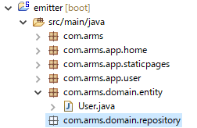
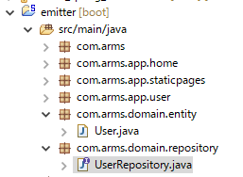
1. Create User
Practical Web Development with Spring Boot
Create Emitter
1-2. Create a repository interface
Create a package com.arms.domain.repository, and UserRepository interface under it
Create com.arms.domain.repository
Create UserRepository
Make sure to extend JpaRepository

Slide 9
1. Create User
Practical Web Development with Spring Boot
Create Emitter
1-2. Create a repository interface
Add the following code to UserRepository
package com.arms.domain.repository;
import org.springframework.data.jpa.repository.JpaRepository;
import org.springframework.stereotype.Repository;
import com.arms.domain.entity.User;
@Repository
public interface UserRepository extends JpaRepository<User, Integer> {
}
Set @Repository annotation
Set Entity type and its primary key type

Slide 10
1. Create User
Practical Web Development with Spring Boot
Create Emitter
1-3. Create a form object
Create a form object to receive form data on sign_up.html, Right-click on “com.arms.app.user” and create UserAddForm
package com.arms.app.user;
import lombok.Data;
import org.hibernate.validator.constraints.NotEmpty;
@Data
public class UserAddForm {
@NotEmpty
private String name;
@NotEmpty
private String email;
@NotEmpty
private String password;
}
Notes:
http://www.objectdb.com/api/java/jpa/Basic

Slide 11
1. Create User
Practical Web Development with Spring Boot
Create Emitter
1-3. Create a form object
Create a form object to receive form data on sign_up.html, Right-click on “com.arms.app.user” and create UserAddForm
package com.arms.app.user;
import lombok.Data;
import org.hibernate.validator.constraints.NotEmpty;
@Data
public class UserAddForm {
@NotEmpty
private String name;
@NotEmpty
private String email;
@NotEmpty
private String password;
}
Notes:
http://www.objectdb.com/api/java/jpa/Basic

Slide 12
1. Create User
Practical Web Development with Spring Boot
Create Emitter
1-4. Create a signup form
Modify sign_up.html
<!DOCTYPE html>
<html xmlns="http://www.w3.org/1999/xhtml"
xmlns:th="http://www.thymeleaf.org"
xmlns:layout="http://www.ultraq.net.nz/thymeleaf/layout"
layout:decorator="layout/main">
<head>
<title>Create new user</title>
</head>
<body>
<div layout:fragment="content" th:remove="tag">
<form th:action="@{/user/add}" th:object="${userAddForm}" method="post">
<div class="row">
<div class="span6 offset3">
</div>
Continue on next page

Slide 13
1. Create User
Practical Web Development with Spring Boot
Create Emitter
1-3. Create a signup form
Modify sign_up.html
<div class="form-group mt20 mb10" th:classappend="${#fields.hasErrors('name')}? 'has-error'">
<label>Name</label>
<input type="text" class="form-control" th:field="*{name}" />
</div>
<span th:if="*{#fields.hasErrors('name')}" th:errors="*{name}" class="help-block">error!</span>
<br>
<div class="form-group mt20 mb10" th:classappend="${#fields.hasErrors('email')}? 'has-error'">
<label>Email</label>
<input type="text" class="form-control" th:field="*{email}" /><br>
</div>
<span th:if="*{#fields.hasErrors('email')}" th:errors="*{email}" class="help-block">error!</span>
<br>
Continue on next page

Slide 14
1. Create User
Practical Web Development with Spring Boot
Create Emitter
1-3. Create a signup form
Modify sign_up.html
<div class="form-group mt20 mb10" th:classappend="${#fields.hasErrors('password')}? 'has-error'">
<label>Password</label>
<input type="password" class="form-control" th:field="*{password}" /><br>
</div>
<span th:if="*{#fields.hasErrors('password')}" th:errors="*{password}" class="help-block">error!</span>
<br>
<input class="btn btn-primary btn-large" type="submit" name="submit" value="Create my account" />
<br>
<br>
</div>
</form>
</div>
</body>
</html>
Continue on next page

Slide 15
1. Create User
Practical Web Development with Spring Boot
Create Emitter
1-3. Create a signup form
Modify SignupController
@RequestMapping("/user/signUp")
public ModelAndView signup(ModelAndView modelAndView){
modelAndView.setViewName("user/sign_up");
modelAndView.addObject("userAddForm", new UserAddForm());
return modelAndView;
}
modelAndView.addObject("userAddForm", new UserAddForm());
sign_up.html
<form th:action="@{/user/add}" th:object="${userAddForm}" method="post">
Empty userAddForm object is set on the View(sign_up.html) and ready to receive form values.

Slide 16

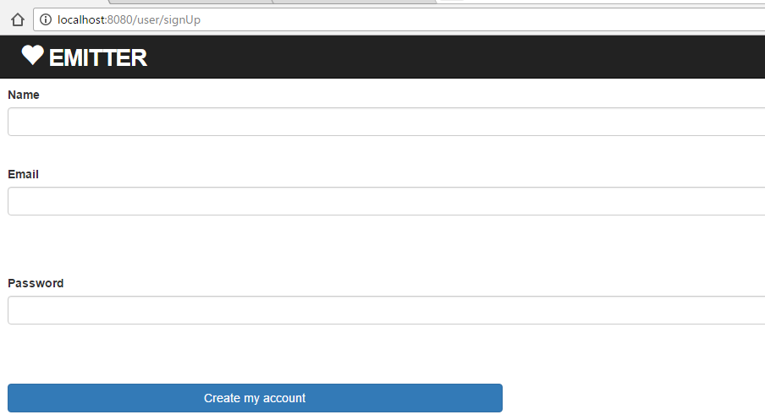
1. Create User
Practical Web Development with Spring Boot
Create Emitter
1-3. Create a signup form
Restart your app and access ---------:8080/
Press “Sign up now!” button and see if you can jump to sing_up.html page
But when you press “Create my account” button, error occurs.

Slide 17
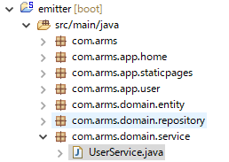
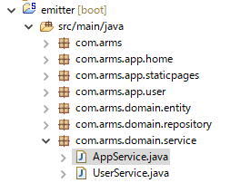
1. Create User
Practical Web Development with Spring Boot
Create Emitter
1-3. Create a signup form
Create a Service class to actually save user data. Create com.arms.domain.service package and UserService under it.
Create com.arms.domain.service
UserService.java
Create AppService to be extended from other Service.

Slide 18
1. Create User
Practical Web Development with Spring Boot
Create Emitter
1-4. Create a signup form
Write common codes in AppService and extend from UserService
Add the following code to AppService
package com.arms.domain.service;
import org.springframework.beans.factory.annotation.Autowired;
import org.springframework.stereotype.Service;
import com.arms.domain.repository.UserRepository;
@Service
public class AppService {
@Autowired
UserRepository userRepository;
}
We will create more Services as we create Emitter, so write common code in AppService

Slide 19
1. Create User
Practical Web Development with Spring Boot
Create Emitter
1-4. Create a signup form
Let UserService extend AppService
Modify UserService and create a createUser method
package com.arms.domain.service;
import java.security.NoSuchAlgorithmException;
import java.util.Calendar;
import java.util.Date;
import org.springframework.stereotype.Service;
import com.arms.app.user.UserAddForm;
import com.arms.domain.entity.User;
@Service
public class UserService extends AppService {
public void createUser(UserAddForm userAddForm) throws NoSuchAlgorithmException {
Date nowDate = Calendar.getInstance().getTime();
User user = new User();
user.setName(userAddForm.getName());
user.setEmail(userAddForm.getEmail());
user.setPassword(userAddForm.getPassword());
user.setCreated(nowDate);
user.setUpdated(nowDate);
userRepository.save(user);
}
}

Slide 20
1. Create User
Practical Web Development with Spring Boot
Create Emitter
1-4. Create a signup form
Understanding the code
userRepository.save(user); → extends AppService
public class AppService {
@Autowired
UserRepository userRepository;
sign_up.html
<form th:action="@{/user/add}" th:object="${userAddForm}”
<input type="text" class="form-control" th:field="*{name}" />
<input type="text" class="form-control" th:field="*{email}" />
<input type="password" class="form-control" th:field="*{password}" />
public void createUser(UserAddForm userAddForm)
user.setName(userAddForm.getName());
Receive userAddForm values and save as user

Slide 21
1. Create User
Practical Web Development with Spring Boot
Create Emitter
1-4. Create a signup form
Modify SignupController
@Controller
public class SignupController {
@Autowired
UserService userService;
@RequestMapping("/user/signUp")
public ModelAndView signup(ModelAndView modelAndView){
modelAndView.setViewName("user/sign_up");
modelAndView.addObject("userAddForm", new UserAddForm());
return modelAndView;
}
@RequestMapping("/user/add")
public Object add(@ModelAttribute("userAddForm") UserAddForm userAddForm) throws NoSuchAlgorithmException{
userService.createUser(userAddForm);
return "redirect:/";
}
}

Slide 22
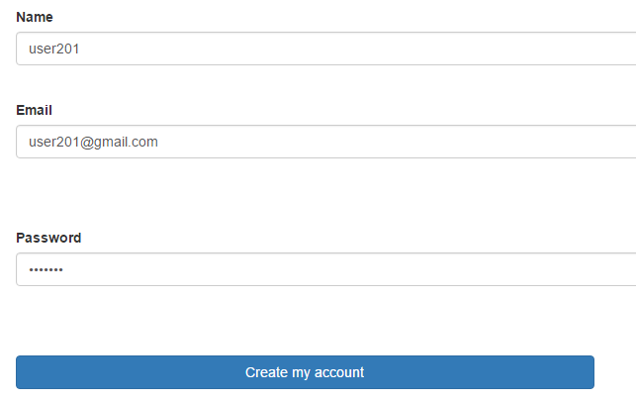
1. Create User
Practical Web Development with Spring Boot
Create Emitter
1-4. Create a signup form
Restart your app and access ---------:8080, then create a few new users

Slide 23

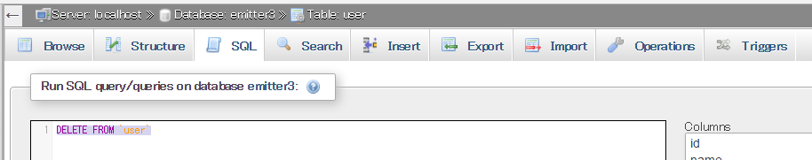
1. Create User
Practical Web Development with Spring Boot
Create Emitter
1-5. Create encrypted password
You can create a user, but password is plain when you see the user table
Access 192.168.33.10/phpMyAdmin and see the user table
Go to SQL tab and run SQL command DELETE FROM `user`
This will delete all users from the user table.

Slide 24
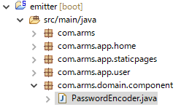
1. Create User
Practical Web Development with Spring Boot
Create Emitter
1-5. Create encrypted password
Create PasswordEncoder class to encrypt a user password
Create com.arms.domain.component package, under which create PasswordEncoder
com.arms.domain.component
PasswordEncoder

Slide 25
1. Create User
Practical Web Development with Spring Boot
Create Emitter
1-5. Create encrypted password
Copy this code to PasswordEncoder
This hashMD5 method in the class will return MD5 hashed password
package com.arms.domain.component;
import org.springframework.stereotype.Component;
import java.security.MessageDigest;
import java.security.NoSuchAlgorithmException;
@Component
public class PasswordEncoder {
public String hashMD5(String original) throws NoSuchAlgorithmException {
MessageDigest md = MessageDigest.getInstance("MD5");
md.update(original.getBytes());
byte[] digest = md.digest();
StringBuffer sb = new StringBuffer();
for (byte b : digest) {
sb.append(String.format("%02x", b & 0xff));
}
return sb.toString();
}
}

Slide 26
1. Create User
Practical Web Development with Spring Boot
Create Emitter
1-5. Create encrypted password
Modify createUser method in UserService
Put @Autowired over PasswordEncoder, and apply it into user.setPassword(----)
@Autowired
PasswordEncoder passwordEncoder;
public void createUser(UserAddForm userAddForm) throws NoSuchAlgorithmException {
Date nowDate = Calendar.getInstance().getTime();
User user = new User();
user.setName(userAddForm.getName());
user.setEmail(userAddForm.getEmail());
user.setPassword(passwordEncoder.hashMD5(userAddForm.getPassword()));
user.setCreated(nowDate);
user.setUpdated(nowDate);
userRepository.save(user);
}
In this way, when you getPassword() from the form object, this method can encrypt it, and setPassword() for user.

Slide 27

1. Create User
Practical Web Development with Spring Boot
Create Emitter
1-5. Create encrypted password
Restart your project and access --------:8080
Try to create a few users and check if passwords are encrypted.

Slide 28
2. Create Security Login
Practical Web Development with Spring Boot
Create Emitter
2-1. Create a LoginController
It will be nice if you are redirected to a login page after created a user so that you can login to Emitter with the user.
Modify add method in SignupController and change the redirected URL
@RequestMapping("/user/add")
public String add(@ModelAttribute("userAddForm") UserAddForm userAddForm) throws NoSuchAlgorithmException{
userService.createUser(userAddForm);
return "redirect:/user/login";
}
In this case, you need @RequestMapping (/user/login)
Note: redirect indicates “URL” not (user folder, login.html)

Slide 29
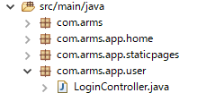
2. Create Security Login
Practical Web Development with Spring Boot
Create Emitter
2-1. Create a LoginController
Create LoginController under com.arms.app.user
LoginController
Add the following code to LoginController
package com.arms.app.user;
import org.springframework.stereotype.Controller;
import org.springframework.web.bind.annotation.RequestMapping;
import org.springframework.web.servlet.ModelAndView;
@Controller
public class LoginController {
@RequestMapping("/user/login")
public ModelAndView login(ModelAndView modelAndView){
modelAndView.setViewName("user/login");
return modelAndView;
}
}

Slide 30
2. Create Security Login
Practical Web Development with Spring Boot
Create Emitter
2-1. Create login.html
Create login.html under templates.user, and add the following code to login.html
login.html
<!DOCTYPE html>
<html xmlns="http://www.w3.org/1999/xhtml"
xmlns:th="http://www.thymeleaf.org"
xmlns:layout="http://www.ultraq.net.nz/thymeleaf/layout"
layout:decorator="layout/main"
>
<head>
<title>Sign in</title>
</head>
<body>
<div layout:fragment="content" th:remove="tag">
<!-- Secure login.html inserted into main.html -->
<div id="login">
<h1>User Login</h1>
<div th:if="${loginFail}" class="alert alert-danger alert-dismissible" role="alert">
<button type="button" class="close" data-dismiss="alert" aria-label="Close"><span aria-hidden="true">&times;</span></button>
<span aria-hidden="true" th:text="${errorMsg}">&times;</span>
</div>
<div th:if="${loginSuccess}" class="alert alert-success alert-dismissible" role="alert">
<button type="button" class="close" data-dismiss="alert" aria-label="Close"><span aria-hidden="true">&times;</span></button>
</div>
Continue on next page

Slide 31
2. Create Security Login
Practical Web Development with Spring Boot
Create Emitter
2-1. Create login.html
login.html
<form th:action="@{/user/login}" method="post" role="form" name="form1">
<p id="username-field">
<div class="form-group">
<label>Email</label>
<div class="text-left w70 vaM">
<input type="text" class=" form-control" name="email" id="email">
</div>
</div>
</p>
<p id="password-field">
<label>Password</label>
<div class="text-left w70 vaM">
<input type="password" class="form-control" name="password" id="password">
</div>
<div style="color: #a94442" class="help-block" th:if="${param.error}" >
<span>Invalid username and password.</span>
</div>
</p>
<p id="signin-field">
<input class="btn btn-primary btn-large" type="submit" id="signin" value="Sign in" />
</p>
Continue on next page

Slide 32
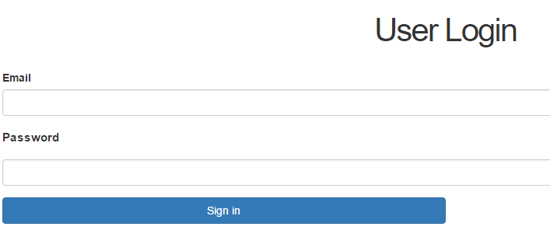
2. Create Security Login
Practical Web Development with Spring Boot
Create Emitter
2-1. Create login.html
login.html
</form>
</div>
<!-- Secure login.html inserted into main.html -->
</div>
</body>
</html>
Restart your app and access -------------:8080/, and create a user and see if you are redirected to the login.html
But can not login

Slide 33
2. Create Security Login
Practical Web Development with Spring Boot
Create Emitter
2-2. Set validation on signup form
Modify add() method in SignupController
@RequestMapping("/user/add")
public Object add(@ModelAttribute("userAddForm") @Valid UserAddForm userAddForm, BindingResult bindingResult,
RedirectAttributes attributes, ModelAndView modelAndView) throws NoSuchAlgorithmException {
if(bindingResult.hasErrors()) {
return "user/sign_up";
}
userService.createUser(userAddForm);
attributes.addFlashAttribute("messageDialog", "User was created.");
return "redirect:/user/login";
}

Slide 34
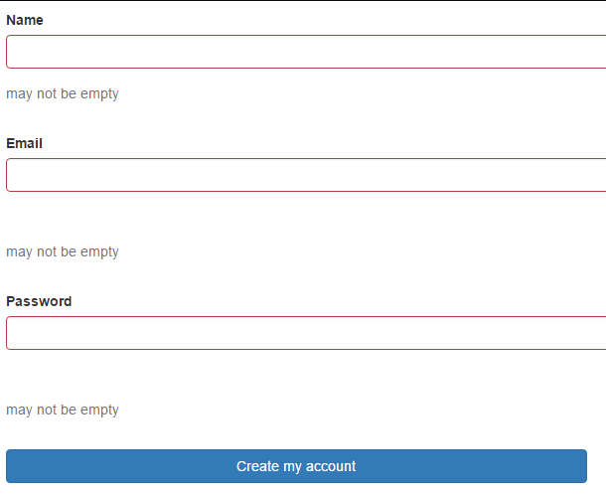
2. Create Security Login
Practical Web Development with Spring Boot
Create Emitter
2-2. Set validation on signup form
Restart your app and access ---------:8080 and see if the validation setting properly works
Make each field empty and press “Create my account” button, you will be redirected to signup page.
And see error messages

Slide 35
2. Create Security Login
Practical Web Development with Spring Boot
Create Emitter
2-2. Set validation on signup form
Let’s see what’s happening during the validation process
@RequestMapping("/user/add")
public Object add(@ModelAttribute("userAddForm") @Valid UserAddForm userAddForm, BindingResult bindingResult,
RedirectAttributes attributes, ModelAndView modelAndView) throws NoSuchAlgorithmException {
if(bindingResult.hasErrors()) {
return "user/sign_up";
}
userService.createUser(userAddForm);
attributes.addFlashAttribute("messageDialog", "User was created.");
return "redirect:/user/login";
}
This Valid annotation checks(validates) values in the UserAddForm
Error check results are in BindingResult
To see if errors are happening, use hasErrors() method
Continue on next page

Slide 36
2. Create Security Login
Practical Web Development with Spring Boot
Create Emitter
2-2. Set validation on signup form
Important point of BindingResult
○
public Object add(@ModelAttribute("userAddForm") @Valid UserAddForm userAddForm, BindingResult bindingResult, RedirectAttributes attributes, ModelAndView modelAndView)
○
public Object add(@Valid @ModelAttribute("userAddForm") UserAddForm userAddForm, BindingResult bindingResult, ModelAndView modelAndView)
×
public Object add(@Valid @ModelAttribute("userAddForm") UserAddForm userAddForm, ModelAndView modelAndView, BindingResult bindingResult)
×
public Object add(@Valid @ModelAttribute("userAddForm") UserAddForm userAddForm, Model model, BindingResult bindingResult)
Where to put BindingResult is important, it should be put right after the corresponding model object.

Slide 37


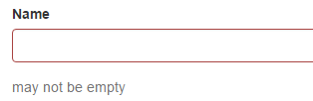
2. Create Security Login
Practical Web Development with Spring Boot
Create Emitter
2-2. Set validation on signup form
How to display errors on View (sign_up.html)
<div class="form-group mt20 mb10" th:classappend="${#fields.hasErrors('name')}? 'has-error'">
<label>Name</label>
<input type="text" class="form-control" th:field="*{name}" />
</div>
If this name field has an error, ‘has-error’ class(css) is appended.
<span th:if="*{#fields.hasErrors('name')}" th:errors="*{name}" class="help-block">error!</span>
If this name field has an error, th:errors (message) is displayed.

Slide 38
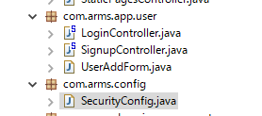
3. Create Security Config
Practical Web Development with Spring Boot
Create Emitter
3-1. Create security config
In this chapter, we will create security config and use Emitter users to login this application (not default user)
Create com.arms.config package, under which create SecurityConfig

Slide 39
3. Create Security Config
Practical Web Development with Spring Boot
Create Emitter
3-1. Create security config
Add the following code to SecurityConfig
package com.arms.config;
import com.arms.domain.service.AuthenticationService;
import org.springframework.beans.factory.annotation.Autowired;
import org.springframework.context.annotation.ComponentScan;
import org.springframework.context.annotation.Configuration;
import org.springframework.security.authentication.encoding.Md5PasswordEncoder;
import org.springframework.security.config.annotation.authentication.builders.AuthenticationManagerBuilder;
import org.springframework.security.config.annotation.method.configuration.EnableGlobalMethodSecurity;
import org.springframework.security.config.annotation.web.builders.HttpSecurity;
import org.springframework.security.config.annotation.web.configuration.EnableWebSecurity;
import org.springframework.security.config.annotation.web.configuration.WebSecurityConfigurerAdapter;
import org.springframework.security.web.util.matcher.AntPathRequestMatcher;
@Configuration
@ComponentScan("com.concretepage")
@EnableWebSecurity
@EnableGlobalMethodSecurity(prePostEnabled=true)
public class SecurityConfig extends WebSecurityConfigurerAdapter {
Continue on next page

Slide 40
3. Create Security Config
Practical Web Development with Spring Boot
Create Emitter
3-1. Create security config
Add the following code to SecurityConfig
@Autowired
AuthenticationService authenticationService;
@Autowired
public void configureGlobal(AuthenticationManagerBuilder auth) throws Exception {
Md5PasswordEncoder encoder = new Md5PasswordEncoder();
auth.userDetailsService(authenticationService).passwordEncoder(encoder);
}
@Override
protected void configure(HttpSecurity http) throws Exception {
http.authorizeRequests()
.and().authorizeRequests().antMatchers("/static/**","/javascripts/**", "/images/**", "/**/favicon.ico","/fonts/**","/stylesheets/**").permitAll()
.and().authorizeRequests().antMatchers("/", "/user/login","/user/signUp", "/user/add", "/help", "/contact", "/about").permitAll()
.anyRequest().authenticated()
.and()
.csrf()
.disable()
.formLogin()
.loginPage("/user/login")
.defaultSuccessUrl("/user/successLogin", true)
Continue on next page

Slide 41
3. Create Security Config
Practical Web Development with Spring Boot
Create Emitter
3-1. Create security config
Add the following code to SecurityConfig
.failureUrl("/user/failLogin")
.usernameParameter("email")
.passwordParameter("password")
.permitAll()
.and()
.logout()
.logoutUrl("/user/logout")
.logoutSuccessUrl("/")
.logoutRequestMatcher(new AntPathRequestMatcher("/user/logout"));
}
}

Slide 42

3. Create Security Config
Practical Web Development with Spring Boot
Create Emitter
3-1. Create security config
Create AuthenticationService under com.arms.domain.service
package com.arms.domain.service;
import com.arms.domain.entity.User;
import com.arms.domain.repository.UserRepository;
import org.springframework.beans.factory.annotation.Autowired;
import org.springframework.security.core.GrantedAuthority;
import org.springframework.security.core.authority.SimpleGrantedAuthority;
import org.springframework.security.core.userdetails.UserDetails;
import org.springframework.security.core.userdetails.UserDetailsService;
import org.springframework.security.core.userdetails.UsernameNotFoundException;
import org.springframework.stereotype.Service;
import java.util.Arrays;
@Service
public class AuthenticationService implements UserDetailsService {
@Autowired
private UserRepository userRepository;
Continue on next page

Slide 43
3. Create Security Config
Practical Web Development with Spring Boot
Create Emitter
3-1. Create security config
Create AuthenticationService under com.arms.domain.service
@Override
public UserDetails loadUserByUsername(String email) throws UsernameNotFoundException {
User user = userRepository.findOneByEmail(email);
GrantedAuthority authority = new SimpleGrantedAuthority("emitter");
boolean isEnabled = true;
boolean isAccountNonExpired = true;
boolean isCredentialsNonExpired = true;
boolean isAccountNonLocked = true;
UserDetails userDetails = (UserDetails) new org.springframework.security.core.userdetails.User(user.getEmail(),
user.getPassword(), isEnabled, isAccountNonExpired, isCredentialsNonExpired, isAccountNonLocked, Arrays.asList(authority));
return userDetails;
}
}

Slide 44
3. Create Security Config
Practical Web Development with Spring Boot
Create Emitter
3-1. Create security config
Modify UserRepository
package com.arms.domain.repository;
import org.springframework.data.jpa.repository.JpaRepository;
import org.springframework.stereotype.Repository;
import com.arms.domain.entity.User;
@Repository
public interface UserRepository extends JpaRepository<User, Integer> {
User findOneByEmail(String email);
}
Is there findOneByEmail method in JpaRepository????
Answer is No, this is one of the benefits of extending JpaRepository.
JPA has an auto-generate feature.
findOne method
↓
From User where email = “argument”

Slide 45
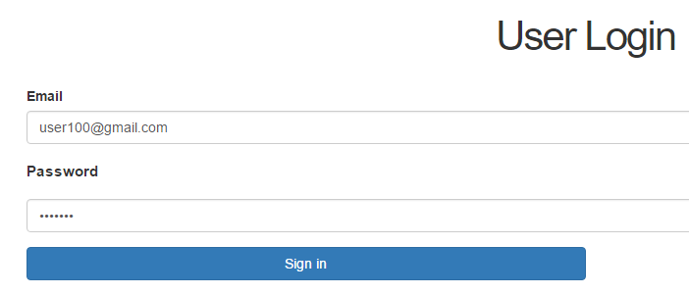
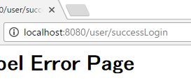
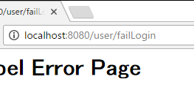
3. Create Security Config
Practical Web Development with Spring Boot
Create Emitter
3-2. Create branch condition
Restart you app and try to login
You can see two different pages if you type correct password or not
/user/successLogin
/user/failLogin

Slide 46
3. Create Security Config
Practical Web Development with Spring Boot
Create Emitter
3-2. Create branch condition
Add failLogin method to LoginController
/user/failLogin
@RequestMapping(value = "/user/failLogin", method = RequestMethod.GET)
public ModelAndView failLogin(ModelAndView model){
model.addObject("errorMsg", "Login failed, Invalid name and/or passwod");
model.addObject("loginFail", true);
model.setViewName("user/login");
return model;
}

Slide 47
3. Create Security Config
Practical Web Development with Spring Boot
Create Emitter
3-2. Create branch condition
Add successLogin method to LoginController
/user/successLogin
@RequestMapping(value = "/user/successLogin", method = RequestMethod.GET)
public Object successLogin(ModelAndView model, BindingResult bindingResult, RedirectAttributes redirectAttributes){
if (bindingResult.hasErrors()){
model.setViewName("/user/login");
return model;
}
redirectAttributes.addFlashAttribute("message", "Login Successful");
model.addObject("loginSuccess", true);
return "redirect:/";
}

Slide 48
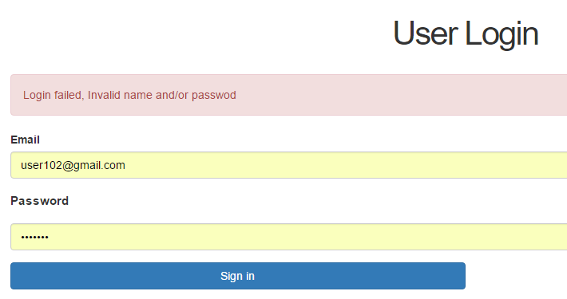
3. Create Security Config
Practical Web Development with Spring Boot
Create Emitter
3-2. Create branch condition
Restart your app and try to login with correct and incorrect password.
Error message you set in the method.

Slide 49

4. Explanation
Practical Web Development with Spring Boot
Create Emitter
4-1. Spring security implementation
Here’s an example of how to configure Spring security
1. Create a SecurityConfig class and configure access control, login procedure, logout procedure, and etc…
2. To configure the above setting, extend WebSecurityConfigurerAdapter and override configure() method in it.
@Override
protected void configure(HttpSecurity http)
-----------Override and customize your own setting------------------

Slide 50
4. Explanation
Practical Web Development with Spring Boot
Create Emitter
4-1. Spring security implementation
Here’s an example of how to configure Spring security
3. Create an authentication object service class
@Service
public class AuthenticationService
4. Implement UserDetailService and generate an authentication object in emitter system.
5. Override loadUserByUsername(String username) method in the UserDetailsService
@Override
public UserDetails loadUserByUsername(String email)

Slide 51
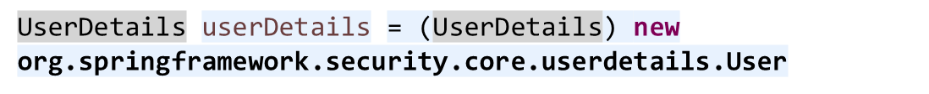
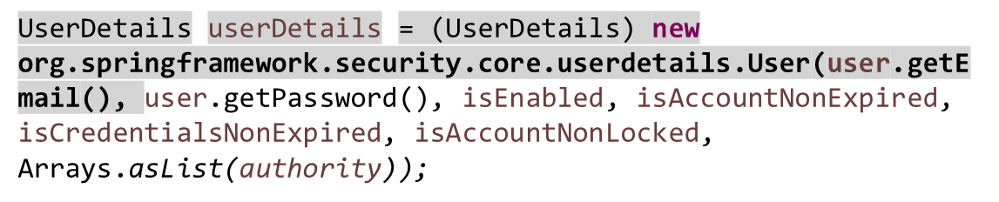
4. Explanation
Practical Web Development with Spring Boot
Create Emitter
4-1. Spring security implementation
Here’s an example of how to configure Spring security
6. Create a User class object and define username, password fields, and etc…
☆username and password in this case are user.getEmail(), user.getPassword()

Slide 52
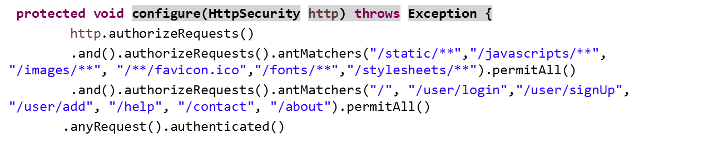
4. Explanation
Practical Web Development with Spring Boot
Create Emitter
4-1. Spring security implementation
Overriding configure() method. The configure(HttpSecurity http) method is where the actual URL-based security is set up.
①
②
③
① allow all users to access static resources
② allow all users to access “/”, “/user/login”, and etc..
③ Besides ① and ②, you can access after the login authenticated.

Slide 53
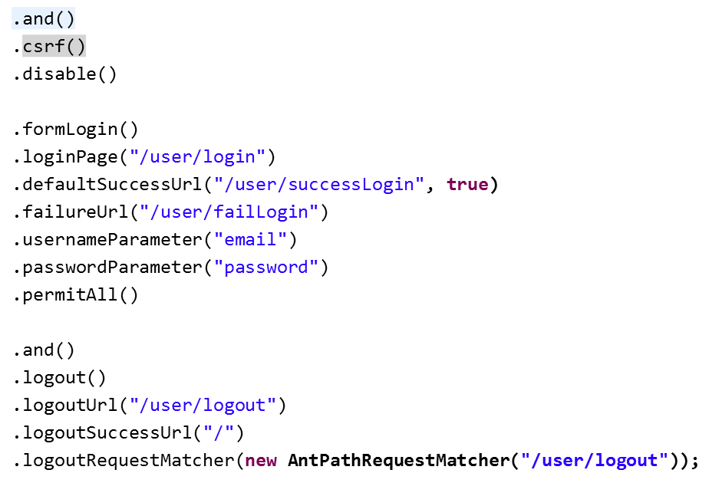
4. Explanation
Practical Web Development with Spring Boot
Create Emitter
4-1. Spring security implementation
Overriding configure(HttpSecurity)
CSRF protection is enabled by default with Java Configuration. If you want to disable CSRF, configure this setting.
The login form is under /user/login, permitted for all.
URL after successful login
On login failure a redirect to "/user/failLogin” will happen
The parameter holding the username in emitter is 'email'
The parameter holding the password in emitter is 'password'
URL for logging out(POST)
URL after logging out.
URL for logging out(GET)

Slide 54
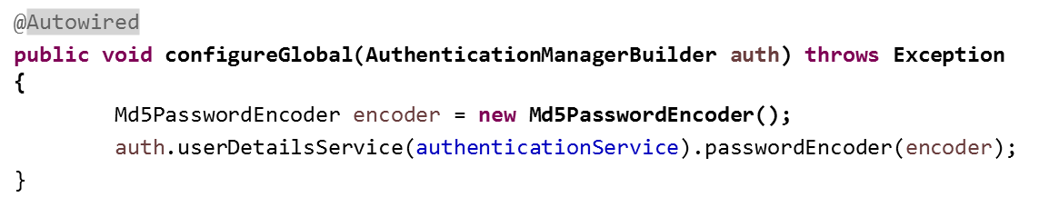
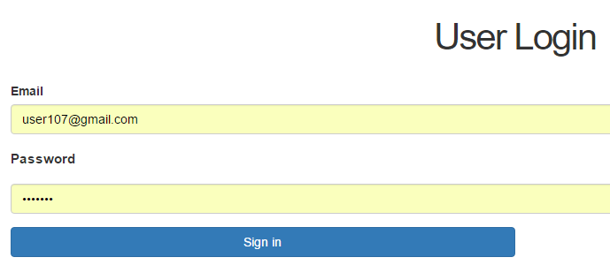
4. Explanation
Practical Web Development with Spring Boot
Create Emitter
4-1. Spring security implementation
Understanding the authentication mechanism
This method “configureGlobal(AuthenticationManagerBuilder auth)” is where the authentication mechanism is set up. This set up will make the authentication handled by UserDetailsService. In this case, User Login Password is supposed to be encrypted by Md5PasswordEncoder.
MD5 Password is stored in DB, so user input should be also MD5 to match
user.setPassword(passwordEncoder.hashMD5(userAddForm.getPassword()));

Slide 55
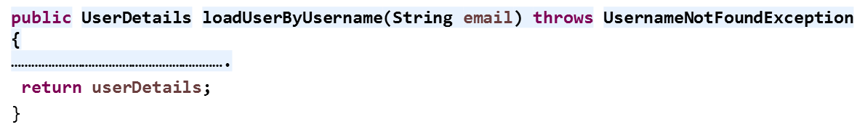
4. Explanation
Practical Web Development with Spring Boot
Create Emitter
4-1. Spring security implementation
Understanding UserDetailsService
The UserDetailsService is an interface that the Spring uses to find out if the user using login form exists, such information as password, authority.
UserDetailsService has only one method, “loadUserByUsername()” which is expected to return UserDetails instance( if the username exists), if not throws UsernameNotFoundException

Slide 56
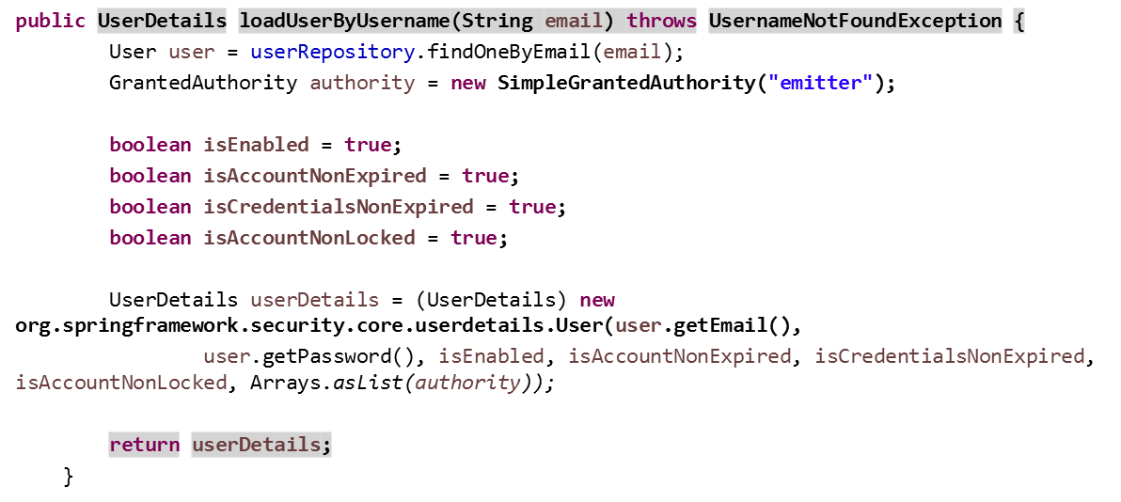
4. Explanation
Practical Web Development with Spring Boot
Create Emitter
4-1. Spring security implementation
Understanding UserDetailsService
GrantedAuthority authority = new SimpleGrantedAuthority("emitter");
Stores a String role of an authority granted to the Authentication object.
In other word, authority(role) given to Principal

Slide 57
4. Explanation
Practical Web Development with Spring Boot
Create Emitter
4-1. Spring security implementation
Understanding UserDetailsService
As you see this class has a user having username(user.getEmail()), password(user.getPassword), GrandtedAuthorith objects, and some account validation flags.

Slide 58
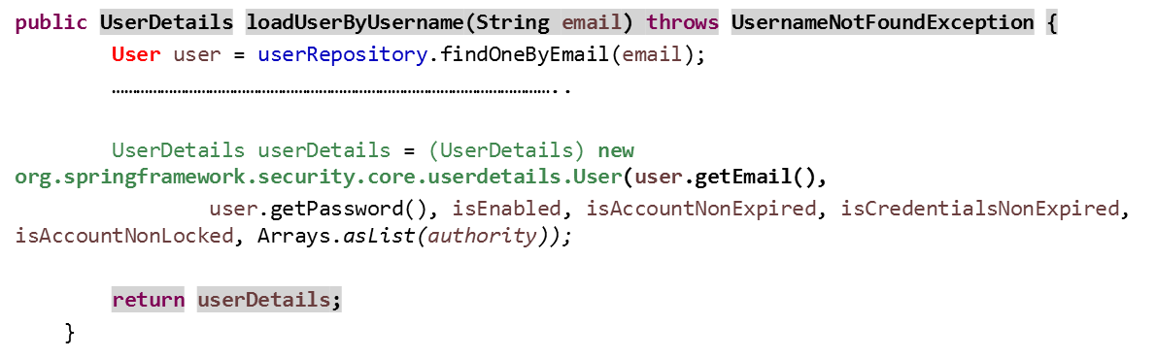
4. Explanation
Practical Web Development with Spring Boot
Create Emitter
4-1. Spring security implementation
Understanding UserDetailsService
Implementation of org.springframework.security.core.userdetails.User is to relate User domain object to Userdetails
This means that userDetails has information as below,
Username is populated from user.getEmail()
Password is populated from user.getPassword()
Other account validation flags
User.role which is converted to String

Slide 59
4. Explanation
Practical Web Development with Spring Boot
Create Emitter
4-1. Spring security implementation
Summary of the flow
・A user access /user/login.
@RequestMapping("/user/login")
・The LoginController returns the login page. modelAndView.setViewName("user/login");
・The user inputs the login form with username(email) and password
login.html
・Spring Security calls AuthenticationService.loadUserByUsername(String email) with a username(email), this email is the value in the login form.
・AuthenticationService gets the user information from the User() returns userDetails.
  return userDetails;
  ・Spring Security calls user.getPassword() and compares it with the password in the login form
  auth.userDetailsService(authenticationService).passwordEncoder(encoder);
  ・If the result is OK, redirected to /user/successLogin, If not, /user/failLogin

Slide 60
4. Explanation
Practical Web Development with Spring Boot
Create Emitter
4-1. Spring security implementation
Continue on the next class

Slide 61

Your Idea Leads Your Ideals
homepage: http://arms-asia.com/
facebook: https://www.facebook.com/arms.asia?fref=ts

