Slide 1


NETWEAVE
Built to Connect. Secured to Protect

Slide 2


PRESENTED BY:
  Singalakha Nguluzane(s224201565)
  Simangaliso Ncengwa (s224513249)
  Manelisi Gumede(s223478105)
4.Mntukathandwa Siphesihle(s219564264)
5. Gloria Bokaba (s224168460)

Slide 3


Overview
Introduction
04
Network Design Principles
05
Initial and Updated Topologies
06-08
Requirements and Specification
09-10
Core Layer
11-12
Distribution Layer
13
Access Layer
14-15
Legend and Conclusion
16-17

Slide 4

INTRODUCTION
This presentation is a German division of five locations of LinkTech, an international technology research and development company. It was initially divided into four branches namely, Munich, Berlin, Frankfurt ,Stuttgart and later joined by a new branch, Hamburg. The focus of the following presentation is to breakdown the division, recommending necessary changes and implementing them in a form of logical diagrams mapping them to the network design Principles .

Slide 5

Network Design principle considered-:
  Requirements Gathering and Planning.
  Network Architecture and Design
  Security and Compliance
  Performance and Scalability
  Implementation and Deployment
  Monitoring and Maintenance
  Evaluation and Optimization

Slide 6
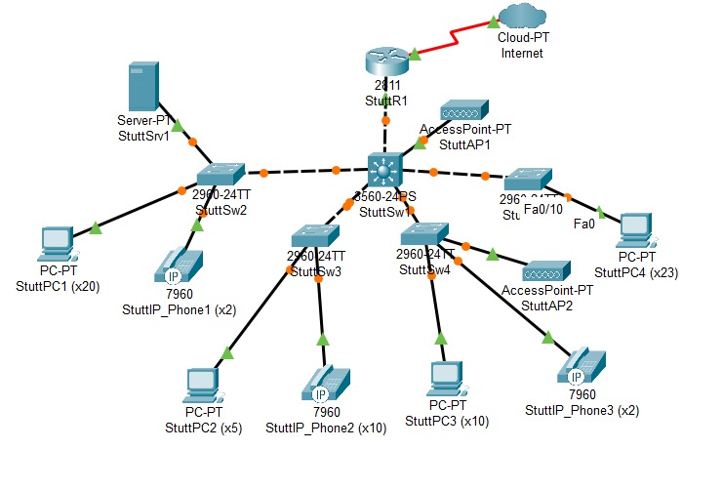
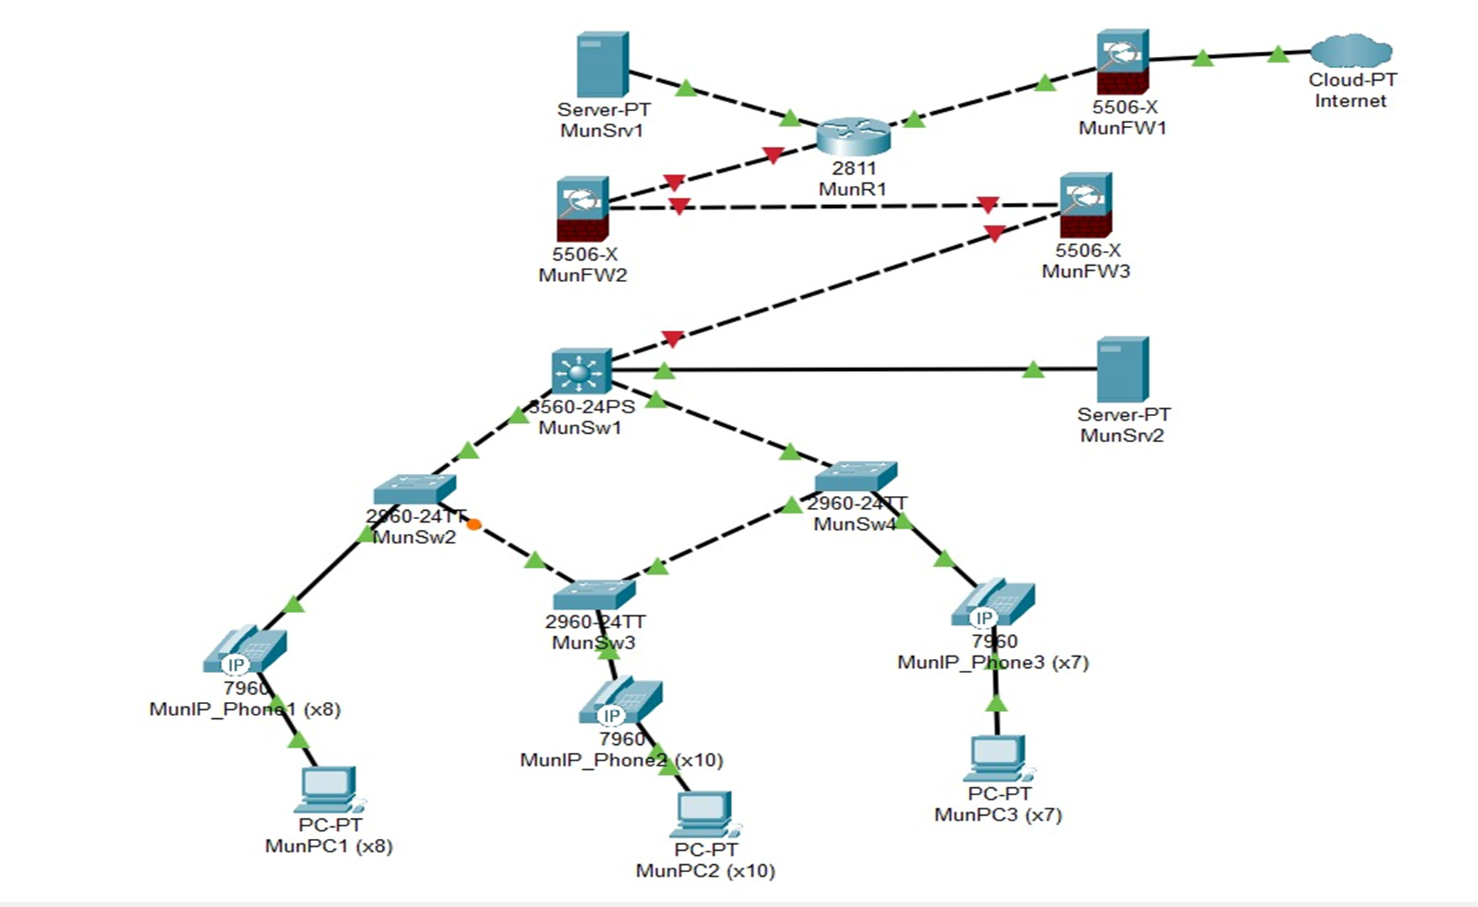
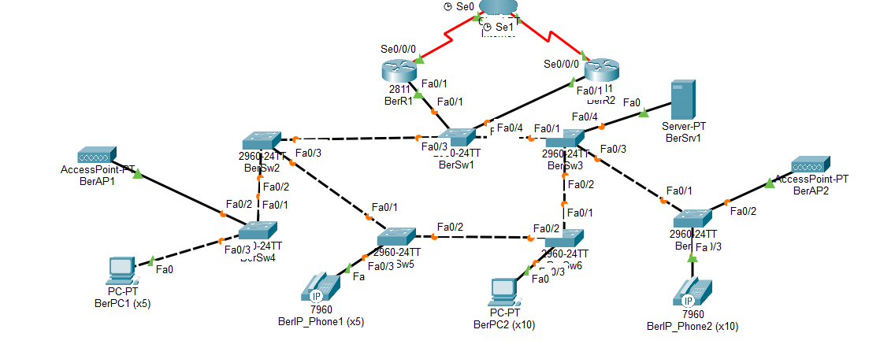
Initial Logical Topologies
Munich LAN
Stuttgart LAN
Berlin LAN
Munich Initial LAN

Slide 7
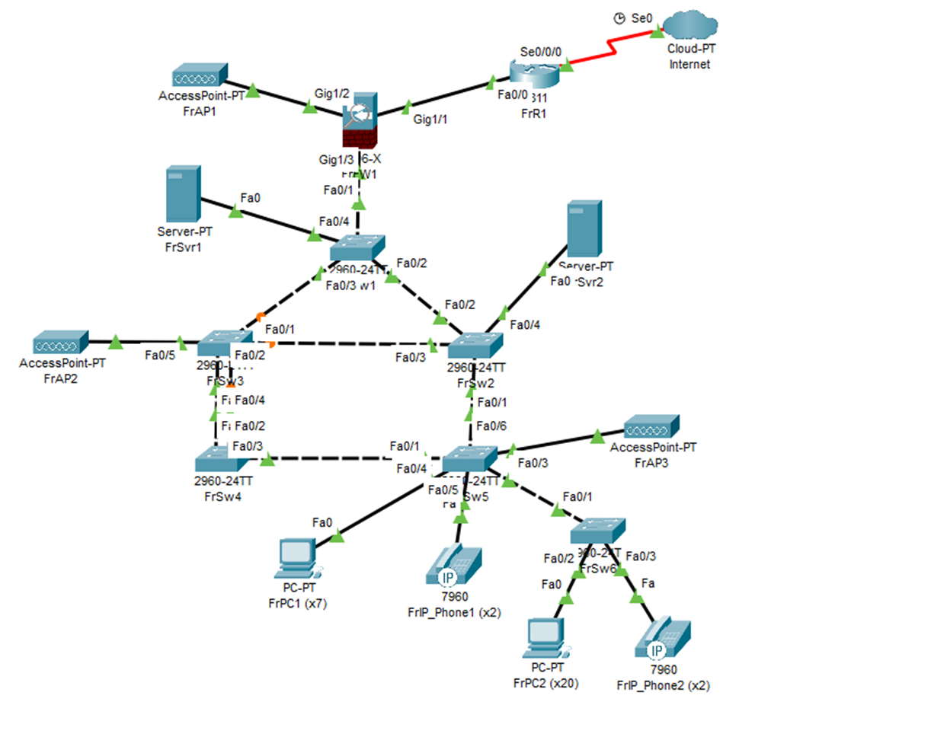
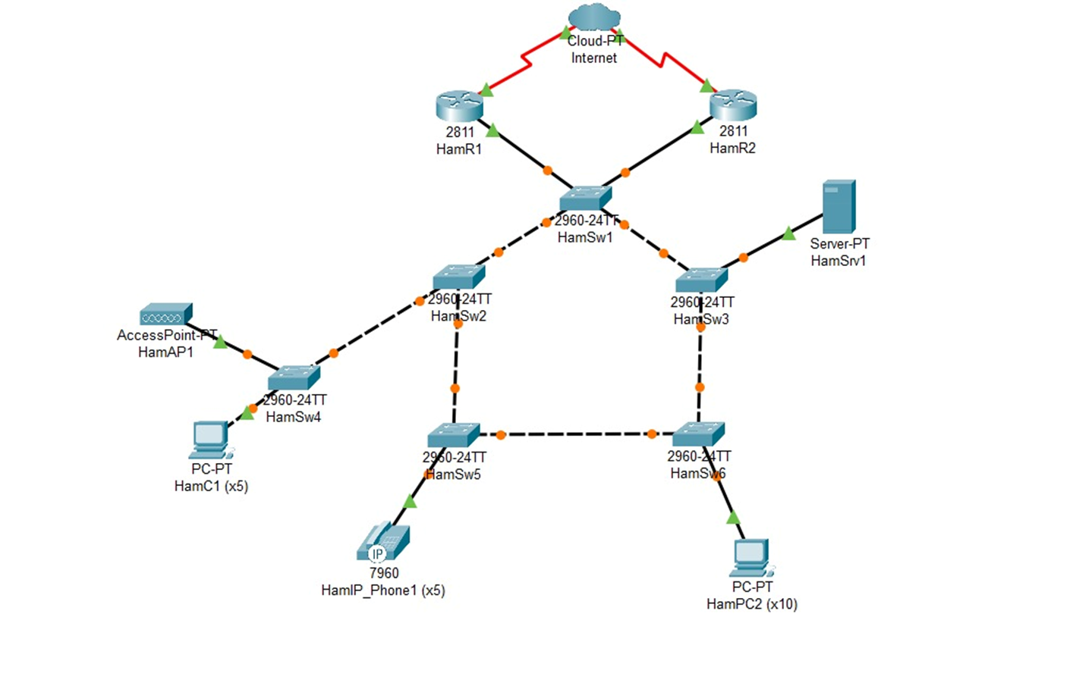
Hamburg LAN
Frankfurt LAN

Slide 8
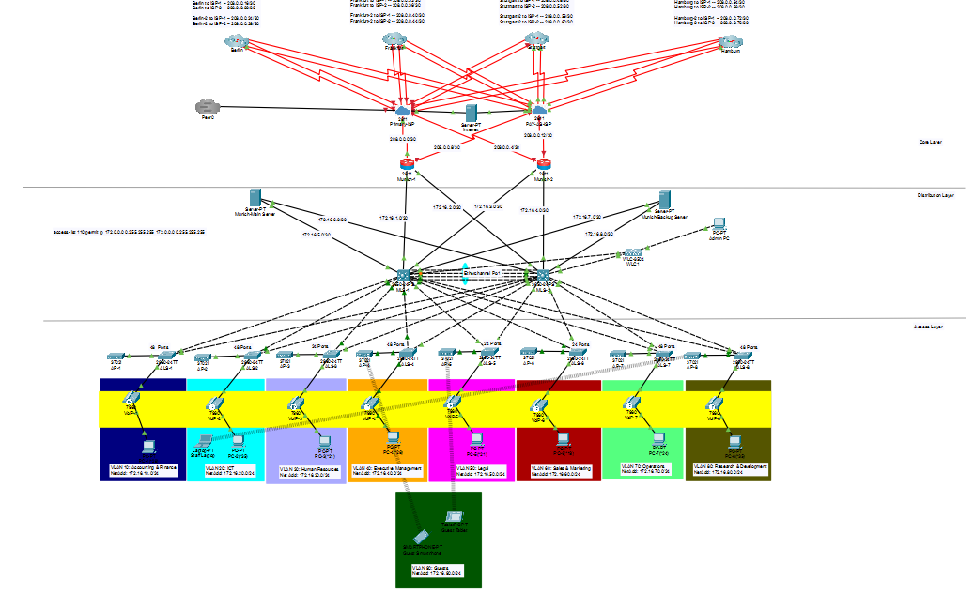
Overview Of the Updated version

Slide 9

Requirements and Specifications
Evaluate the LANs using design principles
Document changes on the RFC
Cater for 150 users, with 40% growth in five years (210 users)
Use hierarchical IPv4 scheme
Create logical topology
Create policies( Failover, Disaster recovery)
Ensure secure inter-branch connectivity
Enable VoIP services

Slide 10
Vlan | Original number of Users | No. of users (+ 40%) | Number of switchports | Number of Access Points
Accounting & Finance | 20 | 28 | 48 | 2
ICT | 25 | 35 | 48 | 2
HR | 15 | 21 | 24 | 2
Executive Management | 20 | 28 | 48 | 2
Legal | 15 | 21 | 24 | 2
Sales & Marketing | 13 | 19 | 24 | 2
Operations | 17 | 24 | 48 | 2
Research & Development | 28 | 35 | 48 | 2
Number of pc’s is equal the number of Ip-phone
Implement Class B type 172.16.0.0/16

Slide 11
Network Architecture and Design
Implemented a 3-Tier Hierarchical Architecture: Transition to a Core, Distribution, and Access layer model to enhance performance, scalability, and resilience.
OSPF – Configured on the network
The Core Layer:
Implement Dual ISP connectivity (ISP-Primary, Pay-as Use -Backup) for high availability.
The services for telephony are running on the core.
NAT – Configured
VPN – Configured
We implemented an integrated firewall, since we are running telephony services on this layer
We used a static route between ISPs, a default route pointing to the primary ISP and a floating route pointing to the PAY AS USE ISP
To demonstrate that the Lan can communicate with the Internet, We added a server connecting to the ISPs
Zone Based Firewall

Slide 12
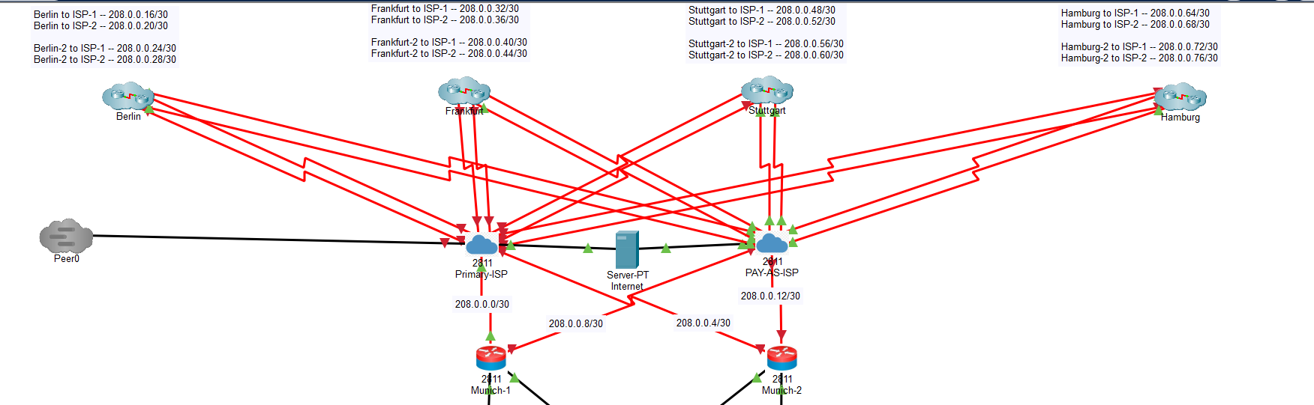

Slide 13
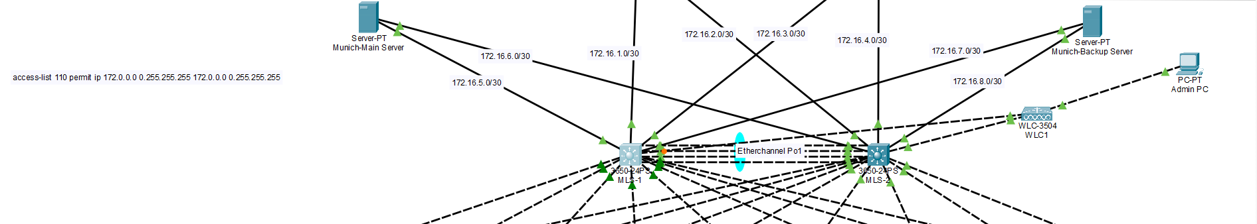
The Distribution Layer
We used HSRP for redundancy
STP – Configured for load balancing
Wireless Lan Controller – Used since there is high availability in the network, there is a lot of bandwidth and faster speed in the distribution.
On the servers we are running FTP for file transfer protocol and email services
VTP – Configured in server mode

Slide 14
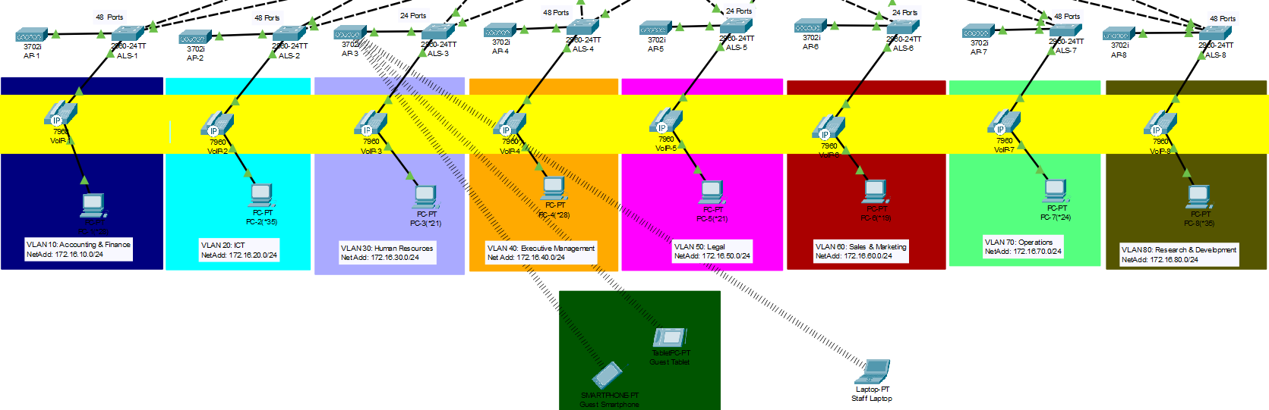
The Access Layer
We configured access ports and trunk ports to connect to the distribution layer.
Bpdu guard - Enabled to protects our network from accidental or malicious STP changes.
Vtp – Configured in client mode to receive vlans from the distribution layer
Portfast – For Faster device connectivity (no STP delay) on access ports.
Rootguard - To prevent access ports from being root bridges
For security purposes, we ran dhcp snooping for attackers not to put wrong dhcp servers in our Lans
Vty lines are protected

Slide 15
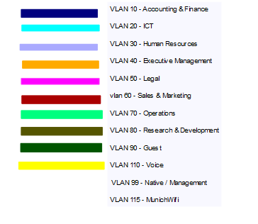
Segmentation

Slide 16
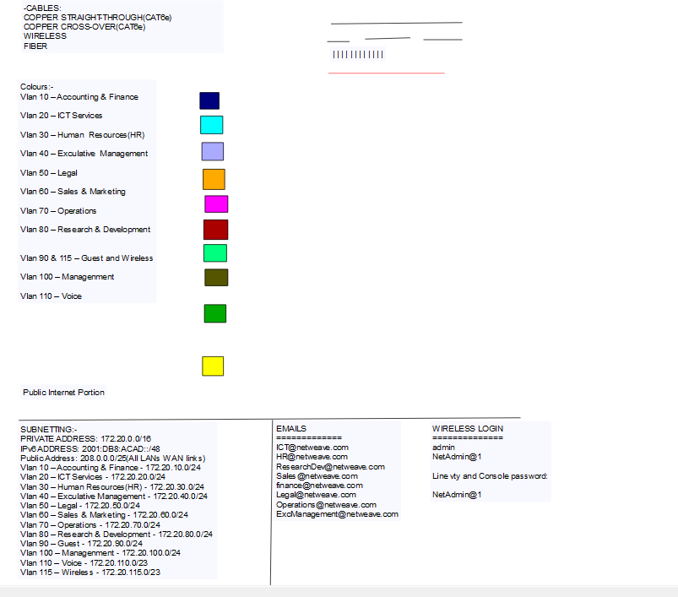
Legend

Slide 17


Conclusion
  The changes made to the network aims to improve performance, scalability and security of the network. The presentation is a logical overview of the implemented changes, for more information on the impact of the changes, please refer to the updated RFCs and Lans.

