Slide 1
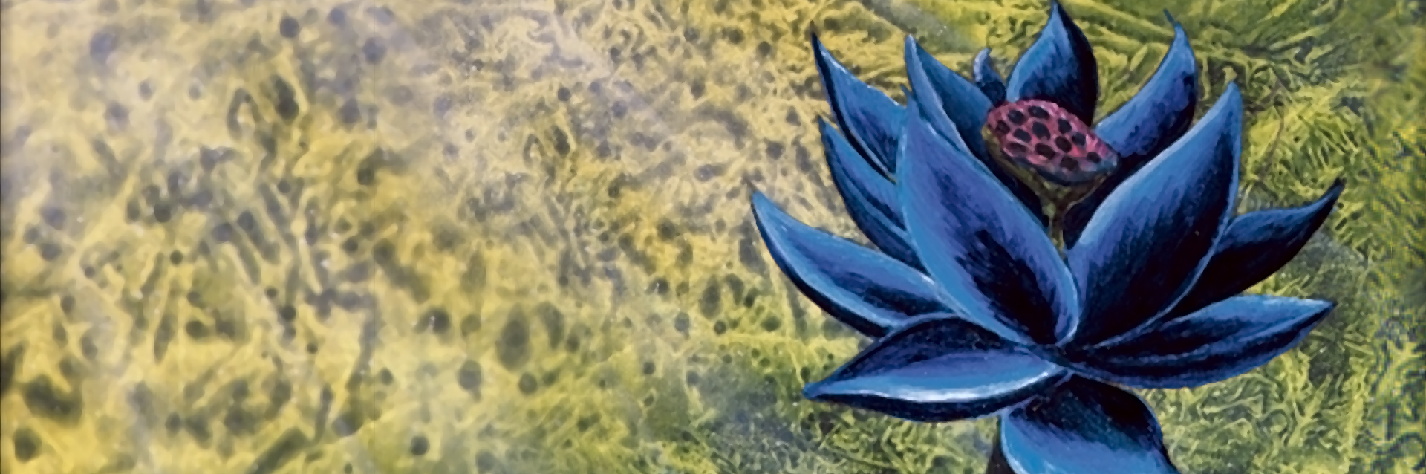
MTG_Assistant
Final upgrades and results

Slide 2
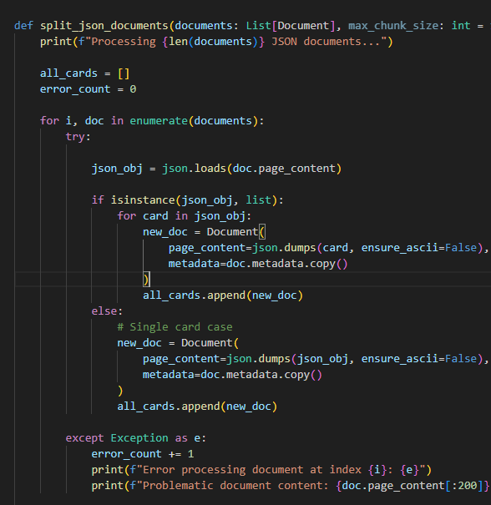
JSON spitting method changed
Was RecursiveJsonSplitter

Slide 3
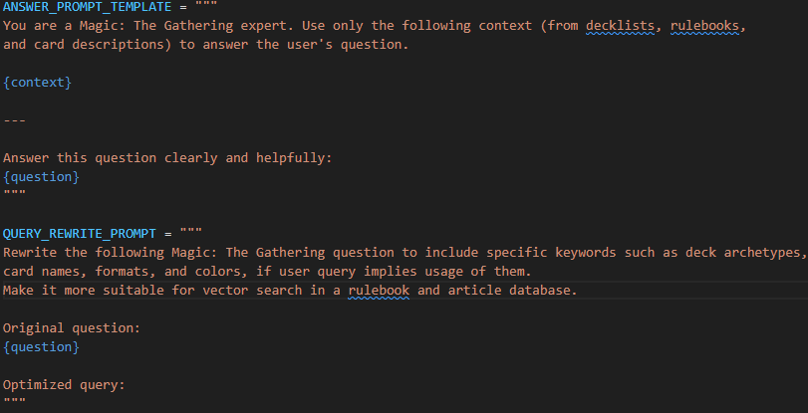
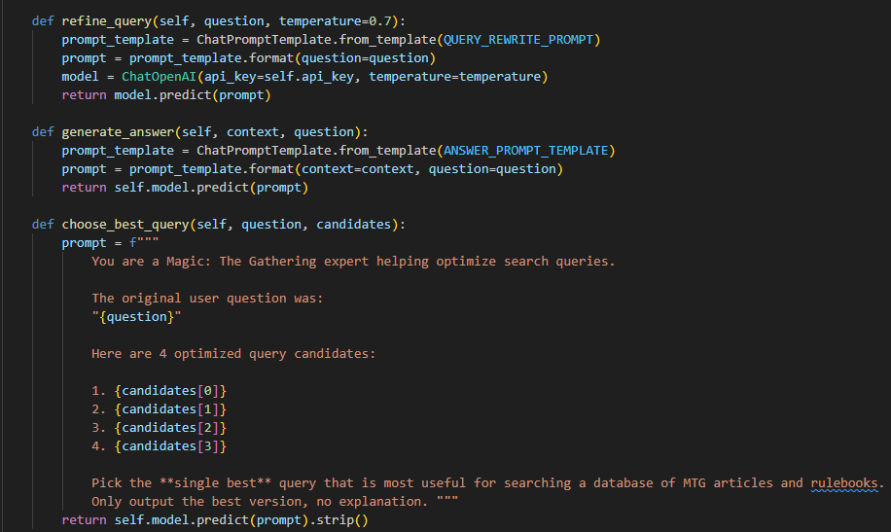
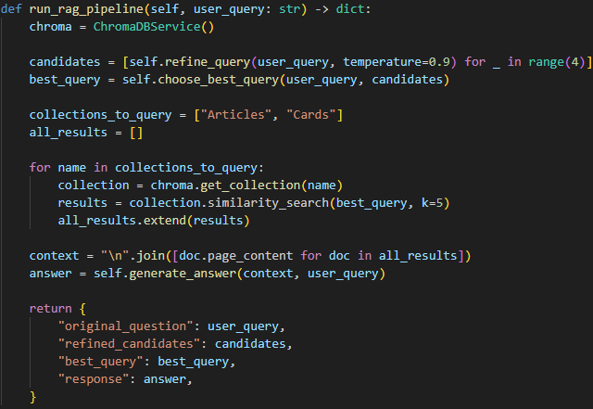
Improved main RAG pipeline
Query refinement and choice of the best query included

Slide 4
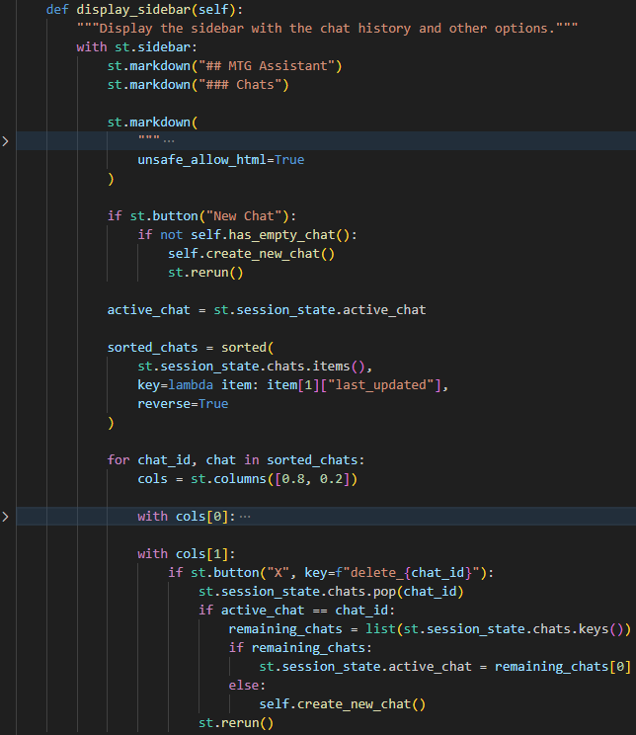
Streamlit UI improvements
Sidebar with chat history
Upgraded visual design

Slide 5
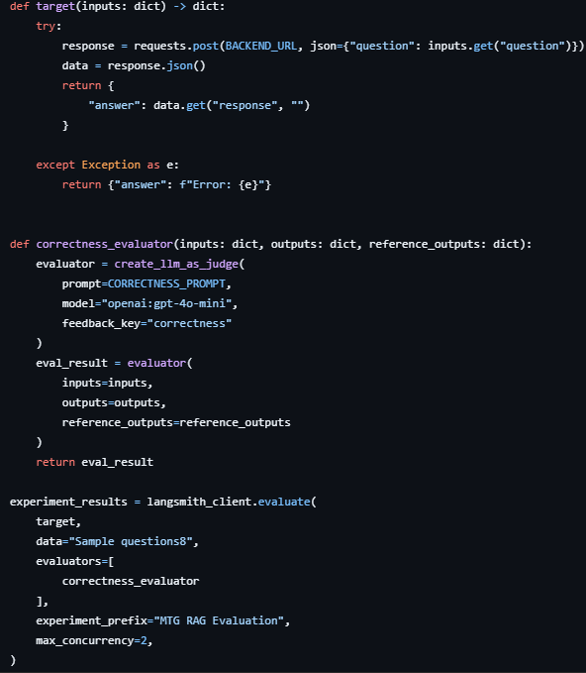
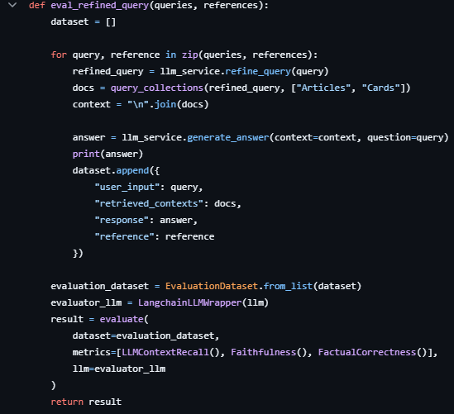
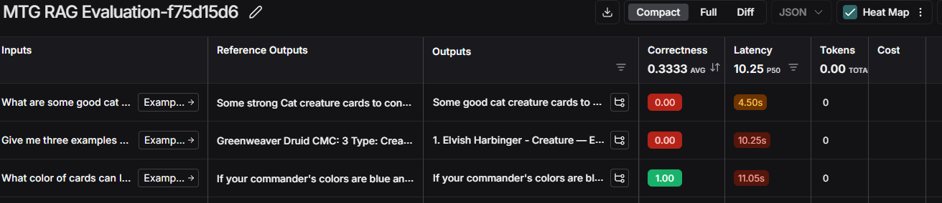
RAGAS and Langsmith tries
Problems with achieving good values of evaluation metrics
Good amount of debugging and problem solving

Slide 6
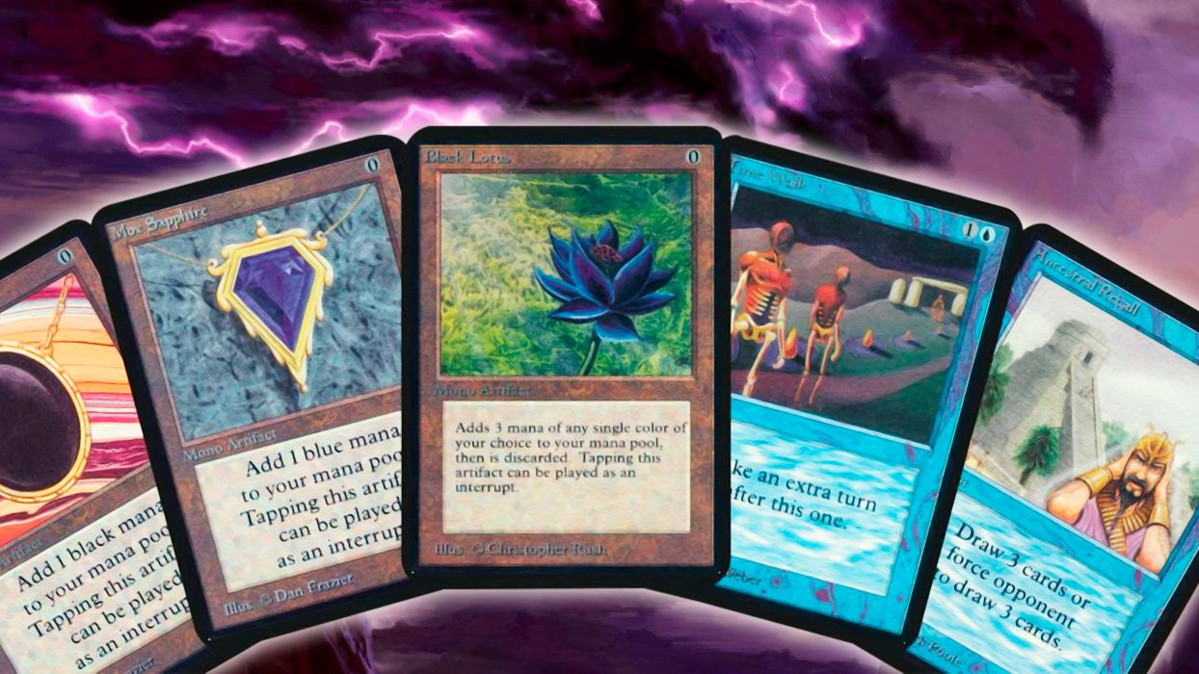
Further development:
Creating successful Langsmith evaluation pipeline
Gathering more data and dataset tuning based on eval.
Moving UI form Streamlit to a more flexible framework
Implementing card view or card hyperlink system in chat view

