Slide 1
BMI5101 GROUP 10
Reproducing scMEDAL for
batch-aware single-cell
analysis in AML
AML: Acute Myeloid Leukemia
Five-fold evaluation of fixed and random effects, benchmark methods, and model-generated donor projections
Presentation version 6 | 12 October 2026
Notes:
中文讲解
开场：我们复现的是 Andrade 等人的 scMEDAL，并没有提出新的架构。本次展示聚焦作者预处理好的 AML 数据，以及我们完成的六种方法五折实验。
AML 全称为 Acute Myeloid Leukemia（急性髓系白血病），是一种血液和骨髓肿瘤，异常、未成熟的髓系细胞增多。本项目用单细胞表达同时观察细胞状态和 donor 相关差异。
English script
Today I will present our reproduction of scMEDAL, a framework for studying shared and donor-associated variation in single-cell RNA sequencing data. We focus on acute myeloid leukemia, or AML. AML is a cancer of the blood and bone marrow in which abnormal immature myeloid cells accumulate. This makes it useful for studying both cell-state differences and differences between donors. We used the authors' preprocessed data and completed five-fold experiments for scMEDAL-FE, scMEDAL-RE, and four comparison methods. I will explain the model, show the results, and discuss what the evidence supports.
Sources / figure context
Source model: Andrade et al., Nature Communications (2026) [1]
AML definition: National Cancer Institute, https://www.cancer.gov/types/leukemia/patient/adult-aml-treatment-pdq

Slide 2
INTRODUCTION
Why batch-aware modeling matters
THE DATA
THE CHALLENGE
Single-cell RNA-seq measures thousands of genes in individual cells. [2]
AML profiles include malignant cells, normal cells, and multiple donors. [1,3]
Processing and donor differences can shift expression independently of cell identity. [1,2]
When patient group aligns with donor, aggressive integration may hide biologically useful variation. [1]
BMI5101 Group 10 • AML reproduction • Version 6
02
Notes:
中文讲解
解释：单细胞 RNA-seq 每个点是一个细胞，基因表达会受到细胞状态，也会受到 donor、样本制备等因素影响。AML 数据中，donor 与疾病状态可能相关，不能简单把所有 donor 差异都视为纯技术噪声。每条英文陈述后都列出来源。
English script
Each cell has an expression profile containing measurements for thousands of genes. Differences between profiles can reflect cell identity, but they can also reflect the donor or how the sample was processed. In AML, we also have malignant and normal cell populations. A donor may belong to only one disease group, so donor identity and disease status can overlap. The challenge is to reduce unwanted variation while keeping biologically useful differences. This motivates looking at both shared cell-state structure and donor-associated structure.
Sources / figure context
[1] Andrade et al. (2026) [2] Tung et al. (2017) [3] van Galen et al. (2019)

Slide 3
INTRODUCTION
How existing methods integrate batches
Harmony
Iteratively adjusts a PCA embedding across batches. [4]
SHARED AIM
Reduce unwanted separation between comparable cells from different batches. [1,4–6]
Scanorama
Matches similar cells across datasets. [5]
Then check whether cell-type structure remains intact. [1]
scVI
Learns a probabilistic latent representation with batch covariates. [6]
BMI5101 Group 10 • AML reproduction • Version 6
03
Notes:
中文讲解
这里只选三种有代表性、也是我们 AML 实验中实际比较的方法：Harmony 在 PCA 空间迭代校正，Scanorama 用跨数据集相似细胞匹配，scVI 用概率生成模型。scANVI 是使用细胞标签的额外比较方法，留到实验结果页介绍。已有方法不是完全消除所有 batch 信息；其目标是得到更适合比较细胞状态的整合表征。
English script
These are three representative methods that we included in our experiments. Harmony iteratively adjusts an embedding in principal-component space. Scanorama matches similar cells across datasets to align their representations. scVI learns a probabilistic representation and includes batch information in its generative model. Their shared aim is to make comparable cells easier to compare across batches while preserving useful biology. We also evaluated scANVI, which uses cell-type labels. I will explain that distinction when we reach the results.
Sources / figure context
[1] Andrade et al. (2026) [4] Korsunsky et al. (2019) [5] Hie et al. (2019) [6] Lopez et al. (2018)

Slide 4
INTRODUCTION
What batch correction may hide
USEFUL CORRECTION
THE AML COMPLICATION
Protocol and library-preparation differences can separate otherwise comparable cells. [1,2]
Donor identity can overlap with patient group; malignant cells occur in diseased samples and cell lines. [1]
Integration aims to reduce this unwanted separation. [1,4–6]
Suppressing donor-associated structure may also weaken a useful biological signal. [1]
Which batch-associated patterns are worth studying?
BMI5101 Group 10 • AML reproduction • Version 6
04
Notes:
中文讲解
这一页从已有整合方法的目标转向 scMEDAL 的核心问题。左侧是需要压低的技术差异，右侧是 AML 中可能和 donor/batch 一起变化的生物信息。对于同一个 donor 只对应一个患者分组的情形，仅凭整合图无法判定差异的技术或疾病来源。这个风险是动机，并不是声称我们已证明每种 baseline 在 AML 都过度校正。
English script
Technical differences, such as library preparation, can separate otherwise comparable cells. Integration tries to reduce that separation. However, donor-associated variation can also contain useful biology. In this AML dataset, donor identity overlaps with patient group. If we suppress all donor-associated patterns, we may also weaken a disease-related signal. This is a motivation for scMEDAL. Our results do not establish that every comparison method overcorrects this dataset. The question is which donor-associated patterns deserve further study.
Sources / figure context
[1] Andrade et al. (2026), Introduction and AML results. [2] Tung et al. (2017). [4–6] Representative integration methods.

Slide 5
INTRODUCTION
A mixed-effects perspective
Observed expression
shared cell-state structure + batch-associated variation + residual [1]
FIXED-EFFECT VIEW
RANDOM-EFFECT VIEW
Patterns that remain informative across donors and batches. [1]
Variation linked to a donor or batch, with technical or biological sources. [1]
scMEDAL learns these two views in separately trained FE and RE networks. [1]
BMI5101 Group 10 • AML reproduction • Version 6
05
Notes:
中文讲解
先用直觉讲：一份细胞表达中，既有跨 batch 共有的细胞状态，也有与 donor/batch 相关的偏移。后者可能同时包含技术因素和生物差异。这里的分解是说明思想，不是 scMEDAL 的精确生成方程。传统线性 mixed-effects model 联合估计 fixed/random effects；scMEDAL 借鉴这个视角，但 FE 和 RE 神经网络分别训练，之后才把表征结合用于预测。原文 Methods 明确说明 scMEDAL 不是形式意义上的传统 LME。
English script
A mixed-effects perspective separates patterns shared across groups from variation associated with particular groups. Here, the groups are donors or batches. The shared component may reflect cell state, while the group-associated component can contain both technical and biological variation. The decomposition on this slide is a conceptual explanation. A classical linear mixed-effects model jointly estimates its effects. scMEDAL borrows the perspective and trains two separate neural networks. Their representations can later be combined for downstream prediction.
Sources / figure context
[1] Andrade et al. (2026), Methods: mixed-effects inspiration and separately trained subnetworks. Conceptual decomposition.

Slide 6
APPROACH
Two independent views of the same cell
Input cell
Expression x; donor/batch label z
scMEDAL-FE
scMEDAL-RE
x enters encoder; z trains adversary
Batch-invariant latent
x and z condition Bayesian autoencoder
Batch-specific latent
Separately trained subnetworks; embeddings can be combined downstream. [1]
BMI5101 Group 10 • AML reproduction • Version 6
06
Notes:
中文讲解
这页的关键：FE 和 RE 是分别训练的两个自编码器。FE 尽量保留与 batch 无关的细胞状态，RE 显式保留 donor/batch 结构。它们的 embedding 可以在后续预测任务拼接，但我们的汇报目前主要评价各自的 latent 表征与反事实重建。
English script
The same cell provides two complementary views. The fixed-effects network, or FE, encodes expression and learns to make batch labels difficult to predict from its latent representation. The random-effects network, or RE, uses batch information in a Bayesian autoencoder to retain donor-associated structure. Both networks reconstruct expression, but their batch-related objectives differ. We train them separately. Although their embeddings can be concatenated for prediction, this presentation evaluates the individual representations and RE donor-conditioned reconstruction.
Sources / figure context
[1] Andrade et al. (2026), Methods and Fig. 1. Diagram is a simplified, editable summary.

Slide 7
APPROACH
What each network learns
FIXED EFFECTS
RANDOM EFFECTS
L_FE = λr·MSE − λa·CE(batch)
L_RE = λr·MSE + λb·CE(batch)
+ λk·KL(q(U) || p(U))
Reconstructs gene expression.
Conditions on batch to model its variation.
Encoder obscures batch labels; adversary learns to predict them. [1]
KL regularizes the learned weight distribution. [1]
BMI5101 Group 10 • AML reproduction • Version 6
07
Notes:
中文讲解
MSE 衡量重建表达与输入的误差。CE 是 batch 分类的交叉熵：adversary 希望准确预测 batch，FE encoder 则希望让这一预测困难。RE 的 batch 分类项方向为正，鼓励表征保留 batch 信息。KL 约束随机权重的近似后验 q(U) 与先验 p(U) 的差异。这些式子是汇报用的简化记号。来源：https://www.nature.com/articles/s41467-026-72666-4 ，Methods Eqs. 2 and 8。
English script
Both networks include a reconstruction objective. Mean squared error measures the difference between input expression and reconstructed expression. In FE, the batch classifier tries to predict the correct batch, while the encoder tries to make that prediction difficult. These are competing objectives. In RE, the batch classification term encourages the representation to retain batch information. The KL term regularizes the approximate posterior distribution of random weights against its prior. The equations on this slide summarize these objectives with simplified notation.
Sources / figure context
[1] Andrade et al. (2026), Eqs. 2 and 8; simplified notation.

Slide 8
EXPERIMENT
AML five-fold reproduction: data and compute
23,049
19
2,916
5
cells [1]
batches [1]
selected genes [1]
train/val/test folds
SHARED EVALUATION
MODEL TRAINING
Author-provided log-transformed AML splits.
FE and RE: 512 / 132 hidden units, 500-epoch cap.
50-dimensional representations; metrics sample up to 10,000 cells.
Early stopping patience 30; formal GPU jobs on NSCC.
BMI5101 Group 10 • AML reproduction • Version 6
08
Notes:
中文讲解
我们使用作者预处理好的 AML split，不复现 FASTQ 比对或 upstream QC。相同五个 split 用于六种方法，模型输出保存在 NSCC ASPIRE 2A；这里只报告验证过的 formal runs。
English script
We used the authors' preprocessed AML data and supplied train, validation, and test splits. The analysis covers nineteen donor or batch categories and 2,916 selected genes. We used fifty-dimensional representations and five folds for all six methods. Clustering metrics sample up to ten thousand cells. FE and RE use hidden layers of 512 and 132 units, with a five-hundred-epoch cap and early stopping. The formal jobs ran on NSCC ASPIRE 2A. Our reproduction starts from the processed expression data rather than raw sequencing reads.
Sources / figure context
[1] Andrade et al. (2026); local source: canonical run manifest and completed PBS logs.

Slide 9
EXPERIMENT
Compare like with like
PRIMARY READOUT
TWO DIFFERENT GOALS
Average silhouette width (ASW), reported as test-fold mean and uncertainty across five folds. [1]
FE, Harmony, Scanorama, scVI, scANVI: assess batch suppression with biology retention. [1]
Cell-type ASW: higher means clearer cell-type grouping. [1]
RE: high batch separability is intended; it is a complementary representation. [1]
scANVI uses cell-type labels; UMAP complements, but does not replace, ASW.
BMI5101 Group 10 • AML reproduction • Version 6
09
Notes:
中文讲解
ASW（average silhouette width）衡量同标签细胞在 latent space 的可分离程度。对于 cell type，越高一般越好；对于 batch-correction embedding，我们看 batch 可分离度是否降低。RE 目标恰好是捕获 batch，所以不能把它当成 correction method 排名。scANVI 使用细胞类型标签，因此是 label-informed baseline。
English script
Our primary readout is average silhouette width, or ASW. It summarizes how well a label separates cells in the latent space. Higher cell-type ASW generally indicates clearer cell-type grouping. For batch-invariant methods, we also examine whether batch separation is reduced. RE has a different objective, because it deliberately captures batch-associated structure. We therefore interpret its batch ASW separately. scANVI uses cell-type labels during training. UMAP provides a qualitative view alongside the numerical evaluation.
Sources / figure context
[1] Andrade et al. (2026), Experiment 1. UMAP panels are qualitative.

Slide 10
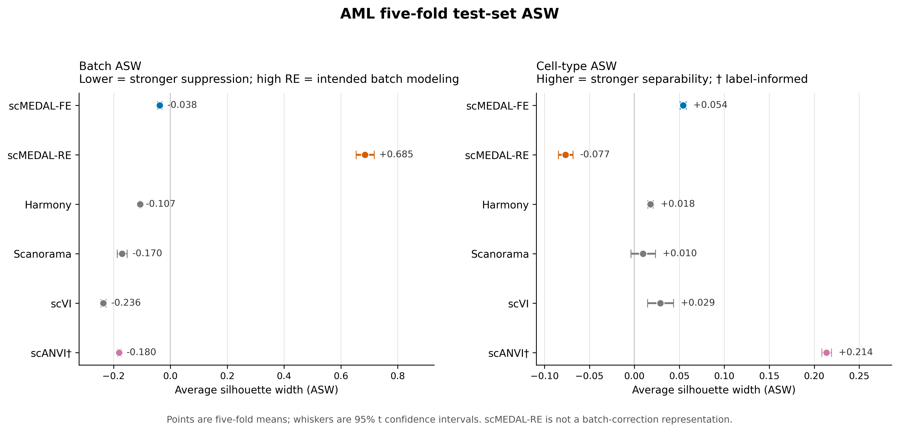
RESULTS
Five-fold test ASW across six methods
BMI5101 Group 10 • AML reproduction • Version 6
10
Notes:
中文讲解
这张图直接来自我们统一汇总的五折 held-out test 结果。点是五折均值，误差线是 t 分布 95% CI。右侧 scANVI 使用标签，所以高 cell-type ASW 不能和无标签方法解释为完全同条件优越。左侧 RE 高 batch ASW 是有意设计。
English script
These points show the mean ASW across five held-out test folds. The whiskers show ninety-five percent Student-t intervals calculated from fold variation. On the right, FE has higher cell-type ASW than Harmony, Scanorama, and scVI in this evaluation. scANVI has the highest value, and its use of cell-type labels is important context. On the left, RE has strong batch separation, consistent with its intended role. The folds reuse donors, so the intervals do not describe uncertainty across five independent donor cohorts.
Sources / figure context
Our reproduction: five-fold held-out test ASW with 95% t CIs. RE is shown as a batch-modeling reference.

Slide 11
RESULTS
The numerical result: mean ± SD
Method | Batch ASW | Cell-type ASW | Role
scMEDAL-FE | −0.038 ± 0.006 | 0.054 ± 0.003 | batch-invariant
scMEDAL-RE | 0.685 ± 0.026 | −0.077 ± 0.007 | batch-specific
Harmony | −0.107 ± 0.001 | 0.018 ± 0.002 | integration
Scanorama | −0.170 ± 0.014 | 0.010 ± 0.011 | integration
scVI | −0.236 ± 0.007 | 0.029 ± 0.012 | generative
scANVI † | −0.180 ± 0.005 | 0.214 ± 0.004 | label-informed
† scANVI uses cell-type labels during training. RE is not a batch-correction embedding.
BMI5101 Group 10 • AML reproduction • Version 6
11
Notes:
中文讲解
表格给出精确五折均值和样本标准差，避免只凭 UMAP 读数。FE cell-type ASW 高于 Harmony、Scanorama 和 scVI；scANVI 高得多，但其训练使用细胞类型标签。RE 的 batch ASW 高，符合 batch-specific 目标。这里不声称 FE 在所有指标上最好。
English script
This table reports the same results as means and standard deviations across folds. FE has cell-type ASW of about 0.054 and batch ASW of about minus 0.038. RE has batch ASW of about 0.685 and cell-type ASW of about minus 0.077. scANVI reaches about 0.214 for cell type, with label-informed training. The table makes the trade-offs easier to see. It supports conclusions about these representations on this AML dataset, rather than a claim that one method performs best in every setting.
Sources / figure context
Our reproduction: test_metrics_long.csv (n = 5 folds). Values rounded to 3 decimals.

Slide 12
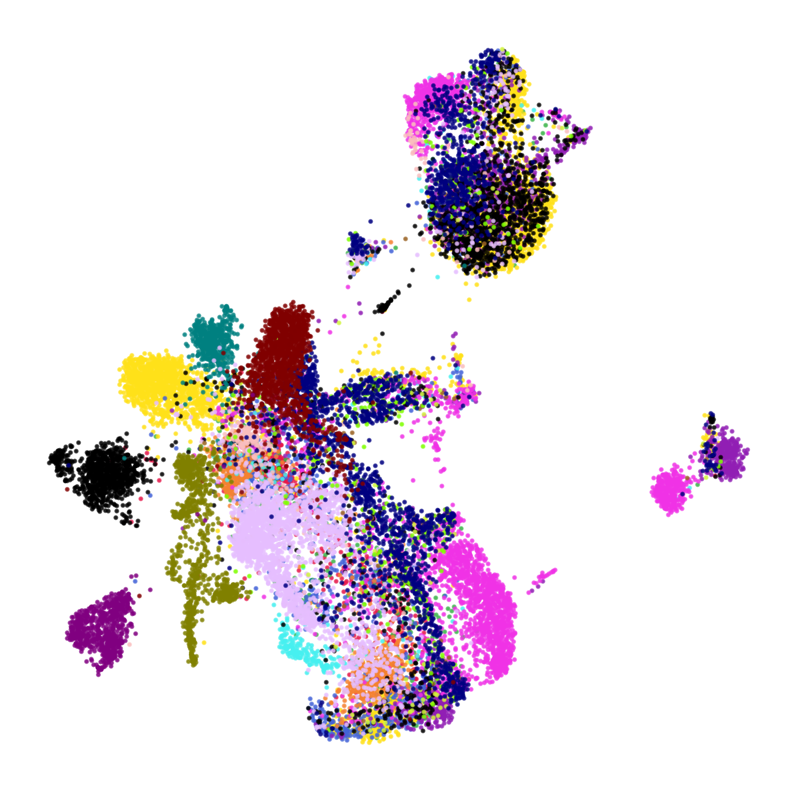

RESULTS
UMAP makes FE and RE behavior visible
scMEDAL-FE: partial batch mixing
scMEDAL-RE: separated batches
BMI5101 Group 10 • AML reproduction • Version 6
12
Notes:
中文讲解
两个 panel 都来自 fold 1 的 train split；每点一个细胞，同色代表同一个 batch。FE 中部分颜色混合，RE 中大量批次形成明显单色岛。UMAP 只作定性补充；两个坐标系各自拟合，不应比较点到点坐标或岛之间距离。
English script
Each point is a cell from the fold-one training partition, and each color represents a batch. FE shows partial mixing of batch colors, with some donor-associated regions still visible. RE shows many clearly separated batch islands. This agrees with their different objectives. The two UMAPs have independently fitted geometries, so their axes and distances cannot be compared directly. We use the label patterns as a qualitative explanation and the five-fold test metrics as the quantitative evidence.
Sources / figure context
Our reproduction: fold 1 training partition, 19-batch coloring. UMAP geometry is qualitative.

Slide 13
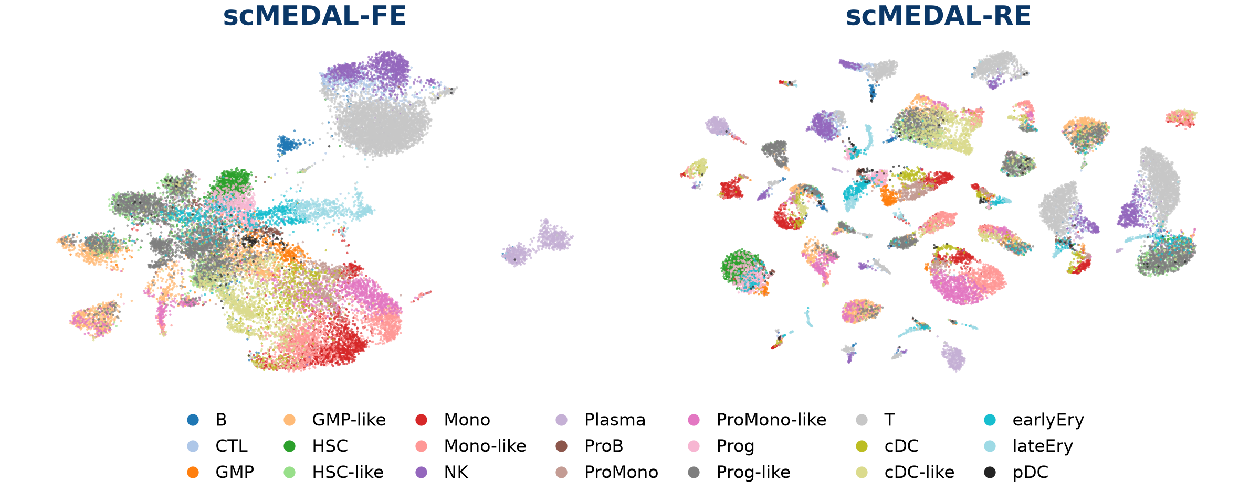
RESULTS
Cell-type structure differs between FE and RE
Test cell-type ASW: FE 0.054; RE −0.077. Donor structure can split the same cell type.
BMI5101 Group 10 • AML reproduction • Version 6
13
Notes:
中文讲解
这里重绘已有的 fold-1 train UMAP 坐标，没有重新拟合 UMAP。两幅图包含相同细胞，颜色代表原有 cell-type 注释。FE 的 T/NK/Plasma 等局部结构仍可见；RE 将部分相同细胞类型分布在不同 donor 岛上，符合 batch-specific 表征目的。整体 cell-type ASW 仍不高，不能仅根据漂亮的 UMAP 宣称完全保留生物信号。来源：results/presentation/figure_manifest.json 和 results/metrics/test_metrics_long.csv。
English script
These panels use the existing UMAP coordinates and color the same cells by their cell-type annotations. In FE, some local structures, including T cells, natural killer cells, and plasma cells, remain visible. In RE, cells with the same annotation can appear in several donor-specific islands. This is consistent with RE emphasizing donor structure. FE's test cell-type ASW is still modest, so the visual patterns alone cannot establish complete biological preservation. We need both the plots and numerical summaries.
Sources / figure context
Reproduction: fold 1 training UMAP, same cells, existing coordinates. Test ASW summarizes five folds.

Slide 14
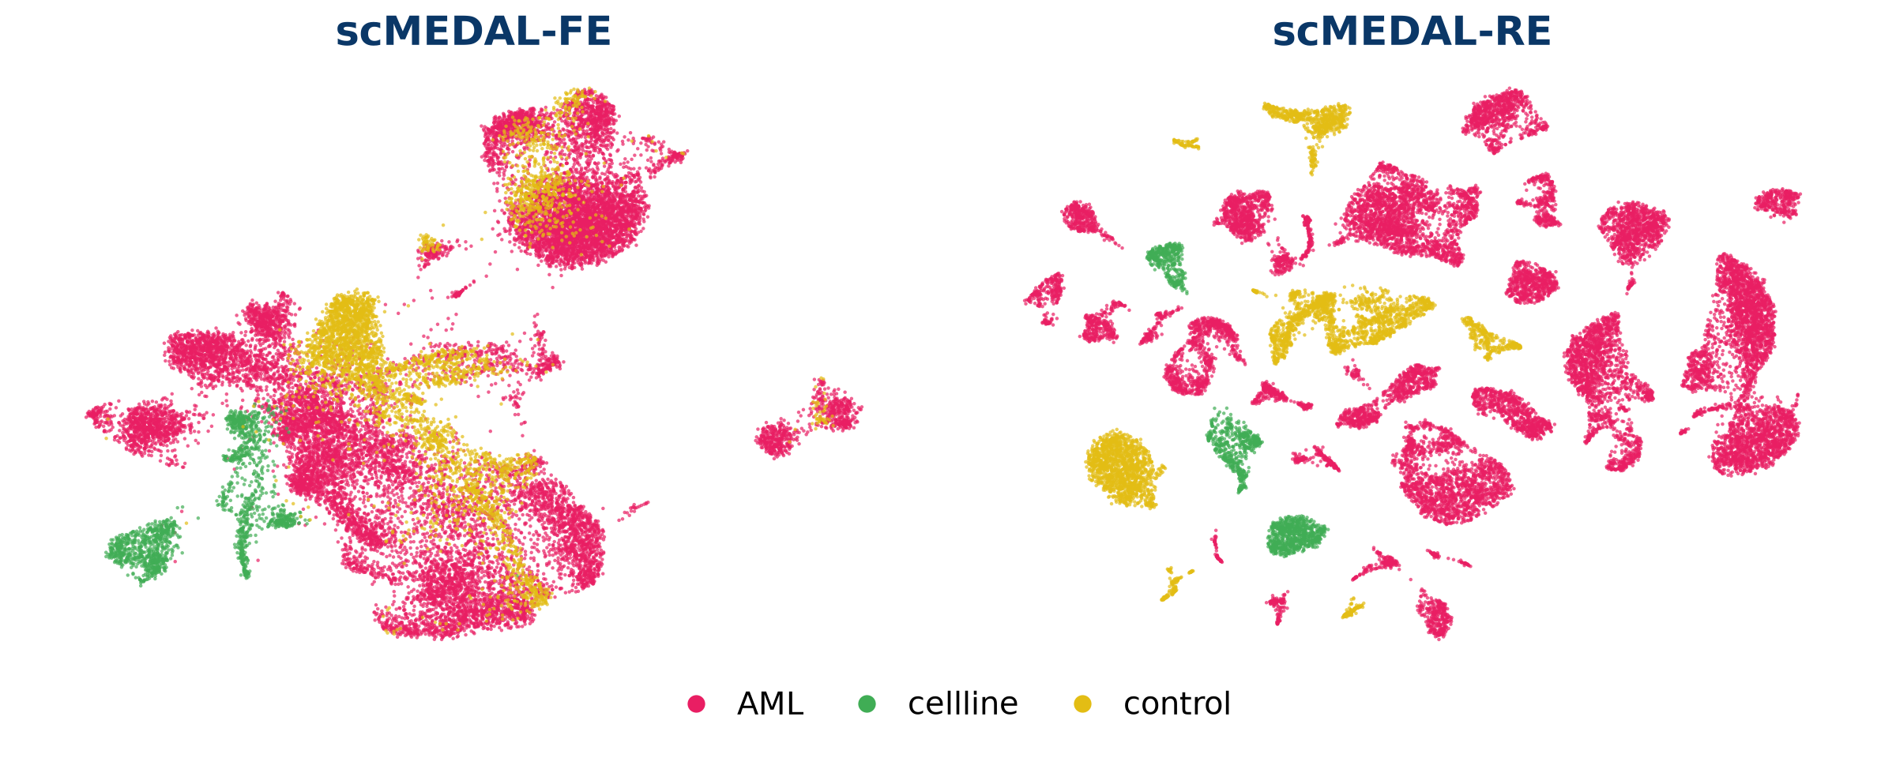
RESULTS
Patient-group patterns follow donor structure
RE retains group-associated structure; donor and patient group remain linked.
BMI5101 Group 10 • AML reproduction • Version 6
14
Notes:
中文讲解
颜色为 AML、control 和 cellline。RE 表征中患者分组形成局部结构，与按 donor 着色的结果一致。但这里 patient group 与 donor 身份相关联，分组清晰不能独立证明疾病原因。FE 和 RE 的坐标各自拟合，不能比较图之间的点坐标或距离。来源：results/presentation/figure_manifest.json；作者论文 Fig. 4。
English script
Now we color the same coordinates by patient group: AML, control, and cell line. RE retains group-associated patterns that also follow donor structure. The important qualification is that donor identity and patient group are linked in this dataset. Clear group separation therefore does not isolate a disease-specific mechanism. This panel helps us inspect the labels together and identify where donor-aware biological validation would be useful.
Sources / figure context
Reproduction: fold 1 training cells, three annotated groups. Independently fitted UMAP geometry is qualitative.

Slide 15
INTERPRETATION
A donor-swap reconstruction is an as-if simulation
1 Encode one cell
2 Swap donor label
3 Reconstruct
Hold the learned
cell-specific latent r fixed.
Replace z with a target
donor or batch label.
Decode a model-generated
expression profile x̂(r,z).
Interpretation: a model-generated hypothetical expression profile
BMI5101 Group 10 • AML reproduction • Version 6
15
Notes:
中文讲解
操作是固定一个细胞的 RE latent，替换输入的 donor/batch one-hot label，让 decoder 重建基因表达。比较不同 donor 条件下模型生成的表达。这个结果是模型的假设性 as-if simulation；不能据此推断改变 donor 会因果性地改变该细胞。
English script
RE also supports donor-swap reconstruction. We first encode a source cell and hold its learned representation fixed. We then replace the donor or batch label with a target label and reconstruct expression. Repeating this step lets us compare the profiles generated under different target conditions. We describe this as an as-if simulation: a hypothetical profile produced by the model under a substituted label. Its interpretation depends on the learned model and the observed data, with causal validation requiring additional evidence.
Sources / figure context
[1] Andrade et al. (2026), Methods and counterfactual figures; our wording emphasizes simulation scope.

Slide 16
RESULTS
Selected donor-conditioned gene shifts
Δ predicted expression = AML-target mean − control-target mean
TXNIP
-0.086
FTL
-0.077
SAMSN1
-0.071
HIST1H1D
+0.065
-0.15
-0.10
-0.05
0.00
+0.05
+0.10
Across 2,916 genes, 216 had the same modeled AML−control direction in all five folds.
BMI5101 Group 10 • AML reproduction • Version 6
16
Notes:
中文讲解
这一页是已完成的五折 Mono/Mono-like source-cell 分析。横轴是模型预测的 target AML donor 平均值减 target control donor 平均值；点为五折平均，线为五折标准差。选的四个基因用于说明读图，不是验证的生物标志物。Target donors 在各折重复出现，五折不是五个独立 donor cohort。
English script
We analyzed held-out test cells annotated as Mono or Mono-like. For each gene, we calculated the average reconstruction across AML target donors minus the average across control target donors. The points show five-fold mean differences, and the whiskers show fold standard deviation. TXNIP, FTL, and SAMSN1 have negative differences, while HIST1H1D has a positive difference. Across all 2,916 genes, 216 retain the same direction in every fold. These are selected descriptive examples of model outputs, with the same target donors recurring across folds.
Sources / figure context
Our reproduction: five-fold Mono/Mono-like analysis; points = fold means, whiskers = fold-to-fold SD. Descriptive as-if simulation.

Slide 17
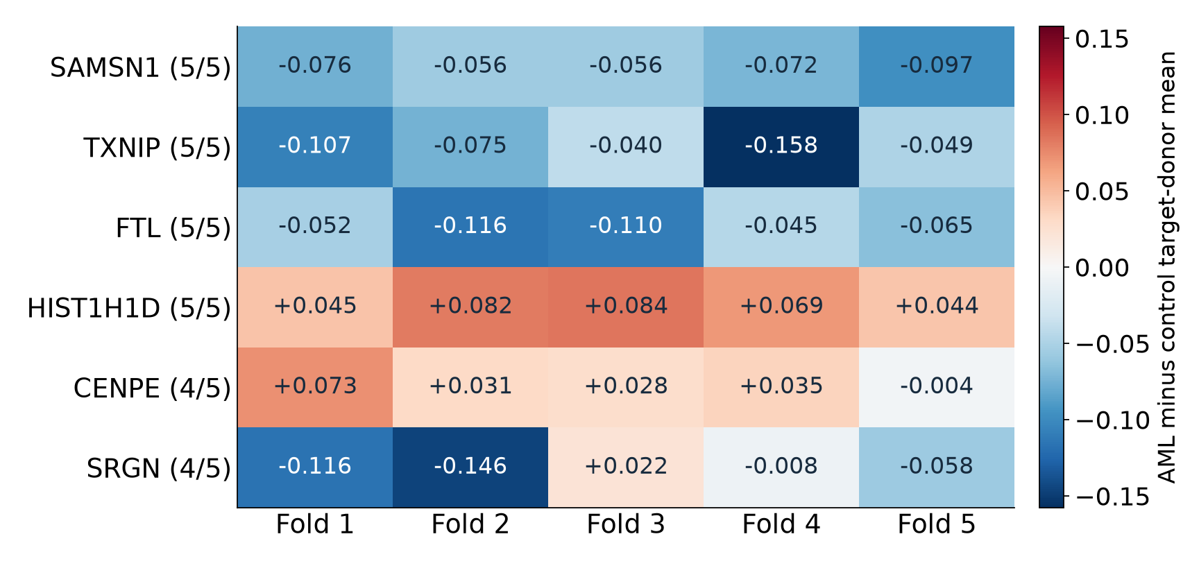
RESULTS
Selected reconstruction shifts across five folds
HOW TO READ
Red: AML-target mean higher
Blue: control-target mean higher
5/5 counts direction consistency across folds.
Direction stability is descriptive. Fold 1 had zero BH-FDR < 0.05 genes.
BMI5101 Group 10 • AML reproduction • Version 6
17
Notes:
中文讲解
热图展示六个例子，不是按显著性选出的 marker。每列为一个 held-out source-cell fold；每个 fold 使用相同的 target donors。颜色和数字为 target AML donor 平均表达减 control donor 平均表达。SAMSN1、TXNIP、FTL、HIST1H1D 在五折中方向一致，CENPE 和 SRGN 只有四折同方向。216 个基因在五折方向一致描述了模型结果稳定性；fold 1 的 BH-FDR 检验没有低于 0.05 的基因。来源：results/counterfactual/fivefold_mono_monolike/aml_counterfactual_fivefold_gene_stability.csv。
English script
The heatmap shows how the selected effects vary across folds. Red indicates a higher AML-target mean, and blue indicates a higher control-target mean. SAMSN1, TXNIP, FTL, and HIST1H1D retain the same direction in all five folds. CENPE and SRGN do so in four folds. Direction consistency describes stability of the modeled contrast. In the fold-one gene-level analysis, no gene passed a Benjamini-Hochberg false-discovery-rate threshold of 0.05. These examples therefore remain exploratory patterns for further validation.
Sources / figure context
Reproduction: selected_gene_stability.csv. Same target donors recur across folds. Model-generated as-if simulation.

Slide 18
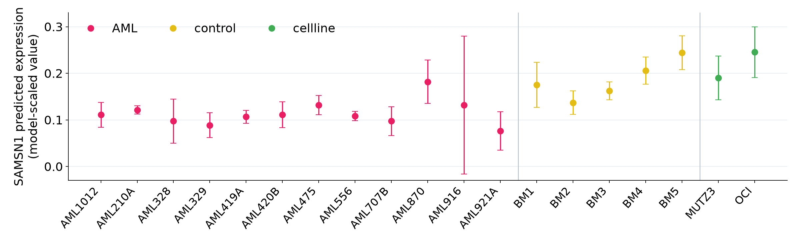
RESULTS
SAMSN1 predictions vary across target donors
Mean AML minus control: −0.0713
After excluding BM5: −0.0565, with the direction retained.
BMI5101 Group 10 • AML reproduction • Version 6
18
Notes:
中文讲解
每个点是一种 target donor/batch 条件下的模型预测表达，按五个 source-cell/model folds 取均值，误差线为折间 SD。这里 AML/control 的组均值并不代表每个 donor 都一致。BM5 的预测值较高。逐一排除 control donor 的已有分析显示，SAMSN1 的负向差异在每次排除后都保留；排除 BM5 后，均值差异由 −0.0713 变为 −0.0565，说明幅度仍对 donor 选择敏感。来源：samsn1_donor_summary.csv 与 selected_control_donor_sensitivity.csv。
English script
This plot focuses on SAMSN1 under all nineteen target donor conditions. Each point shows the mean across five source-cell and model folds, with fold standard deviation. Individual donors vary, even within the same patient group. BM5 has a relatively high predicted value. Omitting BM5 changes the AML-minus-control mean from about minus 0.0713 to minus 0.0565. The negative direction remains, but its magnitude changes. This illustrates why a group average should be accompanied by donor-level inspection and sensitivity analysis.
Sources / figure context
Reproduction: same target donors in five source-cell folds. Points = fold mean; bars = fold SD. Model-scaled expression.

Slide 19
DISCUSSION
Interpretation of the AML evaluation
BATCH-INVARIANT REPRESENTATIONS
BATCH-SPECIFIC REPRESENTATION
FE has modest cell-type separation: ASW 0.054, compared with 0.018 for Harmony, 0.010 for Scanorama and 0.029 for scVI.
RE has high batch ASW (0.685) and fragmented cell-type structure (−0.077), consistent with its donor-aware objective. [1]
Its raw batch ASW is closer to zero (−0.038), indicating more residual batch structure under this readout.
scANVI has the highest cell-type ASW (0.214) and uses cell-type labels during training. [7]
Both labels matter. Combined FE+RE prediction requires a separate evaluation.
BMI5101 Group 10 • AML reproduction • Version 6
19
Notes:
中文讲解
这页把数值和原论文的预期放在一起解释。FE 的 cell-type ASW 高于几个无标签 baseline，但绝对值仍较低，batch 结构也残留。RE 的目标为 donor/batch 结构，因此不按去 batch 的目标给 RE 排名。scANVI 用了 cell-type labels。作者强调 RE 可补充其他表征用于预测；本次已完成的结果支持不同表征模式，预测层面的互补收益还需要 FE 与 FE+RE 的分类比较。Raw batch ASW 是当前记录的标签分离指标，受群体组成影响，结果不能等同于所有混合指标的综合排名。来源：results/metrics/test_metrics_long.csv；https://www.nature.com/articles/s41467-026-72666-4 。
English script
Taken together, FE shows modest cell-type separation and some remaining batch structure. Its cell-type ASW exceeds several unsupervised comparison methods in this evaluation, while its raw batch ASW suggests more residual batch separation under this readout. Cell composition also affects that metric. RE shows strong donor separation, which matches its batch-specific objective. scANVI performs well on cell-type ASW with label-informed training. These results establish different representation patterns. The predictive benefit of combining FE and RE requires a separate downstream evaluation.
Sources / figure context
Reproduction: five-fold held-out test means. [1] Andrade et al. (2026). [7] Xu et al. (2021).

Slide 20
DISCUSSION
Limitations and next experiments
DATA AND EVALUATION
RECONSTRUCTION
One author-preprocessed AML dataset. Cell-level folds reuse donors across partitions.
Target donors recur across folds. Fold-to-fold variation does not measure independent-cohort uncertainty.
Current evidence uses ASW and qualitative UMAP. Additional local mixing and biology checks would broaden validation.
Priorities: donor-held-out validation, FE+RE prediction, and a controlled FE loss-weight study.
Interpretation scope: model-generated as-if simulations with donor–group confounding.
BMI5101 Group 10 • AML reproduction • Version 6
20
Notes:
中文讲解
数据范围是一个作者预处理的 AML 数据集。既有五折为细胞层面划分，相同 donor 在训练、验证、测试中重复，因此结果描述这些 donor 上的细胞泛化，而非新 donor 泛化。反事实分析同样重复使用 target donors，折间 SD 表示模型/细胞折波动。Fold 1 的 donor 级检验没有 FDR<0.05 的基因。下一步可用第二个数据集或 donor-held-out 验证，并另外检验 FE+RE 预测收益。FE 权重敏感性作为未来实验，当前展示只使用已完成的原始参数结果。
English script
Our evidence comes from one author-preprocessed AML dataset. The supplied folds split cells and reuse donors across partitions, so they do not directly test generalization to entirely new donors. Our current evaluation relies on ASW and qualitative UMAPs. Reconstruction analysis also reuses the same target donors across folds. Useful follow-up experiments include donor-held-out validation, additional checks of biological preservation, and a comparison of FE with combined FE-plus-RE prediction. A controlled FE loss-weight study remains prospective work.
Sources / figure context
Sources: canonical run records and reconstruction summaries. [1] scMEDAL. [8] Integration benchmark.

Slide 21
CONCLUSION
Conclusion
01
This reproduction evaluates independent FE and RE networks on the authors’ AML splits.
02
Five-fold results distinguish batch-invariant and batch-specific representation patterns.
03
Donor-swap reconstructions reveal descriptive patterns and donor sensitivity.
BMI5101 Group 10 • AML reproduction • Version 6
21
Notes:
中文讲解
结论围绕已经完成的内容：正式训练了 FE/RE 和四种 baseline，得到同一 AML 数据上的五折评估；FE 和 RE 展现不同的标签结构；重建结果提供了 donor 条件下的模型表达与稳定性信息。FE+RE 的预测收益仍是需要另外检验的问题，当前结论聚焦表征差异与探索性重建。
English script
The main conclusion is that we reproduced and evaluated separate FE and RE networks, together with four comparison methods, on the authors' AML splits. Their five-fold results and visualizations show distinct shared and donor-associated patterns. Donor-swap reconstruction provides an exploratory view of modeled expression differences and sensitivity to individual target donors. The scope of our conclusions is this dataset and these completed analyses. Broader generalization and downstream predictive improvement remain questions for future experiments.
Sources / figure context
Scope: one preprocessed AML dataset with five-fold evaluation and model-generated as-if simulations.

Slide 22
REPRODUCIBILITY
Reproducibility archive
github.com/s2275157/
BMI5101-group10-scMEDAL-repruduction
PRESENTATION
EVIDENCE
Editable deck and a guide to the result figures.
Canonical run manifest, environment notes, five-fold tables, and figure-generation scripts.
README links the upstream implementation and author-provided data.
BMI5101 Group 10 • AML reproduction • Version 6
22
Notes:
中文讲解
代码和小型结果已公开。PPT 中用到的主图位于 results/presentation，完整五折 ASW 与反事实结果表保存在原有 results 子目录。论文作者的代码与预处理数据来源在 README 中链接。当前仓库保存的是执行记录、评估和重绘脚本，正式训练入口使用作者仓库。原始细胞表达、完整 per-cell 坐标和模型权重保留在本地/NSCC。公开网址：https://github.com/s2275157/BMI5101-group10-scMEDAL-repruduction 。
English script
The GitHub repository contains the reproducibility records and small derived results used in this presentation. It includes the canonical run manifest, environment notes, metric tables, and plotting scripts. The README links the original implementation and author-provided data. Large expression matrices, per-cell coordinate files, and model weights remain outside the public archive. This allows readers to trace our results and regenerate the presentation figures from the corresponding analysis outputs.
Sources / figure context
Public archive: README.md, reproducibility/, results/, presentations/. Derived figures and summary tables.

Slide 23
REFERENCES
References and reproducibility sources
[1] Andrade AX et al. scMEDAL. Nature Communications 17, 7075 (2026). doi:10.1038/s41467-026-72666-4.
[2] Tung P-Y et al. Batch effects and effective design in scRNA-seq. Scientific Reports 7, 39921 (2017).
[3] van Galen P et al. Single-cell RNA-seq reveals AML hierarchies. Cell 176, 1265–1281.e24 (2019).
[4] Korsunsky I et al. Harmony. Nature Methods 16, 1289–1296 (2019).
[5] Hie B et al. Scanorama. Nature Biotechnology 37, 685–691 (2019).
[6] Lopez R et al. scVI. Nature Methods 15, 1053–1058 (2018).
[7] Xu C et al. scANVI. Molecular Systems Biology 17, e9620 (2021).
[8] Tran HTN et al. Benchmark of 14 batch-correction methods. Genome Biology 21, 12 (2020). doi:10.1186/s13059-019-1850-9.
[9] Luecken MD et al. Benchmarking atlas-level integration. Nature Methods 19, 41–50 (2022). doi:10.1038/s41592-021-01336-8.
[10] Townsend HA et al. Single-cell data and genetics in inflammation. Frontiers in Immunology 15, 1454263 (2024). doi:10.3389/fimmu.2024.1454263.
Reproduction evidence: canonical run manifest; AML test_metrics_long.csv; five-fold counterfactual summary; fold-1 UMAP assets.
BMI5101 Group 10 • AML reproduction • Version 6
23
Notes:
中文讲解
列出模型、数据集与四种比较方法的原始论文。自己的结果来源是现有 CSV、UMAP 与 counterfactual 汇总；在正式版中可再添加 GitHub commit 和日期。
English script
These references cover the scMEDAL framework, the AML dataset, the comparison methods, and the related integration literature. Our experimental values come from the archived result tables and reconstruction summaries. The repository provides the provenance for those figures. I am happy to discuss either the model objectives or the evaluation details during questions.

Slide 24
APPENDIX
Recorded configuration and figure provenance
Setting | scMEDAL-FE | scMEDAL-RE
Input / scaling | 2,916 log-transformed HVGs / min–max | Same input and supplied folds
Hidden / latent units | 512, 132 / 50 | 512, 132 / 50
Batch size / epoch cap | 512 / 500 | 512 / 500
Early-stopping patience | 30 | 30
Recorded loss weights | reconstruction 1000; adversarial 1 | reconstruction 110; batch classifier 0.1
Training environment | Python 3.8.20; TF 2.13.1 | TFP 0.21.0; TFA 0.21.0
UMAP evidence | Existing fold-1 train coordinates | Seed 5; 15 neighbours; same cells
The run manifest does not record the training random seed.
BMI5101 Group 10 • AML reproduction • Version 6
24
Notes:
中文讲解
正式实验的超参数由 canonical run 名称与 manifest 记录。表中列出可以核对的字段，不补写没有归档的训练 seed 或环境参数。UMAP 使用已经保存的坐标，不重新拟合。scMEDAL 的训练环境与 baseline 分开，版本来自仓库 environment 和 README。此页用于 Q&A 与复现说明。
English script
This appendix records the main configuration fields available in the canonical run names and manifest. FE and RE share the same input, hidden dimensions, latent size, batch size, epoch cap, and early-stopping patience. Their reconstruction and batch-related weights differ because they have different objectives. The environment versions come from the recorded training stack. The manifest does not record a training random seed, so we leave that field unspecified. The UMAP panels preserve the previously saved coordinates.
Sources / figure context
Sources: reproducibility/run_manifest.json, environment/, and results/presentation/figure_manifest.json.

Slide 25
APPENDIX
Disease analysis needs sample and covariate checks
Townsend et al. 2024
What this adds to our AML discussion
RA synovium and UC colon: disease-specific scRNA-seq atlases plus GWAS summary statistics. [10]
Donor and disease group may align; inspect both labels.
Check fine cell states and markers after integration.
Harmony used sample as the batch variable. scDRS then allowed cell-level covariates in disease scoring. [10]
Use patient-aware biology checks before interpretation.
GWAS-based scoring is a future extension requiring suitable genetic data.
BMI5101 Group 10 • AML reproduction • Version 6
25
Notes:
中文讲解
Townsend 等 2024 主要评估 scRNA-seq 与 GWAS 结合识别炎症疾病细胞状态，和批次整合是不同问题。他们对 RA 滑膜和 UC 结肠 scRNA-seq 图谱先按 sample 用 Harmony 整合，再比较 scDRS、scGWAS、scPagwas。scDRS 还容纳细胞层面的协变量；论文在其数据上观察到比 scPagwas 较少的健康状态相关评分偏差。对 AML 项目的启发是，在 donor 与疾病组可能重合时，检查细胞亚群、患者层面的病理信号，并在后续分析中做 donor-aware 验证。当前项目没有运行 GWAS/scDRS，也没有据此建立因果结论。
English script
This optional appendix provides a related disease-analysis example from Townsend and colleagues. Their study combines single-cell RNA sequencing with genome-wide association evidence to investigate inflammatory disease cell states. They use Harmony with sample labels for integration, followed by disease-scoring methods that answer a different question. The connection to our AML project is the importance of checking sample structure and relevant covariates before interpreting disease-associated patterns. Applying these genetic methods to our project would require suitable additional data and a separate analysis.
Sources / figure context
[10] Townsend et al., Frontiers in Immunology 15:1454263 (2024), doi:10.3389/fimmu.2024.1454263.

