Slide 1
BMI5101 GROUP 10
Reproducing scMEDAL for
batch-aware single-cell
analysis in AML
Five-fold evaluation of fixed and random effects, benchmark methods, and model-generated donor projections
Presentation version 5 | 12 October 2026
Source model: Andrade et al., Nature Communications (2026) [1]
Notes:
开场：我们复现的是 Andrade 等人的 scMEDAL，并没有提出新的架构。本次展示聚焦作者预处理好的 AML 数据，以及我们完成的六种方法五折实验。

Slide 2
INTRODUCTION
Why batch-aware modeling matters
THE DATA
THE CHALLENGE
Single-cell RNA-seq measures thousands of genes in individual cells. [2]
AML profiles include malignant cells, normal cells, and multiple donors. [1,3]
Processing and donor differences can shift expression independently of cell identity. [1,2]
When patient group aligns with donor, aggressive integration may hide biologically useful variation. [1]
[1] Andrade et al. (2026) [2] Tung et al. (2017) [3] van Galen et al. (2019)
BMI5101 Group 10 • AML reproduction • Version 5
02
Notes:
解释：单细胞 RNA-seq 每个点是一个细胞，基因表达会受到细胞状态，也会受到 donor、样本制备等因素影响。AML 数据中，donor 与疾病状态可能相关，不能简单把所有 donor 差异都视为纯技术噪声。每条英文陈述后都列出来源。

Slide 3
INTRODUCTION
How existing methods integrate batches
Harmony
Iteratively adjusts a PCA embedding across batches. [4]
SHARED AIM
Reduce unwanted separation between comparable cells from different batches. [1,4–6]
Scanorama
Matches similar cells across datasets. [5]
Then check whether cell-type structure remains intact. [1]
scVI
Learns a probabilistic latent representation with batch covariates. [6]
[1] Andrade et al. (2026) [4] Korsunsky et al. (2019) [5] Hie et al. (2019) [6] Lopez et al. (2018)
BMI5101 Group 10 • AML reproduction • Version 5
03
Notes:
这里只选三种有代表性、也是我们 AML 实验中实际比较的方法：Harmony 在 PCA 空间迭代校正，Scanorama 用跨数据集相似细胞匹配，scVI 用概率生成模型。scANVI 是使用细胞标签的额外比较方法，留到实验结果页介绍。已有方法不是完全消除所有 batch 信息；其目标是得到更适合比较细胞状态的整合表征。

Slide 4
INTRODUCTION
What batch correction may hide
USEFUL CORRECTION
THE AML COMPLICATION
Protocol and library-preparation differences can separate otherwise comparable cells. [1,2]
Donor identity can overlap with patient group; malignant cells occur in diseased samples and cell lines. [1]
Integration aims to reduce this unwanted separation. [1,4–6]
Suppressing donor-associated structure may also weaken a useful biological signal. [1]
Which batch-associated patterns are worth studying?
[1] Andrade et al. (2026), Introduction and AML results. [2] Tung et al. (2017). [4–6] Representative integration methods.
BMI5101 Group 10 • AML reproduction • Version 5
04
Notes:
这一页从已有整合方法的目标转向 scMEDAL 的核心问题。左侧是需要压低的技术差异，右侧是 AML 中可能和 donor/batch 一起变化的生物信息。对于同一个 donor 只对应一个患者分组的情形，仅凭整合图无法判定差异的技术或疾病来源。这个风险是动机，并不是声称我们已证明每种 baseline 在 AML 都过度校正。

Slide 5
INTRODUCTION
A mixed-effects perspective
Observed expression
shared cell-state structure + batch-associated variation + residual [1]
FIXED-EFFECT VIEW
RANDOM-EFFECT VIEW
Patterns that remain informative across donors and batches. [1]
Variation linked to a donor or batch, with technical or biological sources. [1]
scMEDAL learns these two views in separately trained FE and RE networks. [1]
[1] Andrade et al. (2026), Methods: mixed-effects inspiration and separately trained subnetworks. Conceptual decomposition.
BMI5101 Group 10 • AML reproduction • Version 5
05
Notes:
先用直觉讲：一份细胞表达中，既有跨 batch 共有的细胞状态，也有与 donor/batch 相关的偏移。后者可能同时包含技术因素和生物差异。这里的分解是说明思想，不是 scMEDAL 的精确生成方程。传统线性 mixed-effects model 联合估计 fixed/random effects；scMEDAL 借鉴这个视角，但 FE 和 RE 神经网络分别训练，之后才把表征结合用于预测。原文 Methods 明确说明 scMEDAL 不是形式意义上的传统 LME。

Slide 6
APPROACH
Two independent views of the same cell
Input cell
Expression x; donor/batch label z
scMEDAL-FE
scMEDAL-RE
x enters encoder; z trains adversary
Batch-invariant latent
x and z condition Bayesian autoencoder
Batch-specific latent
Separately trained subnetworks; embeddings can be combined downstream. [1]
[1] Andrade et al. (2026), Methods and Fig. 1. Diagram is a simplified, editable summary.
BMI5101 Group 10 • AML reproduction • Version 5
06
Notes:
这页的关键：FE 和 RE 是分别训练的两个自编码器。FE 尽量保留与 batch 无关的细胞状态，RE 显式保留 donor/batch 结构。它们的 embedding 可以在后续预测任务拼接，但我们的汇报目前主要评价各自的 latent 表征与反事实重建。

Slide 7
APPROACH
What each network learns
FIXED EFFECTS
RANDOM EFFECTS
L_FE = λr·MSE − λa·CE(batch)
L_RE = λr·MSE + λb·CE(batch)
+ λk·KL(q(U) || p(U))
Reconstructs gene expression.
Conditions on batch to model its variation.
Encoder obscures batch labels; adversary learns to predict them. [1]
KL regularizes the learned weight distribution. [1]
[1] Andrade et al. (2026), Eqs. 2 and 8; simplified notation.
BMI5101 Group 10 • AML reproduction • Version 5
07
Notes:
MSE 衡量重建表达与输入的误差。CE 是 batch 分类的交叉熵：adversary 希望准确预测 batch，FE encoder 则希望让这一预测困难。RE 的 batch 分类项方向为正，鼓励表征保留 batch 信息。KL 约束随机权重的近似后验 q(U) 与先验 p(U) 的差异。这些式子是汇报用的简化记号。来源：https://www.nature.com/articles/s41467-026-72666-4 ，Methods Eqs. 2 and 8。

Slide 8
EXPERIMENT
AML five-fold reproduction: data and compute
23,049
19
2,916
5
cells [1]
batches [1]
selected genes [1]
train/val/test folds
SHARED EVALUATION
MODEL TRAINING
Author-provided log-transformed AML splits.
FE and RE: 512 / 132 hidden units, 500-epoch cap.
50-dimensional representations; metrics sample up to 10,000 cells.
Early stopping patience 30; formal GPU jobs on NSCC.
[1] Andrade et al. (2026); local source: canonical run manifest and completed PBS logs.
BMI5101 Group 10 • AML reproduction • Version 5
08
Notes:
我们使用作者预处理好的 AML split，不复现 FASTQ 比对或 upstream QC。相同五个 split 用于六种方法，模型输出保存在 NSCC ASPIRE 2A；这里只报告验证过的 formal runs。

Slide 9
EXPERIMENT
Compare like with like
PRIMARY READOUT
TWO DIFFERENT GOALS
Average silhouette width (ASW), reported as test-fold mean and uncertainty across five folds. [1]
FE, Harmony, Scanorama, scVI, scANVI: assess batch suppression with biology retention. [1]
Cell-type ASW: higher means clearer cell-type grouping. [1]
RE: high batch separability is intended; it is a complementary representation. [1]
scANVI uses cell-type labels; UMAP complements, but does not replace, ASW.
[1] Andrade et al. (2026), Experiment 1. UMAP panels are qualitative.
BMI5101 Group 10 • AML reproduction • Version 5
09
Notes:
ASW（average silhouette width）衡量同标签细胞在 latent space 的可分离程度。对于 cell type，越高一般越好；对于 batch-correction embedding，我们看 batch 可分离度是否降低。RE 目标恰好是捕获 batch，所以不能把它当成 correction method 排名。scANVI 使用细胞类型标签，因此是 label-informed baseline。

Slide 10
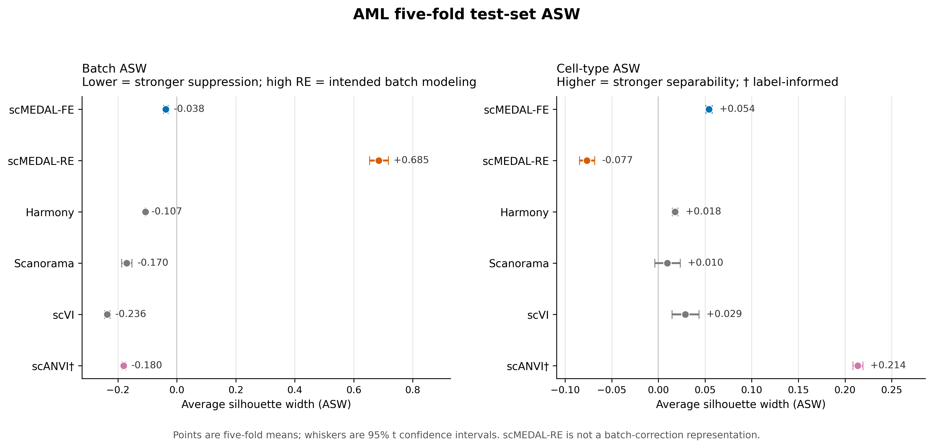
RESULTS
Five-fold test ASW across six methods
Our reproduction: five-fold held-out test ASW with 95% t CIs. RE is shown as a batch-modeling reference.
BMI5101 Group 10 • AML reproduction • Version 5
10
Notes:
这张图直接来自我们统一汇总的五折 held-out test 结果。点是五折均值，误差线是 t 分布 95% CI。右侧 scANVI 使用标签，所以高 cell-type ASW 不能和无标签方法解释为完全同条件优越。左侧 RE 高 batch ASW 是有意设计。

Slide 11
RESULTS
The numerical result: mean ± SD
Method | Batch ASW | Cell-type ASW | Role
scMEDAL-FE | −0.038 ± 0.006 | 0.054 ± 0.003 | batch-invariant
scMEDAL-RE | 0.685 ± 0.026 | −0.077 ± 0.007 | batch-specific
Harmony | −0.107 ± 0.001 | 0.018 ± 0.002 | integration
Scanorama | −0.170 ± 0.014 | 0.010 ± 0.011 | integration
scVI | −0.236 ± 0.007 | 0.029 ± 0.012 | generative
scANVI † | −0.180 ± 0.005 | 0.214 ± 0.004 | label-informed
† scANVI uses cell-type labels during training. RE is not a batch-correction embedding.
Our reproduction: test_metrics_long.csv (n = 5 folds). Values rounded to 3 decimals.
BMI5101 Group 10 • AML reproduction • Version 5
11
Notes:
表格给出精确五折均值和样本标准差，避免只凭 UMAP 读数。FE cell-type ASW 高于 Harmony、Scanorama 和 scVI；scANVI 高得多，但其训练使用细胞类型标签。RE 的 batch ASW 高，符合 batch-specific 目标。这里不声称 FE 在所有指标上最好。

Slide 12
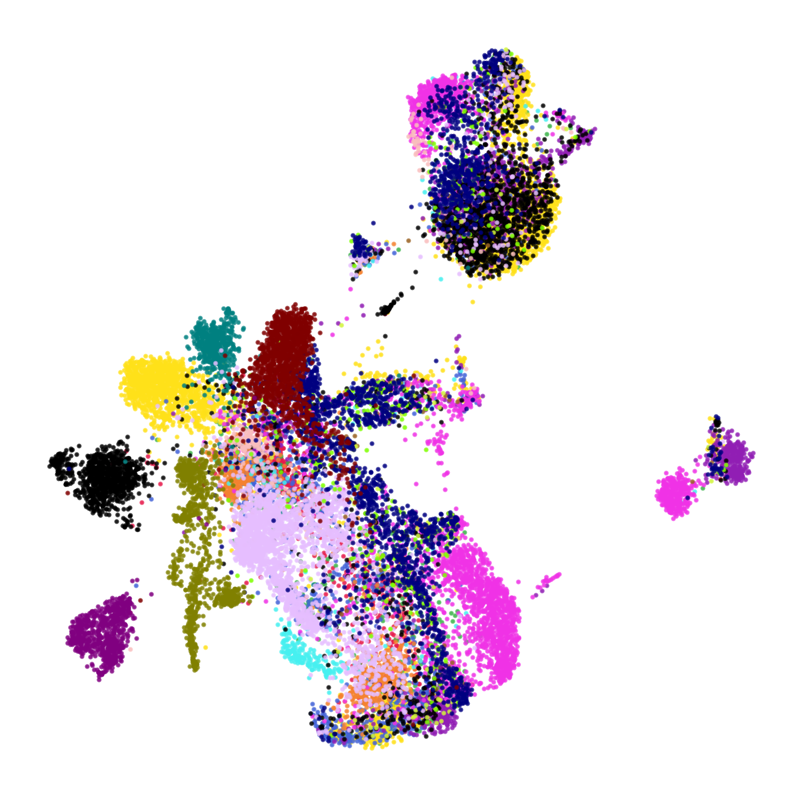

RESULTS
UMAP makes FE and RE behavior visible
scMEDAL-FE: partial batch mixing
scMEDAL-RE: separated batches
Our reproduction: fold 1 training partition, 19-batch coloring. UMAP geometry is qualitative.
BMI5101 Group 10 • AML reproduction • Version 5
12
Notes:
两个 panel 都来自 fold 1 的 train split；每点一个细胞，同色代表同一个 batch。FE 中部分颜色混合，RE 中大量批次形成明显单色岛。UMAP 只作定性补充；两个坐标系各自拟合，不应比较点到点坐标或岛之间距离。

Slide 13
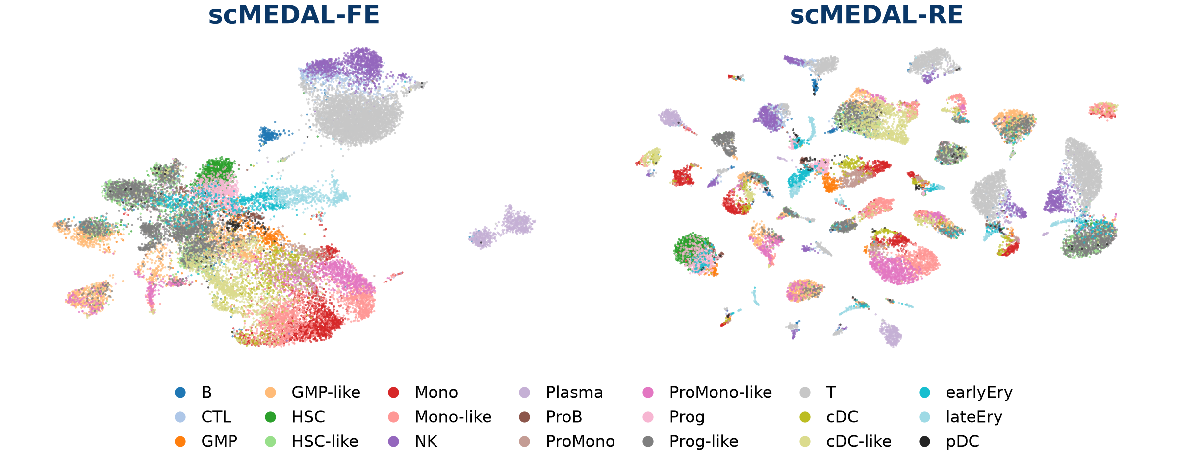
RESULTS
Cell-type structure differs between FE and RE
Test cell-type ASW: FE 0.054; RE −0.077. Donor structure can split the same cell type.
Reproduction: fold 1 training UMAP, same cells, existing coordinates. Test ASW summarizes five folds.
BMI5101 Group 10 • AML reproduction • Version 5
13
Notes:
这里重绘已有的 fold-1 train UMAP 坐标，没有重新拟合 UMAP。两幅图包含相同细胞，颜色代表原有 cell-type 注释。FE 的 T/NK/Plasma 等局部结构仍可见；RE 将部分相同细胞类型分布在不同 donor 岛上，符合 batch-specific 表征目的。整体 cell-type ASW 仍不高，不能仅根据漂亮的 UMAP 宣称完全保留生物信号。来源：results/presentation/figure_manifest.json 和 results/metrics/test_metrics_long.csv。

Slide 14
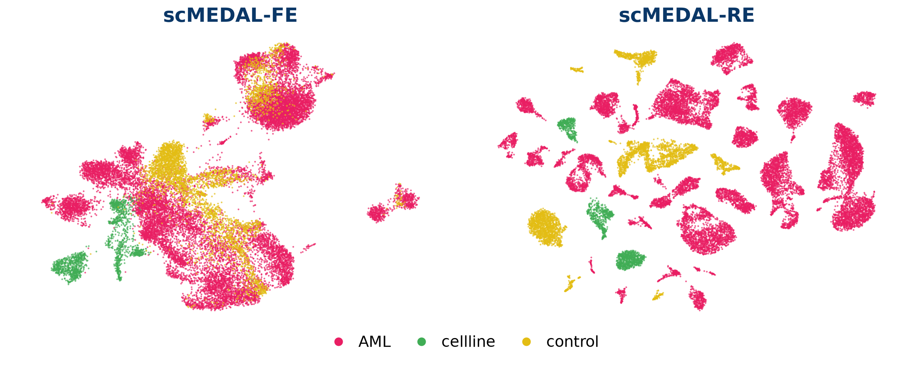
RESULTS
Patient-group patterns follow donor structure
RE retains group-associated structure; donor and patient group remain linked.
Reproduction: fold 1 training cells, three annotated groups. Independently fitted UMAP geometry is qualitative.
BMI5101 Group 10 • AML reproduction • Version 5
14
Notes:
颜色为 AML、control 和 cellline。RE 表征中患者分组形成局部结构，与按 donor 着色的结果一致。但这里 patient group 与 donor 身份相关联，分组清晰不能独立证明疾病原因。FE 和 RE 的坐标各自拟合，不能比较图之间的点坐标或距离。来源：results/presentation/figure_manifest.json；作者论文 Fig. 4。

Slide 15
INTERPRETATION
A donor-swap reconstruction is an as-if simulation
1 Encode one cell
2 Swap donor label
3 Reconstruct
Hold the learned
cell-specific latent r fixed.
Replace z with a target
donor or batch label.
Decode a model-generated
expression profile x̂(r,z).
Interpretation: a model-generated hypothetical expression profile
[1] Andrade et al. (2026), Methods and counterfactual figures; our wording emphasizes simulation scope.
BMI5101 Group 10 • AML reproduction • Version 5
15
Notes:
操作是固定一个细胞的 RE latent，替换输入的 donor/batch one-hot label，让 decoder 重建基因表达。比较不同 donor 条件下模型生成的表达。这个结果是模型的假设性 as-if simulation；不能据此推断改变 donor 会因果性地改变该细胞。

Slide 16
RESULTS
Selected donor-conditioned gene shifts
Δ predicted expression = AML-target mean − control-target mean
TXNIP
-0.086
FTL
-0.077
SAMSN1
-0.071
HIST1H1D
+0.065
-0.15
-0.10
-0.05
0.00
+0.05
+0.10
Across 2,916 genes, 216 had the same modeled AML−control direction in all five folds.
Our reproduction: five-fold Mono/Mono-like analysis; points = fold means, whiskers = fold-to-fold SD. Descriptive as-if simulation.
BMI5101 Group 10 • AML reproduction • Version 5
16
Notes:
这一页是已完成的五折 Mono/Mono-like source-cell 分析。横轴是模型预测的 target AML donor 平均值减 target control donor 平均值；点为五折平均，线为五折标准差。选的四个基因用于说明读图，不是验证的生物标志物。Target donors 在各折重复出现，五折不是五个独立 donor cohort。

Slide 17
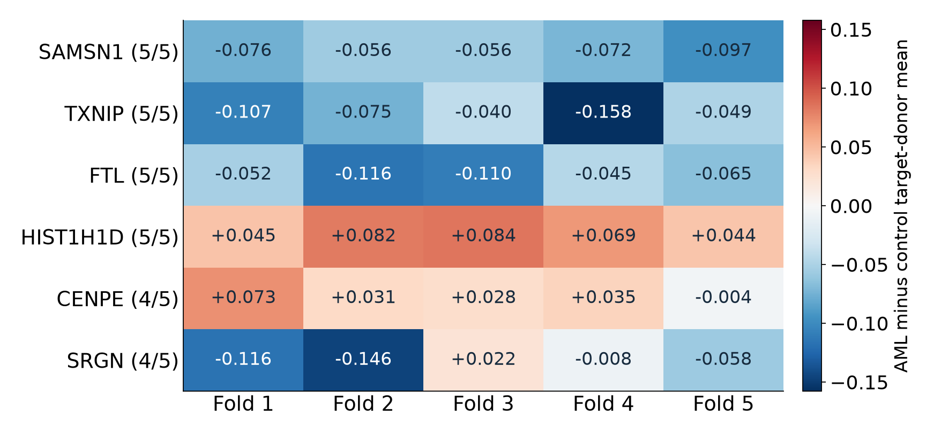
RESULTS
Selected reconstruction shifts across five folds
HOW TO READ
Red: AML-target mean higher
Blue: control-target mean higher
5/5 counts direction consistency across folds.
Direction stability is descriptive. Fold 1 had zero BH-FDR < 0.05 genes.
Reproduction: selected_gene_stability.csv. Same target donors recur across folds. Model-generated as-if simulation.
BMI5101 Group 10 • AML reproduction • Version 5
17
Notes:
热图展示六个例子，不是按显著性选出的 marker。每列为一个 held-out source-cell fold；每个 fold 使用相同的 target donors。颜色和数字为 target AML donor 平均表达减 control donor 平均表达。SAMSN1、TXNIP、FTL、HIST1H1D 在五折中方向一致，CENPE 和 SRGN 只有四折同方向。216 个基因在五折方向一致描述了模型结果稳定性；fold 1 的 BH-FDR 检验没有低于 0.05 的基因。来源：results/counterfactual/fivefold_mono_monolike/aml_counterfactual_fivefold_gene_stability.csv。

Slide 18
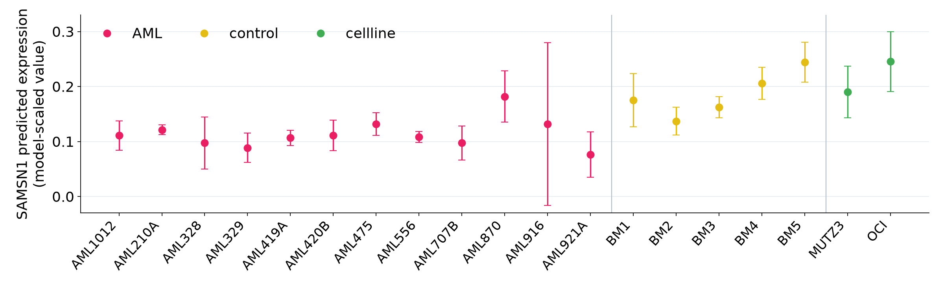
RESULTS
SAMSN1 predictions vary across target donors
Mean AML minus control: −0.0713
After excluding BM5: −0.0565, with the direction retained.
Reproduction: same target donors in five source-cell folds. Points = fold mean; bars = fold SD. Model-scaled expression.
BMI5101 Group 10 • AML reproduction • Version 5
18
Notes:
每个点是一种 target donor/batch 条件下的模型预测表达，按五个 source-cell/model folds 取均值，误差线为折间 SD。这里 AML/control 的组均值并不代表每个 donor 都一致。BM5 的预测值较高。逐一排除 control donor 的已有分析显示，SAMSN1 的负向差异在每次排除后都保留；排除 BM5 后，均值差异由 −0.0713 变为 −0.0565，说明幅度仍对 donor 选择敏感。来源：samsn1_donor_summary.csv 与 selected_control_donor_sensitivity.csv。

Slide 19
DISCUSSION
Interpretation of the AML evaluation
BATCH-INVARIANT REPRESENTATIONS
BATCH-SPECIFIC REPRESENTATION
FE has modest cell-type separation: ASW 0.054, compared with 0.018 for Harmony, 0.010 for Scanorama and 0.029 for scVI.
RE has high batch ASW (0.685) and fragmented cell-type structure (−0.077), consistent with its donor-aware objective. [1]
Its raw batch ASW is closer to zero (−0.038), indicating more residual batch structure under this readout.
scANVI has the highest cell-type ASW (0.214) and uses cell-type labels during training. [7]
Both labels matter. Combined FE+RE prediction requires a separate evaluation.
Reproduction: five-fold held-out test means. [1] Andrade et al. (2026). [7] Xu et al. (2021).
BMI5101 Group 10 • AML reproduction • Version 5
19
Notes:
这页把数值和原论文的预期放在一起解释。FE 的 cell-type ASW 高于几个无标签 baseline，但绝对值仍较低，batch 结构也残留。RE 的目标为 donor/batch 结构，因此不按去 batch 的目标给 RE 排名。scANVI 用了 cell-type labels。作者强调 RE 可补充其他表征用于预测；本次已完成的结果支持不同表征模式，预测层面的互补收益还需要 FE 与 FE+RE 的分类比较。Raw batch ASW 是当前记录的标签分离指标，受群体组成影响，结果不能等同于所有混合指标的综合排名。来源：results/metrics/test_metrics_long.csv；https://www.nature.com/articles/s41467-026-72666-4 。

Slide 20
DISCUSSION
Limitations and next experiments
DATA AND EVALUATION
RECONSTRUCTION
One author-preprocessed AML dataset. Cell-level folds reuse donors across partitions.
Target donors recur across folds. Fold-to-fold variation does not measure independent-cohort uncertainty.
Current evidence uses ASW and qualitative UMAP. Additional local mixing and biology checks would broaden validation.
Priorities: donor-held-out validation, FE+RE prediction, and a controlled FE loss-weight study.
Interpretation scope: model-generated as-if simulations with donor–group confounding.
Sources: canonical run records and reconstruction summaries. [1] scMEDAL. [8] Integration benchmark.
BMI5101 Group 10 • AML reproduction • Version 5
20
Notes:
数据范围是一个作者预处理的 AML 数据集。既有五折为细胞层面划分，相同 donor 在训练、验证、测试中重复，因此结果描述这些 donor 上的细胞泛化，而非新 donor 泛化。反事实分析同样重复使用 target donors，折间 SD 表示模型/细胞折波动。Fold 1 的 donor 级检验没有 FDR<0.05 的基因。下一步可用第二个数据集或 donor-held-out 验证，并另外检验 FE+RE 预测收益。FE 权重敏感性作为未来实验，当前展示只使用已完成的原始参数结果。

Slide 21
CONCLUSION
Conclusion
01
This reproduction evaluates independent FE and RE networks on the authors’ AML splits.
02
Five-fold results distinguish batch-invariant and batch-specific representation patterns.
03
Donor-swap reconstructions reveal descriptive patterns and donor sensitivity.
Scope: one preprocessed AML dataset with five-fold evaluation and model-generated as-if simulations.
BMI5101 Group 10 • AML reproduction • Version 5
21
Notes:
结论围绕已经完成的内容：正式训练了 FE/RE 和四种 baseline，得到同一 AML 数据上的五折评估；FE 和 RE 展现不同的标签结构；重建结果提供了 donor 条件下的模型表达与稳定性信息。FE+RE 的预测收益仍是需要另外检验的问题，当前结论聚焦表征差异与探索性重建。

Slide 22
REPRODUCIBILITY
Reproducibility archive
github.com/s2275157/
BMI5101-group10-scMEDAL-repruduction
PRESENTATION
EVIDENCE
Editable deck and a guide to the result figures.
Canonical run manifest, environment notes, five-fold tables, and figure-generation scripts.
README links the upstream implementation and author-provided data.
Public archive: README.md, reproducibility/, results/, presentations/. Derived figures and summary tables.
BMI5101 Group 10 • AML reproduction • Version 5
22
Notes:
代码和小型结果已公开。PPT 中用到的主图位于 results/presentation，完整五折 ASW 与反事实结果表保存在原有 results 子目录。论文作者的代码与预处理数据来源在 README 中链接。当前仓库保存的是执行记录、评估和重绘脚本，正式训练入口使用作者仓库。原始细胞表达、完整 per-cell 坐标和模型权重保留在本地/NSCC。公开网址：https://github.com/s2275157/BMI5101-group10-scMEDAL-repruduction 。

Slide 23
REFERENCES
References and reproducibility sources
[1] Andrade AX et al. scMEDAL. Nature Communications 17, 7075 (2026). doi:10.1038/s41467-026-72666-4.
[2] Tung P-Y et al. Batch effects and effective design in scRNA-seq. Scientific Reports 7, 39921 (2017).
[3] van Galen P et al. Single-cell RNA-seq reveals AML hierarchies. Cell 176, 1265–1281.e24 (2019).
[4] Korsunsky I et al. Harmony. Nature Methods 16, 1289–1296 (2019).
[5] Hie B et al. Scanorama. Nature Biotechnology 37, 685–691 (2019).
[6] Lopez R et al. scVI. Nature Methods 15, 1053–1058 (2018).
[7] Xu C et al. scANVI. Molecular Systems Biology 17, e9620 (2021).
[8] Tran HTN et al. Benchmark of 14 batch-correction methods. Genome Biology 21, 12 (2020). doi:10.1186/s13059-019-1850-9.
[9] Luecken MD et al. Benchmarking atlas-level integration. Nature Methods 19, 41–50 (2022). doi:10.1038/s41592-021-01336-8.
[10] Townsend HA et al. Single-cell data and genetics in inflammation. Frontiers in Immunology 15, 1454263 (2024). doi:10.3389/fimmu.2024.1454263.
Reproduction evidence: canonical run manifest; AML test_metrics_long.csv; five-fold counterfactual summary; fold-1 UMAP assets.
BMI5101 Group 10 • AML reproduction • Version 5
23
Notes:
列出模型、数据集与四种比较方法的原始论文。自己的结果来源是现有 CSV、UMAP 与 counterfactual 汇总；在正式版中可再添加 GitHub commit 和日期。

Slide 24
APPENDIX
Recorded configuration and figure provenance
Setting | scMEDAL-FE | scMEDAL-RE
Input / scaling | 2,916 log-transformed HVGs / min–max | Same input and supplied folds
Hidden / latent units | 512, 132 / 50 | 512, 132 / 50
Batch size / epoch cap | 512 / 500 | 512 / 500
Early-stopping patience | 30 | 30
Recorded loss weights | reconstruction 1000; adversarial 1 | reconstruction 110; batch classifier 0.1
Training environment | Python 3.8.20; TF 2.13.1 | TFP 0.21.0; TFA 0.21.0
UMAP evidence | Existing fold-1 train coordinates | Seed 5; 15 neighbours; same cells
The run manifest does not record the training random seed.
Sources: reproducibility/run_manifest.json, environment/, and results/presentation/figure_manifest.json.
BMI5101 Group 10 • AML reproduction • Version 5
24
Notes:
正式实验的超参数由 canonical run 名称与 manifest 记录。表中列出可以核对的字段，不补写没有归档的训练 seed 或环境参数。UMAP 使用已经保存的坐标，不重新拟合。scMEDAL 的训练环境与 baseline 分开，版本来自仓库 environment 和 README。此页用于 Q&A 与复现说明。

Slide 25
APPENDIX
Disease analysis needs sample and covariate checks
Townsend et al. 2024
What this adds to our AML discussion
RA synovium and UC colon: disease-specific scRNA-seq atlases plus GWAS summary statistics. [10]
Donor and disease group may align; inspect both labels.
Check fine cell states and markers after integration.
Harmony used sample as the batch variable. scDRS then allowed cell-level covariates in disease scoring. [10]
Use patient-aware biology checks before interpretation.
GWAS-based scoring is a future extension requiring suitable genetic data.
[10] Townsend et al., Frontiers in Immunology 15:1454263 (2024), doi:10.3389/fimmu.2024.1454263.
BMI5101 Group 10 • AML reproduction • Version 5
25
Notes:
Townsend 等 2024 主要评估 scRNA-seq 与 GWAS 结合识别炎症疾病细胞状态，和批次整合是不同问题。他们对 RA 滑膜和 UC 结肠 scRNA-seq 图谱先按 sample 用 Harmony 整合，再比较 scDRS、scGWAS、scPagwas。scDRS 还容纳细胞层面的协变量；论文在其数据上观察到比 scPagwas 较少的健康状态相关评分偏差。对 AML 项目的启发是，在 donor 与疾病组可能重合时，检查细胞亚群、患者层面的病理信号，并在后续分析中做 donor-aware 验证。当前项目没有运行 GWAS/scDRS，也没有据此建立因果结论。

