Slide 1

Amazon Sales Data Analysis
Tools Used
Python
Pandas
Plotly
Streamlit
Jupyter Notebook
by : Sarah Saeed

Slide 2






Project Workflow
Data Understanding
Data Cleaning
Feature Engineering
Exploratory Data Analysis
Business Insights
Interactive Dashboard

Slide 3
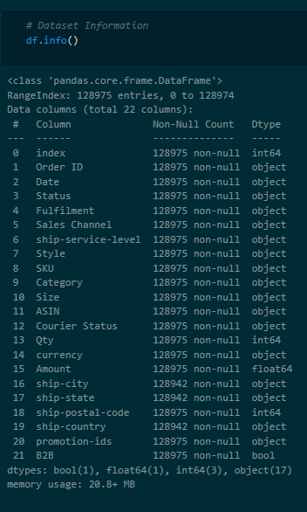

Data Understanding
Number of Rows : 128975
Number of Columns : 22
Order ID
Category
Courier Status
Sales Channel
Column Names
Date
Qty
Fulfilment
Status
Amount
ship-state
B2B

Slide 4
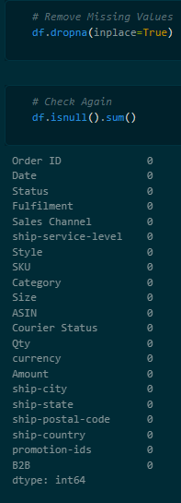


Data Cleaning
Converted Date column to datetime.
Removed unnecessary columns.
Removed missing values

Slide 5




Feature Engineering
These features help analyze sales trends over time
Month
Year
Sales Per Item
Day Name

Slide 6
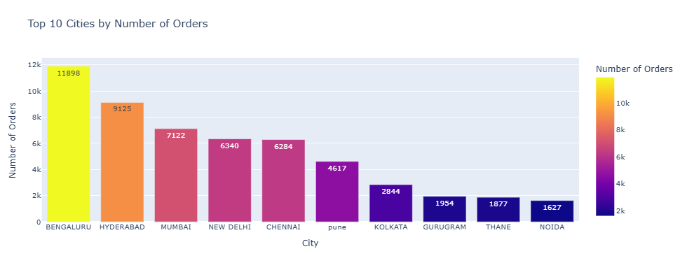
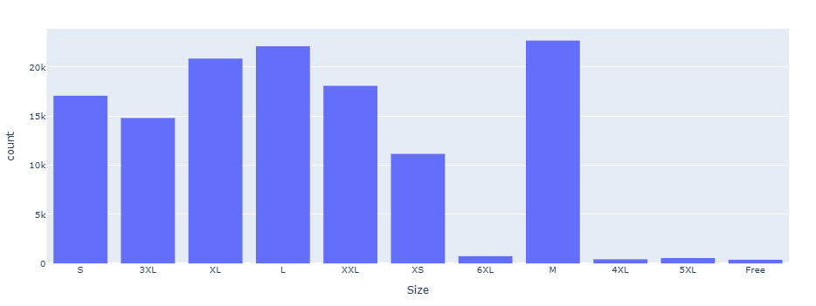

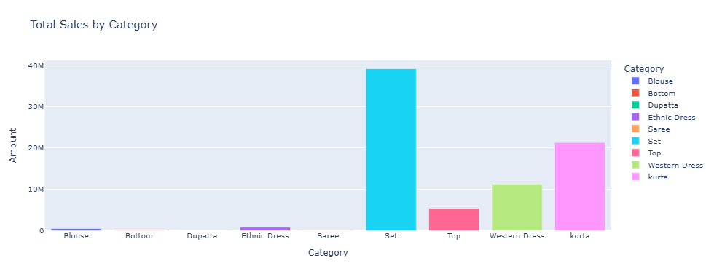
Exploratory Data Analysis
Our Team
Top 10 Cities By Number Of Orders
Number Of Orders By Size
Sales Channel
Total Sales By Category

Slide 7
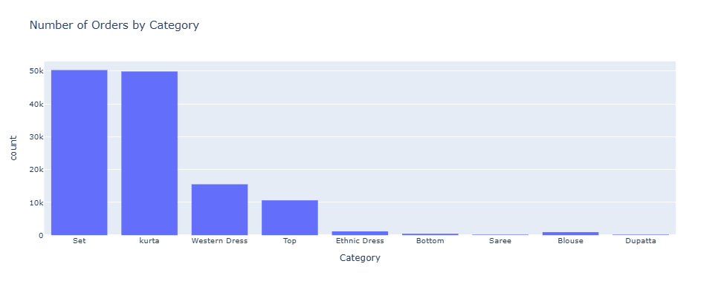
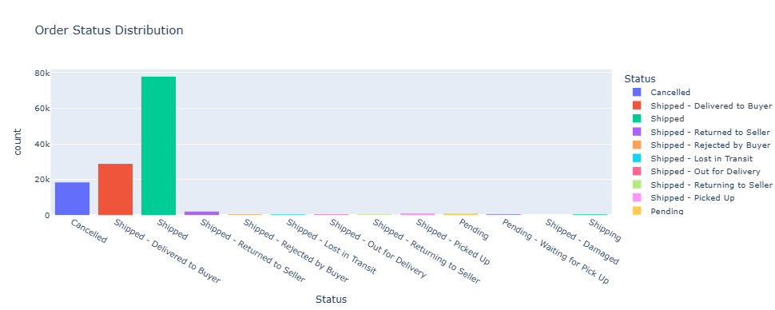
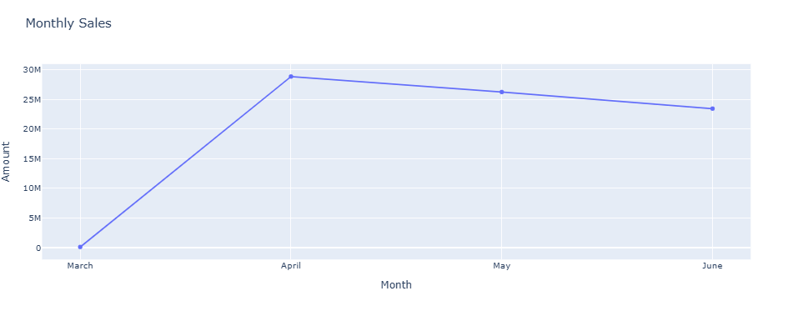
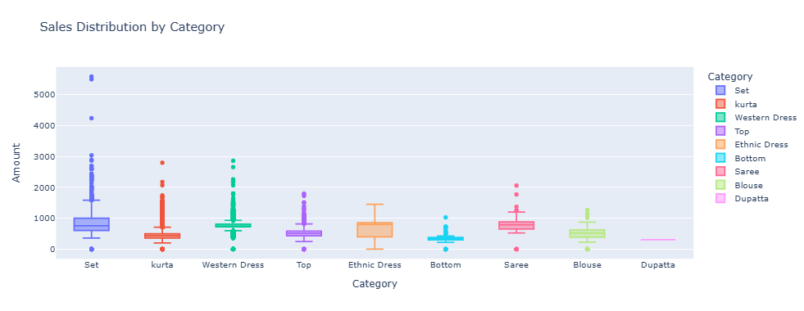
Exploratory Data Analysis
Number Of Orders By Category
Order Status Distribution
Monthly Sales
Sales Distribution by Category

Slide 8
Business Insights
Number of Orders by Category
Sales Distribution by Category
Set and Kurta have the highest number of orders pricing for businesses of all sizes.
Western Dress comes in third place
Dupatta, Bottom, and Saree have the lowest number of orders
Set has the widest price range and several high-value outliers
Most categories have moderate prices
Dupatta has almost no price variation.
Number of Orders by Size
Total Sales by Category
M is the most ordered size
L and XL are also highly demanded
4XL, 5XL, 6XL, and Free Size have very low demand
Set generates the highest total sales
Kurta ranks second
Western Dress ranks third
The remaining categories contribute much less revenue

Slide 9
Business Insights
Top 10 Cities by Number of Orders
Monthly Sales Trend
Bengaluru has the highest number of orders
Hyderabad ranks second
Mumbai, New Delhi, and Chennai also contribute significantly
Sales increased sharply from March to April
Sales decreased slightly during May and June
April recorded the highest monthly sales
Order Status Distribution
Sales Channel
Most orders were successfully Shipped
A considerable number were Delivered to Buyer
Cancelled orders represent a noticeable portion
Other order statuses occur much less frequently
Nearly 100% of orders come from Amazon.in
Non-Amazon sales represent only a tiny fraction

Slide 10
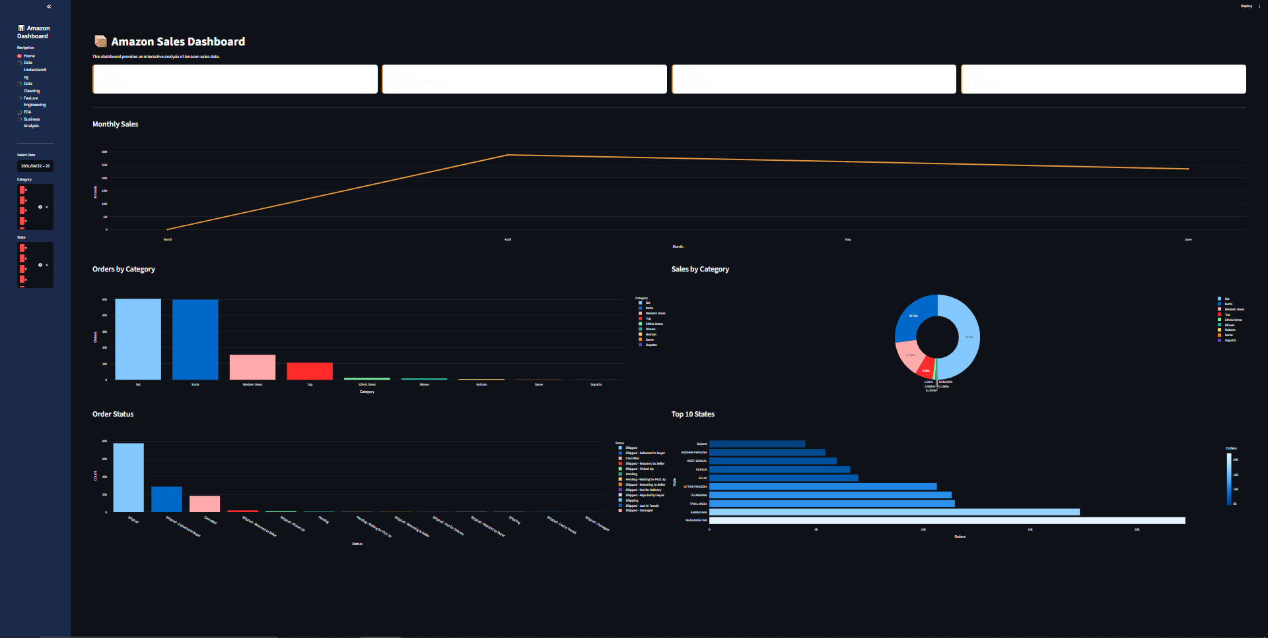
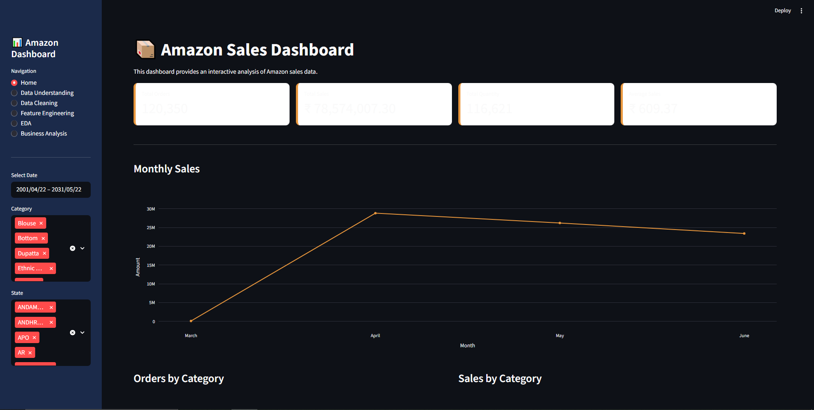
Interactive Dashboard using Streamlit
Home

Slide 11
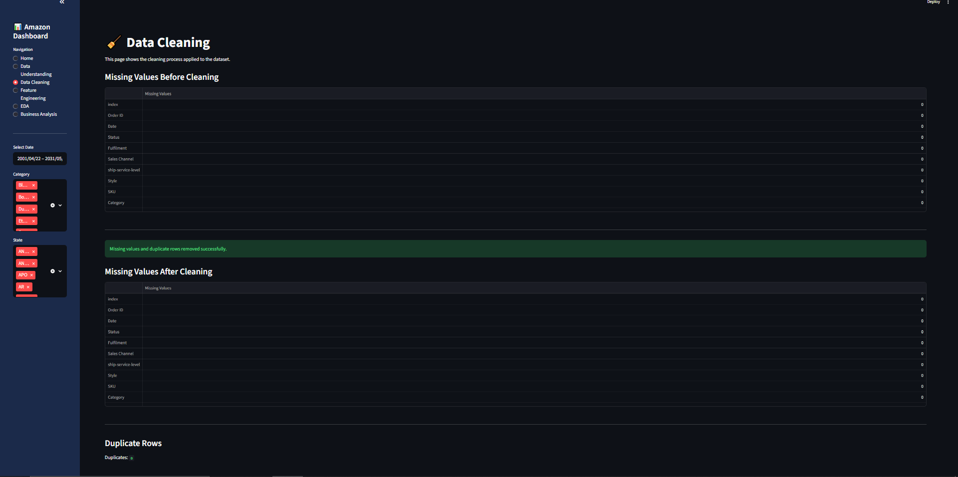
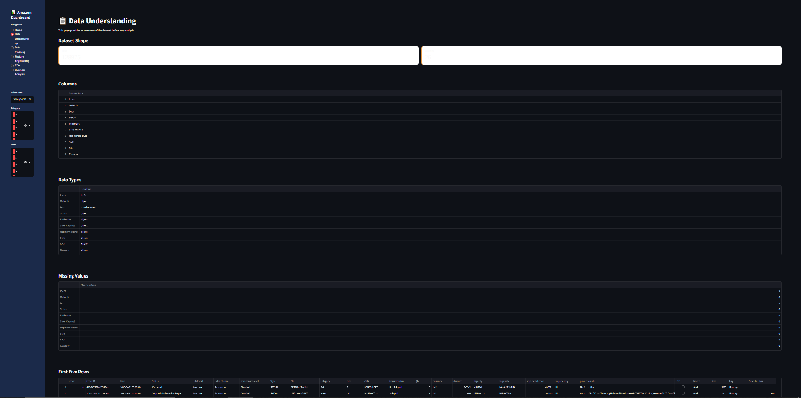
Interactive Dashboard using Streamlit
Data Understanding
Data Cleaning

Slide 12
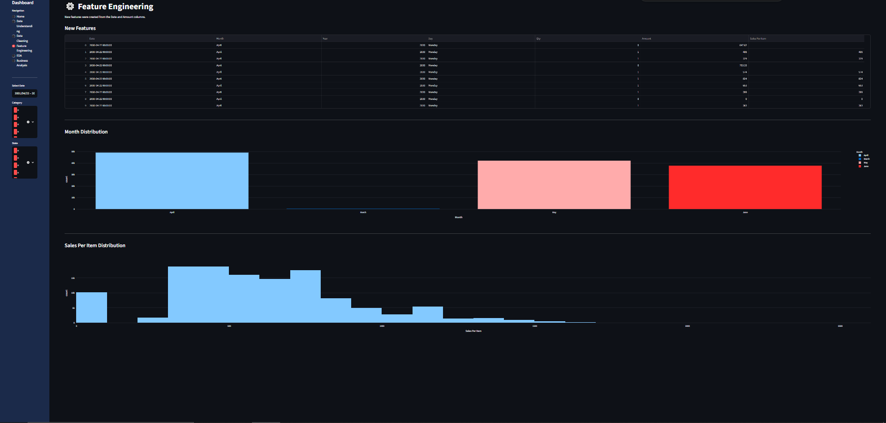
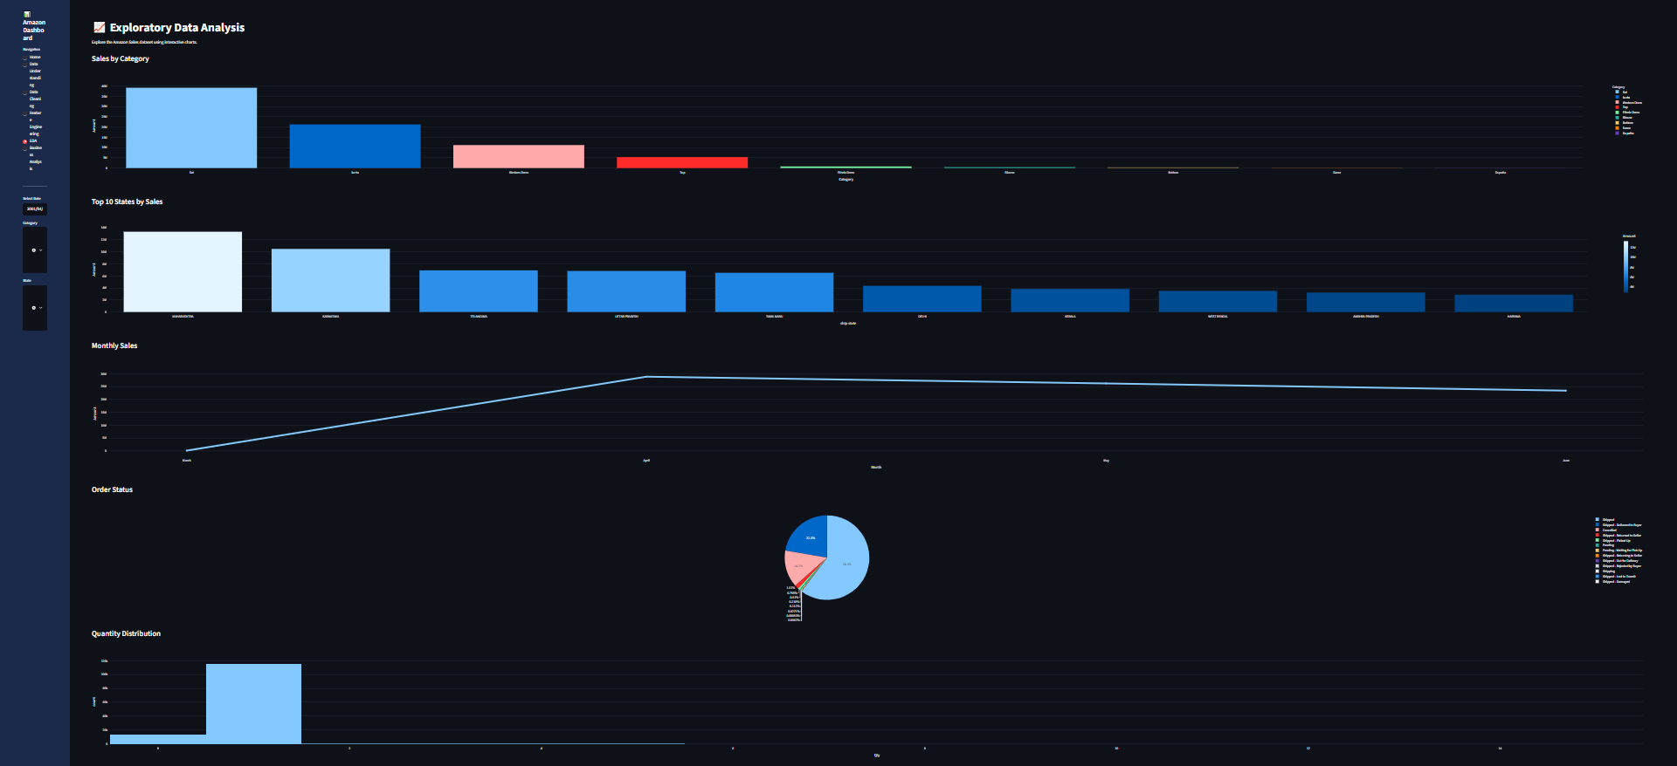
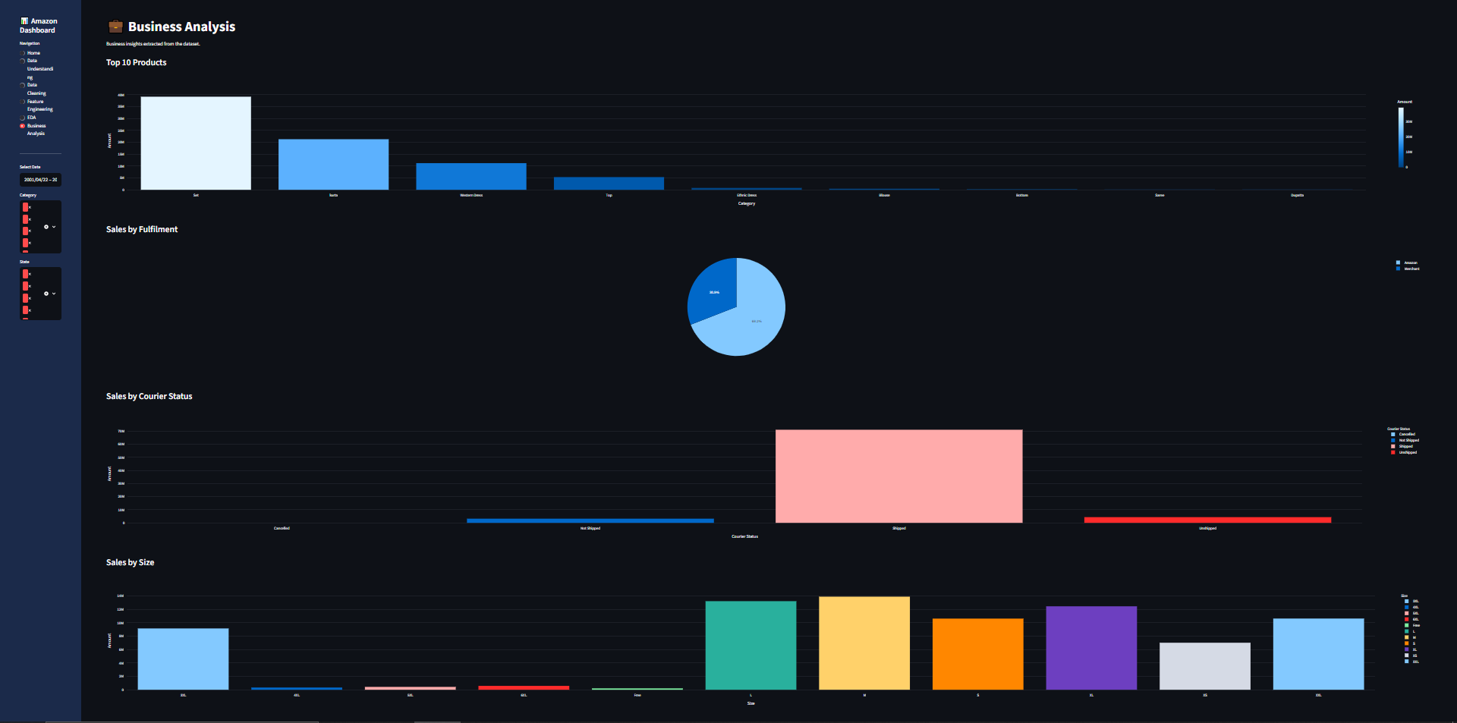
Business Analysis
Interactive Dashboard using Streamlit
Feature Engineering
EDA

