Slide 1
REAL TIME ACCIDENT MONITORING
AND RISK PREDICTION
Presented by: Batch A4
TEAM MEMBERS:
Bejjupuramu Suseela 228T1A0516
Boggavarapu Manasa Lavanya 228T1A0519
Maddali Venkata Raga Nandini 228T1A0566 Beesabathuni S N Manjunath 228T1A0514
Boyapati Venkata Suraj 228T1A0522
Mentor:
Dr. G. Krishna Kishore, Professor, Dept of CSE

Slide 2
Abstract
Road accidents are one of the leading causes of death worldwide, often due to delayed detection and response times. Traditional surveillance systems detect accidents only after they occur, resulting in late medical assistance. To address this, this project proposes a Real-Time Accident Monitoring and Risk Prediction System that integrates Artificial Intelligence (AI) with Internet of Things (IoT) technologies to both detect and predict accidents before or as they occur.
The system uses an LSTM-based sequence model to analyze temporal vehicle motion/scene patterns and assess accident risk.The TAD: A Large-Scale Benchmark for Traffic Accidents Detection from Video Surveillance (IEEE Access, 2024) serves as the base reference dataset and inspiration for model training and evaluation.

Slide 3
In addition to prediction, an IoT module featuring ESP32, MPU6050 accelerometer, GPS, and buzzer modules provides real-time alerts. When a high-risk or accident event is detected, the system sends SOS alerts to pre-configured emergency contacts via Telegram, including severity and Google Maps location. This hybrid model bridges the gap between software-based risk prediction and hardware-based real-time response, improving accident prevention and reducing emergency response time.
Keywords: Accident Detection, IoT, Real-Time Monitoring, Deep Learning,LSTM, Risk Prediction, Smart Transportation.

Slide 4
Introduction:
Road safety is a critical global issue, with millions of accidents occurring every year due to factors such as over-speeding, driver negligence, poor road conditions, and delayed emergency assistance. Traditional accident detection systems are reactive and depend heavily on human reporting or post-event analysis. With the advancement of AI, IoT, and cloud technologies, intelligent transportation systems can now predict and respond to accidents proactively.
This project integrates AI-assisted accident risk prediction with IoT-based real-time accident detection. The prediction module estimates the probability of an accident by combining vehicle motion behavior (MPU6050 data) with live weather conditions such as rain, wind speed, and visibility. This enables early warning before a crash occurs. The IoT module detects physical crash events using onboard sensors and immediately sends alerts with severity and GPS location. By combining prediction and detection, the system improves response efficiency and overall road safety.

Slide 5
Problem Statement:
Road accidents often go undetected for several minutes or hours, especially in remote areas.
Traditional systems lack real-time monitoring and prediction capabilities.
Emergency response is delayed due to lack of immediate accident alerts and precise location data.
Existing solutions focus either on software-based analysis or hardware-based detection, but not both.
There is a need for an integrated system that can predict accident risk in advance and detect accidents instantly when they occur.

Slide 6
Existing System
CCTV-based surveillance systems detect accidents after occurrence.
Manual reporting by eyewitnesses or drivers causes delays.
Some vehicles use basic crash sensors without cloud connectivity.
GPS-based tracking systems only provide location data, not accident prediction.

Slide 7
Drawbacks of Existing System:
Late accident detection leads to delayed medical assistance.
No prediction mechanism to prevent accidents beforehand.
Lack of integration between AI models and real-world vehicle sensors.
Limited automation in emergency alert generation.
High dependency on human intervention.

Slide 8
Proposed System:
1. Risk Prediction Module (Laptop-Based)
Uses real-time sensor telemetry and weather parameters (rain, wind speed, visibility) to estimate accident risk.
Generates early warning (PREALERT) when risk rises before an actual crash.
2. Accident Detection Module (IoT-Based)
Uses ESP32 as the core controller.
MPU6050 detects sudden impact and vigorous shake.
Crash/limit switch supports physical crash confirmation.
GPS module provides real-time latitude and longitude.
Panic button enables manual emergency trigger.
Buzzer and LCD provide immediate local alerts.
3. Alert and Monitoring Module
Sends emergency alerts through Telegram with severity and Google Maps link.
Displays live status on a web dashboard (HTML/CSS/JavaScript + JSON)

Slide 9
Advantages of Proposed System:
Real-time accident detection and prediction.
Faster emergency response through automated alerts.
Accurate location tracking using GPS.
Hybrid approach combining AI and IoT.
Scalable and cost-effective solution.
Reduced dependency on human reporting.

Slide 10
Software and Hardware Specifications
Software Requirements:
Programming Language: Python 3.10+
Embedded Firmware: Arduino (ESP32)
Python Libraries: pyserial, requests, python-dotenv
ESP32 Libraries: Wire, TinyGPS++, LiquidCrystal
APIs/Services: Open-Meteo Weather API, Telegram Bot API
Frontend: HTML, CSS, JavaScript (real-time dashboard via JSON)
Development Environment: Arduino IDE, VS Code / Command Prompt
Operating System: Windows 10/11
Hardware Requirements:
Processor: Intel i5 / AMD Ryzen 5 or higher
RAM: 8 GB (16 GB recommended for deep learning training)
Storage: 256 GB SSD or more
ESP32 Microcontroller – for alert system
MPU6050 Accelerometer/Gyroscope

Slide 11
NEO-6M GPS Module + Antenna
16x2 LCD (JHD162A)
Active Buzzer
Crash/Limit Switch
Panic Push Button
DC Motor (demo vehicle simulation)
Power Supply: 5V (ESP32) and suitable motor supply via driver/transistor

Slide 12
Literature Survey
Road accidents remain a major cause of fatalities, mainly due to delayed detection and delayed emergency communication. Traditional accident reporting methods depend on eyewitnesses or manual calls, which can increase response time in critical situations. Recent research has therefore focused on real-time, sensor-based accident monitoring using IoT platforms and embedded controllers.
Many existing IoT systems use microcontrollers (such as ESP32), motion sensors, GPS modules, and alert units to detect collision events and transmit vehicle location. These systems improve response speed compared to manual reporting by automatically generating alerts when abnormal motion is detected. Studies also show that integrating multiple triggers (impact sensing, manual panic switch, and location tracking) improves practical reliability in real-world conditions.

Slide 13
A second line of work highlights risk-aware monitoring, where contextual factors such as weather and visibility are incorporated into the decision process. Adverse weather conditions, including rain, low visibility, and high wind, are known to increase driving risk and can be used to generate early warnings before an actual crash event.
However, many existing solutions either focus only on post-impact detection or require computationally heavy vision pipelines. For low-cost deployments and MVP-scale implementation, a lightweight architecture that combines onboard sensing, contextual weather analysis, and instant messaging-based alerting is more practical.
Based on these observations, the proposed system integrates ESP32 + MPU6050 + GPS based accident detection with weather-assisted risk prediction and Telegram-based emergency alerts. This hybrid approach provides early warning capability, immediate crash notification, and live location sharing through Google Maps links, improving real-time responsiveness and usability

Slide 14
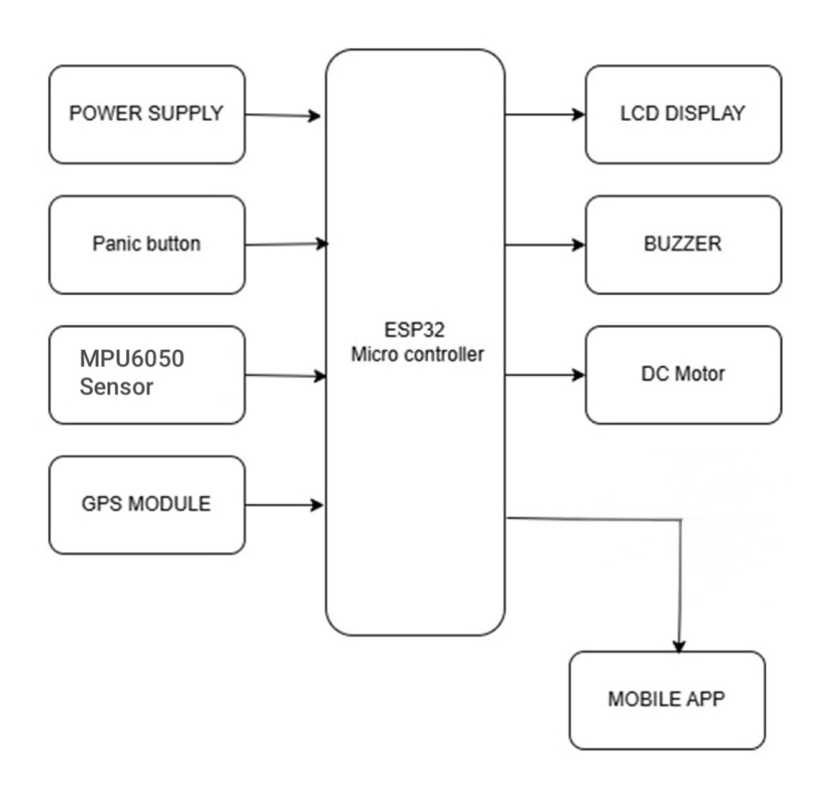
Block Diagram:
The system uses an ESP32 microcontroller as the main control unit to manage hardware operations.
The power supply provides required electrical power to all components.
The MPU6050 sensor continuously monitors motion and impact patterns to identify abnormal events.
A crash(limit switch) provides physical crash confirmation input.
A panic button allows manual emergency triggering in critical situations.
The GPS module (NEO-6M) captures real-time vehicle location (latitude and longitude).
The ESP32 processes sensor data and sends telemetry to the laptop through serial communication.
The buzzer provides immediate local audio alert, and the LCD display shows system status and location.
The Python monitoring module performs risk prediction using sensor behavior and live weather conditions (rain, wind, visibility).
On risk or accident events, alerts are sent through Telegram with severity level and Google Maps location link.
A web dashboard (HTML/CSS/JavaScript + JSON) displays live status, severity, sensor values, weather, and location for quick monitoring.

Slide 15
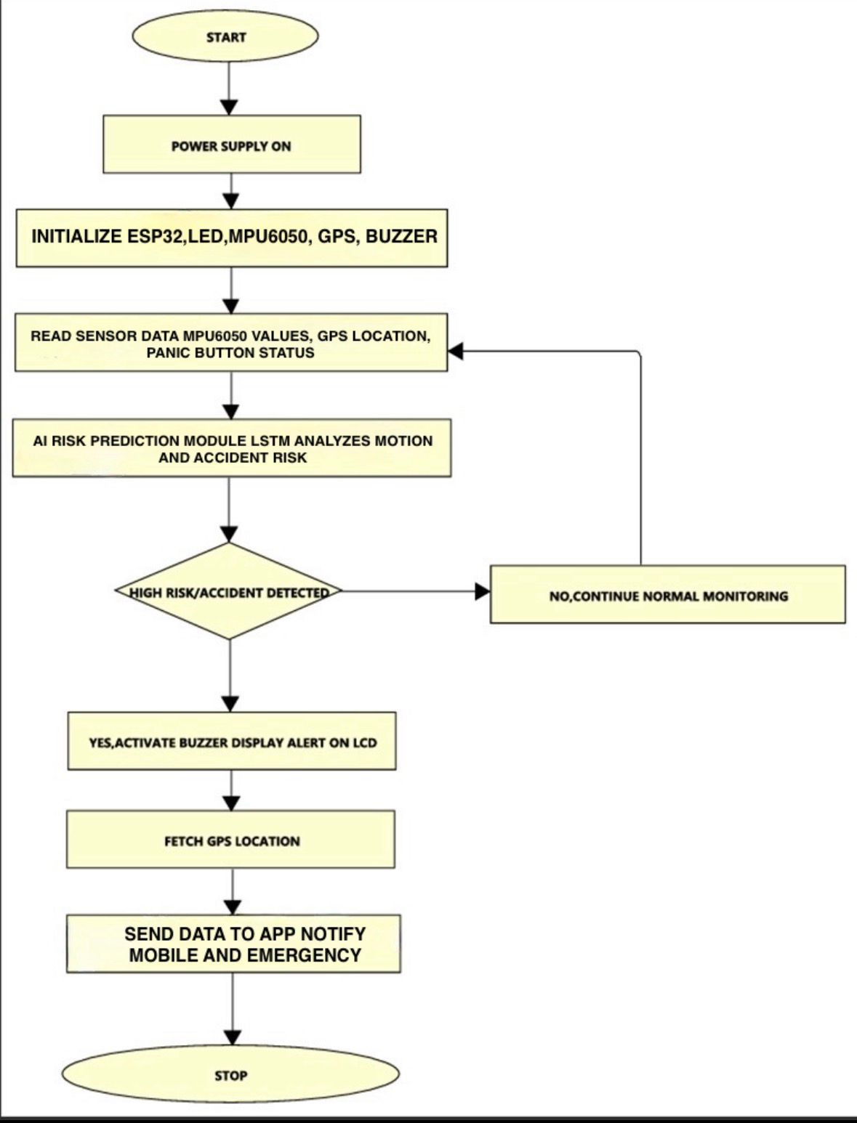
UML DIAGRAMS
Flow Chart Diagram

Slide 16
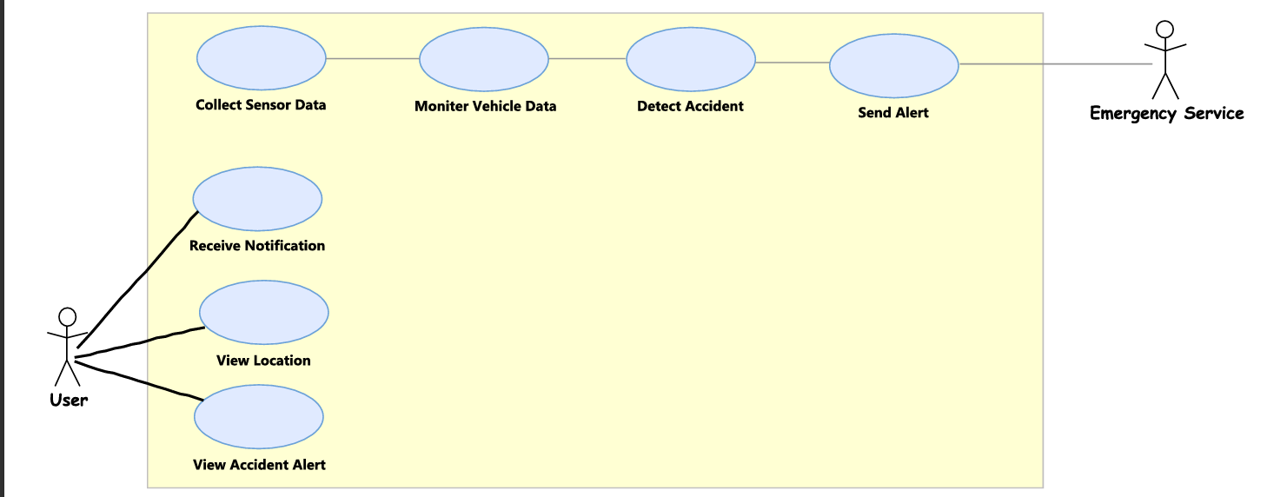
Use Case Diagram

Slide 17
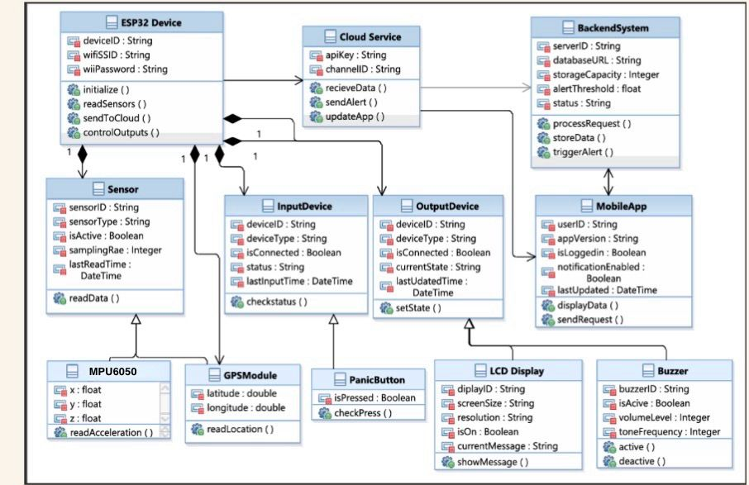
Class Diagram

Slide 18
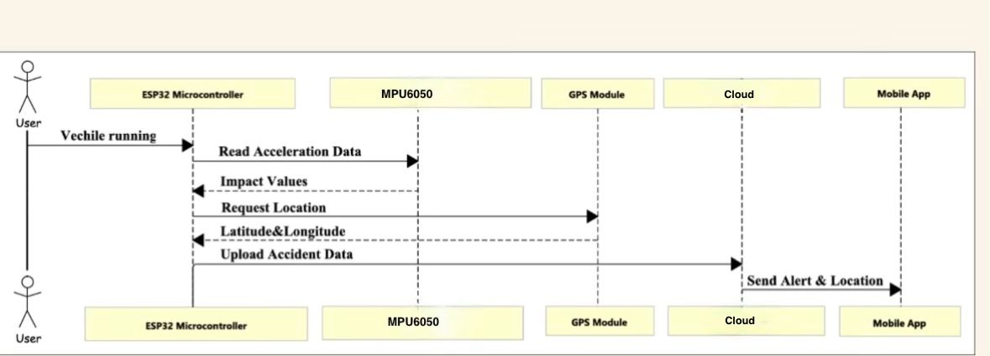
Sequence Diagram

Slide 19
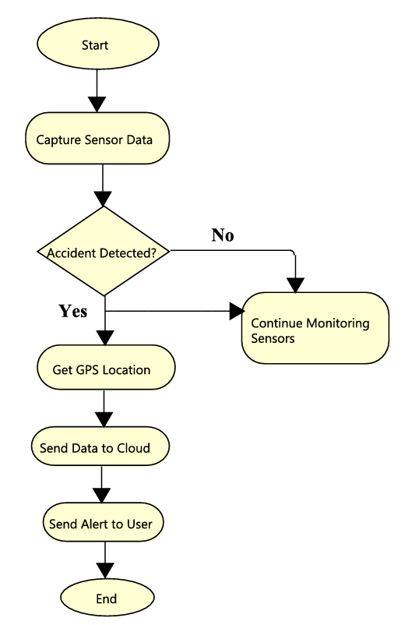
Activity Diagram

Slide 20
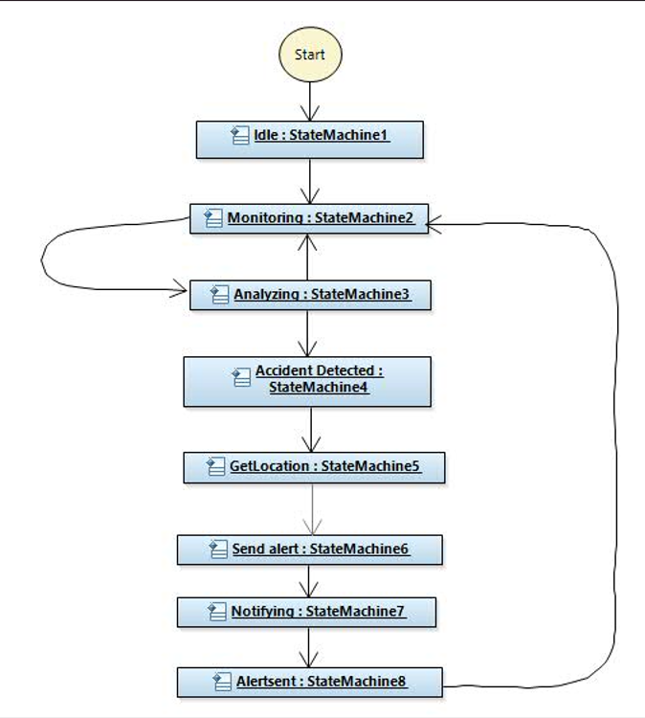
State Machine Diagram

Slide 21
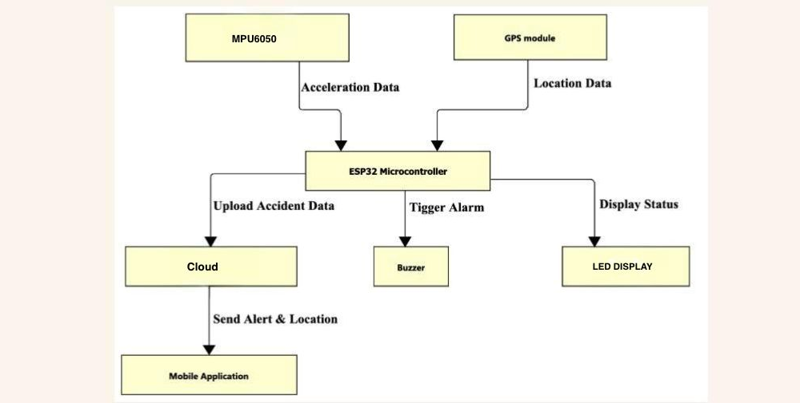
Component Diagram

Slide 22
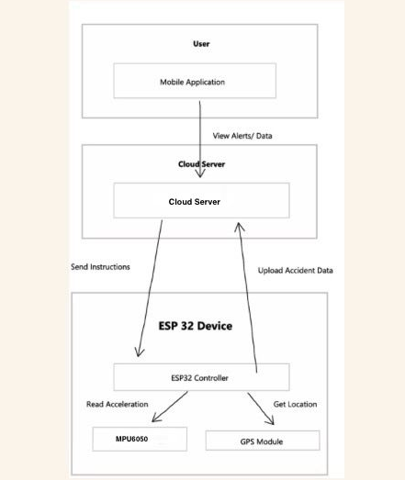
Deployment Diagram

Slide 23
Project Implementation Steps
STEP 1: ENVIRONMENT SETUP
Installed Python 3.10+ and Arduino IDE
Configured virtual environment for dependency management
Installed required Python libraries: pyserial, requests, python-dotenv
Configured .env for API keys, COM port, Telegram chat IDs, and runtime settings
Installed ESP32 libraries: Wire, TinyGPS++, LiquidCrystal
STEP 2: DATA PREPARATION / RISK INPUTS
Collected real-time IoT telemetry from ESP32: MPU6050, crash switch, panic button, GPS
Integrated live weather parameters (rain, wind speed, visibility) using Open-Meteo API
Defined severity mapping rules:
  Crash switch trigger -> LOW
  Sudden impact -> MEDIUM

Slide 24
  Vigorous MPU6050 shake -> HIGH
Included optional LSTM sequence-risk input through vision_state.json bridge
Split dataset:
  70% Training
  15% Validation
  15% Testing
Ensured balanced class distribution
Step 3:LSTM-BASED RISK MODEL
Used LSTM concept for temporal risk understanding (sequence-based behavior)
LSTM output represented as sequence_risk_prob in integrated pipeline

Slide 25
Current MVP combines:
  Sensor event signals
  Weather context
  Optional LSTM sequence score
  Final risk state generated as NORMAL, PREALERT, or ACCIDENT
STEP 4: VALIDATION AND PERFORMANCE
Validated serial communication stability between ESP32 and Python monitor
Verified event transitions and severity mapping under multiple physical tests
Confirmed Telegram delivery and Google Maps link generation
Model benchmark retained from experimental training phase:
  Final Accuracy: 93.33%

Slide 26
STEP 5: REAL-TIME EXECUTION
ESP32 streams JSON telemetry at runtime
Python monitor reads data and computes dynamic risk score
On PREALERT: early warning generated
On ACCIDENT: severity + GPS + Maps link sent via Telegram
Continuous terminal logging and heartbeat monitoring enabled
STEP 6: IoT HARDWARE INTEGRATION
ESP32 used as central controller
MPU6050 detects impact/motion anomalies
Crash switch provides physical accident confirmation
GPS provides latitude/longitude in real time
Buzzer and LCD provide immediate local alerts
Panic button supports manual emergency trigger

Slide 27
STEP 7: SYSTEM WORKFLOW
Sensor Data Captured (MPU6050 + switch + GPS)
Weather Context Fetched
LSTM Sequence Risk (optional input) + rule-based fusion
Risk Classification (NORMAL / PREALERT / ACCIDENT)
Severity Assignment (LOW / MEDIUM / HIGH)
Telegram Emergency Alert Sent with Google Maps link
Live Dashboard Updated (HTML/CSS/JS + JSON)

Slide 28
SOFTWARE TESTING
SOFTWARE TESTING STRATEGY
The system was tested at multiple levels:
Unit Testing
Integration Testing
Functional Testing
Performance Testing
Reliability / Failure Testing
1. Unit Testing
ESP32 sensor acquisition validated (MPU6050, crash switch, panic button, GPS).
Accident trigger logic verified from motion and crash inputs.
Severity mapping validated: crash switch -> LOW, sudden impact -> MEDIUM, vigorous shake -> HIGH.
Weather risk score rule evaluation verified.

Slide 29
2. Integration Testing
Serial JSON telemetry from ESP32 to Python verified.
State command handshake tested (CMD:CLEAR, CMD:PREALERT, CMD:ACCIDENT, ACK).
Telegram API integration tested (sendMessage).
Dashboard live JSON update (live_state.json) verified.
Google Maps link generation from latitude/longitude verified.
3. Functional Testing
Crash switch trigger generated accident alert successfully.
Panic button manual trigger activated emergency alert successfully.
MPU6050 vigorous shake produced high-severity accident status.
LCD, buzzer, motor-stop, and dashboard outputs were verified during alert conditions.

Slide 30
4. Performance Testing
Real-time telemetry processing verified under continuous sensor updates.
Alert response time observed to be suitable for demo-scale monitoring.
Training and validation accuracy of the stacked LSTM model were monitored during model development.
5. Reliability / Failure Testing
GPS unavailable condition handled without application crash.
Internet / Telegram failure handled while local alerting continued.
System remained stable during repeated test runs and manual reset cycles.

Slide 31
Test No
01
Test Name
System Startup and Telemetry Initialization
Power on the ESP32, connect the serial port, and run the Python monitoring program.
Test Scenario
ESP32 should start sending JSON telemetry data. Python should read the serial data successfully. Dashboard should enter NORMAL monitoring state.
Expected Output
Telemetry was received from ESP32 successfully.Python processed the incoming sensor data correctly.Dashboard displayed live NORMAL status.
Actual Output
Remarks
Success

Slide 32
Test No
02
Test Name
Crash Switch Trigger - Low Severity Detection
Press the crash switch while the system is in normal monitoring mode.
Test Scenario
System should detect an accident event.Severity should be classified as LOW.LCD, buzzer, dashboard, and Telegram alert should be triggered.
Expected Output
Crash input was detected successfully.Accident event was generated with LOW severity.Alert outputs were activated and location link was prepared.
Actual Output
Remarks
Success

Slide 33
Test No
03
Test Name
Sudden Motion Trigger - Medium Severity Detection
Create a sudden impact or quick jerk on the MPU6050 sensor without vigorous shaking.
Test Scenario
System should detect abnormal motion.Severity should be classified as MEDIUM.Buzzer, LCD, dashboard, and alert pipeline should respond.
Expected Output
Sudden motion threshold was crossed.System marked the event as an accident condition.Severity was reported as MEDIUM and alert outputs were generated.
Actual Output
Remarks
Success

Slide 34
Test No
04
Test Name
Vigorous MPU6050 Shake - High Severity Detection
Shake the MPU6050 sensor vigorously to simulate a severe accident event.
Test Scenario
System should classify the event as HIGH severity.Motor should stop and accident alert should be displayed on LCD and dashboard.
Expected Output
High motion threshold was detected successfully.Severity was classified as HIGH.Motor stopped and alert indicators were activated correctly.
Actual Output
Remarks
Initially failed, corrected lmmediately

Slide 35
Test No
05
Test Name
GPS / Telegram Failure Handling
Run the system without GPS lock or disconnect the internet during alert generation.
Test Scenario
System should continue local monitoring even if location or remote alert service is unavailable.LCD and buzzer should still function.Application should not crash.
Expected Output
GPS searching / remote alert failure condition was observed.Local accident monitoring continued correctly.Program remained stable and handled the failure without stopping.
Actual Output
Remarks
Failure handled correctly

Slide 36
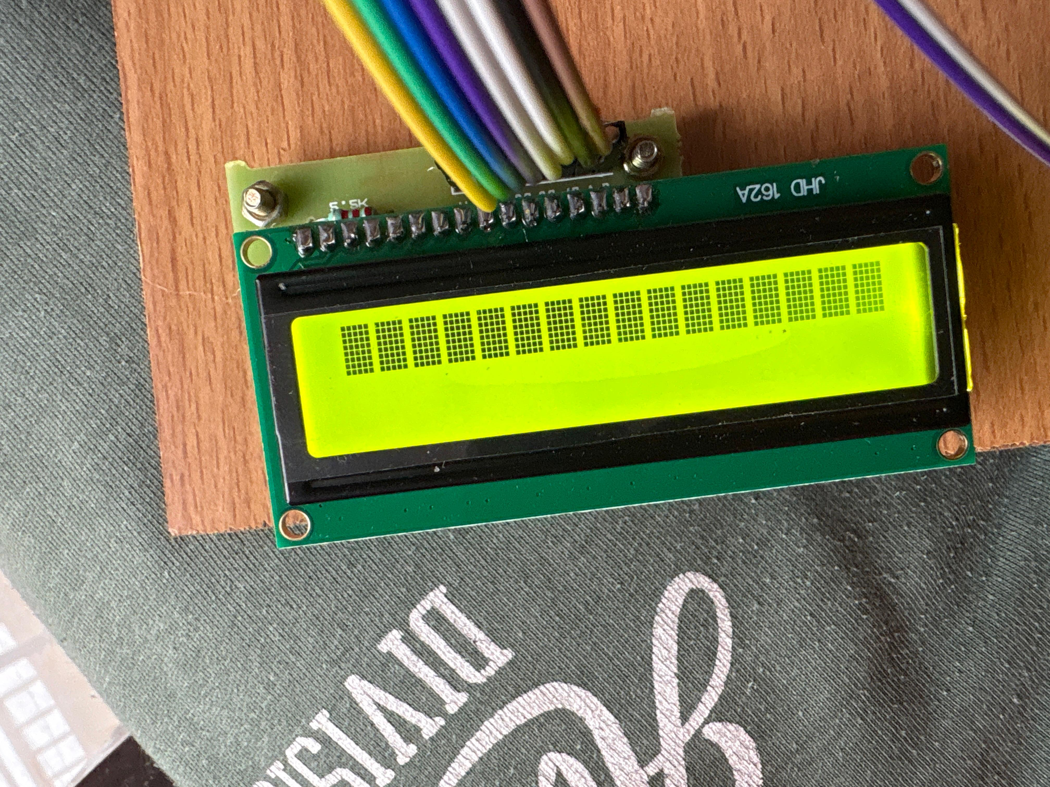
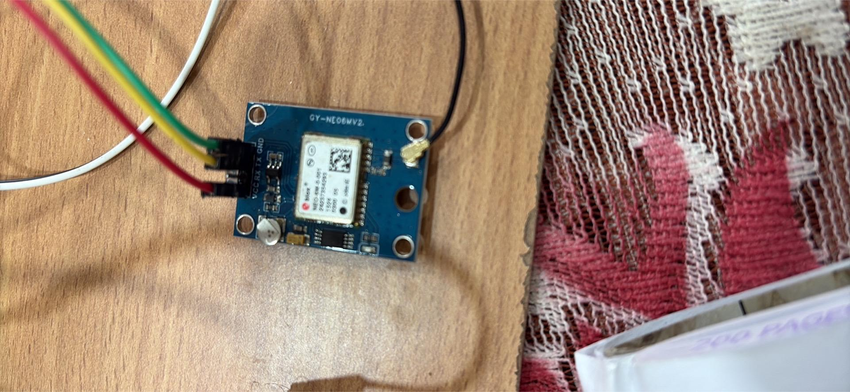
Images of “Failed test cases”
Image of failure in the LED Display
Image of the GPS Module, satellite connection unsuccessful

Slide 37
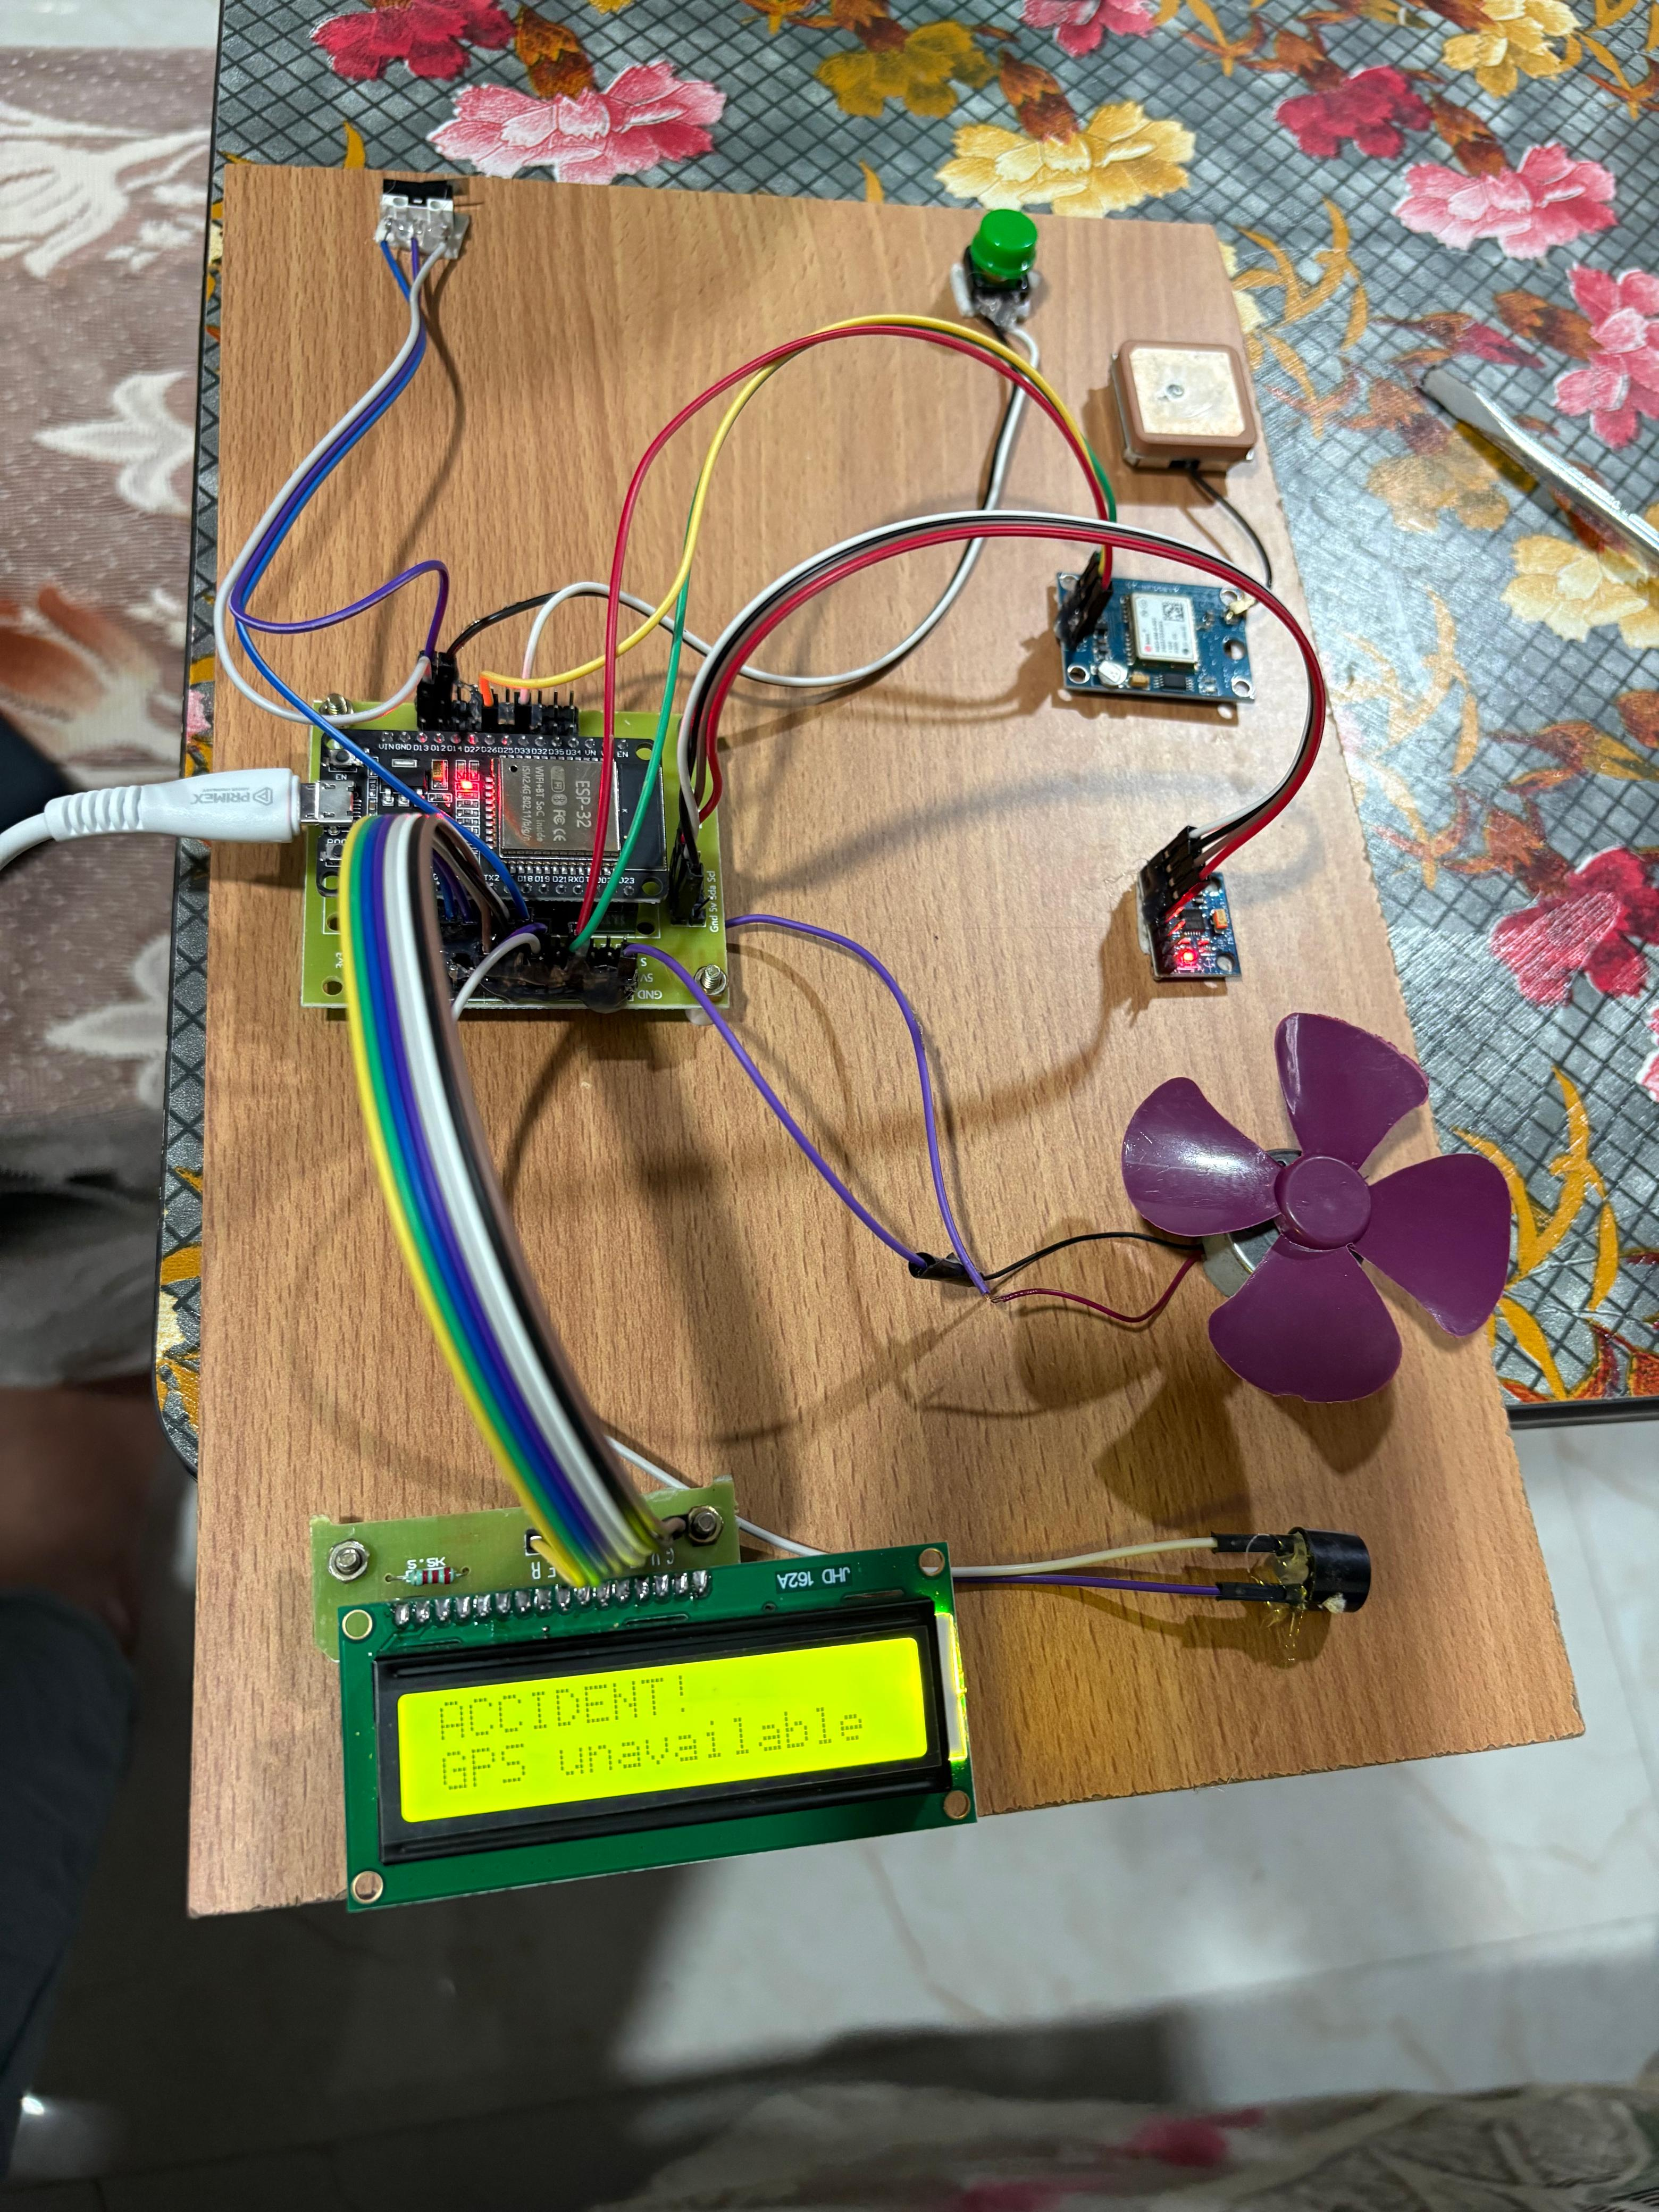
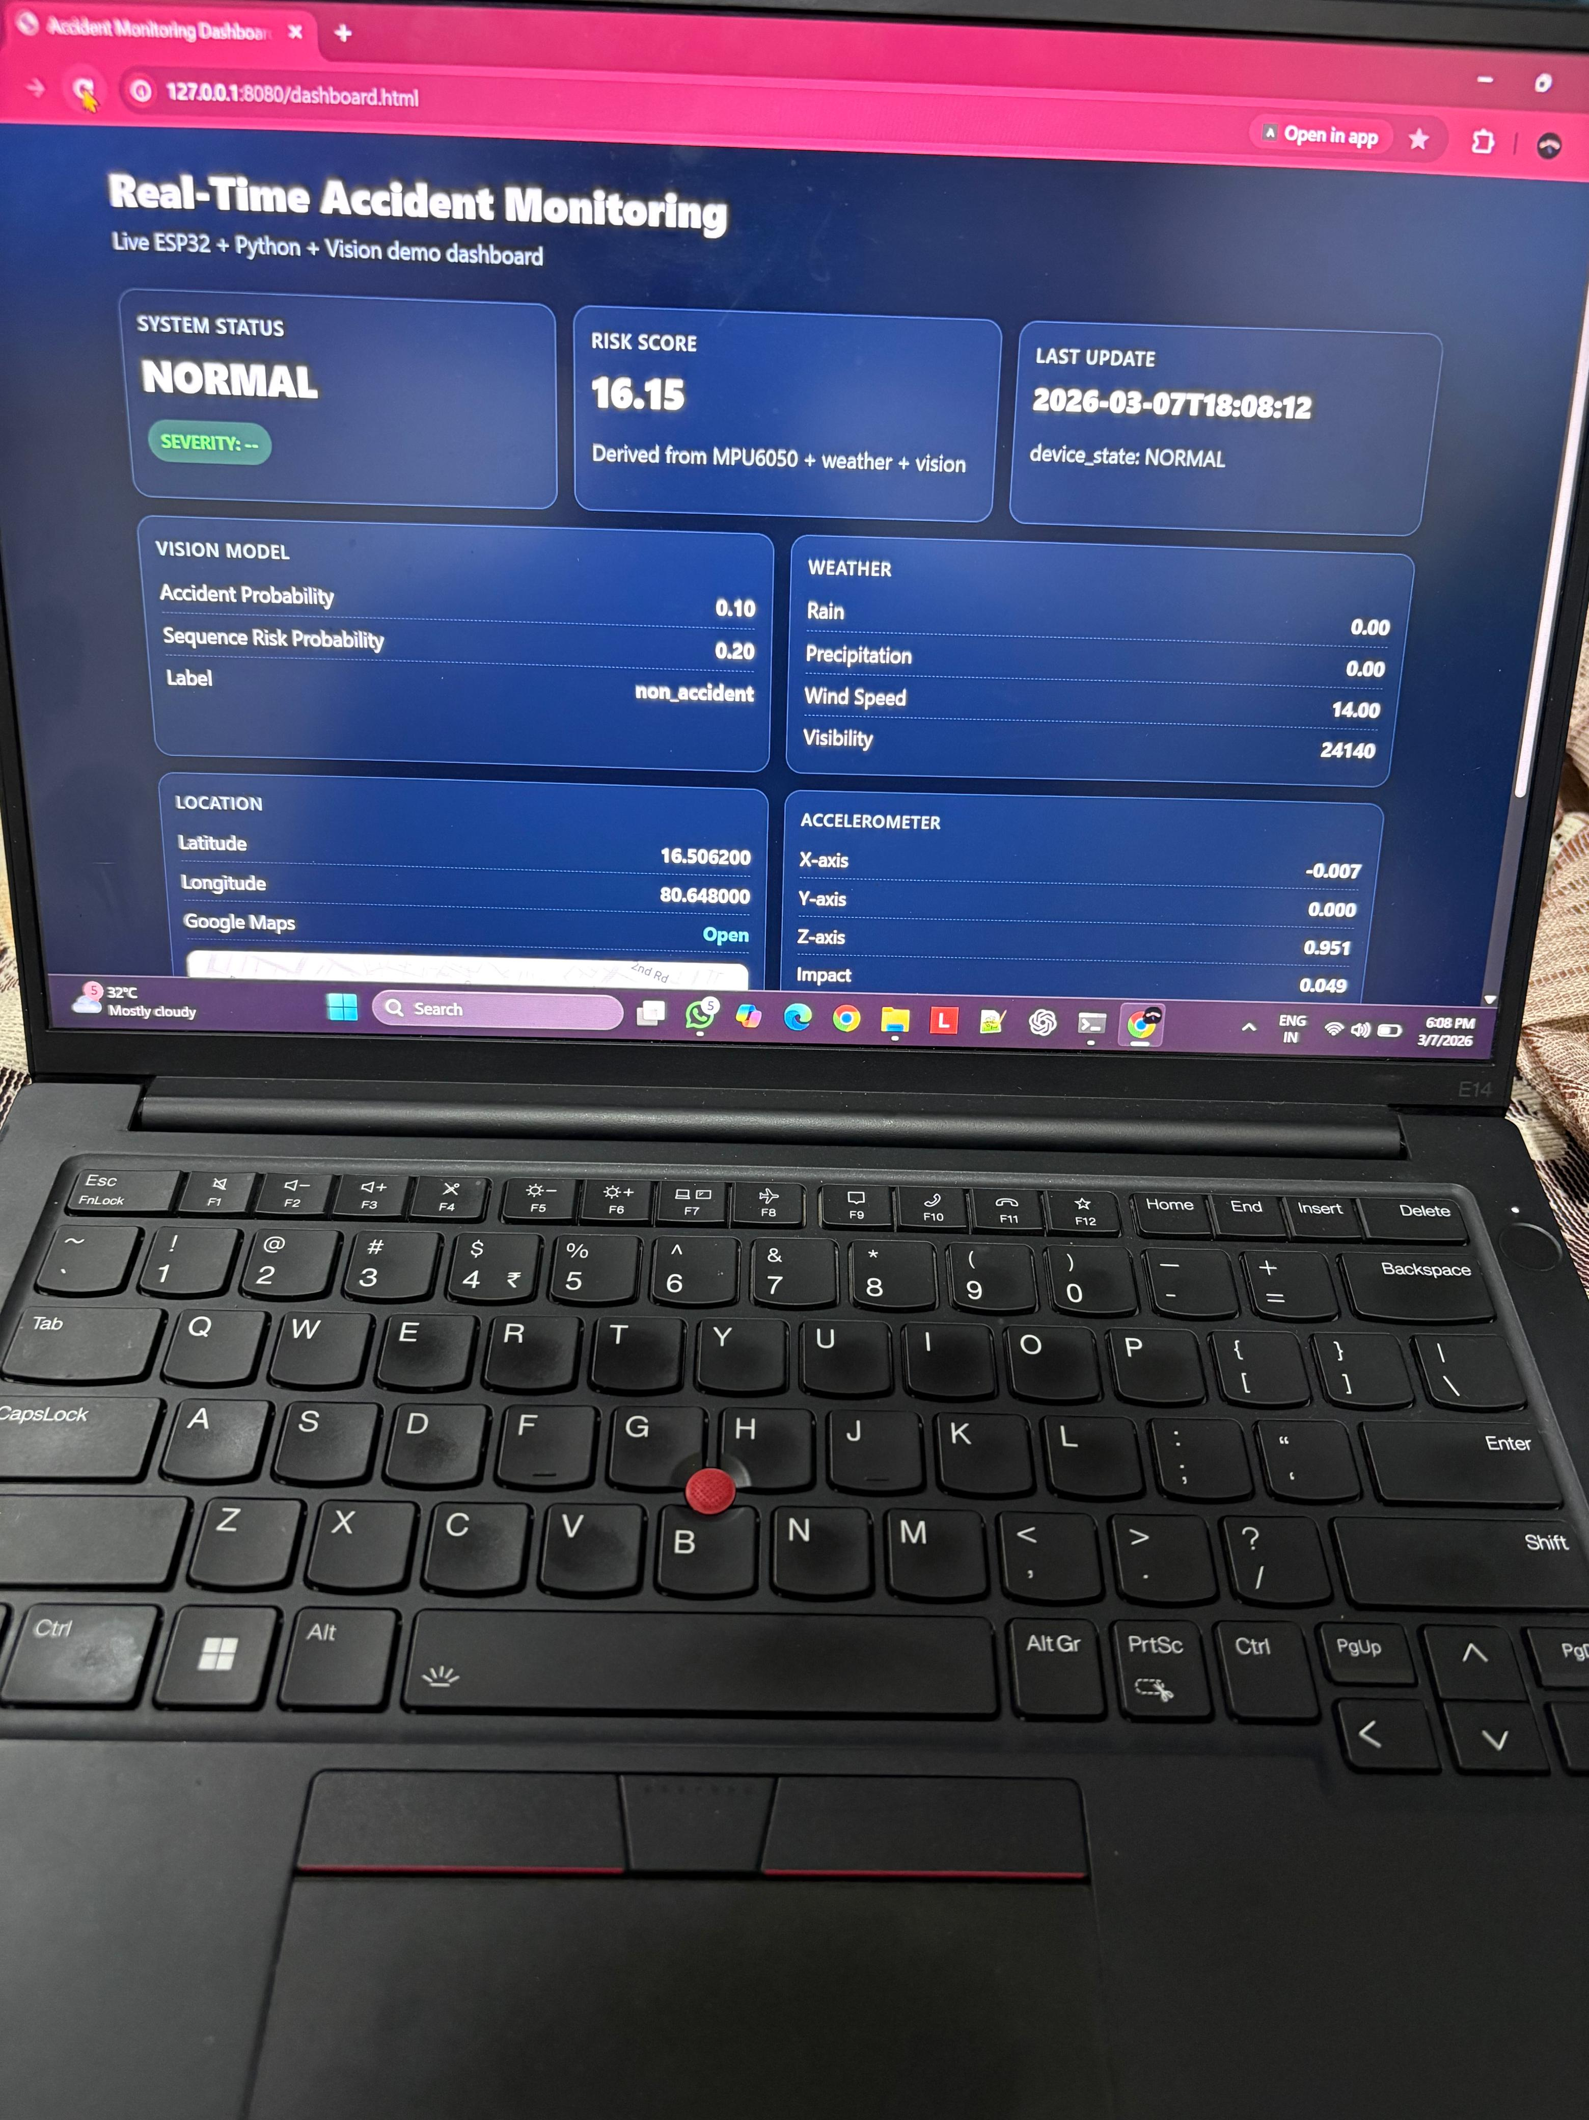
Image showing “ Even the accident, GPS unable to detect the location
Image of Live Website displaying “ Normal condition when the accident happened”

Slide 38
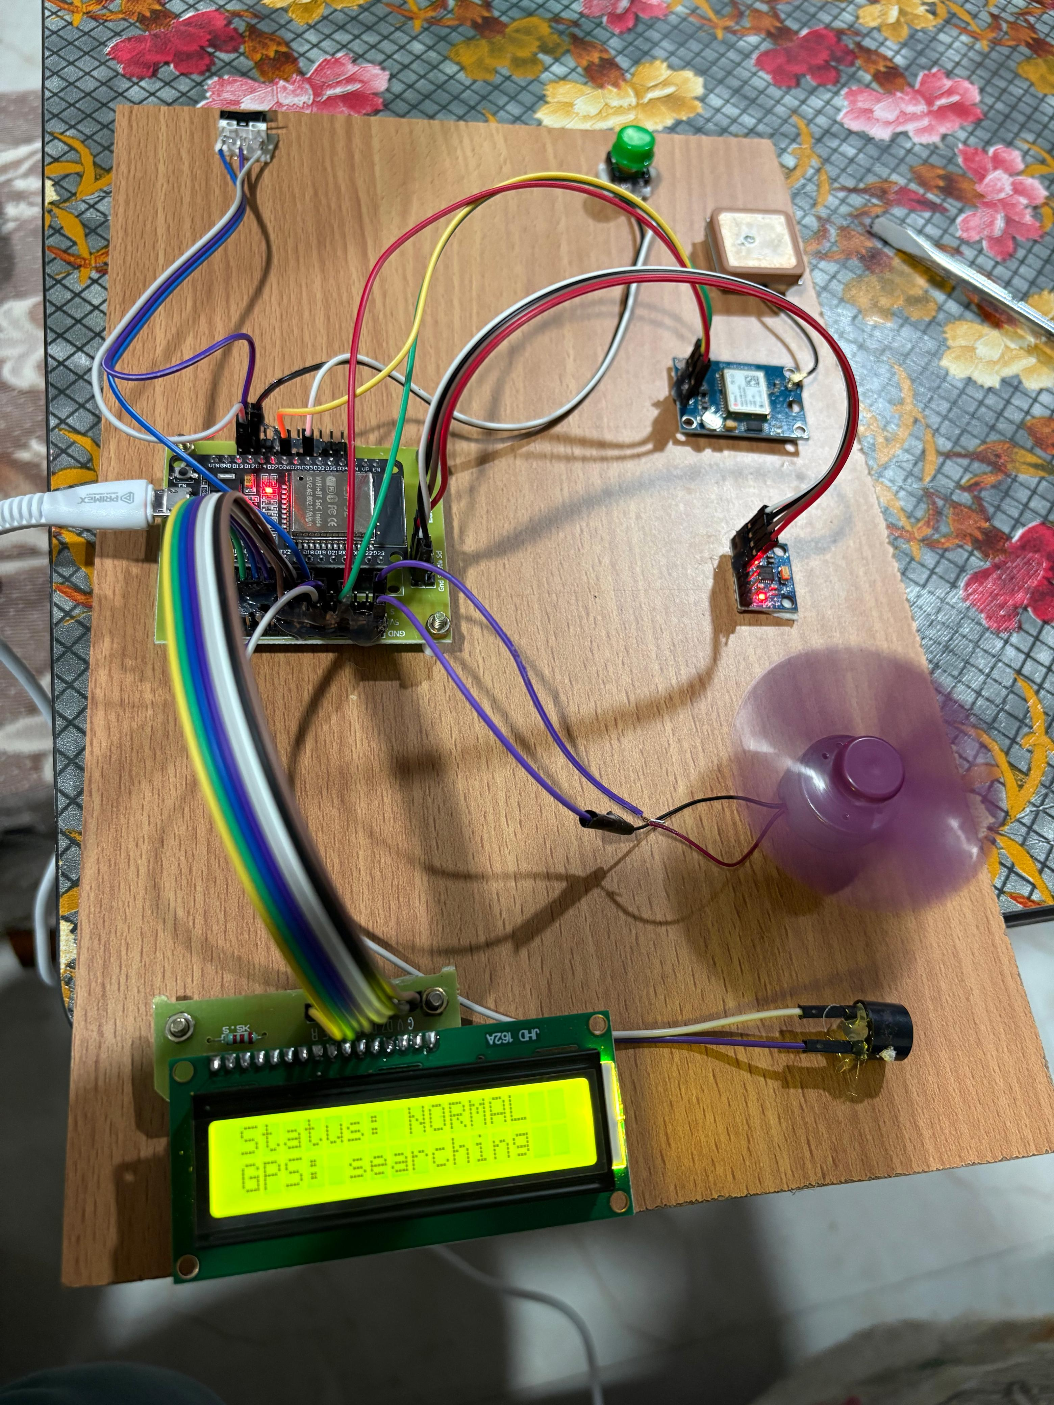
Images of Successful Setup
Image of the corrected LED Display
Image of the complete setup

Slide 39
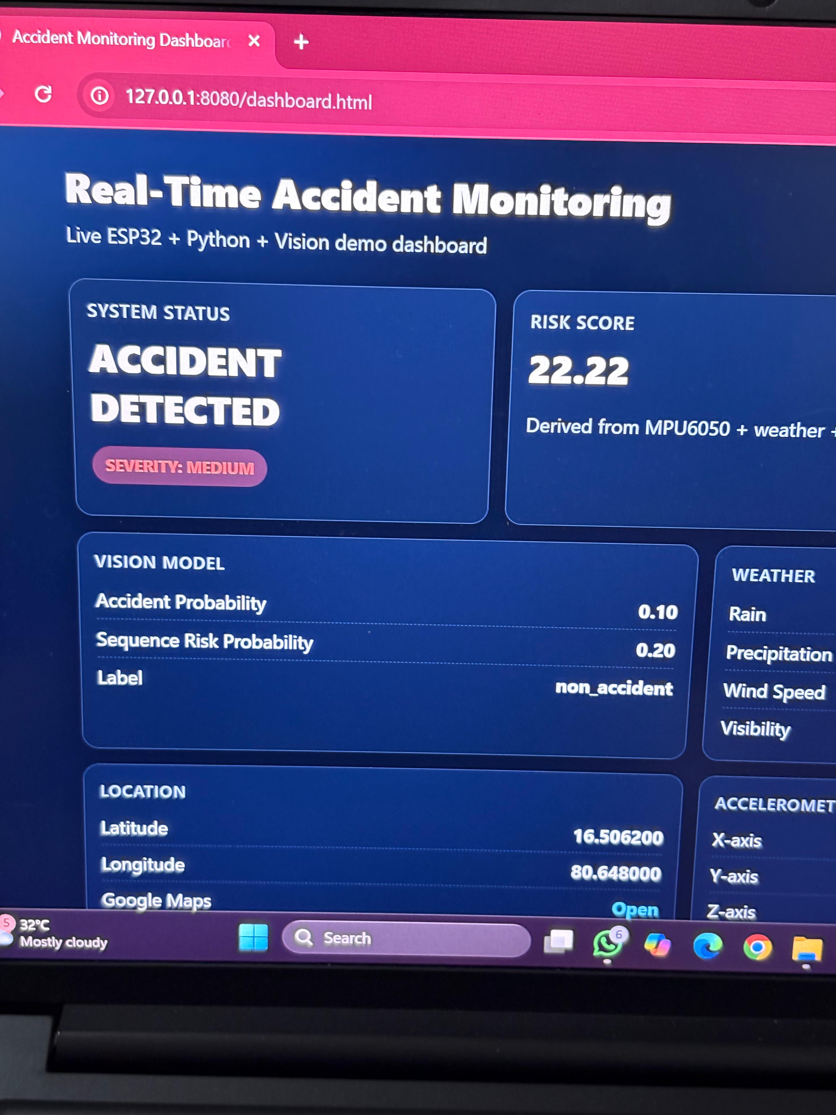
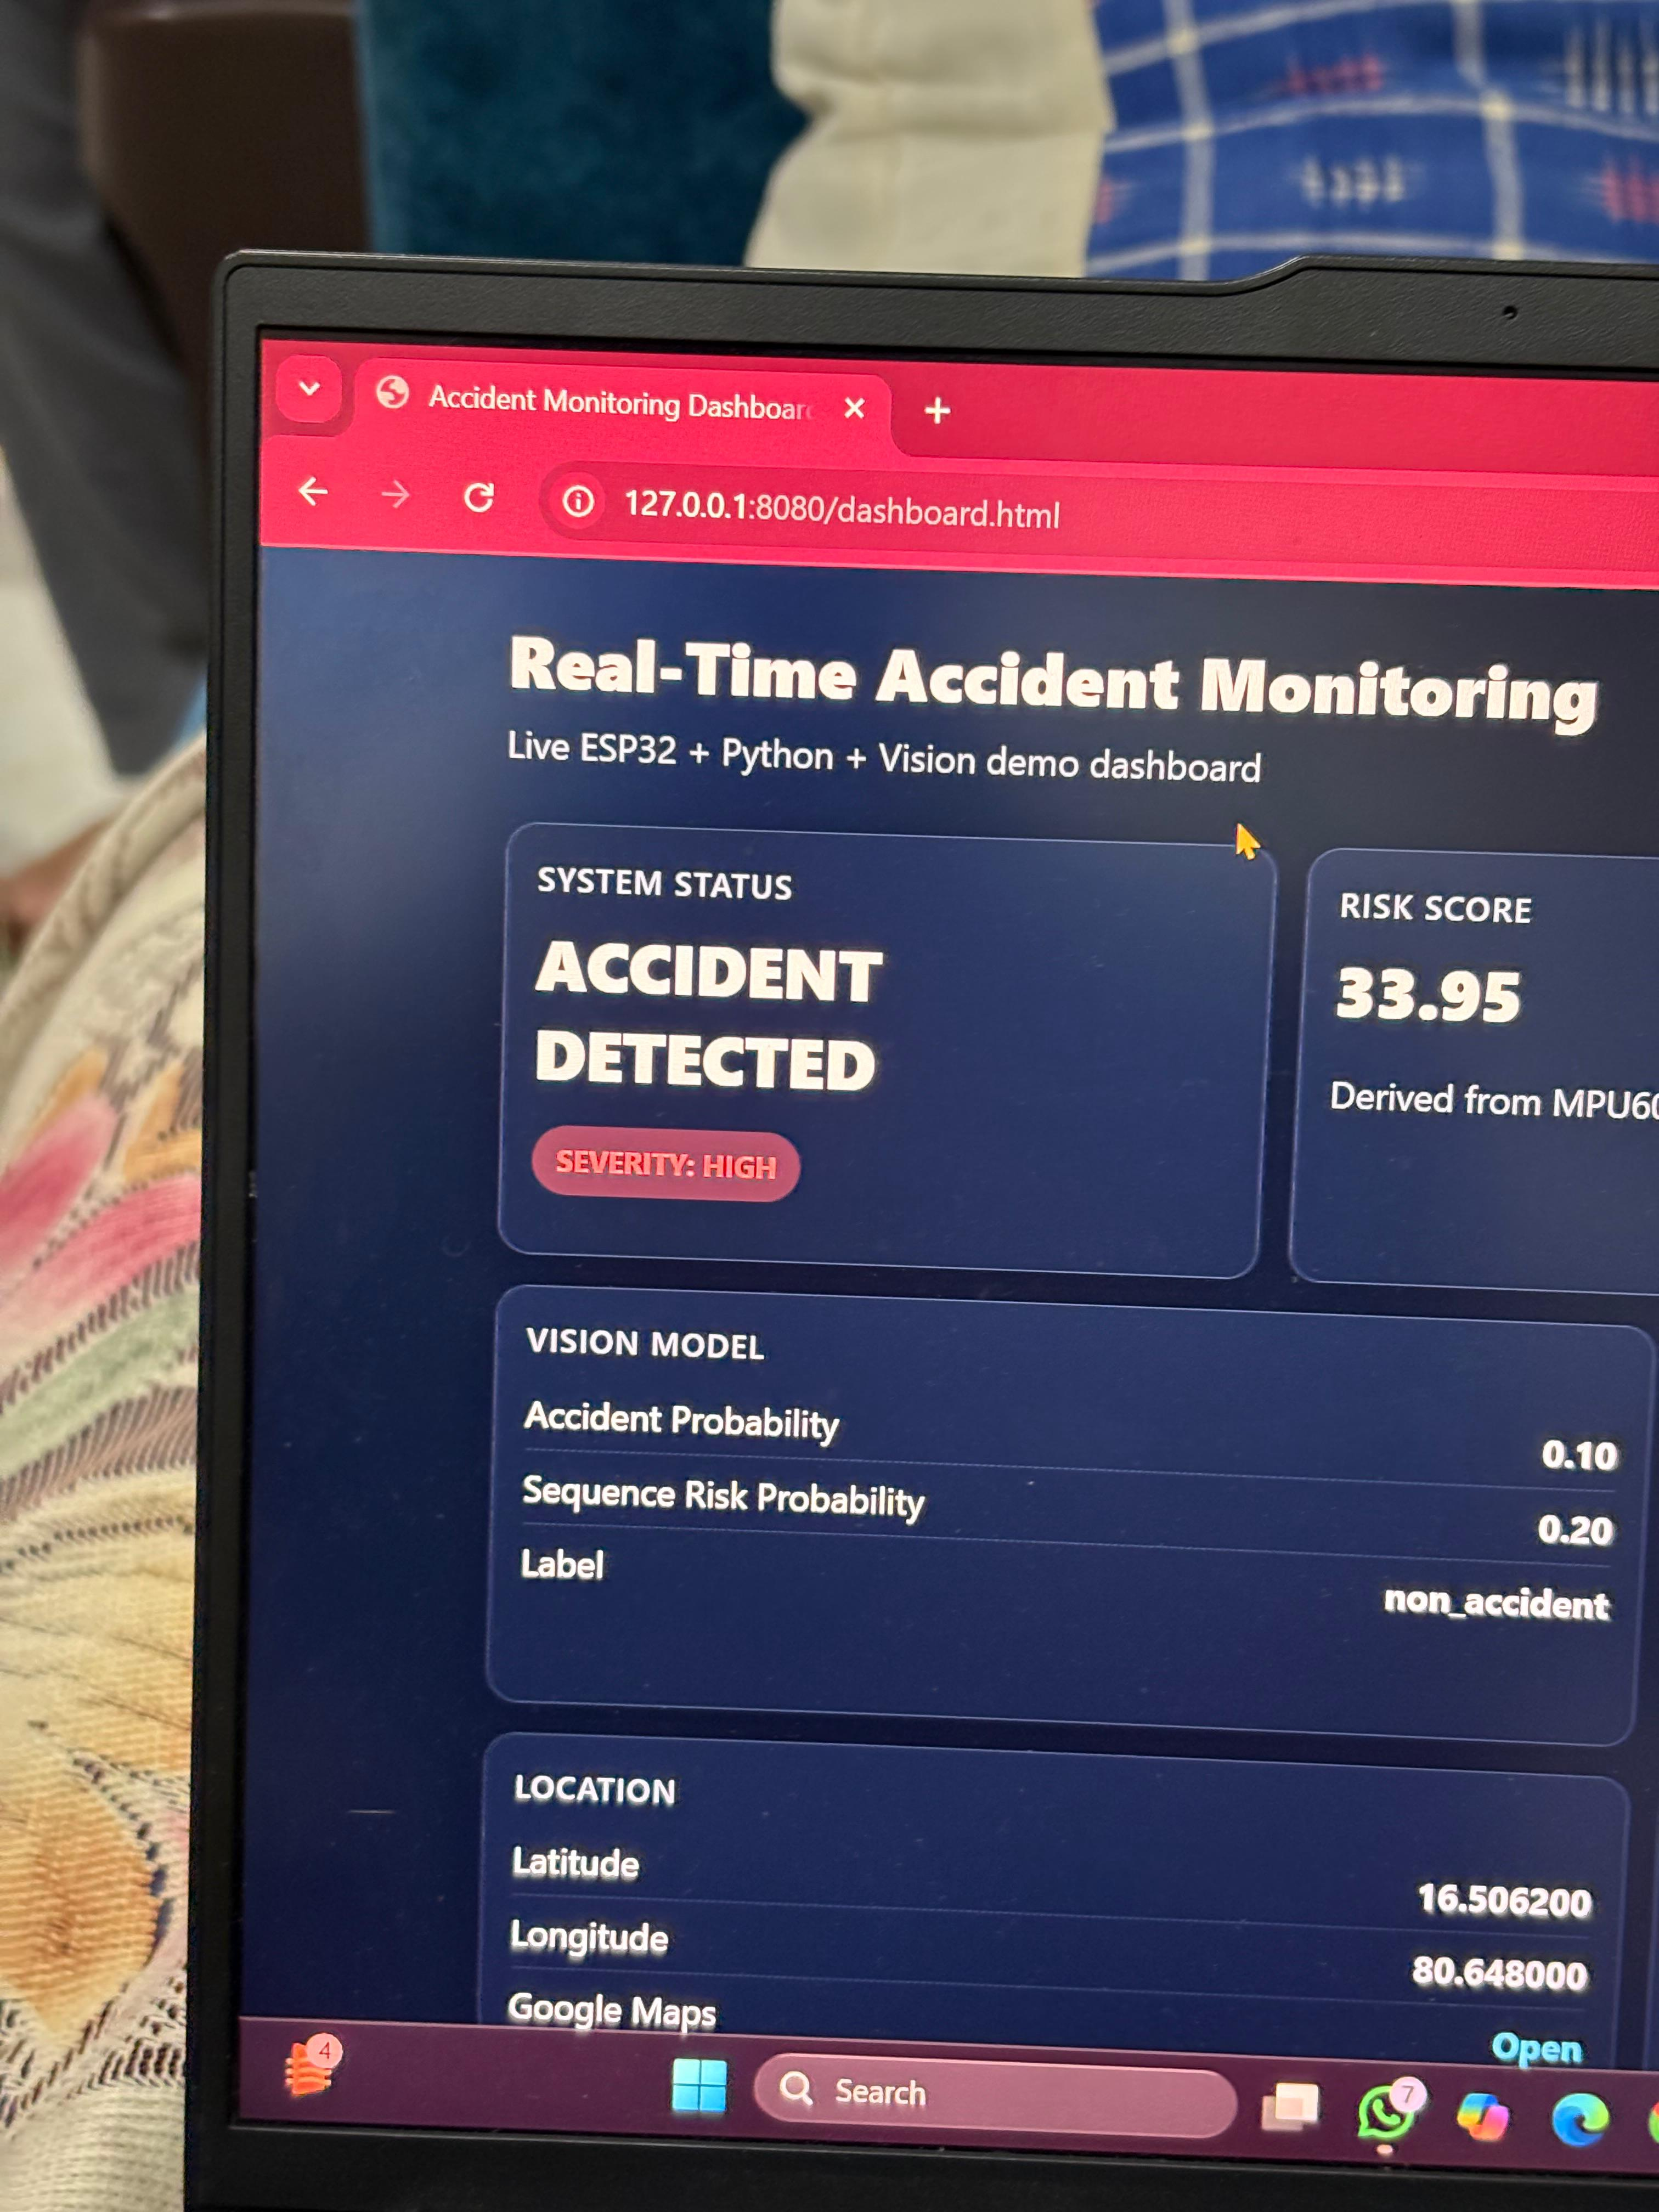
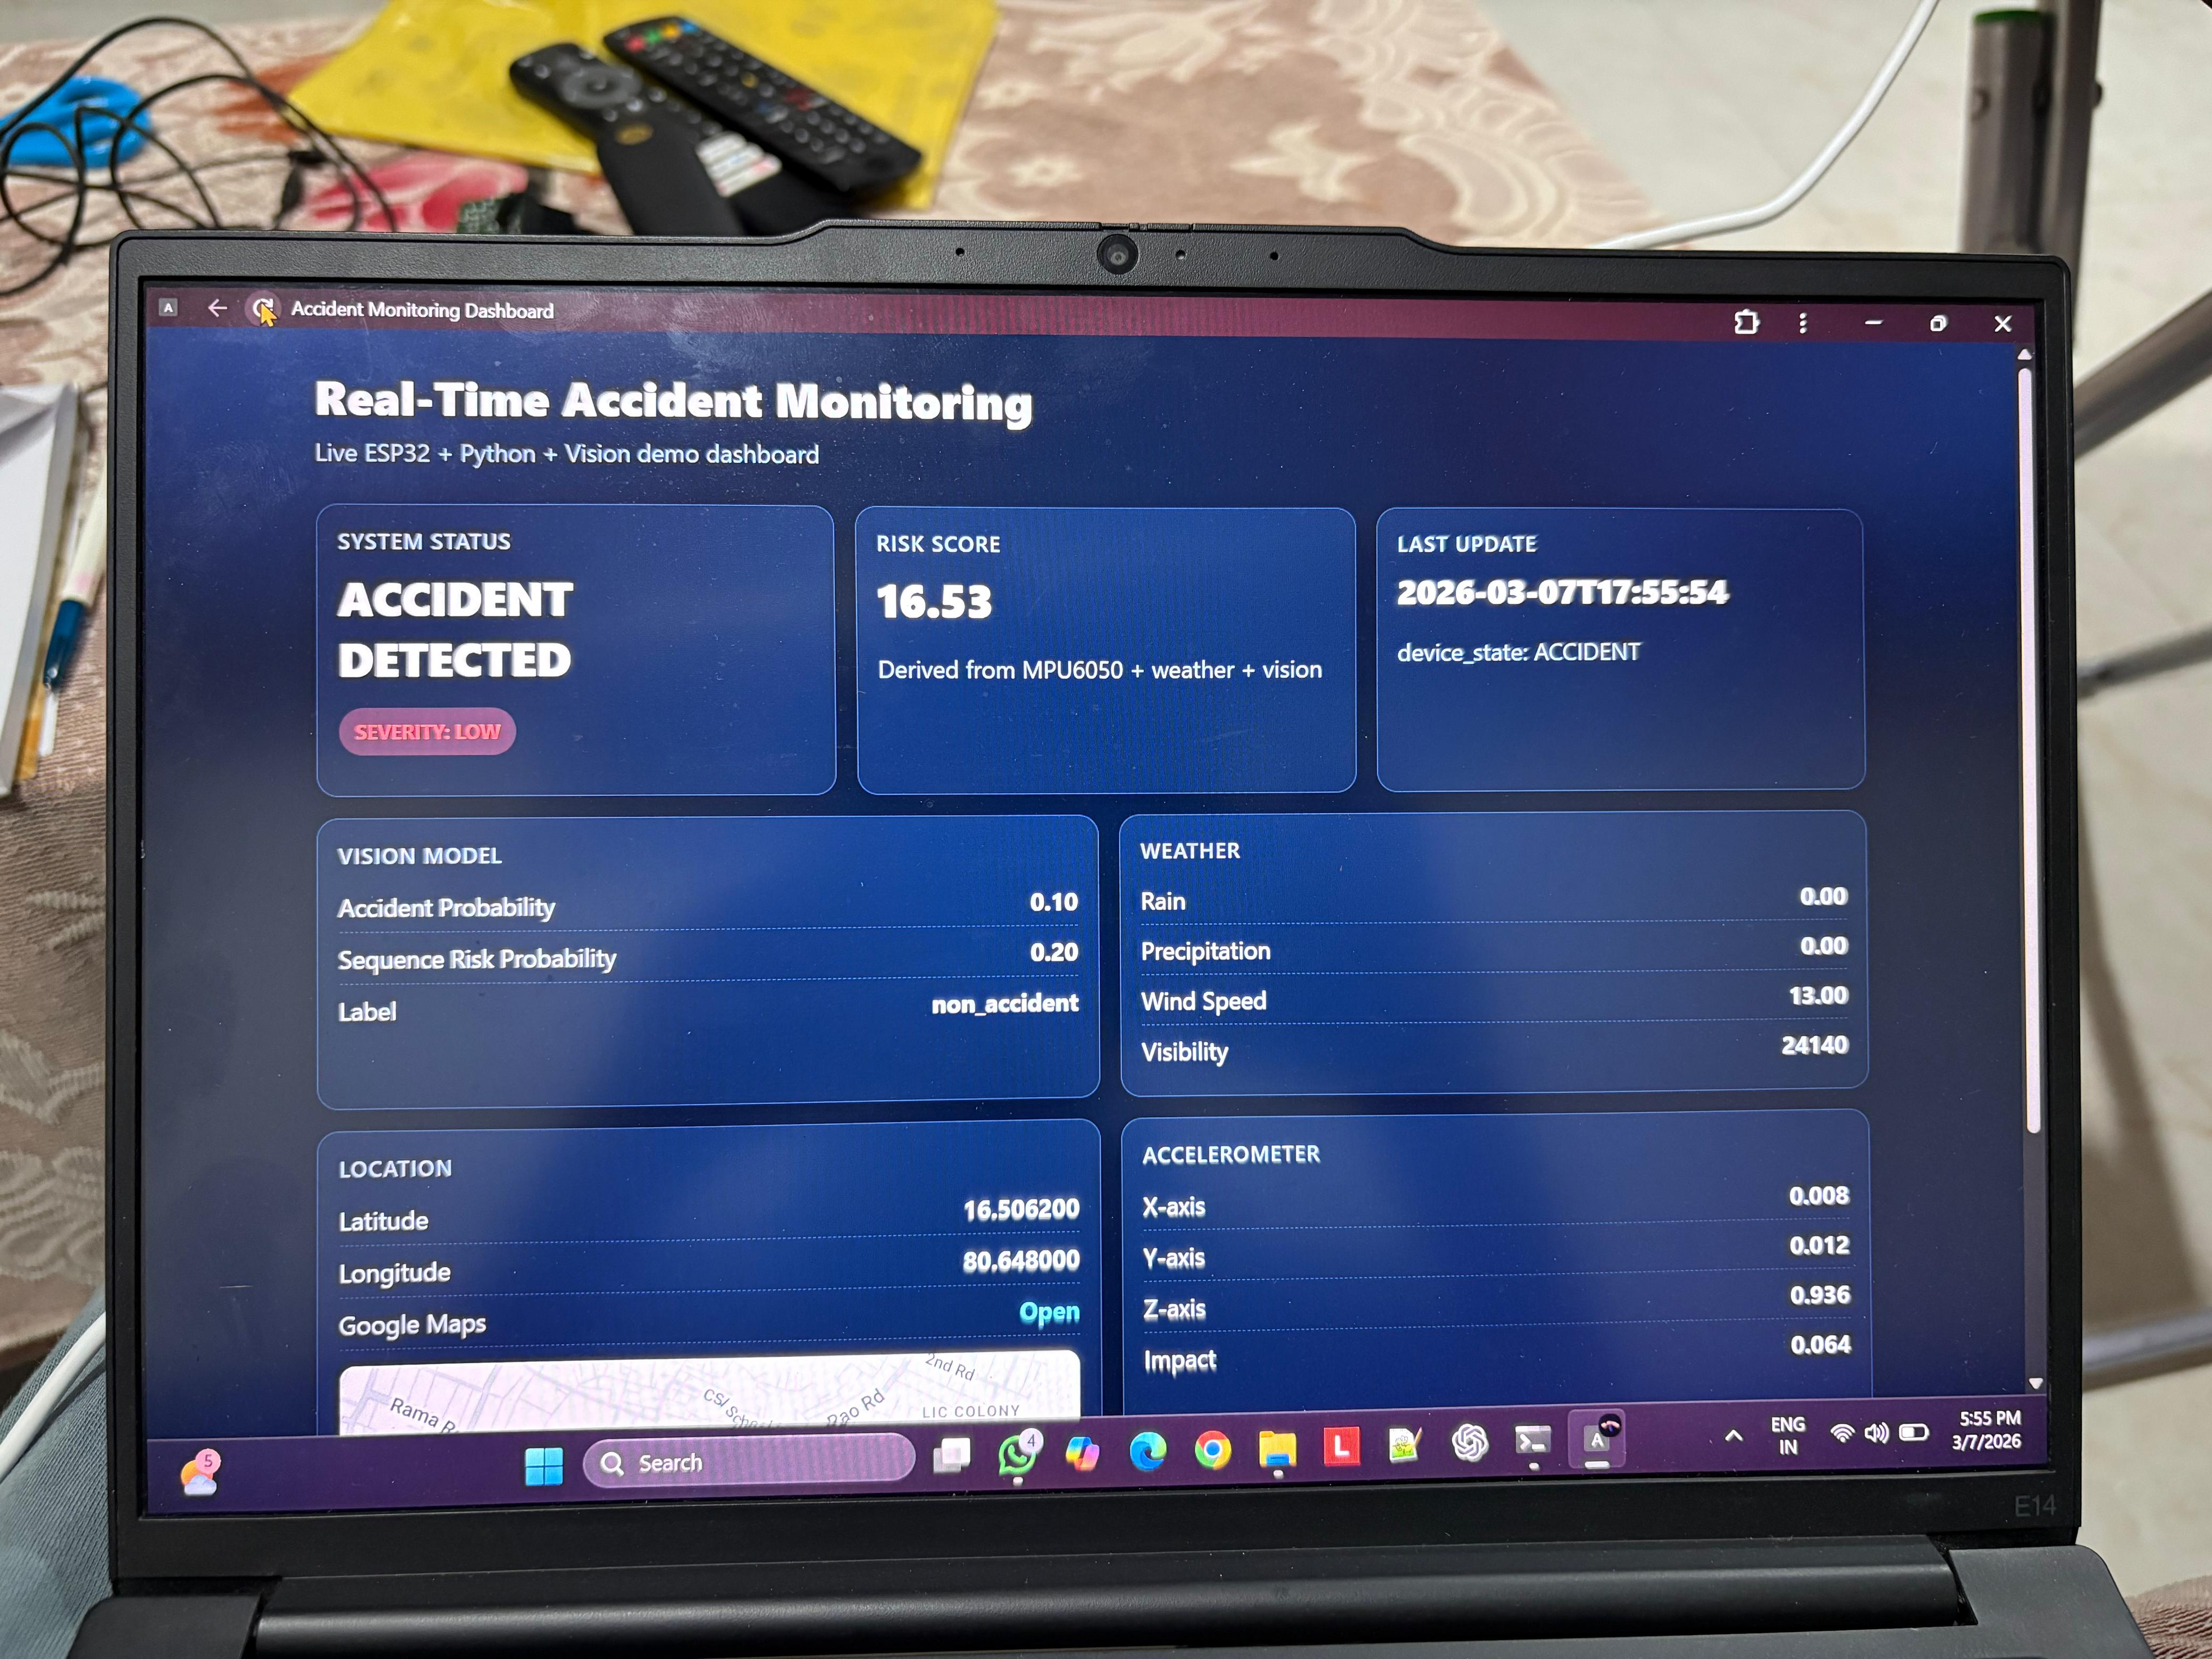
Images showing Severity (corrected):-
1.Low
2.Medium
3.High

Slide 40
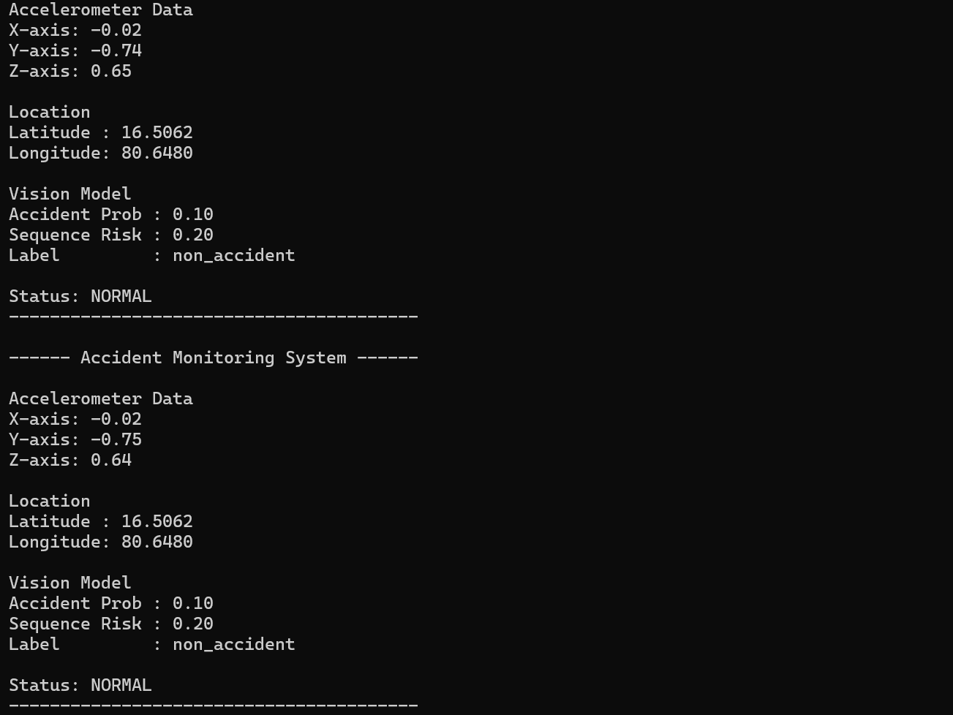
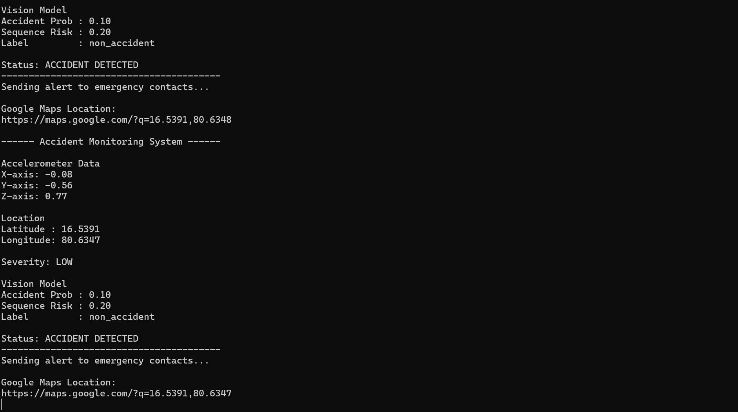
Results
Image showing the “NORMAL” condition dashboard
Image showing the “ACCIDENT “ condition dashboard

Slide 41
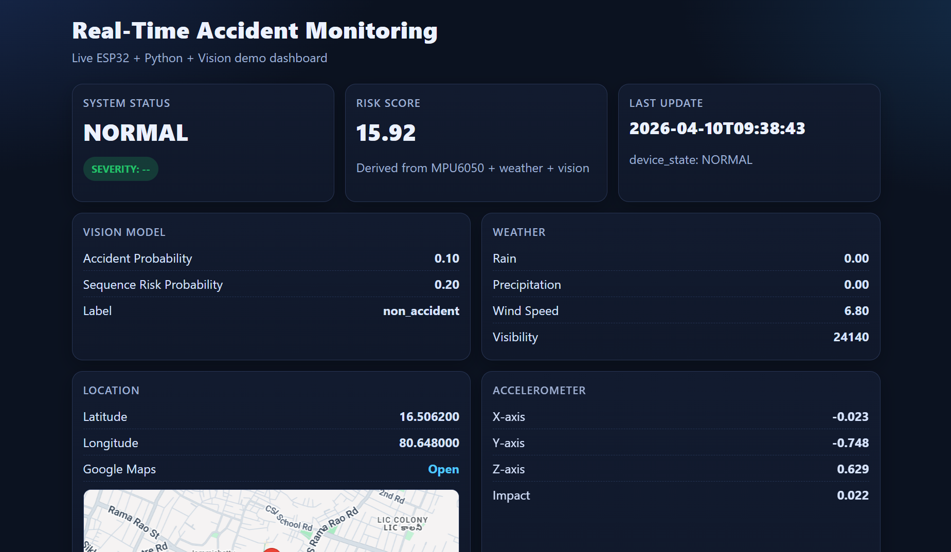
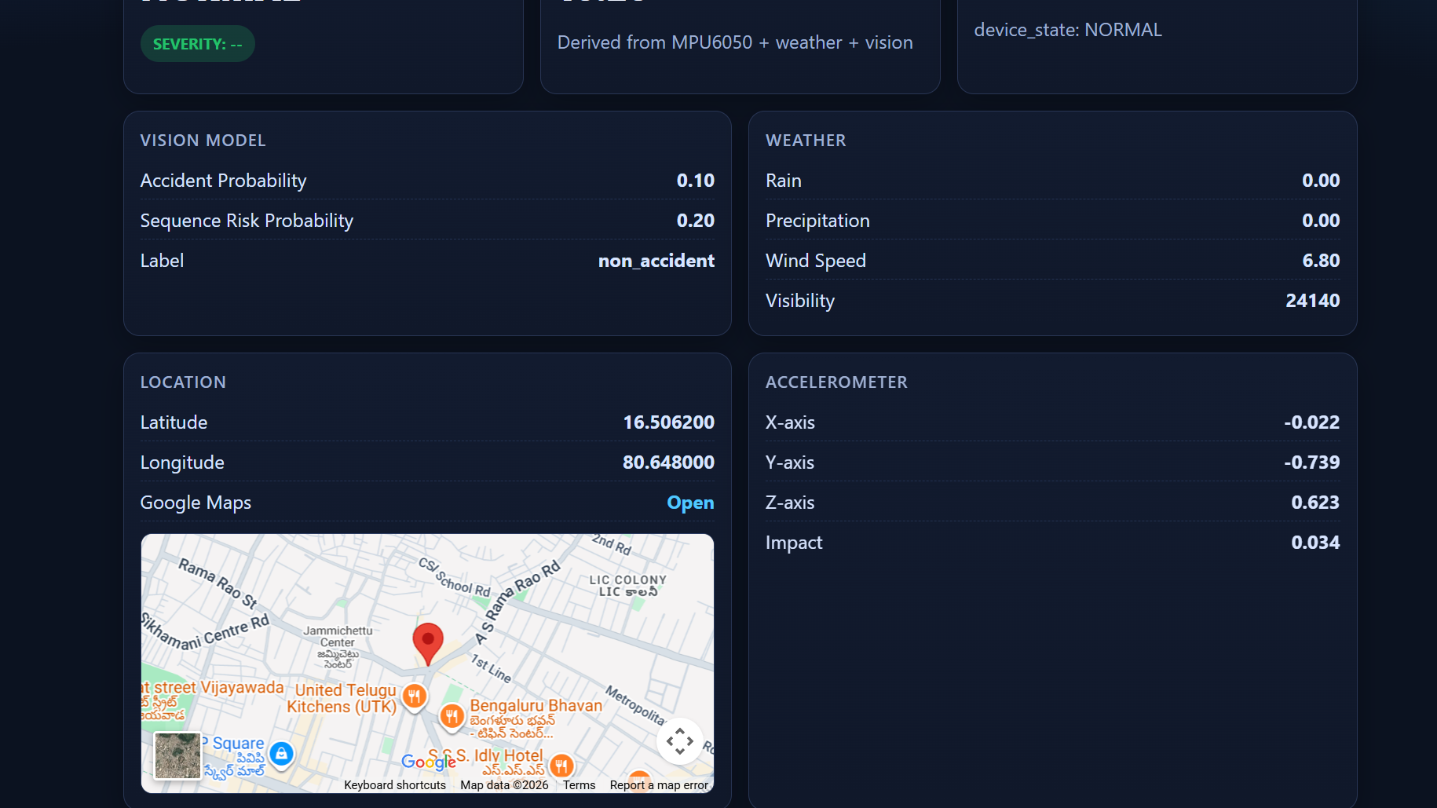
Image of “project dashboard webpage”
Image of “Project dashboard with Google map”

Slide 42
Conclusion
The proposed Real-Time Accident Monitoring and Risk Prediction System combines ESP32-based IoT sensing (MPU6050, crash switch, panic button, GPS), weather-aware risk analysis, and LSTM-based sequence insight for early warning and accident detection.When risk or crash is detected, the system triggers buzzer/LCD alerts and sends Telegram emergency notifications with severity and Google Maps location. These alerts can be configured for emergency/government response contacts such as 100 and 108.Overall, this is a low-cost, real-time project that improves alert speed, situational awareness, and emergency response efficiency.With this model we can able to save a person’s life.

Slide 43
References:
Amir Bahador Parsa, Rishabh S. Chauhan, Homa Taghipour, Sybil Derrible, Abolfazl Mohammadian (2019).
Applying Deep Learning to Detect Traffic Accidents in Real Time Using Spatiotemporal Sequential Data (uses LSTM/GRU).
Debaditya Roy, Tetsuhiro Ishizaka, Krishna Mohan C., Atsushi Fukuda (2019).
Detection of Collision-Prone Vehicle Behavior at Intersections using Siamese Interaction LSTM (SILSTM).
M. N. Khan Khattak, Balawal Shabir, Asad Waqar Malik, Sher Ramzan Muhammad (2020).
A Comprehensive Study on IoT Based Accident Detection Systems for Smart Vehicles. IEEE Access.
Pouya Mehrannia, Shayan Shirahmad Gale Bagi, Behzad Moshiri, Otman Adam Al-Basir (2021).
Deep Representation of Imbalanced Spatio-temporal Traffic Flow Data for Traffic Accident Detection (LSTM).
Luyang Liu et al. (2022).
Smartphone-based Hard-braking Event Detection at Scale for Road Safety Services.
Amal H. Alkhaiwani, Badr S. Alsamani (2023).
A Framework and IoT-Based Accident Detection System to Securely Report an Accident and the Driver’s Private Information. Sustainability.
Tae-wook Kim, Han-jin Lee, Hyeon-Jin Jung, Ji-Woong Yang, Ellen J. Hong (2024).
SST-GCN: Sequential Spatio-Temporal Graph Convolutional Networks for Traffic Accident Risk Prediction (GCN+LSTM).

Slide 44
Nandkumar Niture, Iheb Abdellatif (Published 2024; issue 2025).
A systematic review of factors, data sources, and prediction techniques for earlier prediction of traffic collision using AI and ML.
Abimbola Ogungbire, Srinivas S. Pulugurtha (2025).
Spatiotemporal Risk Mapping of Statewide Weather-related Traffic Crashes: A Machine Learning Approach.
Khaled Alnowaiser (2025).
A Computational Intelligence GNN–LSTM Framework for Spatiotemporal Prediction of Traffic Accident Severity in Smart Cities Using SHAP XAI.
Minal Y. Barhate et al. (2025).
IoT-Enabled Vehicle Accident Detection System Using ESP32 with GPS Tracking and Dual-Channel Emergency Alerts via GSM-SMS and Telegram Bot.
Khaled Alnowaiser (2025).
A Computational Intelligence GNN–LSTM Framework for Spatiotemporal Prediction of Traffic Accident Severity in Smart Cities Using SHAP XAI.
Minal Y. Barhate et al. (2025).
IoT-Enabled Vehicle Accident Detection System Using ESP32 with GPS Tracking and Dual-Channel Emergency Alerts via GSM-SMS and Telegram Bot.

Slide 45
Thank You

