Slide 1

University Management System
A Desktop-Based Administrative Solution for University Operations
A fully functional C# Windows Forms desktop application connecting to a Microsoft SQL Server database, designed to centralize and streamline core administrative workflows.

Slide 2

Universities that rely on fragmented, paper-based, or disconnected digital tools face recurring challenges: duplicate student records, scheduling conflicts, inaccurate enrollment data, and delayed reporting. Without a centralized system, administrative staff must manually cross-reference multiple sources to answer basic questions such as how many students are enrolled in a department, or whether a time slot has a scheduling conflict. These inefficiencies waste staff time, increase the likelihood of data errors, and make it difficult for administrators to make informed decisions. The University Management System addresses all of these pain points through a single, integrated desktop application.
Manual University Administration Creates Costly Inefficiencies

Slide 3

The University Management System is organized around seven major functional modules, all accessible from a single Admin Dashboard after a secure login. These modules are: Student Management, Instructor Management, Department Management, Course Management, Enrollment Management, Scheduling and Time Slot Management, and Reports & Analytics. Each module provides full Create, Read, Update, and Delete (CRUD) capabilities, allowing administrators to manage university data without writing SQL.
One Integrated Platform Covers All Core University Functions

Slide 4

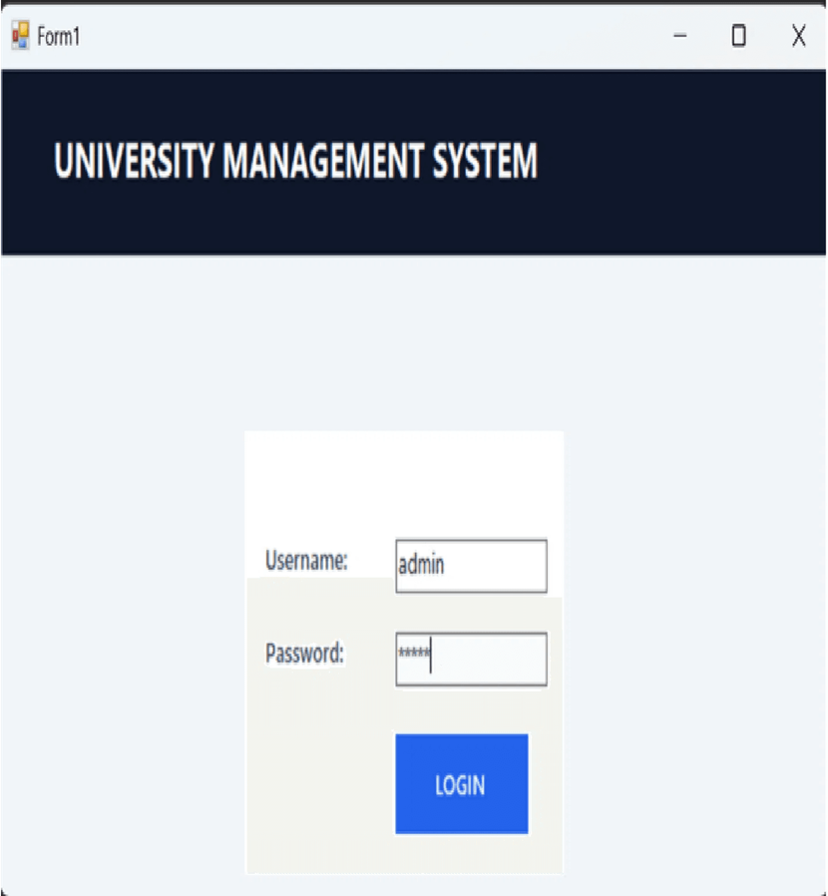
The system begins with a secure login screen. Upon authentication, the system checks the user's role—Admin, Instructor, or Student—and routes them to the appropriate interface. This ensures that sensitive data like salary info and budget figures are only visible to authorized personnel. The login form validates credentials against the SQL Server database before granting access.
Role-Based Login Ensures Secure and Controlled System Access

Slide 5
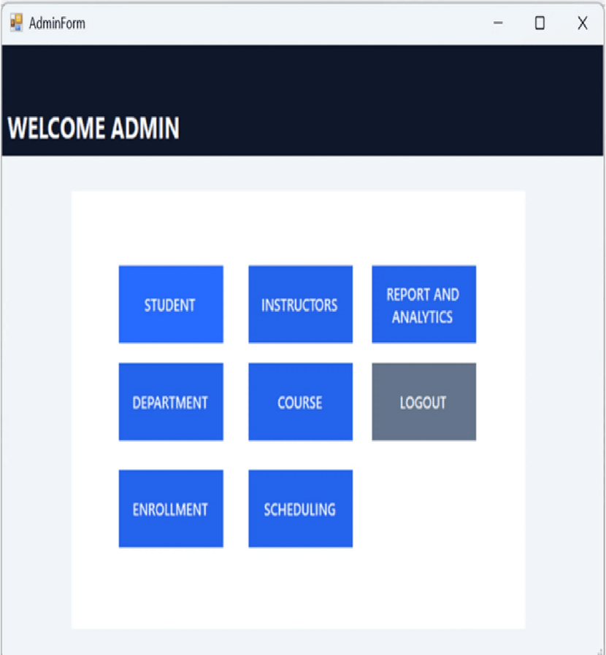
The Welcome Admin dashboard is a clean, tile-based hub providing instant access to Student, Instructors, Department, Course, Enrollment, Scheduling, and Reports. This design prioritizes usability, allowing administrators to navigate the system in a single click. The consistent color scheme and bold typography ensure a professional and accessible administrative environment.
The Admin Dashboard Provides Instant Access to All Management Modules

Slide 6
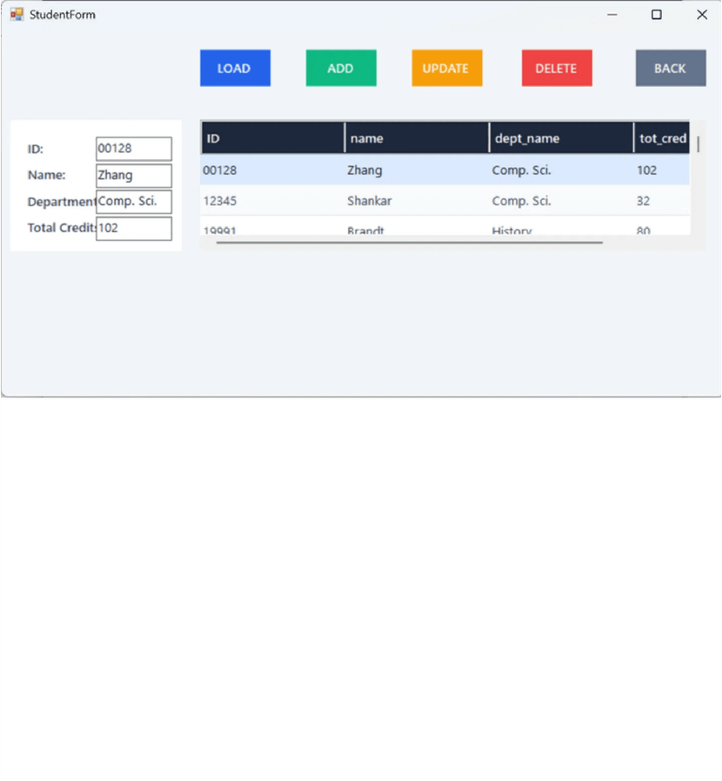
The Student Management module enables full CRUD capabilities for student records, including ID, name, department, and total credits. Built-in validation ensures that departments exist and Student IDs are unique before any database insertion. All administrative actions—Load, Add, Update, and Delete—are immediately reflected in the live data grid, providing real-time data accuracy for university staff.
Administrators Can Add, View, Update, and Delete Student Records in Real Time

Slide 7
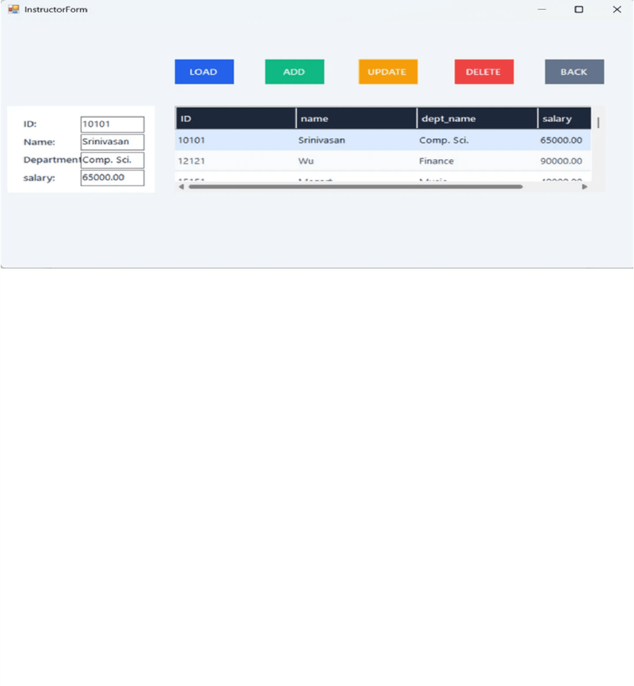
The Instructor Management module maintains faculty records including unique ID, name, department, and salary. This module is essential for HR and payroll administrative tasks. It ensures data integrity by validating department assignments and salary figures. The system also tracks instructor-student advisor relationships, linking faculty directly to the academic progress of their assigned students.
Instructor Records Are Managed with Department Validation and Salary Tracking

Slide 8
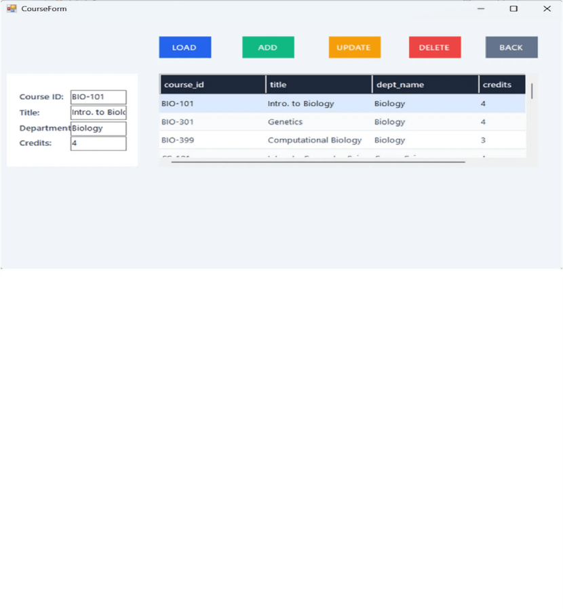
Department Management stores location and budget data, while Course Management maintains the academic catalog. Courses are linked to departments through foreign key relationships, ensuring referential integrity. These modules form the academic backbone of the system—departments and courses must be established before students can enroll or instructors can be assigned to teach.
Departments and Courses Form the Structural Foundation of the University Database

Slide 9
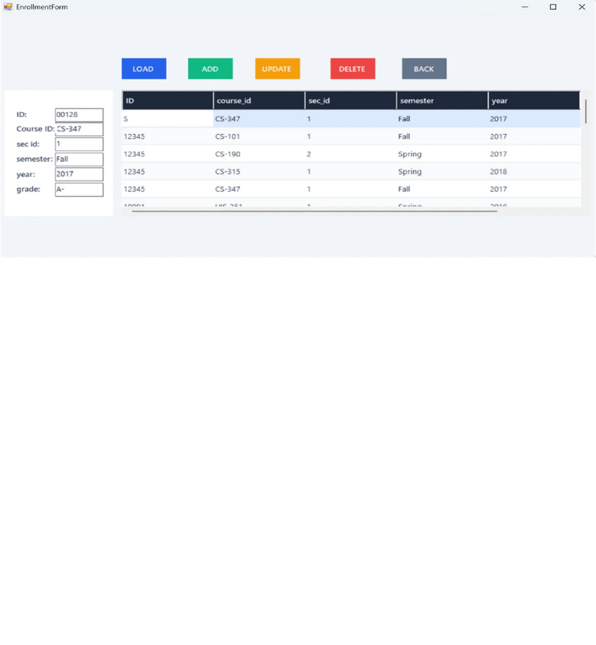
Enrollment Management acts as the relational bridge between students and course sections. Each record captures the Student ID, Course ID, Section, Semester, and Grade. The system validates student and course existence before insertion, preventing invalid entries. This module is critical for academic record-keeping, storing official grade data that determines a student's standing and total credits.
Enrollment Management Tracks Which Students Are Taking Which Courses and Their Grades

Slide 10
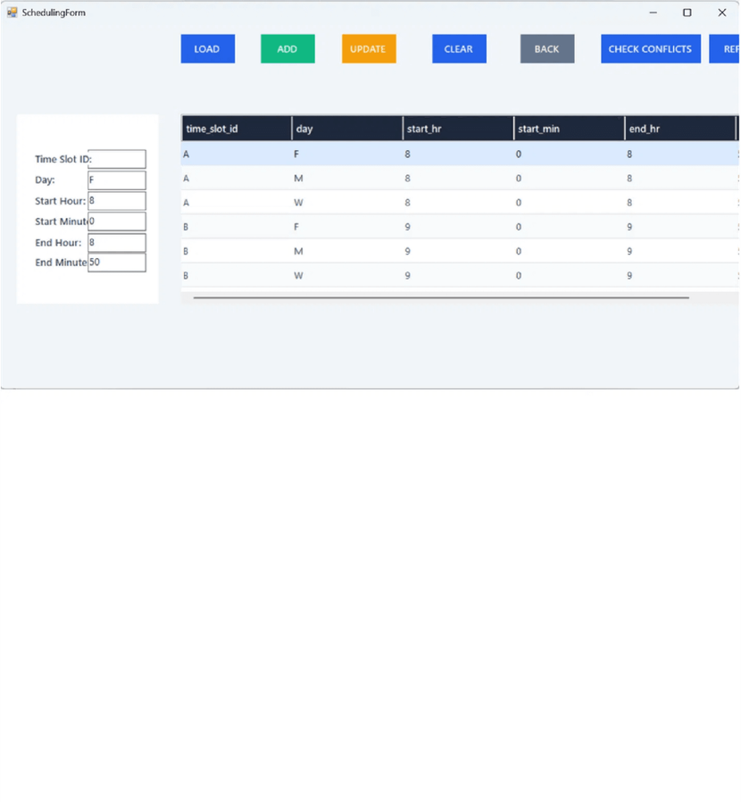
The Scheduling module manages class time slots, defining when and where class sessions occur. A standout feature is automatic conflict detection—the system queries the database to identify overlapping time slots on the same day. This prevents double-booking of classrooms or instructors, ensuring the academic schedule remains logically consistent before publication.
The Scheduling Module Manages Class Time Slots and Automatically Detects Conflicts

Slide 11
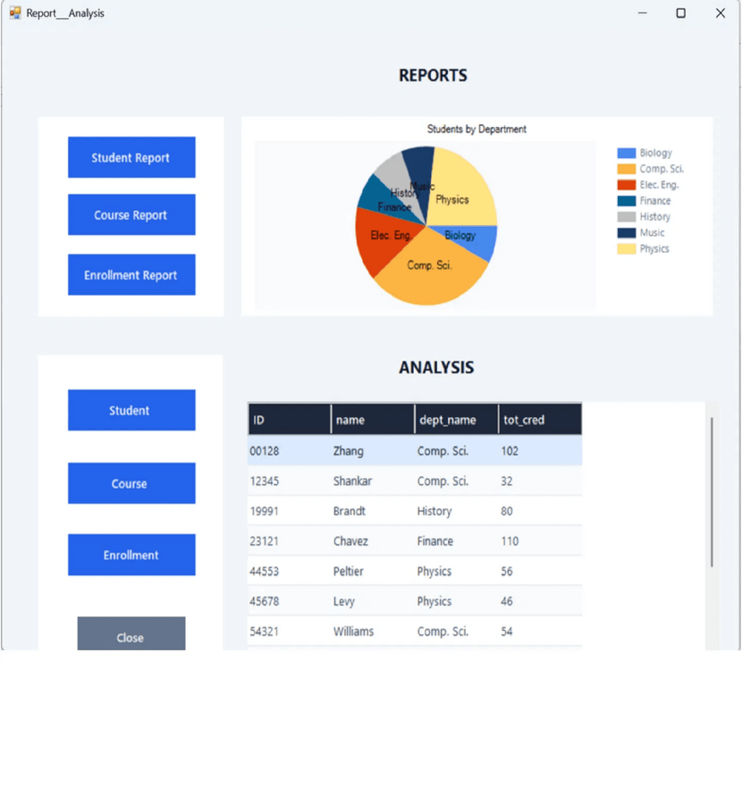
The Reports and Analytics module provides data-driven insights through tabular exports and dynamic visualizations. Administrators can generate pie charts for student distribution and column charts for enrollment and credit analysis. These reports are rendered from live database data, ensuring that university leadership always has access to the most current information for strategic decision-making.
Built-In Analytics Generate Visual Reports on Students, Courses, and Enrollments

Slide 12

Developed using C# with the .NET Framework 4.7.2 and Windows Forms, the system utilizes Microsoft SQL Server LocalDB for structured data management. The architecture leverages both ADO.NET and Entity Framework to ensure high performance and data integrity across its eleven interrelated tables. This standalone executable is designed for secure, offline deployment, providing a robust administrative backbone for university operations.
The System is Built on a Robust and Scalable Technology Foundation

