Slide 1
FLOOD RISK SCORING
A Machine Learning Framework
for Insurance Underwriting
End-to-end ML pipeline · Calibrated probability outputs · SHAP explainability · Interactive dashboard
1.1M
20
4
R² 0.87
4 tabs
Training rows
Risk features
ML models
Best model
Dashboard
By: Ashifa Haneef and Morenike Adesina
Kaggle Playground Series S4E5 · Python · XGBoost · SHAP · Optuna · Streamlit
Notes:
Introduction slide. Mention: insurance underwriting framing, 1.1M rows, 4 models, calibration, SHAP, and Streamlit dashboard.

Slide 2
Project Overview
2 / 16
What problem does this solve?
Before an insurer binds a flood policy — for a home, building, or farm — it must answer one question:
"How likely is this location to flood — and is that risk high enough to charge more, add exclusions, or decline the policy?"
This model answers that question at scale — scoring millions of locations with a calibrated flood probability.
🏢 P&C Insurers
🌍 Reinsurers
📊 Cat Model Firms
🏛️ Gov't & Dev Banks
Price flood policies at quote time. Identify high-risk concentrations in portfolio.
Estimate probable maximum losses. Price catastrophe reinsurance treaties.
Build hazard layers for RMS / AIR / CoreLogic-style catastrophe models.
Assess climate risk in infrastructure lending and planning decisions.
Notes:
The core framing: this is a Stage 1 hazard scoring model. Industry uses: P&C pricing, reinsurance PML, cat models, government infrastructure.

Slide 3
Insurance Value Chain — Where This Model Fits
3 / 16
Catastrophe insurance pricing has 5 stages. This model builds Stage 1 — the hazard scoring layer.
1
2
3
4
5
Hazard Scoring
▶
Exposure
▶
Vulnerability
▶
Loss Estimation
▶
Premium Pricing
How likely is flooding?
Value of the insured asset
Damage given a flood occurs
Expected annual loss
Price = loss + risk load
⭐ THIS PROJECT
What the model takes as input
What the model outputs
What happens next (out of scope)
20 ordinal risk scores covering natural hazard, human infrastructure quality, and socioeconomic vulnerability. All available without site visits.
A calibrated flood probability score (0–1). Can be used directly to tier locations into Low / Moderate / High / Very High risk bands.
Exposure and vulnerability models combine with the hazard score to estimate expected losses, which actuaries convert to premium.
Notes:
Stage 1 = hazard. This project stops there deliberately. Emphasise: this is the first and most critical input to any cat model pipeline.

Slide 4
Project Workflow — End-to-End ML Pipeline
4 / 16
01
02
03
04
05
06
Setup & Data
EDA
Feature Engineering
Model Training
Evaluation
Packaging
· Download dataset
· Target distribution
· Domain composites
· Ridge · RF · XGBoost
· 5-fold CV
· README + model card
· GitHub repo init
→
· Correlation heatmap
→
· Interaction terms
→
· MLP · Optuna tuning
→
· Calibration
→
· Streamlit dashboard
· Folder structure
· Feature vs target
· TotalRiskScore
· SHAP · Residuals
· GitHub push
⏱ 1h
⏱ 1.5h
⏱ 1.5h
⏱ 2.5h
⏱ 2h
⏱ 1.5h
Total: 10 hours
Notes:
Walk through the pipeline. Each box is a notebook or deliverable. Emphasise: professional folder structure, reproducible, model saved as JSON.

Slide 5
The Dataset — Kaggle Playground Series S4E5
5 / 16
1,117,957
20
0
0–1
R² 0.87
rows
features
missing values
target range
top benchmark
🌿 Natural / Climate (6)
🏗️ Human / Infrastructure (8)
👥 Socio-political (6)
• MonsoonIntensity
• Deforestation
• PopulationScore
• TopographyDrainage
• Urbanization
• AgriculturalPractices
• ClimateChange
• RiverManagement
• WetlandLoss
• CoastalVulnerability
• DamsQuality
• PoliticalFactors
• Landslides
• DrainageSystems
• InadequatePlanning
• Watersheds
• DeterioratingInfrastructure
• IneffectiveDisasterPreparedness
• Siltation
• Encroachments
Target: FloodProbability (continuous, 0–1) · mean = 0.504 · near-normal distribution · 0 missing values · all features are ordinal integers on 1–15 scale
Notes:
Dataset is synthetic but generated from real-world flood risk science. Highlight: no missing values, no normalisation needed for tree models, consistent ordinal scale.

Slide 6
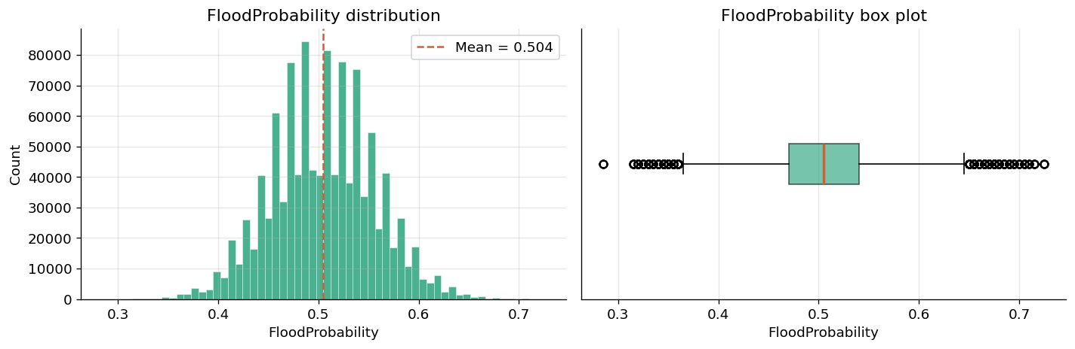
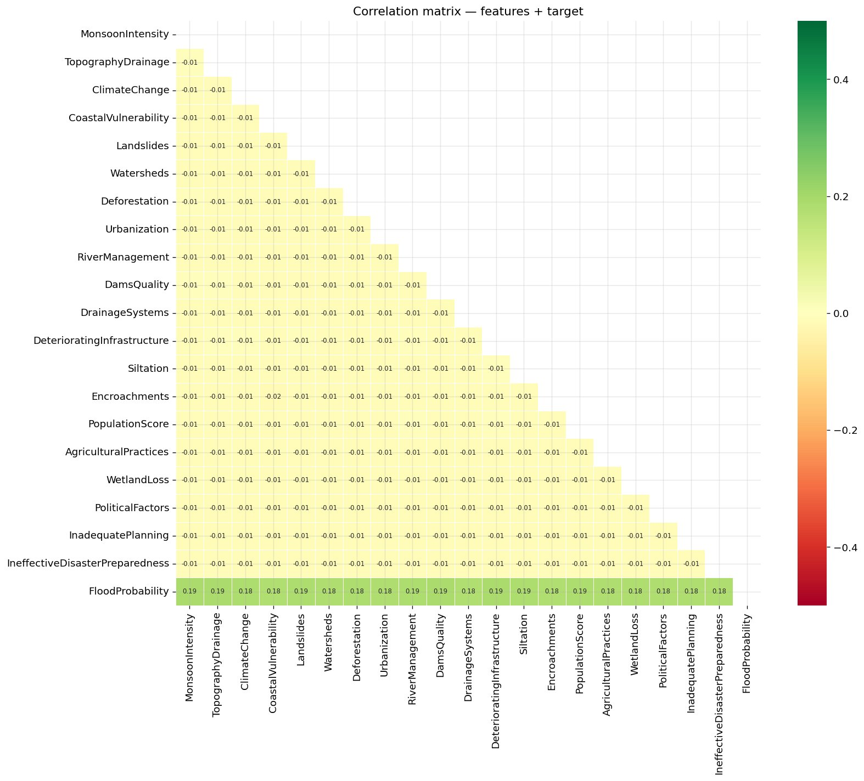
EDA — Target Distribution & Correlation Analysis
6 / 16
Near-normal distribution
Mean = 0.504. Symmetric shape means RMSE penalises over- and under-predictions equally — a fair metric.
No class imbalance
Probabilities spread evenly from 0.30 to 0.73. No need to balance classes or transform the target.
Why EDA first?
🔑 KEY EDA FINDING
EDA tells you which modelling choices are valid. Without checking the target, you might choose the wrong metric or transform.
All pairwise feature correlations ≈ −0.01
Features are statistically independent of each other. No single factor tells the whole story — the combined effect of all 20 is what predicts flood risk.
→ This is why ensemble methods (RF, XGBoost) are needed over linear regression.
→ This is why TotalRiskScore (sum of all 20) becomes the strongest predictor at r = 0.93.
Notes:
Two plots on this slide. Top: target is well-behaved, RMSE is fair. Bottom: near-zero inter-feature correlations is the single most important EDA finding — motivates everything that follows.

Slide 7
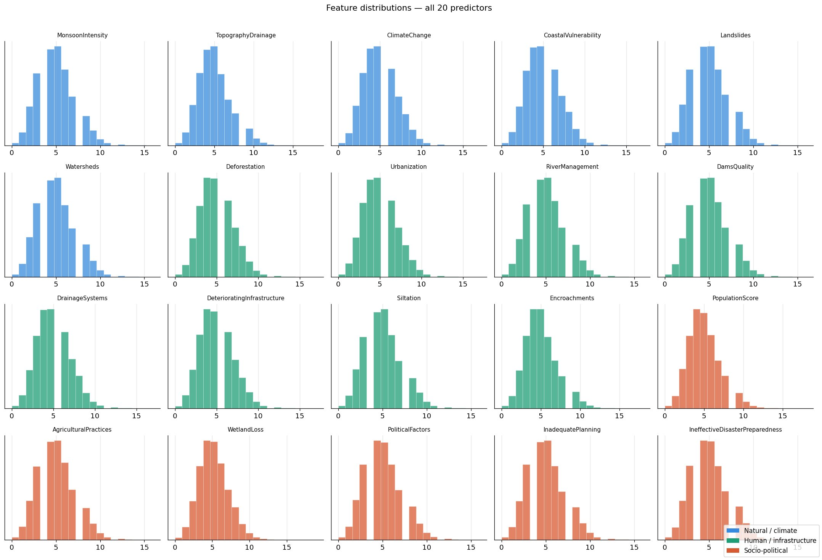
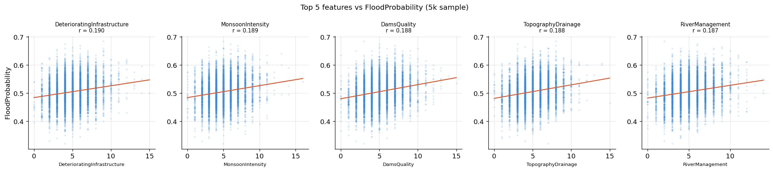
EDA — Feature Distributions & Feature vs Target
7 / 16
All 20 features share a 1–15 scale
No normalisation needed for tree models. Consistent range means feature magnitude doesn't mislead the model.
Right-skewed distributions
Features peak at 3–5 with a long tail to 15. Higher values = worse risk conditions in every case.
Individual correlations r ≈ 0.19
Top 5 features (DeterioratingInfrastructure, MonsoonIntensity, DamsQuality...) all have the same weak individual signal.
Why this matters
Even the best single feature barely predicts flood probability alone. The model needs all 20 simultaneously — confirmed by TotalRiskScore r=0.93.
Notes:
Top: feature distributions — colour coded by group (blue=natural, green=infra, orange=socio). Bottom: scatter plots confirm weak individual r≈0.19 for top features.

Slide 8
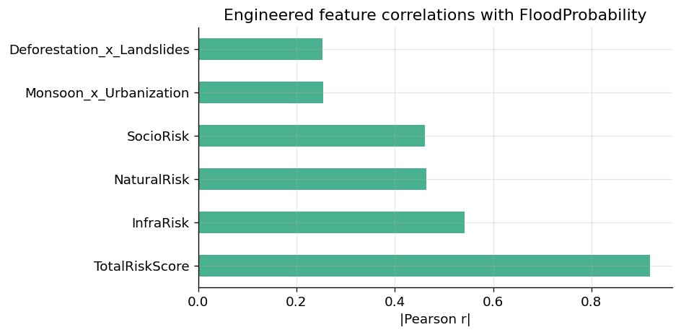
Feature Engineering — Domain Knowledge Encoded in Data
8 / 16
Why engineer features? Individual signals r≈0.19 are weak. Combining them in scientifically meaningful ways amplifies the signal.
TotalRiskScore
r = 0.93 ★
Sum of all 20 features. Signal aggregation cancels noise, amplifies flood risk signal.
InfraRisk
r = 0.53
Mean of 8 infrastructure features. Infrastructure risk domain composite score.
NaturalRisk / SocioRisk
r ≈ 0.45
Mean of natural/climate and socio-political features respectively.
Monsoon × Urbanization
r = 0.25
Urban flash flood: heavy rain on impermeable surfaces compounds risk.
Deforestation × Landslides
r = 0.25
💡 Why does TotalRiskScore jump from r=0.19 to r=0.93?
The same reason opinion polls work: averaging 1,000 independent noisy signals cancels random errors while the shared signal (true risk) accumulates. Each feature adds a small amount of independent information about flood risk — summed together, the noise cancels and the signal dominates.
Land degradation: deforested slopes are more prone to slides damming rivers.
Notes:
The r=0.93 jump from 0.19 is the headline feature engineering result. Explain the polling analogy. Mention the three composite domain scores as scientifically grounded domain knowledge.

Slide 9
Four Models — What They Are & Why Each Was Chosen
9 / 16
01 Ridge Regression
02 Random Forest
What it is:
What it is:
Weighted sum of features with regularisation (L2 penalty). Linear model.
200 decision trees trained on random subsets of data and features. Predictions = average of all trees.
Why we use it:
Why we use it:
Sets the performance floor. Interpretable coefficients tell us exactly how much each feature contributes. If complex models can't beat it significantly, they aren't worth the added complexity.
Captures non-linear relationships that Ridge misses. Out-Of-Bag (OOB) error is a free validation estimate from the bootstrap sampling — no separate test set needed.
→ Produces readable β coefficients per feature
→ OOB score ≈ CV score — confirms no data leakage
03 XGBoost + Optuna
04 MLP Neural Network
What it is:
What it is:
Sequential boosting: each tree corrects errors of all previous trees. 50 Optuna trials tuned learning rate, depth, subsample, and regularisation.
3 hidden layers (128→64→32 neurons), ReLU activation, early stopping. Features are scaled before input.
Why we use it:
Why we use it:
Industry standard for tabular data. Sequential error correction typically outperforms parallel bagging. Optuna's Bayesian search finds better hyperparameters faster than grid search.
Tests whether deep learning adds value over gradient boosting on this tabular dataset. Result: it doesn't — consistent with the broader ML literature on structured data.
→ 50 Optuna trials ≈ 5 minutes on 1.1M rows
→ MLP underperforms XGBoost — known tabular pattern
Notes:
Walk through each model and why it was chosen. Key comparison: RF vs XGBoost (parallel vs sequential). Key finding: MLP loses on tabular data.

Slide 10
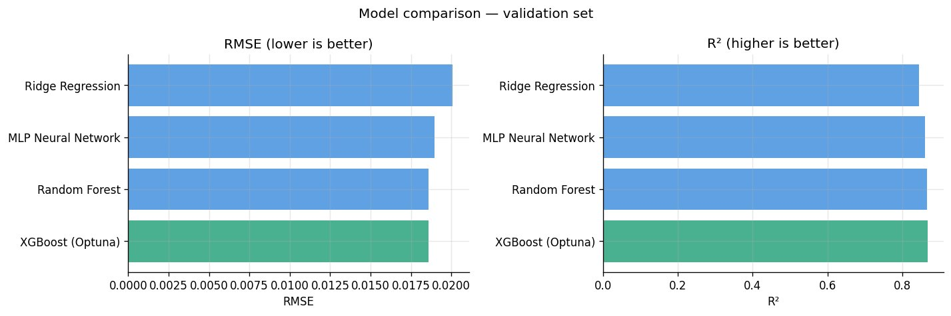
Model Results — Performance Leaderboard
10 / 16
Model
RMSE
R²
CV R²
Ridge Regression
0.02008
0.845
0.845±0.001
MLP Neural Net
0.01897
0.862
0.858±0.001
Random Forest
0.01860
0.867
0.866±0.001
XGBoost ★
0.01857
0.867
0.866±0.001
XGBoost ≈ Random Forest
MLP loses on tabular data
Ridge baseline is strong
RMSE difference is 0.00003 — negligible. Both achieve R²=0.867. Gradient boosting wins but only marginally.
A known empirical pattern. Trees exploit the discrete ordinal structure better than gradient-based optimisation in neural nets.
R²=0.845 shows the problem has a partially linear structure. The non-linear gain from ensemble methods is real but modest.
Notes:
Key numbers: XGBoost RMSE=0.01857, R²=0.867. The chart shows all four models sorted. Biggest gap is Ridge→RF. XGB vs RF gap is tiny. MLP sits between.

Slide 11
Validation — What the Metrics Mean in Practice
11 / 16
RMSE = 0.01857 · Root Mean Squared Error
What is 5-fold cross-validation?
Predictions are off by an average of ±0.019 flood probability units. Since the target ranges 0.30–0.73, this is a typical error of ~4–5% of the full range. Very accurate for a real-world risk model.
TEST
train
train
train
train
→ R²=0.866
train
TEST
train
train
train
→ R²=0.867
R² = 0.867 · Coefficient of Determination
train
train
TEST
train
train
→ R²=0.865
The model explains 86.7% of the variation in flood probability across 1.1M locations. The remaining 13.3% is either random noise or factors not captured in the 20 features.
train
train
train
TEST
train
→ R²=0.866
train
train
train
train
TEST
→ R²=0.867
CV std = ±0.001 · 5-fold Cross-validation
Standard deviation of ±0.001 across 5 folds means the model performs virtually identically regardless of which 20% of data it is tested on. Near-zero variance = no overfitting.
Average: R² = 0.866 ± 0.001
Why use CV? A single train/test split might be lucky or unlucky. 5-fold CV gives a stable, unbiased estimate of how the model performs on new unseen data — the number that matters for deployment.
Notes:
RMSE=0.01857 means typical error of ~4-5% of the full range. R²=0.867 means 86.7% of variance explained. CV std=±0.001 confirms zero overfitting.

Slide 12
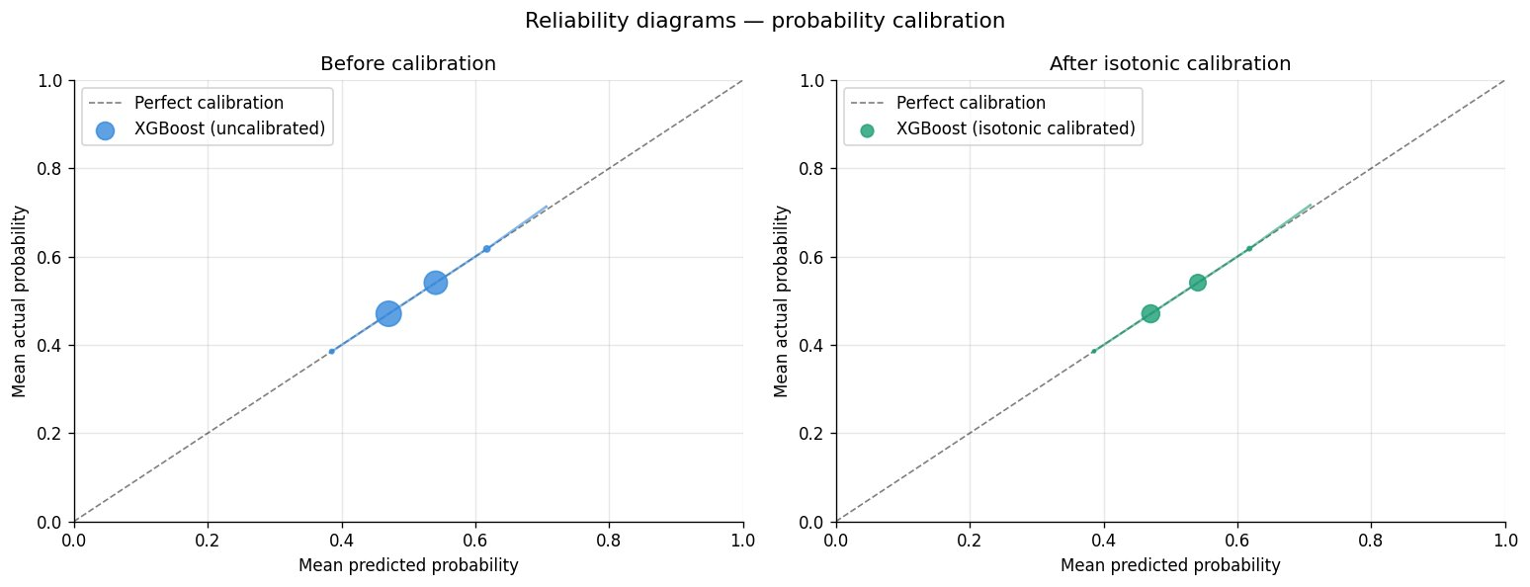
Probability Calibration — Making Outputs Trustworthy
12 / 16
Why calibration?
⚠ The problem with raw outputs
A model predicting 0.8 when the true rate is 0.65 causes mispricing. At 10,000 policies, a 15-point gap = £1.5M in mispriced premium per year.
✓ What calibration does
Isotonic regression maps raw scores to calibrated probabilities. Mean predicted = mean actual per bin. Verified with reliability diagram.
📊 Our result
📌 Portfolio differentiator #1
XGBoost is already well-calibrated on this dataset. Points track the diagonal closely before and after calibration — a positive validation result.
Most ML projects skip calibration. Showing a reliability diagram and explicitly applying isotonic regression demonstrates production-readiness thinking. In regulated industries like insurance, calibration verification is mandatory before model deployment.
Notes:
This is one of two key differentiators. Reliability diagram: x=mean predicted per bin, y=mean actual. Diagonal = perfect. Our model is already well-calibrated — we verified rather than assumed.

Slide 13
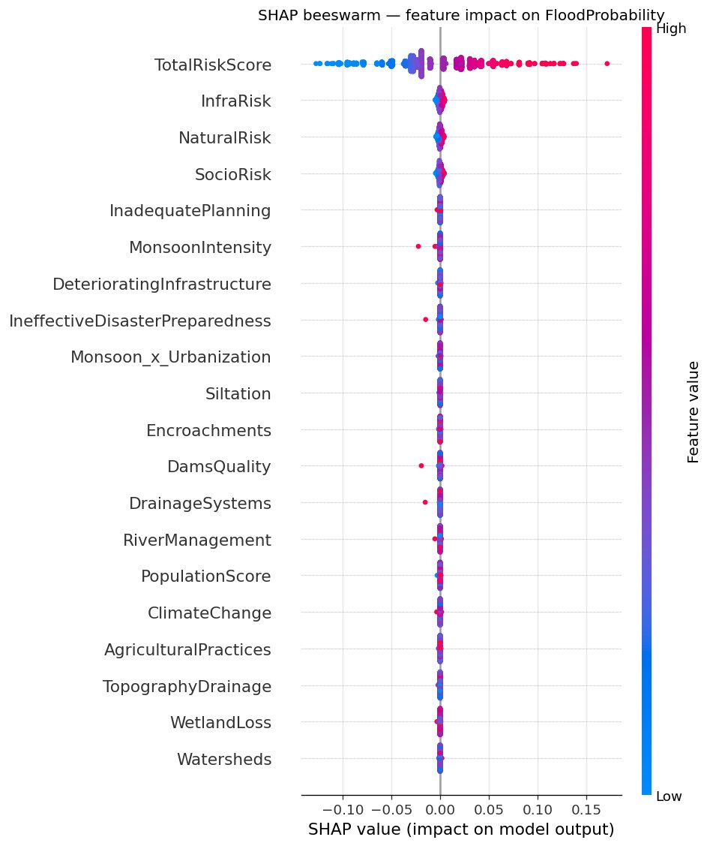
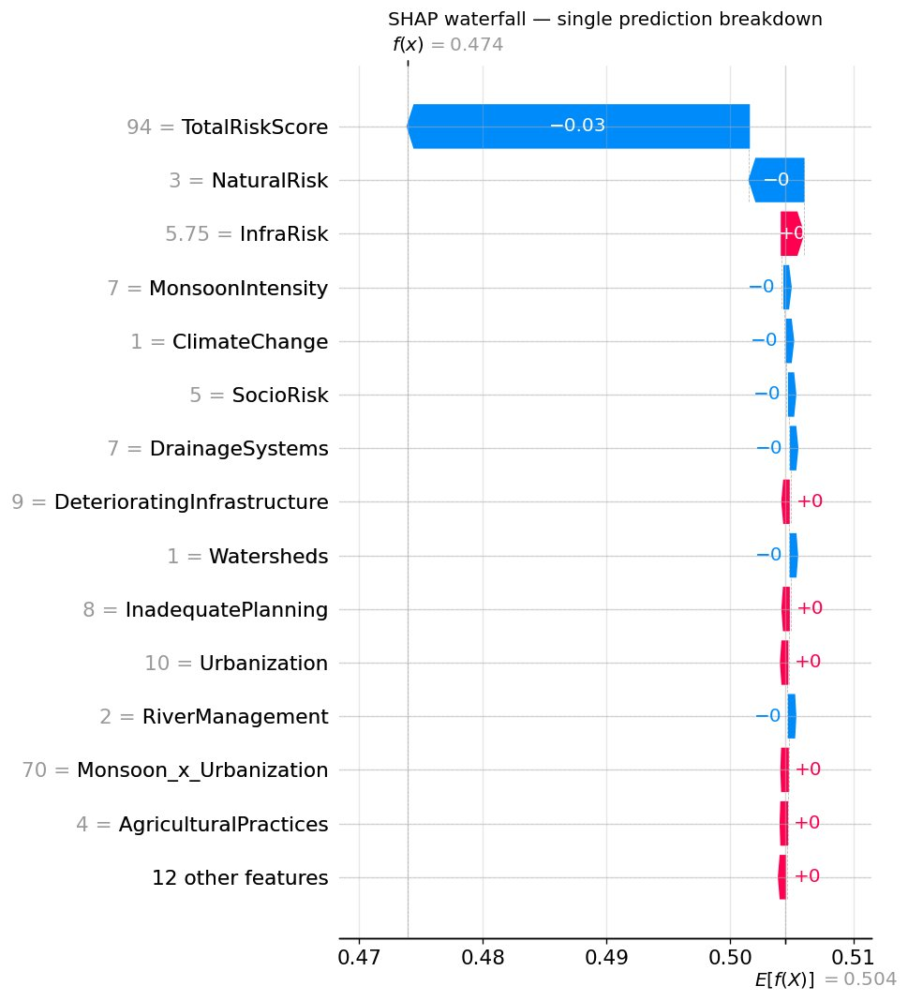
SHAP Explainability — Why the Model Makes Each Decision
13 / 16
What SHAP shows
How much each feature pushed THIS specific prediction above or below the baseline (0.504). Red dots = high feature value → increases risk.
TotalRiskScore dominates
SHAP values stretch to ±0.15+. Other features cluster near zero. Confirms flood risk is approximately additive across all 20 factors.
Waterfall = per-prediction explanation
Shows exactly what drove one location's score. This is what an underwriting dashboard surfaces to an analyst — not a black box.
📌 Portfolio differentiator #2 — SHAP satisfies EU GDPR right to explanation for automated decisions (insurance)
Notes:
Two SHAP outputs: beeswarm (global: which features matter most, which direction) and waterfall (local: why did THIS location get THIS score). SHAP is required for regulatory explainability in insurance.

Slide 14
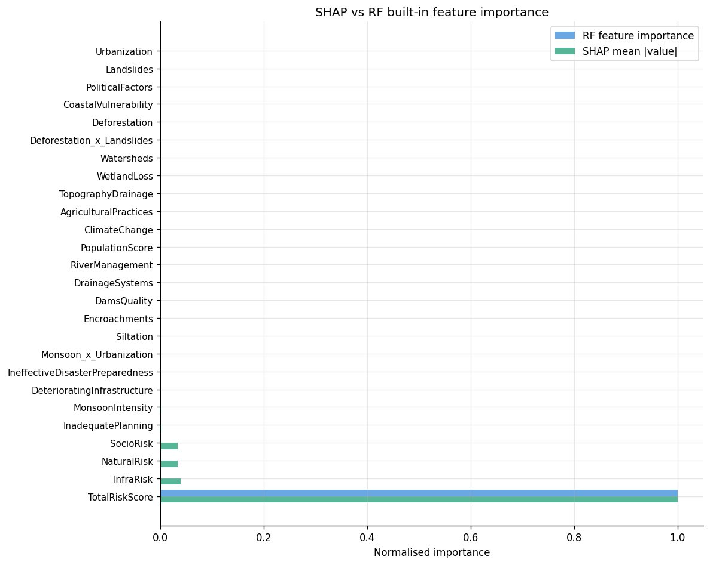
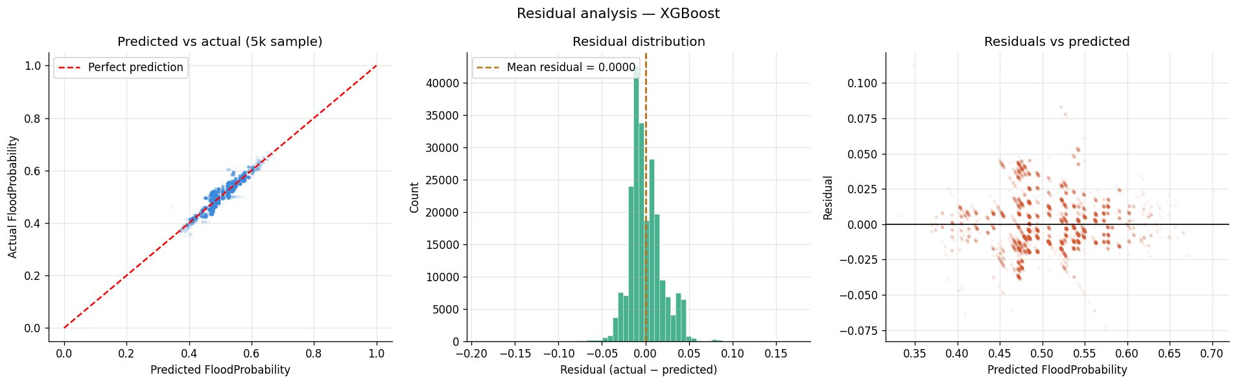
SHAP vs Feature Importance & Residual Analysis
14 / 16
Why SHAP beats built-in importance
RF built-in importance counts how often a feature is used for splits — biased toward features used early in trees and high-cardinality features. SHAP computes each feature's actual marginal contribution to each prediction. Based on Shapley values from cooperative game theory — provably fair, unbiased, and consistent.
For regulated industries like insurance, SHAP satisfies the requirement to explain individual underwriting decisions to regulators and policyholders.
Predictions track actuals tightly — no systematic over/underestimation across the range.
Mean residual = 0.0000 — the model is perfectly unbiased on average.
Slight fanning in tails — model is less certain at extreme probabilities. Expected and normal.
Notes:
Top left: SHAP vs RF importance comparison. Top right: why SHAP is superior. Bottom: three-panel residual analysis showing no bias and expected heteroscedasticity in tails.

Slide 15
Streamlit Dashboard — FloodScore Intelligence Platform
15 / 16
📊 Risk Assessment
🔍 Explainability
🏦 Insurance View
ℹ About Model
Probability gauge with coloured zones
SHAP waterfall per prediction
Underwriting decision card
Full model card
Domain bar chart & radar
Feature contribution table
Premium loading multiplier
Performance metrics
Top 3 risk drivers
Direction: ↑ risk or ↓ risk
Scenario comparison bar chart
Methodology summary
Live scoring via 20 sliders
Baseline comparison
Mitigation measures table
Intended use + limitations
$ pip install streamlit xgboost shap plotly pandas numpy → $ streamlit run app_v2.py
Notes:
The dashboard has 4 tabs. Key feature: Insurance View tab shows automated underwriting decision + scenario comparison + mitigation table. Scenario loader presets 4 risk levels. Demo: load 'very high risk' scenario, show SHAP tab to explain the score.

Slide 16
Key Takeaways
01
Feature engineering is the headline
02
Ensemble > linear > neural net
TotalRiskScore (sum of 20 features) achieves r=0.93 vs r=0.19 for the best individual feature. Signal aggregation cancels noise — the key insight of this project.
Near-zero inter-feature correlations mean XGBoost/RF outperform Ridge (R² gap: 0.845→0.867). MLP underperforms on this tabular problem — a known empirical pattern.
03
Calibration = production readiness
04
SHAP = explainability + regulation
Applied isotonic regression and verified with reliability diagram. In insurance, uncalibrated output = mispriced premium at scale. Most portfolios skip this step.
SHAP satisfies the EU GDPR right to explanation for automated decisions. Per-prediction waterfall chart is what a production underwriting dashboard uses.
05
Dashboard = deployable product
06
Industry framing = career positioning
4-tab Streamlit app with underwriting decision, scenario comparison, mitigation table, and full model card. Demo-ready and deployable in one command.
This is Stage 1 of a catastrophe model — the hazard layer used by RMS, AIR, Swiss Re, Munich Re. The framing connects directly to cat modelling, underwriting, and climate risk roles.
Dataset: Kaggle S4E5 · Models: Ridge · RF · XGBoost · MLP · Tools: Python · sklearn · XGBoost · SHAP · Optuna · Streamlit
Notes:
Closing slide. Six takeaways. Emphasise: feature engineering result (r=0.93), calibration story, SHAP regulatory angle, dashboard demo-readiness, and industry career positioning.

Slide 17
LINK TO REPOSITORY
https://github.com/s26-redi-ml-ai/Machine-Learning-for-flood-Probability-Prediction.git

