Slide 1

League of Legends: Strategic Architecture
Deconstructing the structural components, technical systems, and game mechanics of the ultimate multiplayer competitive arena.

Slide 2


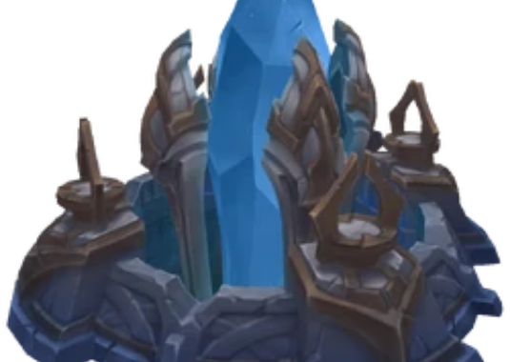
Defend and Destroy
The Core Objective
The primary architectural mission of a match centers on absolute base protection and structured force projection.
✦
Team Symmetry: Two opposing squads of five players operate on a mirrored, balanced battlefield landscape.
✦
The Defense Rule: Each side must shelter their own base core from progressive ingress.
✦
Nexus Termination: Victory is unlocked strictly upon the full destruction of the opponent's core node—the Nexus.

Slide 3










The Four Pillars of Gameplay
1. The Battlefield
2. The Champions
3. The Economy Loop
4. Major Objectives
Where we play. The symmetrical arena design containing tactical paths, structural boundaries, and neutral sectors.
Who we play. Diverse agents possessing specialized statistical scaling modules, roles, and unique ability kits.
How we grow. An engine of micro-objectives driving constant accumulation of gold and character experience.
What we conquer. Key neutral targets requiring strategic timing and coordination to achieve victory.

Slide 4
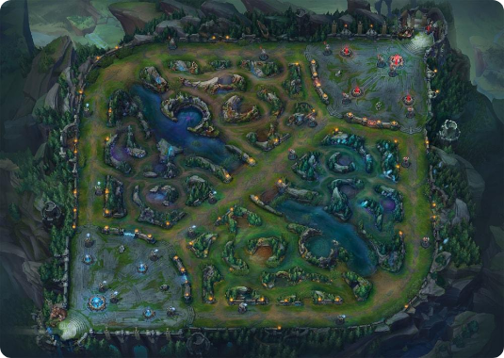
Summoner's Rift Topology
Arena Geographic Distribution
The battlefield is engineered to compartmentalize conflict zones into predictable tactical lines.
✦
Lanes (Primary Paths): Three pathways establish the principal movement vectors of the game.
✦
The Jungle Divide: Densely occluded forests sit between paths, housing neutral resource opportunities.
✦
The Neutral River: A central aquatic canyon separates both sides, defining the key contested threshold.

Slide 5


Lane Management Dynamics
Three Lanes Framework
Automated Streams
The lanes are designed to split the team's localized responsibilities.
Every lane experiences constant pressure from computer-controlled units called Minions.
The Top Lane remains an isolated island of heavy combat. Mid Lane offers immediate map rotation access. Bottom Lane acts as a high-resource hub requiring synchronized double defense.
These units act as continuous automated siege machines, clashing in predictable waves to define map priority and generate safe resource streams for defending champions.

Slide 6
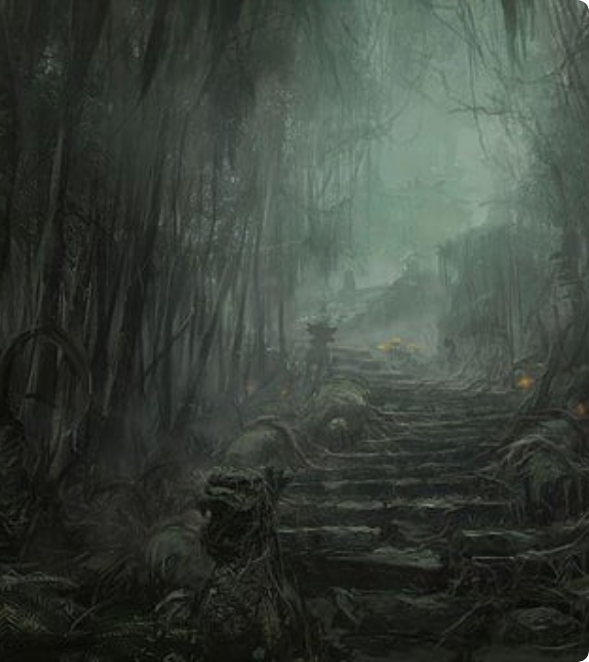
The Jungle & Fog of War
Unmapped Territory
The Jungle is the dangerous sector dividing lanes, hiding critical opportunities in complete mystery.
It remains heavily masked by the Fog of War—a software mechanism hiding map telemetry unless illuminated by champion presence or structural sensors called Wards.
Jungle players navigate this shadows-rich region to claim hidden camps and execute unpredictable flank maneuvers on lane targets.

Slide 7
Five Distinct Tactical Roles
Tactical Role | Position Mapping | Behavioral Trait | Primary Responsibility
Top Laner | Top Lane | Resilient Frontline | Absorbs critical damage and initiates front engagements.
Jungler | Jungle Sectors | Mobile / Unpredictable | Roams the map, controls objective areas, and ambushes.
Mid Laner | Mid Lane | Explosive / Agile | Controls the center map and deals massive magical damage.
ADC | Bottom Lane | Fragile / High-DPS | Provides persistent, high-damage physical attack output.
Support | Bottom Lane | Protective / Vision Core | Preserves team carries, heals, and secures map vision.

Slide 8




The Economy Optimization Loop
2. Accumulate XP
4. Gear Purchase
Secured gold and experience points are allocated dynamically to level up base stats and lock abilities.
Accumulated currency is traded for inventory items, transforming statistical math into game impact.
1. Defeat Entities
3. Base Recalls
Champions kill automated minions, neutral monsters, and enemy player assets to extract raw value.
Players channel temporary teleports back to the spawning Fountain to restore health and safely bank gold.

Slide 9
The Power of Scaling
Linear vs. Exponential Growth
2.5x
Scaling describes a character's mechanical escalation from fragile starting units to massive end-game engines of destruction.
By continuously looping through the economy engine, item statistics (such as Critical Strike, Ability Power, and Attack Speed) feed into mathematical formulas, resulting in exponential damage multipliers over time.
LATE-GAME MULTIPLIER

Slide 10
Structural Defense Systems
Progressive Defense: Turrets
Critical Gatekeepers: Inhibitors
Turrets are heavily armed structural nodes guarding each lane sequentially.
Inhibitors are the ultimate lane anchors located inside the base boundary walls.
They fire high-potency energy blasts that scale in damage with consecutive strikes. Attacking players must sacrifice incoming allied minion streams to draw turret fire safely and secure structural progress.
Destroying an inhibitor temporarily disables the lane's structural shield, triggering the spawn of massive allied "Super Minions" that apply extreme auto-pressure onto the enemy's final core defenses.

Slide 11


Major Contested Map Objectives
The Decisive Neutral Bosses
Neutral pits host supreme entities that act as strategic accelerations toward victory.
✦
Elemental Dragons: Slaying these beasts grants permanent team-wide statistical blessings. Reaching four unlocks a game-altering Dragon Soul.
✦
Baron Nashor: The supreme beast of Summoner's Rift. It awards a temporary aura that empowers nearby minions, allowing teams to shatter base walls.

Slide 12

Strategic Synthesis
Victory in League of Legends is not a matter of pure speed or individual reflexes. It is the ultimate alignment of team synergy, economic scaling, and strict coordinate-based map control.

Slide 13




Image Sources
https://static.wikia.nocookie.net/leagueoflegends/images/c/cb/Order_Nexus_TwistedTreeline_Render.png/revision/latest/scale-to-width-down/250?cb=20200601161057
Source: leagueoflegends.fandom.com
https://www.lolvvv.com/_next/image?url=https%3A%2F%2Fwww.lolvvv.com%2Fwp-content%2Fuploads%2F2022%2F07%2Fsummoners-rift.jpg&w=1200&q=75
Source: www.lolvvv.com
https://preview.redd.it/jungle-path-art-world-of-warcraft-mists-of-pandaria-v0-qof3uh0lbhy51.jpg?width=640&crop=smart&auto=webp&s=43a1a79bc18685804b2ebfbf03f869e42cf49425
Source: www.reddit.com
https://media.altchar.com/prod/images/gm_featured_image/6df0bec906de-baron-nashor-lol.jpg
Source: www.altchar.com

