Slide 1
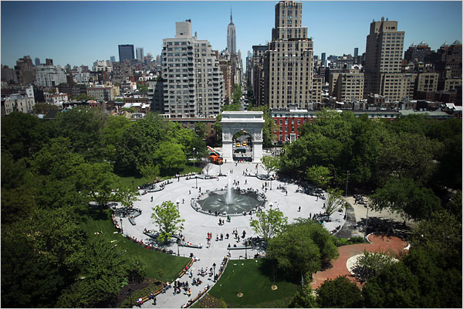
S²I² Conceptualization and CWP Session: Introduction
ATLAS Overview Week
NYU
June 29, 2016
Mark Neubauer
University of Illinois at Urbana-Champaign
Peter Elmer
Princeton University
Mike Sokoloff
University of Cincinnati

Slide 2
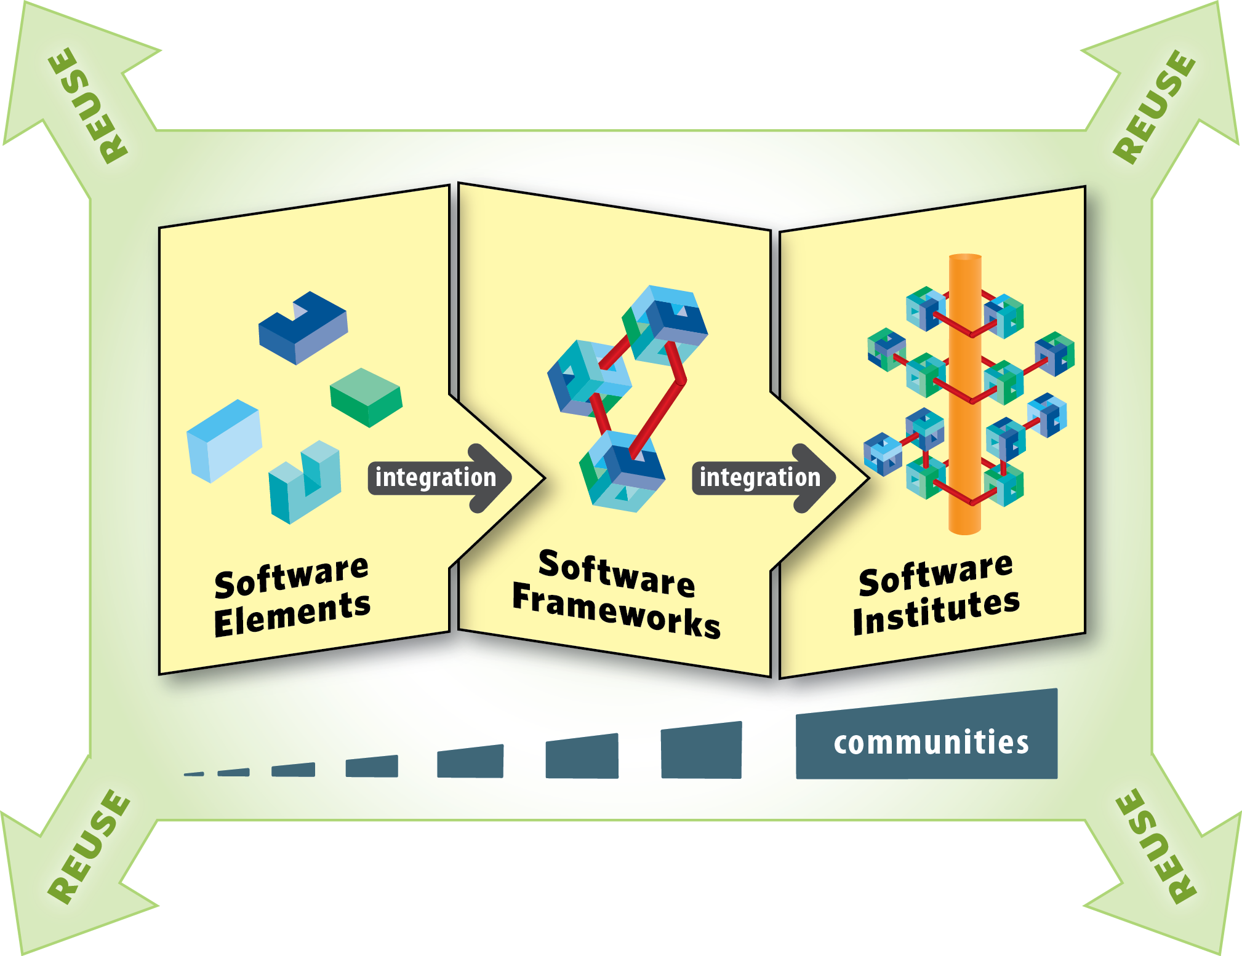
NSF Software Institutes
From NSF's Cyberinfrastructure Framework for 21st Century Science and Engineering (CIF21) Vision, classes of software infrastructure typically fall into three classes:
https://www.nsf.gov/funding/pgm_summ.jsp?pims_id=504817

Slide 3
S²I² / CWP Parallel Session
The aim of this parallel session is to discuss
A process by which a roadmap document in the form of a Community White Paper (CWP) is produced which aims to broadly identify the key issues of computing infrastructure and software R&D required to enable realization of the scientific potential of the large investment in upgraded detectors for the HL-LHC.
Conceptualization of a Scientific Software Innovation Institute (S²I²) where U.S. university-based researchers can play an important role in key software infrastructure efforts that will complement those led by U.S. national laboratory-based researchers and international collaborators.

Slide 4
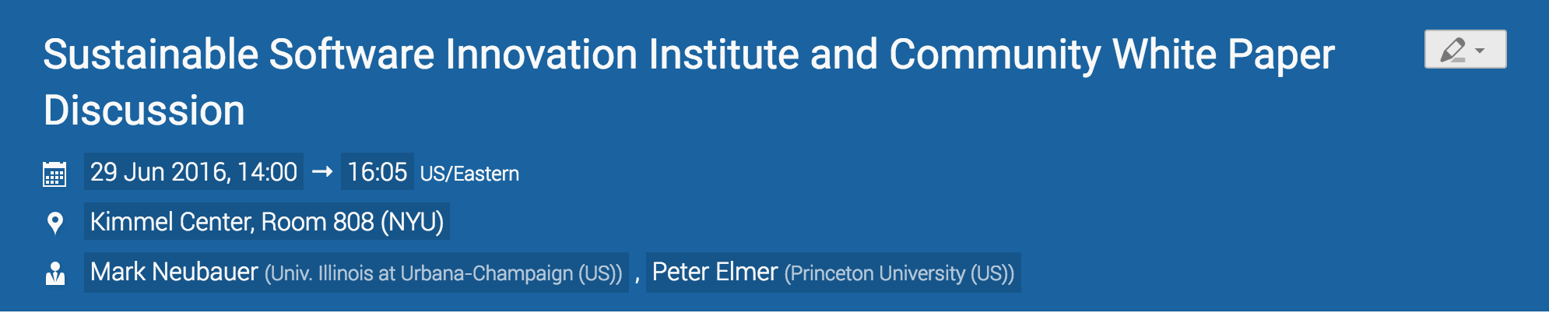
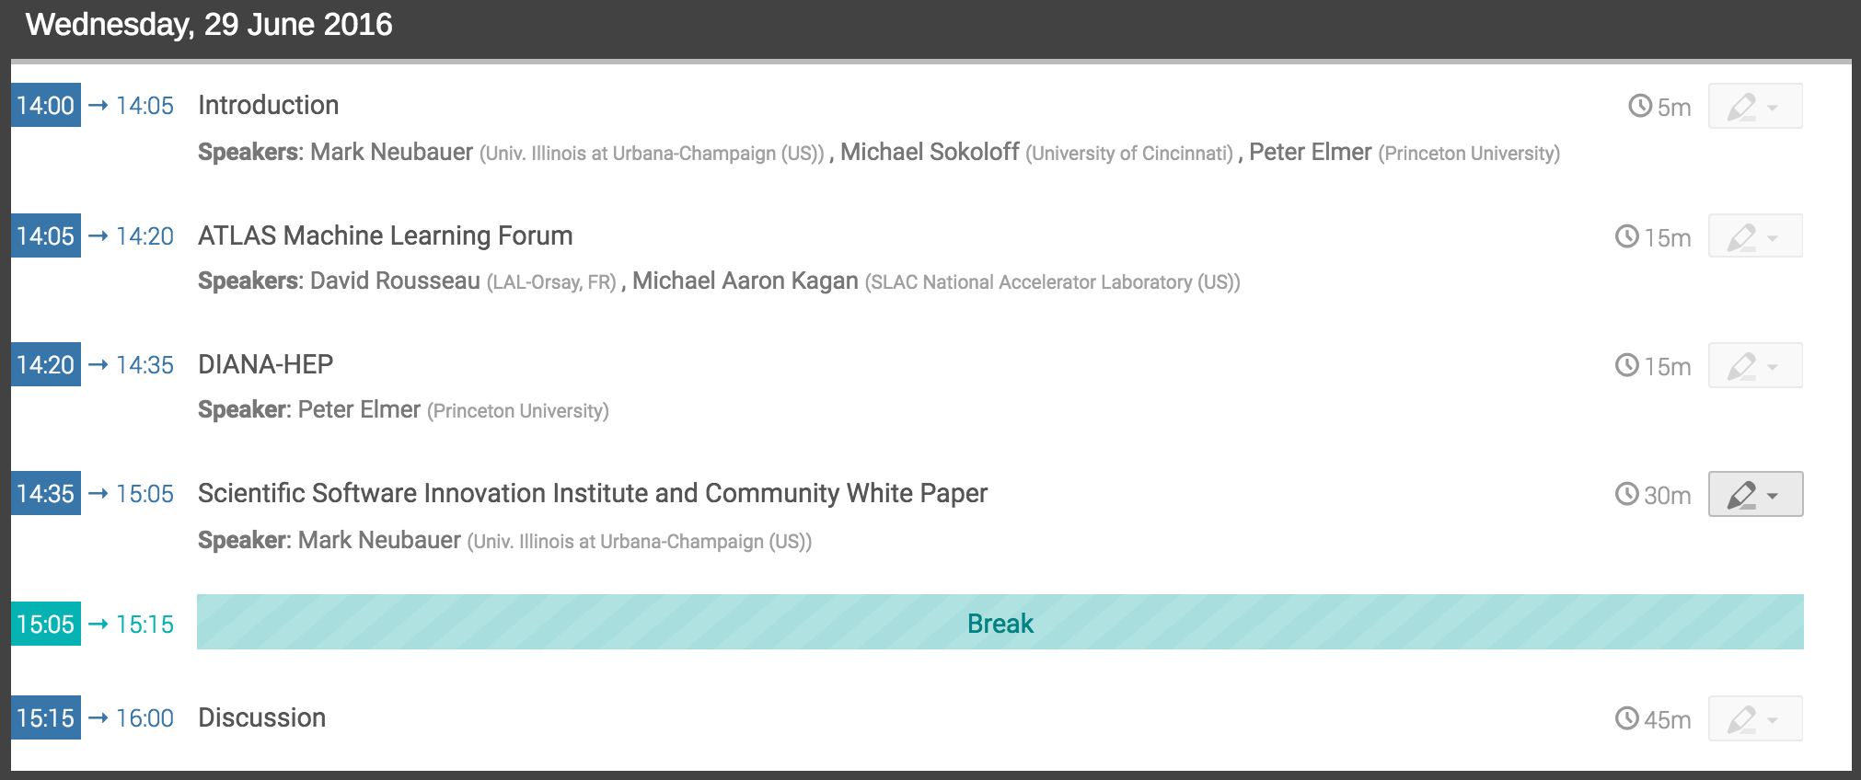
S²I² / CWP Parallel Session

