Slide 1
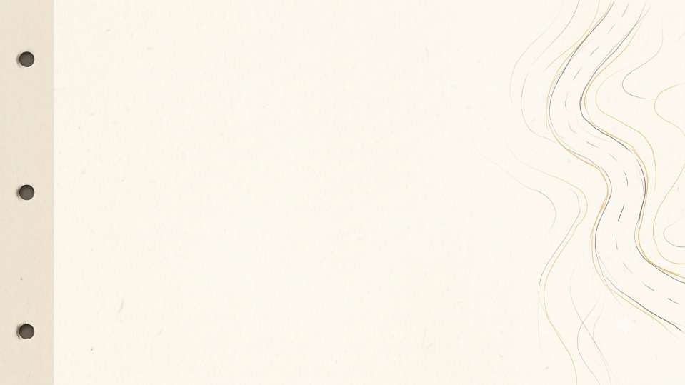
Vision-Based Road
Drivable Region
Estimation for Lane-Less
Roads
with Adaptive Trust-Weighted Fusion Segmentation (ATWFS)
BACSE324 · Embedded Systems Architecture
Sunil Kumar – 25BCE0388
Varshith R S – 25BCE0351
Suyash Gupta – 25BCE0371

Slide 2

Introduction
• Unstructured Road Topologies: Lane-less rural and semi-urban roads lack demarcated painted lines, exhibiting irregular asphalt boundaries, earthen shoulders, and dirt transitions that cause conventional lane-tracking systems to fail.
• Inference Disconnect in Deep Models: Modern deep segmentation networks typically terminate at passive 2D probability masks or isolated steering angles without closed-loop kinematic coupling to vehicle dynamics.
• OOD Fallibility & Calibration Absence: Off-the-shelf vision systems lack dynamic camera pitch/roll self-calibration and provide no fail-safe fallback mechanism when encountering out-of-distribution (OOD) visual anomalies.
• Closed-Loop Monocular Objective: Develop a camera-only, real-time edge architecture that concurrently delivers metric drivable space estimation, dynamic obstacle avoidance, and coupled speed/steering control.
Camera Frame
Monocular RGB dashcam stream
ATWFS Pipeline
Hybrid DL segmentation + Evidential trust
Drivable Mask
Metric free-space corridor & obstacle gating
Speed + Steering
Kinematically clamped control packet
2

Slide 3
Literature Review
Existing Methods & Paradigms:
• Classical Computer Vision (Canny/Hough): Highly compute-efficient for embedded systems, but fundamentally relies on high-contrast painted lane lines; collapses on broken tar, dirt roads, or mud.
• Deep Semantic Segmentation (U-Net/SegNet): Robust feature representation on complex road surfaces, but computationally heavy and typically outputs raw pixel masks without driving commands.
• Direct Mask-to-Steering (Rasib et al., 2021): Couples drivable masks to steering commands via geometric path extraction, but lacks uncertainty awareness and provides zero fallback when the network is blind.
• Surface Normal Multi-Modal (SNE-RoadSegV2): Introduces fallibility and surface-normal awareness, but strictly depends on costly LiDAR point clouds or calibrated stereo camera pairs.
Classical CV
Fast edge/line detection; fragile to missing markings
Deep Segmentation
High semantic accuracy; passive, uncalibrated
Mask + Steering Only
Geometric control derivation; lacks safety fallback
ATWFS (Ours)
Monocular, self-calibrating, uncertainty-aware trust fusion
3

Slide 4
Research Gap
• Dynamic Pitch/Roll Vulnerability: Vehicle motion over uneven terrain continuously alters camera orientation, distorting metric distance mapping when using fixed perspective calibration.
• Uncalibrated Model Confidence: Standard neural networks suffer from overconfidence, producing erroneous predictions on out-of-distribution road domains without warning.
• Absence of Pre-Actuation Safety Verification: Steering and throttle commands are frequently driven directly by unverified network outputs without geometric or temporal consistency safety checks.
• Prohibitive Multi-Sensor Hardware Costs: High reliance on multi-beam LiDAR and stereo setups prevents practical adoption on low-cost edge vehicles.
• Extreme Environmental Fragility: Off-the-shelf models trained on Western highways degrade severely on chaotic Indian roads featuring stray cattle, dust, glare, and irregular road edges.
No calibration
Fixed camera height assumption
IMU-based IPM
Self-calibrating pitch/roll homography
No fallback
Blind neural trust on edge cases
Trust-weighted blend
Continuous Dirichlet evidential fusion
No safety check
Unverified actuator commands
Geometric & temporal checks
Perspective validity & optical flow gating
Costly sensors
Expensive LiDAR / stereo rigs
Monocular camera
Standard dashcam on low-cost edge CPU
4

Slide 5
Problem Formulation
• 1. Sequential Monocular Input Stream: Continuous video stream I_t in R^(H x W x 3) captured from an uncalibrated forward dashcam operating under uncontrolled lighting, shadow transitions, and camera vibrations.
• 2. Multi-Task Output Tuple: Concurrent prediction of binary drivable free-space mask M_t in {0, 1}^(H x W), closed-form evidential epistemic uncertainty U_t in (0, 1], and discrete surface classification C_terrain in {dry tar, wet/mud, gravel, waterlogged}.
• 3. Dynamic In-Path Obstacle Subtraction: Active identification and spatial subtraction of critical dynamic obstacles (pedestrians, vehicles, stray cattle) from the drivable corridor using safety-dilated bounding boxes.
• 4. Coupled Speed & Steering Kinematics: Simultaneous computation of steering angle theta_t in [-30°, +30°] via pure pursuit trajectory tracking and target velocity v_t in [0.0, 1.5] m/s constrained by road width, curvature, and obstacle proximity.
• 5. Trust-Mediated Dynamic Fallback: Continuous, smooth transition to a deterministic classical color-space (HSV/Lab) and morphological flood-fill estimator whenever neural trust drops below safe operational margins.
5

Slide 6

Proposed System
• Self-Calibrating IPM from IMU Pitch/Roll: Dynamically updates homography matrices using vehicle IMU telemetry and vanishing-point geometry to maintain an accurate metric Bird's-Eye-View (BEV) road grid (10 m x 25 m).
• YOLOv8n Dynamic Obstacle Subtraction: Lightweight single-pass detector detects pedestrians, oncoming traffic, and stray animals; dilates their contact footprints to subtract them from the drivable corridor.
• Multi-Factor Trust Arbitration: Combines deep learning segmentation with classical HSV/Lab color flood-fill based on evidential uncertainty, mask shape geometry, and temporal frame-to-frame continuity.
• Coupled Speed and Steering Decision: Jointly derives forward speed and steering angle, enforcing physical rate limits (5°/frame) and speed-dependent minimum turn radii (R_min = v^2 / a_lat).
• Deterministic Telemetry Packet: Generates a standardized 4-field control packet: [angle, speed, trust, obstacle_flag] transmitted over serial to low-level vehicle actuators.
Camera + IMU
Synchronized monocular video & 6-DOF inertial data
Self-Calibrating IPM
Real-time pitch/roll homography projection
Geometric + Temporal Checks
Perspective narrowing & flow consistency
ATWFS Trust Fusion
Multi-signal arbitration: DL vs. Classical
Speed + Steering Packet
Safety-clamped kinematics to vehicle actuators
6

Slide 7
Model Architecture
• MobileNetV3-Large Encoder: Employs depthwise separable convolutions, inverted bottleneck blocks, and squeeze-and-excitation (SE) modules for efficient visual feature extraction on low-power edge CPUs.
• GroupNorm Stability Throughout: Replaces standard BatchNorm2d with GroupNorm (8 groups per layer) throughout the network to eliminate batch-size dependency and ensure 100% deterministic inference across edge batch sizes.
• Multi-Task U-Net Decoder: Decodes multiscale stride-[32, 16, 8, 4] skip features to concurrently output binary drivable logits and Dirichlet evidential concentration parameters alpha = softplus(z) + 1.
• Stride-8 Auxiliary Terrain Head: Branches from intermediate encoder representations into a lightweight classification MLP predicting 4 surface types (dry tar, wet/mud, gravel, waterlogged) to inform traction control and speed derating.
Input Image
288 x 512 x 3 RGB Frame
MobileNetV3 Encoder
GroupNorm + Inverted Residuals
U-Net Decoder
Skip Connections
Terrain Head
Stride-8 Features
Mask + Uncertainty
Logits & Dirichlet alpha
Terrain Type
4 Surface Classes
7

Slide 8
ATWFS: Trust Fusion
• Multi-Signal Reliability Metric: Evaluates network reliability using three independent signals: evidential uncertainty (U), geometric perspective validity (G), and temporal consistency (T).
• Adaptive MLP Weight Generation: A lightweight neural fusion layer maps (U, G, T, P_terrain) to an optimal scalar blend factor alpha in [0, 1].
• Terrain-Aware Risk Derating: Slippery or unpaved terrain categories penalize the trust score, demanding higher certainty before trusting the deep model.
U: Uncertainty
Evidential Vacuity
G: Geometry
Perspective Trapezoid
Trust Weight (α)
Sigmoid Fusion
T: Temporal
IoU Motion Continuity
Z = 12.0 × [0.50(1 - U) + 0.25G + 0.25T - 0.75 - P_terrain]
Trust (α) = (1 + e^-Z)^-1
Final Mask = α · DL mask + (1 - α) · Classical Fallback
Final Mask
Fleshed Free-Space
Terrain
Friction Penalty
Novelty: Learned, continuous blend — eliminates violent steering chatter and threshold oscillation.
8

Slide 9
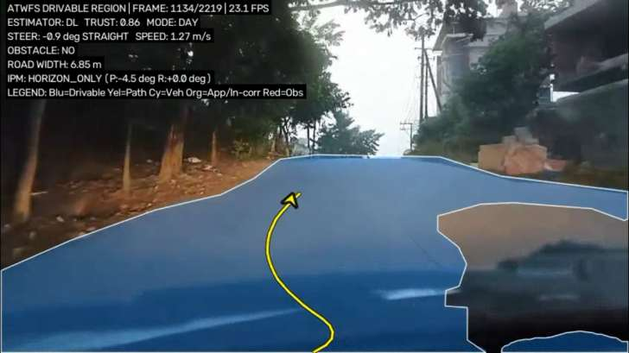
Drivable Region with ATWFS
In-Cab HUD & Actuation Breakdown:
• Drivable Free-Space (Blue): Fused high-resolution surface mask filtered for sub-pixel boundary smoothness and zero edge flutter.
• Hermite Trajectory (Yellow): S-curve spline anchored strictly to the ego bumper (0° launch) and converging to lane curvature at the horizon.
• Seamless Arrowhead Alignment: Polyline terminates strictly into the arrowhead notch with continuous tangent vector alignment.
• Real-Time Telemetry Box: Continuous display of active estimator (DL/Fallback), trust score (0.86), steering angle (-0.9°), road width (6.85 m), and 23.1 FPS throughput.
9

Slide 10

Computational Efficiency
Metric | Teacher | Student
Inference time (ms/frame) | ~110.8 ms/frame | ~31.8 – 45.1 ms/frame
FLOPs (GFLOPs) | 8.78 GFLOPs | 3.23 GFLOPs
Parameters (M) | 4.59 Million | 1.39 Million
Throughput (FPS) | 9.0 FPS | 22.5 FPS
End-to-end latency (ms) | 151.9 ms | ~44.4 ms
Peak memory (MB) | ~1069.8 MB | ~893.4 MB
Benchmark Setup & Analysis
• Teacher Model: MobileNetV3-Large MultiTaskUNet backbone with GroupNorm.
• Student Model: MobileNetV3-Small MultiTaskUNet trained via knowledge distillation.
• Input Resolution: 288 × 512 pixels matching the native optical aspect ratio.
• Hardware Envelope: Standard low-to-medium tier laptop CPU (Intel Core i5).
• 2.5x Speedup: Student achieves 22.5 FPS real-time throughput on edge hardware.
• 3.3x Compression: Memory footprint reduced from 52 MB to 16 MB checkpoint size.
* Benchmarks measured on standard commodity x86 laptop CPU (no discrete GPU).
10

Slide 11

Dataset and Training
• Benchmark Corpus (IDD 20k Part I): Utilizes 10,003 unconstrained Indian road scenes capturing unstructured road edges, ambiguous margins, and heterogeneous traffic patterns.
• Standardized Partitioning: Formally split into 6,993 training, 981 validation, and 2,029 testing images for reproducible benchmarking.
• Semantic Class Collapse: Aggregates fine-grained 41 semantic classes into binary free-space (level3Ids {0, 1} -> drivable, all valid obstacles -> non-drivable, 255 ignored).
• Custom Edge-Case Collection: Augmented with custom dashcam footage annotated in CVAT covering low-light night driving, muddy unpaved roads, and stray cattle.
• Independent Test Verification: Evaluated on an isolated held-out test split ensuring strict zero data leakage.
IDD Images
10,003 Scenes
Binary Masks
Collapsed 41->2
Train Teacher
MobileNetV3-Large
Own Data (CVAT)
Night, Terrain, Cattle
Fine-Tune
Domain Adaptation
Held-Out Test
Unbiased Evaluation
11

Slide 12
Progress and Next Steps
• Completed Milestones:
End-to-end inference pipeline architecture with automated per-stage timing and regression smoke tests. Integrated YOLOv8n dynamic obstacle detection with dilated corridor subtraction and coupled steering/velocity decision logic. Self-calibrating IPM with IMU telemetry and dynamic horizon tracking.
• Current Limitations:
FusionNet operates on calibrated heuristic priors pending full multi-condition terrain annotation. Evidential uncertainty calibration requires expanded out-of-distribution validation across severe monsoon weather.
• Strategic Next Steps:
Distributed GPU knowledge distillation from Teacher to Student (T=2.0). Post-training INT8 quantization and structured pruning for ultra-low latency edge deployment. Physical vehicle hardware-in-the-loop (HIL) microcontroller demonstration.
Data Preparation
Dataset curation & binary mask generation
Train Teacher
MobileNetV3-Large baseline model
Train FusionNet
Multi-signal trust fusion optimization
Distill + Compress
Student distillation & INT8 quantization
Hardware Demo
Embedded vehicle deployment & validation
12

Slide 13

References
1. Varma, G., Subramanian, A., Namboodiri, V., Chandraker, M., & Jawahar, C. V. (2019). IDD: A Dataset for Exploring Problems of Autonomous Navigation in Unconstrained Environments. In IEEE Winter Conference on Applications of Computer Vision (WACV).
2. Howard, A., Sandler, M., Chu, G., Chen, L. C., Chen, B., Tan, M., Wang, W., Zhu, Y., Pang, R., Vasudevan, V., Le, Q. V., & Adam, H. (2019). Searching for MobileNetV3. In IEEE/CVF International Conference on Computer Vision (ICCV).
3. Ronneberger, O., Fischer, P., & Brox, T. (2015). U-Net: Convolutional Networks for Biomedical Image Segmentation. In Medical Image Computing and Computer-Assisted Intervention (MICCAI).
4. Sensoy, M., Kaplan, L., & Kandemir, M. (2018). Evidential Deep Learning to Quantify Classification Uncertainty. In Advances in Neural Information Processing Systems (NeurIPS).
5. Rasib, M. N., Javid, M. A., & Kim, D. (2021). Drivable road region detection and steering angle estimation for autonomous driving in unstructured environments. IEEE Access, 9, 154210–154222.

Slide 14
Thank You
Questions & Technical Discussion
BACSE324 · Embedded Systems Architecture
Sunil Kumar (25BCE0388) | Varshith R S (25BCE0351) | Suyash Gupta (25BCE0371)

