Slide 1

EXASOL HACKATHON 2026
AEGIS
Multi-Layer Fraud Detection for UPI Transactions
Real-time velocity ML, fraud-ring graph analytics, and plain-language
explanations — built on Exasol.
TEAM 404 FOUNDERS

Slide 2

THE PROBLEM
UPI Fraud Has Outgrown
Single-Transaction Rules
Scale
UPI moves billions of transactions a month — fraud has to be caught in real time, not after the fact.
Coordinated rings
Fraud increasingly runs across networks of linked accounts and devices, invisible to per-transaction rules.
Black-box alerts
Flagging a transaction isn't enough — investigators need a clear, explainable reason before they act.
404 FOUNDERS | AEGIS | 02

Slide 3

THE SOLUTION
AEGIS, At a Glance
A three-layer detection engine, wrapped in an investigator-facing dashboard.
01
Velocity ML
XGBoost classifier scores every transaction on behavioral velocity features in real time.
02
Ring Detection
A networkx-based graph scorer (with optional GNN) uncovers coordinated fraud rings across accounts.
03
Explainability
SHAP + Bayesian-style reasoning turn every flag into a plain-language case file.
404 FOUNDERS | AEGIS | 03

Slide 4

ARCHITECTURE
How a Transaction Flows Through AEGIS
Transactions
→
Feature Engg.
→
XGBoost
→
Graph Scorer
→
SHAP + Bayesian
→
FastAPI
Exasol
Velocity feats.
Risk score
+ optional GNN
Explanation
React War Room
Every stage reads and writes through Exasol as the single system of record.
404 FOUNDERS | AEGIS | 04

Slide 5
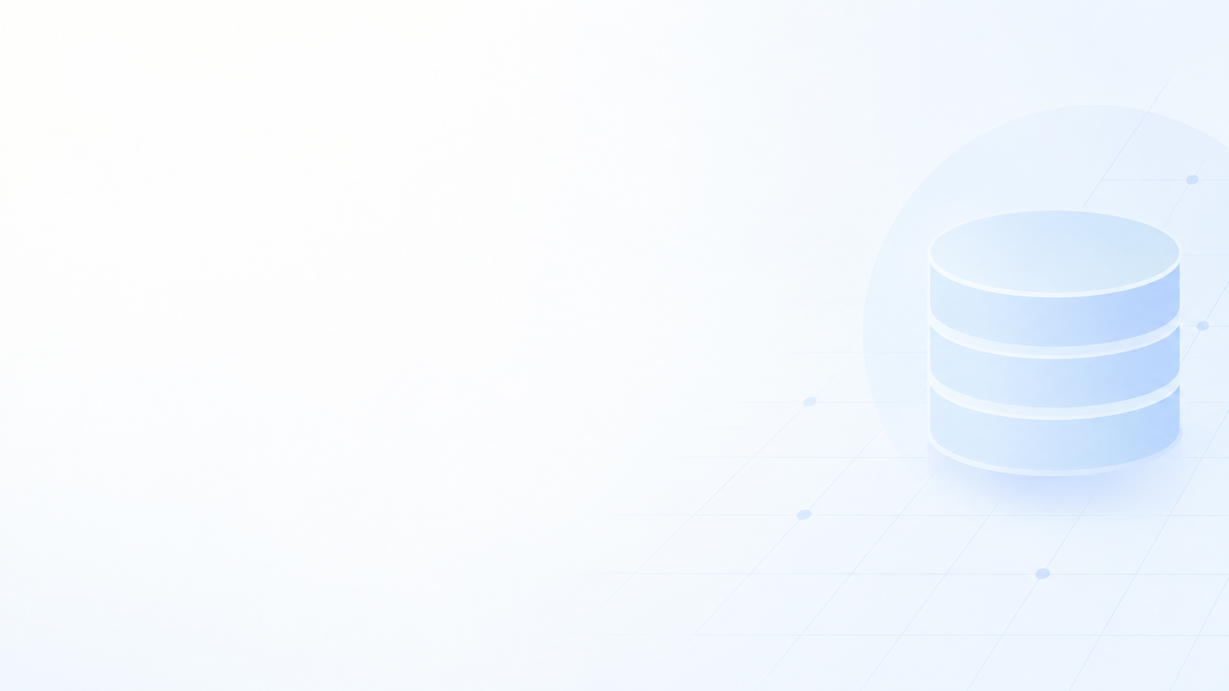
WHY EXASOL
Exasol Is the System of Record
Every transaction, score, and explanation lives in Exasol
the ML pipeline, API, and dashboard all read/write the same tables.
Hierarchical queries trace fraud rings
CONNECT BY / START WITH / SYS_CONNECT_BY_PATH walk multi-hop account links — no WITH RECURSIVE needed.
Analytical speed at hackathon scale
fast enough to re-score thousands of transactions on every pipeline run.
404 FOUNDERS | AEGIS | 05

Slide 6

THE WAR ROOM
Built for the Investigator, Not Just the Model
Fraud Ring Graph
Time Scrubber
Case Files
Entity Inspector
Force-directed topology view of linked accounts and shared devices.
Replay a ring's transaction history step by step.
Click-to-explain panel with SHAP-driven, plain-language reasoning.
Drill into any account, device, or route in one click.
404 FOUNDERS | AEGIS | 06

Slide 7

RESULTS
Working, End to End
A single pipeline run trains, scores, and explains — then serves it all through a live API.
~4,700
risk-scored transactions written to Exasol per pipeline run
4
detection stages: XGBoost → ring scoring → autoencoder → SHAP
1
live endpoint (/risk-scores) returning explained fraud scores
404 FOUNDERS | AEGIS | 07

Slide 8

THANK YOU
Questions?
AEGIS — Multi-Layer UPI Fraud Detection
TEAM 404 FOUNDERS
github.com/s2kumar2007/Aegis

