Slide 1


Infographics

Slide 2
Without GLDAS

Slide 3
Name | Dates Available | Temporal Resolution | Spatial Resolution | Domain | Projection
CONUS404 | October 1979–September 2021 | Hourly | 4km x 4km (≈ 0.036°) | CONUS | Latitude/longitude
UFS S2S | Apr 2011-Mar 2018 | Hourly; initialized 2x monthly, out to 35 days | 0.25° x 0.25° | Global | Latitude/longitude
ERA5 | 1940 to Present | Hourly | 0.25° x 0.25° | Global | Latitude/longitude
NCEP Reanalysis | 1949 to Present | 4x Daily | 2.5° x 2.5° | Global | Latitude/longitude
NAM Reanalysis | Mar 02, 2004–May 15, 2020 | 4x Daily | 12km x 12km (~0.108°) | North America | Lambert Conformal
NARR Reanalysis | Jan 01, 1979- Oct 02, 2014 | 8x Daily | 0.3° x 0.3° (~32km) | North America | Lambert Conformal
HRRR Reanalysis | 2015 to Present | Hourly | 3km x 3km (~0.027°) | CONUS | Lambert Conformal
NNME Retrospective | 1991 to Present | Daily | 1° x 1° () | Global
SubX(C) Retrospective | 1999 to Present | Daily | 1° x 1° () | Global

Slide 4
Temporal Range
April 2014
HRRR
Apr 2011
Mar 2018
UFS S2S
Mar 2004
NAM
May 2020
Jan 1999
SubX
Jan 1991
NMME
Oct 1979
NARR
Oct 2014
Oct 1979
CONUS404
Sep 2021
Jan 1949
NCEP Reanalysis II
Jan 1940
ERA5
1940
2000
Present

Slide 5
Resolution
Low
NCEP Reanalysis II
2.5° x 2.5°
SubX
1° x 1°
NMME
0.25° x 0.25°
NARR
1° x 1°
0.3° x 0.3°
UFS S2S
12km x 12km
ERA5
NAM
0.25° x 0.25°
CONUS
404
4km x 4km
HRRR
High
3km x 3km

Slide 6

CONUS404
HRRR
NAM
NARR
ERA5
NCEP Reanalysis
NMME
SubX
UFS S2S

Slide 7
Resolution
Name | Temporal Resolution
CONUS404 | Hourly
UFS S2S | Hourly; initialized 2x monthly, out to 35 days
ERA5 | Hourly
NCEP Reanalysis | 4x Daily
NAM Reanalysis | 4x Daily
NARR Reanalysis | 8x Daily
HRRR Reanalysis | Hourly
NNME Retrospective | Daily
SubX(C) Retrospective | Daily
GLDAS | 8x Daily
HRRR
UFS S2S
NAM
SubX
NMME
NARR
CONUS404
NCEP REANALYSIS II
ERA5
Hourly
8x Daily
4x Daily
Daily
*Derived
Temperature
Wind
Hot Dry Windy*
Relative Humidity
Soil
Moisture
PBL
CAPE
Precipitation
Vapor
Pressure
Deficit*
Fosberg Fire
Weather Index*
Lightning
Index*
Notes:
Add VPD and Lightning Count Indicator

Slide 9
Calculation overview
VPD = vapor pressure deficit in Pa
WS = wind speed in m/s
# = not-to-scale fake value for example
For a given dataset, for a given day, MM-DD-YYYY, with 4 timesteps:
VPD 00z
x
=
→
WS 00z
HDWI 00z
10 00z
HDWI_MAX_MMDDYYYY
10000
=
VPD 06z
x
=
→
WS 06z
HDWI 06z
100 06z
24-H resample
HDWI_MIN _MMDDYYYY
→
=
10
VPD 12z
x
=
→
WS 12z
HDWI 12z
1000 12z
HDWI_AVG _MMDDYYYY
=
2777.5
VPD 18z
x
=
→
WS 18z
HDWI 18z
10000 18z
HDWI_ABS _MMDDYYYY

Slide 10
Resolution
Name | Temporal Resolution
CONUS404 | Hourly
UFS S2S | Hourly; initialized 2x monthly, out to 35 days
ERA5 | Hourly
NCEP Reanalysis | 4x Daily
NAM Reanalysis | 4x Daily
NARR Reanalysis | 8x Daily
HRRR Reanalysis | Hourly
NNME Retrospective | Daily
SubX(C) Retrospective | Daily
GLDAS | 8x Daily
HRRR
UFS S2S
NAM
SubX
NMME
NARR
CONUS404
NCEP REANALYSIS II
ERA5
Hourly
8x Daily
4x Daily
Daily
*Derived
Temperature
Wind
Hot Dry Windy*
Relative Humidity
Soil
Moisture
Mixing
Height
CAPE
Precipitation
Vapor
Pressure
Deficit*
Lightning
Index*
Notes:
Add VPD and Lightning Count Indicator

Slide 11
Resolution
HRRR
UFS S2S
NAM
SubX
NMME
NARR
CONUS404
NCEP REANALYSIS
ERA5
Tavg, Tmin, Tmax
Temperature
WSavg, WSmin, WSmax, Wsgust
WDavg, WDmin, WDmax, WDchange
Wind
Surface?
Hot Dry Windy*
Hourly
8x Daily
RHmin, RHmax
Relative Humidity
4x Daily
Surface?
Soil
Moisture
Daily
*Derived
Mixing
Height
PBL
All Surface Vars
Reach Goals:
-Transport Wind
-Fuel Moisture
-Soil Temp
-Integrated Water Vapor
-Surface TKE?
CAPEmin, CAPEmax
CAPE
Paccum, Prate, Ptime, Pconv
Precipitation

Slide 12
With GLDAS

Slide 13
Name | Dates Available | Temporal Resolution | Spatial Resolution | Domain | Raw File Projection
CONUS404 | October 1979–September 2021 | Hourly | 4km x 4km (≈ 0.036°) | CONUS | Latitude/longitude
UFS S2S | Apr 2011-Mar 2018 | Hourly; initialized 2x monthly, out to 35 days | 0.25° x 0.25° | Global | Latitude/longitude
ERA5 | 1940 to Present | Hourly | 0.25° x 0.25° | Global | Latitude/longitude
NCEP Reanalysis | 1949 to Present | 4x Daily | 2.5° x 2.5° | Global | Latitude/longitude; Gaussian Grid
NAM Reanalysis | Mar 02, 2004–May 15, 2020 | 4x Daily | 12km x 12km (~0.108°) | North America | Lambert Conformal
NARR Reanalysis | Jan 01, 1979- Oct 02, 2014 | 8x Daily | 0.3° x 0.3° (~32km) | North America | Lambert Conformal
HRRR Reanalysis | 2015 to Present | Hourly | 3km x 3km (~0.027°) | CONUS | Lambert Conformal
NNME Retrospective | 1991 to Present | Daily | 1° x 1° () | Global
SubX(C) Retrospective | 1999 to Present | Daily | 1° x 1° () | Global
GLDAS | Jan 01, 1948- Present | 8x Daily | 0.25° x 0.25 °, 1.0° x 1.0° (km) | Global, North America | Latitude/longitude

Slide 14
Temporal Range
Jan 2015
HRRR
Apr 2011
Mar 2018
UFS S2S
Mar 2004
NAM
May 2020
Jan 1999
SubX
Jan 1991
NMME
Oct 1979
NARR
Oct 2014
Oct 1979
CONUS404
Sep 2021
Jan 1948
GLDAS
Jan 1949
NCEP Reanalysis II
Jan 1940
ERA5
1940
2000
Present

Slide 15
Low
Resolution
NCEP Reanalysis II
2.5° x 2.5°
SubX
1° x 1°
NMME
GLDAS
1° x 1°
UFS S2S
0.5° x 0.5°
0.5° x 0.5°
ERA5
NARR
0.5° x 0.5°
0.3° x 0.3°
NAM
12km x 12km
CONUS
404
4km x 4km
HRRR
3km x 3km
High

Slide 16
CONUS404
HRRR
NAM
NARR
ERA5
NCEP Reanalysis
GLDAS
NMME
SubX
UFS S2S

Slide 17
Resolution
Name | Temporal Resolution
CONUS404 | Hourly
UFS S2S | Hourly; initialized 2x monthly, out to 35 days
ERA5 | Hourly
NCEP Reanalysis | 4x Daily
NAM Reanalysis | 4x Daily
NARR Reanalysis | 8x Daily
HRRR Reanalysis | Hourly
NNME Retrospective | Daily
SubX(C) Retrospective | Daily
GLDAS | 8x Daily
HRRR
UFS S2S
NAM
SubX
NMME
NARR
CONUS404
GLDAS
NCEP REANALYSIS II
ERA5
Hourly
8x Daily
4x Daily
Daily
*Derived
Temperature
Wind
Hot Dry Windy*
Relative Humidity
Soil
Moisture
Mixing
Height
CAPE
Precipitation
Notes:
Add VPD and Lightning Count Indicator

Slide 18
Resolution
HRRR
UFS S2S
NAM
SubX
NMME
NARR
CONUS404
GLDAS
NCEP REANALYSIS
ERA5
Temperature
Wind
Hot Dry Windy*
Hourly
Relative Humidity
8x Daily
4x Daily
Soil
Moisture
Daily
Mixing
Height
*Derived
CAPE
Precipitation

Slide 19
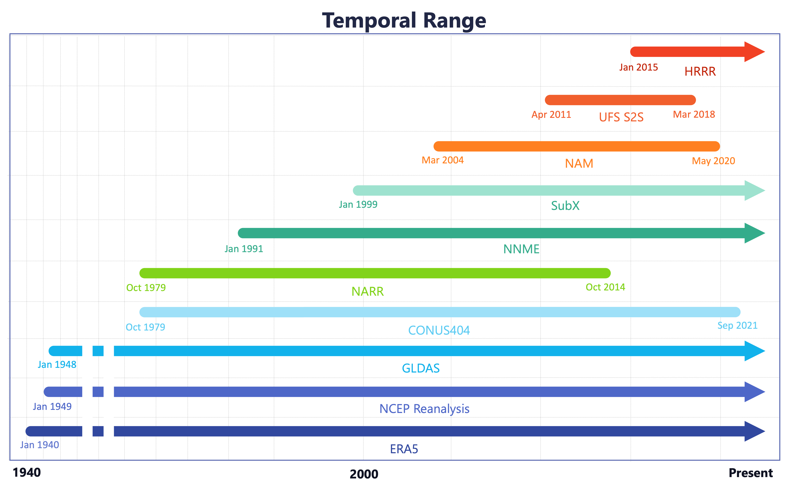
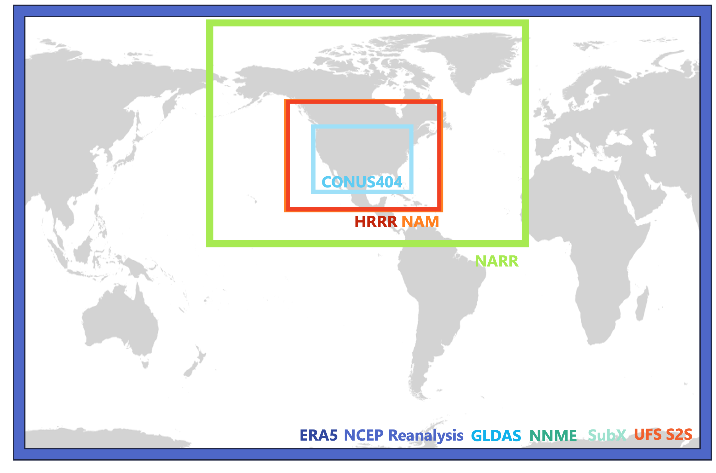
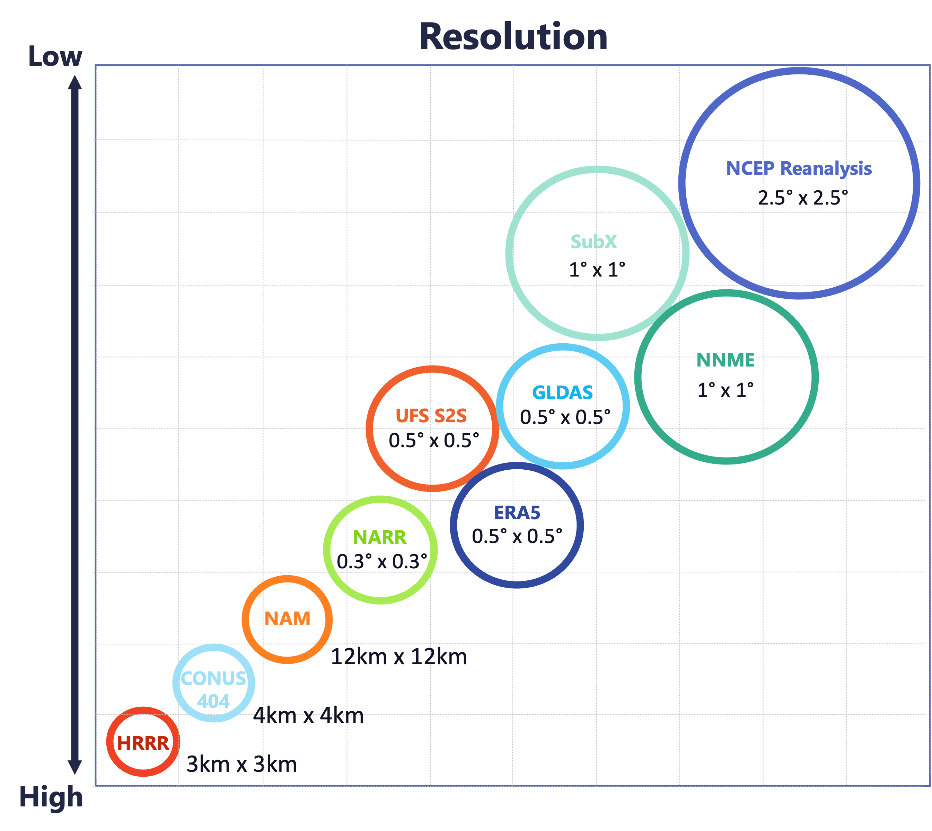
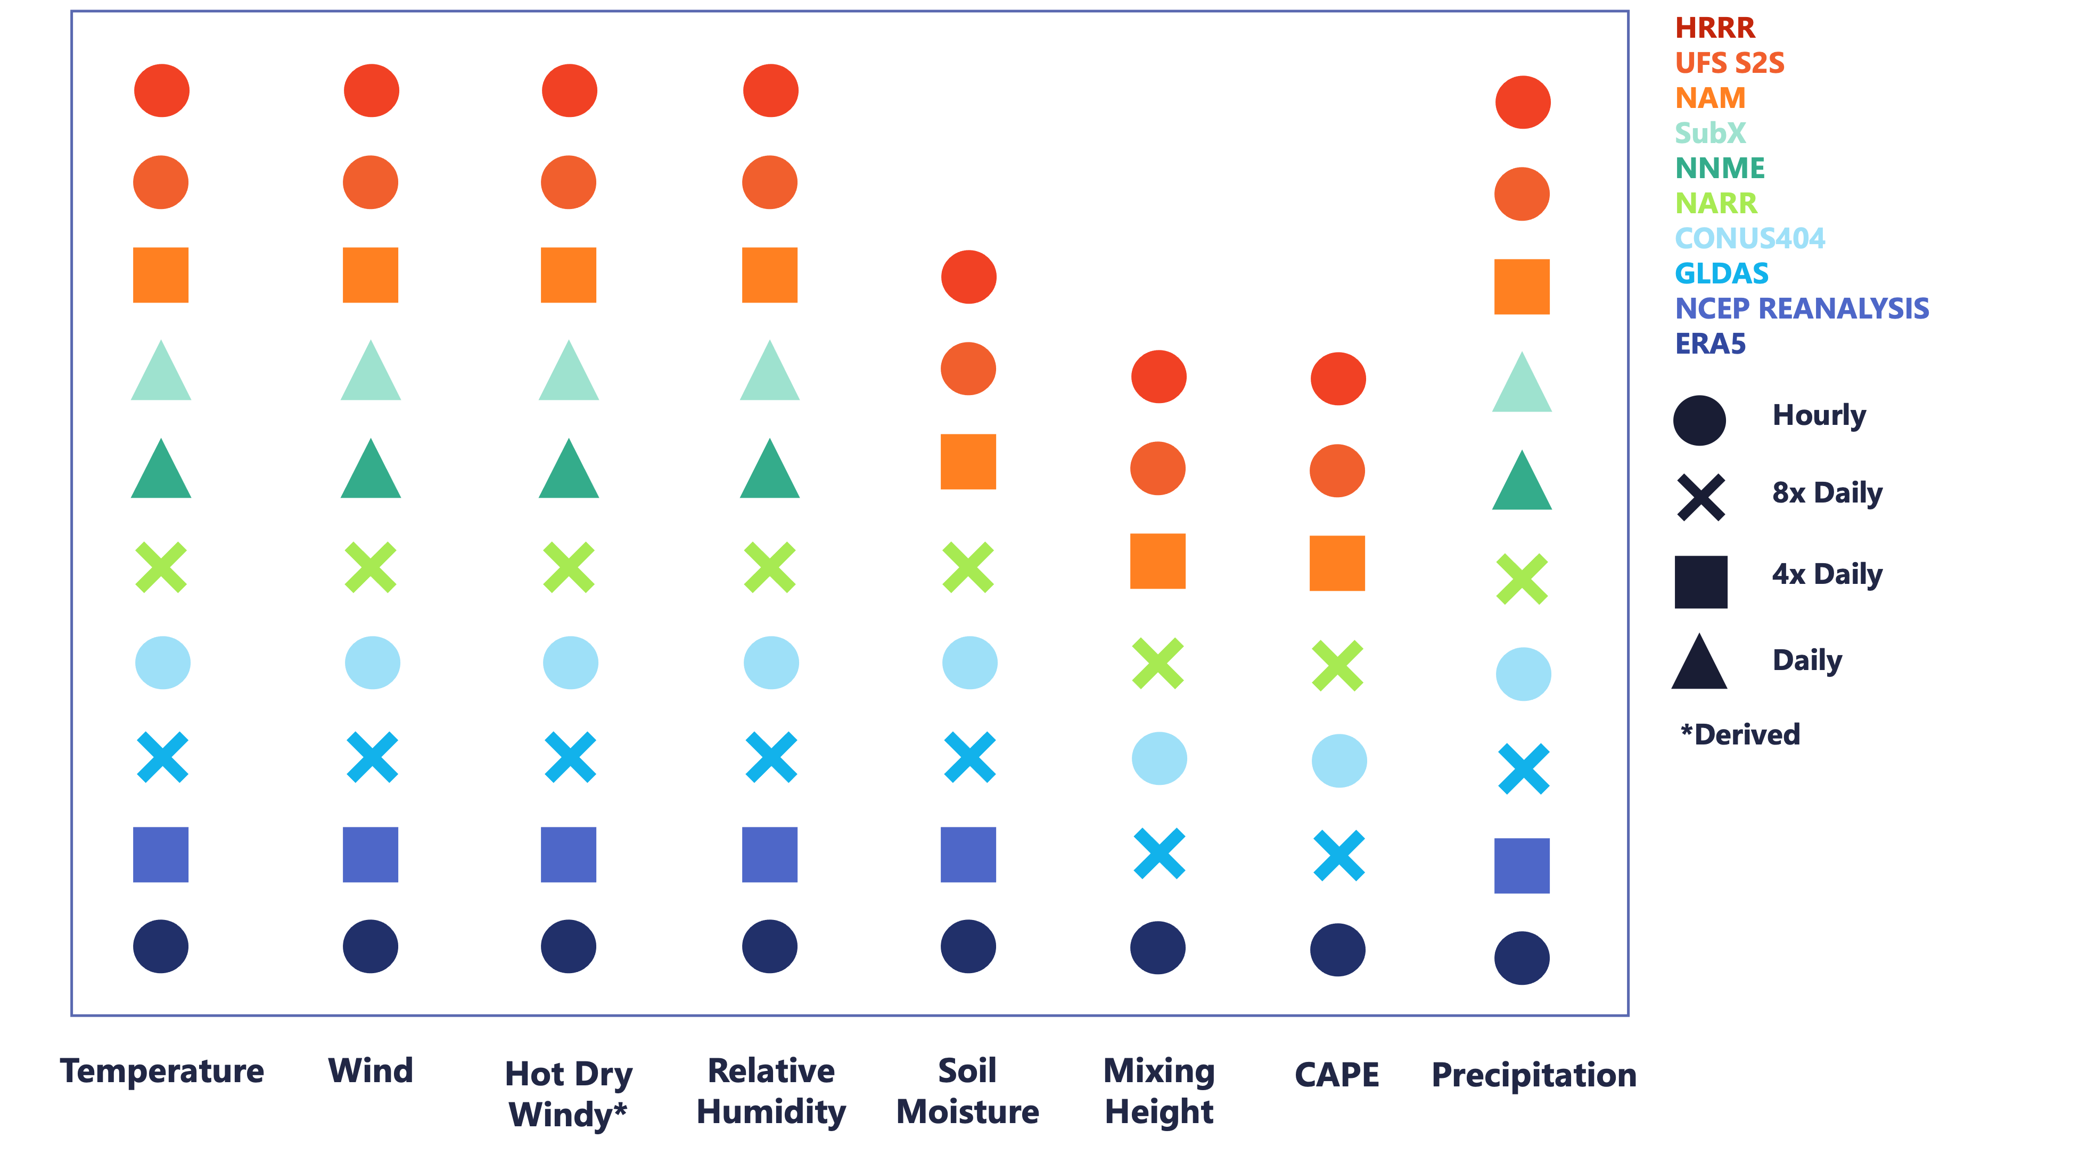

Slide 20
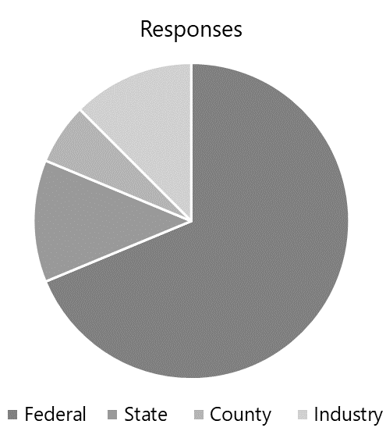
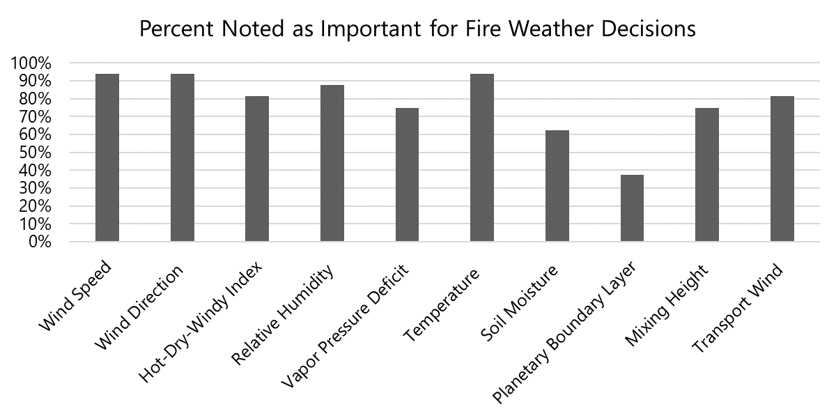
Stakeholder Poll
Variable Write-ins :
CAPE
Lapse Rates
Atmospheric Instability
Ventilation Index
Surface Ozone
High Impact Precipitation
Lightning

Slide 21
Timeline
Grid Res
Domain (global, conus, north am)
Time Res (daily, 8x, )
Future graphic or table (variables)

