Slide 1

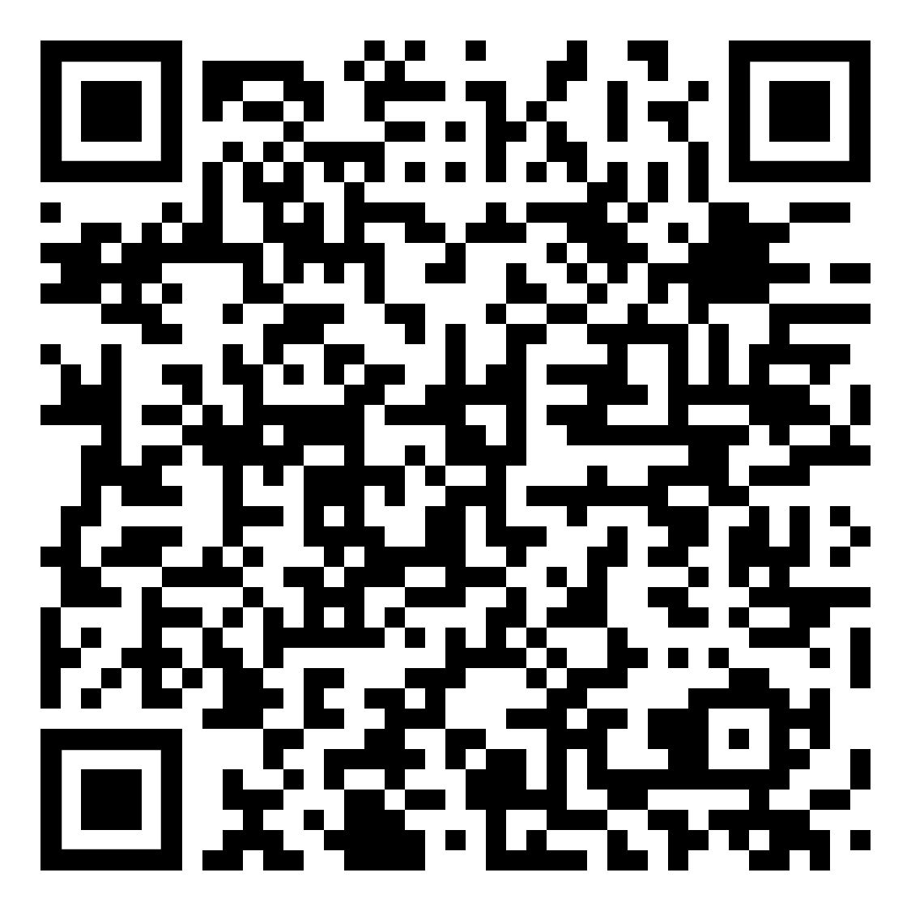
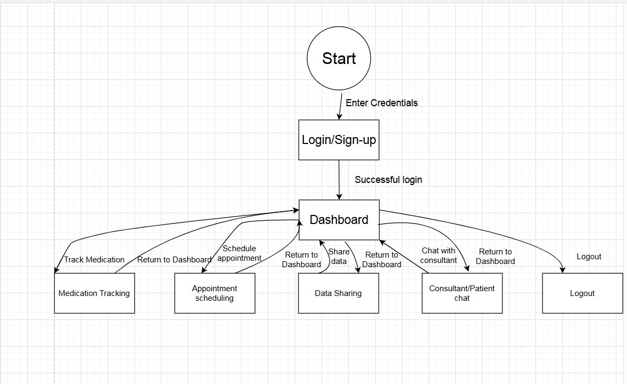
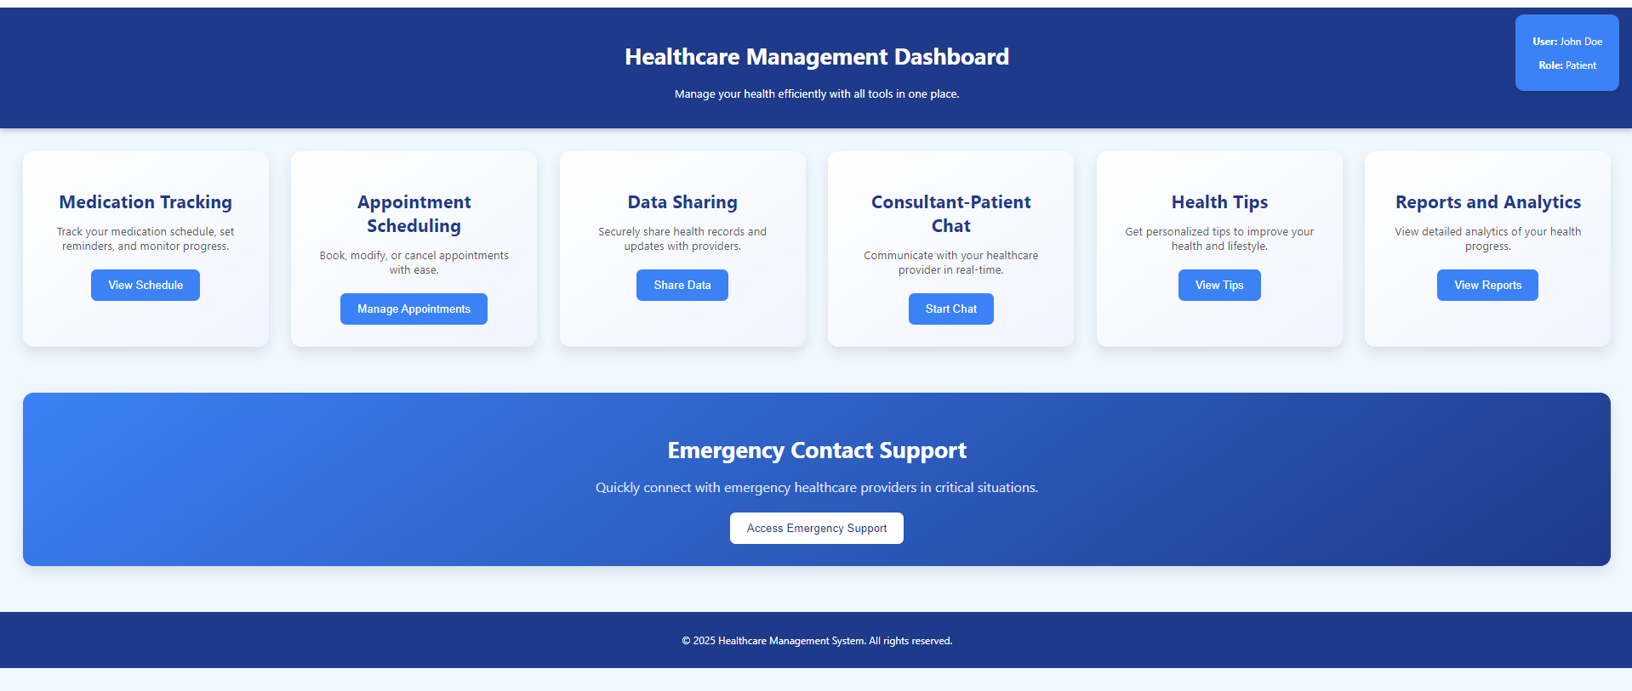
Research: Healthcare systems face critical challenges, including fragmented functionality, poor usability, and limited real-time communication capabilities. Non-adherence to medications affects over 50% of chronic patients, leading to worsened health outcomes and increased healthcare costs (BMJ Open, 2018). Current tools, such as mobile apps for medication reminders and patient education programs, often fail due to limited integration with healthcare systems, complex interfaces, and lack of real-time interaction (Nieuwlaat et al., 2014). Patients also face challenges in accessing personalized care tailored to their unique health needs. Many existing platforms fail to incorporate features that adapt to individual user preferences, such as customizable dashboards or tailored health tips, which can significantly enhance user engagement and treatment adherence. This lack of personalization results in reduced user satisfaction and limits the effectiveness of digital health tools (NHS England, 2023). This project aims to close these gaps by developing a comprehensive, integrated system. The proposed solution will empower patients, enhance provider-patient collaboration, and streamline healthcare management through personalized and user-centric design.
UFCFXK-30-3: Digital Systems Project
Student name: Seif Mansour
Project Title: Real-time integrated healthcare management platform
Video
QR Code
Abstract:
This project proposes a comprehensive web-based healthcare management platform to address challenges like medication non-adherence, fragmented systems, and poor user engagement. The platform integrates medication tracking, appointment scheduling, real-time communication, and secure data sharing into a user-friendly, centralized system. By leveraging modern technologies, it aims to empower patients, enhance healthcare provider collaboration, and improve overall healthcare outcomes.
Design, Implementation & Testing
State Diagram
Aims and objectives:
Aims: To develop a secure, user-friendly digital platform that empowers patients to manage their health information and actively engage in their healthcare journey.
Objectives:
Enable users to securely manage personal details, track medication adherence, and share health information with providers.
Enhance communication between patients and healthcare providers by offering real-time access to essential health data.
Simplify appointment scheduling to allow patients to arrange consultations and maintain consistent follow-ups.
Address gaps in medication management and doctor-patient communication, promoting a patient-centered approach.
Prioritize security, usability, and data privacy to meet the needs of both patients and providers effectively.
Implementation artefacts
This is my initial simple UI for the healthcare management user’s dashboard with features like medication tracking, appointment scheduling, data sharing, and chat support.
Testing
The testing phase will focus on ensuring the platform's functionality, usability, and security. Functional tests will verify that all features, such as medication tracking and appointment scheduling, work as intended. Usability testing will involve user feedback to improve the interface and experience. Security testing will validate data encryption and compliance with privacy standards. Automated tools like Selenium and Postman could be used for efficiency.
Planning and Management
Project Milestones: The project will involve researching healthcare needs, designing the system, developing core features, testing for usability, and deploying the platform.
Estimated Timeline:
Week 1-2: Finalize design and Requirements section; update the report.
Week 3-4: Begin development (core features); write Methodology and draft Design section.
Week 5-6: Integrate front-end and back-end; complete Design section.
Week 7-9: Test the platform; write Implementation and testing results.
Week 10-11: Refine platform; draft Evaluation and Conclusion sections.
Week 12: Verify with the supervisor and finalize the report.
Week 13: Submit the project and report.
Tools and Resources: Tools like Figma for design, React.js for front-end, Node.js for back-end, MongoDB for database and Trello for tracking will be used to ensure smooth execution.
Risk Management: Security measures, Gantt charts for tracking progress, and early usability testing will reduce risks and improve outcomes.
References:
Key requirements:
Functional Requirements:
User Authentication: Secure login and registration for patients and healthcare providers.
Medication Management: Allow users to add, track, and update medication schedules with reminders.
Appointment Scheduling: Enable patients to book, modify, or cancel appointments seamlessly.
Data Sharing: Provide real-time data sharing between patients and healthcare providers.
User Dashboard: Centralized dashboard for managing appointments, medications, and health data.
Consultant-Patient Chat: Facilitate secure, real-time communication between patients and healthcare providers.
Non-Functional Requirements:
Security and Privacy: Protect sensitive health data with strong encryption and ensure compliance with privacy standards.
Usability: Design an intuitive interface accessible to users of all technological skill levels.
Performance: Provide fast and reliable system responses for real-time interactions.
Scalability: Support an increasing number of users without compromising performance.
BMJ Open (2018) 'Medication adherence in chronic diseases: Rates and factors.' BMJ Open, 8(1), e016982. Available from: https://bmjopen.bmj.com/content/8/1/e016982 [Accessed 10 January 2025].
Nieuwlaat, R., Wilczynski, N., Navarro, T., Hobson, N., Jeffery, R., Keepanasseril, A., Agoritsas, T., Mistry, N., Iorio, A. and Jack, S. (2014) 'Interventions for enhancing medication adherence.' Cochrane Database of Systematic Reviews, (11). Available from: https://doi.org/10.1002/14651858.CD000011.pub4 [Accessed 10 January 2025].
NHS England (2023) 'Digital transformation.' NHS England. Available from: https://www.england.nhs.uk/digitaltechnology/ [Accessed 10 January 2025]

