Slide 1
Raising card usage: segment-level diagnostic
Credit card activation & loyalty analysis for a Polish retail bank (fictional client)
Portfolio project, public dataset

Slide 2
Falling usage predicts churn: an early-warning trigger could reach 42% of churners in 23% of the base
What we found
1. Customers whose Q4 transactions fell by more than 60% vs Q1 churned at 60.0%, vs 7.1% for those with flat or rising use.
2. Attrition rises from 4.5% at 1 inactive month to 21.5% at 3 and 29.9% at 4 months.
3. Every contact with the bank adds risk: 1.8% attrition at 0 contacts, 20.1% at 3, 33.5% at 5.
The 'At risk' segment is 13.5% of customers but 37.7% of churners.
What we recommend
1. Early-warning trigger: flag customers with 3+ inactive months AND 3+ bank contacts (2,317 customers, 29.6% attrition) and the 'At risk' segment; contact them with a retention offer.
2. Activation offer for the 'Low-activity' segment (1,815 customers, 26.4% attrition): reward reaching a monthly transaction target.
3. Service-contact review: treat the 3rd contact in a year as a churn signal; find and fix the top contact reasons.
Source: Kaggle 'Credit Card Customers' (BankChurners), n = 10,127 customers; author's analysis

Slide 3
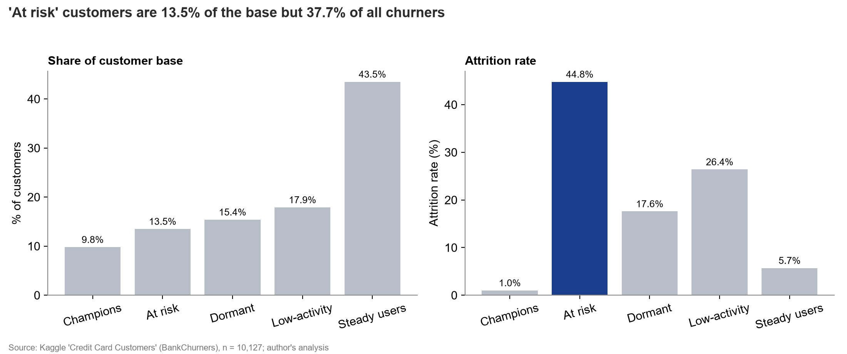
'At risk' customers are 13.5% of the base but 37.7% of all churners
So what?
At risk: 44.8% attrition (3+ inactive months and Q4 transactions down 40%+).
Low-activity: 26.4% attrition, the second retention priority.
Champions: 1.0% attrition; Steady users: 5.7%.
Source: Kaggle 'Credit Card Customers' (BankChurners), n = 10,127 customers; author's analysis

Slide 4
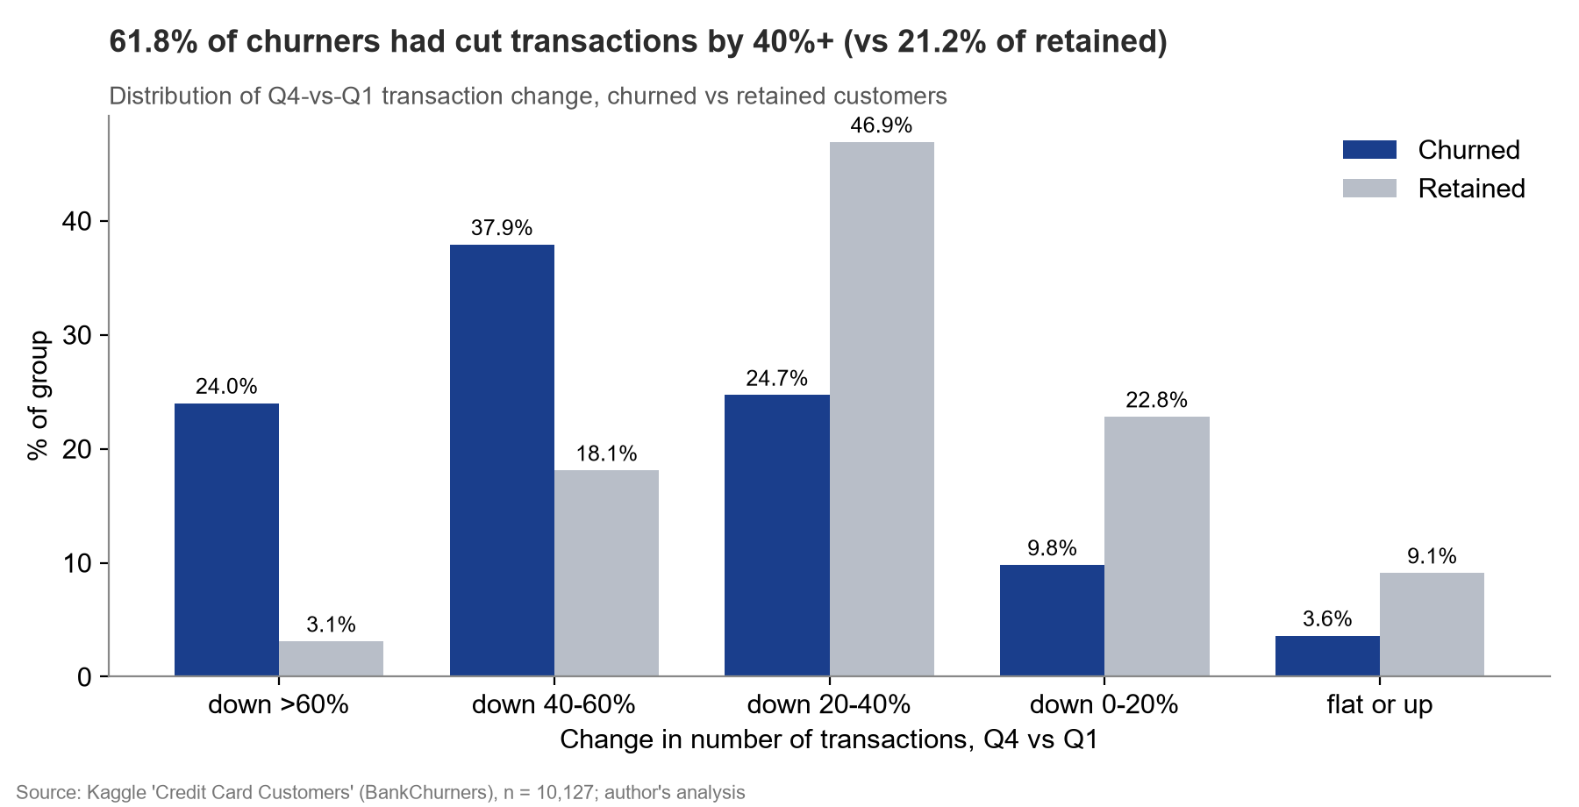
Finding 1: 61.8% of churners had cut transactions by 40%+ (vs 21.2% of retained)
So what?
Median Q4/Q1 transaction ratio: 0.53 for churners vs 0.72 for retained.
Customers down >60% churned at 60.0% vs 7.1% when flat or up.
A drop in usage is visible in the data the bank already has: it can be monitored monthly.
Source: Kaggle 'Credit Card Customers' (BankChurners), n = 10,127 customers; author's analysis

Slide 5
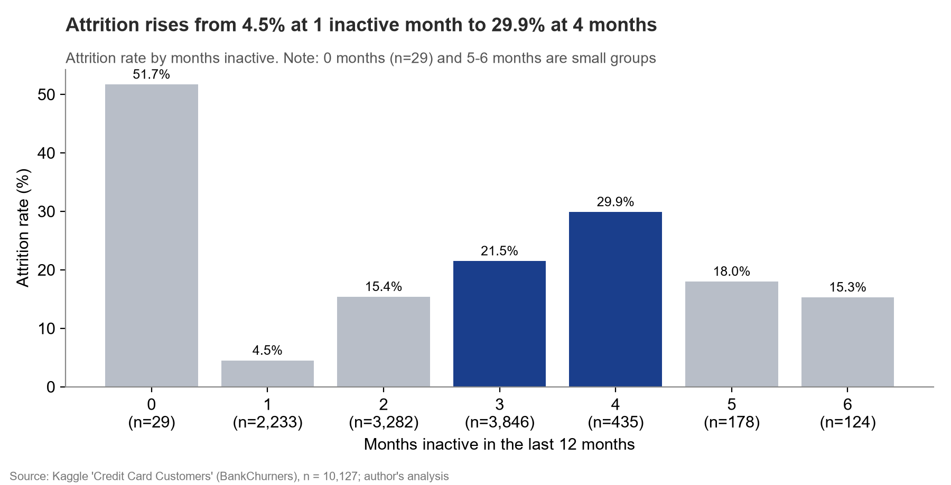
Finding 2: attrition rises from 4.5% at 1 inactive month to 29.9% at 4 months
So what?
3,846 customers sit at exactly 3 inactive months (21.5% attrition): the largest pool to act on.
5-6 months and 0 months are small groups with noisy rates.
Act at month 2-3, before the customer has mentally left.
Source: Kaggle 'Credit Card Customers' (BankChurners), n = 10,127 customers; author's analysis

Slide 6
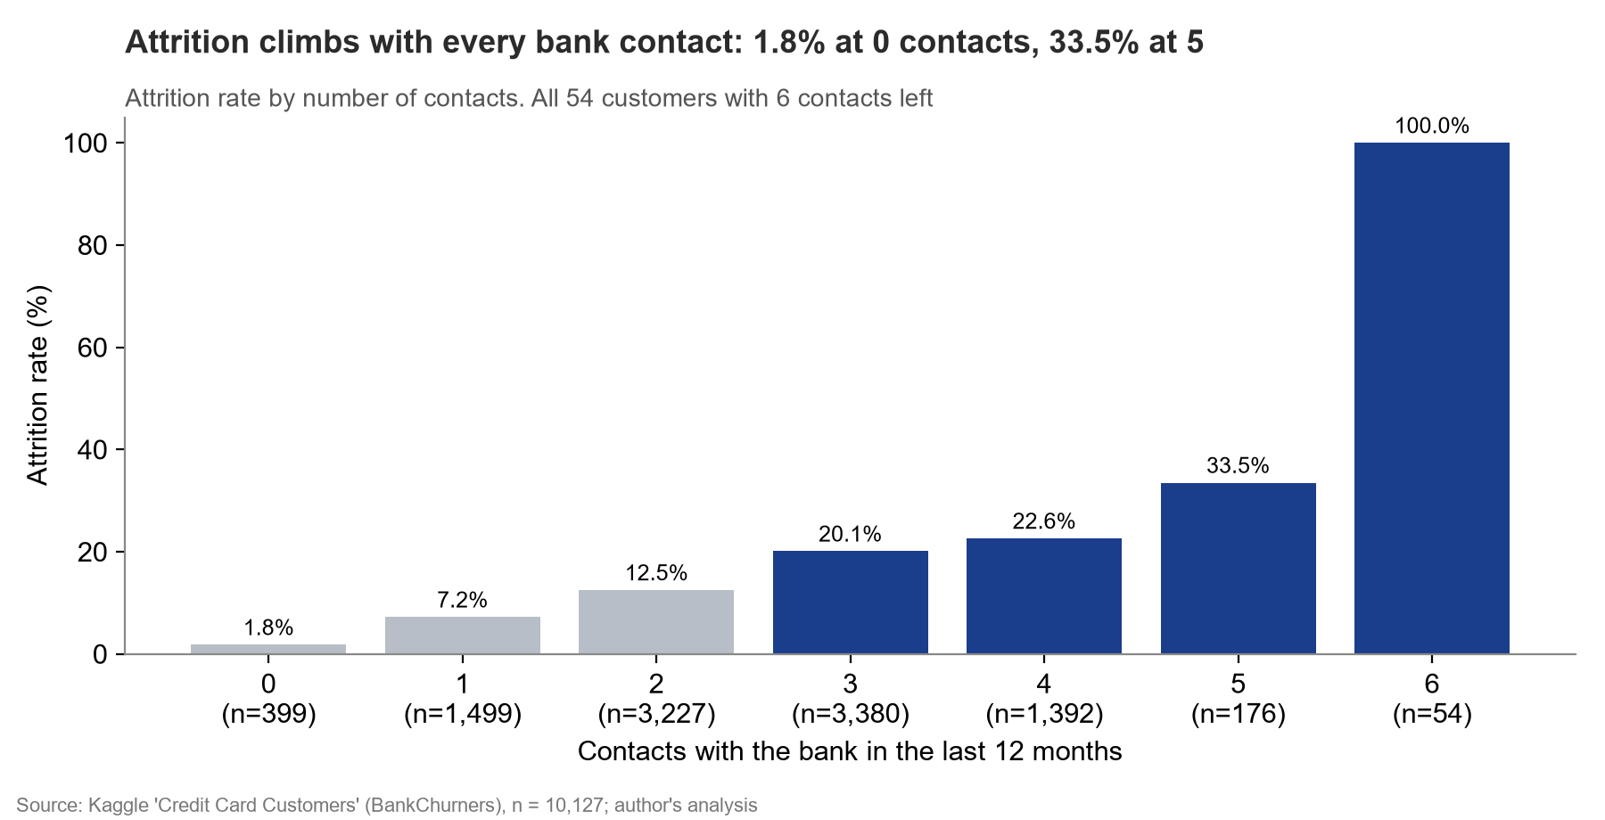
Finding 3: attrition climbs with each bank contact, from 1.8% to 33.5% at 5 contacts
So what?
All 54 customers with 6 contacts left.
Contacts likely reflect unresolved problems (we cannot see the reason in this data).
3+ inactive months AND 3+ contacts: 22.9% of customers, 42.2% of churners, 29.6% attrition (vs 12.0% for the rest).
Source: Kaggle 'Credit Card Customers' (BankChurners), n = 10,127 customers; author's analysis

Slide 7
Three actions, each tested against a control group, can show impact within 6 months
Action | Target segment | Metric to track
1. Early-warning trigger + retention offer: 3+ inactive months AND 3+ contacts, or 3+ inactive months with Q4/Q1 transactions < 0.6 ('At risk') | Flagged (2,317, 29.6% attrition) and At risk (1,367, 44.8% attrition) | Attrition rate vs. control group
2. Activation offer: cashback for reaching N transactions a month for 3 months | Low-activity (1,815 customers, 26.4% attrition) | Transactions per active card; activation rate
3. Service-contact review: root-cause top contact reasons; senior handling from the 3rd contact | Customers with 3+ contacts (5,002) | Attrition rate of 3+ contact customers; repeat-contact rate
Next steps: (1) agree the trigger rule and offer budget, (2) pilot on a random half of each target group with the other half as control, (3) read results monthly for 6 months, (4) validate with the bank's own transaction-level data (exact dates, merchant categories, contact reasons).
Source: Kaggle 'Credit Card Customers' (BankChurners), n = 10,127 customers; author's analysis

