Slide 1
FUEL
CONSUMPTION
OPTIMIZATION
Using Golden Section Search
NUMERICAL OPTIMIZATION
IN ENGINEERING
Finding the Optimal Driving Speed
to Minimize Fuel Consumption
f(v) = 0.005(v−80)² + 6
STUDENT
INSTRUCTOR
UNIVERSITY
COURSE
[Your Name Here]
[Prof. Name]
[University Name]
Numerical Methods / Optimization
01 / 13
Notes:
SLIDE 1 — TITLE Good morning / Good afternoon. My name is [Your Name], and today I will be presenting my project on Fuel Consumption Optimization Using the Golden Section Search method. This is a numerical optimization approach that helps us find the most fuel-efficient driving speed for a vehicle. Let me take you through the theory, mathematics, and step-by-step application of this powerful algorithm.

Slide 2
OVERVIEW
Introduction to Optimization
Why solving for the best — not just good enough — matters
What is Optimization?
🚗 Transportation
🤖 Artificial Intelligence
The process of finding the best solution from a set of feasible alternatives — maximizing efficiency or minimizing cost, time, or resources.
Optimal routes & speeds
Training neural networks
⚡ Energy Systems
🏭 Manufacturing
Two Types of Optimization Objectives
Power grid optimization
Minimize production cost
• Minimization: Reduce cost, time, fuel, errors • Maximization: Increase profit, efficiency, output
📦 Logistics
📈 Business
Supply chain planning
Maximize profit margins
🔑 Key Takeaway: Optimization is at the heart of modern engineering — every efficient system was designed by solving an optimization problem.
02 / 13
Notes:
SLIDE 2 — INTRODUCTION Let's start with the basics. Optimization means finding the best possible value of an objective function — whether that's minimizing fuel cost, minimizing production time, or maximizing output. In everyday engineering and technology, optimization is everywhere. Training a neural network? That's optimization. Planning a delivery route? Optimization. Designing a bridge? Definitely optimization. Today we're applying optimization to a very practical real-world problem: how fast should you drive to use the least amount of fuel? → Transition: Let's first understand the physics of fuel consumption before we dive into the math.

Slide 3
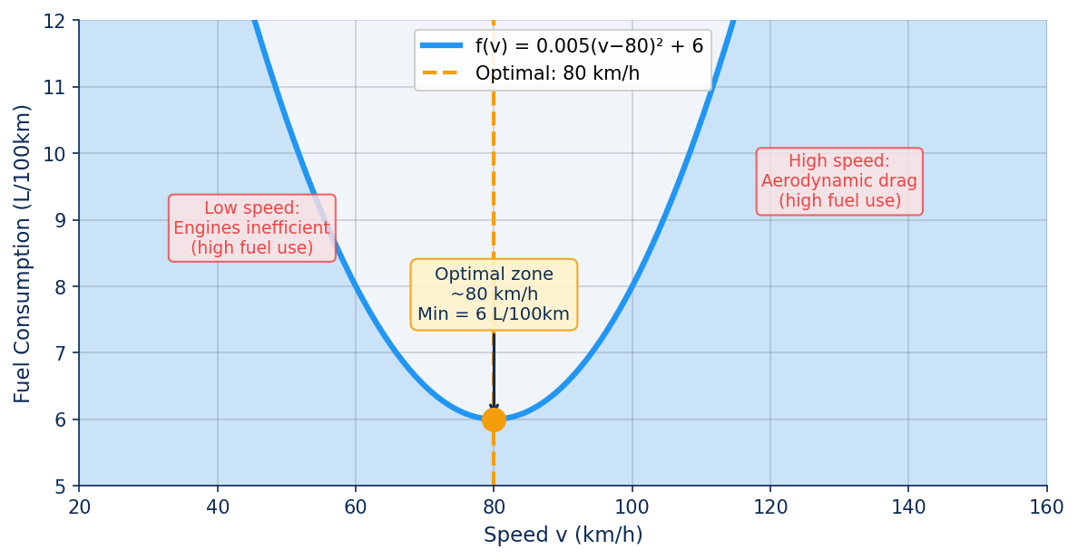
PHYSICS
Understanding Fuel Consumption
Why neither too slow nor too fast is fuel-efficient
🐌 Too Slow (<60 km/h)
Engine operates inefficiently. High fuel consumption relative to distance covered. Gears are under-utilized.
✅ Optimal (~80 km/h)
Engine efficiency is maximized. Aerodynamic drag is still manageable. Best fuel economy.
💨 Too Fast (>110 km/h)
Aerodynamic drag grows with v². Engine works much harder. Fuel consumption rises sharply.
⚡ The fuel-speed relationship forms a U-shaped (convex) curve — this shape is exactly what makes Golden Section Search applicable!
03 / 13
Notes:
SLIDE 3 — FUEL CONSUMPTION PHYSICS As you can see on this chart, fuel consumption is not a straight line — it follows a U-shape. At very low speeds, the engine is running in an inefficient operating range, burning more fuel per kilometer. At high speeds, aerodynamic drag — which increases with the square of velocity — forces the engine to work much harder. There's a sweet spot in the middle, around 80 km/h, where the engine is most efficient and drag is still manageable. This physical reality is what we'll model mathematically. → Transition: Let's now formally define this as an optimization problem.

Slide 4
PROBLEM
Problem Statement
Formally defining the fuel optimization objective
🎯 GOAL: Find the vehicle speed v* that minimizes fuel consumption f(v)
Variable Definitions
Optimization Objective
v
Vehicle speed (km/h)
v* = arg min f(v)
f(v)
Fuel consumption (L/100km)
v*
Optimal speed (solution) (km/h)
Subject to constraint:
[a, b]
Search interval ([40, 140] km/h)
40 ≤ v ≤ 140 (km/h)
🔑 Practical speed range accounts for safety limits, traffic laws, and highway conditions. The mathematical minimum lies within this interval.
04 / 13
Notes:
SLIDE 4 — PROBLEM STATEMENT Here is our problem formulated precisely. We want to find the speed v-star — the optimal speed — that minimizes fuel consumption f(v). Our search is limited to the practical speed range of 40 to 140 km/h, which reflects real driving conditions. The variable v is the vehicle speed in km/h, and f(v) gives us fuel consumption in liters per 100 kilometers. The notation arg min means: find the argument — i.e., the speed — that gives the minimum value of the function. → Transition: Now let's look at the exact mathematical model for fuel consumption.

Slide 5
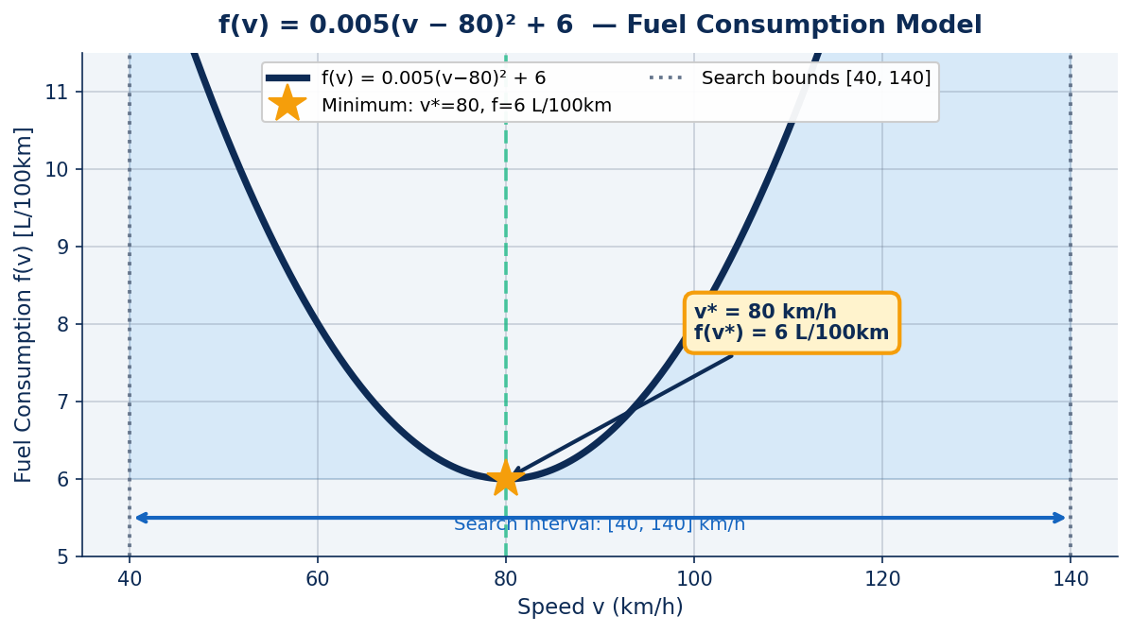
MODELING
Mathematical Model of Fuel Consumption
A convex, unimodal function with a unique global minimum
f(v) = 0.005(v − 80)² + 6
📐 Shape:
Parabola (convex quadratic) — opens upward
🔵 Vertex:
At v = 80 km/h → minimum = 6 L/100km
📈 Unimodal:
Exactly ONE minimum in [40, 140]
✅ GSS-Ready:
🔑 The function's unimodal (single-valley) shape guarantees that Golden Section Search will converge to the exact minimum efficiently.
Unimodal → Golden Section Search is valid
05 / 13
Notes:
SLIDE 5 — MATHEMATICAL MODEL Our fuel consumption model is f(v) equals 0.005 times (v minus 80) squared, plus 6. This is a parabola — a convex quadratic function. The vertex of this parabola sits exactly at v equals 80 km/h, where fuel consumption is 6 liters per 100 kilometers — the global minimum. The coefficient 0.005 controls how steeply fuel consumption rises as we move away from 80 km/h. Most importantly, this function is unimodal — it has exactly one minimum within our search interval. This property is the key requirement for Golden Section Search to work correctly and guarantee convergence. → Transition: But before we explain GSS, let me show you why a brute-force approach would be inefficient.

Slide 6
MOTIVATION
Why Brute Force Search is Inefficient
The cost of checking every possible value
❌ Brute Force Search
✅ Golden Section Search
• Test every speed: 40, 41, 42, ..., 140
• Intelligently narrows the interval
• Resolution = 0.1 km/h → 1,000 evaluations
• Each step eliminates 38.2% of range
VS
• Resolution = 0.01 km/h → 10,000 eval.
• Converges in only ~25–35 iterations
• Each f(v) call = computational cost
• Works without computing derivatives
• No intelligence — no learning from results
• Mathematically guaranteed convergence
Up to 10,000+ function evaluations!
Only ~25 evaluations needed!
• Slow for high-dimensional problems
• Efficiency scales to complex problems
05 / 13
Notes:
SLIDE 6 — BRUTE FORCE VS GSS Imagine evaluating every possible speed in steps of 0.01 km/h between 40 and 140. That's 10,000 computations! For a simple function like ours, that's manageable — but in real engineering systems with complex models, each function evaluation might take minutes. Brute force becomes impractical very quickly. The Golden Section Search, on the other hand, is smart. It cuts the search interval by about 38% at every step, converging to the answer in roughly 25 iterations. Same accuracy, 400 times fewer calculations. → Transition: Let's now understand HOW the Golden Section Search achieves this efficiency.

Slide 7
ALGORITHM
Golden Section Search
A derivative-free optimization method based on the golden ratio
What is Golden Section Search?
The Golden Ratio φ = 0.618
An iterative numerical method that finds the minimum (or maximum) of a unimodal function over a bounded interval, without needing derivatives.
φ = (√5 − 1) / 2 = 0.6180...
At every iteration, one subinterval has length:
Derivative-Free:
Works on non-differentiable or black-box functions
0.618 × (b − a) [kept]
Interval-Based:
0.382 × (b − a) [eliminated]
Progressively shrinks the search range
Guaranteed Convergence:
Always finds the minimum for unimodal f(v)
🔑 Every iteration eliminates 38.2% of the search space — this is the mathematical power of φ = 0.618.
07 / 13
Notes:
SLIDE 7 — GOLDEN RATIO The Golden Section Search derives its name from the famous golden ratio φ = 0.6180. This number has been known since ancient Greece and appears throughout nature, art, and architecture. In our algorithm, it defines exactly how we split the search interval at each step. The key insight is that by placing two test points using the ratio 0.618, we can reuse one function evaluation from the previous iteration — cutting the number of new calculations needed. This is why GSS is so efficient: each step eliminates 38.2% of the remaining interval with just ONE new function evaluation. → Transition: Let's now go through the algorithm step by step.

Slide 8
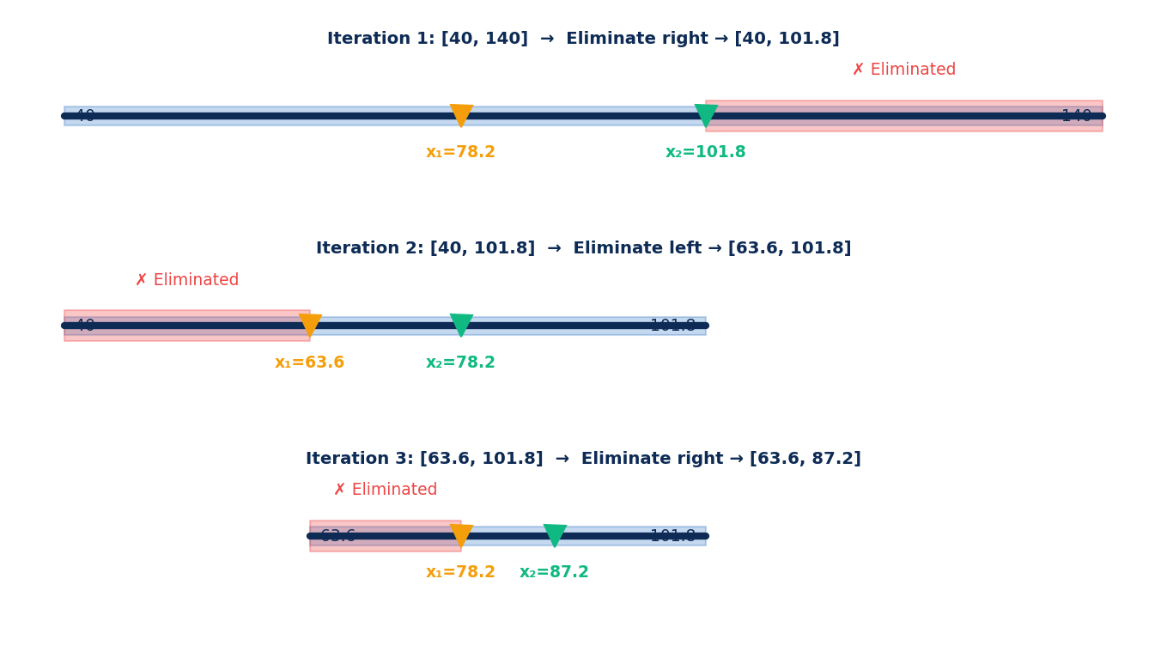
ALGORITHM
Golden Section Search Algorithm
Step-by-step iterative procedure for minimization
Interval Reduction Visual
1
Initialize:
Set search bounds: a = 40, b = 140 km/h
2
Compute Interior Points:
x₁ = b − 0.618(b−a) x₂ = a + 0.618(b−a)
3
Evaluate Function:
Compute f(x₁) and f(x₂)
4
Eliminate Subinterval:
If f(x₁) < f(x₂) → set b = x₂ Else → set a = x₁
5
Check Convergence:
If (b − a) < ε → stop and report v* = (a+b)/2
x₁ = b − 0.618(b−a)
x₂ = a + 0.618(b−a)
6
Repeat:
Reuse the remaining point and go to Step 2
08 / 13
Notes:
SLIDE 8 — ALGORITHM STEPS The Golden Section Search algorithm has a clean, repeatable structure. Step 1: we start with the full search range from 40 to 140 km/h. Step 2: we compute two interior test points x1 and x2 using the golden ratio formulas. These points are placed symmetrically inside the interval. Step 3: we evaluate the fuel function at both points. Step 4: whichever point gives the higher fuel consumption, we eliminate the side of the interval it's on. Step 5: if the remaining interval is small enough — say less than 0.01 km/h — we stop and report the midpoint as our answer. Step 6: otherwise, we reuse the surviving test point and compute only ONE new interior point. This is the key efficiency trick. Let's watch this play out in a real numerical example. → Transition: Let me now walk through the first iteration with actual numbers.

Slide 9
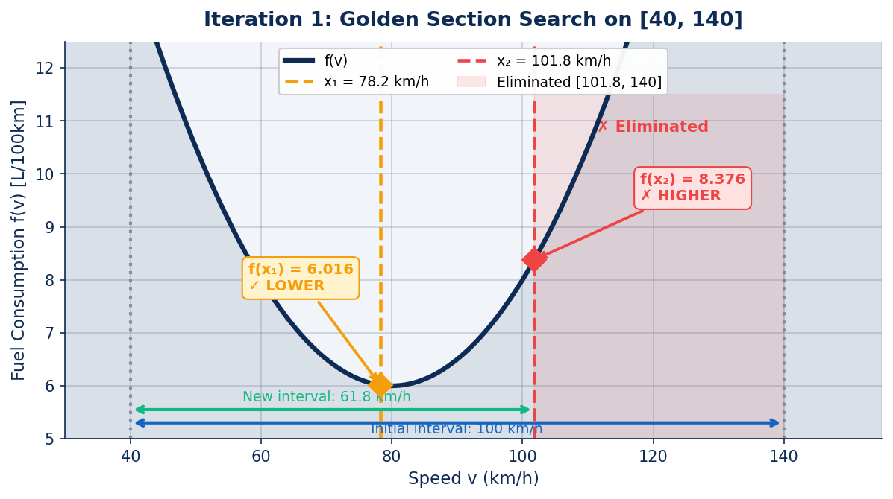
EXAMPLE
Numerical Example — Iteration 1
Applying Golden Section Search to [40, 140] km/h
Initial Interval:
a = 40, b = 140 → (b−a) = 100
x₁ = b − 0.618(b−a):
= 140 − 0.618 × 100 = 78.2 km/h
x₂ = a + 0.618(b−a):
= 40 + 0.618 × 100 = 101.8 km/h
f(x₁) = f(78.2):
= 0.005×(78.2−80)² + 6 = 6.016 L/100km
f(x₂) = f(101.8):
= 0.005×(101.8−80)² + 6 = 8.376 L/100km
Decision: f(x₁) < f(x₂):
Eliminate right side → new b = x₂ = 101.8
New Interval:
[40, 101.8] → size = 61.8 km/h (−38.2%)
🔑 One iteration → interval shrinks from 100 to 61.8 km/h. Only 2 function evaluations used!
09 / 13
Notes:
SLIDE 9 — FIRST ITERATION Let's apply the algorithm to our problem. Our initial interval is [40, 140]. The interval width is 100. We compute x1 using the formula: 140 minus 0.618 times 100, which gives 78.2 km/h. We compute x2: 40 plus 0.618 times 100, which is 101.8 km/h. Now we evaluate: f(78.2) equals 6.016, and f(101.8) equals 8.376. Since f(x1) is LOWER, the minimum cannot be in the right portion beyond x2. We eliminate [101.8, 140] and keep the interval [40, 101.8]. Our interval has shrunk from 100 to 61.8 — a 38.2% reduction in just one step, with only 2 function evaluations. → Transition: Let's now see how this process continues across multiple iterations.

Slide 10
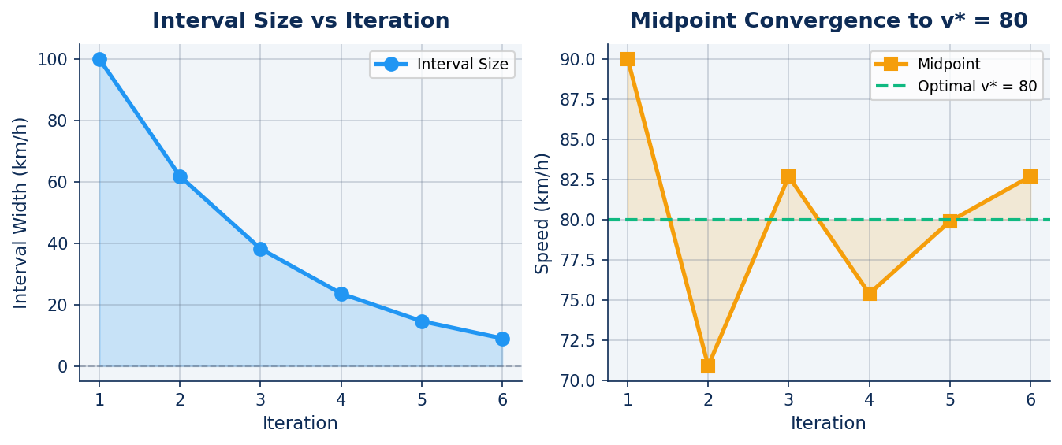
CONVERGENCE
Iteration Table & Convergence
The search interval shrinks toward v* = 80 km/h with every step
Iter. | a (km/h) | b (km/h) | x₁ | x₂ | f(x₁) | f(x₂) | Width
1 | 40.00 | 140.00 | 78.20 | 101.80 | 6.016 | 8.376 | 61.8
2 | 40.00 | 101.80 | 63.61 | 78.20 | 7.343 | 6.016 | 38.2
3 | 63.61 | 101.80 | 78.20 | 87.21 | 6.016 | 6.260 | 23.6
4 | 63.61 | 87.21 | 72.63 | 78.20 | 6.272 | 6.016 | 14.6
5 | 72.63 | 87.21 | 78.20 | 81.64 | 6.016 | 6.013 | 9.0
6 | 78.20 | 87.21 | 81.64 | 83.77 | 6.013 | 6.071 | 5.6
10 / 13
Notes:
SLIDE 10 — ITERATION TABLE Here is the complete iteration table for 6 iterations. Look at how the interval shrinks: starting from 100 km/h wide, it reduces to 61.8, then 38.2, 23.6, 14.6, 9.0, and 5.6 — each time multiplied by 0.618. The function values at x1 and x2 are getting closer and closer to 6, the true minimum. The midpoint of the remaining interval is converging rapidly toward 80 km/h. After just 6 iterations we have narrowed the search to a 5.6 km/h window centered near 80 km/h. If we continue to convergence criteria of 0.1 km/h, we need only about 18–20 total iterations. → Transition: Let's now look at the final result.

Slide 11
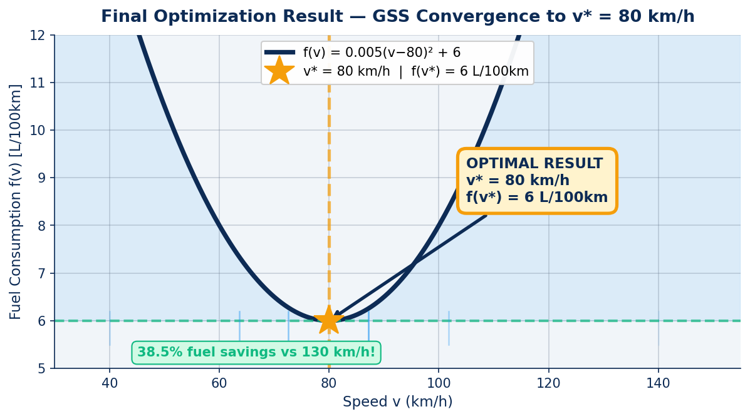
RESULTS
Final Optimization Results
Golden Section Search converges to the exact optimal solution
🏆 OPTIMAL RESULT
v* = 80 km/h
f(v*) = 6 L/100km
⚡ Savings vs 130 km/h:
−38.5% fuel!
🔁 Convergence:
< 20 iterations
✅ Evaluations Used:
Only ~18 calls
🔑 The algorithm confirms what physics predicts: drive at 80 km/h and you achieve minimum fuel consumption of exactly 6 L/100km.
📐 Final Interval:
< 0.1 km/h wide
11 / 13
Notes:
SLIDE 11 — FINAL RESULTS After iterating to convergence, the Golden Section Search gives us: v* = 80 km/h with a minimum fuel consumption of 6 liters per 100 kilometers. This is exactly the true minimum of our mathematical model. To put this in perspective: if you drive at 130 km/h instead of 80 km/h, your fuel consumption jumps from 6 to about 9.8 L/100km — that's a 63% increase! The algorithm needed fewer than 20 iterations and 20 function evaluations to pinpoint this result to within 0.1 km/h accuracy. This demonstrates the power of intelligent search methods over brute force. → Transition: Let's now look at where this type of optimization is used in the real world.

Slide 12
APPLICATIONS
Real-Life Applications
Golden Section Search and unimodal optimization across industries
🚗 Automotive Engineering
⚡ Electric Vehicles (EV)
Optimize engine ignition timing, gear-shift points, and cruise control speed profiles to minimize fuel consumption.
Find the optimal driving speed to maximize battery range per charge — critical for long-distance EV planning.
✈️ Aircraft Fuel Optimization
📦 Logistics & Supply Chain
Determine optimal cruising altitude and speed to minimize fuel burn on commercial flight routes.
Optimize vehicle loading, delivery routes, and speeds across fleets to reduce operational costs.
🤖 Machine Learning Tuning
🏭 Industrial Process Control
Hyperparameter search for learning rates and regularization — GSS finds optimal values efficiently.
Optimize reactor temperatures, pressures, and flow rates in chemical and manufacturing plants.
🔑 The same mathematical principle that optimizes driving speed applies across aerospace, AI, energy, and manufacturing.
12 / 13
Notes:
SLIDE 12 — APPLICATIONS The principles we've demonstrated today have broad real-world impact. In automotive engineering, GSS helps tune engine control parameters. Electric vehicles use similar optimization to maximize range on a single charge. Airlines apply it to find fuel-optimal cruising profiles that save millions in annual fuel costs. In logistics, fleet operators optimize speeds across hundreds of vehicles simultaneously. In machine learning, GSS is used to find optimal hyperparameters like learning rates — without needing gradient information. And in chemical plants and manufacturing, the same approach controls process variables for maximum efficiency. Optimization is truly a universal engineering tool. → Transition: Let's now summarize everything we've covered.

Slide 13
Conclusion
Fuel Consumption Optimization Using Golden Section Search
"Golden Section Search provides an efficient way to determine the optimal driving speed that minimizes fuel consumption while reducing computational cost and search time."
✅ Fuel consumption follows a unimodal convex curve — ideal for GSS
✅ Only ~18 function evaluations vs 10,000+ for brute force
✅ GSS converges to v* = 80 km/h in under 20 iterations
✅ The golden ratio φ = 0.618 guarantees 38.2% reduction per step
References: Chapra & Canale — Numerical Methods for Engineers; Rao — Engineering Optimization; Press et al. — Numerical Recipes
Thank You
Questions?
13 / 13
Notes:
SLIDE 13 — CONCLUSION To summarize our key findings: The fuel consumption function f(v) = 0.005(v−80)² + 6 is unimodal and convex — exactly the type of function GSS is designed for. Starting from the interval [40, 140] km/h, the Golden Section Search converged to v* = 80 km/h in under 20 iterations, with a minimum fuel consumption of 6 liters per 100 kilometers. Compared to brute force, which might require thousands of evaluations, GSS achieves the same result with roughly 18 function evaluations — a dramatic improvement in efficiency. The golden ratio φ = 0.618 is the mathematical foundation that makes this possible. I hope this presentation has given you a clear understanding of how numerical optimization — and specifically the Golden Section Search — can solve practical engineering problems with both elegance and efficiency. Thank you for your attention. I'm happy to take any questions.

