Slide 1
PORTFOLIO WEBSITE
TECH STACK: HTML, CSS & A SPRINKLING OF JAVASCRIPT.

Slide 2
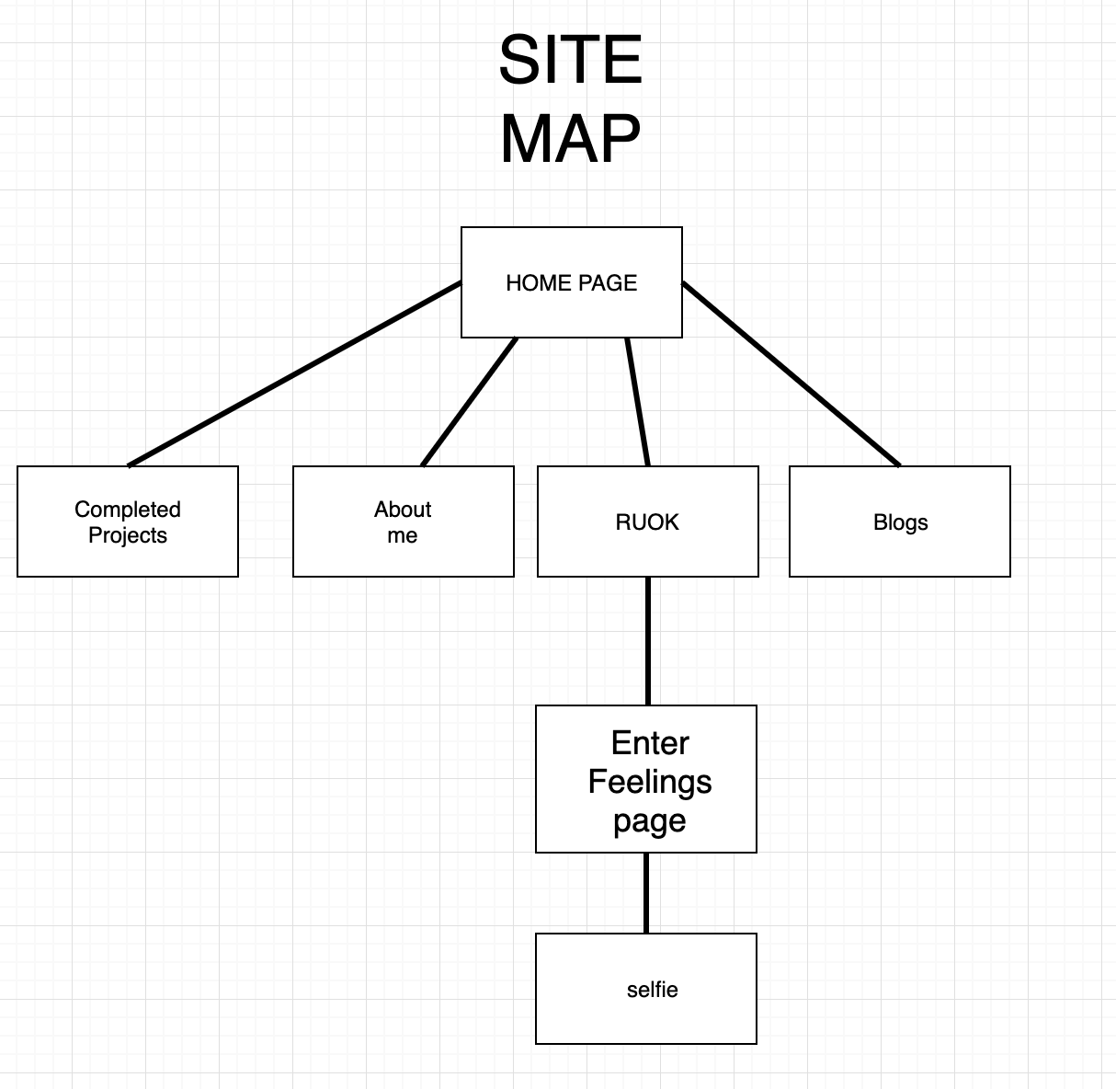
SITE MAP
Simple layout allows users to easily navigate site

Slide 3
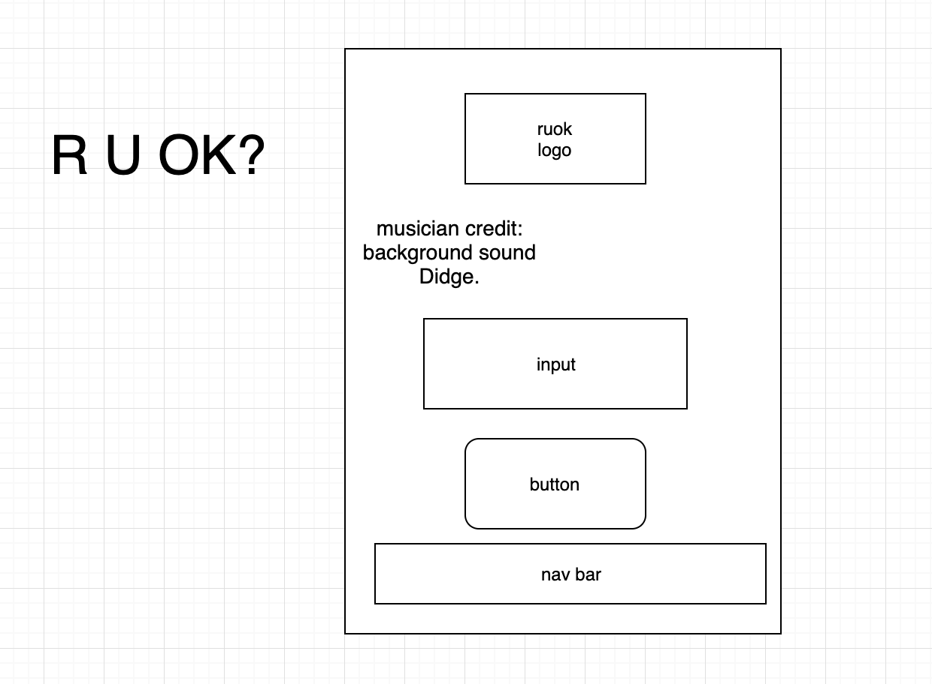
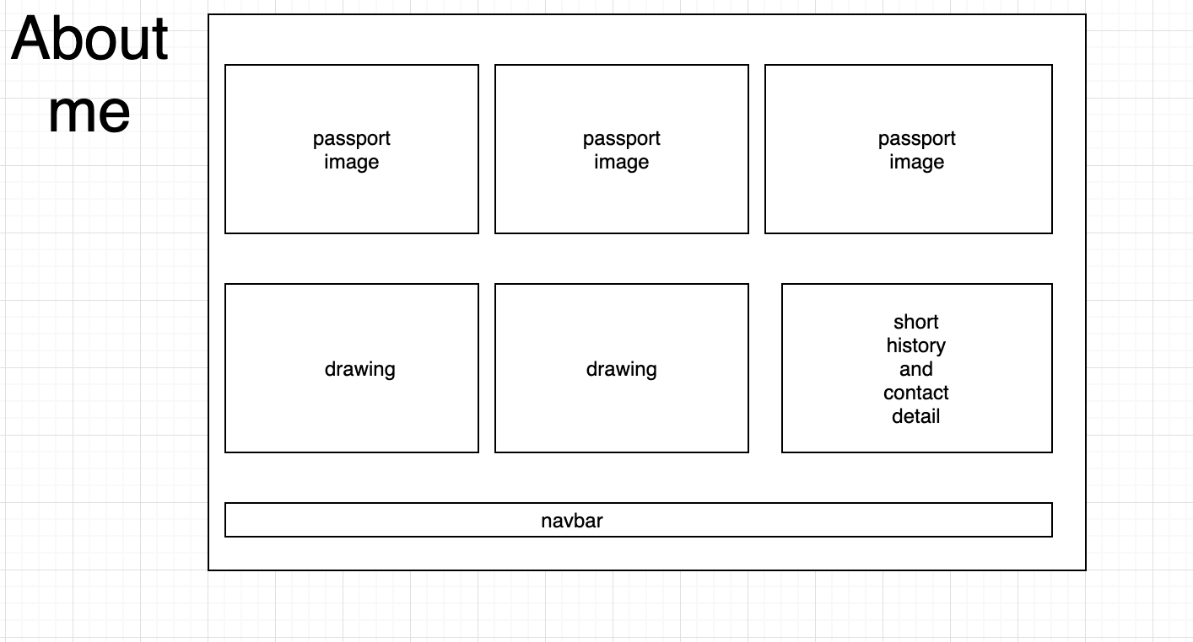
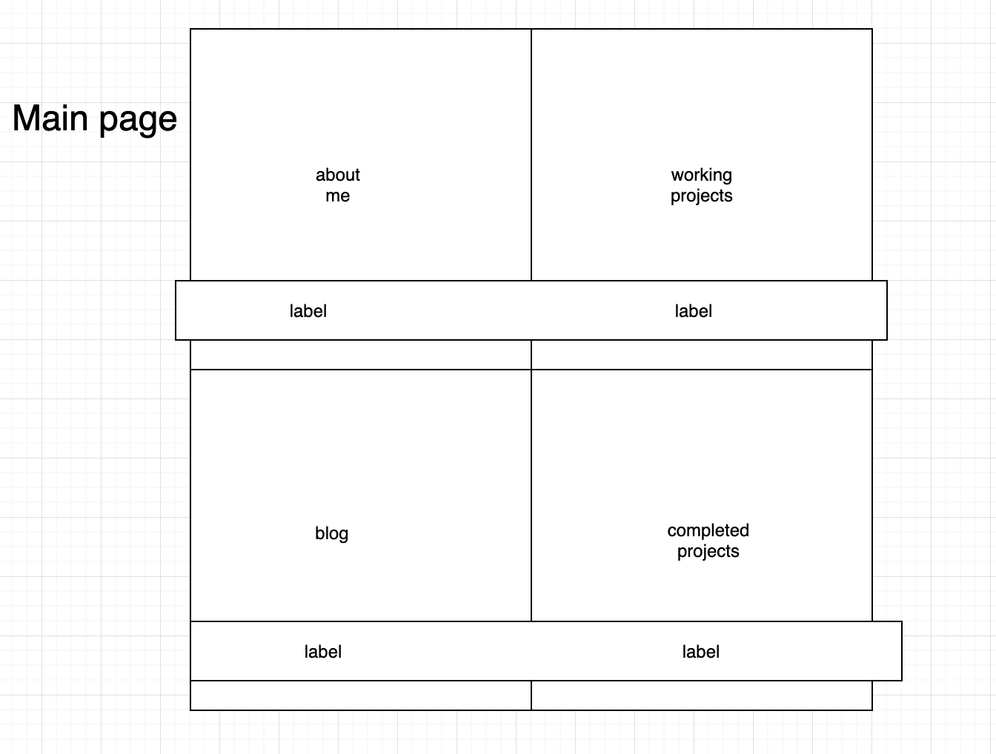
WIREFRAMES

Slide 4
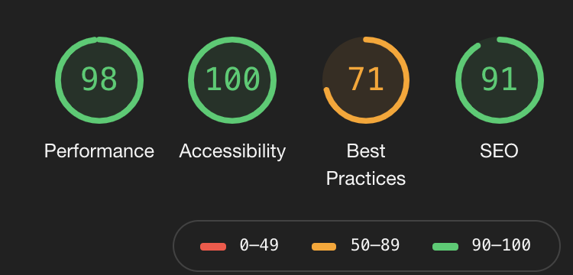
SPLASH OF JAVASCRIPT DEMO
Switch to android phone

