Slide 1
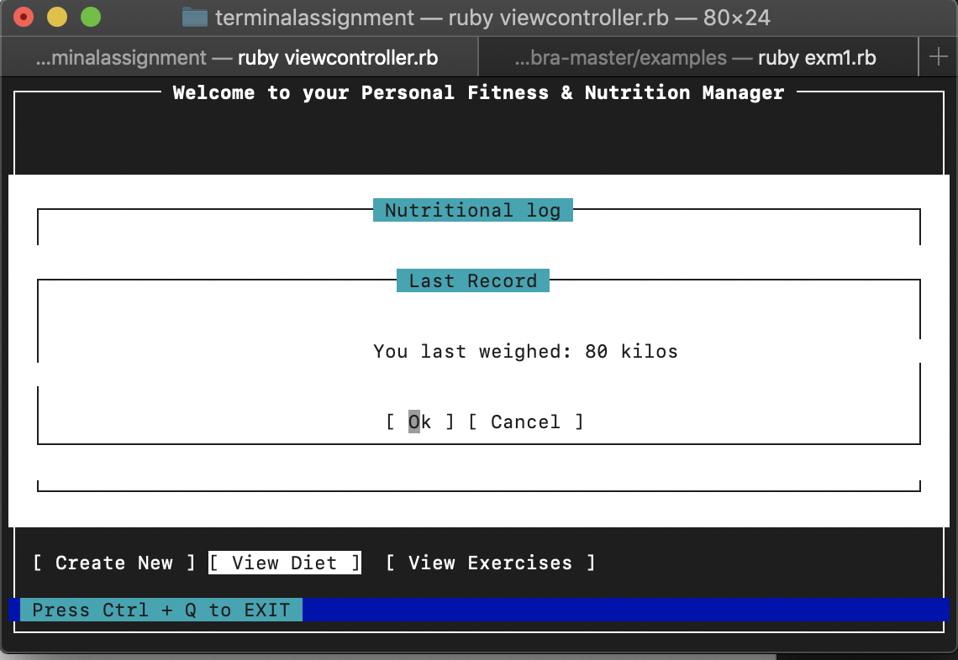
GUI is based on Ncumbra

Slide 2
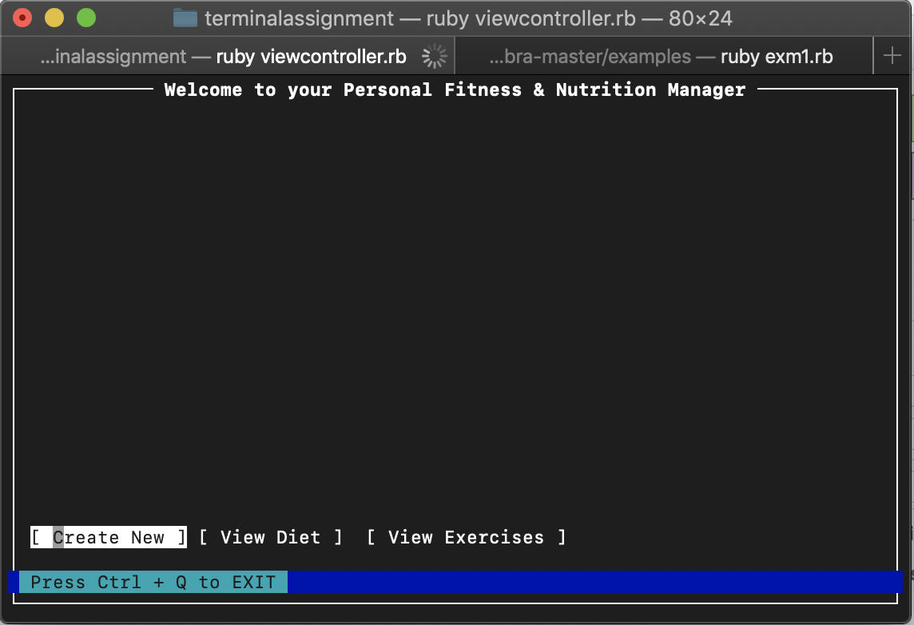
Start page allows us to toggle three options

Slide 3
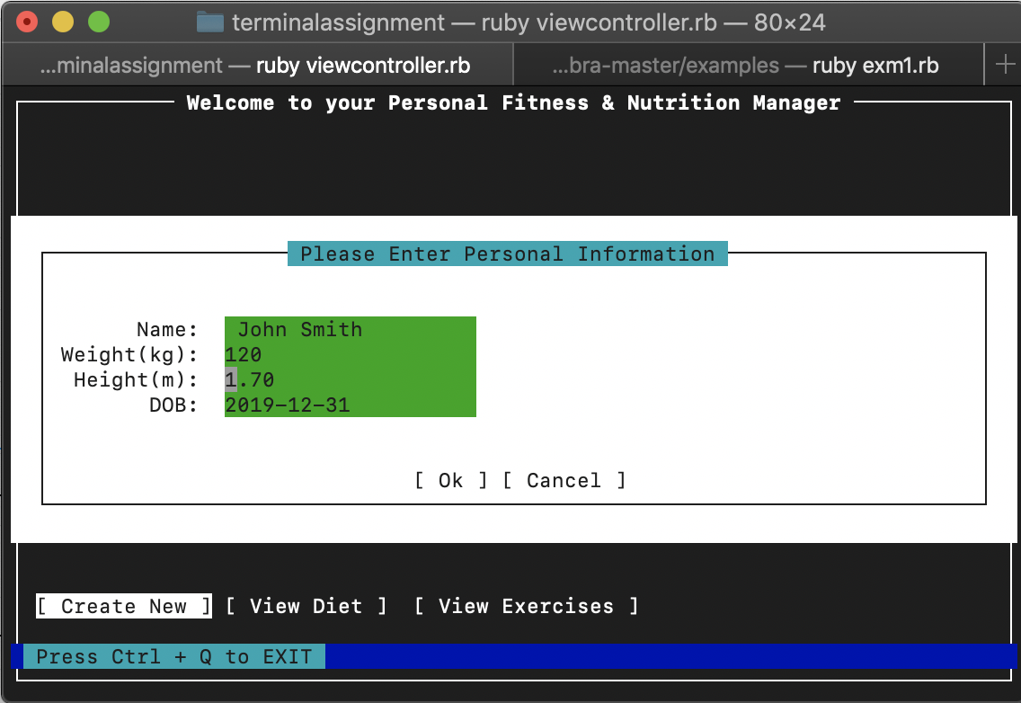
Userinput is pushed to a file using ”fireutils”

Slide 4
Feature 1: Displays data in an engaging way
Feature 2: Retrieves Data from File system
Feature 3: Gives motivational advice
Re-wrote a gem built ontop of curses to display widgets.
Uses FileutilsUses fileutils
It display motivation from a customized faker gem

Slide 5
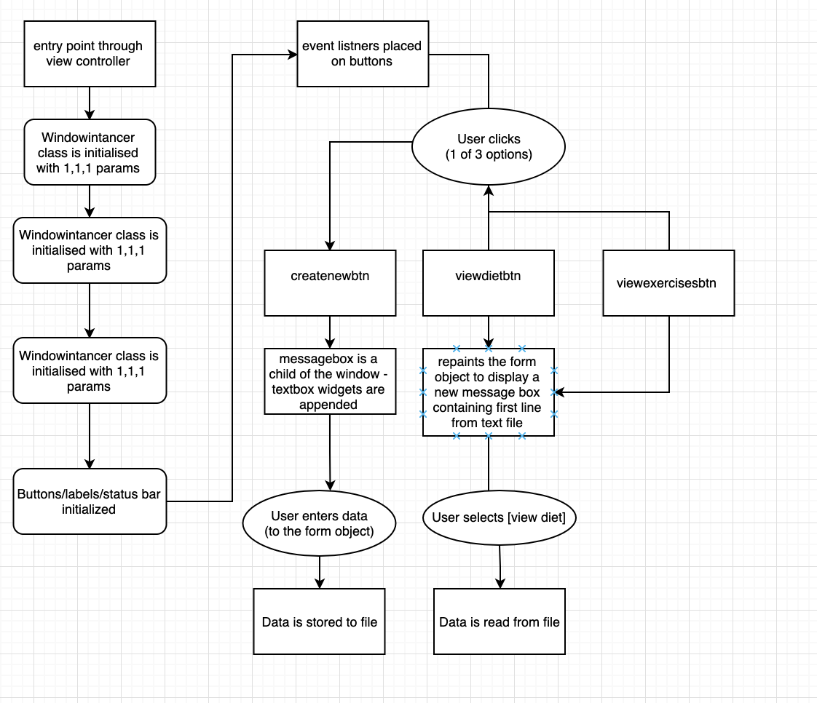
View controller: while input is not equal to ctrt_q display GUI.

Slide 6
Difficulties faced/Satisfactory Moments/What have I learnt?
Difficulties Faced
Broken gem files, poorly documented repos
Poorly structured gems – requiring data abstraction to conform to DRY
Satisfactory Moments
Getting it running
Seeing green when running a test
What have I learnt
Absolutely every detail of the UI has to be described, in painstaking detail.

