Slide 1
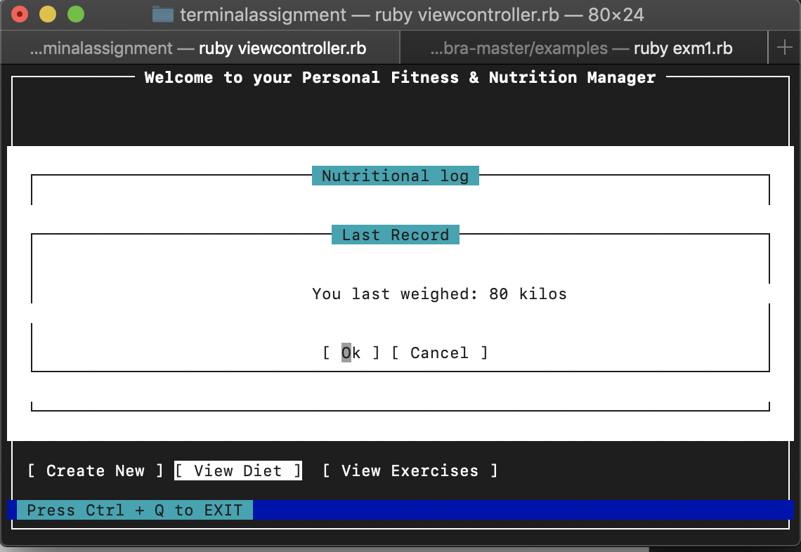
GUI is based on Ncumbra

Slide 2
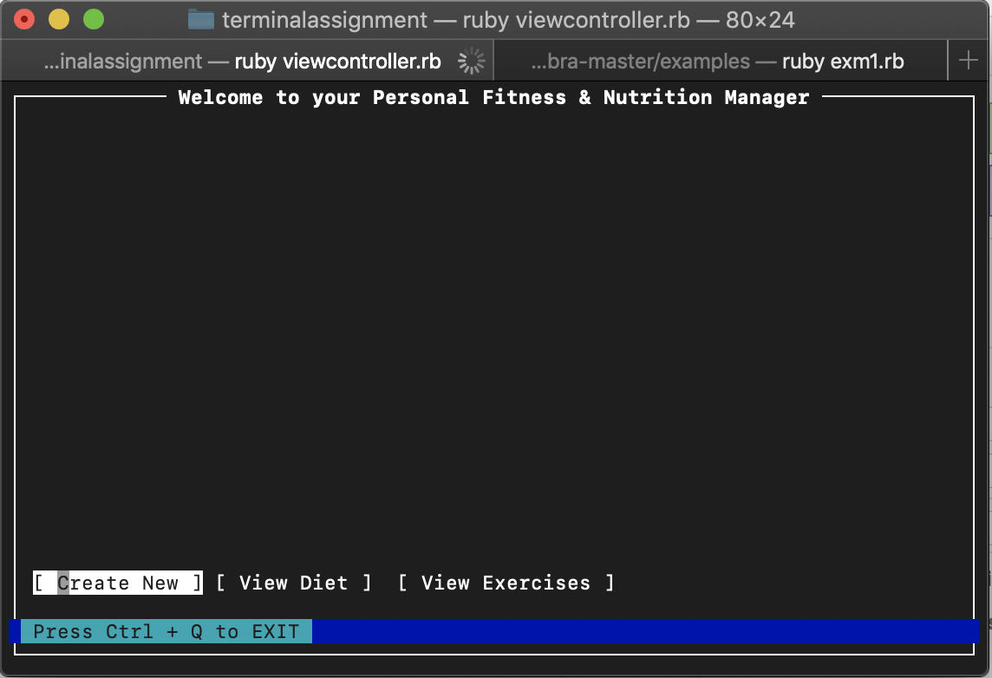
Start page allows us to toggle three options

Slide 3
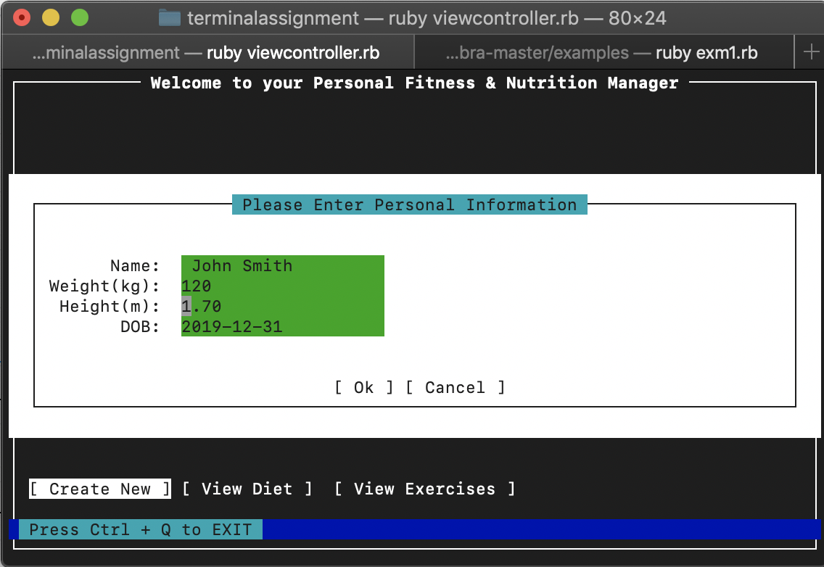
Userinput is pushed to a file using ”fireutils”

Slide 4
Feature 1: Displays data in an engaging way
Feature 2: Retrieves Data from File system
Feature 3: Gives motivational advice
Re-wrote a gem built ontop of curses to display widgets.
Uses FileutilsUses fileutils
It display motivation from a customized faker gem

