Slide 1
Used Car Price Prediction with Neural Regression Models
Presentation One
Igor Hebda s34836

Slide 2
Source code:
https://github.com/s34836/WUM_PROJECT

Slide 3

Part I:
1. Goal Definition
2. Data Collection
Objective:
Build and compare models for predicting used car prices using structured vehicle data and text descriptions from Otomoto.pl.
Dataset:
206k listings after cleaning; includes numeric, categorical, equipment features, and PCA-reduced HerBERT text embeddings.

Slide 4
3. Exploratory Data Analysis
4. Data Preprocessing
Main preprocessing steps:
• Removed listings with missing key attributes (price, mileage, year, gearbox)
• Filtered extreme outliers and unrealistic prices (>3M PLN)
• Removed rare make–model pairs (<20 listings)
• Target encoding for categorical variables
• Log transformation of price
• Standardization of continuous features
Key EDA insights:
• Strong nonlinear patterns between log-price and mileage, age, power
• Equipment categories show high sparsity
• Text descriptions contain useful but noisy signals

Slide 5
3. Exploratory Data Analysis
4. Data Preprocessing
Linear models benefit from one-hot encoding because they can learn separate coefficients per category, and we have shape (206545, 792)
Tree models can handle target-encoded categories well and avoid the high dimensionality of one-hot, and we have shape (206545, 122).
BART models process text directly, so categorical features are kept as strings rather than encoded, and we have shape (206545, 199). [No dimension reduction on equipment]

Slide 6
3. Exploratory Data Analysis
4. Data Preprocessing
# Data Collection and Description
2-1.py - Web scraping script for collecting car listing URLs from Otomoto.pl. Uses BeautifulSoup to extract car listing URLs from search result pages with progress tracking and error handling.
2-2.py - URL deduplication utility that removes duplicate car listing URLs from the scraped data. Reads from otomoto_car_urls.txt and outputs unique URLs to otomoto_car_urls_unique.txt.
2-3.py - Car details scraper that extracts detailed information from individual car listing pages. Processes URLs from the unique list and extracts JSON data containing car specifications, prices, and features with progress tracking.
2-4.py - Data preprocessing and cleaning pipeline that processes the raw scraped car data. Converts JSON data to structured format, handles currency conversion (EUR to PLN), filters for undamaged used vehicles, concatenates text fields, and prepares data for modeling.
2-5.ipynb - Initial data exploration and preprocessing notebook. Analyzes the parsed car data, converts boolean columns, and prepares the dataset for feature engineering.
2-6.ipynb - Feature engineering and text processing notebook. Creates embeddings from car descriptions, generates PCA components, and prepares multiple datasets for different modeling approaches.
2-7.ipynb - Data preparation and cross-validation setup notebook. Creates train/test splits and prepares datasets for LinearRegression, DecisionTree, and BART models.
2-8.ipynb - Advanced feature engineering and dataset creation notebook. Generates final modeling datasets with proper cross-validation folds and feature transformations.

Slide 7
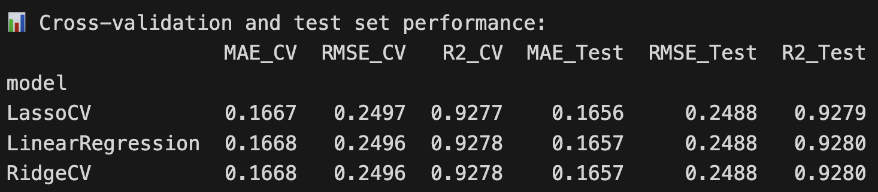
Baseline Model
(Linear and Regularized Regression Models)
FILE: 3-1.ipynb

Slide 8
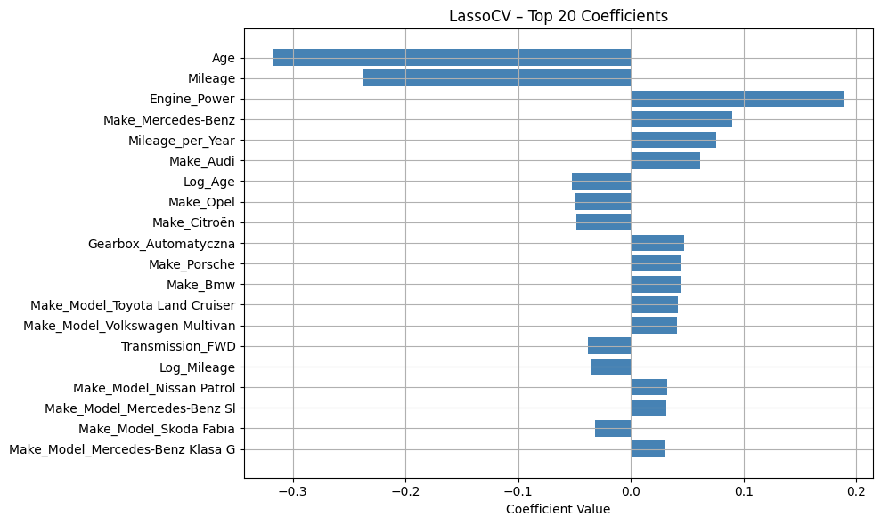
Baseline Model
(Linear and Regularized Regression Models)
FILE: 3-1.ipynb

Slide 9
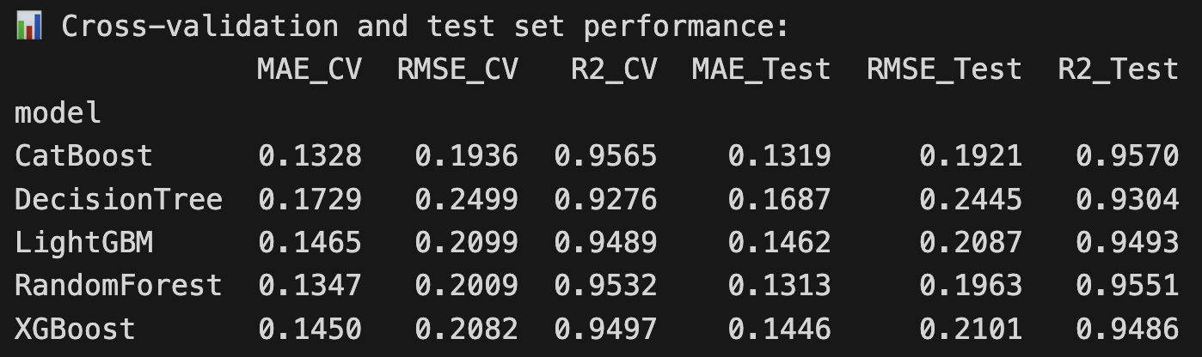
Baseline Model
(Tree Ensembles for Structured Price Estimation )
FILE: 3-2.ipynb

Slide 10
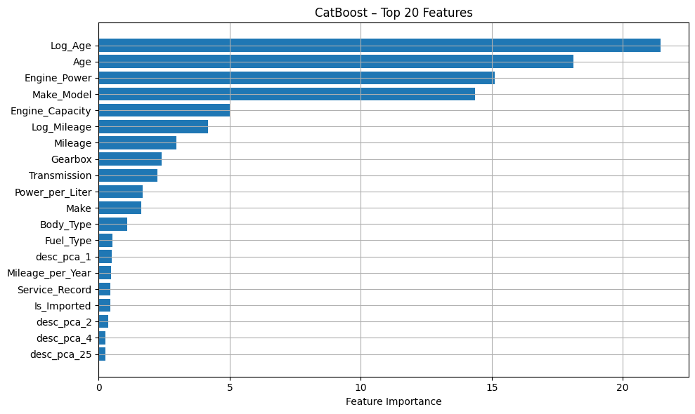
Baseline Model
(Tree Ensembles for Structured Price Estimation )
FILE: 3-2.ipynb

Slide 11
Baseline Model
(Simple MLP)
Description:
A minimal fully connected neural network trained on all structured features. It provides a simple nonlinear benchmark and captures basic interactions between variables such as mileage, age, and engine power.
Architecture (summary):
• Input layer → one hidden layer (128 units) → output layer
• Hidden layer uses Linear → ReLU
• Output: single neuron predicting log-price
Why this design:
• Very lightweight and easy to interpret
• ReLU introduces nonlinearity while keeping training stable
• Ideal as a baseline to compare with deeper or multimodal architectures
Role in the project:
Serves as the simplest neural benchmark, showing how a minimal MLP performs before introducing more advanced models.
FILE: 3-3-1.ipynb

Slide 12
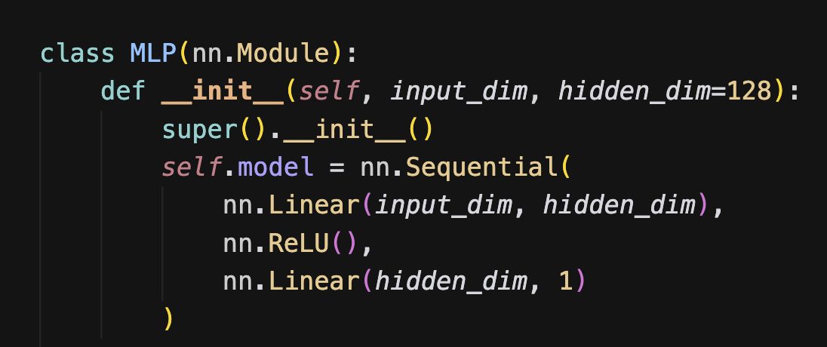
Baseline Model
(Simple MLP)

Slide 13
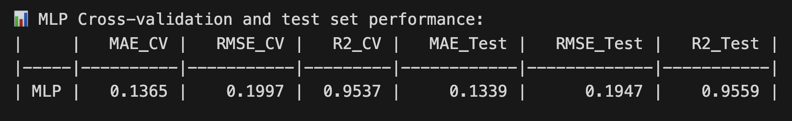
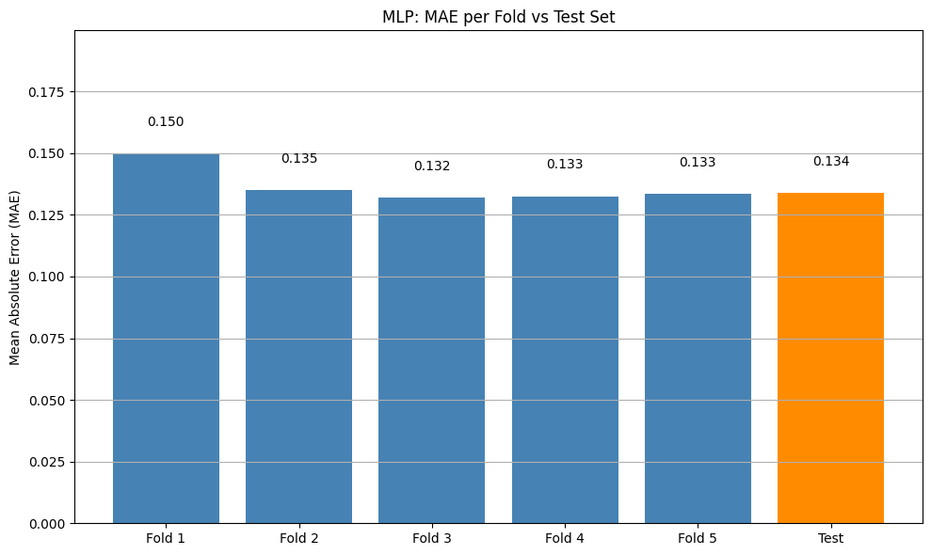
Baseline Model
(Simple MLP)

Slide 14
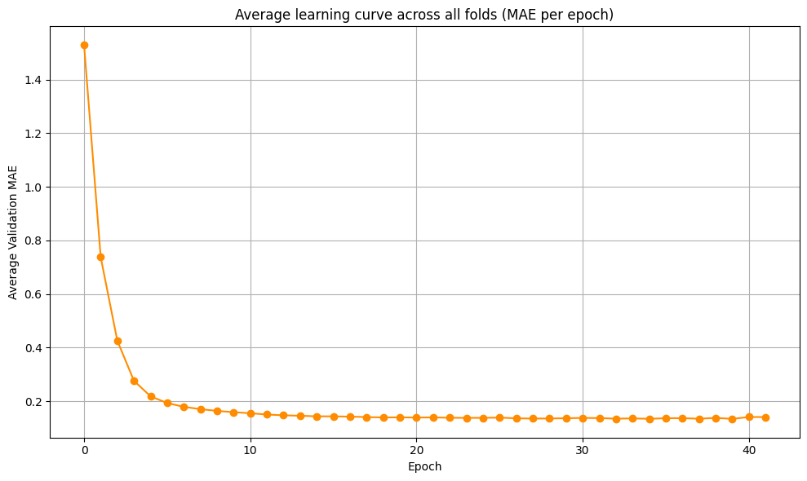
Baseline Model
(Simple MLP)

Slide 15
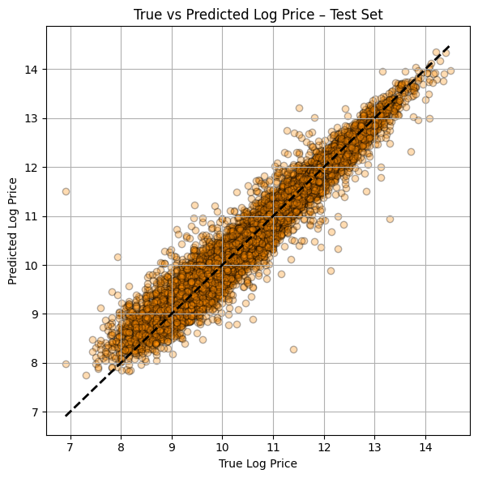
Baseline Model
(Simple MLP)

Slide 16
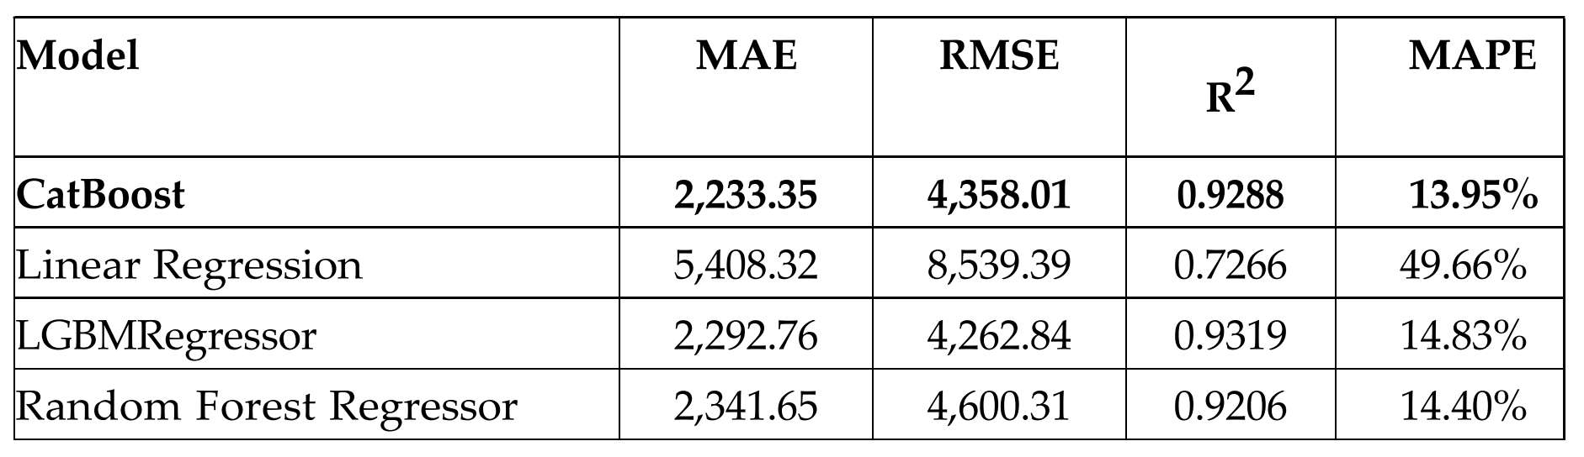
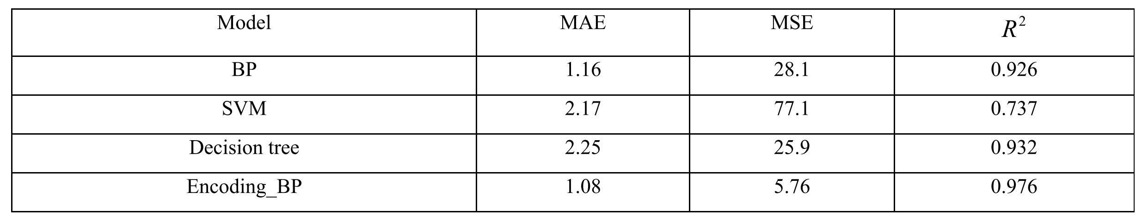
Results of Previous Studies
Isaev, R., Nuradilova, B., & Gimaletdinova, G. (2024).
Predicting Passenger Car Prices with Machine Learning Models.
Kan, D., Jiang, L., Liu, C., Yang, Z., & Song, D. (2023).
Prediction of used car prices using back propagation neural network model
based on mean encoding.

Slide 17
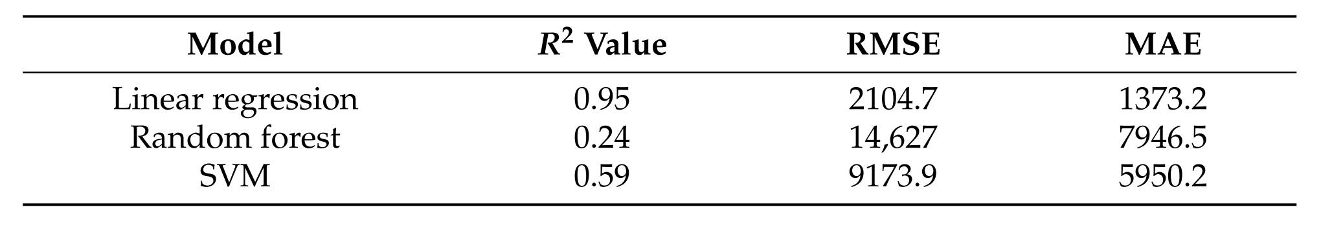
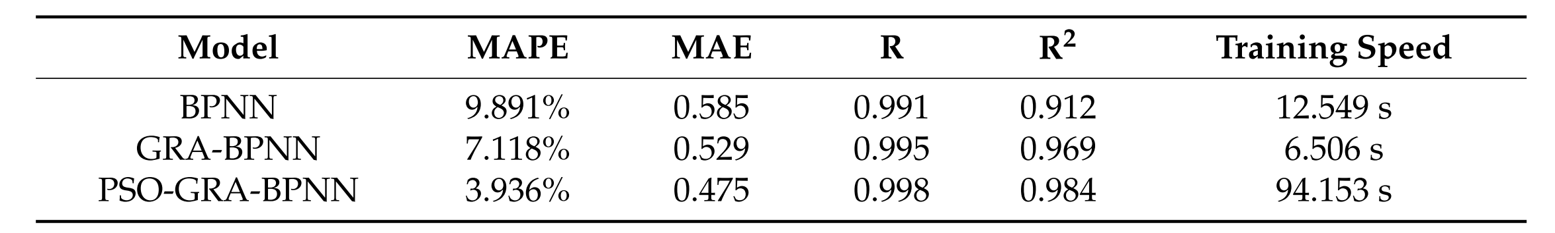
Results of Previous Studies
Bukvić, L., Pašagić Škrinjar, J., Fratrović, T., & Abramović, B. (2022).
Price Prediction and Classification of Used-Vehicles Using Supervised
Machine Learning. Sustainability (Switzerland), 14(24).
Liu, E., Li, J., Zheng, A., Liu, H., & Jiang, T. (2022). Research on the Prediction
Model of the Used Car Price in View of the PSO-GRA-BP Neural Network.
Sustainability (Switzerland), 14(15).

Slide 18
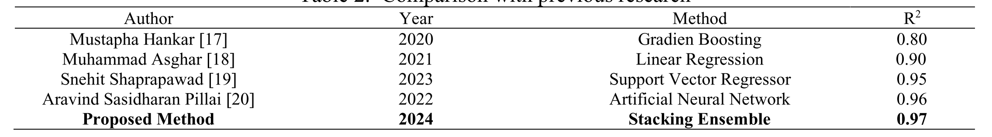
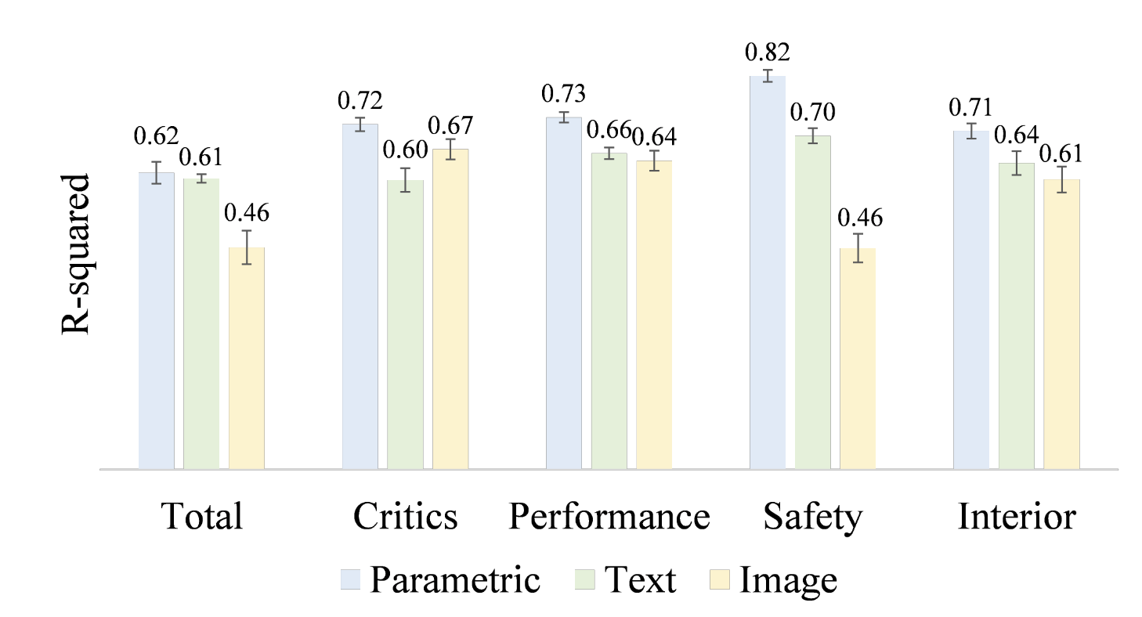
Results of Previous Studies
Tanga, Y. M. P., Simanjuntak, R. P. R., Rofik, R., & Muslim, M. A. (2024).
Improving car price prediction performance using stacking ensemble learning
based on ann and random forest.
Journal of Soft Computing Exploration, 5(3), 290–298.
Su, H., Song, B., & Ahmed, F. (n.d.). Multi-modal Machine Learning for Vehicle
Rating Predictions Using Image, Text, and Parametric Data.
Sustainability (Switzerland), 14(15).

Slide 19
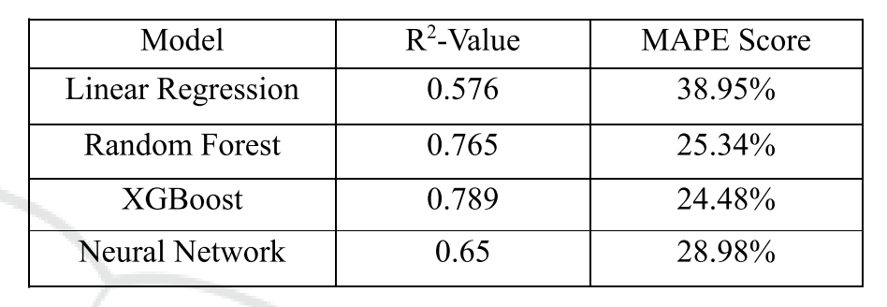
Results of Previous Studies
Zhu, A. (2024). Pre-Owned Car Price Prediction Using Machine Learning
Techniques. 363–367.

