Slide 1
Used Car Price Prediction with Neural Regression Models
Presentation Two
Igor Hebda s34836

Slide 2
Source code:
https://github.com/s34836/WUM_PROJECT

Slide 3
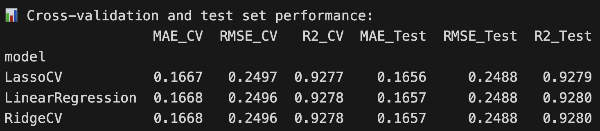
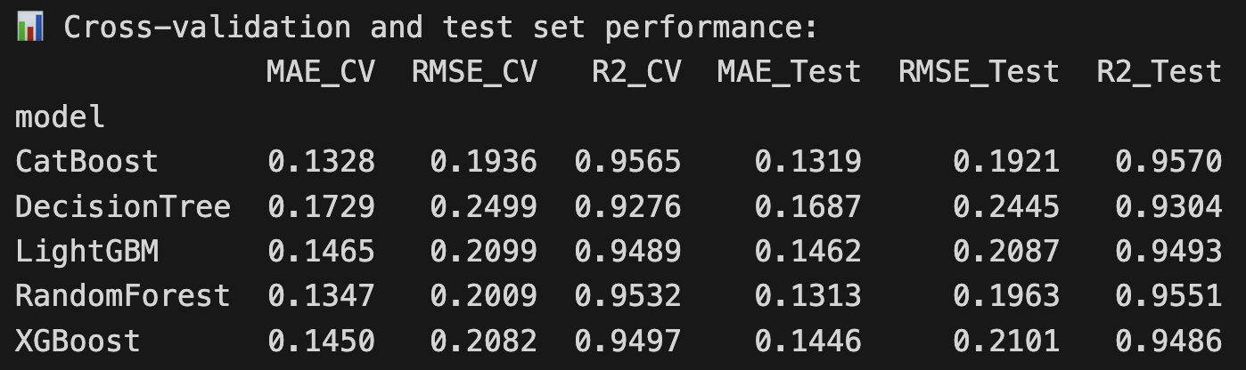
Baseline Model
(Regression & Trees)

Slide 4
Baseline Model
(Simple MLP)
Description:
A minimal fully connected neural network trained on all structured features. It provides a simple nonlinear benchmark and captures basic interactions between variables such as mileage, age, and engine power.
Architecture (summary):
• Input layer → one hidden layer (128 units) → output layer
• Hidden layer uses Linear → ReLU
• Output: single neuron predicting log-price
Why this design:
• Very lightweight and easy to interpret
• ReLU introduces nonlinearity while keeping training stable
• Ideal as a baseline to compare with deeper or multimodal architectures
Role in the project:
Serves as the simplest neural benchmark, showing how a minimal MLP performs before introducing more advanced models.
FILE: 3-3-1.ipynb

Slide 5
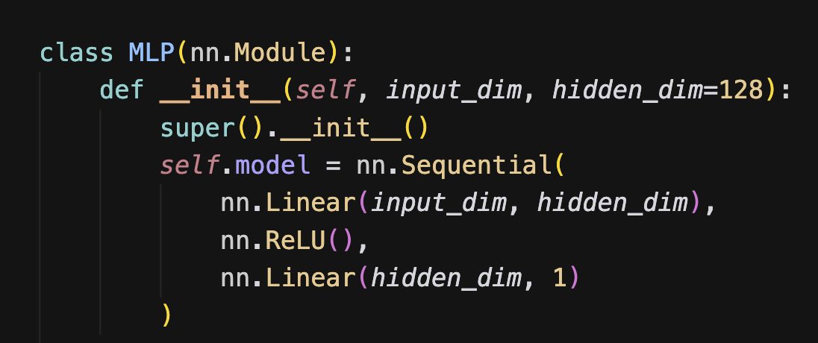
Baseline Model
(Simple MLP)

Slide 6
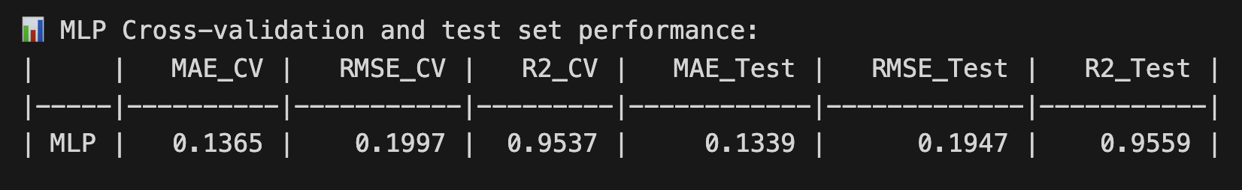
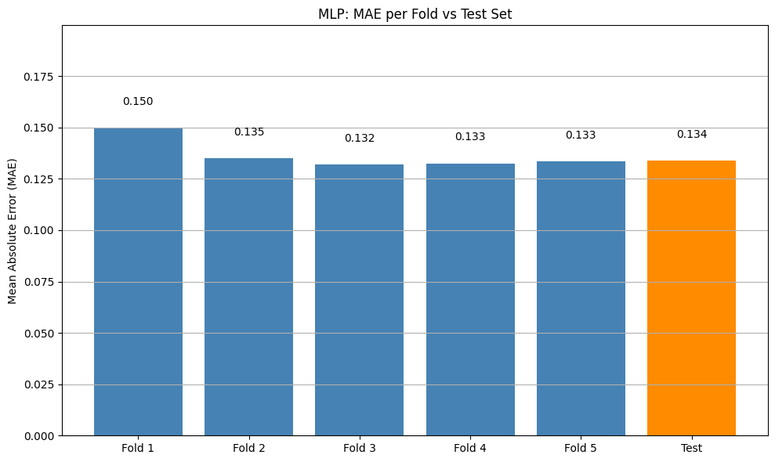
Baseline Model
(Simple MLP)

Slide 7
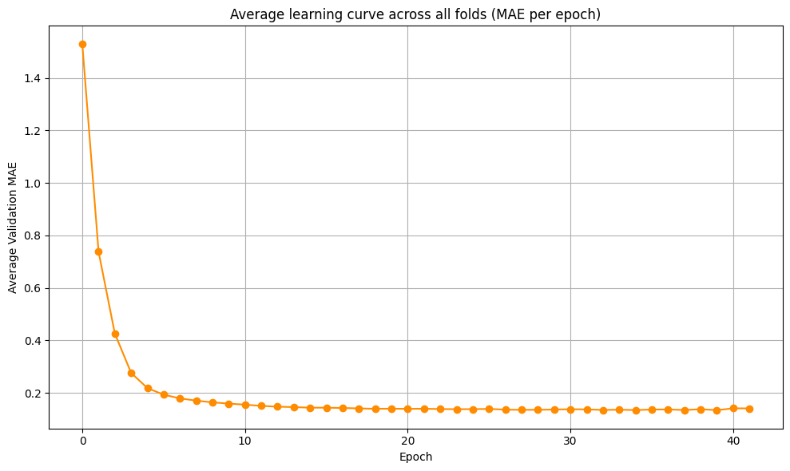
Baseline Model
(Simple MLP)

Slide 8
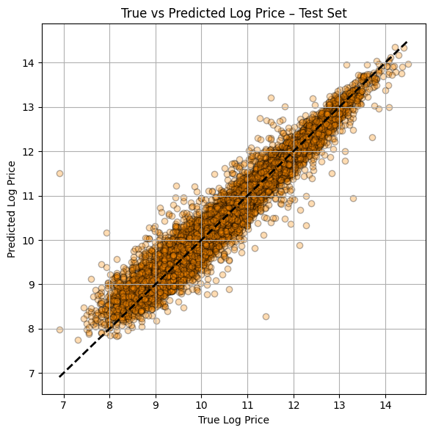
Baseline Model
(Simple MLP)

Slide 9
Regularized MLP (LayerNorm + Dropout)
Description:
Architecture: Two hidden layers (hidden_dims=[128, 64])
Normalization: LayerNorm after each hidden layer
Regularization: Progressive dropout [0.2, 0.1]
Optimizer: Adam with lr=0.001, weight_decay=1e-4
Learning rate: ReduceLROnPlateau scheduler (reduces LR when validation loss plateaus)
FILE: 3-3-2.ipynb

Slide 10
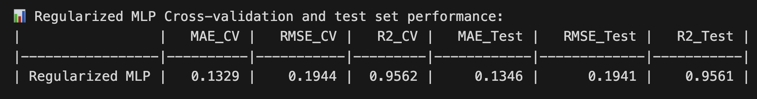
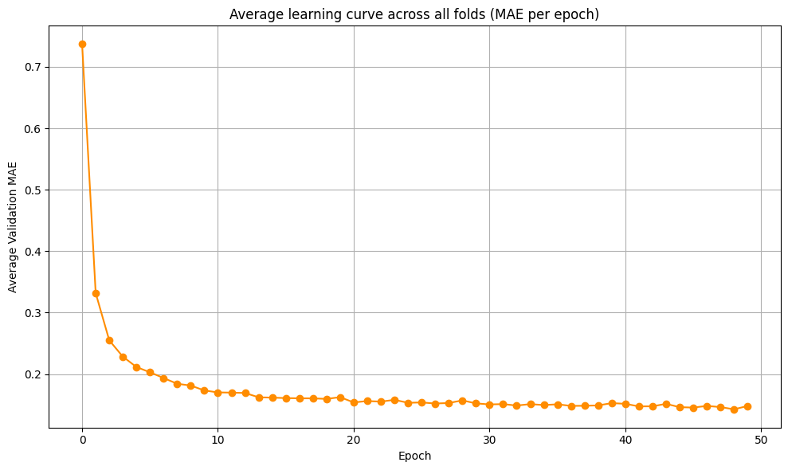
Regularized MLP (LayerNorm + Dropout)

Slide 11
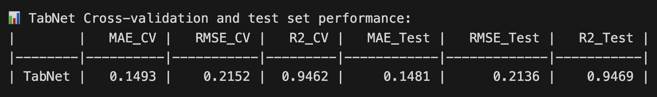
TabNet Model
Description:
Architecture: Feature transformer with 5 decision steps using shared and independent blocks (n_d = 64, n_a = 64, n_shared = 2, n_independent = 2)
Feature selection: Entmax-based sparse masks dynamically selecting relevant features at each step (mask_type=‘entmax’)
Regularization: Built-in sparsity constraint controlled by γ = 1.5 and virtual_batch_size = 128 (ghost batch normalization)
Optimizer: Adam with lr=0.02
Learning rate: Early stopping with validation MAE monitoring (patience = 10), max_epochs = 100
FILE: 3-4.ipynb

Slide 12
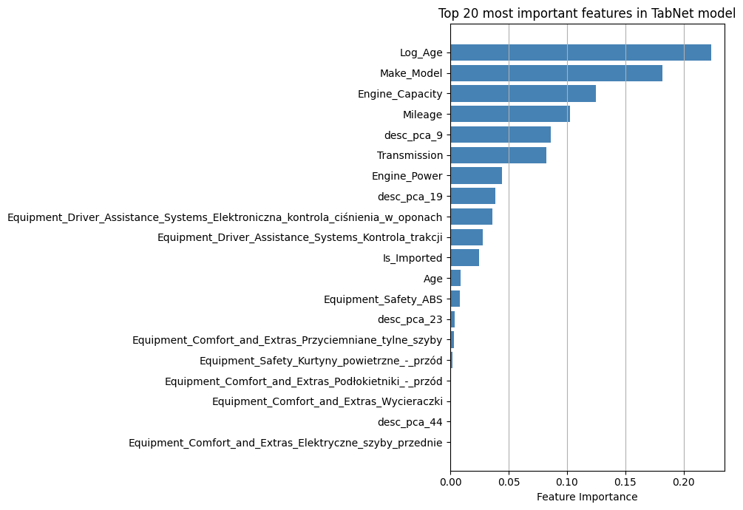
TabNet Model
TabNet is a widely recognized deep learning architecture for tabular data, introduced by Google Research, which combines sequential feature selection with sparsity-inducing attention masks. Although not as commonly used in industry as gradient boosting models, it has become a standard point of reference in academic work on neural networks for structured data.

Slide 13
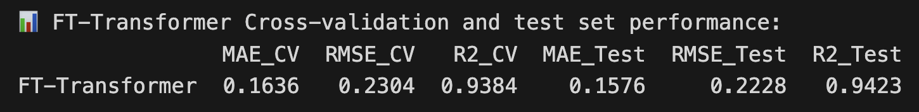
FT-Transformer is a neural architecture designed specifically for tabular data.
Instead of processing features as a flat numerical vector like an MLP, the model first tokenizes each feature into an embedding, treating features analogously to tokens in NLP models. These feature tokens are then passed through a Transformer encoder, where self-attention learns interactions between features in a data-driven way.
This enables the model to capture complex, high-order feature dependencies without hand-crafted feature engineering. Unlike standard Transformers, FT-Transformer includes a lightweight FeatureTokenizer layer, does not rely on positional encoding, and uses pre-normalization and dropout to stabilize training on small and medium tabular datasets.
FILE: 3-5.ipynb
FT-Transformer (Feature Tokenizer Transformer)

Slide 14
FT-Transformer (Feature Tokenizer Transformer)
Description:
Architecture: FT-Transformer with FeatureTokenizer and Transformer backbone
Token dimension: d_token=96
Transformer blocks: 2 blocks (n_blocks=2)
Attention mechanism: 2 heads (attention_n_heads=2), Kaiming initialization
Normalization: LayerNorm for attention, FFN, and head
Regularization:
Attention dropout: 0.1
FFN dropout: 0.1
Residual dropout: 0.0
FFN configuration: Hidden dimension 192 (ffn_d_hidden=192), ReLU activation
KV compression: Ratio 0.5, key-value sharing
Normalization strategy: Prenormalization enabled, first prenormalization disabled
Optimizer: Adam with lr=0.001 (no weight decay)
Training configuration:
Batch size: 1024
Max epochs: 25
Early stopping: Patience=5 (monitors validation RMSE)
Loss function: MSE
Cross-validation: 5-fold CV with shuffling
Input features: Numerical features only (no categorical features, cat_cardinalities=[])

Slide 15
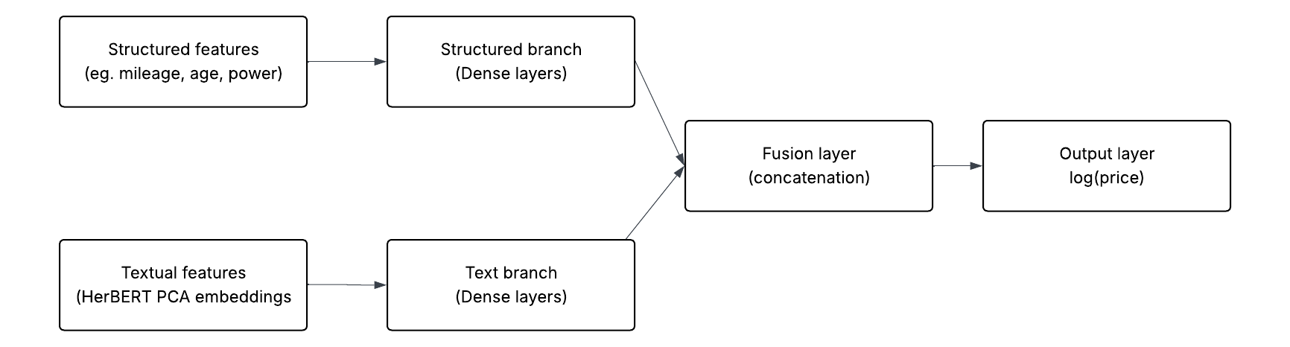
Early Fusion
Architecture: Early Fusion Regressor with dual-branch structure
Optimizer: Adam with lr=0.001
Training configuration:
Batch size: 1024
Max epochs: 50
Early stopping: Patience=5 (monitors validation RMSE)
Loss function: MSE
Cross-validation: 5-fold CV with shuffling
FILE: 3-6.ipynb

Slide 16
Early Fusion
1. struct_branch (Structured Features Network)
Layers: 1 Linear layer
Architecture:
Linear(struct_dim → 512) (69 → 512)
ReLU
LayerNorm(512)
Output: 512-dimensional vector
2. text_branch (Textual Features Network)
Layers: 1 Linear layer
Architecture:
Linear(50 → 512) (text_dim → 512)
ReLU
LayerNorm(512)
Output: 512-dimensional vector

Slide 17
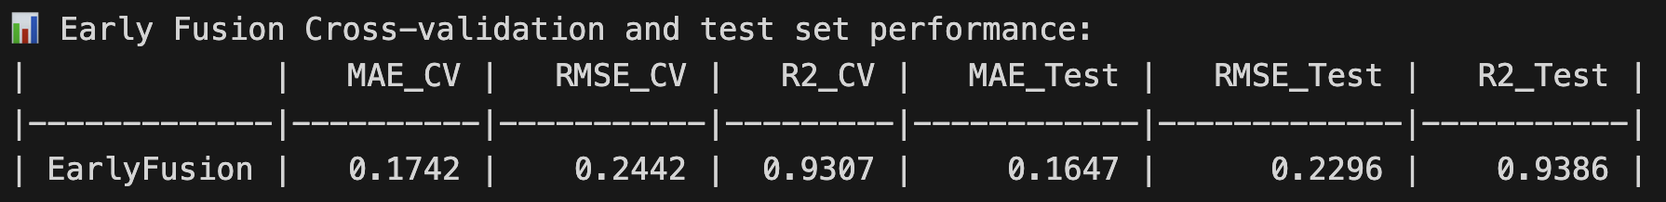
3. combined (Fusion Network)
Layers: 3 Linear layers
Architecture:
Layer 1: Linear(1024 → 256) (concatenated 512+512 → 256)
ReLU
LayerNorm(256)
Dropout(0.3)
Layer 2: Linear(256 → 128)
ReLU
Dropout(0.3)
Layer 3: Linear(128 → 1)
Output: 1-dimensional scalar (regression prediction)
Early Fusion

Slide 18
3. combined (Fusion Network)
Layers: 3 Linear layers
Architecture:
Layer 1: Linear(1024 → 256) (concatenated 512+512 → 256)
ReLU
LayerNorm(256)
Dropout(0.3)
Layer 2: Linear(256 → 128)
ReLU
Dropout(0.3)
Layer 3: Linear(128 → 1)
Output: 1-dimensional scalar (regression prediction)
Early Fusion

Slide 19
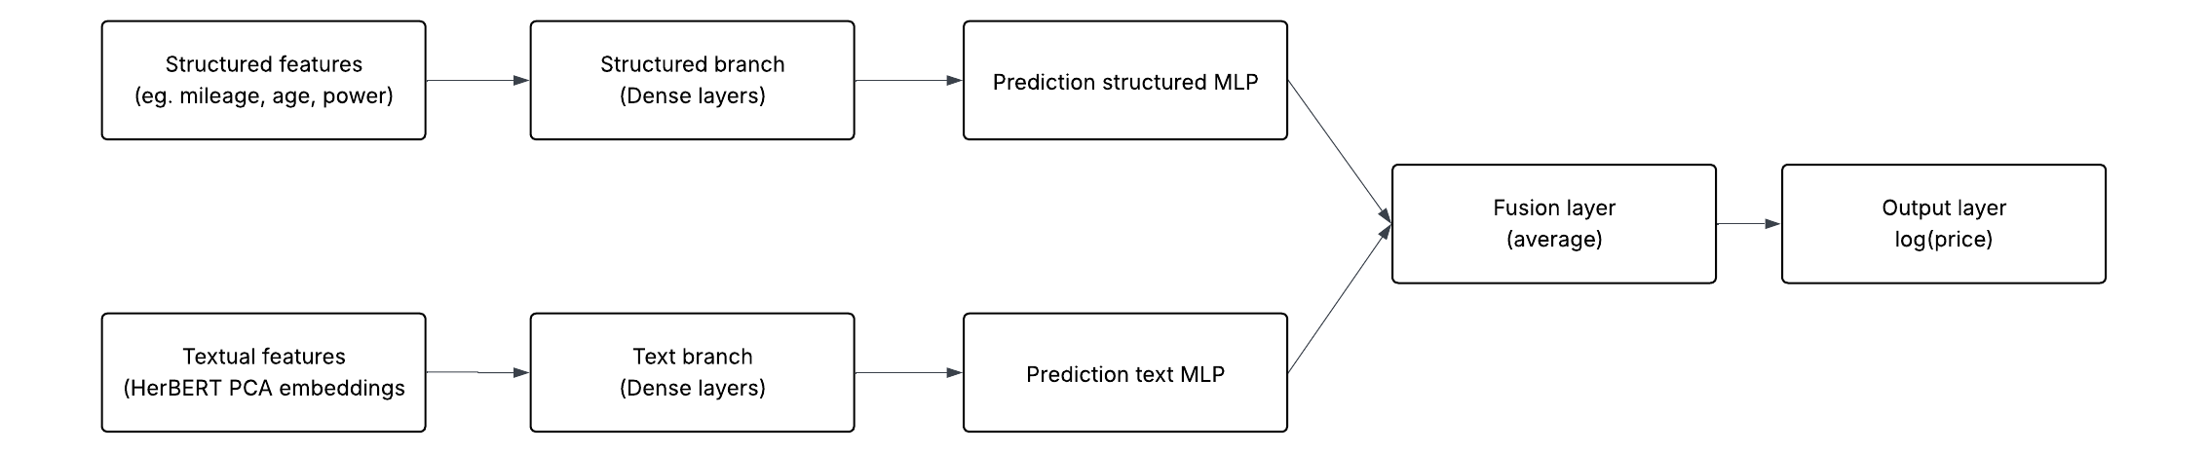
Late Fusion with two independent MLP models
Architecture: Late Fusion with two independent MLP models
Model 1 - Structured Features MLP:
Input: 119 structured features (continuous + categorical)
Hidden layers: Two layers (hidden_dims=[256, 128])
Normalization: LayerNorm after first hidden layer
Regularization: Dropout 0.3 after each hidden layer
Output: 1-dimensional prediction
FILE: 3-7.ipynb

Slide 20
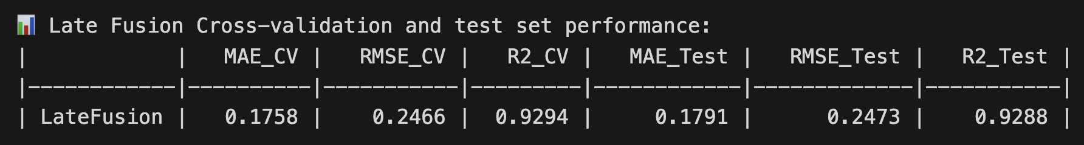
Model 2 - Textual Features MLP:
Input: 50 PCA components (desc_pca_0 to desc_pca_49)
Hidden layers: Two layers (hidden_dims=[256, 128])
Normalization: LayerNorm after first hidden layer
Regularization: Dropout 0.3 after each hidden layer
Output: 1-dimensional prediction
Fusion strategy: Late fusion via weighted average (0.5 × structured_pred + 0.5 × text_pred)
Training configuration:
Optimizer: Adam with lr=0.001 (separate optimizers for each model)
Batch size: 1024
Max epochs: 50
Early stopping: Patience=5 (monitors validation RMSE)
Loss function: MSE (computed on fused prediction)
Cross-validation: 5-fold CV with shuffling
Note: Models are trained independently; fusion occurs at prediction time by averaging outputs.
Late Fusion with two independent MLP models

Slide 21
Model | MAE (CV) | RMSE (CV) | R² (CV) | MAE (Test) | RMSE (Test) | R² (Test)
Random Forest | 0.1347 | 0.2009 | 0.9532 | 0.1313 | 0.1963 | 0.9551
CatBoost | 0.1328 | 0.1936 | 0.9565 | 0.1319 | 0.1921 | 0.9570
MLP (shallow) | 0.1365 | 0.1997 | 0.9537 | 0.1339 | 0.1947 | 0.9559
Regularized MLP (LayerNorm + Dropout) | 0.1329 | 0.1944 | 0.9562 | 0.1346 | 0.1941 | 0.9561
XGBoost | 0.1450 | 0.2082 | 0.9497 | 0.1446 | 0.2101 | 0.9486
LightGBM | 0.1465 | 0.2099 | 0.9489 | 0.1462 | 0.2087 | 0.9493
TabNet | 0.1493 | 0.2152 | 0.9462 | 0.1481 | 0.2136 | 0.9469
FT-Transformer | 0.1636 | 0.2304 | 0.9384 | 0.1576 | 0.2228 | 0.9423
Early Fusion (HerBERT + MLP) | 0.1742 | 0.2442 | 0.9307 | 0.1647 | 0.2296 | 0.9386
Lasso Regression | 0.1667 | 0.2497 | 0.9277 | 0.1656 | 0.2488 | 0.9279
Linear Regression | 0.1668 | 0.2496 | 0.9278 | 0.1657 | 0.2488 | 0.9280
Ridge Regression | 0.1668 | 0.2496 | 0.9278 | 0.1657 | 0.2488 | 0.9280
Decision Tree | 0.1729 | 0.2499 | 0.9276 | 0.1687 | 0.2445 | 0.9304
Late Fusion (text + struct) | 0.1758 | 0.2466 | 0.9294 | 0.1791 | 0.2473 | 0.9288
Summary

