Slide 1
Attacking a Smart Bulb via BLE Protocol
Indraraj Biswas

Slide 2
Agenda
BLE in IoT devices
MiTM
Analyzing Advertisement and Service packets for an IoT device
Overhearing and dumping the data transferred between the mobile and the device
Performing a replay attack with the dumped file
Summary

Slide 3
Bluetooth Low Energy – In short
Wireless technology standard,designed from ground up.
• Simple and easy to use model.
• Small bursts of data.
• Impressive battery life.
• Low cost.
• Works on free 2.4 Ghz band.
• Ideal for sensors/ IoT.
Notes:
<number>

Slide 4
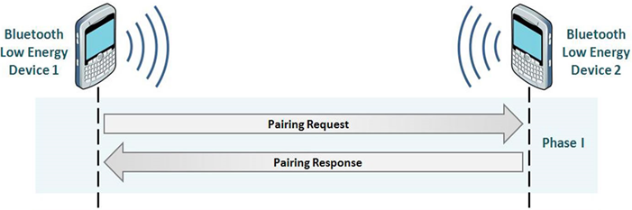

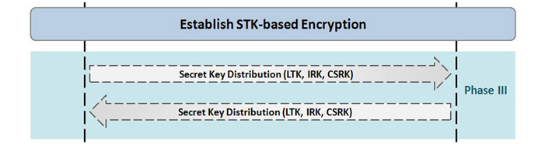
BLE Pairing Process
Phase-1 → Information required for generating the temporary key is exchanged between the master and the slave.
Phase-2 → The short term key is generated independently on both the ends and the process of encryption is started.
Phase-3 →Once the connection is secured by encryption and only if bonding is performed, the permanent keys can be distributed for storage and reuse at a later time.

Slide 5
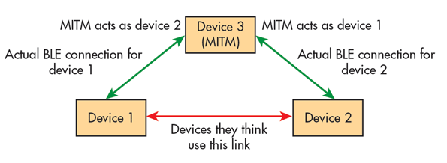
MAN IN THE MIDDLE
How It Works
As the name suggests this method involves the third device apart from the two connecting devices in a BLE Connection which emulates one of the devices, thus virtually taking control of the data transfer between the two devices. While in most cases the attack is done before a successful connection is established, here we perform the attack after a successful connection is established between both the devices.

Slide 6
Man in the Middle
Hacker Tools
Gattacker:
The tool creates an exact copy of attacked device in Bluetooth layer, and then tricks mobile application to interpret its broadcasts and connect to it instead of the original device. At the same time, it keeps active connection to the device, and forwards to it the data exchanged with mobile application. In this way, acting as “Man-in-the-Middle”, it is possible to intercept and/or modify the transmitted requests and responses.

Slide 7
Hacking The Smart Bulb

Slide 8


Capturing Advertisements
sniffing
BLE
Device
Mobile Device
First we capture the normal advertisement of the bulb.
Now using the model number we can now capture the service advertisement of the bulb.

Slide 9
Cloning the Original Device
BLE
Device
GATTACKER
Now the MASTER starts snuffing packets transferred between the devices and thus the packets will be captured by the MASTER.
The packets shown here controls RGB values of the bulb and determines the colour of the bulb. Changes in these packets would change the colour of the bulb.

Slide 10
Dump and Replay Attack
BLE
Device
GATTACKER
Now by modifying the dump file,and sending it back to the bulb we can do a replay attack.
According to the data we send the bulb will now start following our commands.
If you will look at the bulb now, the attack has successfully been executed, and we have been able to control a BLE enabled IoT Smart Light Bulb using Gattacker.

Slide 11
Summary
Bluetooth Low Energy is a secure wireless communication protocol, but only if you implement it properly. The only serious vulnerability it has is during the second phase of pairing, but you can always secure this phase with an appropriate pairing method.
Manufacturers should not sacrifice security over convenience.Also cost cutiing should not effect the security of the device.

Slide 12
QUESTIONS

