Slide 1
Our Amazing Chess Game
Drew
Caleb
Chris
Duncan

Slide 2
Product Backlog
Story | Points / Hours
Make a ‘start menu’ / Add initial sign in | 4
Construct a board and pieces | 5
Allow Pieces to be moved | 5
Add a turn timer | 4
As a player, I want to protect my turn via log-in, so that my friend cannot cheat. | 3
As a player, I want to make correct moves, so I can play the game properly | 10
As a player, I want to see the current score, so that I can judge how the game is going | 2
As a player, I want to see all valid moves for my pieces so that I can use the best possible move | 3
As a player, I want to be able to undo my moves to a certain extent, so I can understand more variations of the moves I can do | 4
As a player, I want to be able to take my turn, so that we both take turns playing | 3
As a player, I want to have a standardised interface, so that I can clearly see the game state | 4
As a player, I want to see all valid moves for my pieces so that I can use the best possible move | 6

Slide 3
Initial Release Backlog
Story | Point/Hours
As a player, I want to make correct moves, so I can play the game properly | 10
As a player, I want to have a standardized interface, so that I can clearly see the game state | 3
As a player, I want to protect my turn via log-in, so that my friend cannot cheat | 3
Construct a board and pieces | 5
Allow Pieces to be moved | 5

Slide 4
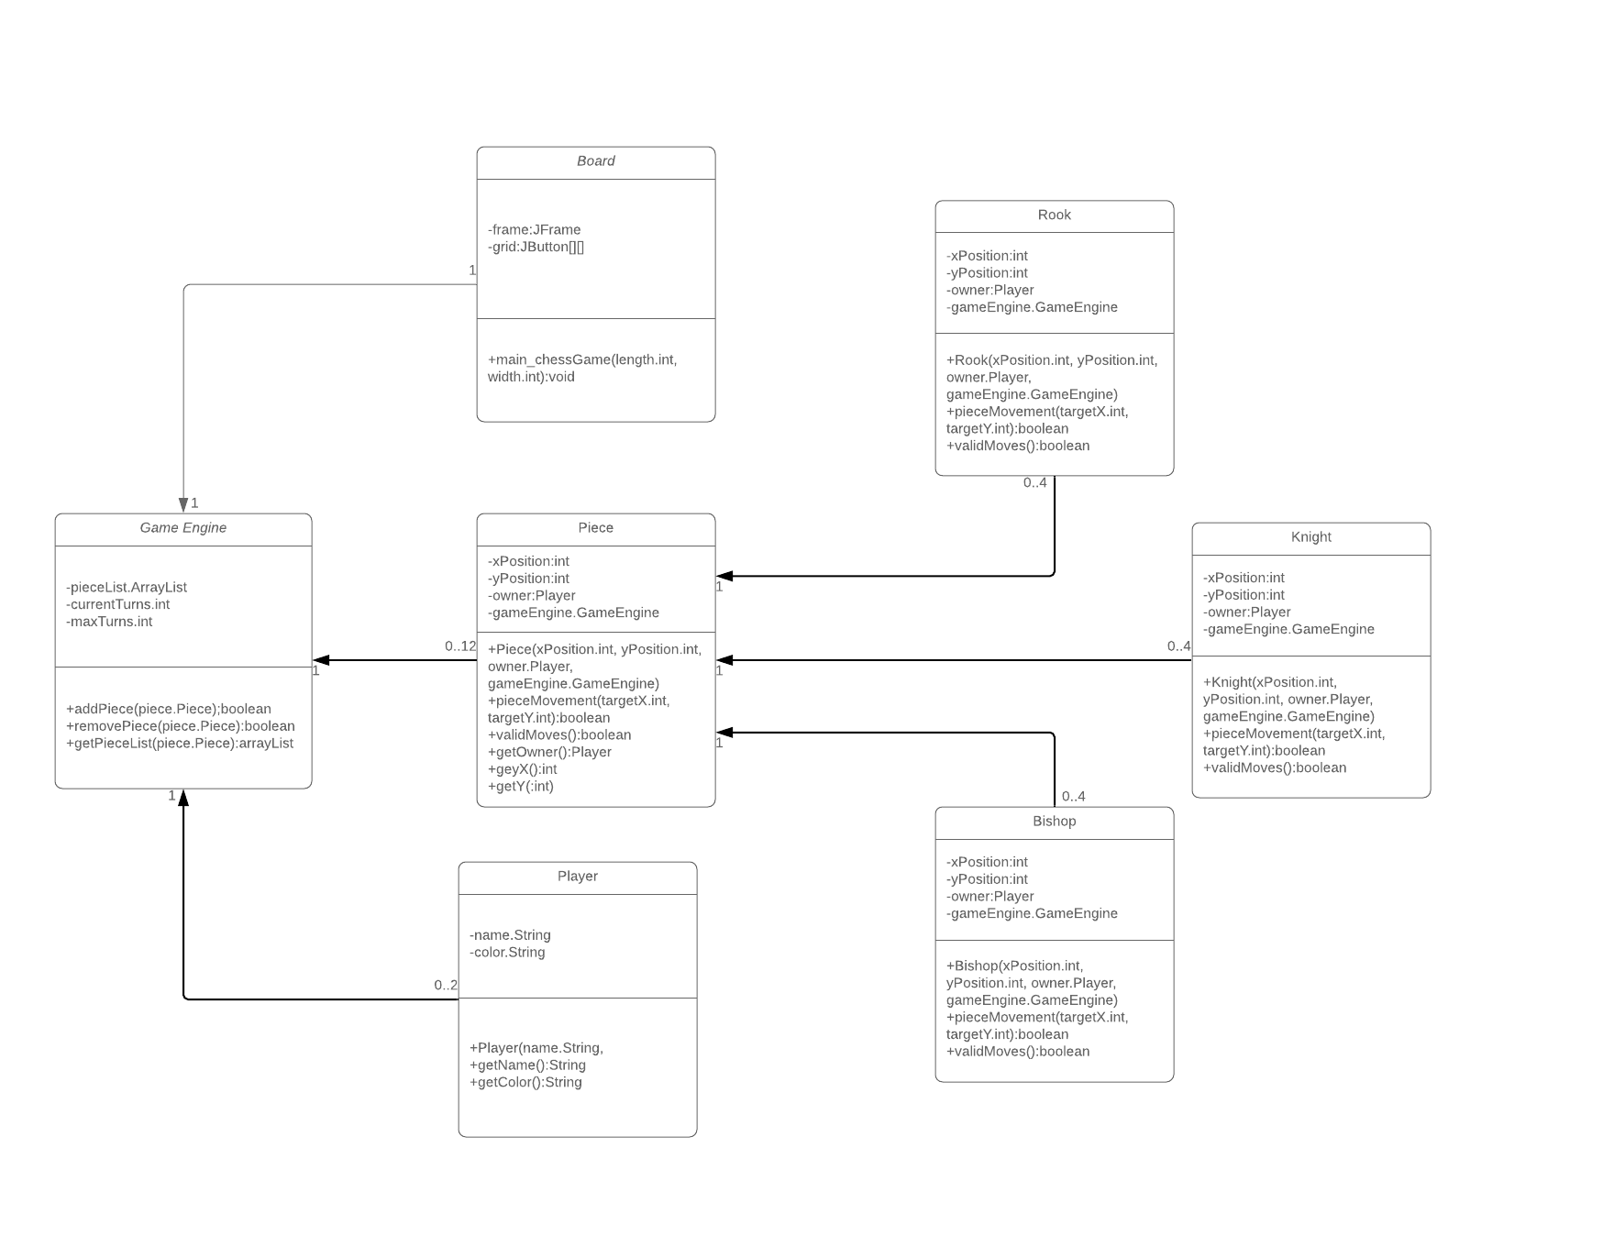
Class Diagram

Slide 5
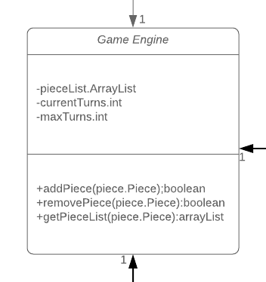
Class diagram: Game Engine

Slide 6
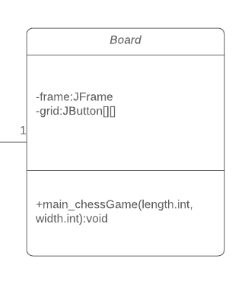
Class Diagram: Board

Slide 7
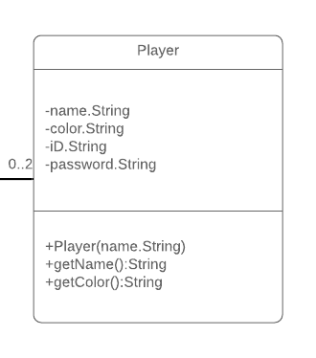
Class Diagram: Player

Slide 8
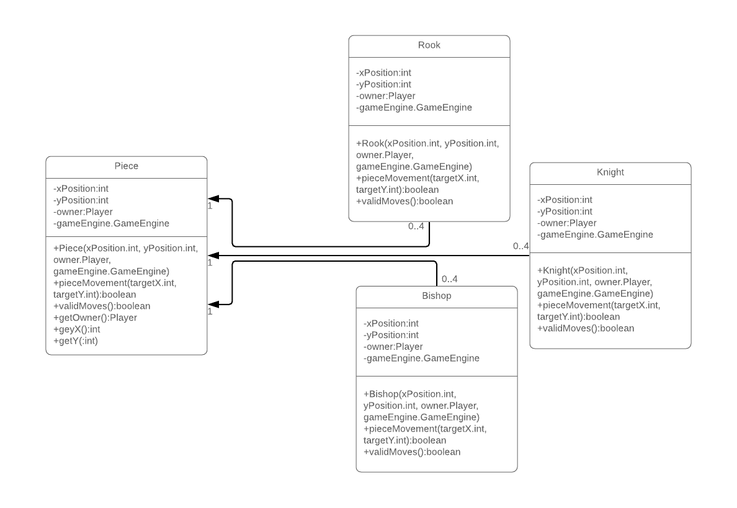
Class Diagram: Piece

Slide 9
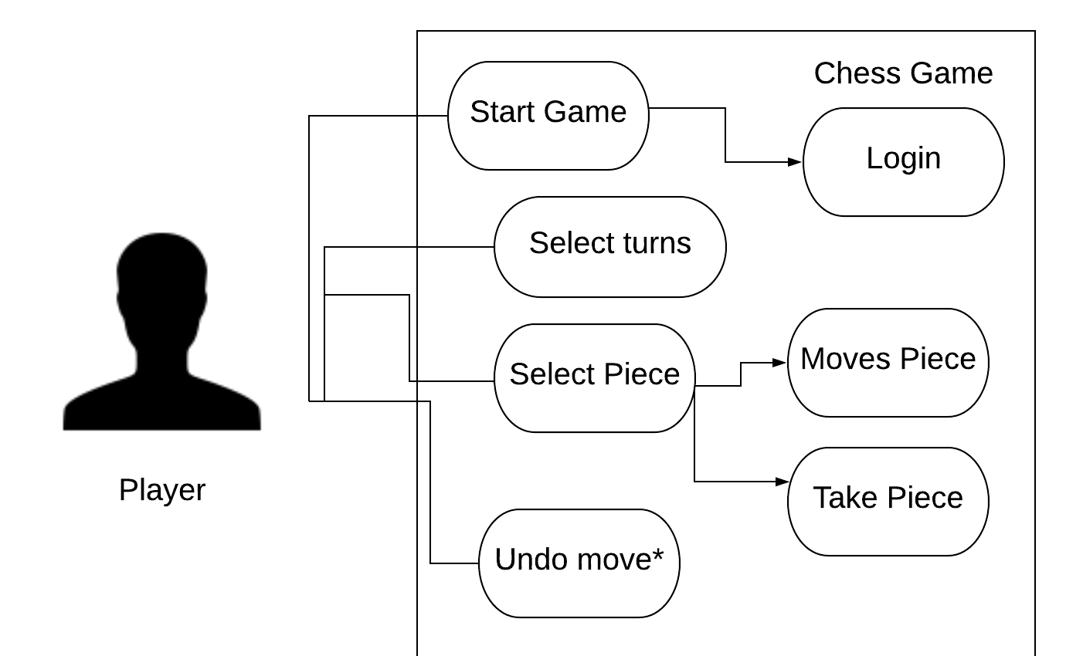
Use Case Diagram

Slide 10
Piece
Drew

Slide 11
Backlog items
Story | Point/Hours
As a player, I want to make correct moves, so I can play the game properly (Valid Moves) | 10
As a player, I want to have a standardized interface, so that I can clearly see the game state | 3
As a player, I want to protect my turn via log-in, so that my friend cannot cheat | 3
Construct a board and pieces | 5
Allow Pieces to be moved | 5

Slide 12
Piece
-Attempt to move a bishop piece diagonally up to two cells, succeeds when there are no pieces. - Attempt to move a bishop piece diagonally bypassing other pieces fails. - Attempt to move a bishop piece diagonally more than two cells fails when there are no pieces. - Attempt to move a bishop piece in any direction other than diagonally fails - Attempt to move a rook piece in horizontal or vertical directions up to two cells succeeds when there are no pieces - Attempt to move a rook piece in horizontal or vertical directions bypassing other pieces fails - Attempt to move a rook piece in any direction other than horizontally or vertically fails - Attempt to move a knight piece along L shape (2 + 1) succeeds - Attempt to move a knight piece to any other cell fails - Attempt to move a knight piece over another piece succeeds

Slide 13
Player
Duncan

Slide 14
Backlog items
Story | Point/Hours
As a player, I want to make correct moves, so I can play the game properly | 10
As a player, I want the game to understand the rules of chess | 2
As a player, I want to have a standardized interface, so that I can clearly see the game state | 3
As a player, I want to protect my turn via log-in, so that my friend cannot cheat | 3
Construct a board and pieces | 5
Allow Pieces to be moved | 5

Slide 15
Player
-Attempt to start game without entering IDs -Attempt to start game without entering passwords - Attempt to register two members with the same login ID fails. - Attempt to login with invalid login ID and fails - Attempt to login with invalid login password fails - Attempt to login with valid login ID succeeds
- Attempt to login with valid password succeeds - Attempt to login with the same valid ID and login fails

Slide 16
board
caleb

Slide 17
Backlog items
Story | Point/Hours
As a player, I want to make correct moves, so I can play the game properly | 10
As a player, I want the game to understand the rules of chess | 2
As a player, I want to have a standardized interface, so that I can clearly see the game state | 3
As a player, I want to protect my turn via log-in, so that my friend cannot cheat | 3
Construct a board and pieces | 5
Allow Pieces to be moved | 5

Slide 18
Board
- Generate board

Slide 19
Game Engine
Chris

Slide 20
Backlog items
Story | Point/Hours
As a player, I want to make correct moves, so I can play the game properly | 10
As a player, I want the game to understand the rules of chess | 2
As a player, I want to have a standardized interface, so that I can clearly see the game state | 3
As a player, I want to protect my turn via log-in, so that my friend cannot cheat | 3
Construct a board and pieces | 5
Allow Pieces to be moved | 5

Slide 21
Game Engine
- Player points are increased by 5 whenever an opponent piece is removed
- Both players enter the same desired turns and the set amount of turns is correct
- Attempt to undo 1 move - Attempt to undo 2 moves - Attempt to undo more than 2 moves - Each player enters a different desired turn number and the set amount of turns is correct

