Slide 1
CS340400 Compiler Design Homework 1
Deadline
2018/04/11 17:00

Slide 2
Overview

Slide 3
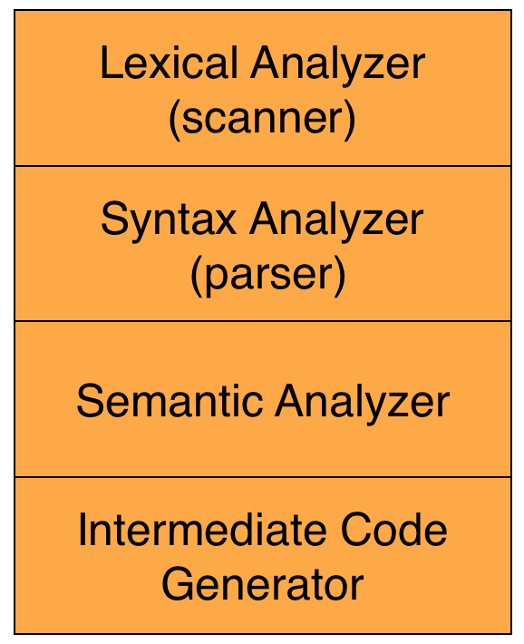
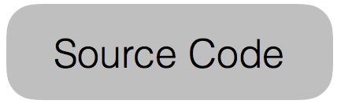
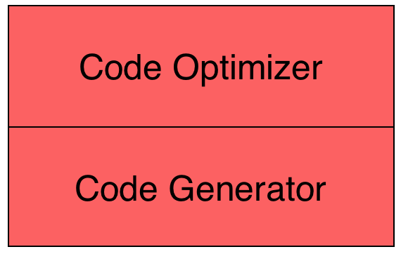
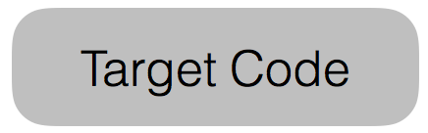
The Structure of a Modern Compiler
Front End
Back End

Slide 4
What are we Going to do?
HW1
a = b + c * d
source code
Lexical Analyzer
tokens
id = id + id * id
HW2
Syntax Analyzer
syntax tree
=
id
+
id
*
id
id
HW3
Code Generator
generated code
mul $r1, $r2, $r3
add $r0, $r1, $r4 …

Slide 5
The Structure of Compiler
HW1
a = b + c * d
source code
Lexical Analyzer
tokens
id = id + id * id
HW2
Syntax Analyzer
syntax tree
=
id
+
id
*
id
id
HW3
Code Generator
generated code
mul $r1, $r2, $r3
add $r0, $r1, $r4 …

Slide 6
Lex - lexical analyser generator

Slide 7
What is Lex?
Lex is a program generator designed for lexical processing of character input streams. It accepts a high-level, problem oriented specification for character string matching, and produces a program in a general purpose language which recognizes regular expressions.
The regular expressions are specified by the user in the source specifications given to Lex.
Lex generates a deterministic finite automaton (DFA) from the regular expressions in the source.
The Lex written code recognizes these expressions in an input stream and partitions the input stream into strings matching the expressions.
From http://dinosaur.compilertools.net/lex/
Notes:
RE-(E-NFA)-NFA-DFA-MINIMAL DFA
Table maintain MINIMAL DFA

Slide 8
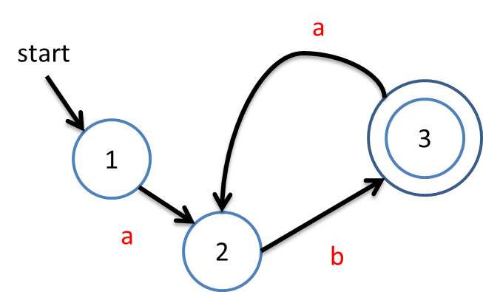
(ab)+
LEX
Input Stream
If (matches the DFA expression)
Do Something…….

Slide 9
Lex with Yacc
HW1
HW2
Lex source
(Lexical Rules)
Yacc source
(Grammar Rules)
Lex
Yacc
lex.yy.c
y.tab.c
call
yylex()
yyparse()
Parsed
Input
Input
return token

Slide 10
How to Write Lex?
Definition Section
%%
Rules Section
%%
C Code Section
(required)
(required)
(optional)

Slide 11
How to Write Lex?
%{
#include <stdio.h>
int lineCount=0;
%}
Definition Section
%%
Rules Section
%%
C Code Section
The Definition Section will be copied to the top of generated C program. Include header files, declare variables.

Slide 12
How to Write Lex?
\n { lineCount++;
printf(“line:%d\n”, lineCount); }
Definition Section
%%
Rules Section
%%
C Code Section
The Rules Section is for writing regular expression to recognize tokens. When pattern is matched, then execute action
[Regular expression rule] { The things you want to do; }

Slide 13
How to Write Lex?
int main(void) {
yylex();
return 0;
}
int yywrap() {
return 1;
}
// Other function you defined.
Definition Section
%%
Rules Section
%%
C Code Section
The C Code Section will be copied to the bottom of generated C program.

Slide 14
How to Write Lex?
%{
#include <stdio.h>
int lineCount=0;
%}
%%
\n { lineCount++;
printf(“line:%d\n”, lineCount); }
%%
int main(void){
yylex();
return 0;
} ……
A completed Lex program
Definition Section
%%
Rules Section
%%
C Code Section

Slide 15
Compilation Flow
We use Flex(Fast Lex) instead of Lex.
Output
Input
$ flex scanner.l
Lex program
scanner.l
Flex
lex.yy.c
1
$ gcc -o scanner lex.yy.c
lex.yy.c
GCC compiler
scanner
2
$ ./scanner < test.c
C program
test.c
scanner
tokens
3

Slide 16
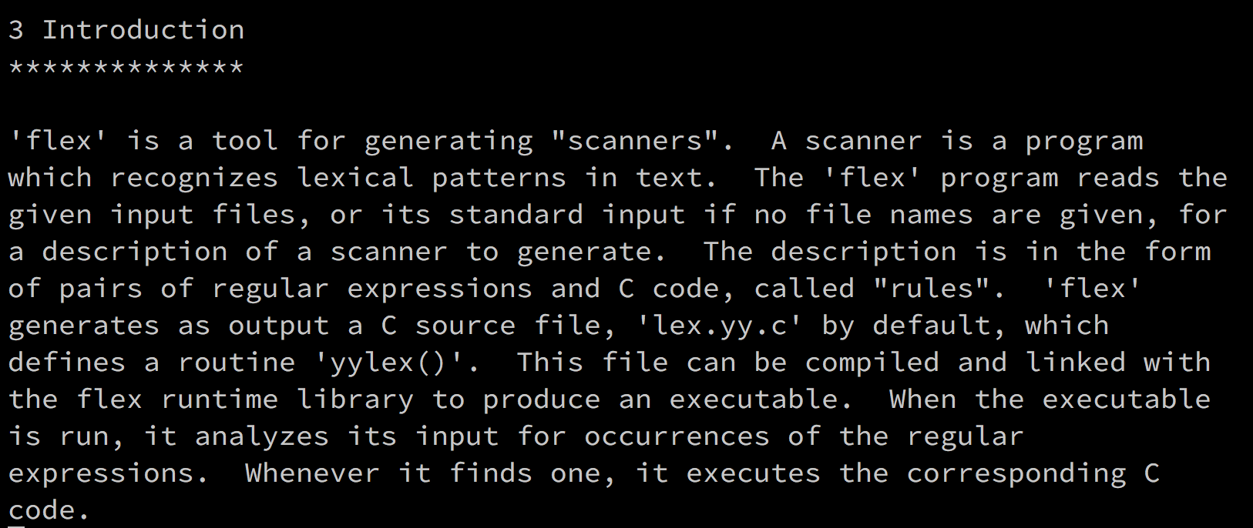
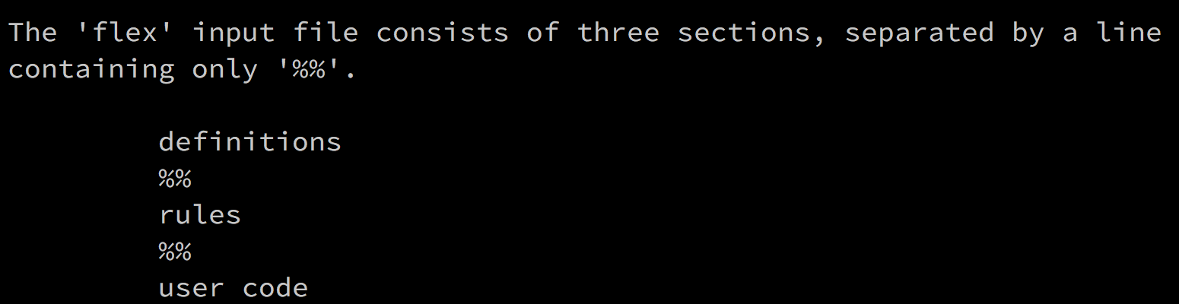
Flex: the Fast Lexical Analyser Generator
Link with library libfl.a

Slide 17
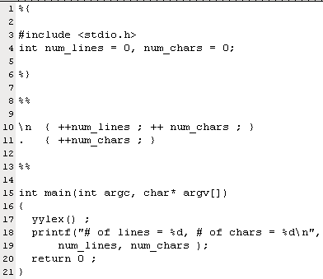
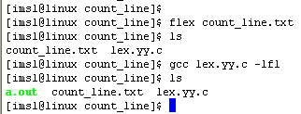

From: http://oz.nthu.edu.tw/~d947207/chap10_lex.ppt
Flex Example:
Count Number of Lines and Number of Characters
count_line.l
Press Enter
Press Ctrl+D
1
2
3
4
5
6
7
8
9
10
11
12
13
14
15
T
h
i
s
i
s
a
b
o
o
k
\n
b
y
e
b
y
e
\n
.l
Generate source C-code lex.yy.c
l
l
Library libfl.a
Notes:
Control-D: handle "end of file”

Slide 18
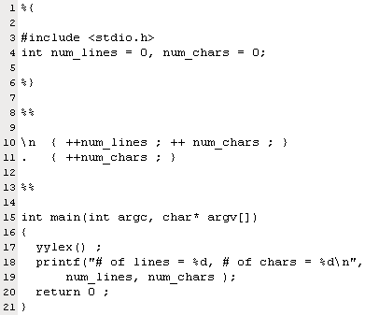
From: http://oz.nthu.edu.tw/~d947207/chap10_lex.ppt
Grammar of Input file of Flex
Lex copy data enclosed by %{ and %} into C source file
pattern
action
\n
{ ++num_lines ; ++ num_chars ; }
.
{ ++ num_chars ; }
wild card character, represent any character expect line feed \n
User code
grammar of input file
definition section
%%
rule section
%%
user code
pattern action
When pattern is matched, then execute action

Slide 19

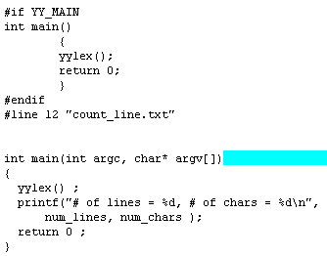
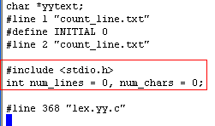
Grammar of Input file of Flex
lex.yy.c
default main
From: http://oz.nthu.edu.tw/~d947207/chap10_lex.ppt

Slide 20
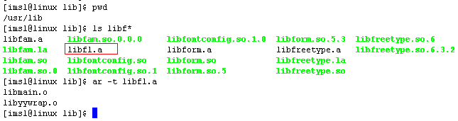
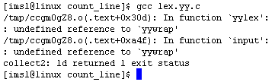
Can we Compile lex.yy.c without –lfl ?
We want to use lex.yy.c on different platforms (Linux and windows), to avoid specific library is lesson one.
Library libfl.a contains function yywrap()
-lfl means “include library libfl.a”, this library locates in /usr/lib
contains function mian() and yywrap()
From: http://oz.nthu.edu.tw/~d947207/chap10_lex.ppt

Slide 21
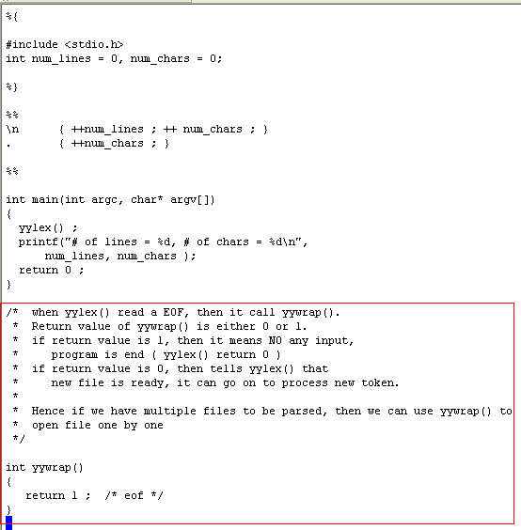
From: http://oz.nthu.edu.tw/~d947207/chap10_lex.ppt
Can we Compile lex.yy.c without –lfl ?
count_line.l
Implement function yywrap explicitly
Notes:
不用 –lfl ，一定要給定main及yywrap

Slide 22
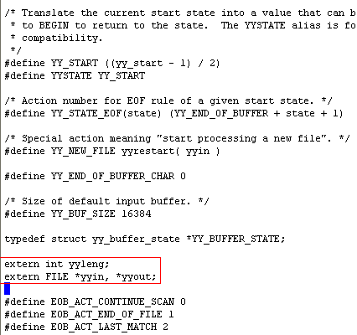
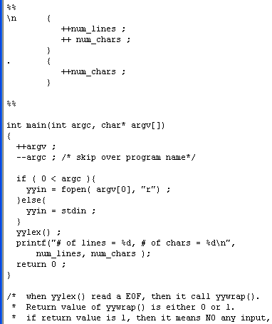
How to Process a file?
count_line.l
lex.yy.c
yyin is a file pointer in lex, function yylex() read characters from yyin
From: http://oz.nthu.edu.tw/~d947207/chap10_lex.ppt

Slide 23
Lex Predefined Variables
Name | Function
char *yytext | Pointer to matched string.
int yyleng | Length of matched string.
int yylex(void) | Function call to invoke lexer and return token.
int yywrap(void) | Return 1 if no more files to be read.
char *yymore(void) | Return the next token.
int yyless(int n) | Retain token except the first n characters in yytext.
FILE *yyin | Input stream pointer.
FILE *yyout | Output stream pointer.
ECHO | Print out the yytext.
BEGIN | Condition switch.
REJECT | Go to the next alternative rule.
man flex or info flex to get more info

Slide 24
Regular Expressions
. | Any character excepts ‘\n’. | . = {a, b, c, d, ……}
* | Zero or more. | ab* = {a, ab, abb, abbb, ……}
+ | One or more. | ab+ = {ab, abb, abbb, ……}
? | Zero or one. | a? = {ԑ, a}
| | Or. | a|b = {a, b}
[] | Any character of the character set. | [abc] = {a, b, c}
() | To group characters. | (ab)* = {ԑ, ab, abab, ……}
\ | For escape character. | \* = {*}, \\ = {\}
“…” | Literally. | “a*” = {a*}
{} | Repeat. Substitution. | a{1,3} = {a, aa, aaa}
^ | Head of line. Exclude. | [^a] = {b, c, d, e, ……}
$ | End of line.
/ | Followed with specific character. | a/b = {ab}

Slide 25
Regular Expressions
Input
String
she
%%
she { printf(“she\t”); }
[sS]he { printf(“another she\t”); }
he { printf(“he\t”); }
s { printf(“s\t”); }
%%
Rule
Section
The output result is “she”.
Always choose the longest matching pattern.
If the length are the same, choose the first met rule.

Slide 26
More Elegant Way to Write Regular Expressions
%{
#include <stdio.h>
int lineCount=0;
%}
ch [a-z]
%%
\n { lineCount++;
printf(“line:%d\n”, lineCount) ;}
{ch}+ { ECHO; }

Slide 27
More Elegant Way to Write Regular Expressions
%{
#include <stdio.h>
int lineCount=0;
%}
%%
\n { lineCount++;
printf(“line:%d\n”, lineCount); }
[[:alpha:]]+ { ECHO; }

Slide 28
Regular Expressions
Regular Expression | Meaning
[a-zA-Z] | Any character of a ~ z and A ~ Z.
[0-9] | Any character of 0 ~ 9.
[:lower:] | [[:lower:]] = [a-z]
[:upper:] | [[:upper:]] = [A-Z]
[:alpha:] | [[:alpha:]] = [a-zA-Z]
[:digit:] | [[:digit:]] = [0-9]
[:alnum:] | [[:alnum:]] = [a-zA-Z0-9]
Notes:
report

Slide 29
Start Condition
What if you encounter the string like this?
/* int count
is for counting line number */
Input
String
printf( “int is 32-bit” );
Input
String

Slide 30
Start Condition
%{
…
%}
%x COMMENT
%%
Declare at Definition Section
%s STATE_NAME – inclusive
If the start condition is inclusive, then rules with no start conditions at all will also be active.
%x STATE_NAME – exclusive
If it is exclusive, then only rules qualified with the start condition will be active.
Notes:
flex provides a mechanism for conditionally activating rules. Any rule whose pattern is prefixed with "<sc>" will only be active when the scanner is in the start condition named "sc".
• Start conditions are declared in the definitions (first) section of the input using unindented lines beginning with either `%s' (inclusive start conditions) or `%x' (exclusive start conditions)
• Initial starting condition of flex is 0 (INITIAL)
• A start condition is activated using the BEGIN action. Until the next BEGIN action is executed, rules with the given start condition will be active and rules with other start conditions will be inactive.
• If the start condition is inclusive, then rules with no start conditions at all will also be active.
• If it is exclusive, then only rules qualified with the start condition will be active.

Slide 31
Start Condition
Input
String
/*int
%{
…
%}
%x COMMENT
/* Exclusive */
%%
“/*” { BEGIN COMMENT; }
int { printf(“normal\n”);}
<COMMENT>int { printf(“special\n”);
BEGIN 0; }
%%
Notes:
只選擇前面有對應 condition 的規則

Slide 32
Start Condition
Input
String
/*int
%{
…
%}
%s COMMENT
/* Inclusive */
%%
“/*” { BEGIN COMMENT; }
int { printf(“normal\n”);}
<COMMENT>int { printf(“special\n”);
BEGIN 0; }
%%
Notes:
所有規則都可以選擇，最先碰到的優先

Slide 33
Versions of Lex
AT&T: lex
http://www.combo.org/lex_yacc_page/lex.html
GNU: flex
http://www.gnu.org/manual/flex-2.5.4/flex.html
a Win32 version of flex
http://www.monmouth.com/~wstreett/lex-yacc/lex-yacc.html
or Cygwin
http://sources.redhat.com/cygwin/
Lex on different machines is not created equal.

Slide 34
Homework1 - Requirements

Slide 35
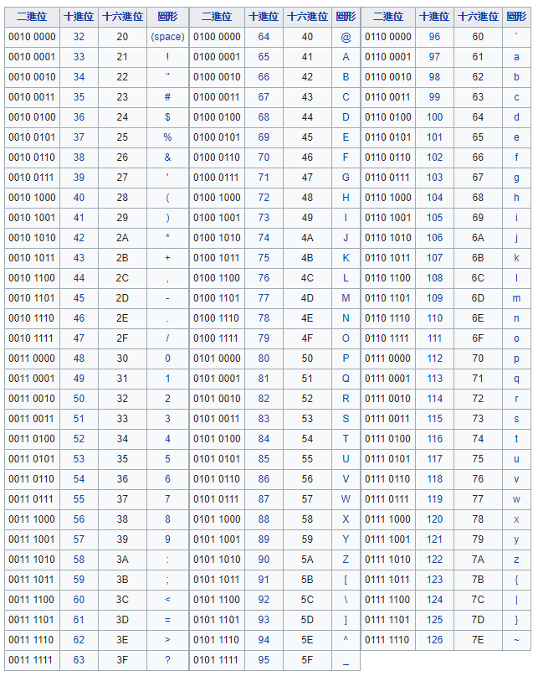
Subset of C Language
Character Set
ASCII,
but control characters only ‘\n’ and ‘\t’.

Slide 36
Subset of C Language
Keywords
void int double bool char null for while do if else switch return break continue const true false struct case default
Library functions( from stdio.h ) - https://www.tutorialspoint.com/c_standard_library/stdio_h.htm

Slide 37
Subset of C Language
Identifiers (case­sensitive) - C variable naming rules
Operators
+ - * / % ++ -- < <= > >= == != = && || !
*(Pointer to a variable) &(Returns the address of a variable)
Punctuation characters
: ; , . [] () { }

Slide 38
Subset of C Language
Integer constant
Floating point constant
Scientific notation (E notation: aEb, aeb)
String constant
Variable declaration(Only consider illegal variable names)/initialization
Types
Simple statements
Control structures (goto)
Functions
Library functions( from stdio.h )
Arrays
Pointers
Comments
Pragma directives
pragama source on
pragama source off
Pragama token on
Pragama token off
*The pragama isn’t defined in hw1 should be as an error
eg. #include …. is an error
#pragama system on is an error
Error Handling (Red line part)
Note: Lexeme will not exceed 256.

Slide 39
Output Format
Token type
Keywords (key) : refer to the slide page 36
Identifiers (id) : refer to the slide page 37
Operators (op) : refer to the slide page 37
Punctuation characters (punc) : refer to the slide page 37
Integer (integer): Eg. 10, 234, …
Double (double) : Eg. 0.9, 34.56, …
Char (char) : Eg. ‘s’, ‘a’, …
Scientific notation (sci) Eg. 1.23E4, 1.23E+4, 147e-1, …
String (string) : Eg. “apple”, “ddef”, …
You must follow the rules to classify the tokens and print the token types with the type names we gave in the parentheses!
Notes:
Functions (func)

Slide 40
Output Format
(Each line) Legal code
You must print the results with the formats described below
If it is a comment or a pragma directive, just print the line number and the line.
linenum:line_content
Others, print token type first, then, print the line number and the line.
#token type:token
…
linenum:line_content
(Each line) Error code
Error handling: All error messages must be printed to stderr and follow the format described below. Your scanner should be exit with code 1.
Error at line 5: .
fprintf(stderr, "Error at line %d: %s\n", linenum, errorMessage); exit(1);

Slide 41
Output Format Examples: Test Case 0_1
char a = 'i';
Output Format Examples: Result
#key:char
#id:a
#op:=
#char:'i'
#punc:;
1:char a = 'i';

Slide 42
Output Format Examples: Test Case 0_2
//This test case is only for homework explanation
int main () {
double a = 6.0;
int i;
int b[2];
for (i = 0; i < 2; i++) {
b[i] = i;
}
printf("b[1]=%d\n", b[1]);
if (b[0] > 1){
a = a * 1.23e-1;
}
return 0;
}

Slide 43
Output Format Examples: Result
1://This test case is only for homework explanation
#key:int
#id:main
#punc:(
#punc:)
#punc:{
2:int main () {
#key:double
#id:a
#op:=
#double:6.0
#punc:;
3: double a = 6.0;
#key:int
#id:i
#punc:;
4: int i;

Slide 44
#key:int
#id:b
#punc:[
#integer:2
#punc:]
#punc:;
5: int b[2];
#key:for
#punc:(
#id:i
#op:=
#integer:0
#punc:;
#id:i
#op:<
#integer:2
#punc:;
#id:i
#op:++
#punc:)
#punc:{
6: for (i = 0; i < 2; i++) {

Slide 45
#id:b
#punc:[
#id:i
#punc:]
#op:=
#id:i
#punc:;
7: b[i] = i;
#punc:}
8: }
#key:printf
#punc:(
#string:b[1]=%d\n
#punc:,
#id:b
#punc:[
#integer:1
#punc:]
#punc:)
#punc:;
9: printf("b[1]=%d\n", b[1]);

Slide 46
#key:if
#punc:(
#id:b
#punc:[
#integer:0
#punc:]
#op:>
#integer:1
#punc:)
#punc:{
10: if (b[0] > 1){
#id:a
#op:=
#id:a
#op:*
#sci:1.23e-1
#punc:;
11: a = a * 1.23e-1;
#punc:}
12: }

Slide 47
#key:return
#integer:0
#punc:;
13: return 0;
14:
#punc:}
15:}
Please use command diff or vimdiff to check whether your output format is correct or not!

Slide 48
Pragma Directives: Source
default
#pragma source on
char a = 'i';
#pragma source off
char a = 'i';
1:#pragma source on
#key:char
#id:a
#op:=
#char:'i'
#punc:;
2:char a = 'i';
#key:char
#id:a
#op:=
#char:'i'
#punc:;

Slide 49
Pragma Directives: Token
default
#pragma token on
char a = 'i';
#pragma token off
char a = 'i';
1:#pragma token on
#key:char
#id:a
#op:=
#char:'i'
#punc:;
2:char a = 'i’;
1:#pragma token off
2:char a = 'i';

Slide 50
Error Example
Integer constant – 45ab2
Floating point constant – 10.56.23
Scientific notation – 12.3E+asb2
String constant – “abcdefg
Variable name – @error
Pragma directives – #pragma something off

Slide 51
Error handler example
b = 12 + 12.3E-ss +24; -> #id:b
#op:=
#integer:12
#op:+
Error at line 1: 12.3E-ss +24;
The error message must contain every character in the same line that follows the error

Slide 52
Grading Policies
For all the homework,
Warnings: minus 20 points
Late homework: minus 10 points per day
Not executable (include not following the output format and not following the submission rules): You can still get 50 points if you turn in your codes and the report.
Cheating: You will receive zero credit!

Slide 53
Grading Policies
If your scanner can classify and print the token – keywords, identifiers, operators, punctuation characters, integer, double, character, you will get 60 vvvvvvv
Scientific notation and string +5 vvvvv
Comment +10 vvvvv
Error handling +10
Test cases +15

Slide 54
Report
For student who can not finish the homework,
Describe the abilities of your scanner
Describe the difficulties you faced
Describe the methods you tried to solve your problems

Slide 55
Submission
You must upload 2 items: your source code, a makefile in server or you will get zero credit!
Server: Source code
Must create “hw1” under your home directory
e.g. Student ID = 104062634 Your home directory is /home/104062634/hw1
In your home directory/hw1, you must provide
A source code file named ‘scanner.l’.
A makefile for TAs to compile your code.
The makefile in which the name of the output executable file must be named ‘scanner’.
iLMS: Report (if you can’t finish your homework)
Upload the report in PDF format to iLMS.
e.g. file name is “100062801_report.pdf”

Slide 56
How to Connect to our Server?
PieTTY
https://sites.google.com/view/pietty-project/download
MobaXterm
http://mobaxterm.mobatek.net/download.html
Terminal : for MAC OS/ Linux-based
ssh –p 7878 your_account@140.114.88.219
Notes:
有要用 scp 上傳檔案的話，請注意 pietty 的版本

Slide 57
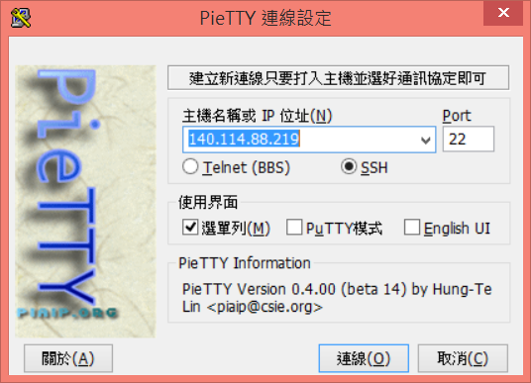
PieTTY
SSH
IP: 140.114.88.219 Port: 7878
7878

Slide 58
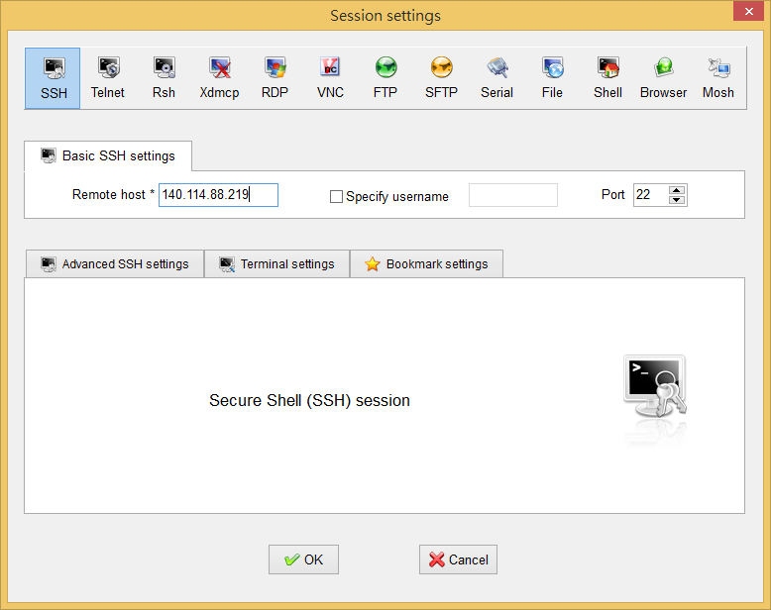
MobaXTerm
Toolbar > Session > SSH
Remote host: 140.114.88.219 Port: 7878
7878

Slide 59
Account
Account: student ID (lowercase letter)
Password: same as account
Please change the password when you first login!
Steps:
Enter old password
Enter new password
Enter new password again
Connect to our server again
If you want to change your password afterwards,
$ passwd

Slide 60
Tutorials
Linux command
http://linux.vbird.org/linux_basic/0220filemanager.php
Vim
http://linux.vbird.org/linux_basic/0310vi.php
Shell script
http://linux.vbird.org/linux_basic/0320bash.php
Makefile
http://www.csie.nuk.edu.tw/…/Embedded%20Syst…/8-Makefile.pdf
http://www.cprogramming.com/tutorial/makefiles.html
http://jimmynuts.blogspot.tw/2010/12/gnu-makefile.html

Slide 61
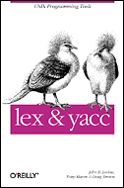
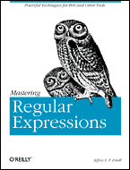
Reference
lex & yacc
by John R.Levine, Tony Mason & Doug Brown
O’Reilly
ISBN: 1-56592-000-7
Mastering Regular Expressions
by Jeffrey E.F. Friedl
O’Reilly
ISBN: 1-56592-257-3

Slide 62
Contact Us
Facebook Group
If you have any questions, feel free to discuss with everyone in class.
TAs
呂秉松 bslu@pllab.cs.nthu.edu.tw
陳泰良 tlchen@pllab.cs.nthu.edu.tw

