Slide 1
A 3D cube
Y
2(0,1,0)
6 (1,1,0)
F1: 0 1 3 2
F2: 4 6 7 5
F3: 0 2 6 4
F4: 1 5 7 3
F5: 0 4 5 1
F6: 2 3 7 6
3 (0,1,1)
7 (1,1,1)
0 (0,0,0)
X
4 (1,0,0)
1 (0,0,1)
Z
5(1,0,1)

Slide 2

Map 3D cube to 2D plot
We need to design a 2x3 matrix A such that A[x, y, z]^{T}=[u, v]^{T}
What A is depends on the viewpoint (the direction your eyes look at).
Suppose the viewpoint is at [1/2, 1/2, sqrt(2)/2]^{T}.
Y
X
Z

Slide 3
Find the transition matrix A
6 variables to decide A = [[a11, a12, a13], [a21, a22, a23]]
We need 6 equations, which can be obtained from mapping 3 points
We can choose any 3 points we like so that the equation can be solved easily.
(1, 0, 0) → (sqrt(3)/2, 0),
(0, 1, 0) → (0, sqrt(3)/2),
(0, 0, 1) → (-1/2, -1/2)
Solve that we can have A = [[sqrt(3)/2, 0, -1/2], [0, sqrt(3)/2, -1/2]]
Y
(0,1,0)
X
(1,0, 0)
(0,0, 1)
Z

Slide 4
Hidden surface removal
To make an object look solid, we want to remove the surfaces that cannot be seen.
For a convex object, we can use normal vectors of surfaces and the direction of view port to solve this problem.
Y
X
Z

Slide 5
Normal vector of a surface
The normal vector (法向量) of a surface is the vector perpendicular to the surface.
For a right-hand-side coordinate system, the normal vectors of the cube look like that.
Y
X
Z

Slide 6
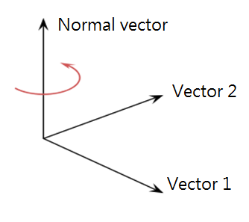
How to compute the normal vector
Give 3 points, we can first compute vector 1 (v) and vector 2 (u).
The normal vector n is perpendicular to v and u. ➔ Their inner products are 0.
<(v1, v2, v3), (n1, n2, n3)> = 0
<(u1, u2, u3), (n1, n2, n3)> = 0
Two equations but there are 3 variables
You can decide another equation, such as n1*n1+n2*n2+n3*n3 = 1 (or some constants)

Slide 7
Inner product and cross product in 2D & 3D
On blackboard
Definition of inner product
Cosine theta and inner product
Sine theta and the cross product

