Slide 1
HW4 supplement
Something you should know!

Slide 2
PART 1
Bézier Curve

Slide 3

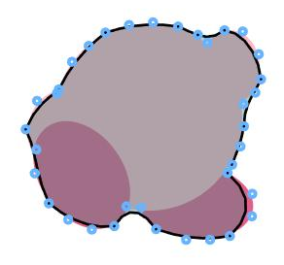
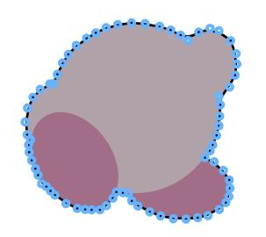
Part 1 – drawAndFillPolygon.m
input image
36 control points
72 control points

Slide 4
PART 2
3D Models

Slide 5
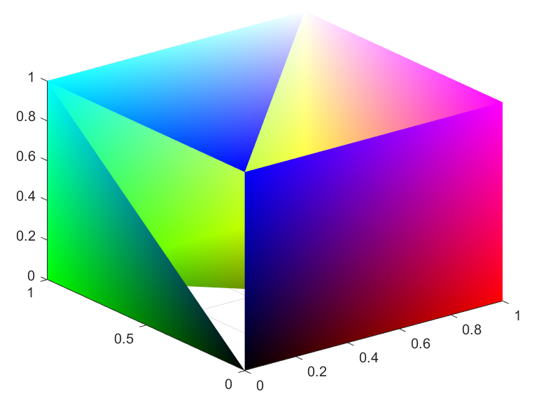
Part 2 – (A)
When you run makeRGBcube.m,
you will get …

Slide 6
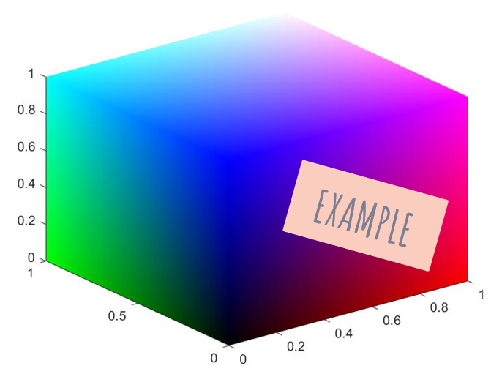
Part 2 – (A)
Modify the code to get a complete cube!

Slide 7
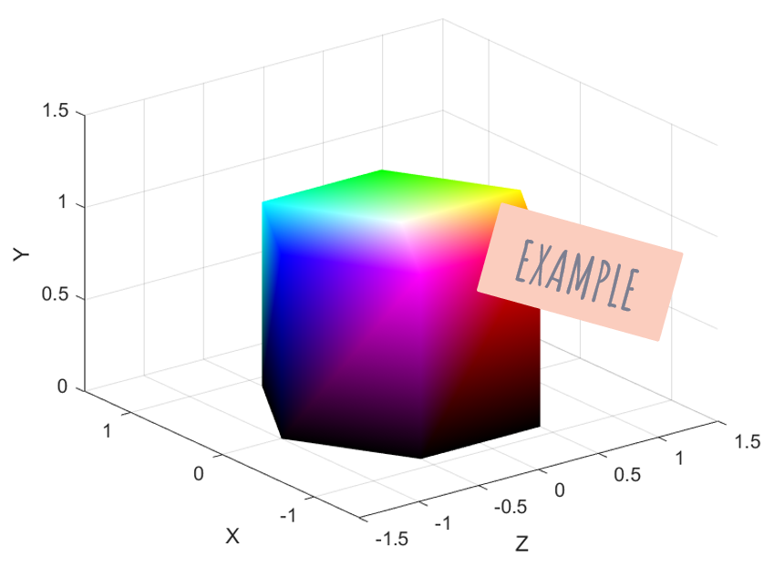
Part 2 – (c)
Generate a HSV color hexagonal prism(六角柱).

Slide 8
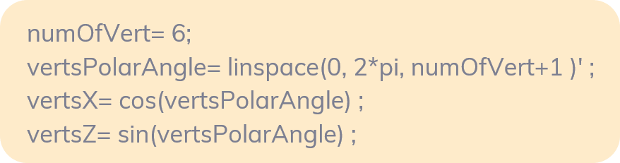
hexagonal prism HINTS
To approximate a prism, we usually start from a regular polygon.

Slide 9
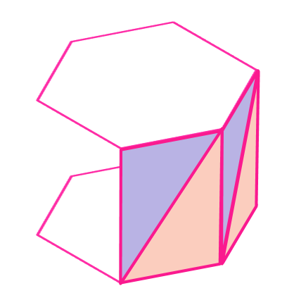
hexagonal prism HINTS
To fill the top surface or bottom surface:
To fill the side surface:

Slide 10
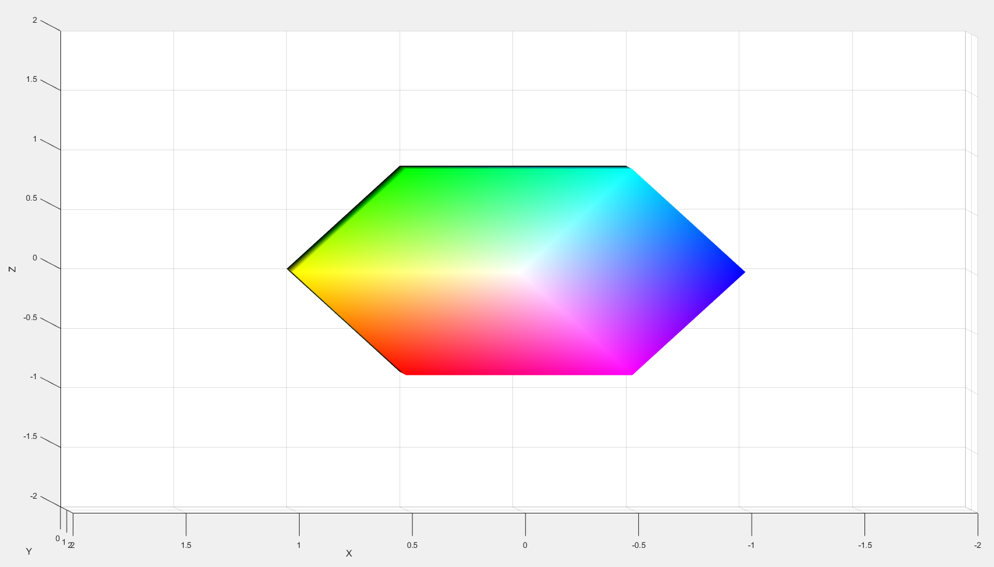
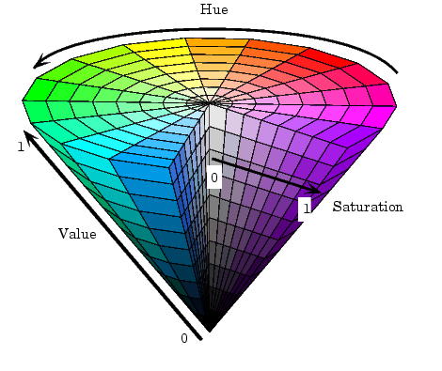
hexagonal prism HINTS
HSV (Hue, Saturation, Value)
colorization:
See also: rgb2hsv, hsv2rgb
Notes:
色相、飽和度、明度

Slide 11
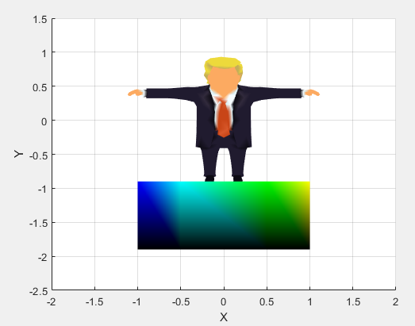
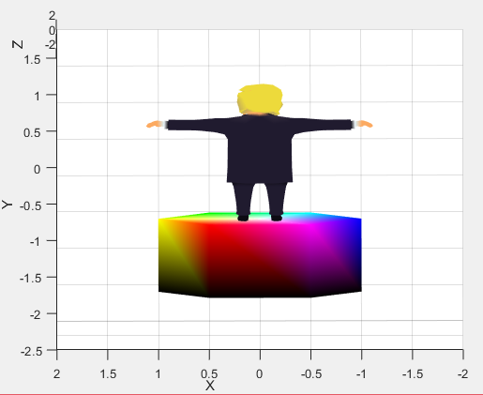
Part 2 – (d)

