Slide 1

DECISION TREES
Sebastien GONCALVES CLARO
Master Bioinformatics
Research & Development initiation

Slide 2

One of the most popular classification technique
Machine learning : parametric supervised learning method.
Goal : create a model that predicts the value of a target variable by learning simple decision rules inferred from the data features.
Advantage : generate simple knowledge to solve difficult ones.
The best to discover knowledge (outperformed by SVM and ensemble classifier).

Slide 3
Family of algorithm to train a classifier
ID3 : form a decision tree iteratively till all objects are classified.
C4.5, C5.0 : enhancement of ID3 algorithm.
CART : Classification and Regression Trees.
For the presentation : CART

Slide 4
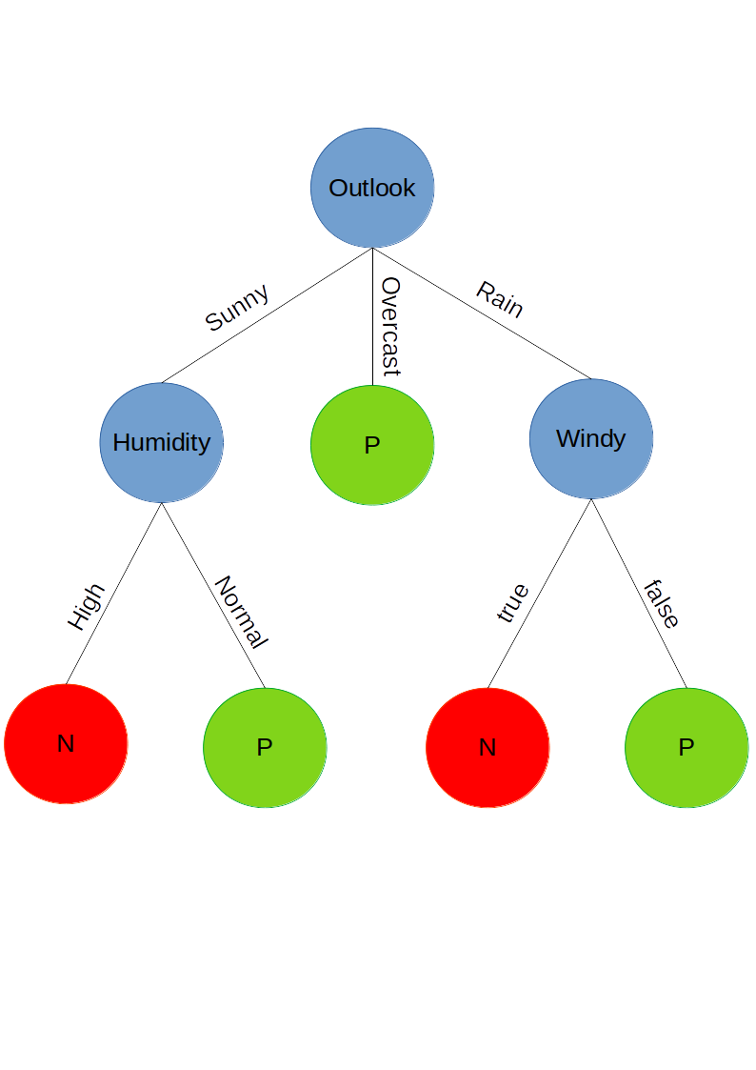
From the data to the classification
No. | Outlook | Windy | Humidiy | Class
1 | sunny | false | high | N
2 | sunny | true | high | N
3 | overcast | false | high | P
4 | rain | false | normal | P
5 | overcast | true | normal | P
... | ... | ... | ... | ...
Classifier
Quinlan, J. R. (1986). Induction of Decision Trees. Machine Learning, 1(1), 81–106. https://doi.org/10.1023/A:1022643204877

Slide 5
Features = Nodes
Features
No. | Outlook | Windy | Humidiy | Class
1 | sunny | false | high | N
2 | sunny | true | high | N
3 | overcast | false | high | P
4 | rain | false | normal | P
5 | overcast | true | normal | P
... | ... | ... | ... | ...
Classifier
Values

Slide 6
Labels = Leaves
No. | Outlook | Windy | Humidiy | Class
1 | sunny | false | high | N
2 | sunny | true | high | N
3 | overcast | false | high | P
4 | rain | false | normal | P
5 | overcast | true | normal | P
... | ... | ... | ... | ...
Classifier
Labels

Slide 7
Gini impurity : potential question
Impurity represents the chance to be incorrect if we randomly assign a label to an example.
Gini impurity = 1 - P(label)
Gini impurity : metrics between 0 and 1.
  close to 0 stand for purity
  close to 1 stand for impurity
0,84
50% P
50% N
75% P
25% N
0,50
0,25
100% P
0,00

Slide 8
Information Gain : reduce uncertainty
Find the question that unmixed the most the labels.
IG = Gini[node] - AVG(Gini[childs])
Goal : to keep track of the best question with the best information gain (0 to 1).
Root : « Is Humidity Normal ? » OR « Is Windy false ? » OR « Is the Outlook Overcast ? »
IG = 0,70
0,85
0,25

Slide 9


UCI dataset and Scikit-Learn visualization
Dua, D. and Karra Taniskidou, E. (2017). UCI Machine Learning Repository [http://archive.ics.uci.edu/ml]. Irvine, CA: University of California, School of Information and Computer Science.
API design for machine learning software: experiences from the scikit-learn project, Buitinck et al., 2013.

Slide 10
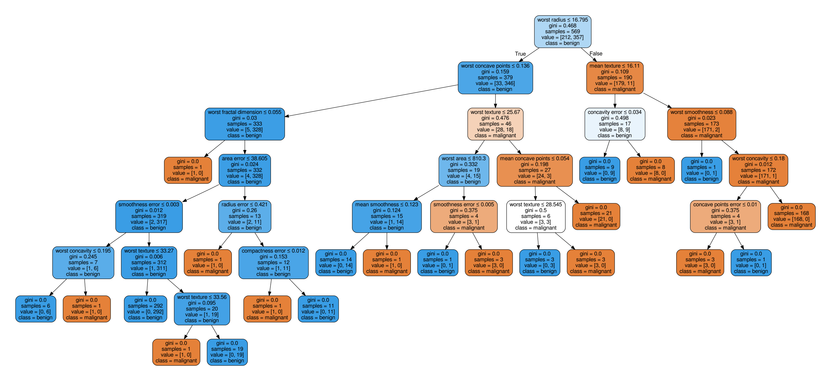
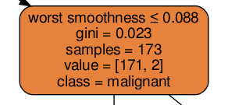
Complex decision tree : Breast Cancer

Slide 11
References
Bibliography
  Quinlan, J. R. (1986). Induction of Decision Trees. Machine Learning, 1(1), 81–106. https://doi.org/10.1023/A:1022643204877
  Stiglic, G., Kocbek, S., Pernek, I., & Kokol, P. (2012). Comprehensive decision tree models in bioinformatics. PLoS ONE, 7(3). https://doi.org/10.1371/journal.pone.0033812
  Venkatesan, E., & Velmurugan, T. (2015). Performance Analysis of Decision Tree Algorithms for Breast Cancer Classification. Indian Journal of Science and Technology, 8(29), 1–8. https://doi.org/10.17485/ijst/2015/v8i
Webography
  Google developpers. Machine learning with Josh Gordon. 2016-2018 Youtube videos.
  https://www.youtube.com/watch?v=TF1yh5PKaqI&list=PLOU2XLYxmsIIuiBfYad6rFYQU_jL2ryal&index=10
  API design for machine learning software: experiences from the scikit-learn project, Buitinck et al., 2013
  Dr. William H. Wolberg, General Surgery Dept., University of Wisconsin, Clinical Sciences Center, Madison, WI 53792 wolberg@eagle.surgery.wisc.edu
  Dua, D. and Karra Taniskidou, E. (2017). UCI Machine Learning Repository [http://archive.ics.uci.edu/ml]. Irvine, CA: University of California, School of Information and Computer Science.

