Slide 1
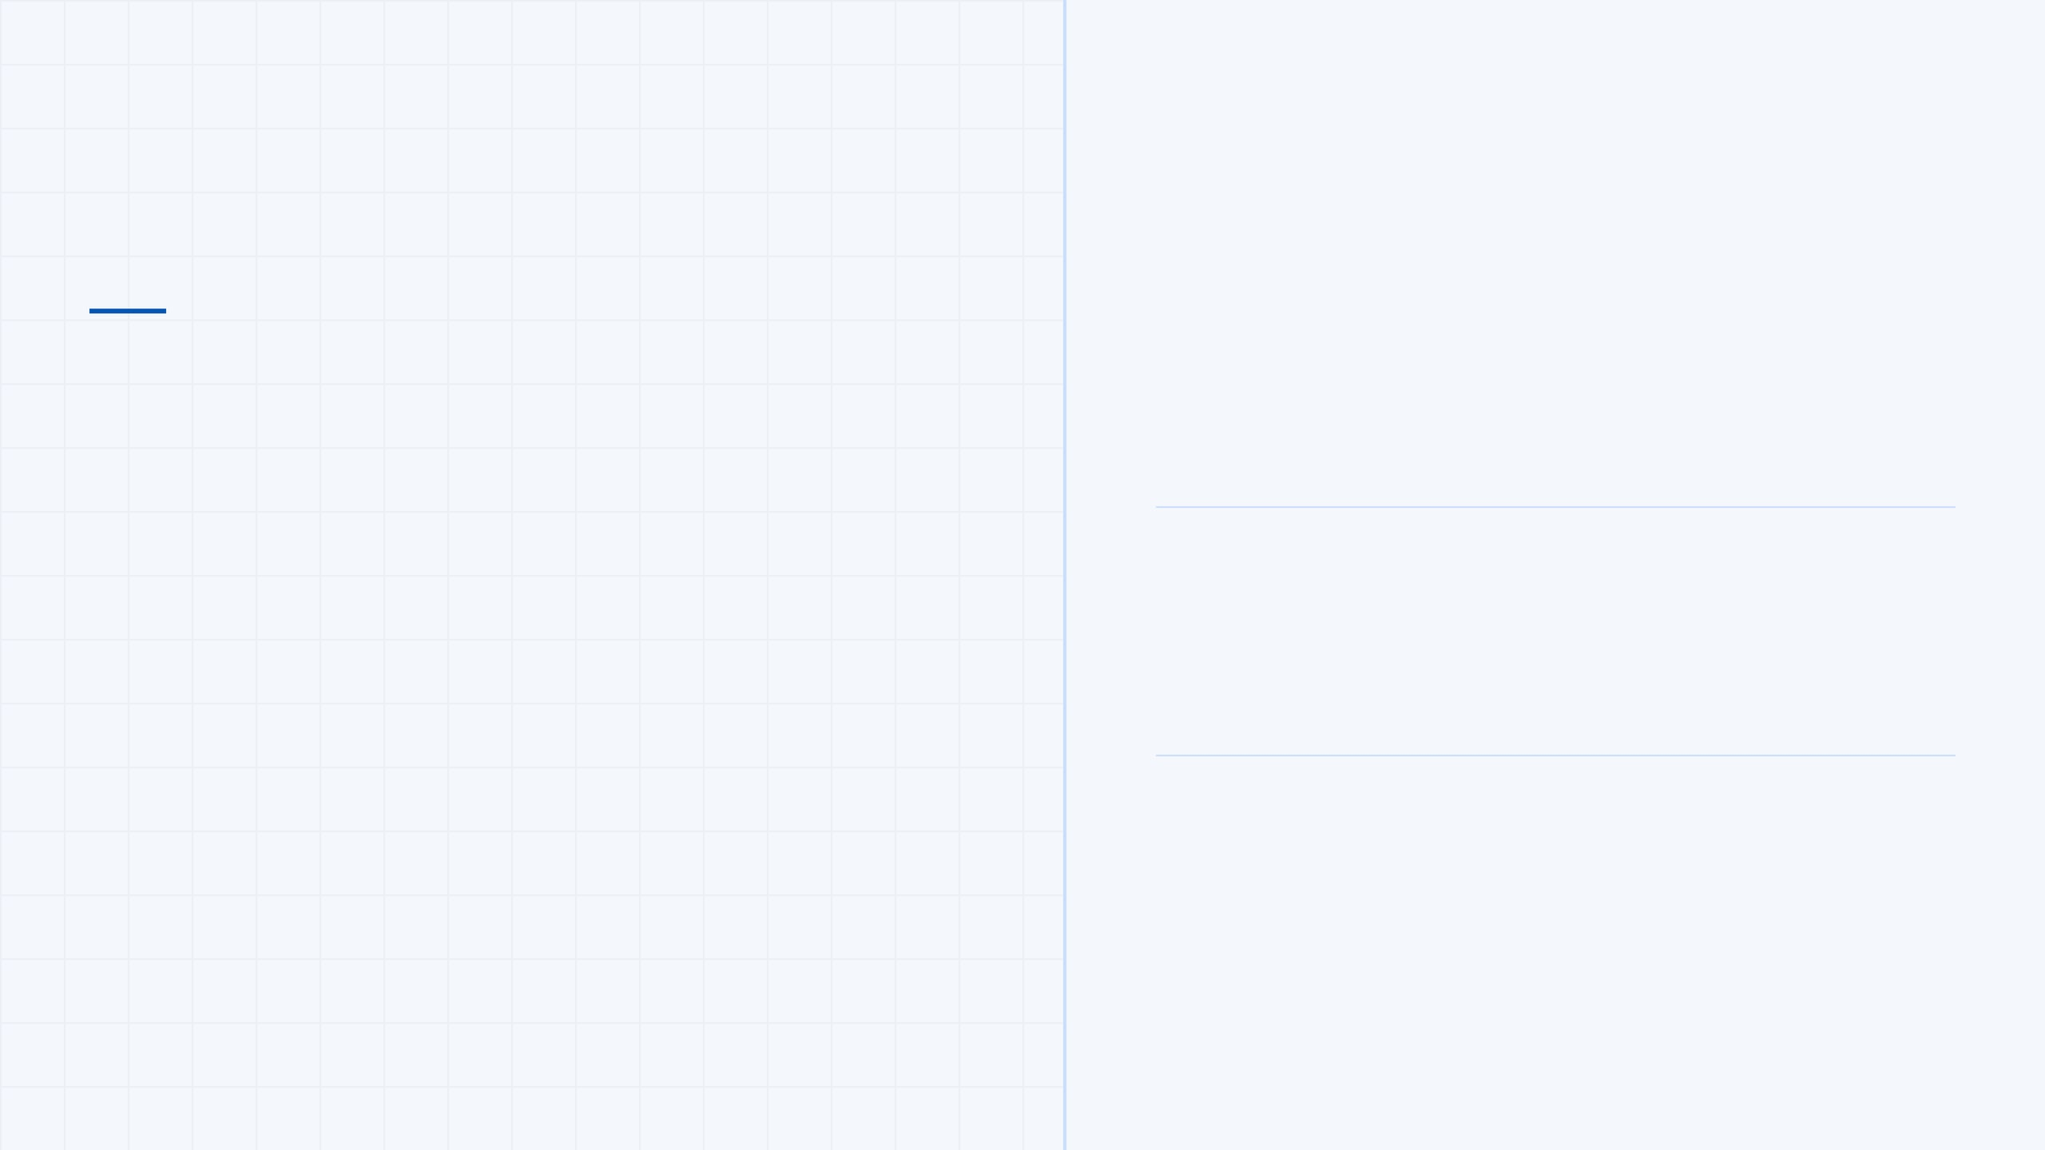

CMP600 · DISSERTATION
VIVA VOCE — ORAL EXAMINATION
PhishGuard A Machine Learning Approach to Real-Time Phishing URL Detection
STUDENT
Sergiu Ionut Pascaru
PROGRAMME
BSc (Hons) Computing [Top-up]
INSTITUTION
Elizabeth School of London
Viva Voce Presentation · June 2026
MODULE
SUPERVISOR
DATE
CMP600
Oti Edema
June 2026
Notes:
Good morning. My name is Sergiu Ionut Pascaru. My dissertation is titled PhishGuard: A Machine Learning Approach to Real-Time Phishing URL Detection. This presentation will cover my research, methodology, and findings for my CMP600 dissertation.

Slide 2
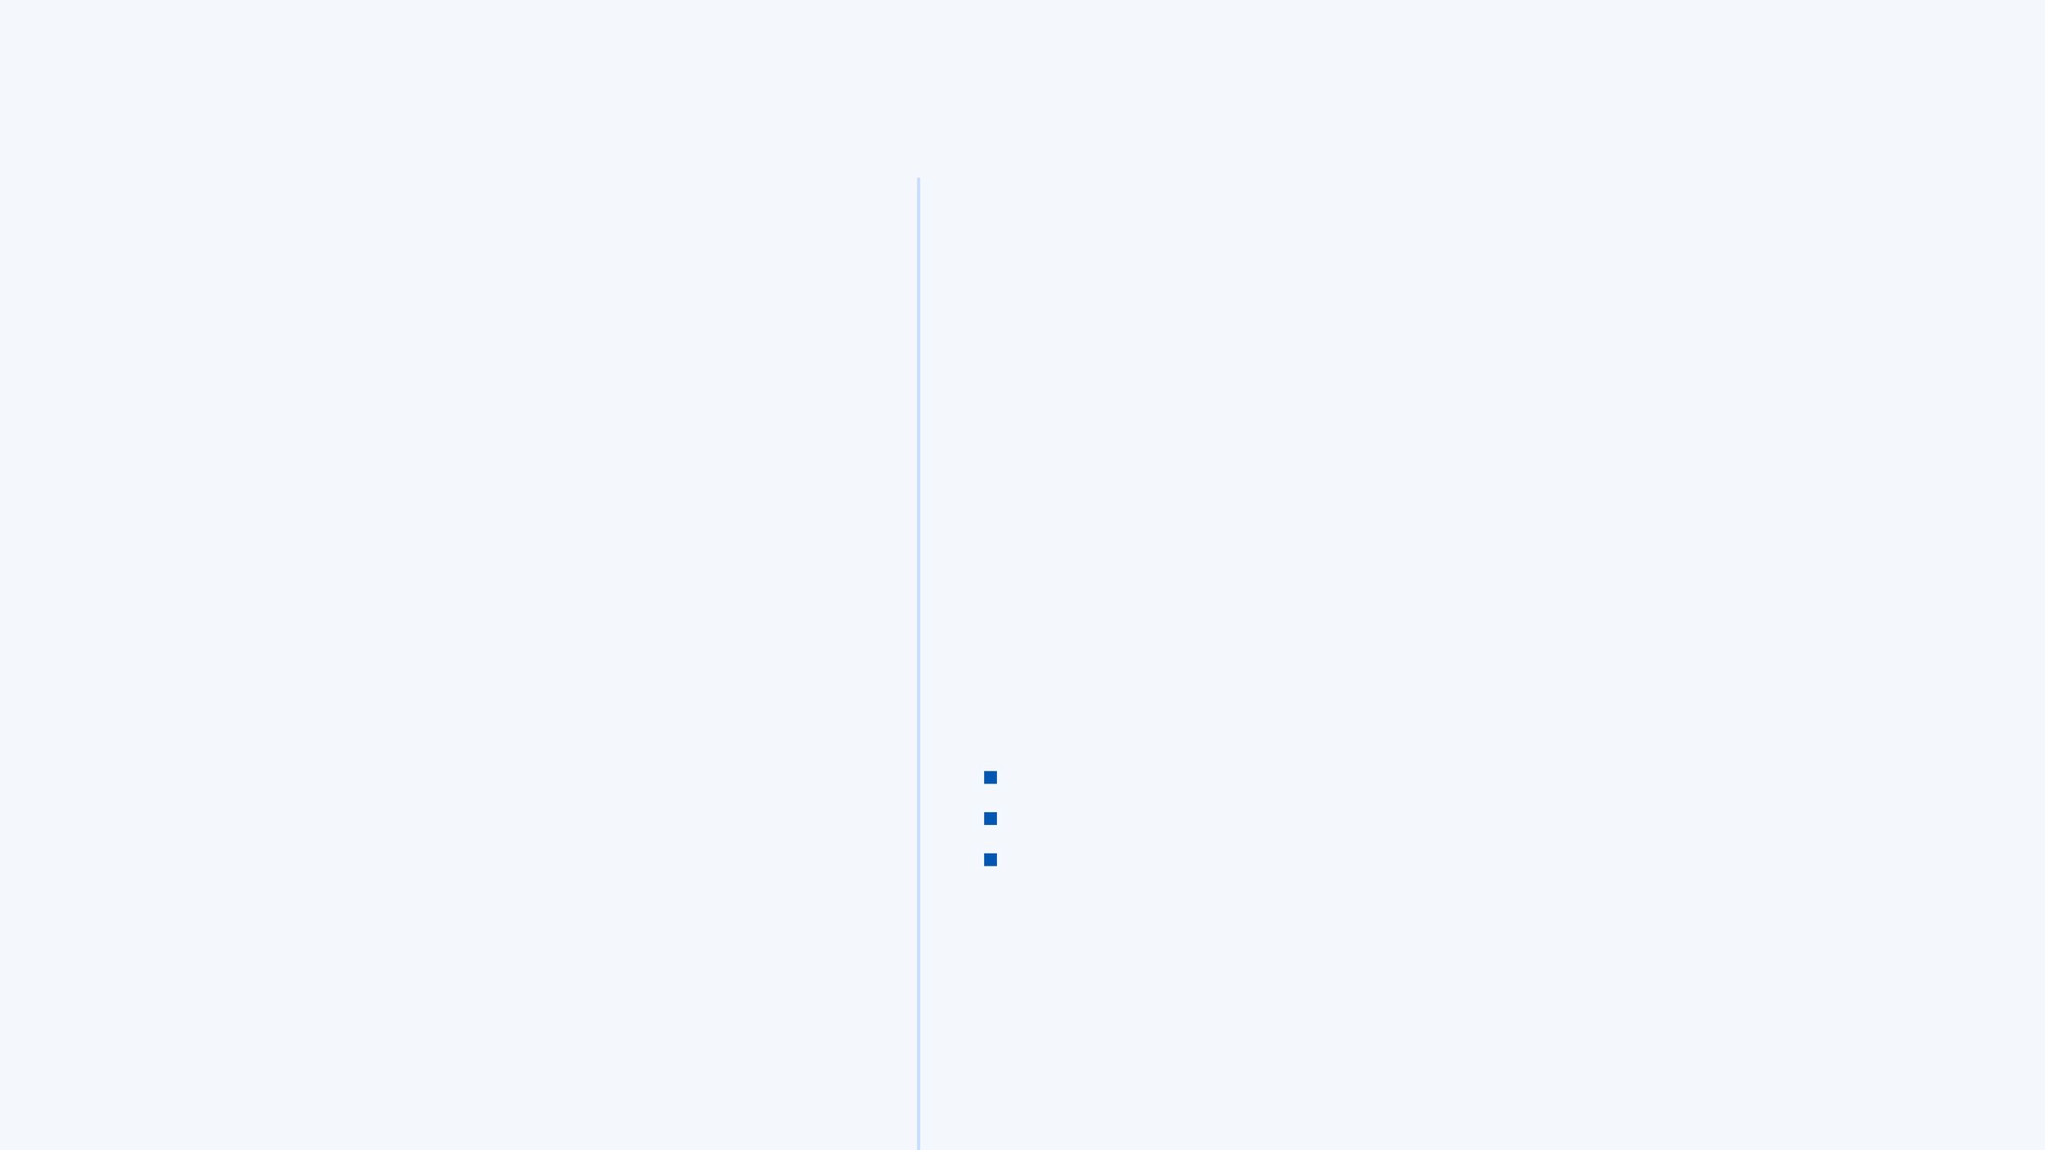
02 / 10
Research Aim & Background
SCALE OF THE PROBLEM
RESEARCH QUESTION
651,191
"Can machine learning models using only lexical URL features detect phishing URLs accurately enough for real-world deployment, and which classifier performs best?"
URLs analysed in this study — one of the largest lexical-only datasets in published research
#1
RESEARCH AIM
To design, implement, and evaluate a lexical-feature-based machine learning pipeline that classifies URLs as benign or malicious in real time — without external API calls, DNS lookups, or page content analysis.
Phishing remains the most prevalent cyber threat — APWG recorded record attack volumes in 2022 (APWG, 2024)
0ms
WHY THIS MATTERS
Blacklists fail on zero-hour attacks — new URLs not yet catalogued
Time blacklists take to detect a zero-hour phishing URL — they simply cannot. ML can.
Content-based ML requires page loading — too slow for real-time use
Lexical-only ML analyses the URL string alone — instant, private, scalable
Notes:
Phishing is not a new problem, but it is a growing one. The APWG reported record-high phishing volumes in 2022. The key challenge is zero-hour attacks—brand new URLs that no blacklist has seen yet. Machine learning trained on the structural patterns of URLs can detect these instantly. My research question asks if machine learning using only lexical URL features can accurately detect phishing for real-world use, and which classifier performs best. This leads us to the existing literature and the gap my study addresses.

Slide 3
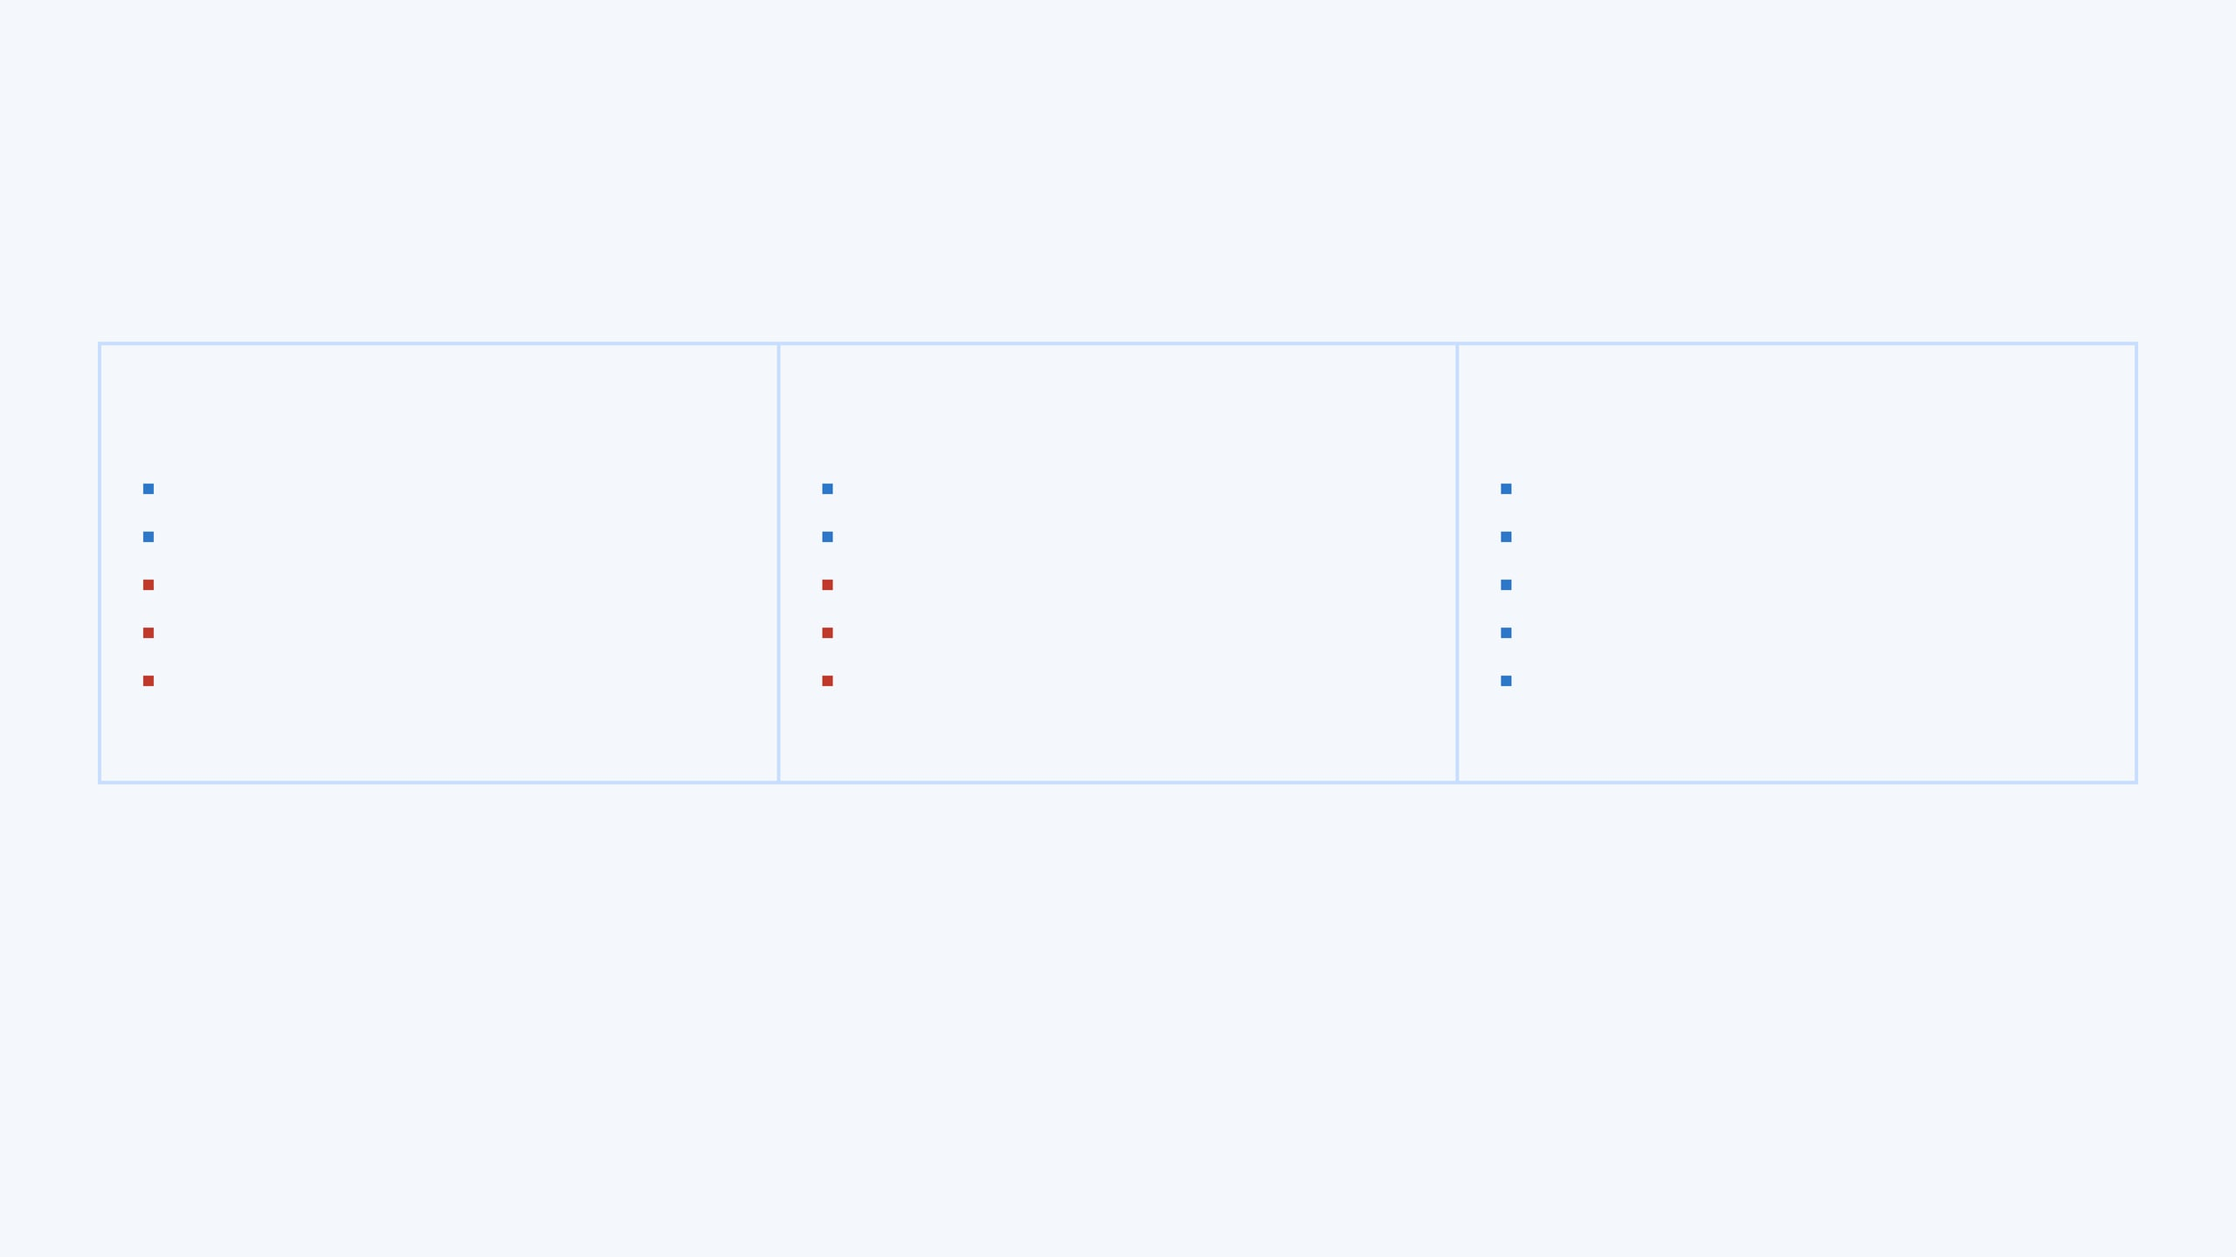
03 / 10
Literature Overview & Research Gap
THREE GENERATIONS OF PHISHING DETECTION
GENERATION 1
GENERATION 2
THIS STUDY — GENERATION 3
BLACKLISTING
CONTENT-BASED ML
LEXICAL-ONLY ML
Fast lookup — milliseconds
High accuracy possible
Real-time — under 1ms per URL
Simple to implement
Detects new URLs
No external API calls needed
Fails on zero-hour attacks
Requires page loading — slow
Privacy-preserving
Requires constant manual updates
DNS + WHOIS + HTML needed
Detects zero-hour attacks
Reactive, not predictive
Privacy concerns; API costs
Fully reproducible pipeline
e.g. Google Safe Browsing
e.g. Rao & Pais (2020)
e.g. Sahingoz et al. (2019) + this work
RESEARCH GAP IDENTIFIED — THREE MISSING ELEMENTS IN LITERATURE
01
No controlled comparison of purely lexical classifiers on a large-scale modern dataset (>600K URLs)
02
FPR rarely reported — critical for user experience, yet absent from most published studies
03
No open-source reproducible pipeline with working web prototype demonstrating real-world viability
Notes:
The literature shows three generations of phishing detection. Blacklists are fast but reactive. Content-based ML is accurate but slow. The gap I identified is that no study had done a rigorous, controlled comparison of purely lexical classifiers on a large, modern dataset—with explicit False Positive Rate reporting. This study fills that gap by focusing solely on lexical features for real-time detection. Now, let's look at how I approached this research.

Slide 4
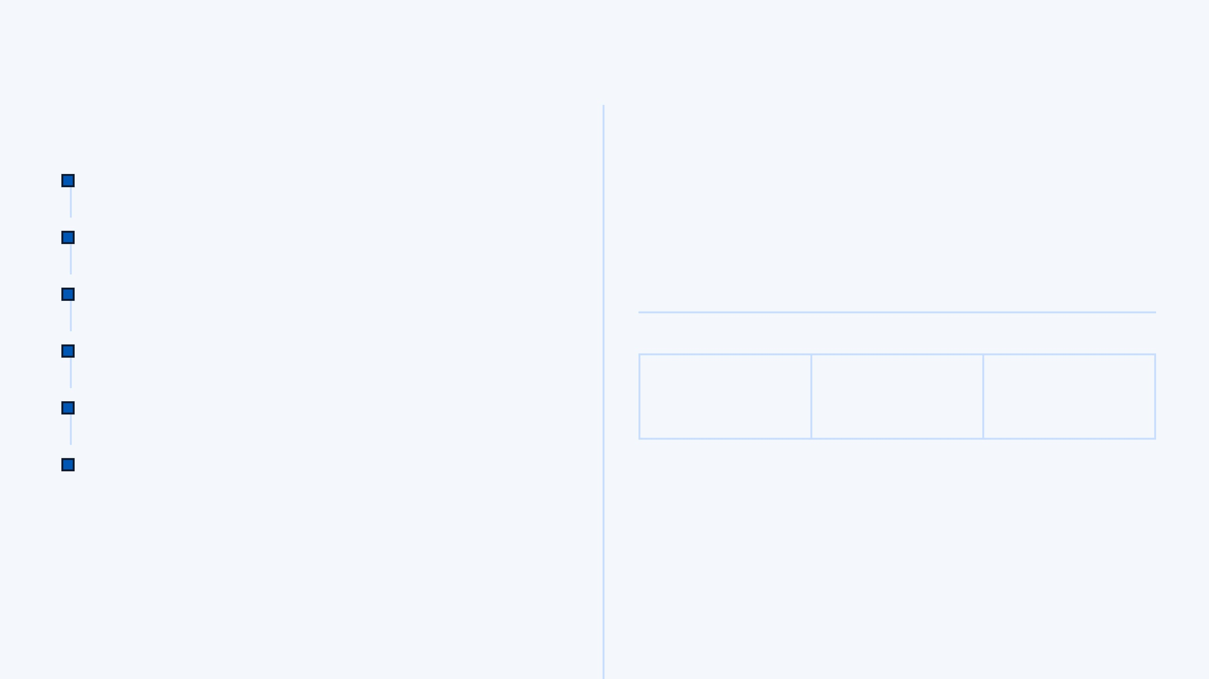
04 / 10
Methodology — CRISP-DM + Agile Scrum
CRISP-DM PHASES → SPRINT MAPPING
RESEARCH PHILOSOPHY
Business Understanding
Sprint 1
Project setup, tools, proposal writing
PHILOSOPHY
APPROACH
STRATEGY
Positivist
Deductive
Experimental
Data Understanding
Sprint 2
Knowledge from observable, measurable, reproducible phenomena
Hypotheses from literature tested empirically on real data
Controlled comparison of 3 classifiers under identical conditions
EDA, class distribution, visualisations
Data Preparation
Sprints 3–4
Cleaning, deduplication, feature engineering
Modelling
DATASET — MALICIOUS URLS (KAGGLE, SIDDHARTHA 2024)
Logistic Regression, Random Forest, SVM
Sprints 5–7
641,053
80/20
66.7%
Evaluation
Sprints 8–9
Unique URLs after cleaning
Stratified train/test split
Benign class proportion
Cross-validation, ANOVA, final comparison
Deployment
Sprint 10+
Why CRISP-DM + Agile? CRISP-DM is the industry-standard data mining framework. Mapping each phase to a 2-week Agile sprint provided structured iteration with retrospectives, ensuring each decision was documented and justified before proceeding.
PhishGuard web prototype (React + ML)
Notes:
I used CRISP-DM because it is the industry-standard data mining methodology and maps naturally to Agile sprints. My philosophy is positivist—I believe knowledge comes from observable, measurable phenomena. My approach is deductive—I took hypotheses from the literature and tested them empirically. This structured approach ensured a robust and reproducible study. Next, I'll explain the specific features I engineered for this detection system.

Slide 5

05 / 10
The 10 Lexical Features
ALL 10 STRUCTURAL URL FEATURES — NO EXTERNAL API CALLS REQUIRED
TOP FEATURES BY ANOVA F-SCORE
RANK
FEATURE
DESCRIPTION
RANK 1 — MOST DISCRIMINATIVE
dot_count
#1
dot_count
Number of periods — subdomain stacking mimics legitimacy (F = 31,994)
F-Score: 31,994 · p < 0.001
#2
path_length
URL path length — deep paths obscure true destination (F = 19,041)
Subdomain stacking mimics legitimacy — e.g. paypal.com.verify.attacker.net
#3
slash_count
Forward slashes — indicates directory depth and complexity (F = 10,162)
#4
special_char_count
Count of @, !, %, etc. — obfuscation uses special characters (F = 8,873)
RANK 2
#5
domain_length
Length of network location — unusual lengths signal suspicious activity
path_length
url_length
Total character count — malicious URLs are longer to obscure the domain
F-Score: 19,041 · p < 0.001
#6
Deep directory paths hide the true destination
#7
entropy
Shannon entropy — high entropy indicates randomness or obfuscation
#8
digit_count
Total numeric digits — IP addresses and random strings inflate digit count
RANK 3
slash_count
#9
letter_count
Total alphabetic characters — baseline character composition metric
F-Score: 10,162 · p < 0.001
#10
digit_ratio
Ratio of digits to URL length — high ratio = algorithmically generated
High slash count correlates with obfuscated URL structures
< 1ms
Extraction time per URL — all 10 features computed from the URL string alone. No DNS, no WHOIS, no page loading required.
Notes:
These 10 features were selected based on the literature and validated by ANOVA F-test. The most discriminative feature is dot_count with an F-score of 31,994—phishing URLs stack subdomains to look legitimate. All features are purely structural—no DNS lookups, no page loading, which makes the system real-time capable. This focus on speed and privacy is central to PhishGuard's design. Now, let's see how these features performed with different models.

Slide 6
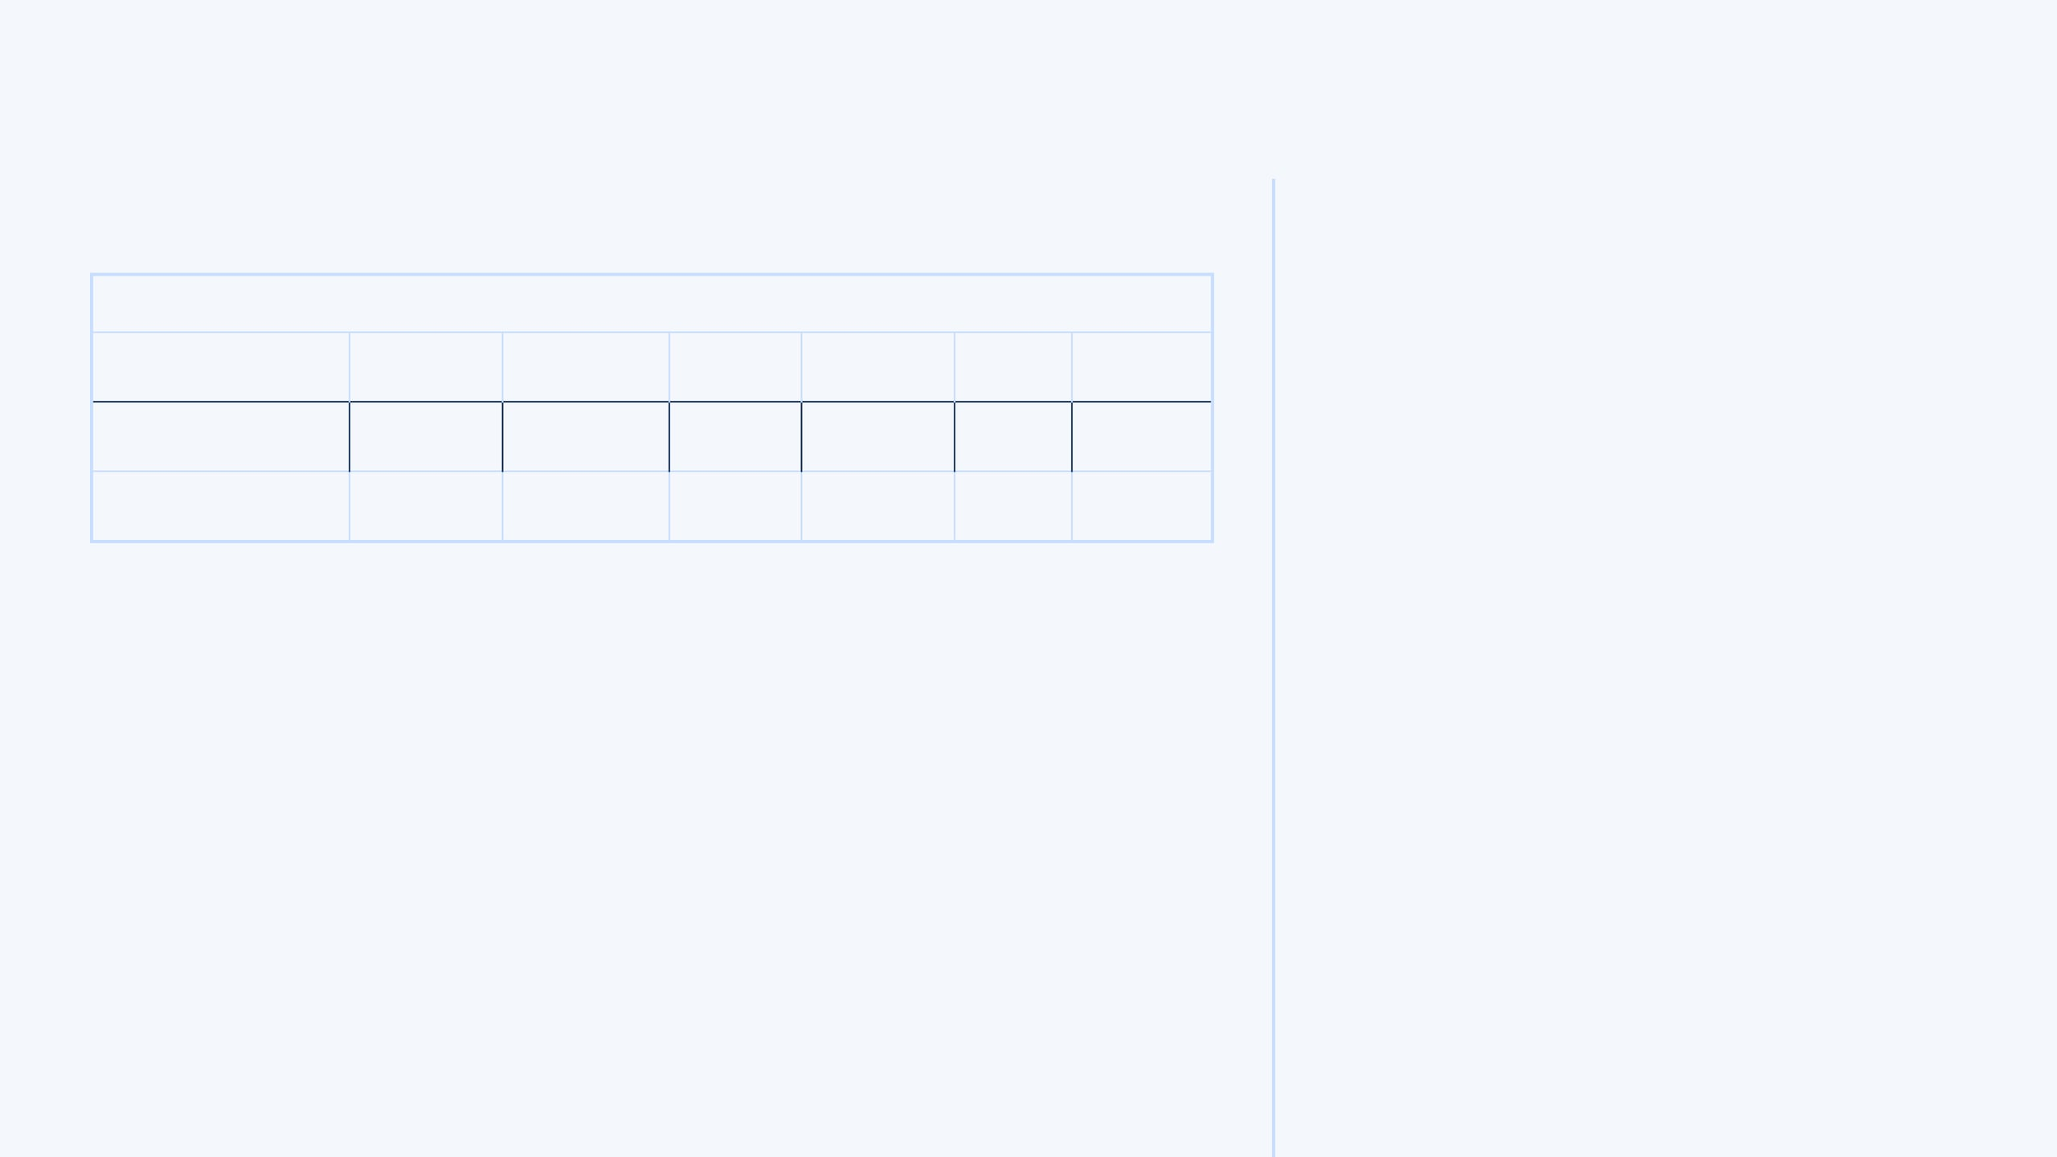
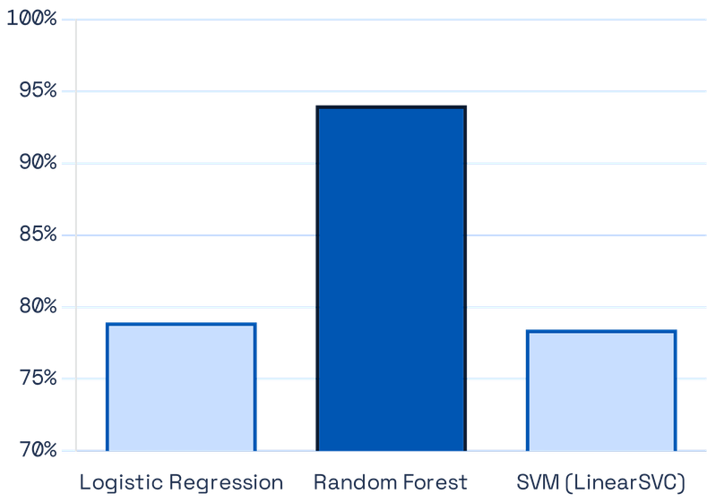
06 / 10
Results — Model Performance
TEST SET PERFORMANCE — 128,211 URLS
ACCURACY COMPARISON
MODEL
ACCURACY
PRECISION
RECALL
F1-SCORE
FPR
ROC AUC
Logistic Regression
78.94%
0.7883
0.5008
0.6125
6.69%
0.8241
Random Forest ★
94.03%
0.8946
0.9300
0.9120
5.45%
0.9855
SVM (LinearSVC)
78.43%
0.7716
0.4984
0.6056
7.34%
0.8286
5-FOLD CROSS-VALIDATION (100,000 ROWS) — STABILITY CHECK
Logistic Regression
75.82% ± 0.19% | F1: 0.7497 ± 0.0024
Random Forest
91.95% ± 0.17% | F1: 0.9198 ± 0.0017 ★
SVM (LinearSVC)
75.81% ± 0.19% | F1: 0.7487 ± 0.0024
KEY FINDING
Random Forest outperforms linear models by +15 percentage points in accuracy and +0.30 in F1-Score. Cross-validation confirms this is not overfitting — stability ±0.17%.
Notes:
Here are the core results. Random Forest achieved 94.03% accuracy with a False Positive Rate of just 5.45%. This means only about 1 in 18 legitimate URLs would be incorrectly flagged. The linear models, Logistic Regression and SVM, plateaued at around 78-79% accuracy. This 15-percentage-point gap is significant. Cross-validation confirmed that Random Forest's performance is stable and not due to overfitting. It shows the model generalizes well to unseen data. This clear difference in performance leads us to the next question: why did Random Forest win?

Slide 7

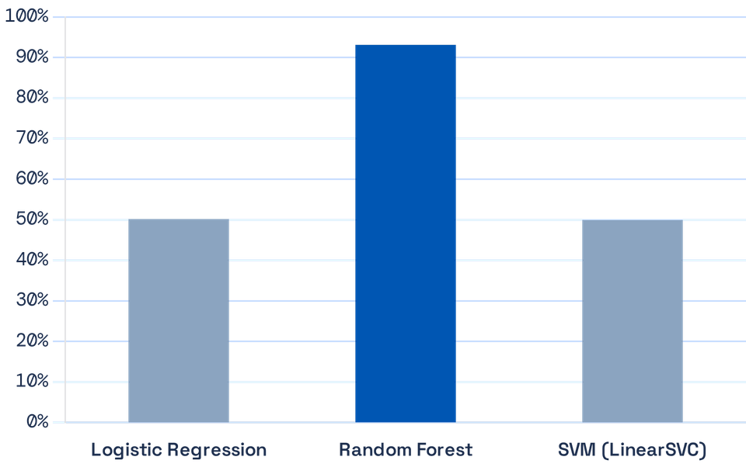
07 / 10
Why Random Forest Won
THREE REASONS FOR SUPERIORITY
RECALL COMPARISON — THE CRITICAL METRIC
01
NON-LINEARITY OF PHISHING PATTERNS
URL features interact in complex, non-linear ways. A long URL with high entropy AND many dots is far more suspicious than any single feature alone. Random Forest captures these interactions; linear models cannot.
02
ENSEMBLE ROBUSTNESS — 200 TREES
200 decision trees vote on each URL. No single tree dominates. This reduces variance and handles the diversity of phishing tactics — from IP-based attacks to domain-spoofing to obfuscated paths.
03
CLASS IMBALANCE HANDLING
With class_weight='balanced', RF adjusts for the 66/34 class split automatically. Linear models achieved only ~50% Recall — missing half of all phishing URLs. RF achieved 93% Recall.
Recall advantage of Random Forest over linear models — meaning RF catches 43% more phishing URLs that LR and SVM would miss entirely
+43%
Notes:
The 15-percentage-point gap between Random Forest and the linear models is the central finding of this dissertation. It confirms that ensemble methods excel when decision boundaries are complex. First, phishing patterns are non-linear. A long URL with high entropy and many dots is far more suspicious than any single feature alone. Random Forest captures these complex interactions, but linear models cannot. Second, ensemble robustness is key. With 200 decision trees voting on each URL, no single tree dominates. This reduces variance and handles the diversity of phishing tactics. Finally, Random Forest handled class imbalance well. It adjusted for the 66/34 class split automatically, achieving 93% recall. Linear models struggled, missing half of all phishing URLs. This brings us to the limitations of the study.

Slide 8

08 / 10
Limitations & Discussion
ACKNOWLEDGED LIMITATIONS
CONTRIBUTIONS TO LITERATURE
01
Temporal Drift
C1
Largest Controlled Comparison
The dataset is historical. As phishing tactics evolve, the model requires periodic retraining on fresh data to maintain accuracy in a production environment.
Empirical comparison of three classifiers on 641,053 URLs — one of the largest purely lexical datasets in reviewed literature, with a standardised evaluation protocol.
02
Lexical-Only Scope
C2
Explicit FPR Reporting
Sophisticated domain-spoofing attacks (e.g. paypal.com.verify-login.net) may score lower than expected. Content-based features would improve detection of these cases.
False Positive Rate reported for all three models — a metric critical for user experience yet absent from most published studies. RF achieved 5.45% FPR, meeting the <10% non-functional requirement.
03
Dataset Representativeness
C3
Open-Source Reproducible Pipeline
The Kaggle dataset may not fully represent current phishing campaigns, particularly mobile-targeted attacks, homograph attacks, or newly emerging URL obfuscation patterns.
Complete codebase on GitHub with fixed random seeds, modular scripts, and a working web prototype — enabling full replication and extension by future researchers.
"Limitations do not undermine the contribution — they define the boundaries of what this study claims and where future work should focus." · Intellectual honesty is a research strength.
Notes:
I want to be honest about what this study cannot do. The model is trained on historical data, so it will experience temporal drift as phishing tactics evolve. A production system would need periodic retraining. Also, it's lexical-only. This means sophisticated domain-spoofing attacks, like 'paypal.com.verify-login.net', might score lower than expected. Content-based features would improve this. Finally, the Kaggle dataset might not represent all current phishing campaigns, especially new mobile or homograph attacks. However, these limitations don't undermine the core contribution. This is a rigorous, reproducible baseline that others can build on. This leads me to the overall conclusion and contributions.

Slide 9
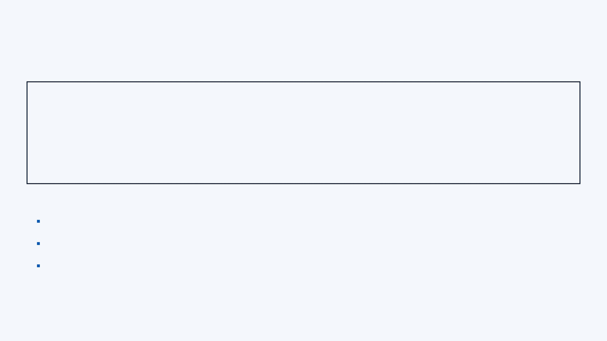
09 / 10
Conclusion & Contributions
THREE KEY CONTRIBUTIONS TO KNOWLEDGE
CONTRIBUTION 1 — EMPIRICAL
CONTRIBUTION 2 — TECHNICAL
CONTRIBUTION 3 — APPLIED
Largest Controlled Lexical Comparison
Open-Source Reproducible Pipeline
Working Web Prototype
Confirmed that Random Forest significantly outperforms linear classifiers for lexical phishing detection on a large-scale dataset. Provides a reproducible empirical baseline for future research.
Complete codebase with fixed random seeds, modular scripts, and full documentation on GitHub. All preprocessing, feature engineering, model training, and evaluation scripts available for replication.
PhishGuard demonstrates real-world viability — any URL analysed in real time using the trained Random Forest model. Proves the system is fast, accurate, and privacy-preserving.
94.03% Accuracy
github.com/s3giu
phishguardapp.manus.space
RECOMMENDATIONS FOR FUTURE RESEARCH
FINAL RESULTS SUMMARY
Lightweight NLP: Character-level n-gram analysis to complement lexical features and improve detection of domain-spoofing attacks
Best Model
Random Forest
Temporal retraining pipeline: Automated periodic retraining on fresh data to address model drift in production deployment
Accuracy
94.03%
Multi-class classification: Extend binary detection to four classes — phishing, malware, defacement, and benign — for richer threat intelligence
F1-Score
0.9120
False Positive Rate
5.45%
ROC AUC
0.9855
Live prototype: phishguardapp.manus.space
Notes:
To conclude, this dissertation makes three key contributions. First, we have empirical evidence. Random Forest significantly outperforms linear classifiers for lexical phishing detection, achieving 94.03% accuracy and a low 5.45% False Positive Rate. This provides a strong, reproducible baseline. Second, I've created a complete open-source pipeline on GitHub. All the code for preprocessing, feature engineering, training, and evaluation is there for anyone to replicate. Finally, there's a working web prototype, PhishGuard. It demonstrates the real-world viability of this system. It's fast, accurate, and privacy-preserving, making it a viable first layer in a multi-layered security architecture. Now, let me show you PhishGuard in action.

Slide 10

10 / 10
Live Demo — PhishGuard
● LIVE
APPLICATION URL
WHAT TO HIGHLIGHT DURING DEMO
https://
phishguardapp.manus.space
→
Risk Score (0–100) — colour-coded verdict badge (green / amber / red)
DEMO SEQUENCE — THREE TEST URLS
→
Feature Table — each of the 10 features shown with its value and risk level
VERDICT
URL TO ENTER
SCORE
SAY TO EXAMINERS
SAFE
https://www.google.com
~5/100
Short URL, low entropy, no suspicious characters — all features at low risk
→
Importance % — shows which features drove the decision for that specific URL
SUSPICIOUS
http://myaccount-update.net/verify
~50/100
Hyphenated domain, no HTTPS, path keyword "verify" — medium risk indicators
→
About the Model panel — confirms Random Forest, 94.03% accuracy, 641K training URLs
→
Response time — analysis completes in under 1 second, demonstrating real-time capability
MALICIOUS
http://192.168.1.1/paypal/login/secure/verify/account
100/100
Raw IP address, 9 slashes, 13 digits, high entropy — all 10 features flagged
BACKUP PLAN — IF INTERNET FAILS
Show Figures F.1–F.6 from Appendix F of the dissertation — six pre-captured screenshots covering Safe, Suspicious, and Malicious results with full feature tables.
GITHUB REPOSITORY
github.com/s3giu/phishing-url-detection
Notes:
Let me show you the system working live. This is the PhishGuard prototype. It takes any URL and analyses it using the Random Forest model we just discussed. It's trained on over 641,000 URLs. I'll show you a safe URL, a suspicious one, and a clearly malicious one. You'll see the risk score, how each of the 10 features contributes to that score, and how quickly it provides a verdict. This demonstrates its real-time capability. If the internet fails, I have screenshots in the appendix as a backup. So, let's start with a safe URL.

