Slide 1
Chess Database
Team 3
Danny Luong 007969221
Dennis Simon 007742215
Luther Pedeglorio 008503664
Anahat Sarao 008435583
Nicholas Randhawa 008457293
Notes:
Everyone

Slide 2
Project Idea
Create a database for a chess game
Frontend CLI to provide limited functionalities with database.
Ability to create user account.
Remove information
Update information
Perform queries
Backend database written in MySQL
Notes:
Dennis

Slide 3
Technologies, Frameworks, Languages
QtCreator IDE and Qt Frameworks - Simple Command Line Application Client
C/C++ language used for client and server
TCP Socket Communication (To communicate from client to server)
MySQL - Database and relational model
MySQL++ Library (C++ wrapper for MySQL C API)
HeidiSQL - Convenient open source frontend program for MySQL
Sha256 encryption for passwords
Notes:
Danny

Slide 4
Notes:
Luther

Slide 5
Relational Map
Relational map was generated using the already created database by using reverse engineering tool in MySQL.
Database was created first using the script then the script/tables used to generate relational map.
Notes:
Nicholas

Slide 6
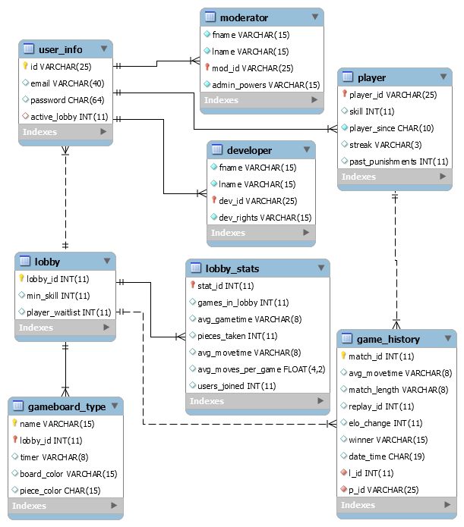
Relational Map
Notes:
Nicholas

Slide 7
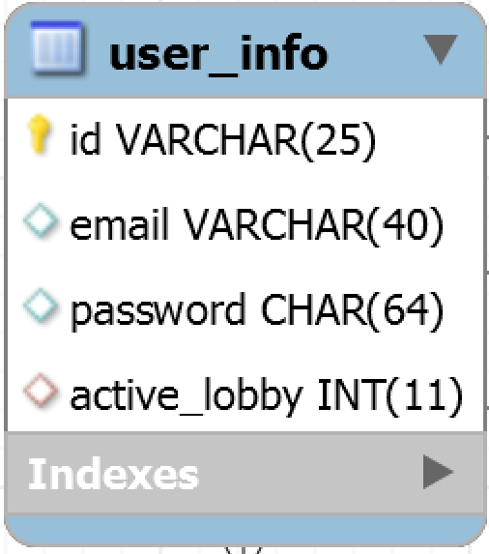
User Superclass
Notes:
Dennis

Slide 8
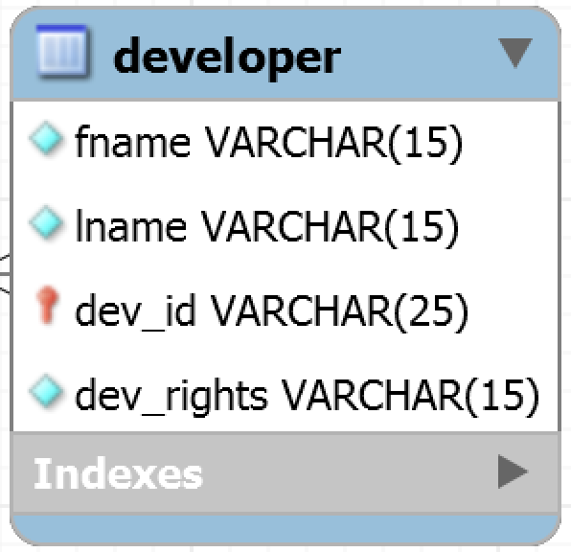
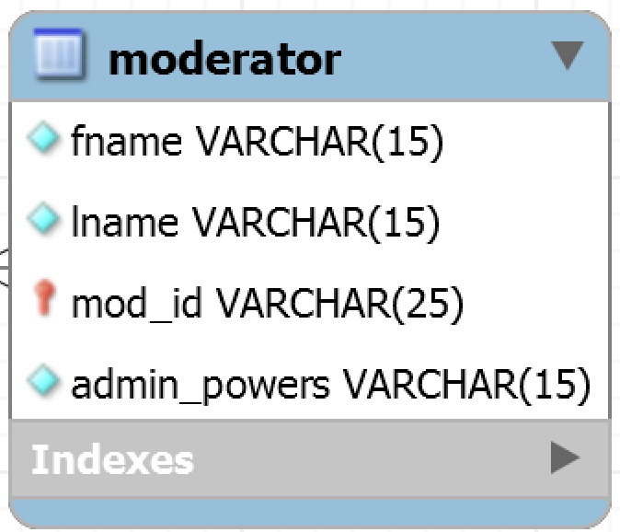
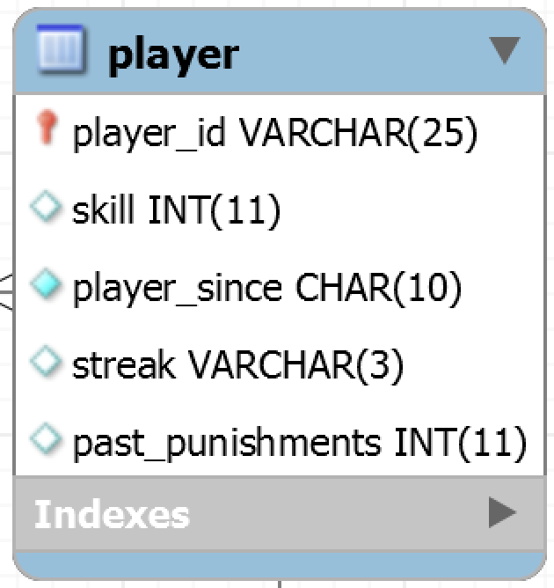
Subclasses of User
Notes:
Dennis

Slide 9
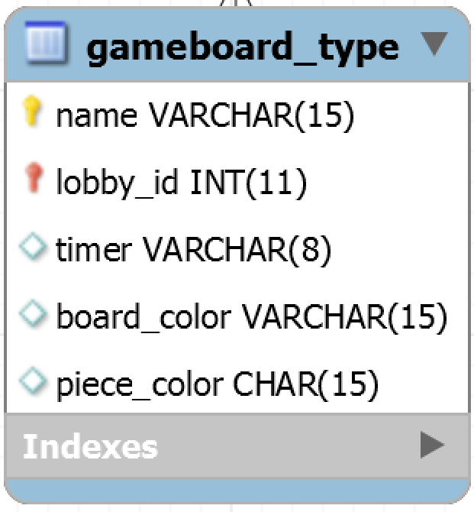
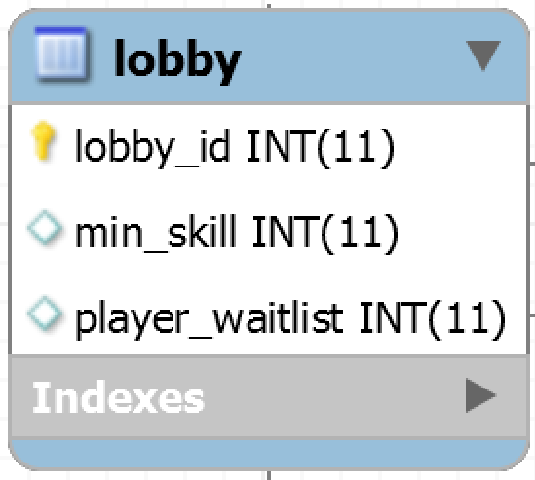
Lobby and Game Boards
Notes:
Nicholas

Slide 10
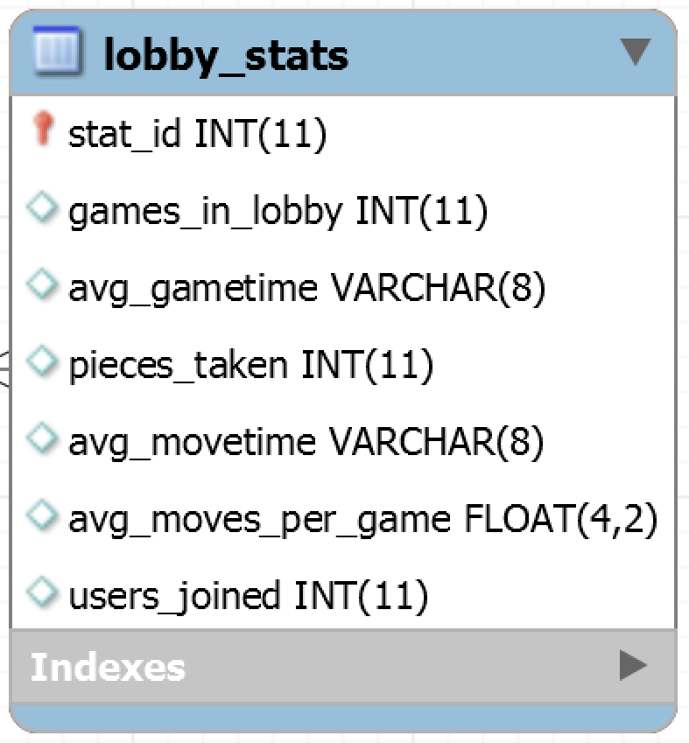
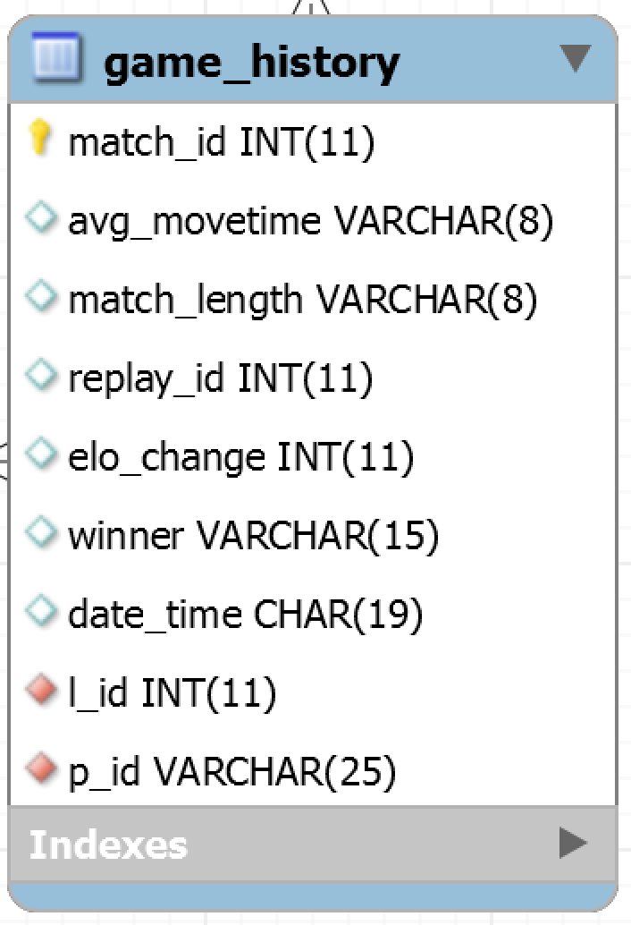
Stats and History
Notes:
Nicholas

Slide 11
Functional Dependencies and Normalization
First Normal Form
All non-PK must depend on PK
Second Normal Form
All non-PK must be fully functionally dependent on PK
Third Normal form
User_info does not satisfy this
Transitive dependence: password>email>id
Notes:
Luther

Slide 12
Database
MySQL
Script generates tables and inserts sample data into tables
Script upload to HeidiSQL to create DB on server
HeidiSQL was a convenient open source frontend for MySQL
Notes:
Danny

Slide 13
Database Logging and Transactions
All SQL statements were set to AutoCommit transactions.
Implicit_Transactions function is turn OFF to allow atomicity of all transaction.
The transaction and application logs are stored within the /var/log directory within the server.
Notes:
Anahit

Slide 14
Database Application
Basic Console Command Line Application made using QtCreator and Qt Frameworks and connected to server via TCP socket
Debian Server on Linux; Server program coded in C/C++
Server is able to authenticate users and use SHA256 encryption
Handles specific queries and allows for admin login to unlock (insert/update/delete commands/create account)
Basic logging of commands in query.log file
Notes:
Danny

Slide 15
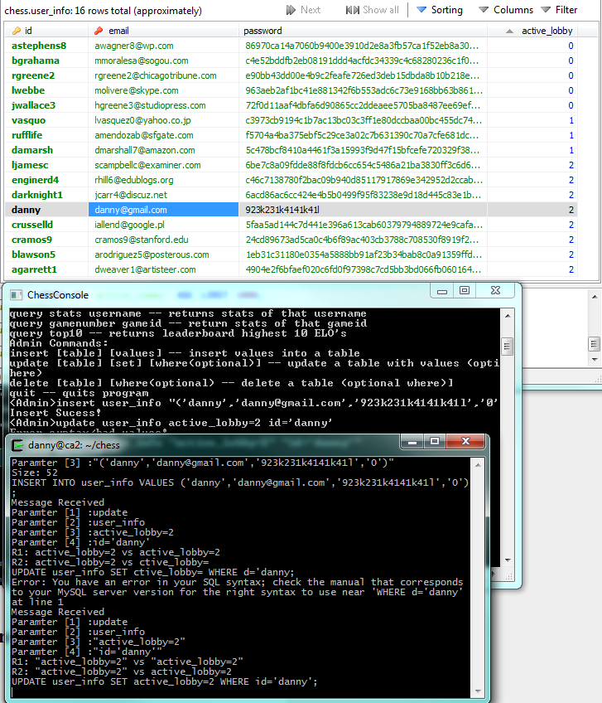
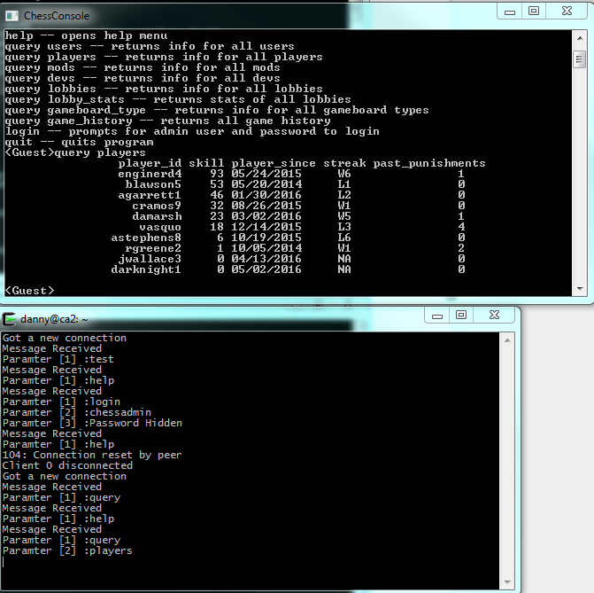
Sample Execution
Notes:
Danny

Slide 16
Testing
Black box testing with front end application of valid and invalid commands
White box testing each query using database before coding it on server with valid and invalid inputs
Admin commands were tested by trying to access them as guest
Notes:
Anahit

Slide 17
Conclusion
Successful implementation of CLI application talking to MySQL database
Possible Improvements
Add more queries
Enhance logging and transactions
Make the GUI more pleasing visually
Notes:
Anahit

Slide 18
Questions?
Notes:
Everyone

