Slide 1
Heat in Aviation
Anahit Sarao
008435583
Computer Engineering

Slide 2
Introduction
Heat is the fundamental property which exists in every physical and chemical reaction.
Aviation technology uses two forms of cooling to dissipate heat in large avionic systems.
Air cooling (convection)
Liquid Cooling
Jet Fuel Properties:
Melting Point -47 C
Boiling Point 176 C

Slide 3
Jet Turbine
1400 C Nominal Temp
33% of air is reused for cooling. Liquid cooling handles the rest.
Without cooling components would overheat and cause failure

Slide 4
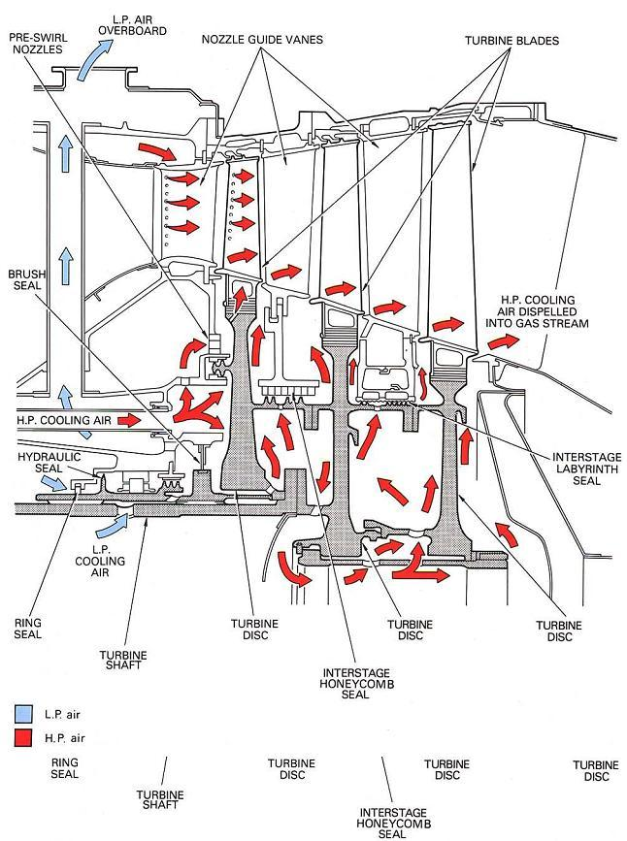
Air Cooling
Basic air cooling method such as releasing pressurized cold air into cooling chamber. Allowing air to expand and escape using the escape ducts.
Fuel and Oxidizers used:
Liquid hydrogen
Liquid oxygen
Ammonium perchlorate
Liquid Nitrogen
Hydrogen maintain a temperature of ‑253 degrees Celsius

Slide 5
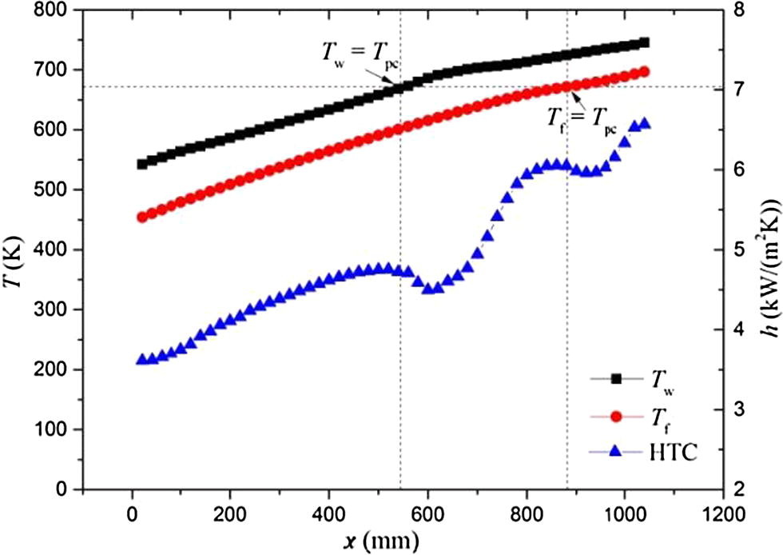
Fluid temperature, wall temperature and heat transfer coefficient of fuel

Slide 6
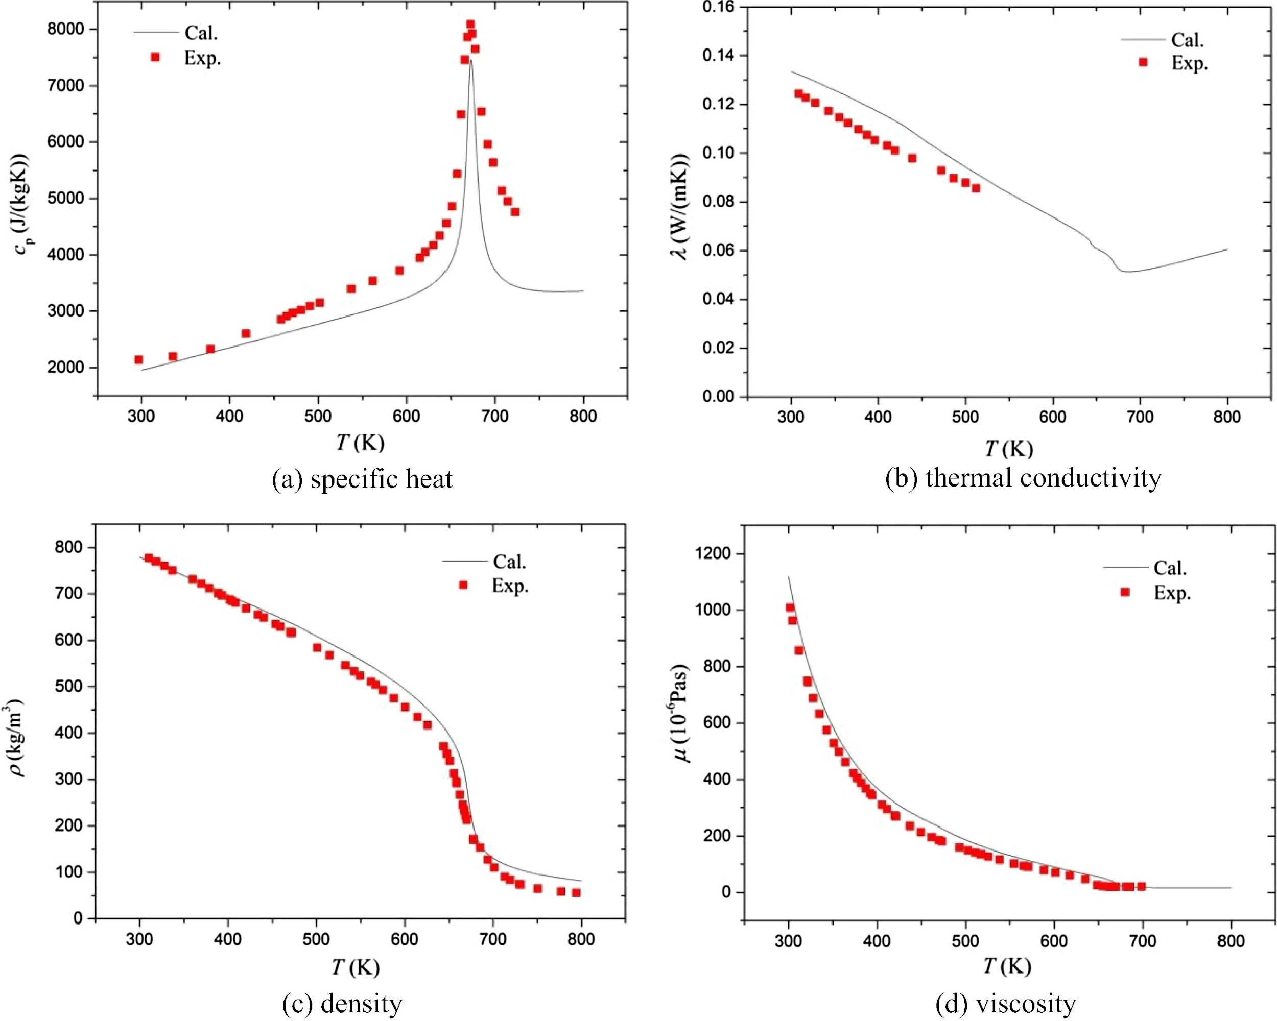
Comparison of numerical data and experimental data for the thermo-physical properties of aviation fuel

Slide 7
Conclusion
During the cooling process there are two forms of heat transfer deterioration.
The first form is dependent on the components and alloys used in the system which do not exceed the pseudo-critical temperature.
The second is when the cooling liquid does not exceed the pseudo-critical temperature.
Currently new forms of jet fuel are being tested such as kerosene which burns at a lower temperature and has a less carbon footprint.

