Slide 1
MP3 Presentation
Group: Clouds
Anahit Sarao
Ali Baqar
Maxwell Cheshier

Slide 2
Introduction
Vs1053 Audio Decoder
http://www.vlsi.fi/fileadmin/datasheets/vs1053.pdf
UART LCD
https://www.sparkfun.com/products/9568
https://www.sparkfun.com/tutorials/246
https://www.sparkfun.com/datasheets/LCD/SerLCD_V2_5.PDF
https://www.sparkfun.com/datasheets/LCD/ADM1602K-NSW-FBS-3.3v.pdf
Source Code Repository
https://github.com/s3nu/rtos-system-design.git
SJOne Board
http://www.socialledge.com/sjsu/index.php?title=Main_Page

Slide 3
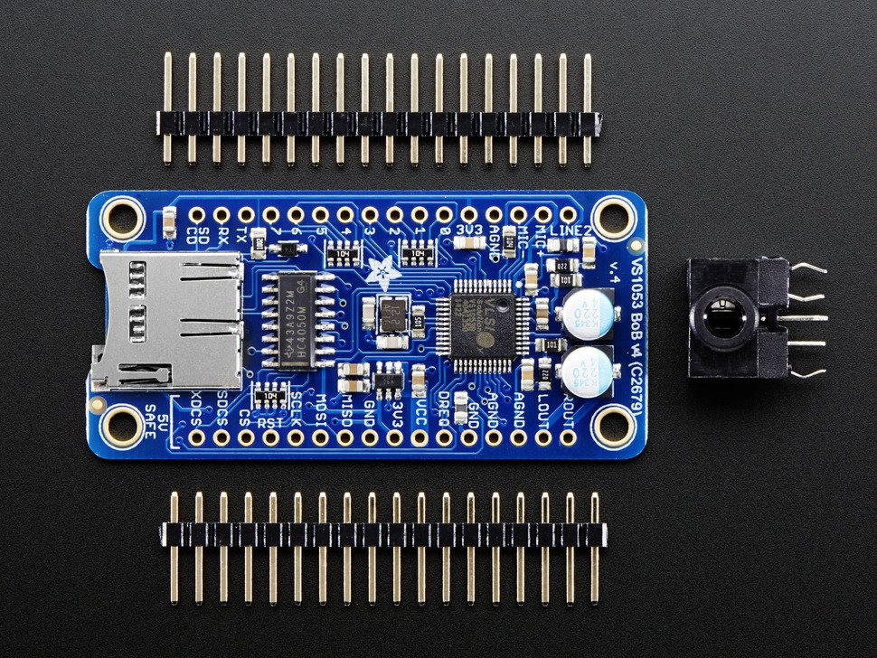
MP3 Hardware
VS1053 Decoder
VS1053 - Ogg Vorbis/MP3/AAC/WMA/FLAC/ MIDI AUDIO CODEC CIRCUIT
Using auxiliary port
Three external buttons using GPIO pins
External battery source to power the MP3 and SJSUone board
Large enclosure that packages everything
Notes:
Max

Slide 4
MP3 Transfer Algorithm
MP3 board uses SPI protocol
SSP0 SJOne board pins used
Reads 512 bytes of data from SD card, 12 songs loaded on SD card
Tasks implemented for each action such as: play, pause, lcd
Output of mp3 decoder stutters sometimes, unable to debug problem, possible hardware problem
Notes:
Max

Slide 5
LCD Hardware and Algorithm
UART LCD utilizes UART3 on SJOne Board
Utilizes built in UART functions
Each song is displayed on LCD
38400 baud rate
Attempted to display memory and cpu usage on LCD (does not work everytime)

Slide 6
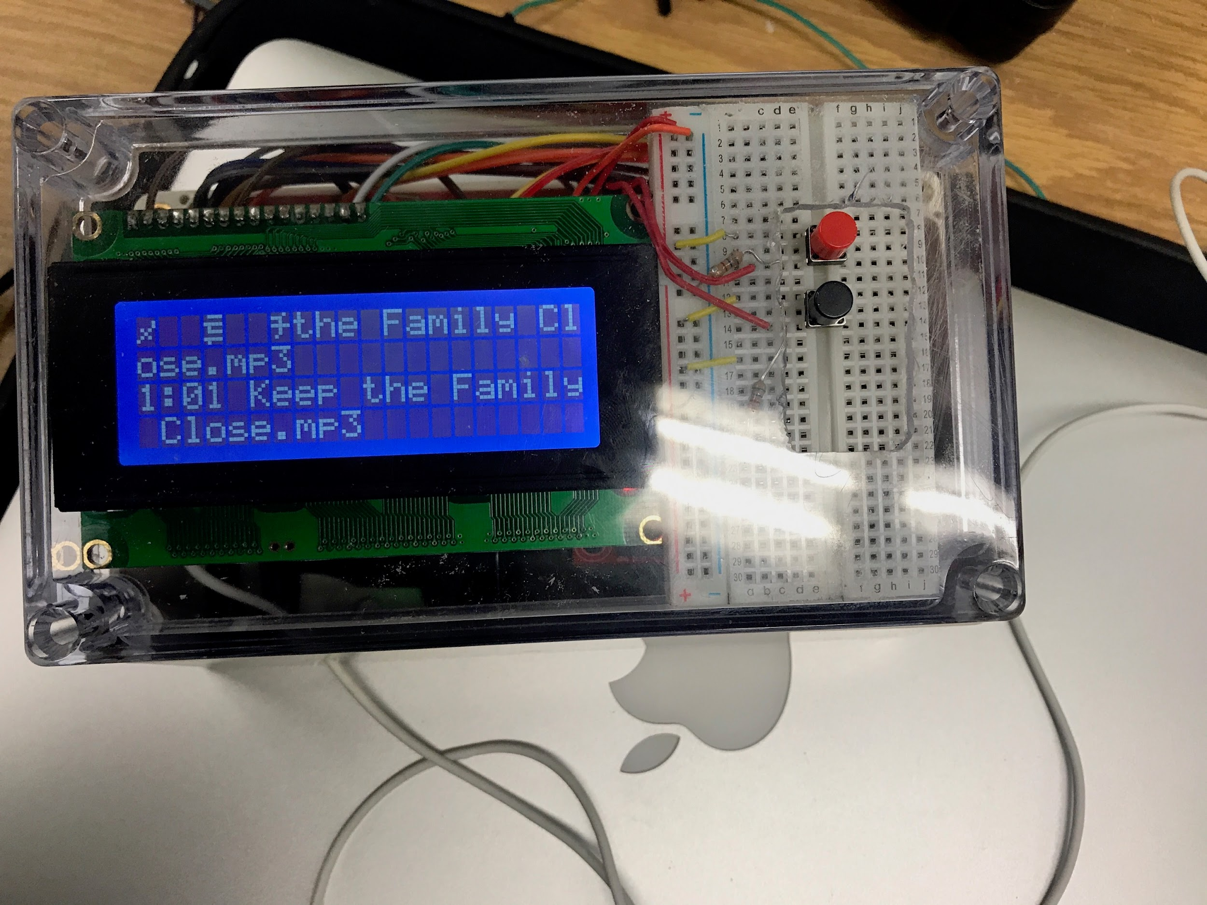
Control Instructions
Power on board and peripherals
See LCD for song details
Use buttons to play, pause
Final product with enclosure shown on the right

