Slide 1

Q25.1
Two copper wires of different diameter are joined end to end, and a current flows in the wire combination.
When electrons move from the larger-diameter wire into the smaller-diameter wire,
A. their drift speed increases.
B. their drift speed decreases.
C. their drift speed stays the same.
D. not enough information given to decide
Notes:
Answer: A

Slide 2

A25.1
Two copper wires of different diameter are joined end to end, and a current flows in the wire combination.
When electrons move from the larger-diameter wire into the smaller-diameter wire,
A. their drift speed increases.
B. their drift speed decreases.
C. their drift speed stays the same.
D. not enough information given to decide

Slide 3
Q25.2
Electrons in an electric circuit pass through a resistor. The wire has the same diameter on each side of the resistor.
Compared to the drift speed of the electrons before entering the resistor, the drift speed of the electrons after leaving the resistor is
A. faster.
B. slower.
C. the same.
D. not enough information given to decide
Notes:
Answer: C

Slide 4
A25.2
Electrons in an electric circuit pass through a resistor. The wire has the same diameter on each side of the resistor.
Compared to the drift speed of the electrons before entering the resistor, the drift speed of the electrons after leaving the resistor is
A. faster.
B. slower.
C. the same.
D. not enough information given to decide

Slide 5
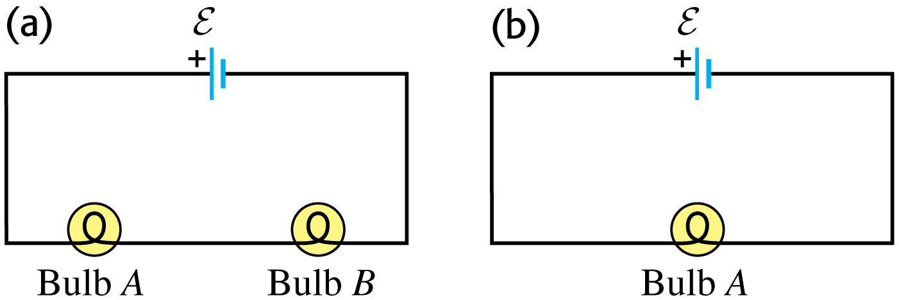
Q25.3
In the circuit shown, the two bulbs A and B are identical. Compared to bulb A,
A. bulb B glows more brightly.
B. bulb B glows less brightly.
C. bulb B glows just as brightly.
D. The answer depends on whether the mobile charges in the wires are positively or negatively charged.
Notes:
Answer: C

Slide 6
A25.3
In the circuit shown, the two bulbs A and B are identical. Compared to bulb A,
A. bulb B glows more brightly.
B. bulb B glows less brightly.
C. bulb B glows just as brightly.
D. The answer depends on whether the mobile charges in the wires are positively or negatively charged.

Slide 7
Q25.4
In the circuit shown in (a), the two bulbs A and B are identical. Bulb B is removed and the circuit is completed as shown in (b). Compared to the brightness of bulb A in (a), bulb A in (b) is
brighter.
B. less bright.
C. just as bright.
D. Any of the above, depending on the rated wattage of the bulb.
Notes:
Answer: A

Slide 8
A25.4
In the circuit shown in (a), the two bulbs A and B are identical. Bulb B is removed and the circuit is completed as shown in (b). Compared to the brightness of bulb A in (a), bulb A in (b) is
brighter.
B. less bright.
C. just as bright.
D. Any of the above, depending on the rated wattage of the bulb.

Slide 9
Q25.5
An ideal voltmeter
A. has zero resistance and should be connected in parallel with the circuit element being measured.
B. has zero resistance and should be connected in series with the circuit element being measured.
C. has infinite resistance and should be connected in parallel with the circuit element being measured.
D. has infinite resistance and should be connected in series with the circuit element being measured.
Notes:
Answer: C

Slide 10
A25.5
An ideal voltmeter
A. has zero resistance and should be connected in parallel with the circuit element being measured.
B. has zero resistance and should be connected in series with the circuit element being measured.
C. has infinite resistance and should be connected in parallel with the circuit element being measured.
D. has infinite resistance and should be connected in series with the circuit element being measured.

Slide 11
Q25.6
An ideal ammeter
A. has zero resistance and should be connected in parallel with the circuit element being measured.
B. has zero resistance and should be connected in series with the circuit element being measured.
C. has infinite resistance and should be connected in parallel with the circuit element being measured.
D. has infinite resistance and should be connected in series with the circuit element being measured.
Notes:
Answer: B

Slide 12
A25.6
An ideal ammeter
A. has zero resistance and should be connected in parallel with the circuit element being measured.
B. has zero resistance and should be connected in series with the circuit element being measured.
C. has infinite resistance and should be connected in parallel with the circuit element being measured.
D. has infinite resistance and should be connected in series with the circuit element being measured.

