Slide 1

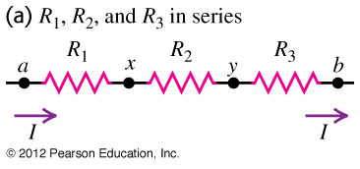
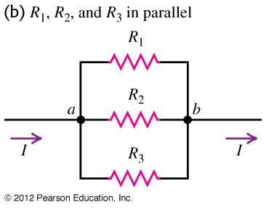
Q26.1
Which of the two arrangements shown has the smaller equivalent resistance between points a and b?
A. the series arrangement
B. the parallel arrangement
C. The equivalent resistance is the same for both arrangements.
D. The answer depends on the values of the individual resistances R₁, R₂, and R_{3.}
Notes:
Answer: B

Slide 2

A26.1
Which of the two arrangements shown has the smaller equivalent resistance between points a and b?
A. the series arrangement
B. the parallel arrangement
C. The equivalent resistance is the same for both arrangements.
D. The answer depends on the values of the individual resistances R₁, R₂, and R_{3.}

Slide 3
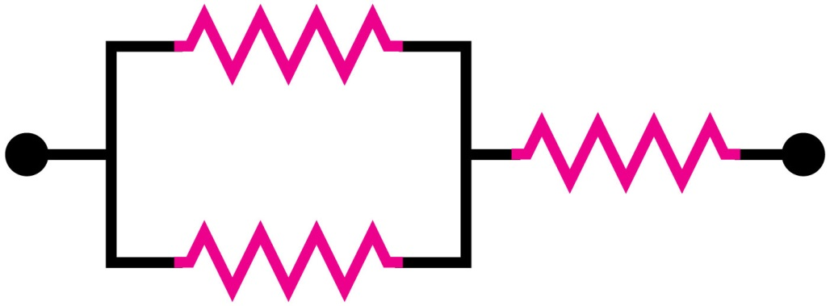
Q26.2
Three identical resistors, each of resistance R, are connected as shown. What is the equivalent resistance of this arrangement of three resistors?
A. 3R
B. 2R
C. 3R/2
D. 2R/3
E. R/3
Notes:
Answer: C

Slide 4
A26.2
Three identical resistors, each of resistance R, are connected as shown. What is the equivalent resistance of this arrangement of three resistors?
A. 3R
B. 2R
C. 3R/2
D. 2R/3
E. R/3

Slide 5
Q26.3
A 120-V, 60-W light bulb, a 120-V, 120-W light bulb, and a 120-V, 240-W light bulb are connected in parallel as shown.
The voltage between points a and b is 120 V. Across which bulb is there the greatest voltage drop?
120 V
60 W
120 V
120 W
a
b
A. the 120-V, 60-W light bulb
B. the 120-V, 120-W light bulb
C. the 120-V, 240-W light bulb
D. All three light bulbs have the same voltage drop.
120 V
240 W
Notes:
Answer: D

Slide 6
A26.3
A 120-V, 60-W light bulb, a 120-V, 120-W light bulb, and a 120-V, 240-W light bulb are connected in parallel as shown.
The voltage between points a and b is 120 V. Across which bulb is there the greatest voltage drop?
120 V
60 W
120 V
120 W
a
b
A. the 120-V, 60-W light bulb
B. the 120-V, 120-W light bulb
C. the 120-V, 240-W light bulb
D. All three light bulbs have the same voltage drop.
120 V
240 W

Slide 7
Q26.4
A 120-V, 60-W light bulb, a 120-V, 120-W light bulb, and a 120-V, 240-W light bulb are connected in parallel as shown.
The voltage between points a and b is 120 V. Which bulb glows the brightest?
120 V
60 W
120 V
120 W
a
b
A. the 120-V, 60-W light bulb
B. the 120-V, 120-W light bulb
C. the 120-V, 240-W light bulb
D. All three light bulbs glow with equal brightness.
120 V
240 W
Notes:
Answer: C

Slide 8
A26.4
A 120-V, 60-W light bulb, a 120-V, 120-W light bulb, and a 120-V, 240-W light bulb are connected in parallel as shown.
The voltage between points a and b is 120 V. Which bulb glows the brightest?
120 V
60 W
120 V
120 W
a
b
A. the 120-V, 60-W light bulb
B. the 120-V, 120-W light bulb
C. the 120-V, 240-W light bulb
D. All three light bulbs glow with equal brightness.
120 V
240 W

Slide 9
Q26.5
a
A 120-V, 60-W light bulb, a 120-V, 120-W light bulb, and a 120-V, 240-W light bulb are connected in series as shown.
The voltage between points a and b is 120 V. Across which bulb is there the greatest voltage drop?
120 V
60 W
120 V
120 W
A. the 120-V, 60-W light bulb
B. the 120-V, 120-W light bulb
C. the 120-V, 240-W light bulb
D. All three light bulbs have the same voltage drop.
120 V
240 W
b
Notes:
Answer: A

Slide 10
A26.5
a
A 120-V, 60-W light bulb, a 120-V, 120-W light bulb, and a 120-V, 240-W light bulb are connected in series as shown.
The voltage between points a and b is 120 V. Across which bulb is there the greatest voltage drop?
120 V
60 W
120 V
120 W
A. the 120-V, 60-W light bulb
B. the 120-V, 120-W light bulb
C. the 120-V, 240-W light bulb
D. All three light bulbs have the same voltage drop.
120 V
240 W
b

Slide 11
Q26.6
a
A 120-V, 60-W light bulb, a 120-V, 120-W light bulb, and a 120-V, 240-W light bulb are connected in series as shown.
The voltage between points a and b is 120 V. Which bulb glows the brightest?
120 V
60 W
120 V
120 W
A. the 120-V, 60-W light bulb
B. the 120-V, 120-W light bulb
C. the 120-V, 240-W light bulb
D. All three light bulbs glow with equal brightness.
120 V
240 W
b
Notes:
Answer: A

Slide 12
A26.6
a
A 120-V, 60-W light bulb, a 120-V, 120-W light bulb, and a 120-V, 240-W light bulb are connected in series as shown.
The voltage between points a and b is 120 V. Which bulb glows the brightest?
120 V
60 W
120 V
120 W
A. the 120-V, 60-W light bulb
B. the 120-V, 120-W light bulb
C. the 120-V, 240-W light bulb
D. All three light bulbs glow with equal brightness.
120 V
240 W
b

Slide 13
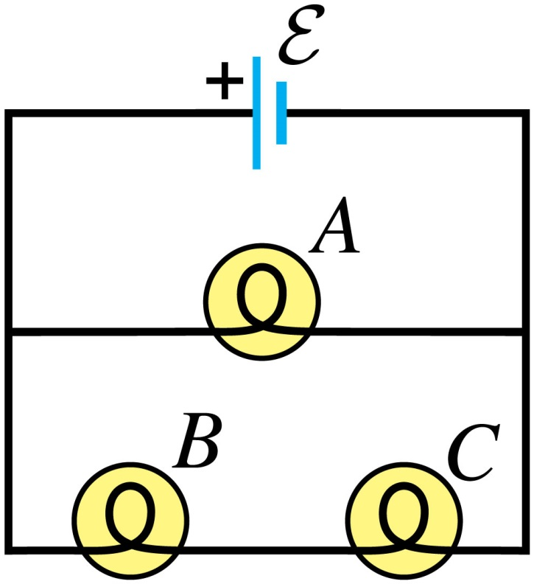
Q26.7
Three identical light bulbs are connected to a source of emf as shown. Which bulb is brightest?
A. light bulb A
B. light bulb B
C. light bulb C
D. both light bulbs B and C (Both are equally bright and are brighter than light bulb A.)
E. All bulbs are equally bright.
Notes:
Answer: A

Slide 14
A26.7
Three identical light bulbs are connected to a source of emf as shown. Which bulb is brightest?
A. light bulb A
B. light bulb B
C. light bulb C
D. both light bulbs B and C (Both are equally bright and are brighter than light bulb A.)
E. All bulbs are equally bright.

Slide 15
Q26.8
You wish to study a resistor in a circuit. To simultaneously measure the current in the resistor and the voltage across the resistor, you would place
A. an ammeter in series and an voltmeter in series.
B. an ammeter in series and an voltmeter in parallel.
C. an ammeter in parallel and an voltmeter in series.
D. an ammeter in parallel and an voltmeter in parallel.
Notes:
Answer: B

Slide 16
A26.8
You wish to study a resistor in a circuit. To simultaneously measure the current in the resistor and the voltage across the resistor, you would place
A. an ammeter in series and an voltmeter in series.
B. an ammeter in series and an voltmeter in parallel.
C. an ammeter in parallel and an voltmeter in series.
D. an ammeter in parallel and an voltmeter in parallel.

Slide 17
Q26.9
A battery, a capacitor, and a resistor are connected in series. Which of the following affect(s) the maximum charge stored on the capacitor?
A. the emf ε of the battery
B. the capacitance C of the capacitor
C. the resistance R of the resistor
D. both ε and C
E. all three of ε, C, and R
Notes:
Answer: D

Slide 18
A26.9
A battery, a capacitor, and a resistor are connected in series. Which of the following affect(s) the maximum charge stored on the capacitor?
A. the emf ε of the battery
B. the capacitance C of the capacitor
C. the resistance R of the resistor
D. both ε and C
E. all three of ε, C, and R

