Slide 1


Q27.1
A beam of electrons (which have negative charge q) is coming straight toward you. You put the north pole of a magnet directly above the beam. The magnetic field from the magnet points straight down. Which way will the electron beam deflect?
N
A. upward
B. downward
C. to the left
D. to the right
E. It won’t deflect at all.
Beam of electrons coming toward you
Notes:
Answer: C

Slide 2

A27.1
A beam of electrons (which have negative charge q) is coming straight toward you. You put the north pole of a magnet directly above the beam. The magnetic field from the magnet points straight down. Which way will the electron beam deflect?
N
A. upward
B. downward
C. to the left
D. to the right
E. It won’t deflect at all.
Beam of electrons coming toward you

Slide 3
Q27.2
When a charged particle moves through a magnetic field, the direction of the magnetic force on the particle at a certain point is
A. in the direction of the magnetic field at that point.
B. opposite to the direction of the magnetic field at that point.
C. perpendicular to the magnetic field at that point.
D. none of the above
E. The answer depends on the sign of the particle’s electric charge.
Notes:
Answer: C

Slide 4
A27.2
When a charged particle moves through a magnetic field, the direction of the magnetic force on the particle at a certain point is
A. in the direction of the magnetic field at that point.
B. opposite to the direction of the magnetic field at that point.
C. perpendicular to the magnetic field at that point.
D. none of the above
E. The answer depends on the sign of the particle’s electric charge.

Slide 5
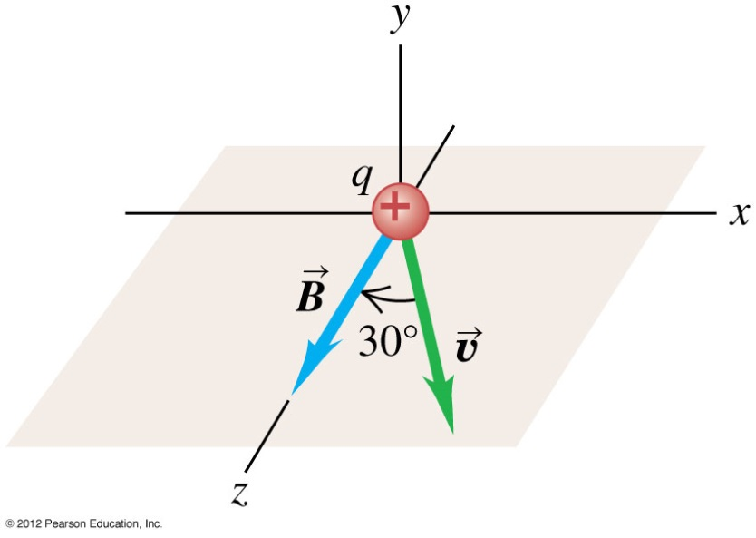
Q27.3
A particle with a positive charge moves in the xz-plane as shown. The magnetic field is in the positive z-direction. The magnetic force on the particle is in
A. the positive x-direction.
B. the negative x-direction.
C. the positive y-direction.
D. the negative y-direction.
E. none of these
Notes:
Answer: D

Slide 6
A27.3
A particle with a positive charge moves in the xz-plane as shown. The magnetic field is in the positive z-direction. The magnetic force on the particle is in
A. the positive x-direction.
B. the negative x-direction.
C. the positive y-direction.
D. the negative y-direction.
E. none of these

Slide 7
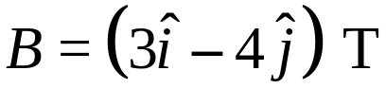
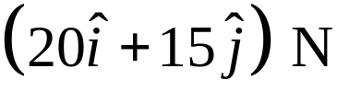
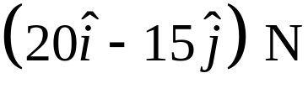
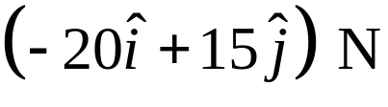
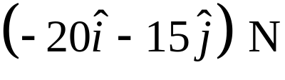
Q27.4
A particle with charge q = –1 C is moving in the positive z-direction at 5 m/s. The magnetic field at its position is
What is the magnetic force on the particle?
A.
B.
C.
D.
E. none of these
Notes:
Answer: D

Slide 8
A27.4
A particle with charge q = –1 C is moving in the positive z-direction at 5 m/s. The magnetic field at its position is
What is the magnetic force on the particle?
A.
B.
C.
D.
E. none of these

Slide 9
Q27.6
A positively charged particle moves in the positive z-direction. The magnetic force on the particle is in the positive y-direction. What can you conclude about the y-component of the magnetic field at the particle’s position?
A. B_{y} > 0
B. B_{y} = 0
C. B_{y} < 0
D. not enough information given to decide
Notes:
Answer: B

Slide 10
A27.6
A positively charged particle moves in the positive z-direction. The magnetic force on the particle is in the positive y-direction. What can you conclude about the y-component of the magnetic field at the particle’s position?
A. B_{y} > 0
B. B_{y} = 0
C. B_{y} < 0
D. not enough information given to decide

Slide 11
Q27.7
A positively charged particle moves in the positive z-direction. The magnetic force on the particle is in the positive y-direction. What can you conclude about the z-component of the magnetic field at the particle’s position?
A. B_{z} > 0
B. B_{z} = 0
C. B_{z} < 0
D. not enough information given to decide
Notes:
Answer: D

Slide 12
A27.7
A positively charged particle moves in the positive z-direction. The magnetic force on the particle is in the positive y-direction. What can you conclude about the z-component of the magnetic field at the particle’s position?
A. B_{z} > 0
B. B_{z} = 0
C. B_{z} < 0
D. not enough information given to decide

Slide 13
Q27.8
Under what circumstances is the total magnetic flux through a closed surface positive?
A. if the surface encloses the north pole of a magnet, but not the south pole
B. if the surface encloses the south pole of a magnet, but not the north pole
C. if the surface encloses both the north and south poles of a magnet
D. none of the above
Notes:
Answer: D

Slide 14
A27.8
Under what circumstances is the total magnetic flux through a closed surface positive?
A. if the surface encloses the north pole of a magnet, but not the south pole
B. if the surface encloses the south pole of a magnet, but not the north pole
C. if the surface encloses both the north and south poles of a magnet
D. none of the above

Slide 15
Q27.9
When a charged particle moves through a magnetic field, the trajectory of the particle at a given point is
A. parallel to the magnetic field line that passes through that point.
B. perpendicular to the magnetic field line that passes through that point.
C. neither parallel nor perpendicular to the magnetic field line that passes through that point.
D. any of the above, depending on circumstances.
Notes:
Answer: D

Slide 16
A27.9
When a charged particle moves through a magnetic field, the trajectory of the particle at a given point is
A. parallel to the magnetic field line that passes through that point.
B. perpendicular to the magnetic field line that passes through that point.
C. neither parallel nor perpendicular to the magnetic field line that passes through that point.
D. any of the above, depending on circumstances.

Slide 17
Q27.10
A charged particle moves through a region of space that has both a uniform electric field and a uniform magnetic field. In order for the particle to move through this region at a constant velocity,
A. the electric and magnetic fields must point in the same direction.
B. the electric and magnetic fields must point in opposite directions.
C. the electric and magnetic fields must point in perpendicular directions.
D. The answer depends on the sign of the particle’s electric charge.
Notes:
Answer: C

Slide 18
A27.10
A charged particle moves through a region of space that has both a uniform electric field and a uniform magnetic field. In order for the particle to move through this region at a constant velocity,
A. the electric and magnetic fields must point in the same direction.
B. the electric and magnetic fields must point in opposite directions.
C. the electric and magnetic fields must point in perpendicular directions.
D. The answer depends on the sign of the particle’s electric charge.

Slide 19
Q27.11
A circular loop of wire carries a constant current. If the loop is placed in a region of uniform magnetic field, the net magnetic force on the loop is
A. perpendicular to the plane of the loop, in a direction given by a right-hand rule.
B. perpendicular to the plane of the loop, in a direction given by a left-hand rule.
C. in the same plane as the loop.
D. zero.
E. The answer depends on the magnitude and direction of the current and on the magnitude and direction of the magnetic field.
Notes:
Answer: D

Slide 20
A27.11
A circular loop of wire carries a constant current. If the loop is placed in a region of uniform magnetic field, the net magnetic force on the loop is
A. perpendicular to the plane of the loop, in a direction given by a right-hand rule.
B. perpendicular to the plane of the loop, in a direction given by a left-hand rule.
C. in the same plane as the loop.
D. zero.
E. The answer depends on the magnitude and direction of the current and on the magnitude and direction of the magnetic field.

Slide 21
Q27.12
A circular loop of wire carries a constant current. If the loop is placed in a region of uniform magnetic field, the net magnetic torque on the loop
A. tends to orient the loop so that its plane is perpendicular to the direction of the magnetic field.
B. tends to orient the loop so that its plane is edge-on to the direction of the magnetic field.
C. tends to make the loop rotate around its axis.
D. is zero.
E. The answer depends on the magnitude and direction of the current and on the magnitude and direction of the magnetic field.
Notes:
Answer: A

Slide 22
A27.12
A circular loop of wire carries a constant current. If the loop is placed in a region of uniform magnetic field, the net magnetic torque on the loop
A. tends to orient the loop so that its plane is perpendicular to the direction of the magnetic field.
B. tends to orient the loop so that its plane is edge-on to the direction of the magnetic field.
C. tends to make the loop rotate around its axis.
D. is zero.
E. The answer depends on the magnitude and direction of the current and on the magnitude and direction of the magnetic field.

