Slide 1
ARD
A1
Ali Baqar
Anahit Sarao
Maxwell Cheshier
Brian Josefowicz
Notes:
Everyone

Slide 2
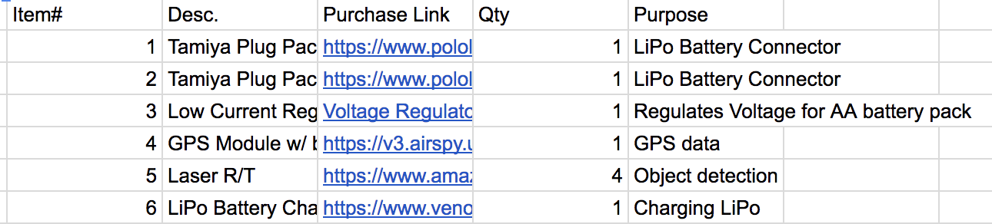
Progress
Soldered headers onto Core for testing
Designed solution for chassis motor connections
Molex (3.16mm or .1” pitch) 2.65mm or .1” pin width
Solder cup and RTV headers
Molex dongle for quick disconnect
Specified remaining hardware for full interface and testing capability
Professor advised us to look into certain parts
Laser R/T for distance detection
GPS module (specific one without breakout board)
Waiting for new parts to arrive
Ali Baqar
Notes:
Ali

Slide 3
Current Status
Currently hardware and software testing.
Hardware and software being tested:
Camera mounts
Rpi’s
Lipo Battery
PX4 loaded CrazyFile Extension Board
Major drone components will go into final stages of assembly and testing once each smaller component is fully tested
Anahit Sarao
Notes:
Anahit

Slide 4
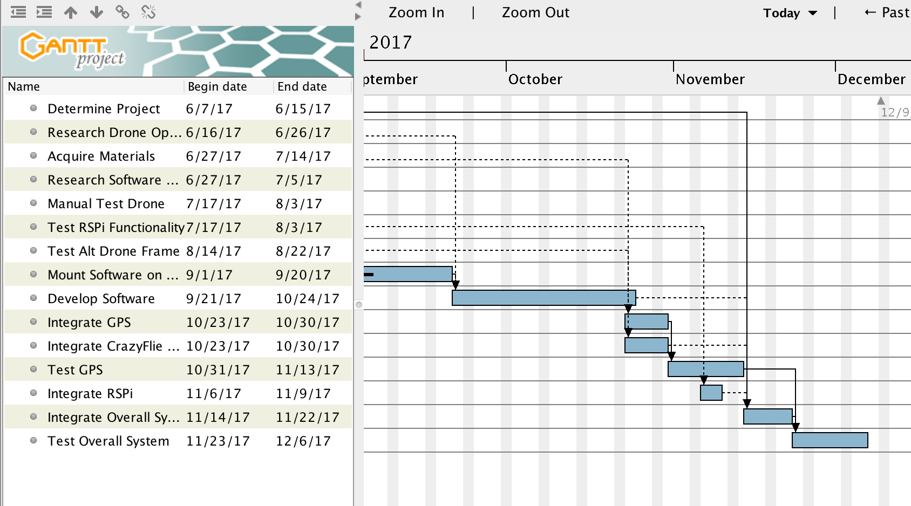
Gantt Chart
Maxwell Cheshier
Notes:
Max

Slide 5
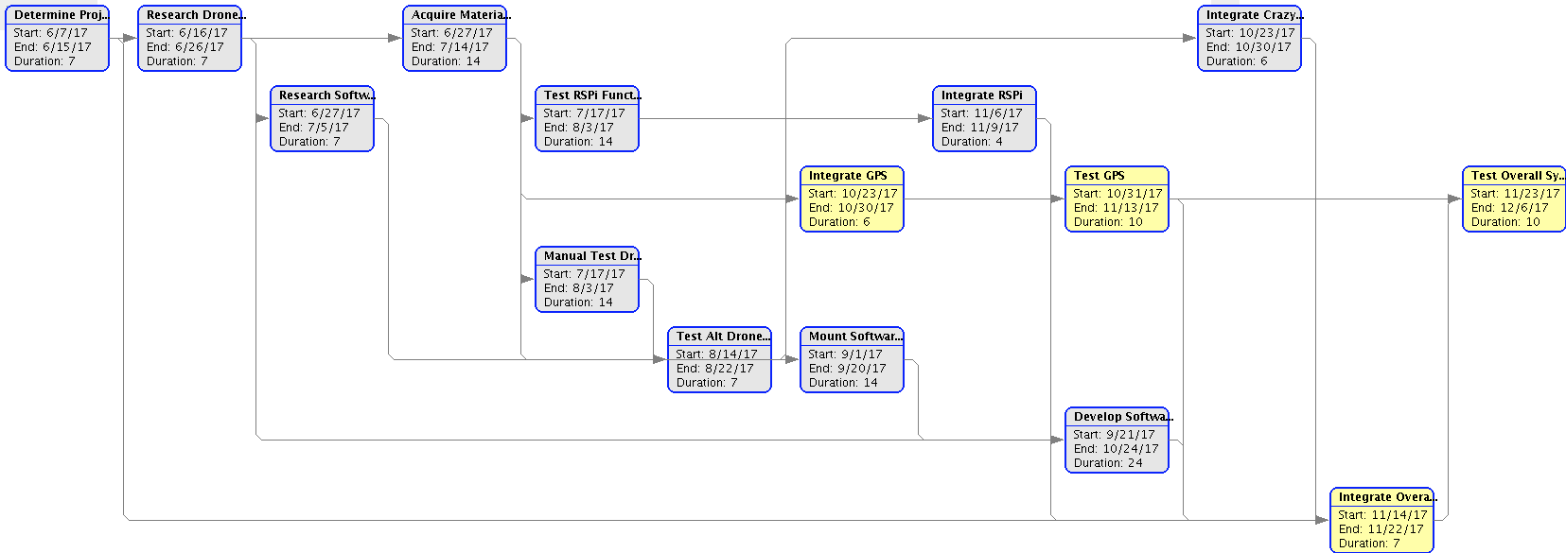
PERT Chart
Maxwell Cheshier
Notes:
Max

Slide 6
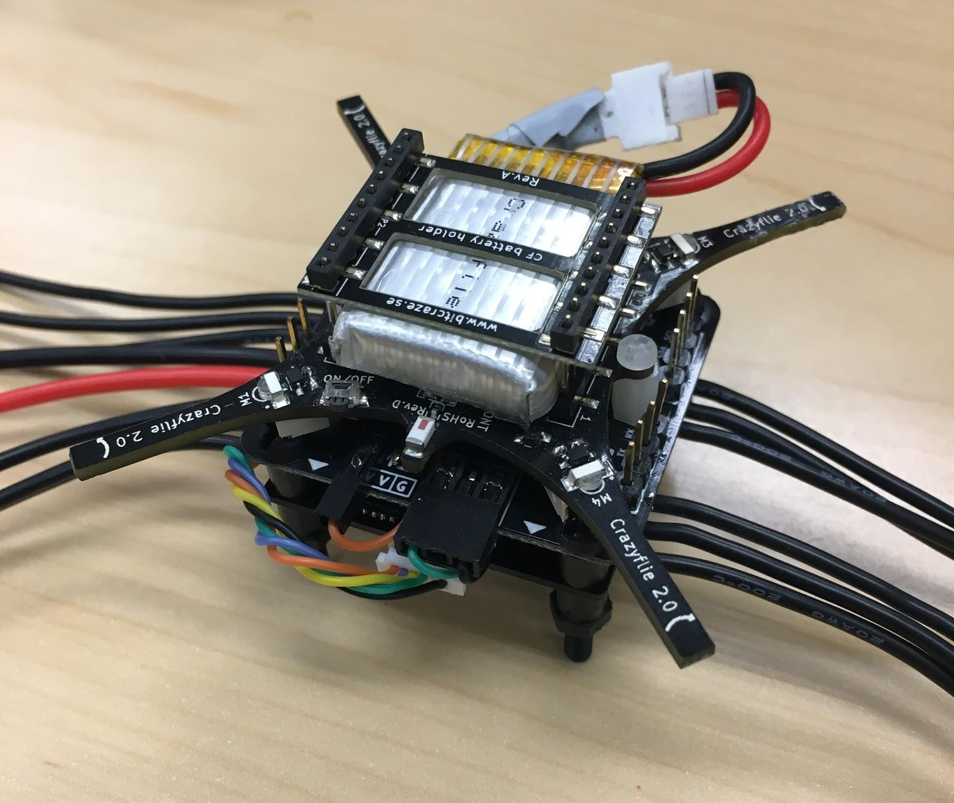
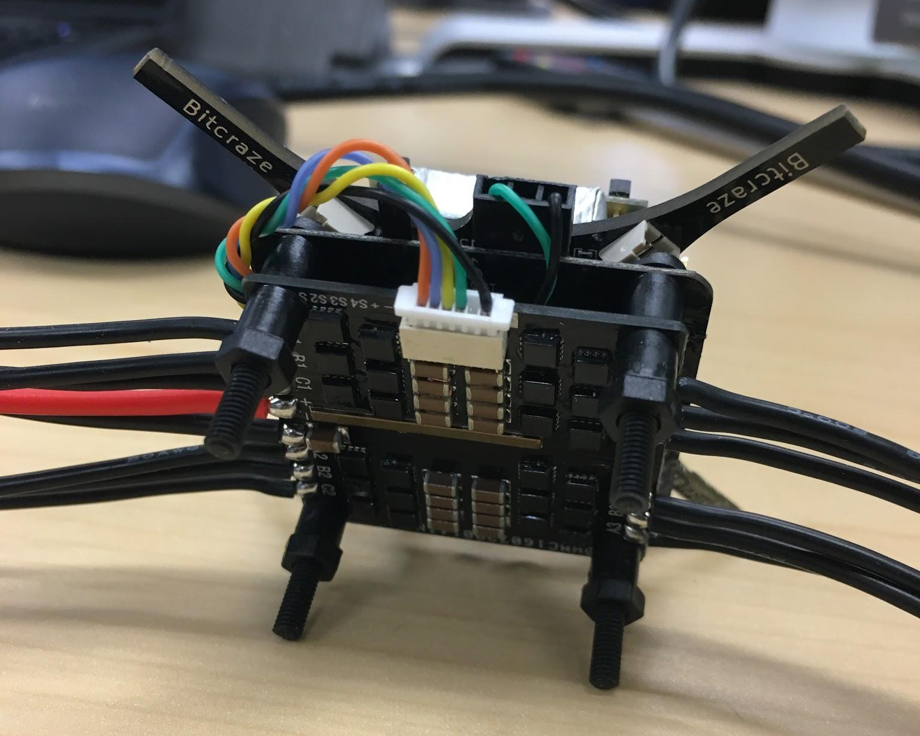
Drone Core Assembly (controller, exp., ESC)
Brian Josefowicz
Notes:
Brian

Slide 7
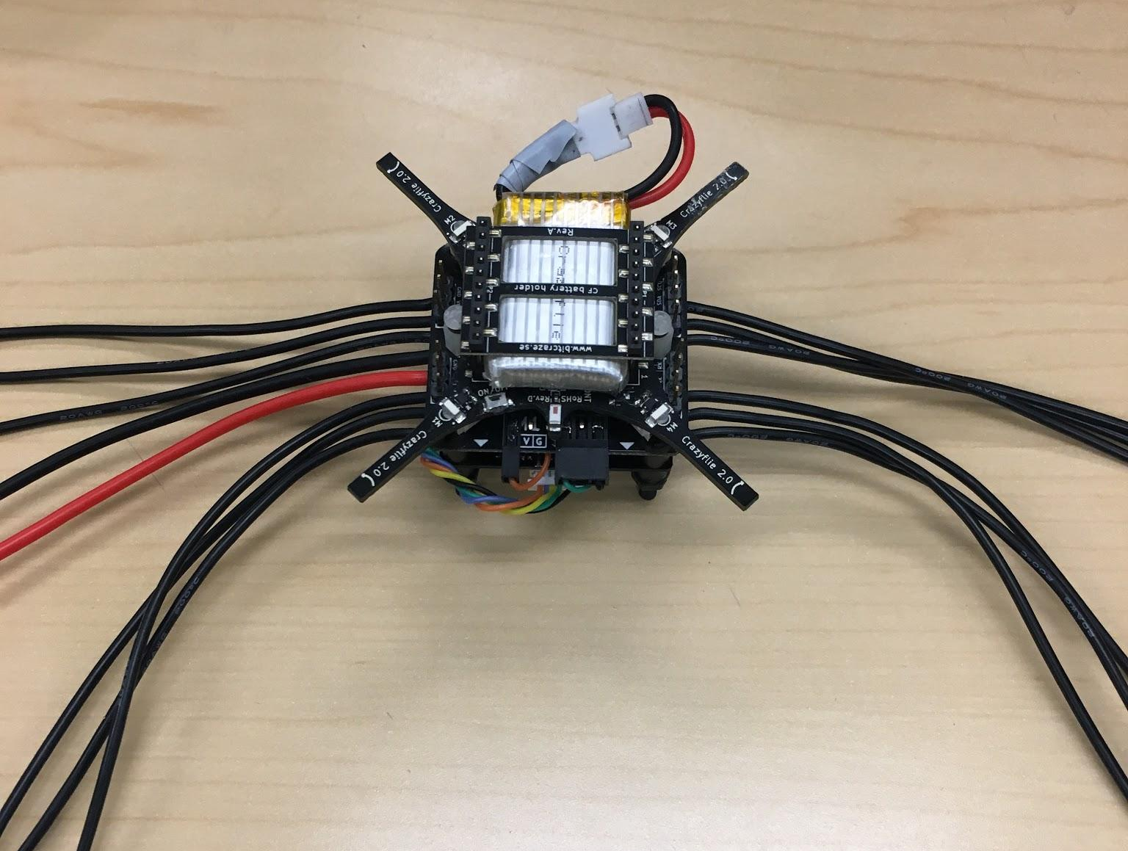
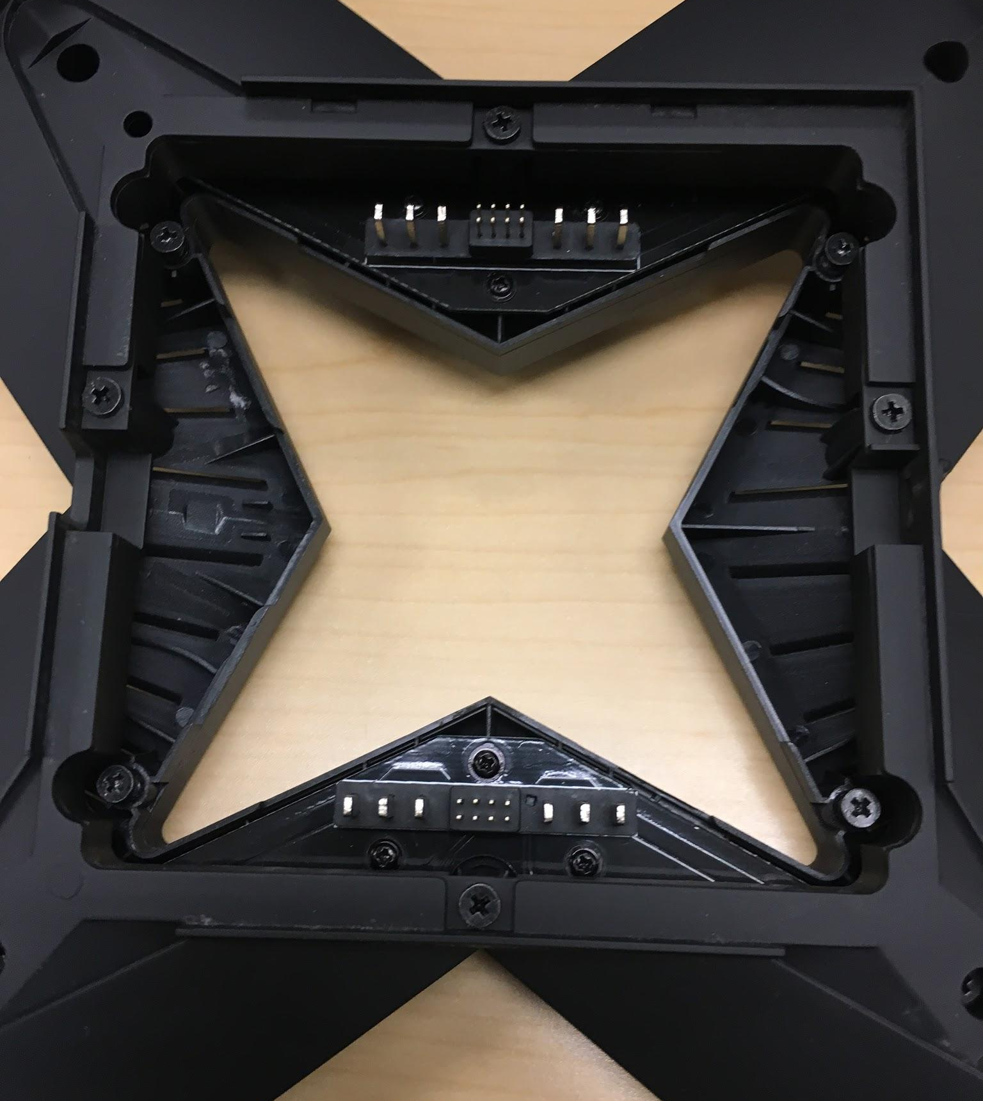
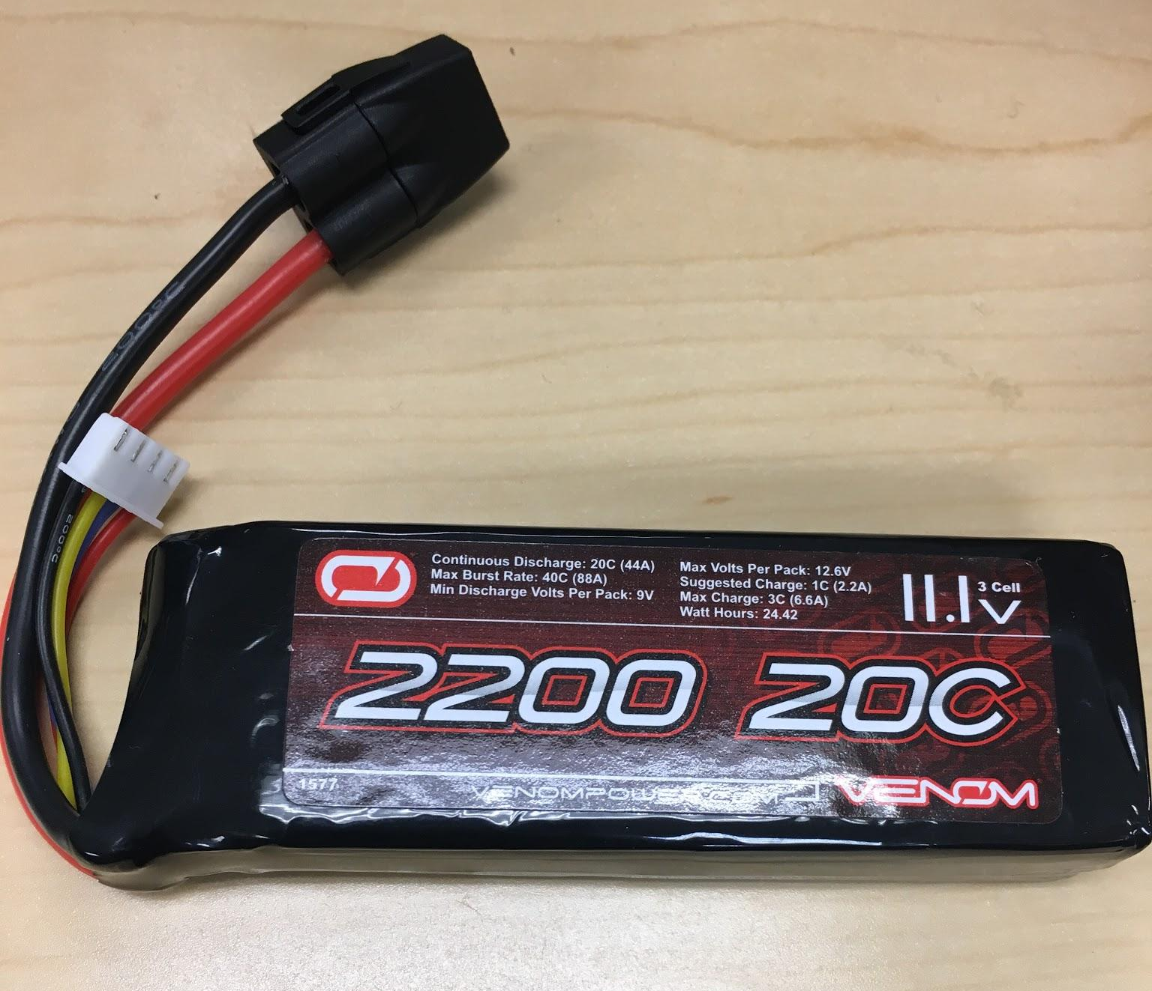
Hardware Interface
Brian Josefowicz
Notes:
Brian

Slide 8
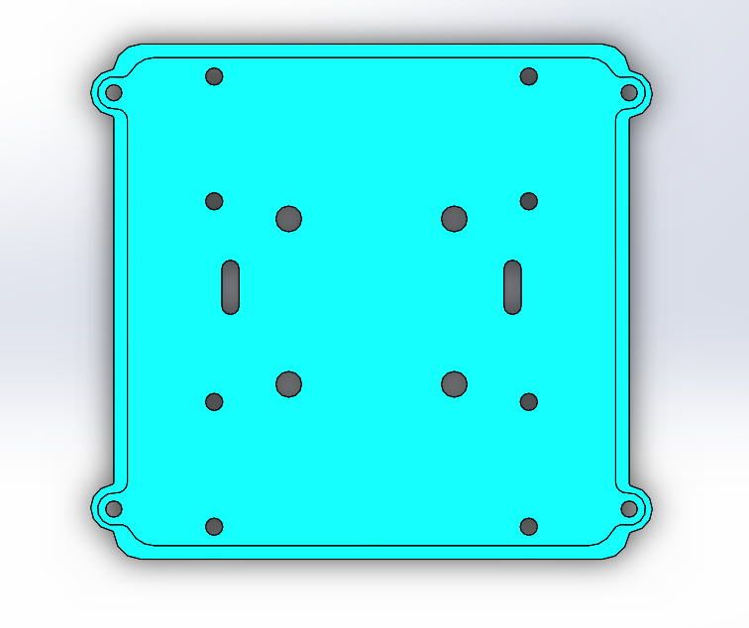
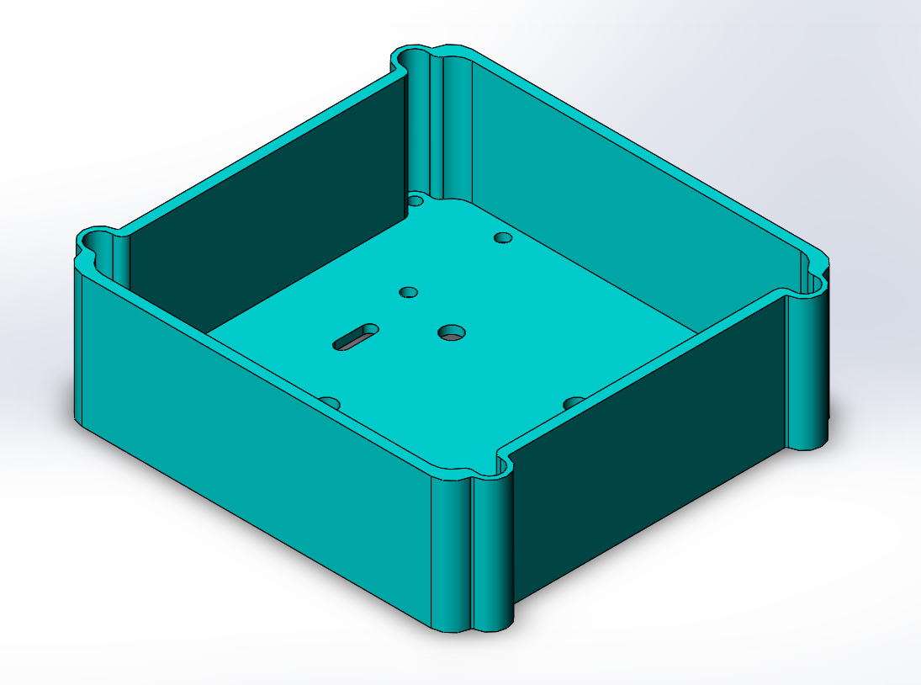
Mount design
RPi Zero W mount holes
LiPo mount slots
Drone Core mount holes
Chassis mount holes
Brian Josefowicz
Notes:
Brian

